Slide 1
Welcome to Springboard
Notes:
Facilitator note:
Gather family-facing resources to support orientation.
Share Family welcome resource. (This resource can also be used or revisited during in the team-building huddle)
Share How do I earn incentives?
This presentation includes both English and Spanish slides. Delete or hide slides you don’t need.
Note that the screen shots are in English but Connect is available in Spanish, too.
You could also play the Welcome to the Springboard Learning Accelerator! found on https://www.youtube.com/c/SpringboardCollaborative
Suggested script
Welcome to the Springboard Learning Accelerator!
In this presentation we’ll explain a little more about what a learning accelerator is, the digital tools you’ll be using during this accelerator and what comes next.
Suggested script in Spanish
Bienvenido a la Springboard Learning Accelerator. En este presentación, revisaremos qué es un acelerador de aprendizaje, las herramientas digitales que usará durante un acelerador y lo que viene a continuación.

Slide 2
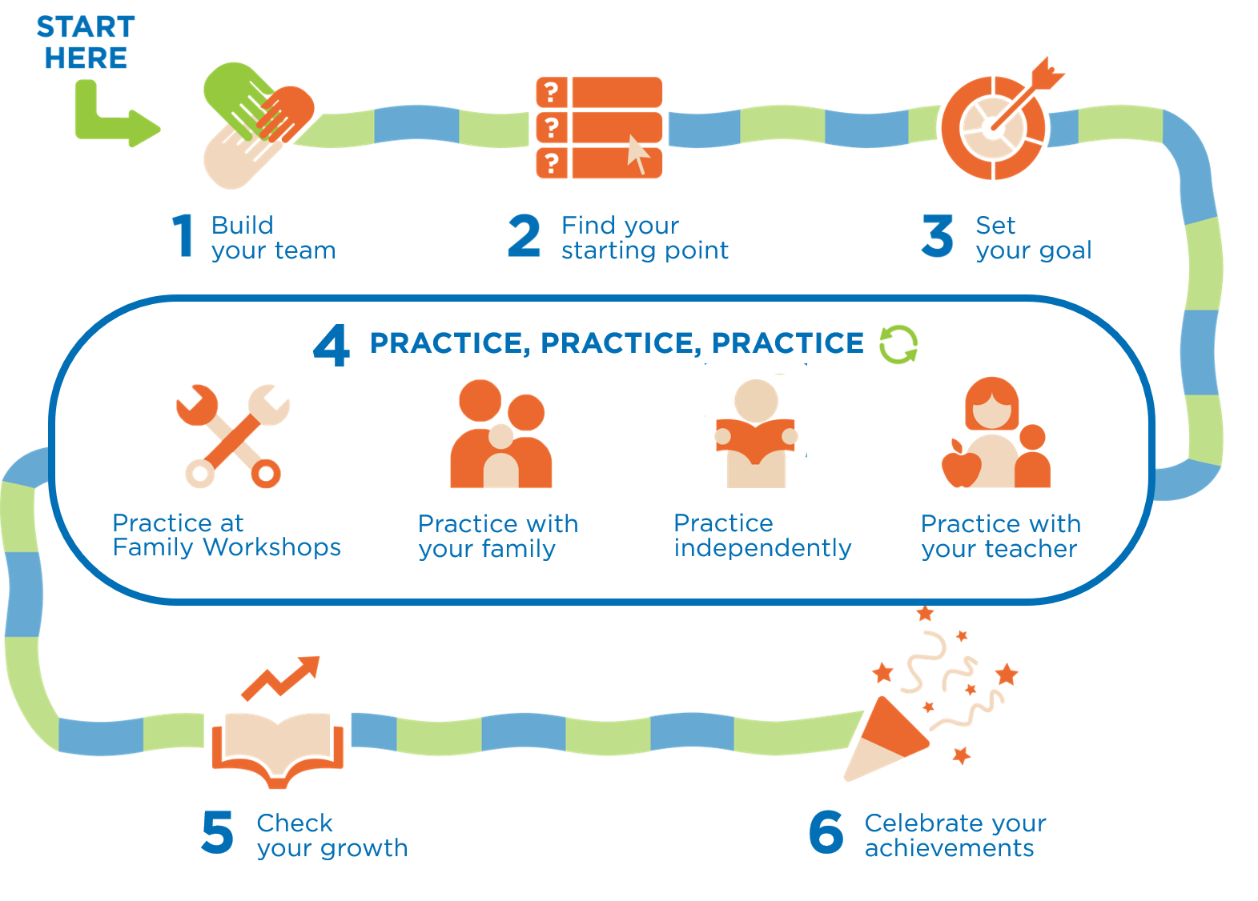
Waa maxay Xawaareeyaha Waxbarashadu?
Waxbarasho jaangooysan ee lala shiishay oo gaaban oo ku aaddan xirfadaha ilmahaagu u horaeyba uga shaqaynayo
Halkan ka bilow
Iyada oo ku saleysan cilaaqaadka!
Dhis kooxdaada
Hel bartaaad ka bilaabayso
Yoolkaaga dejiso
TABABBARO, TABABBARO, TABABBARO
Ku tababbaro aqoon-is-weydaarsiyada qoyska
La tababbaro
qoyskaaga
Ku tababbaro
madax bannaani
La tababbaro
macallinkaaga
Wax badan oo ula kac ah waqtiga tababbarka
U dabbaaldeg guulahaaga
Hubi kobacaaga

Slide 3
Maxay yihiin rajooyinka aad qabto?
Maxaad rajayneysaa adigu inuu u qabsoomi doono qoyskaaga inta lagu jiro xawaareynta waxbarashada?
Buuxi inta ka dhiman weedha: “Anigu waxaan rajaynayaa…”
Ku qor sanduuqa lagu sheekeysto (chat)!

Slide 4
6 qaybood
1
3
5
Dhis kooxdaada
Yoolkaaga dejiso
Hubi kobacaaga
Ku tababbaro aqoon-is-weydaarsiyada qoyska
La tababbaro
qoyskaaga
Ku tababbaro
madax bannaani
La tababbaro
macallinkaaga
2
4
6
TABABBARO, TABABBARO, TABABBARO
Hel bartaaad ka bilaabayso
U dabbaaldeg guulahaaga

Slide 5
6 qaybood
1
3
5
Dhis kooxdaada
Yoolkaaga dejiso
Hubi kobacaaga
Ku tababbaro aqoon-is-weydaarsiyada qoyska
La tababbaro
qoyskaaga
Ku tababbaro
madax bannaani
La tababbaro
macallinkaaga
2
4
6
TABABBARO, TABABBARO, TABABBARO
Hel bartaaad ka bilaabayso
U dabbaaldeg guulahaaga

Slide 6
6 qaybood
1
3
5
Dhis kooxdaada
Yoolkaaga dejiso
Hubi kobacaaga
Ku tababbaro aqoon-is-weydaarsiyada qoyska
La tababbaro
qoyskaaga
Ku tababbaro
madax bannaani
La tababbaro
macallinkaaga
2
4
6
TABABBARO, TABABBARO, TABABBARO
Hel bartaaad ka bilaabayso
U dabbaaldeg guulahaaga

Slide 7
6 qaybood
1
3
5
Dhis kooxdaada
Yoolkaaga dejiso
Hubi kobacaaga
Ku tababbaro aqoon-is-weydaarsiyada qoyska
La tababbaro
qoyskaaga
Ku tababbaro
madax bannaani
La tababbaro
macallinkaaga
2
4
6
TABABBARO, TABABBARO, TABABBARO
Hel bartaaad ka bilaabayso
U dabbaaldeg guulahaaga

Slide 8
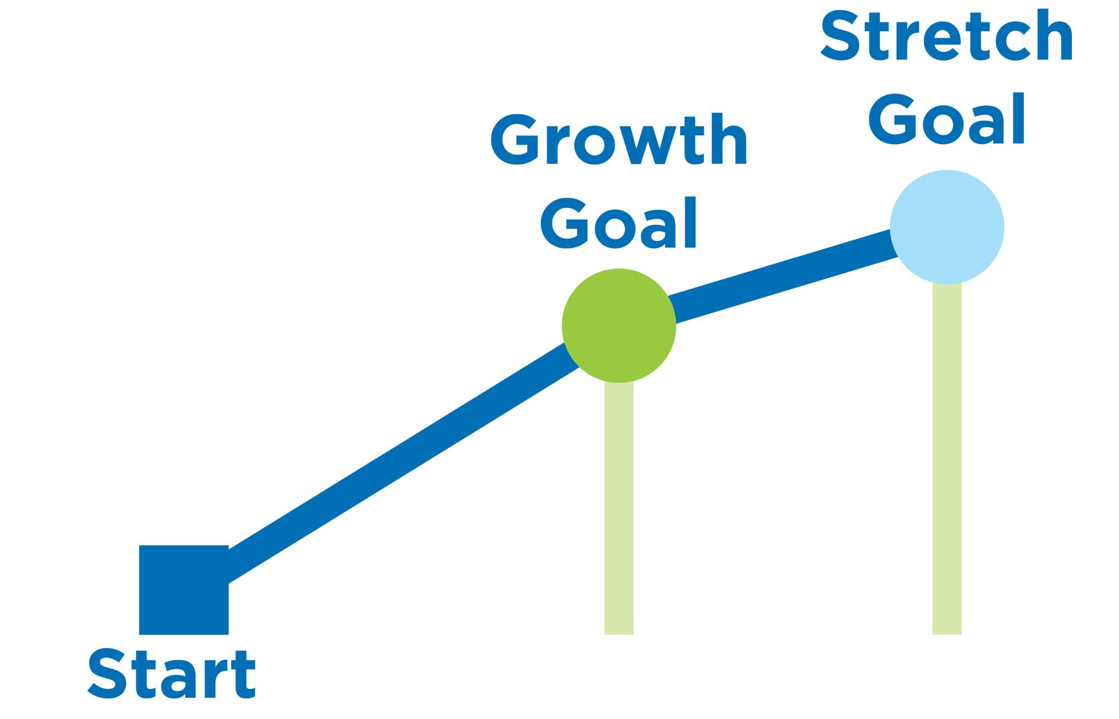
Goal is based on reading test
Choose between slides 8,9, or 10!
Reading reward!

Slide 9
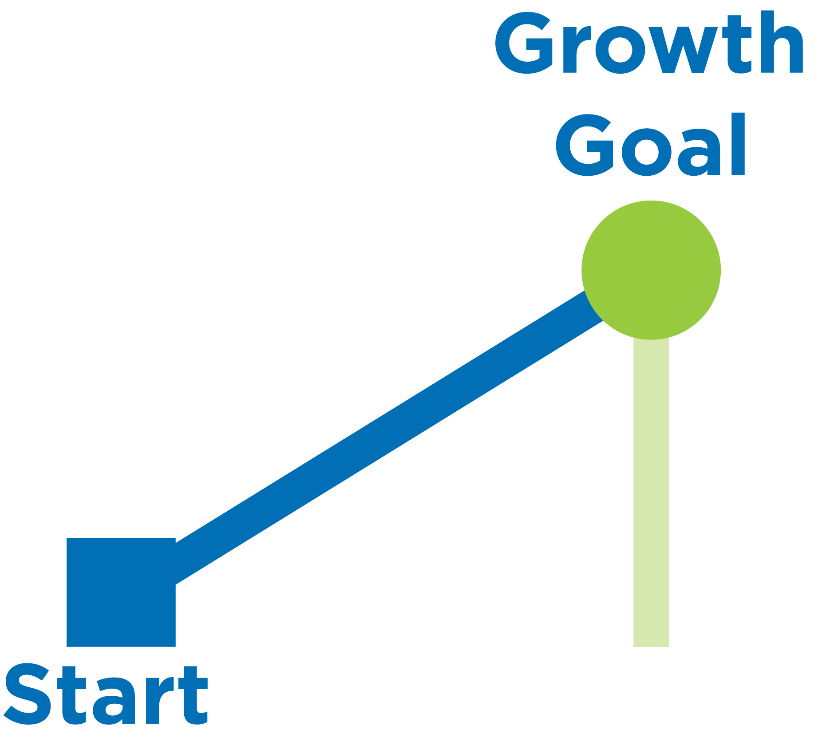
Goal is based on reading test
Choose between slides 8,9, or 10!
Reading reward!

Slide 10
Goal is based on reading target
Choose between slides 8,9, or 10!
Reading reward!

Slide 11
Qaybtee ayaad adigu ku faraxsan tahay?
1
3
5
Ku qor lamabar sanduuqa lagu sheekeysto!
2
4
6

Slide 12
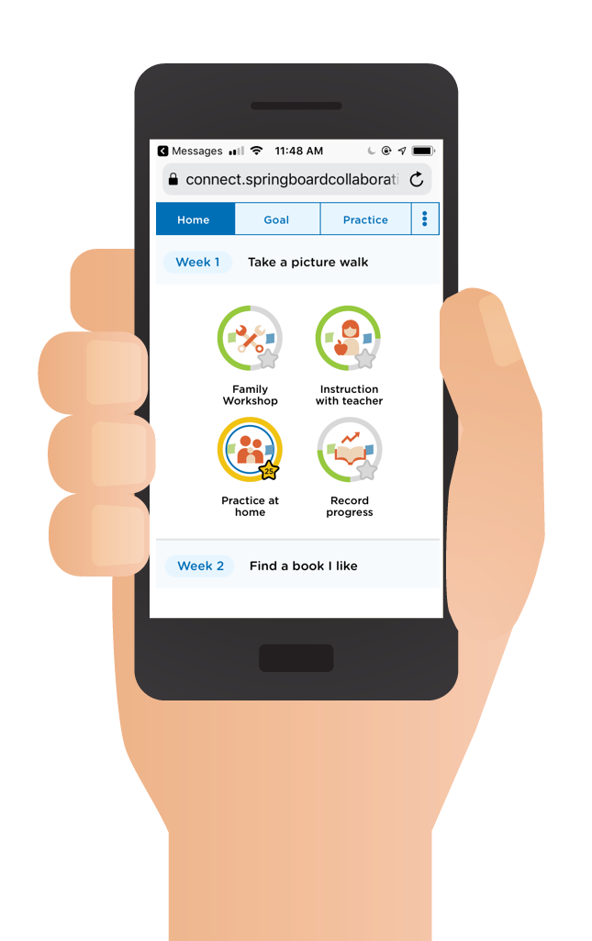
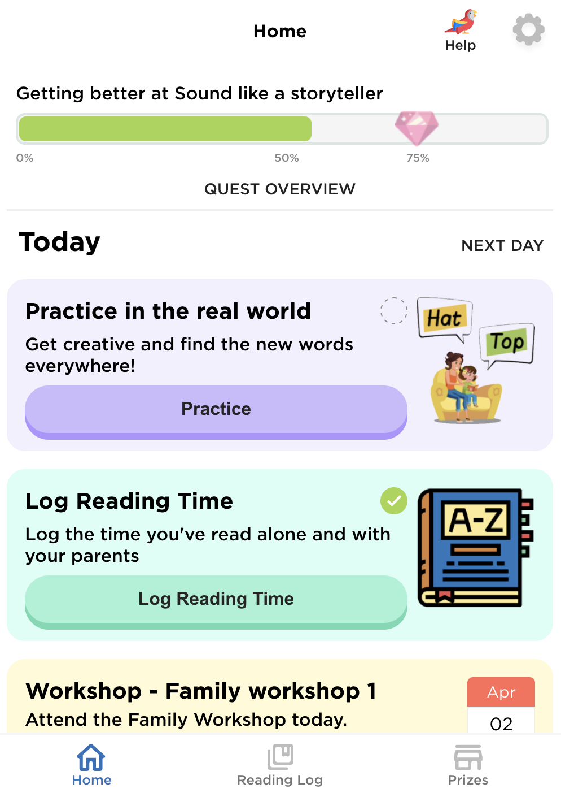
Springboard Connect
Kheyraadkayga waxtarka badan ee:
Web-salka ku haysa, aabka farriimaha (in la soo dejisto looma baahna)
Wuxuu u hagayaa ilmahaaga diirad saaridda xirfadda akhriska
Wuxuu u sharxayaa xeeladaha aad si wadajir ah ugu isticmaali kartaan si aad uga caawiso ilmahaaga horumar
Wuxuu muujiyaa horumarkaaga xagga abaalmarinta

Slide 13
Abaalmarinno kasbo
Insert incentives
Insert incentives
Insert incentives
Notes:
Facilitator note
Share the ways families can earn incentives.
Use the resource How do I earn incentives? to help you. If you are unsure, speak to your Springboard coach.
For sites with 3 tiers of incentives, the requirements are:
Tier 1: Attend programming
Tier 2: Attend programming + reach growth goal or reading practice target
Tier 3: Attend programming + reach stretch goal or exceeded reading practice target + 100% family workshop attendance
For sites with 2 tiers of incentives, the requirements are
Tier 1: Attend programming
Tier 2: Attend programming + reach growth goal or reading practice target
Suggested script
In order to get reading rewards, you must [insert].
Suggested script in Spanish
Al usar Springboard Connect para realizar un seguimiento del tiempo de práctica, su hijo gana recompensas como mochilas, libros y útiles escolares (or gift cards)
El maestro de su hijo también ingresará información en Connect que lo ayudará a ganar recompensas. El maestro de su hijo ingresara su asistencia los talleres y el tiempo de instrucción de su hijo (ambos tipos de práctica son muy importantes). Connect también le ayuda a llevar a su hijo a la hora de instrucción con el maestro y los talleres familiares. Su pantalla de tareas diarias se asegurará de que nunca pierda la oportunidad de practicar la lectura.
Y está registrando los minutos que su familia lee en casa y reflexionando sobre cómo van las estrategias de lectura.

Slide 14
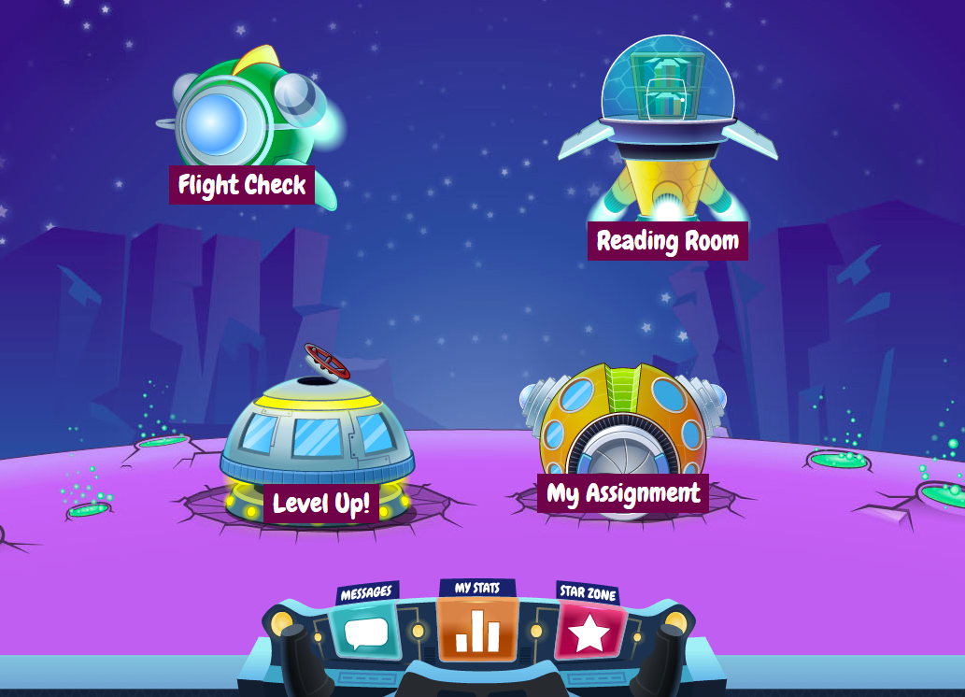
Waxaad marin ugu heli doontaa buugaag
Macallinka ilmahaaga ayaa kuu soo diri doona macluumaadka soo gelidda goobta.

Slide 15
Fill in dates
Family Workshop dates
Start and end time
start and end date
learning bonus celebration
days off
Any other important dates
Notes:
Facilitator note
Note: This will vary from site to site; be prepared to share the dates and time your site will be holding family workshops

Slide 16
Fill in information
drop off/pick up
sick or leave early
alternate pick up person
any additional paperwork from families
any additional info to give to families
Write a question in the chat box!
Notes:
Facilitator note
Fill in your program specific information here.

Slide 17
Ma qabtaa su'aal?
Waad ku mahadsan tahay imaatinkaaga!
Waad joogi kartaa oo wayddiin kartaa su'aalo haddii aad rabto.
Su'aal ku qor sanduuqa sheekeysiga (chat)!

Slide 18
Aan isku aragno kulanka kooxda!
Macallinka ilmahaaga ayaa idin la soo xiriiri doona si uu u ballansado kulan kooban oo si ka sii fiican aad isku barataan adiga iyo ilmahaaguba.

