Slide 1
Welcome to Springboard
Notes:
Facilitator note
Gather family-facing resources to support orientation.
Edit deck NOTE: you will need to choose one slide that aligns with the goals of your program from slides 8,9 or 10!
Share How do I earn incentives?
Note that the screen shots are in English but Connect is available in Spanish, too.
You could also play the Springboard Collaborative Family Orientation! found on https://www.youtube.com/c/SpringboardCollaborative
Suggested script
Welcome to the Springboard!
In this presentation we’ll explain a little more about what a Springboard program is, tools you’ll be using during this accelerator and what comes next.
Suggested script in Spanish
¡Bienvenidos a Springboard!
En esta presentación, explicaremos un poco más sobre lo que es un programa Springboard, las herramientas que van a usar durante este acelerador, y lo que sigue.

Slide 2
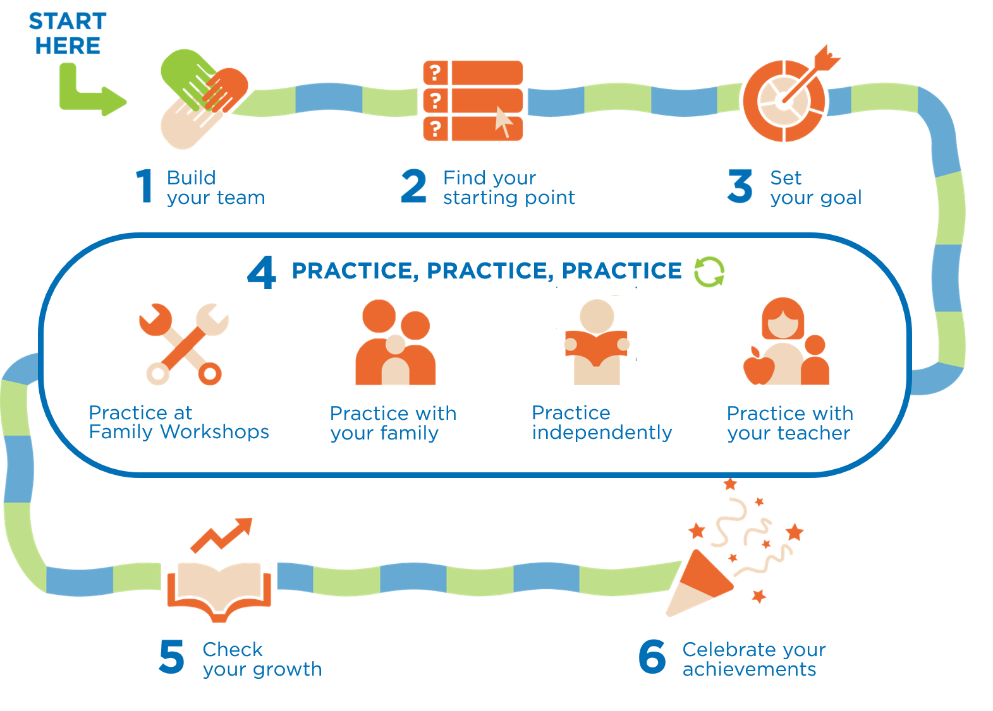
What is Springboard?
Focused, short learning burst on skills your child is already working on
Based on relationships!
Lots of deliberate practice time
Notes:
Facilitator note
The slide is animated. Push click on the * of each of the scripted points below.
Suggested script
A Springboard program is a short, focused reading program , designed to give your child a reading boost.
*It’s a program that works because it’s based on relationships—the irreplaceable relationship you have with your child and the working relationship you and your child build with a teacher. Everything we do in the program helps develop our reading team.
*It’s short, based on the reading skills your child is already working on so it’s not something “extra”, it’s focused.
*And a Springboard program works because it zero’s in on what growing readers need most—deliberate practice with a caring and knowledgeable adult. They’ll get lots of practice with you, a teacher, and the whole team together!
We like to think of the Springboard program as a 6-step journey--a journey that begins with a clear goal and ends with a party!
Suggested script in Spanish
Un programa Springboard es un programa de lectura corto y enfocado, diseñado para darle a su hijo un impulso de lectura.
Es un programa que funciona porque se basa en las relaciones: la relación irremplazable que usted tiene con su hijo y la relación de trabajo que usted y su hijo construyen con un maestro. Todo lo que hacemos en el programa ayuda a desarrollar nuestro equipo de lectura.
Es corto, basado en las habilidades de lectura en las que su hijo ya está trabajando, por lo que no es algo "extra", está enfocado.*
Y un programa Springboard funciona porque se enfoca en lo que los lectores necesitan más: práctica deliberada con un adulto atento y bien informado. ¡Tendrán mucha práctica con Usted, un maestro y todo el equipo juntos!
Nos gusta pensar en el programa Springboard como un viaje, ¡un viaje que comienza con un objetivo claro y termina con una fiesta!

Slide 3
What are Your Hopes?
What do you hope will happen for your family during this Springboard?
Fill in the sentence: “I hope…”
Write in the chat box!
Notes:
Facilitator note
Pause and ask participants to share with a partner (if in-person) or drop in the chat (if virtual) one hope they have Springboard or something they’re excited about with the program.
Give adequate wait time.
Invite volunteers to share with the group (if in-person)
If participants are using the chat, be sure to read the responses and react enthusiastically.
Encourage participants to share these hopes with their child’s teacher at the Team-Building Huddle.

Slide 4
6 Parts
Notes:
Facilitator note
Share any additional information about Team-Building Huddles at your site.
Suggested script
Let’s look more closely at the 6 parts that make up the accelerator
It starts with a Team-Building Huddle. Because Springboard programs are built on relationships—we build a foundation with a 1:1 meeting between you, your child and their teacher.
Our Team-Building Huddles will happen [virtually or in-person] between the dates of x and y.
Suggested script in Spanish
Vamos a mirar más de cerca a cada una de las 6 partes que componen el acelerador
Comienza con una reunión del equipo. Debido a que los programas de Springboard se basan en las relaciones, construimos la base con una reunión 1:1 entre usted, su hijo y su maestro.
Nuestras reuniones en equipo serán [virtual or in-person] entre las fechas de x & y.

Slide 5
6 Parts
Notes:
Facilitator note
n/a
Suggested script
Then, step 2 we use [assessments or reading practice targets] to see where your child is in their reading.
You will receive the [scores or reading practice targets] via a letter that explains the goal and what you can do at home to reach it! We call this the student action plan and your Springboard teacher will make sure everyone knows how to use the information.
The student action plan will give you a strategy and tips to help you support your child in building their reading skills. We also have an optional app that will help you work towards your goal.
Suggested script in Spanish
Luego, en el paso 2 usamos [assessments or reading practice targets] para ver en qué nivel de lectura está su hijo.
Ustedes recibirán los [scores or reading practice targets] por medio de una carta que explica la meta y lo que pueden hacer en casa para lograrla. A esto lo llamamos el plan de acción del estudiante y su maestra de Springboard se asegurará de que todos sepan usar la información.
El plan de acción del estudiante le dará una estrategia y unos consejos para ayudarle a apoyar a su hijo en el desarrollo de sus capacidades lectoras. También tenemos una aplicación opcional que les ayudará a trabajar hacia su meta.

Slide 6
6 Parts
Notes:
Facilitator note
Note, slide is animated. Push click with the * on the bullet point below.
Explain the particulars of Family Workshops and instruction at your site (e.g., date, time, platform)
Suggested script
Reading is a complicated process so we use practice time to hit it from multiple angles:
*We practice as a whole team in Family Workshops. These are virtual or in-person events where you, your child and your child’s teacher and other families, just like you, all come together to practice a specific reading tip. Through videos, specific examples, and role play, the teacher shows you what they do in class and help you become a better at-home reading coach
*And your child practices with you at home. You use the reading tips & strategies that you learn in Family Workshops and the strategy that the family reading companion, Springboard Connect, suggests to help your child improve in their reading. Springboard Connect sends you texts and reminders.
*They are also practicing on their own--either using the strategies they are practicing with you or the ones they learn in school.
*All the while, your child practices with the teacher in small learning groups. They focus on the skills readers need. Your child will love the individual attention as the teacher targets what your child needs.
And the best part—your child can earn rewards for all this practice time. Your child will see their hard work paying off!
Making sure that an adult (it doesn’t have to be you) is at every Family Workshop with your child and that your child attends practice with the teacher time is a requirement of this program.
Suggested script in Spanish
La lectura es un proceso complicado por lo que utilizamos el tiempo de práctica para aprender desde múltiples ángulos:
Practicamos como todo un equipo en talleres familiares. Estos son eventos virtuales o en persona en los que usted, su hijo y el maestro de su hijo y otras familias, al igual que usted, se unen para practicar un consejo específico de lectura. A través de videos, ejemplos específicos y juegos de rol, la maestra le muestra lo que hacen en su clase, y aprenderá todo sobre cómo ser un entrenador de lectura en casa
Y su hijo practica con Usted en casa. Usted utiliza los consejos y estrategias que aprenden en los talleres familiares y las estrategias que el guía familiar de lectura, Springboard Connect, sugiere para ayudar a su hijo mejorar su capacidad lectora. Springboard Connect le manda textos y recordatorios.
También está practicando sólo - o utilizando las estrategias que practican con Usted, o las que aprende en la escuela.
Mientras tanto, su hijo practica con su maestro en grupos pequeños de aprendizaje. Se enfocan en habilidades que necesitan los lectores. ¡A su hijo le encantará la atención individual que recibe del maestro!*
Y la mejor parte: su hijo puede ganar puntos y recompensas por todo este tiempo de práctica. ¡Su hijo verá su arduo trabajo dando frutos!
Asegurarse de que un adulto (no tiene que ser Usted) esté presente en cada taller familiar con su hijo y que su hijo asista al tiempo de práctica con su maestro es un requisito de este programa.

Slide 7
6 Parts
Notes:
Facilitator note
Share the end date for your particular program with families.
Suggested script
After a few weeks we move onto step 5 and 6. We see if your child has met their goal and check to see how much their reading skills have grown.
Then we all celebrate the hard work and reading growth of your child!
Suggested script in Spanish
Después de unas semanas, pasamos al paso 5 y 6. Vamos a ver si su hijo ha logrado su meta y verificamos cuánto han crecido sus habilidades de lectura.
¡Entonces todos celebramos el arduo trabajo y crecimiento en la lectura de su hijo!

Slide 8
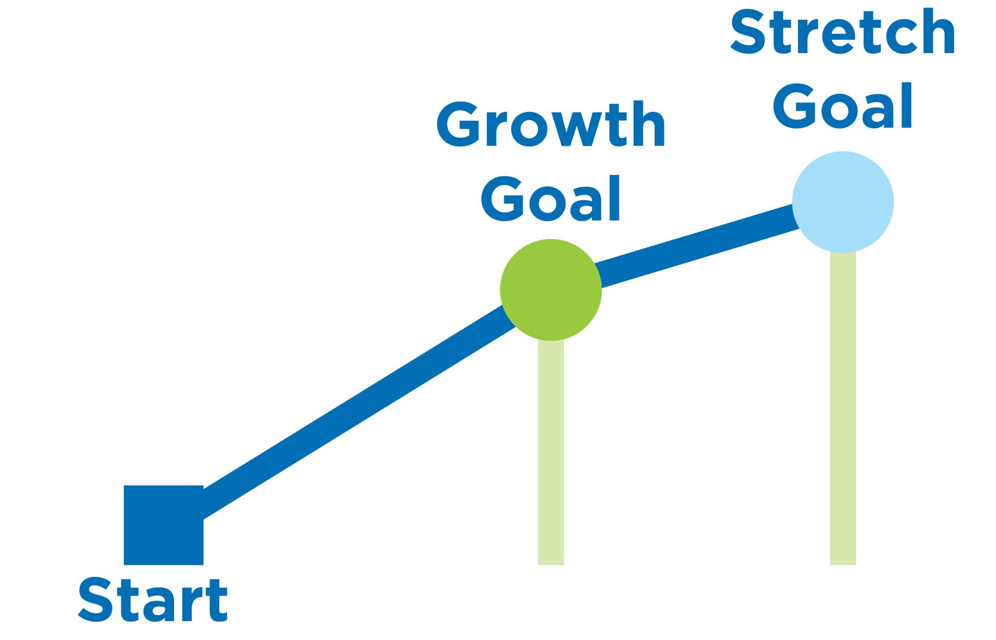
Goal is Based on Reading Test
Reading reward!
Choose between slides 8,9, or 10!
Notes:
Facilitator note
This is the slide for a program with 3 tiers. If you are unsure, speak to your Springboard coach before presenting to families.
Suggested Script
Your child will take an assessment at the beginning of programming and we will use this assessment to monitor their reading growth.
Growth goal = Your child’s reading will improve by a specific amount based on their beginning assessment.
Stretch goal = Your child’s reading will improve by even more!
These are the goals that you and your family will be working towards during the program. Meeting these goals will help your child improve their reading and earn reading rewards! In order to get reading rewards, you also need to attend Family Workshops. Family workshop is required for your child to get those reading rewards. Remember it can be any loving adult in your child’s life.
Suggested Script in Spanish
Su hijo tendrá una evaluación al principio del programa y utilizaremos esta evaluación para monitorear su crecimiento en la lectura.
Meta de crecimiento - La lectura de su hijo mejorará cierta cantidad según indica la evaluación inicial
Meta de estiramiento - La lectura de su hijo mejorará todavía más!
Estas son las metas hacia las que Usted y su familia estarán trabajando durante el programa. Lograr estas metas ayudarán a su hijo a mejorar en la lectura y ganar recompensas de lectura. Para ganar recompensas de lectura, también necesitan asistir a los talleres familiares. Los talleres familiares son obligatorios para que su hijo obtenga esos premios de lectura. Acuérdese que puede ser cualquier adulto cariñoso en la vida de su hijo.

Slide 9
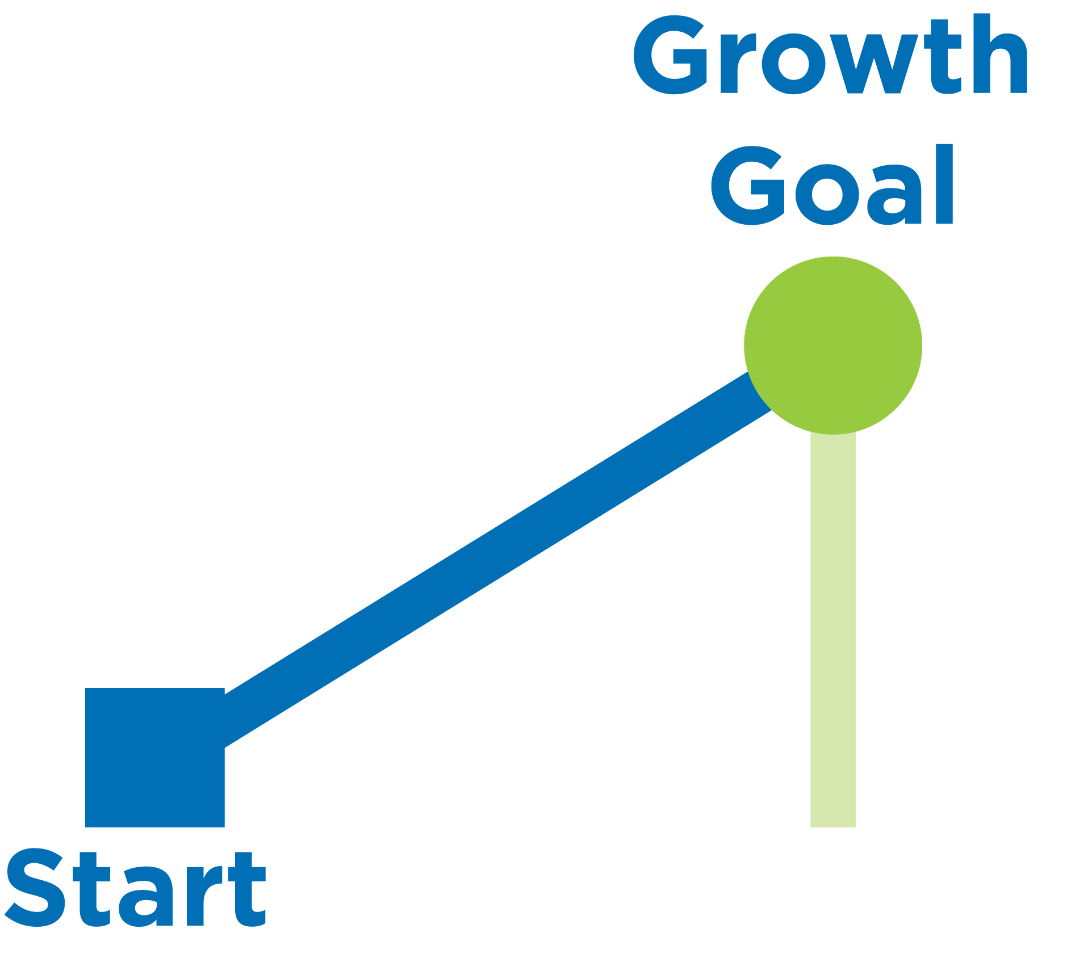
Goal is Based on Reading Test
Choose between slides 8,9, or 10!
Reading reward!
Notes:
Facilitator note
This is the slide for a program with 2 tiers. If you are unsure, speak to your Springboard coach before presenting to families.
Suggested Script
Your child will take an assessment at the beginning of programming and we will use this assessment to monitor their reading growth.
Growth goal = Your child’s reading will improve by a specific amount based on their beginning assessment.
This is the goal that you and your family will be working towards during the program. Meeting this goal will help your child improve their reading and earn reading rewards!

Slide 10
Goal is Based on Reading Target
Choose between slides 8,9, or 10!
Reading reward!
Notes:
Facilitator note
This is the slide for partners who are using Reading Practice targets to determine 2 or 3 reward tiers. If you are unsure, speak to your Springboard coach before presenting to families.
Suggested Script
Your child will have a reading practice target based on [books read or minutes read]. This reading target will help children get more practice reading so they can increase their reading skills.
A Reading target - reading improvement by a specific amount based on reading outputs (minutes read or books read)
[If you are doing a 2 tier reward program]:
If your child reaches their reading target, they get reading rewards. So make sure you are helping them get their reading at home!
[If you are doing a 3 tier reward program]:
If your child reaches their reading target, they get reading rewards. So make sure you are helping them get their reading at home!
If your child exceeds their target or achieves a specific amount beyond their growth goal (minutes read or books read) they will get more rewards.
In order to get reading rewards, you also need to attend Family Workshops. Family Workshop is required for your child to get those reading rewards. Remember it can be any loving adult in your child’s life.
Suggested script in Spanish
Su hijo tendrá una meta de práctica lectora basado en [books read or minutes read]. Esta meta ayuda a los niños a practicar más para que puedan aumentar sus habilidades lectoras.
Una meta de lectura - mejorar cierta cantidad en la lectura basado en la producción lectora [minutes read or books read]
[Si está participando en un programa de incentivos de 2 niveles]
Si su hijo logra su meta de lectura, recibirá recompensas de lectura. Así que asegúrese de ayudarlo a completar su lectura en casa!
[Si está participando en un programa de incentivos de 3 niveles]
Si su hijo logra su meta de lectura, recibirá recompensas de lectura. Así que asegúrese de ayudarlo a completar su lectura en casa!
Si su hijo excede su meta de lectura, o logra leer cierta cantidad más de lo que indica su meta de crecimiento [minutes read or books read] ganará más recompensas.
Para poder recibir premios de lectura, Usted también necesita asistir a los talleres familiares. familiares son obligatorios para que su hijo obtenga esos premios de lectura. Acuérdese que puede ser cualquier adulto cariñoso en la vida de su hijo.

Slide 11
What Part are You Excited For?
Write a number in the chat box!
Notes:
Facilitator note
Pause and ask participants to share with a partner (if in-person) or drop in the chat (if virtual) the part of the Springboard journey they are excited about.
Give adequate wait time.
Invite volunteers to share with the group (if in-person)
If participants are using the chat, be sure to read the responses and react enthusiastically.
Elicit questions about any of the steps.

Slide 12
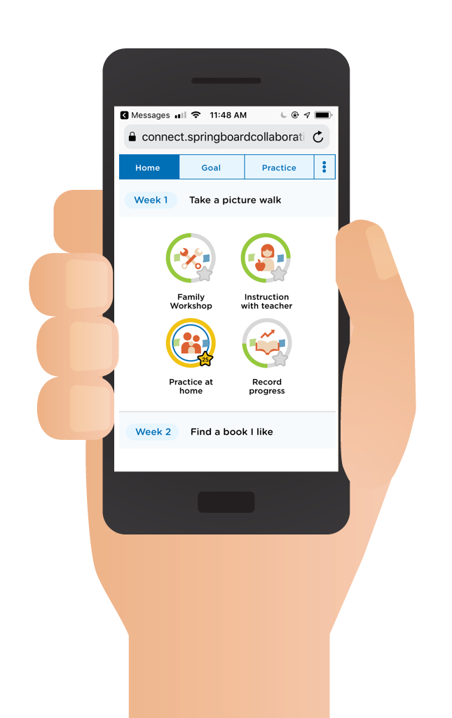
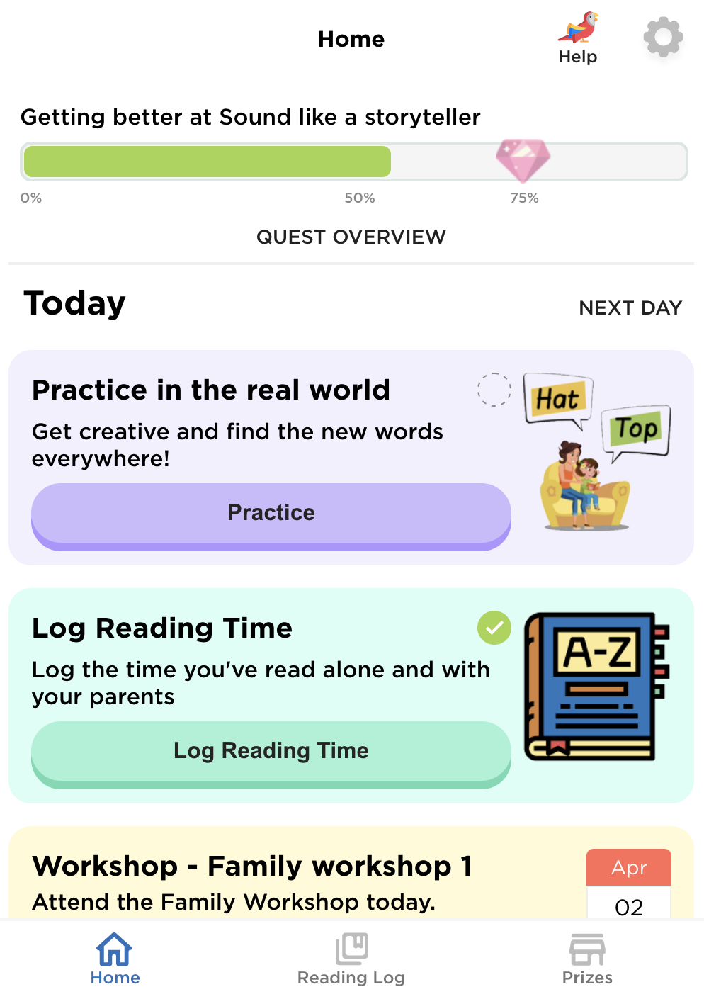
Springboard Connect
Our amazing resource:
Web-based, texting app (no download required)
Gives you reading skills to focus on with your child
Explains a strategy you can use together to help your child improve
Tracks your reading time
Notes:
Facilitator note
Consider having families show, by raising their hands, who has received an enrollment message. Follow up as needed.
Suggested script
We have a clear, digital map to guide us through the Springboard. You’ve already heard of it. It’s Springboard Connect!
This amazing resource is a Web-based, texting app (no download required)
Springboard Connect keeps your child’s student action plan top of mind. This is a specific strategy for your child that will help them reading their reading goals.
You can track your child’s time spend reading by [ways they should track].
Suggested script in Spanish
Tenemos un mapa digital claro para guiarnos a través del programa Springboard. Ya han oído hablar de él. ¡Es Springboard Connect!
Este increíble recurso es una aplicación de mensajes de texto basada en la web (no se requiere descarga)
Springboard Connect mantiene el plan de acción de su hijo en primera línea. Esta es una estrategia específica para su hijo que le va a ayudar a lograr sus metas de lectura.
Usted puede monitorear el tiempo que pasa su hijo leyendo por medio de [ways they should track]

Slide 13
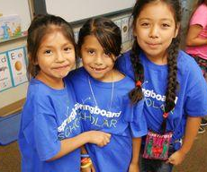
Earn Reading Rewards
Insert incentives
Insert incentives
Insert incentives
Notes:
Facilitator note
Share the ways families can earn rewards.
Use the resource How do I earn rewards? to help you. If you are unsure, speak to your Springboard coach.
Suggested script
In order to get reading rewards, you must [insert].
Suggested script in Spanish:
Para recibir recompensas de lectura, uno tiene que [insert]

Slide 14
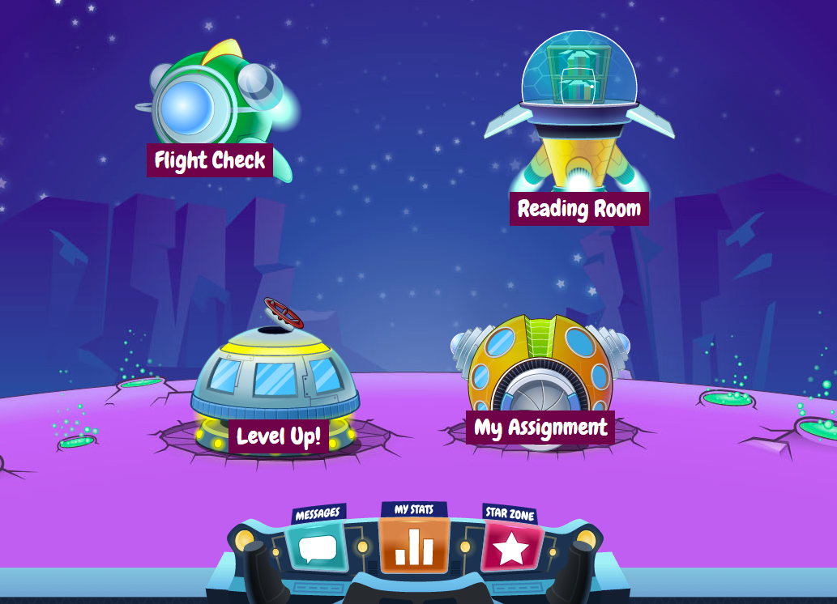
You’ll Have Access to Books
Your child’s teacher will send you the log in information
Notes:
Facilitator note
n/a
Suggested script
Now, we can’t practice reading unless we have books. So we have one more digital tool for you! You’ll have thousands of books, at your fingertips, through Kids A-Z. Your child’s teacher will give you all the information you need to sign up for this resource.
Suggested script in Spanish
Ahora bien, no podemos practicar la lectura a menos que tengamos libros. ¡Así que tenemos una herramienta digital más para usted! Tendrá miles de libros, al alcance de tu mano, a través de Kids A-Z. La maestra de su hijo le dará toda la información que necesita para inscribirse en este recurso

Slide 15
Springboard Calendar
Fill in dates
Family Workshop dates
Start and end time
start and end date
learning bonus celebration
days off
Any other important dates
Notes:
Facilitator note
Note: This will vary from site to site; be prepared to share the dates and time your site will be holding Family Workshops

Slide 16
Program Procedures
Fill in information
drop off/pick up
sick or leave early
alternate pick up person
any additional paperwork from families
any additional info to give to families
Write a question in the chat box!
Notes:
Facilitator note
Fill in your program specific information here.

Slide 17
Questions?
Thanks for coming!
You can stay and ask questions if you’d like.
Write a question in the chat box!
Notes:
Facilitator note
Make yourself available for questions and answers during this time.

Slide 18
See You at the Team Huddle!
Your child’s teacher will reach out to schedule a brief meeting to get to know you and your child better.
Notes:
Facilitator note
n/a
Suggested script
You’re ready to begin your Springboard journey! Your child’s teacher will reach out to schedule a brief meeting to get to know you and your child better.
Suggested script in Spanish
¡Está listo para comenzar su viaje en Springboard! La maestra de su hijo se pondrá en contacto para programar una breve reunión para conocerlo mejor a usted y a su hijo.

