Slide 1
Welcome to Springboard
Notes:
Facilitator note:
Gather family-facing resources to support orientation.
Share Family welcome resource. (This resource can also be used or revisited during in the team-building huddle)
Share How do I earn incentives?
This presentation includes both English and Spanish slides. Delete or hide slides you don’t need.
Note that the screen shots are in English but Connect is available in Spanish, too.
You could also play the Welcome to the Springboard Learning Accelerator! found on https://www.youtube.com/c/SpringboardCollaborative
Suggested script
Welcome to the Springboard Learning Accelerator!
In this presentation we’ll explain a little more about what a learning accelerator is, the digital tools you’ll be using during this accelerator and what comes next.
Suggested script in Spanish
Bienvenido a la Springboard Learning Accelerator. En este presentación, revisaremos qué es un acelerador de aprendizaje, las herramientas digitales que usará durante un acelerador y lo que viene a continuación.

Slide 2
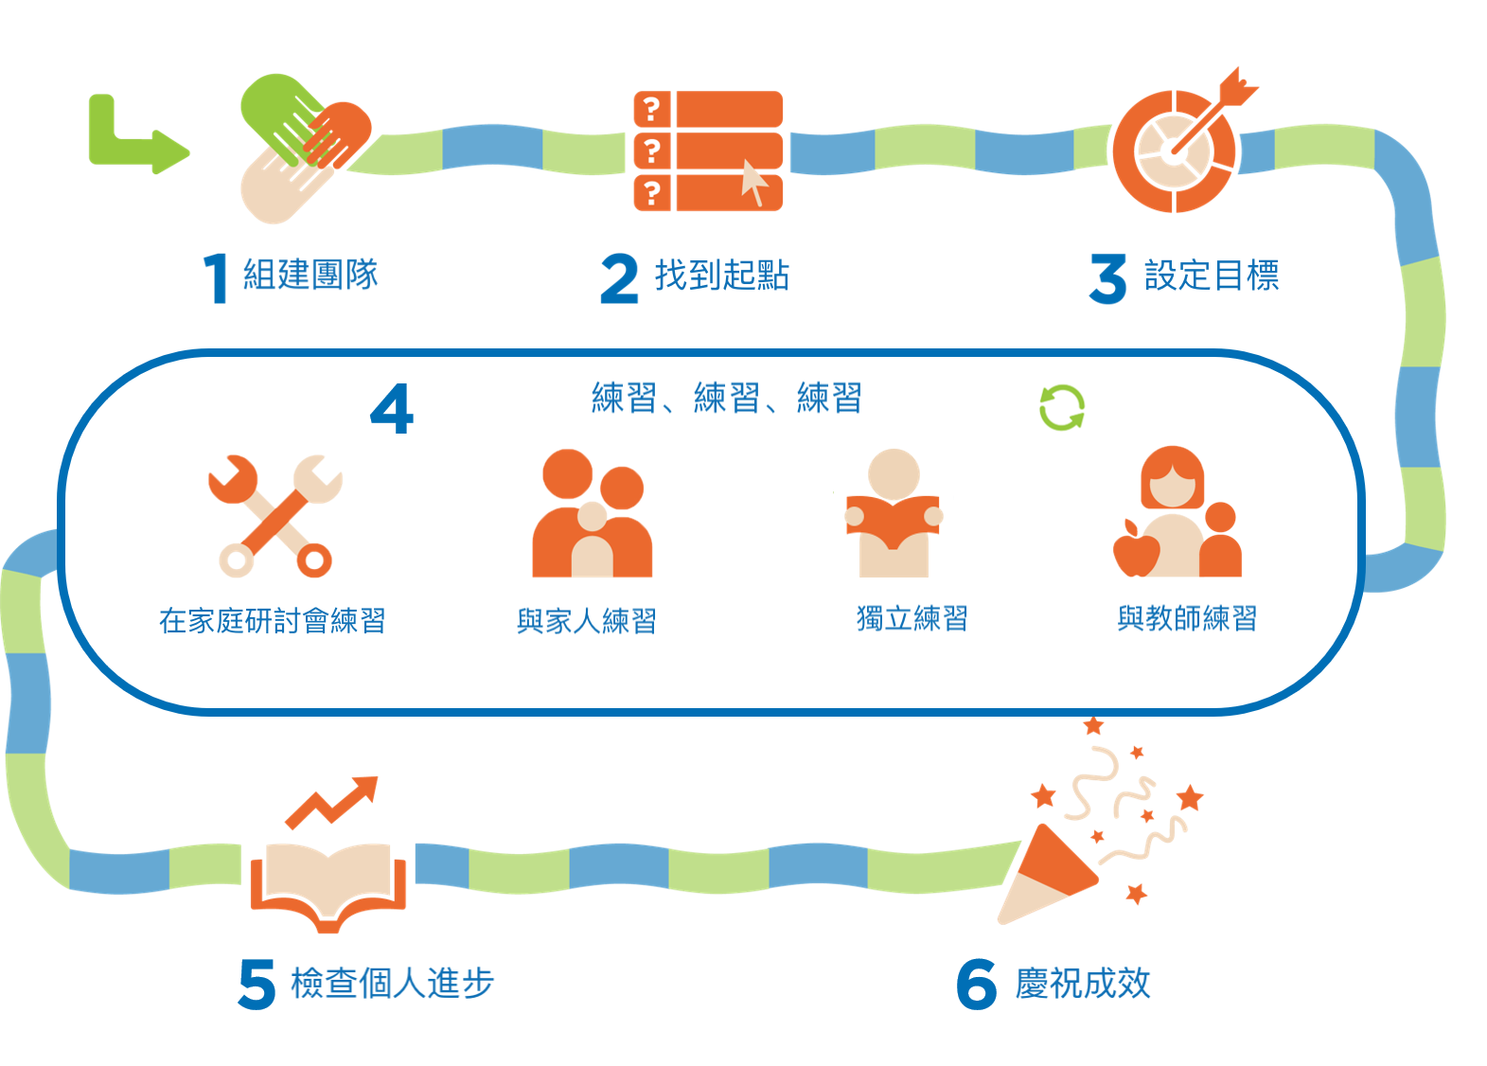
Springboard
孩子已關注技能的集中短期學習爆發
基於多種關聯！
大量專門設置練習時間

Slide 3
您有什麼希望目標？
您希望家人在學習加速器中有什麼收穫？
填寫句子：「我希望……」
在聊天框中填寫！

Slide 4
6部分
1
3
5
組建團隊
設定目標
檢查個人進步
在家庭研討會練習
與家人練習
獨立練習
與教師練習
2
4
6
練習、練習、練習
找到起點
慶祝成效

Slide 5
6部分
1
3
5
組建團隊
設定目標
檢查個人進步
在家庭研討會練習
與家人練習
獨立練習
與教師練習
2
4
6
練習、練習、練習
找到起點
慶祝成效

Slide 6
6部分
1
3
5
組建團隊
設定目標
檢查個人進步
在家庭研討會練習
與家人練習
獨立練習
與教師練習
2
4
6
練習、練習、練習
找到起點
慶祝成效

Slide 7
6部分
1
3
5
組建團隊
設定目標
檢查個人進步
在家庭研討會練習
與家人練習
獨立練習
與教師練習
2
4
6
練習、練習、練習
找到起點
慶祝成效

Slide 8
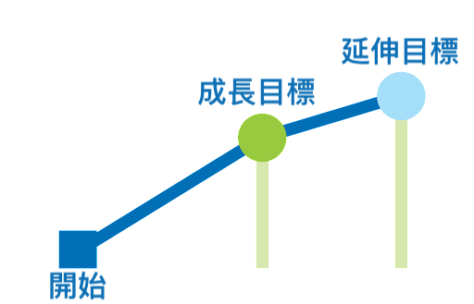
基於閱讀測試之目標
Choose between slides 8,9, or 10!
閱讀
獎勵！
Notes:
Orientation slides

Slide 9
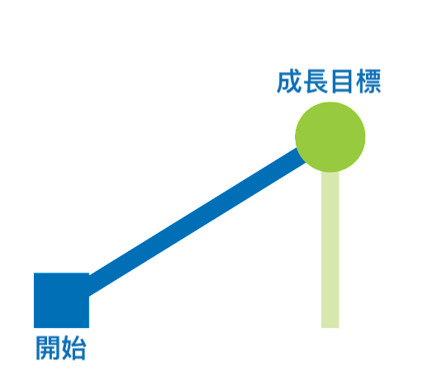
基於閱讀測試之目標
Choose between slides 8,9, or 10!
閱讀
獎勵！

Slide 10
基於閱讀目的之目標
Choose between slides 8,9, or 10!
閱讀
獎勵！

Slide 11
哪部分最令您興奮？
1
3
5
在聊天框中填寫數字！
2
4
6

Slide 12
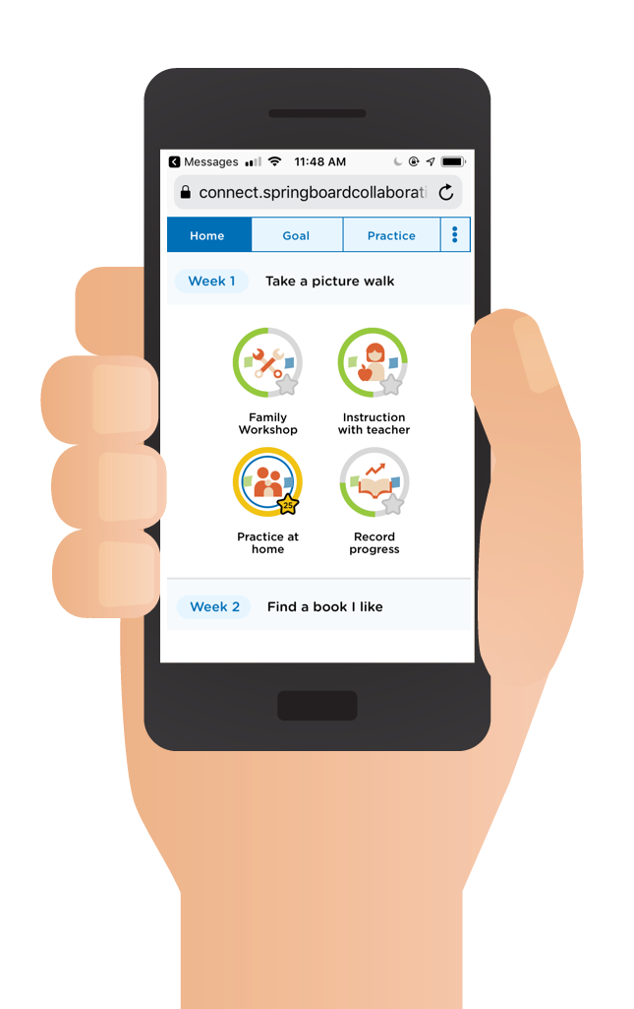
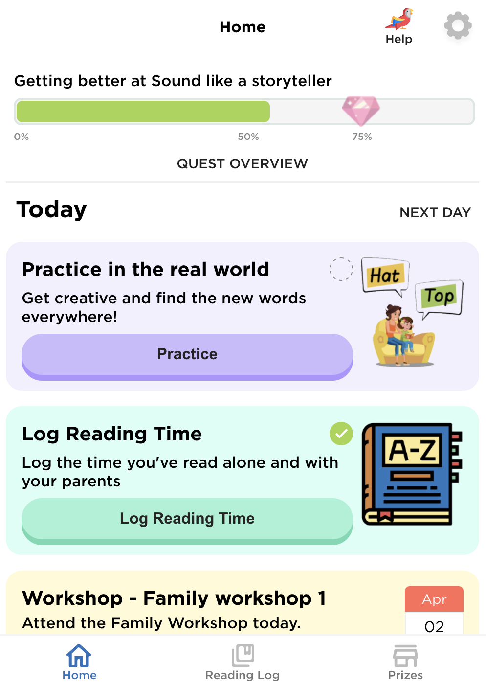
Springboard 連接
資源豐富：
聯網短信應用程式（無需下載）
引導孩子關注閱讀技能重點
講解您可以共用的策略，幫助您的孩子提高
顯示您的獎勵進展情況

Slide 13
贏得獎勵
Insert incentives
Insert incentives
Insert incentives
Notes:
Facilitator note
Share the ways families can earn incentives.
Use the resource How do I earn incentives? to help you. If you are unsure, speak to your Springboard coach.
For sites with 3 tiers of incentives, the requirements are:
Tier 1: Attend programming
Tier 2: Attend programming + reach growth goal or reading practice target
Tier 3: Attend programming + reach stretch goal or exceeded reading practice target + 100% family workshop attendance
For sites with 2 tiers of incentives, the requirements are
Tier 1: Attend programming
Tier 2: Attend programming + reach growth goal or reading practice target
Suggested script
In order to get reading rewards, you must [insert].
Suggested script in Spanish
Al usar Springboard Connect para realizar un seguimiento del tiempo de práctica, su hijo gana recompensas como mochilas, libros y útiles escolares (or gift cards)
El maestro de su hijo también ingresará información en Connect que lo ayudará a ganar recompensas. El maestro de su hijo ingresara su asistencia los talleres y el tiempo de instrucción de su hijo (ambos tipos de práctica son muy importantes). Connect también le ayuda a llevar a su hijo a la hora de instrucción con el maestro y los talleres familiares. Su pantalla de tareas diarias se asegurará de que nunca pierda la oportunidad de practicar la lectura.
Y está registrando los minutos que su familia lee en casa y reflexionando sobre cómo van las estrategias de lectura.

Slide 14
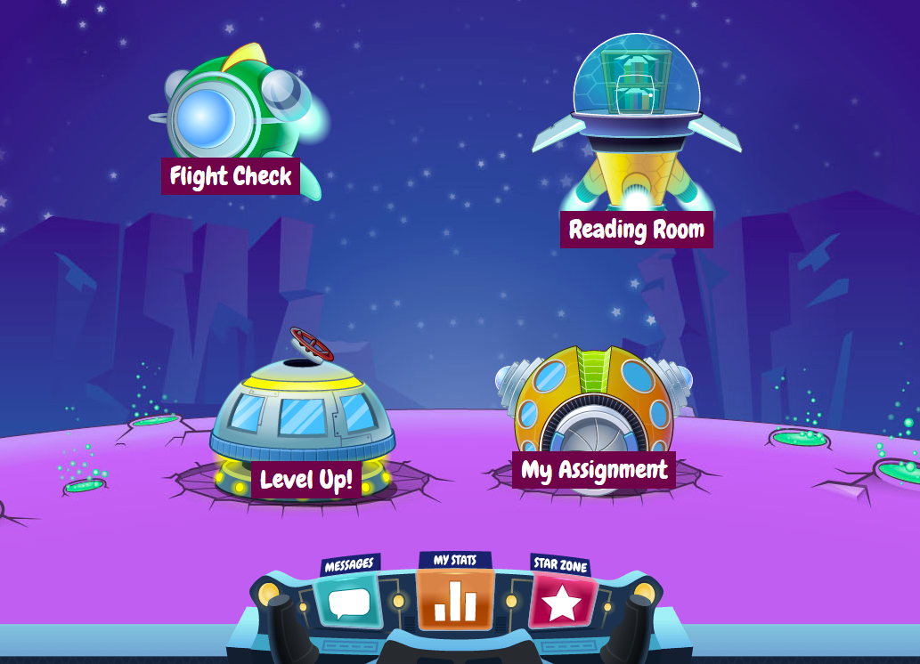
您可以訪問圖書
孩子的教師會向您發送登入資訊

Slide 15
Fill in dates
Family Workshop dates
Start and end time
start and end date
learning bonus celebration
days off
Any other important dates
Notes:
Facilitator note
Note: This will vary from site to site; be prepared to share the dates and time your site will be holding family workshops

Slide 16
Fill in information
drop off/pick up
sick or leave early
alternate pick up person
any additional paperwork from families
any additional info to give to families
Notes:
Facilitator note
Fill in your program specific information here.

Slide 17
有問題嗎？
感謝您蒞臨！
如果您願意，可以留下來提問。
在聊天框中填寫一個問題！

Slide 18
團隊會面見！
孩子的教師會聯系您安排一次簡短會面，以期更好地了解您和孩子。

