Slide 1



Introduce the sounds
Bossy e
  flame
  /f/ /l/ /ā/ /m/
  = flame
It’s time to learn new sounds!
We use the sound rule to help us read!
Notes:
See lesson plan for specific instructional guidance.
Introduce the Sound!
Say: Learning new sounds is so cool! Repeat our chant after me!
"It's time to learn new sounds!
We use the sound rule to help us read!"
Do: Say one sentence at a time of the Introduce the Sound chant and ask the students to repeat after you.
Say: Let's learn a super cool new rule today!
Say: In this unit, we are reading words that end with a bossy e, we use the long vowel sound and the e doesn't make any sounds. For example, flame has a bossy e and the vowel will make the long vowel sound, so we read the word /f/ /l/ /a/ /m/ = flame.

Slide 2





Introduce the sounds
Notes:
See lesson plan for specific instructional guidance.
Introduce the Sound!
Say: Before we start practicing that, let's review our sound letter vowel cards. We say the short vowel sound, followed by the long vowel sound.
Do: Flip through the Sound Letter cards for a, e, i, o, and u, guiding students to say the short vowel sound and long vowel sound for each letter.

Slide 3
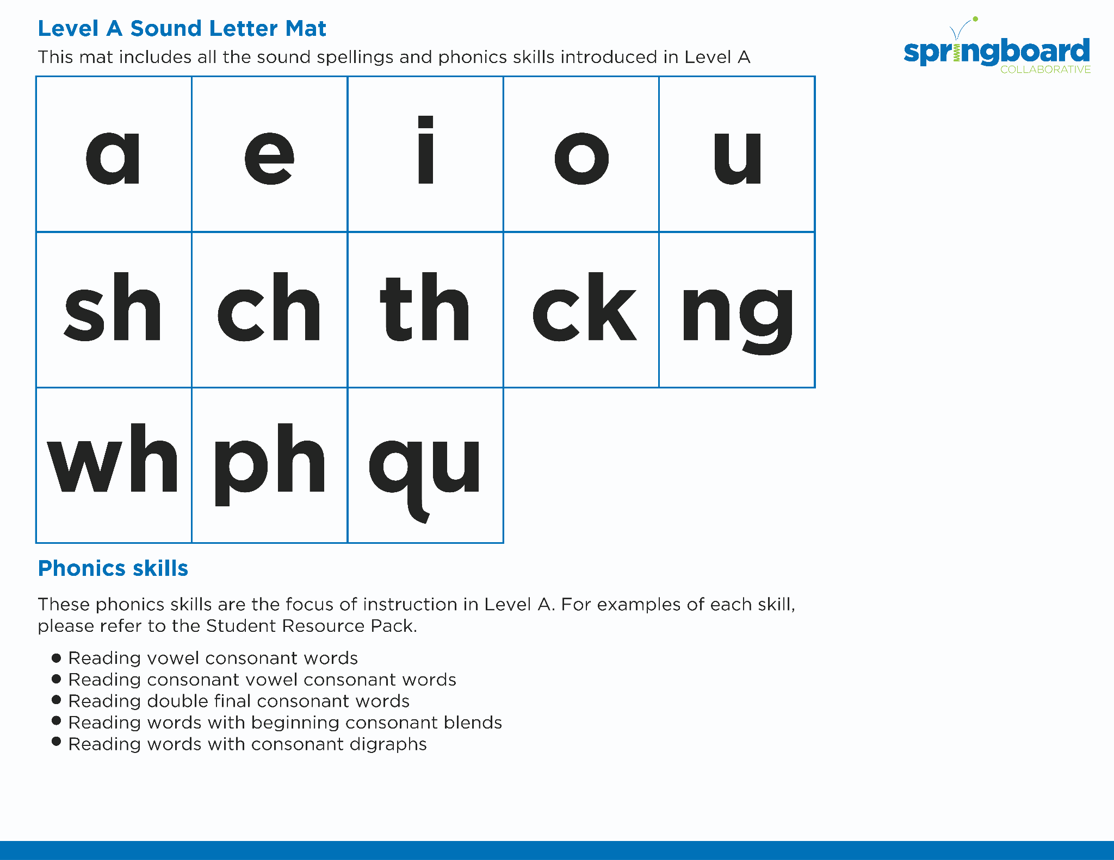
Introduce the sounds
Notes:
See lesson plan for specific instructional guidance.
Introduce the Sound!
Say: When we read words that end in a vowel consonant bossy e, we use the long vowel sound. Let's practice our short and long vowel sounds one more time and the consonant digraphs we've learned in Level A.
Do: Flip through the Sound Letter cards for a, e, i, o, and u and wh, sh, ch, ng, ck, ph, and qu or using the Level A Sound Letter Mat, guiding students to say the short vowel sound and long vowel sound for each letter.
Say: When we read words that end with a bossy e, we use the long vowel sound and the e doesn't make any sounds. Let's practice reading our new word pattern!

Slide 4



Blend
the sounds
same
Family Activity
flame
It’s time to blend the sounds!
It’s time to blend the sounds to help us read the words smoothly!
Notes:
See lesson plan for specific instructional guidance.
Blend the Sounds!
Say: Blending sounds helps us read the words smoothly! Repeat our chant after me!
"It's time to blend the sounds!
It's time to blend the sounds to help us read the words smoothly!"
Do: Say one sentence at a time of the Blend the Sounds chant and ask the students to repeat after you.
Say: Let's practice blending the sounds in some words today!
Say: When we blend the sounds in words, it helps us read the words smoothly. Let's try it. When words end with a bossy e, the e makes the vowel make the long vowel sound, or says its name. The e doesn't make any sound.
Do: Point to the word same.
Say: This word begins with a consonant, s. S says /s/. I notice that the rest of the word is a-m-e. The bossy e makes the a say the long vowel sound /a/. We have /s/ /a/ so far. Next is a consonant m. M says /m/. This last e does not make any sounds. The e's job was to make the a says its name. The words says /s/ /a/ /m/ = "same". Let's segment and blend the word together now using our Double Decker Elkonin Boxes.
Do: Segment and blend the word same using the Double Decker Elkonin Boxes.
Say: Why is this word read as /s/ /a/ /m/ = "same"?
Do: Listen as students explain bossy e.
Say: Smart explanations! Let's look at another word.
Do: Point to the word flame.
Say: This word begins with a consonant blend, /f/ /l/. f-l says /f/ /l/. Next comes a vowel, a. But, I notice the spelling pattern vowel consonant e. This is bossy e. What happens when we have this spelling pattern?
Do: Listen as students explain the rule.
Say: Yes! The final bossy e makes a use the long vowel sound. We have /f/ /l/ /a/ and the consonant /m/. The word is /f/ /l/ /a/ /m/ = "flame". Blend the word using your Double Decker Elkonin Boxes.
Do: Listen as students blend the word. Take notes on the students that can accurately blend the open syllable using the long vowel sound and students that may need reteaching and/or additional support.
Say: Final bossy e makes the vowel say its name. Great thinking while blending the sounds today!

Slide 5


Read
the words
Family Activity
skate
shake
It’s time to read the words!
It’s time to read the words so we can read smoothly like we are speaking!
Take this page and date it.
Notes:
See lesson plan for specific instructional guidance.
Read the Words!
Say: When we practice reading the words, it can help us read the words faster and faster. This helps us learn to read smoothly like when we are speaking! Repeat our chant after me!
"It's time to read the words!
It's time to read the words so we can read smoothly like we are speaking!"
Do: Say one sentence at a time of the Read the Words chant and ask the students to repeat after you.
Say: Let's practice reading words today!
Say: We are going to read the words. When we practice reading the words, it helps us read faster and faster. This helps us focus on what we can learn from the words. Let's look at the first word.
Do: Point to the word skate.
Say: When we read this word, we look to see what spelling pattern it uses so we know what vowel sound to make. I see a consonant digraph, vowel, consonant, final bossy e. We'll use the long vowel sound. /s/ /k/ /a/ /t/ = skate. Your turn using the Double Decker Elkonin Boxes.
Do: Listen as students read the word. Take notes on the students that can accurately articulate the sounds and read the word, and students that may need reteaching and/or additional support.
Say: Yes, the word is "skate". Let's look at the next word. How would you read this word? Use the Double Decker Elkonin Boxes.
Do: Point to the word shake.
Say: Look at this spelling pattern! I see a consonant digraph, vowel, consonant, final bossy e. Underline the s-h consonant digraph because the letters stick together. How will you read this word?
Do: Listen as students read the word. Take notes on the students that can accurately articulate the sound and read the word, and students that may need reteaching and/or additional support.
Say: Yes, the word is "shake".
Do: Display the sentence: Take this page and date it.
Say: Take a couple minutes to read this sentence with your partner. All of the words follow rules you've learned or are High Frequency Words you've learned. Raise your hands when you have the whole sentence read and I'll come listen. You can do it!
Do: Monitor and assist. You may support by asking students to recognize the spelling pattern, prompting students to use the long or short vowel sound, asking students to underline letters that stick together, etc.
Say: I'll read it aloud as you read it with me.
Do: Read sentence.
Say: Amazing work! Remember, a word that uses consonant, vowel, consonant, with a final bossy e, uses the long vowel sound. Those brains are growing!

Slide 6


Decode
the words
  brave grade
  crane plane
  save
It’s time to decode the sounds in the words!
It’s time to decode the sounds in the words so
we can read the words!
Notes:
See lesson plan for specific instructional guidance.
Decode the Words!
Say: Decoding is when you break up the sounds in a word and read each sound one at a time. Then you blend the sounds together to read the word! Repeat our chant after me!
"It's time to decode the sounds in the words!
It's time to decode the sounds in the words so we can read the words!"
Do: Say one sentence at a time of the Decode the Words chant and ask the students to repeat after you.
Say: Let's practice decoding the sounds in words today!
Say: We are going to decode the words. Remember, decoding is when you break up the sounds in a word and read each sound one at a time. Then you blend the sounds together to read the word! When we decode the sounds in words, it helps us read the words correctly. Look at our words for today.
Do: Point to the words.
Say: First, look at the spelling pattern to decide what vowel sound to use. Next, say each sound. Finally, blend the sounds together to read the words.
Do: Partner students.
Say: You and your partner work together to decode these words (brave, grade, crane, plane, save). I'll be by to listen. Use your Double Decker Elkonin Boxes.
Do: Listen as students decode the word. Take notes on the students that can accurately articulate the sounds and read the word, and students that may need reteaching and/or additional support.
Say: Excellent work applying our new rule to decoding words today!

Slide 7





Spell
the words
b
r
a
v
e
It’s time to spell the words!
It’s time to spell the words to show we understand the rule!
Notes:
See lesson plan for specific instructional guidance.
Spell the Words!
Say: When we can spell words, it shows that we met the target. When we hear the sounds, we can match the sounds to the correct letters and spell the word! Repeat our chant after me!
"It's time to spell the words!
It's time to spell the words to show we understand the rule!"
Do: Say one sentence at a time of the Spell the Words chant and ask the students to repeat after you.
Say: Let's practice spelling words today!
Say: We are going to spell the words. Remember, when we can spell words with the correct rule, it shows that we met the target. When we hear the sounds, we can match the sounds to the correct letters and spell the word! Listen to our words for today. The word is brave. How would we spell the word brave? Let's listen to the sounds and match the sound to the correct letter. The word is "brave". I hear /b/ /r/ /a/ /v/. I know that sound for /b/ = b and the sound for /r/ = r, /a/ = a. I hear a /v/ sound at the end. We learned that by adding a final bossy e, we can make the long vowel sound. Grab your whiteboards and write the word.
Do: Watch as students spell the word using the letter and sound connections. Take notes on the students that can accurately articulate the sound and spell the word, and students that may need reteaching and/or additional support.
Say: Yes, when we spell the word brave we write the letters b-r-a-v-e.

Slide 8

Spell
the words
s
a
v
e
Notes:
See lesson plan for specific instructional guidance.
Spell the Words!
Say: Now I want to make a new word by changing the beginning consonant sound. What would the word be if we changed the /b/ /r/ sound in brave, to the /s/ sound? /s/ /a/ /v/. Grab your whiteboards and write the word.
Do: Watch as students spell the word using the letter and sound connections. Take notes on the students that can accurately articulate the sound and spell the word, and students that may need reteaching and/or additional support.
Say: Yes, when we change the beginning sound from /b/ in brave to /s/ we write the letters make for the word "save". The final bossy e makes the a say the long vowel sound. Great thinking! Awesome job spelling words today!

Slide 9
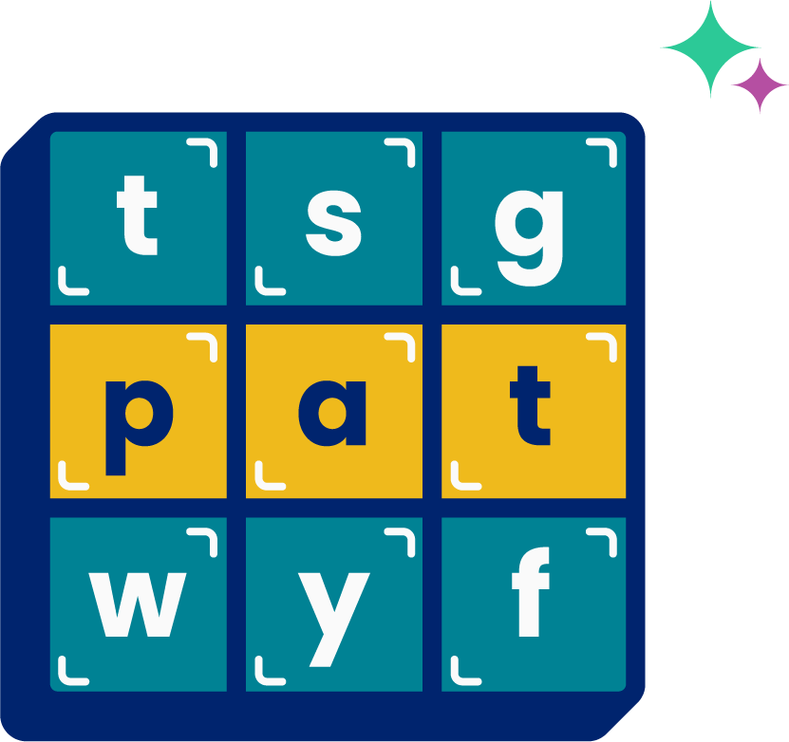
High
Frequency
Words
Family Activity
call
small
We see high frequency words all the time!
Let’s figure out how to read them!
Notes:
See lesson plan for specific instructional guidance.
High Frequency Words!
Say: Some words we can sound out now, some words we'll learn how to sound out later, and some words are rule breakers and we can't sound out. Words that show up a lot in books are called High Frequency Words. Let's learn some! Repeat our chant after me!
"We see high frequency words all the time!
Let's figure out how to read them!"
Do: Say one sentence at a time of the High Frequency Words chant and ask the students to repeat after you.
Say: Let's read our high frequency words!
Say: Today, we're learning 2 new words that follows rules you learned about: the schwa sound and double consonants at the end of words!
Do: Display the word call.
Say: This word begins with the consonant /c/ and uses a schwa sound for the a, read as /a/ and l says /l/. That's it! This word is read as "call". Read this word with me.
Do: Listen to responses.
Say: Yes! "call". I am going to call my mom tonight. Read it again.
Do: Point to words and listen to students read.
Say: We have one more word today that just has a different beginning blend. Let's substitute the /c/ in "call" for /s/ /m/. What is our new word?
Do: Give students a chance to work it out.
Say: Yes! Our other high frequency word is "small"! Read it with me.
Do: Point or display both new words for students to read. Point to each.
Say: Excellent! Let's read our previous high frequency words!
Do: Point to or hold up all the high frequency words to this point as the students read them.
Say: Excellent work learning 2 new high frequency words today.
call, small

