Slide 1
Connect: Educator
Step by Step Guide
Helping 100,000 students reach reading goals and 30,000 students read on grade level by 2023

Slide 2
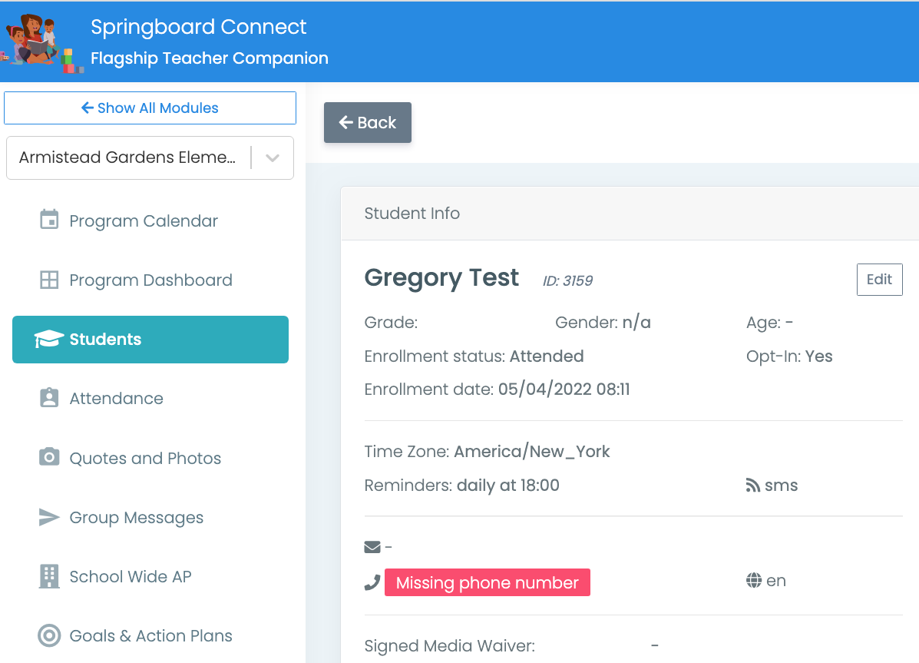
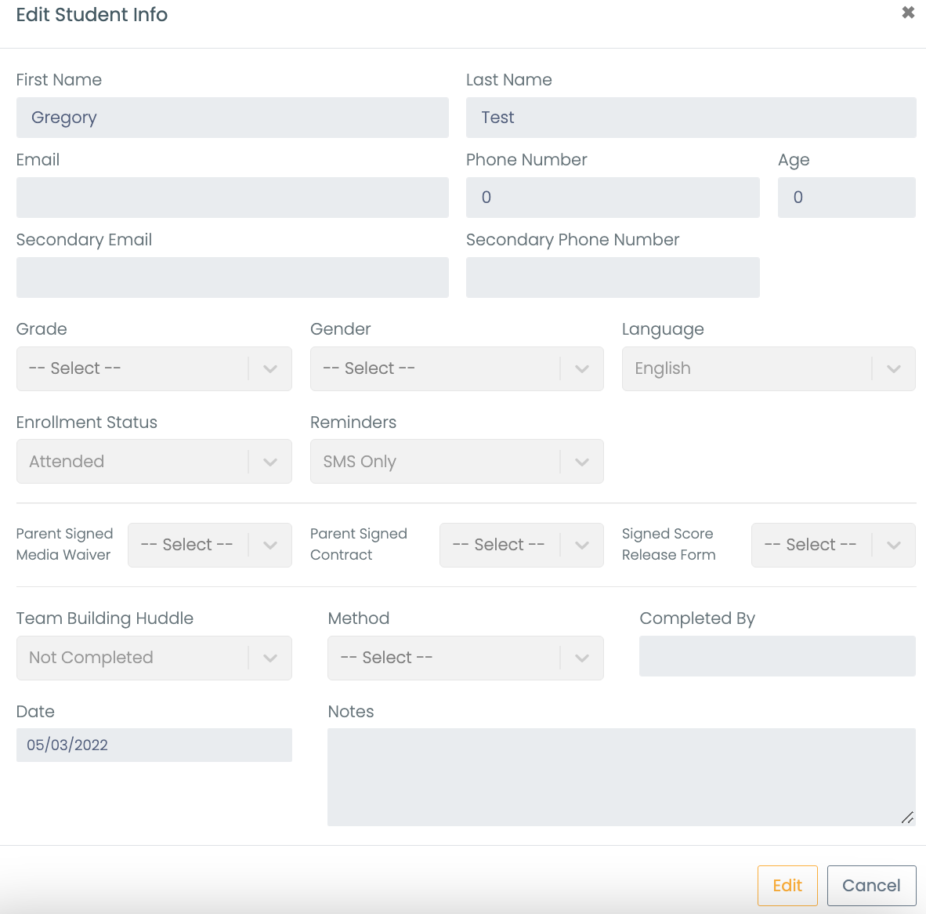
Logging Team-Building Huddles
2
1
4
3
5
Notes:
Click on students. A list of students will display to the right. Select a specific student.
Click on edit
Click on edit at bottom of window
Update team-building huddle status
Click save changes at bottom of the window.

Slide 3
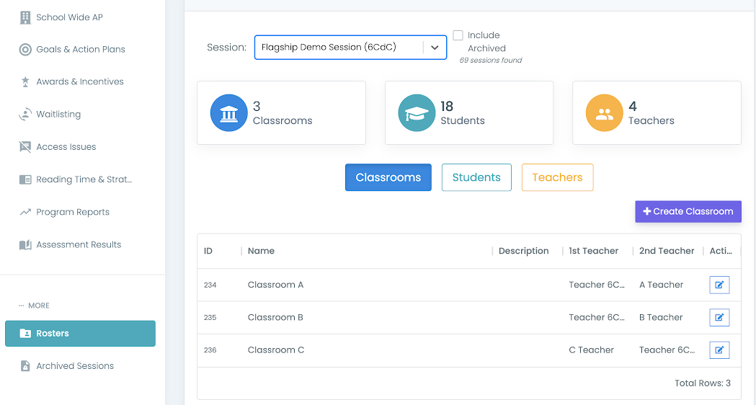
Creating Classroom
2
3
1
4
5
6
Notes:
Go to the roster tab
Click on the Classroom tab
Click “Create Classroom
Create a name and description (if needed)
Pick the primary and secondary (if needed) teacher for the classroom
Select Save

Slide 4
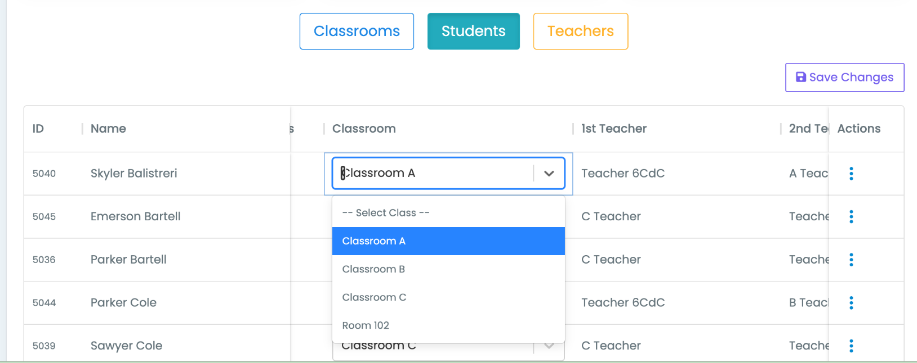
Rostering to Classrooms
1
4
2
3
Notes:
Click Students
Click the down caret under classroom next to the student’s name
Pick the classroom you wish to place them in
Click Save changes

Slide 5
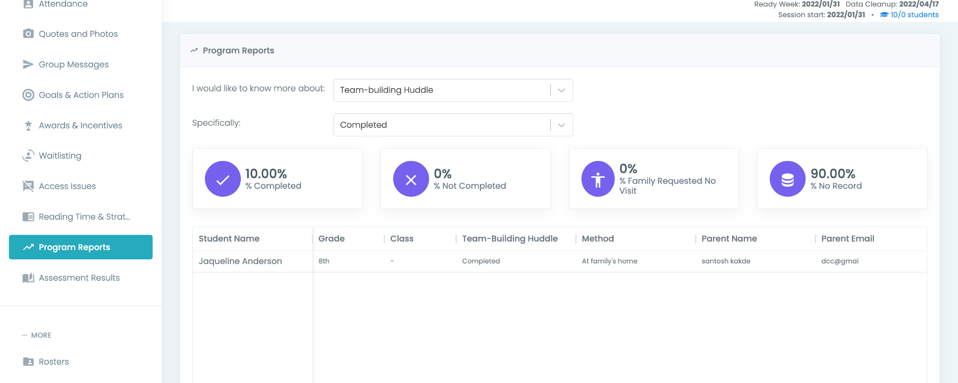
Running Reports in Connect
2
3
1
Notes:
Go to the Program Reports tab
Click the first down caret to select which aspect of programing you want a report on
Click the second down caret to select which specific part of that topic you want to see a report on

Slide 6
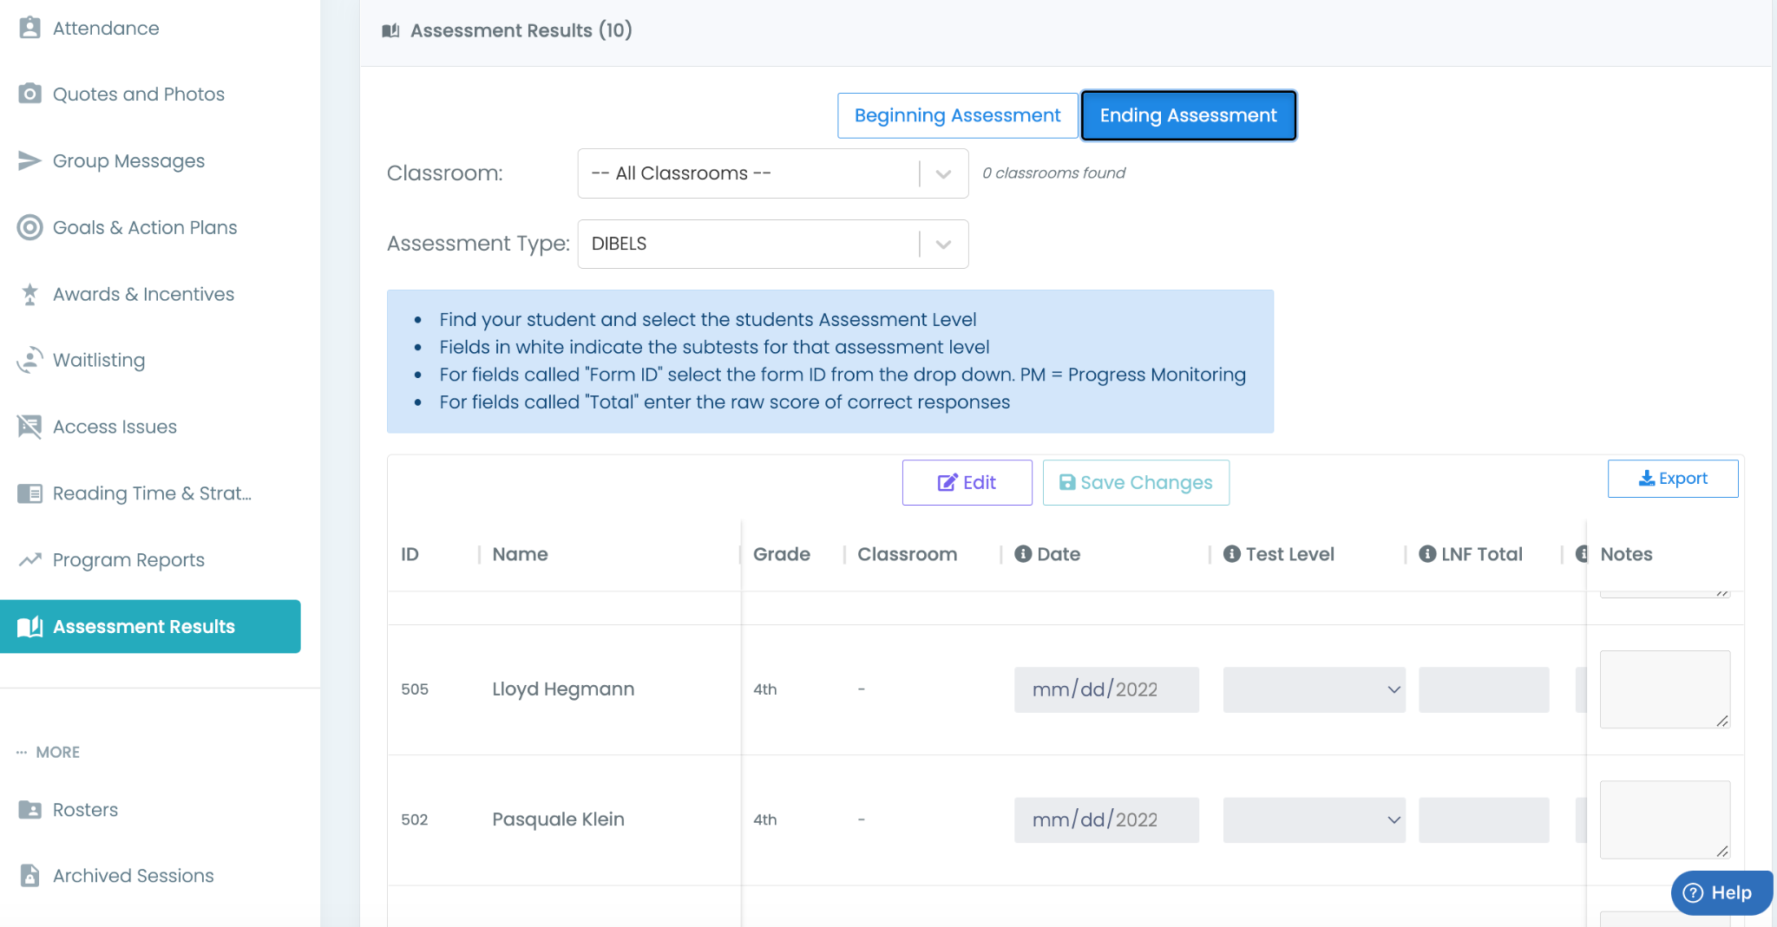
Selecting Beginning or Ending Assessments in Connect
2
3
4
1
Notes:
Go to the Assessments Results tab
Choose either Begging Assessment or Ending Assessment
Use the first down caret to select the correct classroom
Use the second down caret to select the assessment type you want to view
The table below will update based on your selections and will contain the relevant data

Slide 7
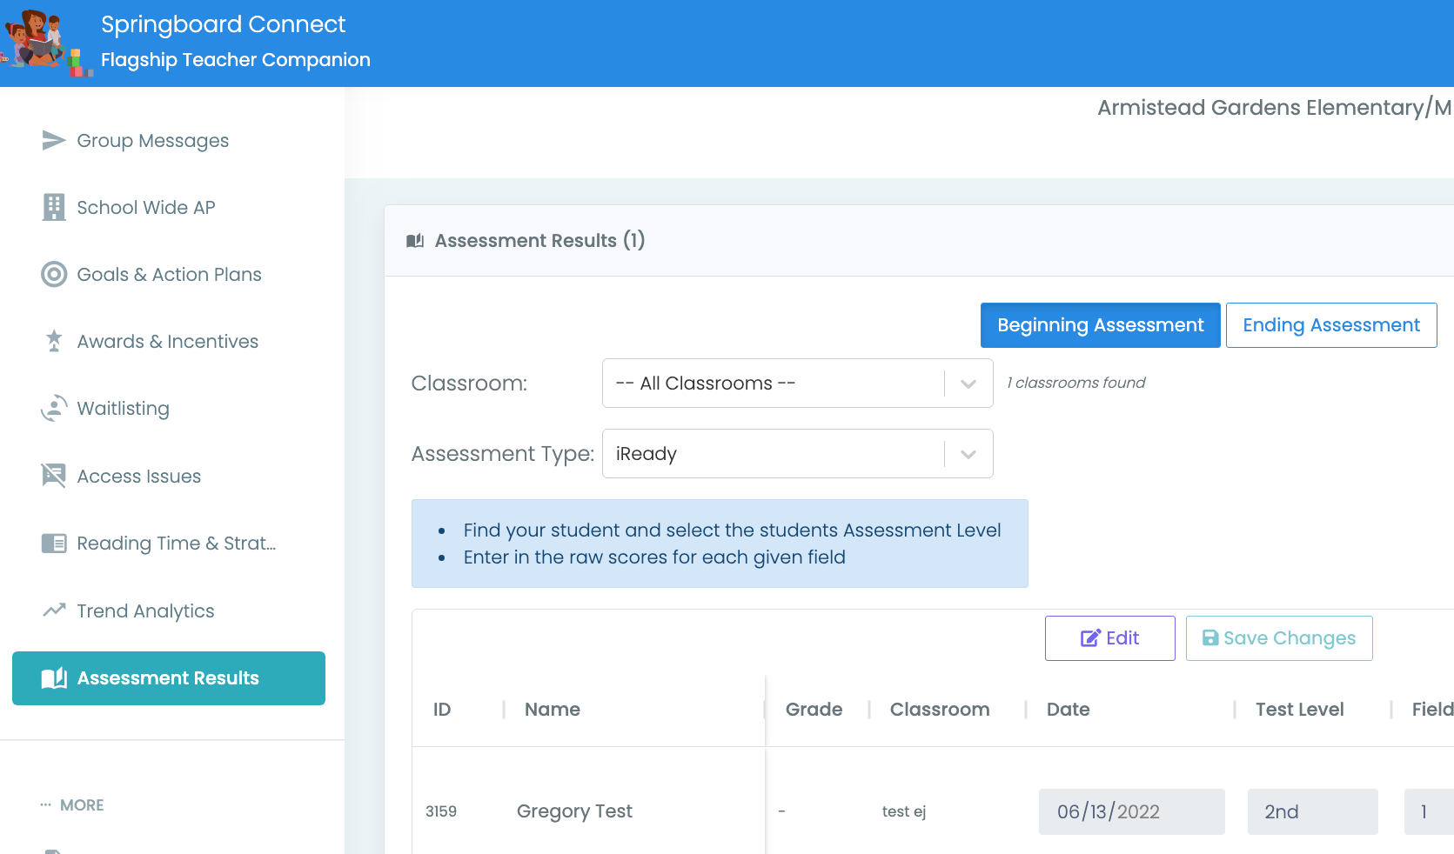
Entering Beginning Assessments
2
3
7
4
1
6
5
Notes:
Click on Assessment Results
Select Beginning Assessment
Choose assessment type
Click edit to make the table editable
Select a student
Enter the assessment information by scrolling across to fill in each box
Click Save Changes

Slide 8
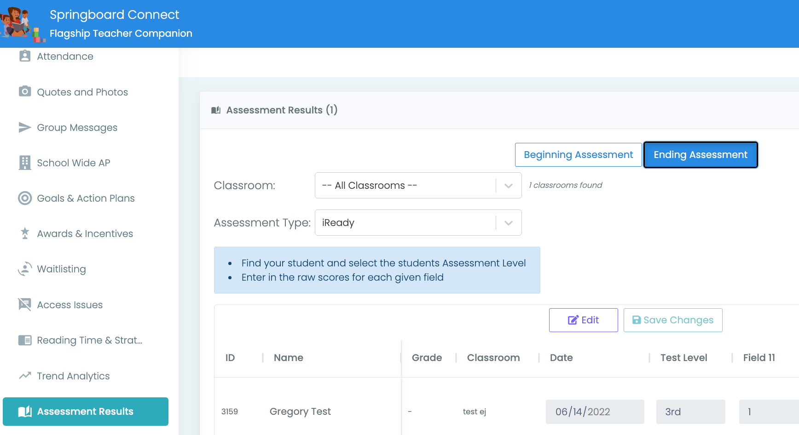
Entering Ending Assessments
2
3
4
7
1
6
5
Notes:
Click on Assessment Results
Select Ending Assessment
Choose assessment type
Click edit to make the table editable
Select a student
Enter the assessment information by scrolling across to fill in each box
Click Save Changes

Slide 9
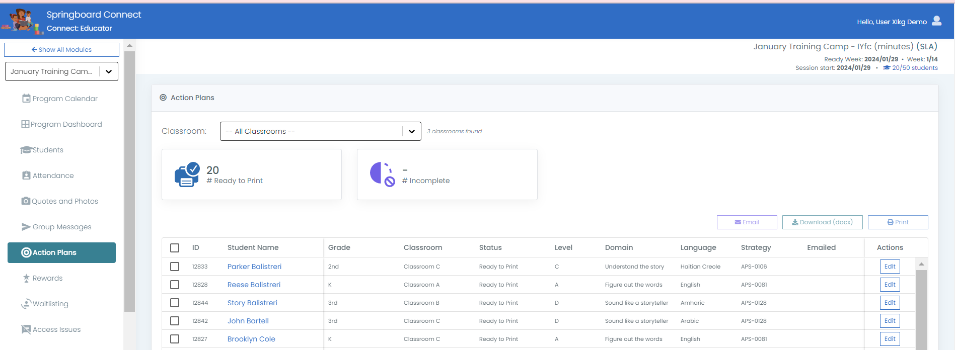
Review Action Plan–Talk in PLC
1
2
Connect Educator > Action Plans > Select the Students > Edit
info@springboardcollaborative.org
Notes:
In Connect: Educator, click the Action Plans tab.
Click the edit button on the right-side of the student you want to create or review the action plan for.

Slide 10
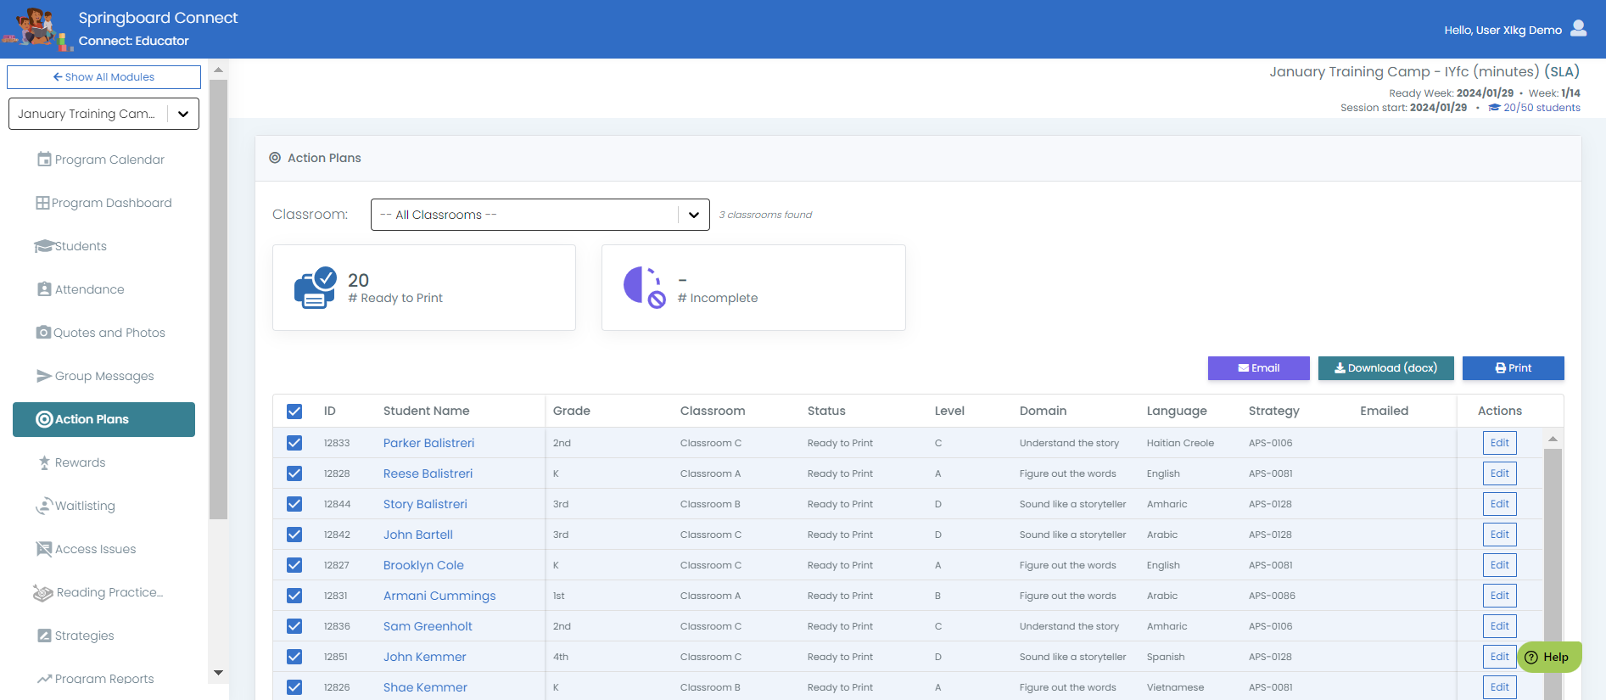
Distributing the Action Plan and Goal Letters
3
2
1
Connect Educator > Action Plans > Select the Students > Print, Download or Email
info@springboardcollaborative.org
Notes:
In Connect: Educator, click the Action Plans tab.
Select the students you want to print letter for.
Click either Print, Download or Email

Slide 11
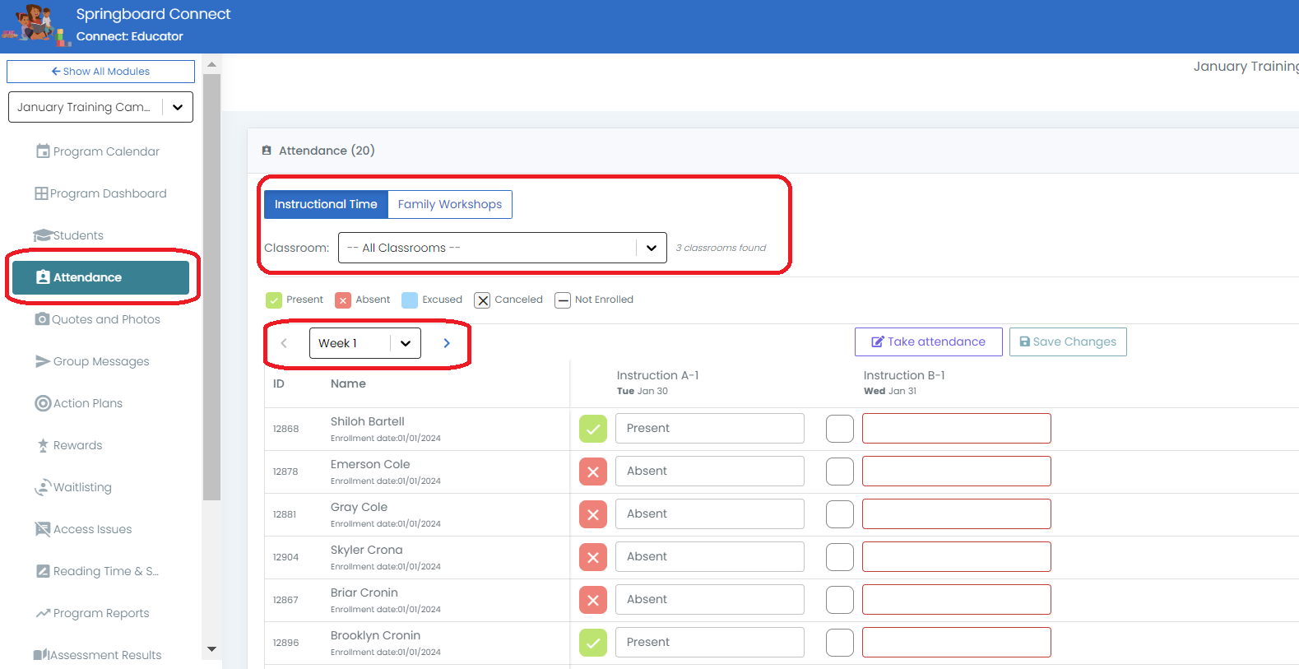
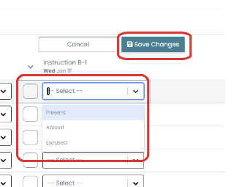
Logging Instruction Attendance
2
1
3
4
6
5
Notes:
Click on Attendance
Choose Instruction Time
Click Take attendance to make the attendance table editable
Select a student
Use the drop-down menu to update the attendance options
Click Save Changes

Slide 12
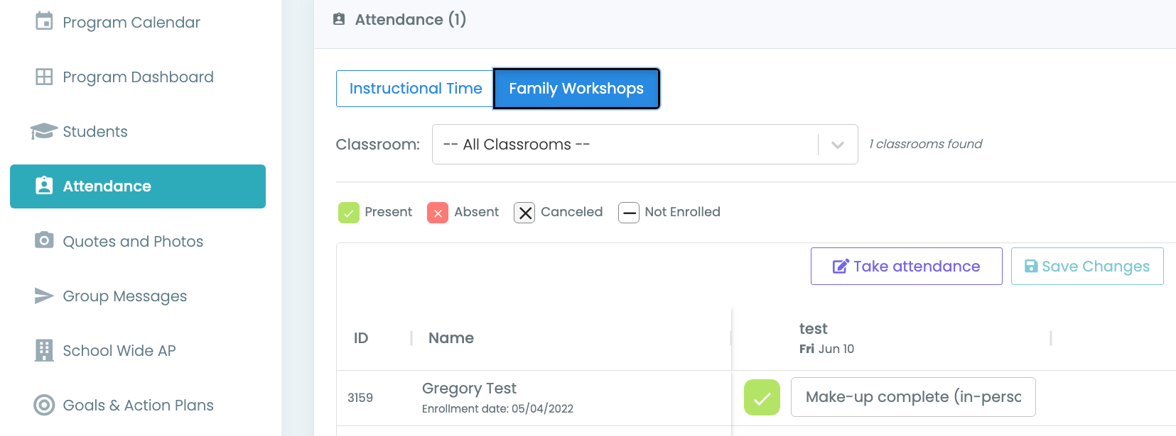
Logging Workshop Attendance
2
1
6
3
4
5
Notes:
Click on Attendance
Choose Family workshops
Click Take attendance to make the attendance table editable
Select a student
Use the drop-down menu to update the attendance options
Click Save Changes

Slide 13
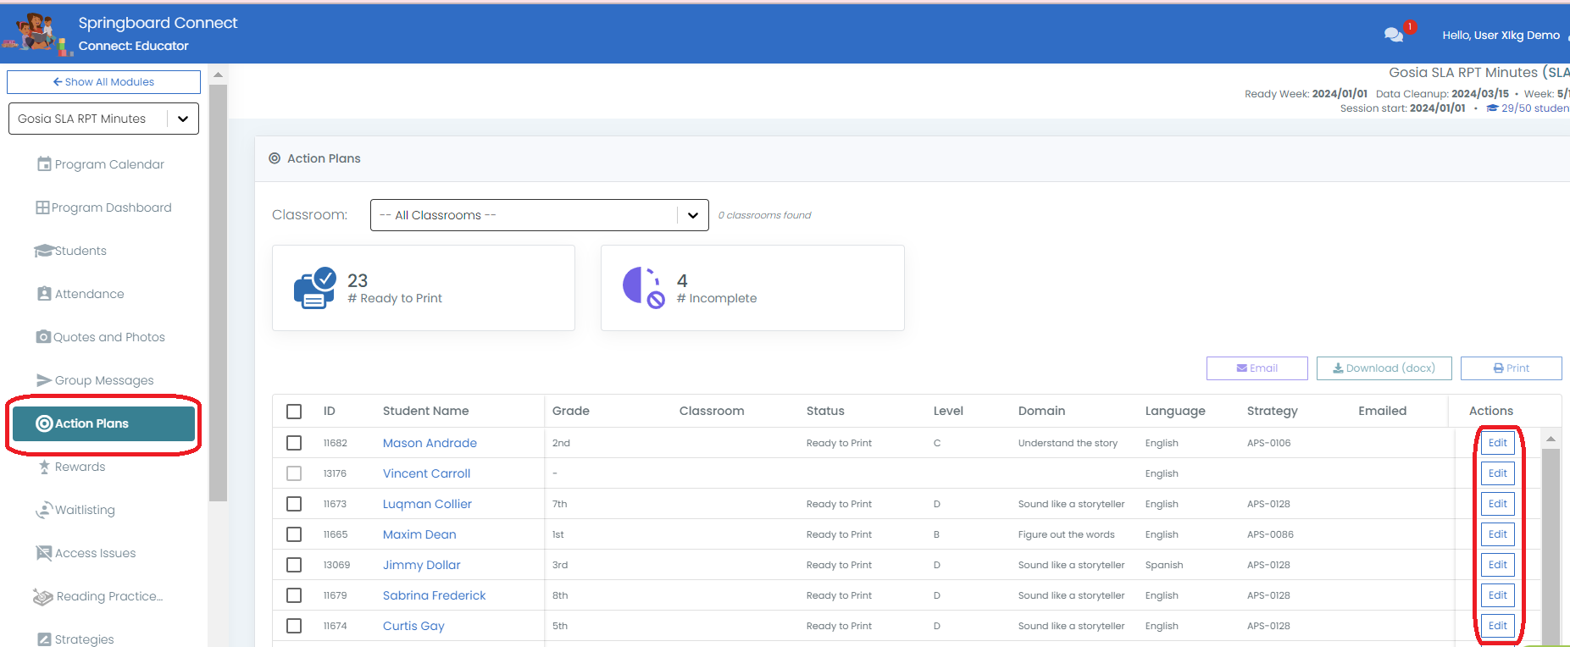
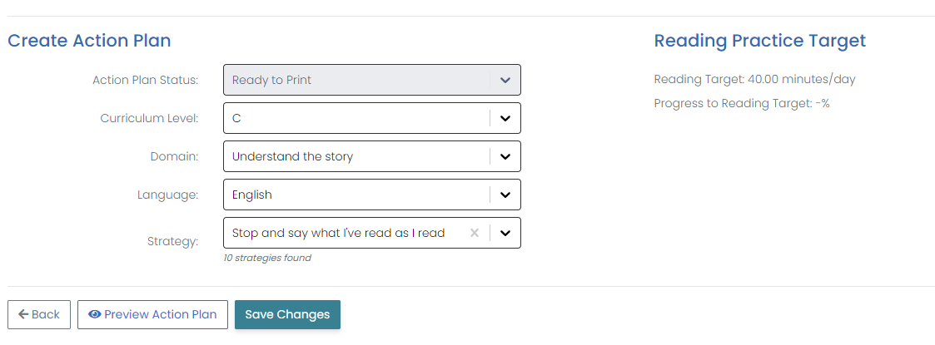
Editing Action Plans (optional)
1
2
3
5
4
Notes:
Navigate to Action Plan tab
Find the student whose Action Plan you want to edit, select ‘Edit’
Adjust the Curriculum Level, Domain, Strategy or Language for the Letter
Hit ‘Save Changes’
You can view your changes by hitting ‘Preview Action Plan’

Slide 14
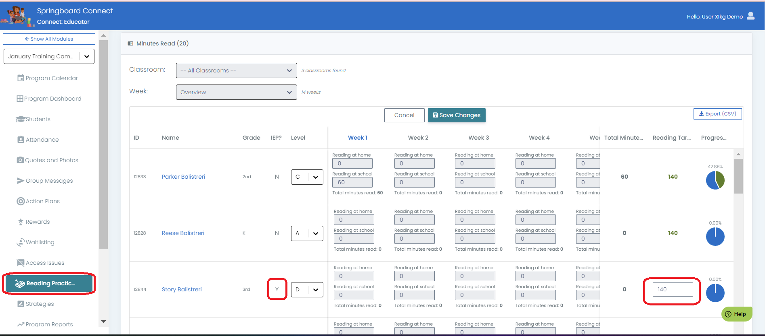
Editing Reading Practice Targets for Student with IEP’s
2
1
3
4
Notes:
Navigate to Reading Practice Targets
Hit ‘Edit’
Find students who have IEP’s by viewing the IEP column and looking for ‘Y’
Note that you can edit the Target(s) for students with IEP’s only

Slide 15
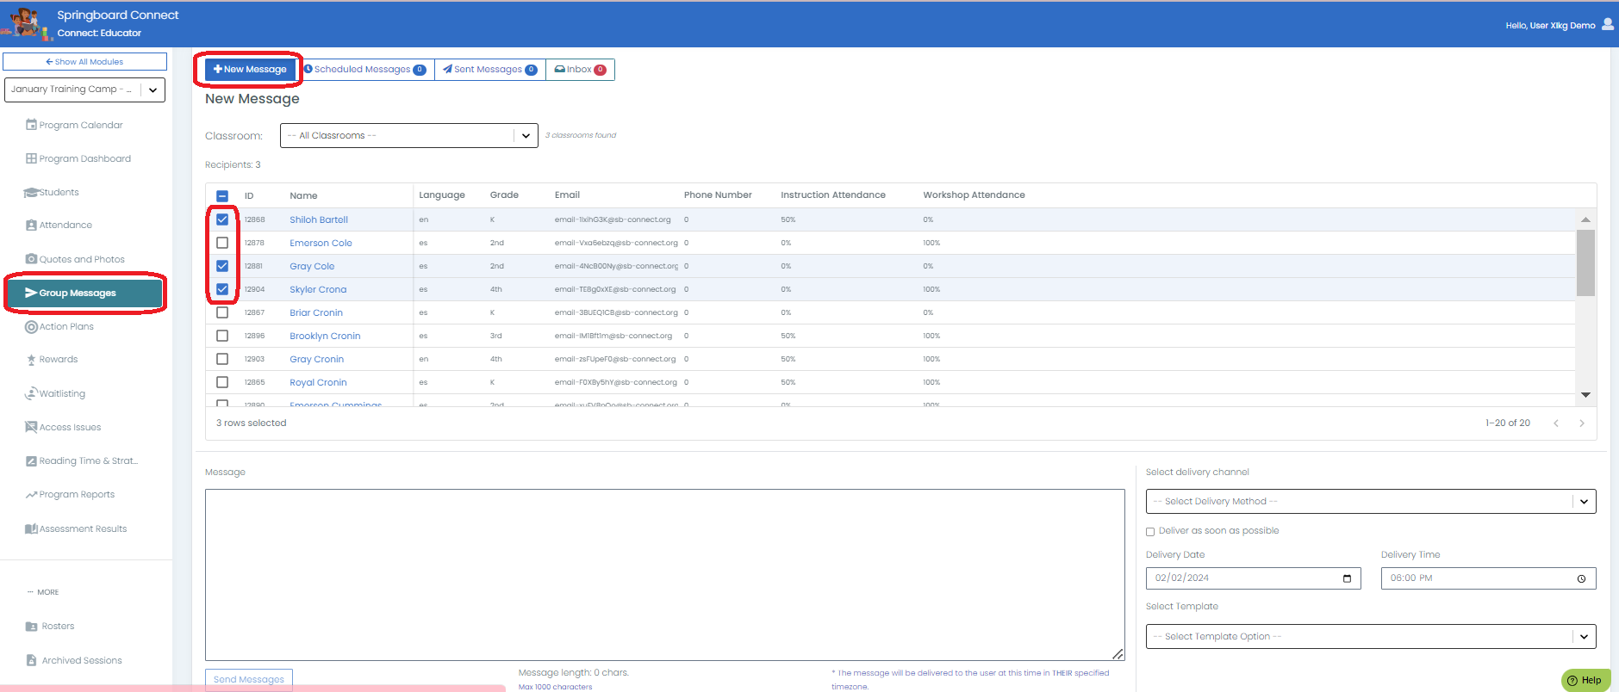
Group Messages (custom)
2
3
1
5
4
6
Notes:
Navigate to Group Messages
Confirm you are on the ‘+ New Message’ tab
Select the student(s) you want to send a message to
Type your message in the box
Select delivery method, date and time
Hit ‘Send Message’

Slide 16
Group Messages (templated)
2
1
3
4
6
5
Notes:
Navigate to Group Messages
Confirm you are on the ‘+ New Message’ tab
Select the student(s) you want to send a message to
Hit ‘Select Template’ and view the message template in the message box
Some messages require you to enter in info on the left such as dates and times which will then populate in the message box
Hit Send Messages

Slide 17
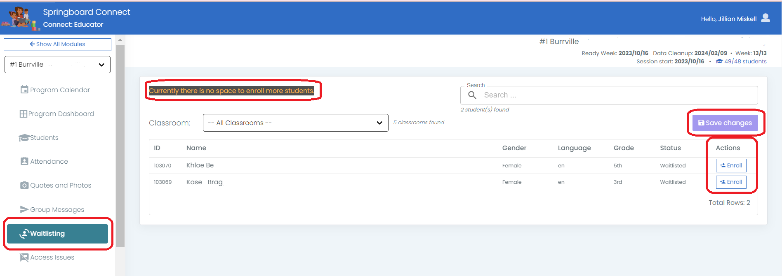
Waitlist
2
4
3
1
Notes:
Navigate to Waitlisting tab
View the message on top which will indicate if there are spaces available in the session or if the session is at capacity
Find the student(s) you want to enroll and select the ‘Enroll’ button
Hit ‘Save Changes’

Slide 18
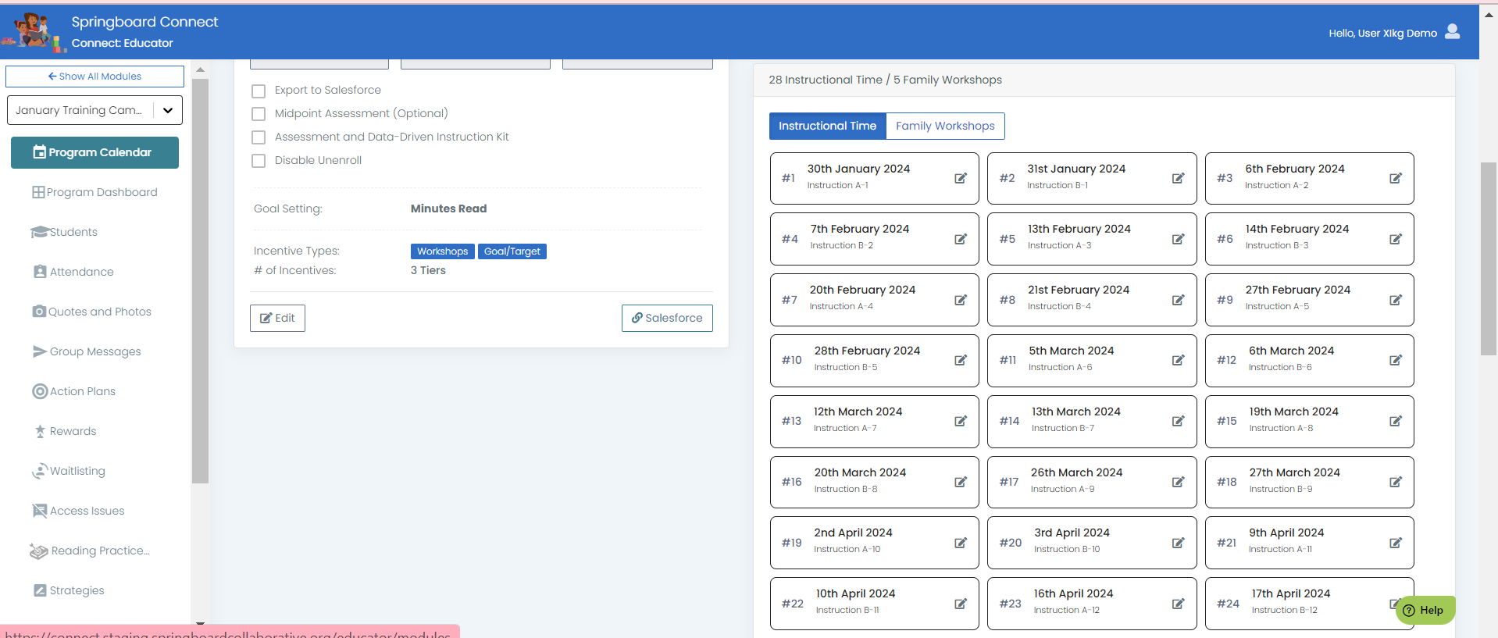
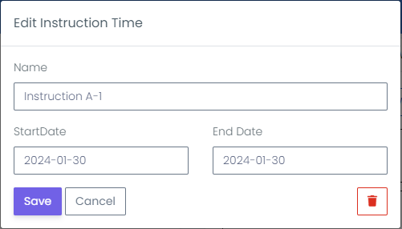
Changing Program Event Dates
(Program Directors & Project Managers Only)
2
1
3
4
5
Notes:
Click Program Calendar
Pick either instructional time or family workshop (both work the same way)
Click the down caret of a current instructional time or workshop
Edit the name (if needed) and date to the date you wish to make it
Click save
If you need to fully delete the schedule session, click the red trash can in the edit instruction time window

