Slide 1
Facilitator Slide
This yellow slide and blue boxes are for you to review.
As you design your slide deck, please be aware of those notes and slides. They are NOT meant to be seen by the participants, only you.
Notes:
Site-based Logistics (60 minutes)
Agenda
Opening (10 minutes)
Review logistics (15 min)
Discuss resources (5 minutes)
Work time (30 minutes)
Facilitator Notes:
Consider completing this Site-Based Logistics Form to distribute at this meeting.
Consider leaving a printed copy with the front desk.
Copyright 2024 Springboard Collaborative, all rights reserved.

Slide 2
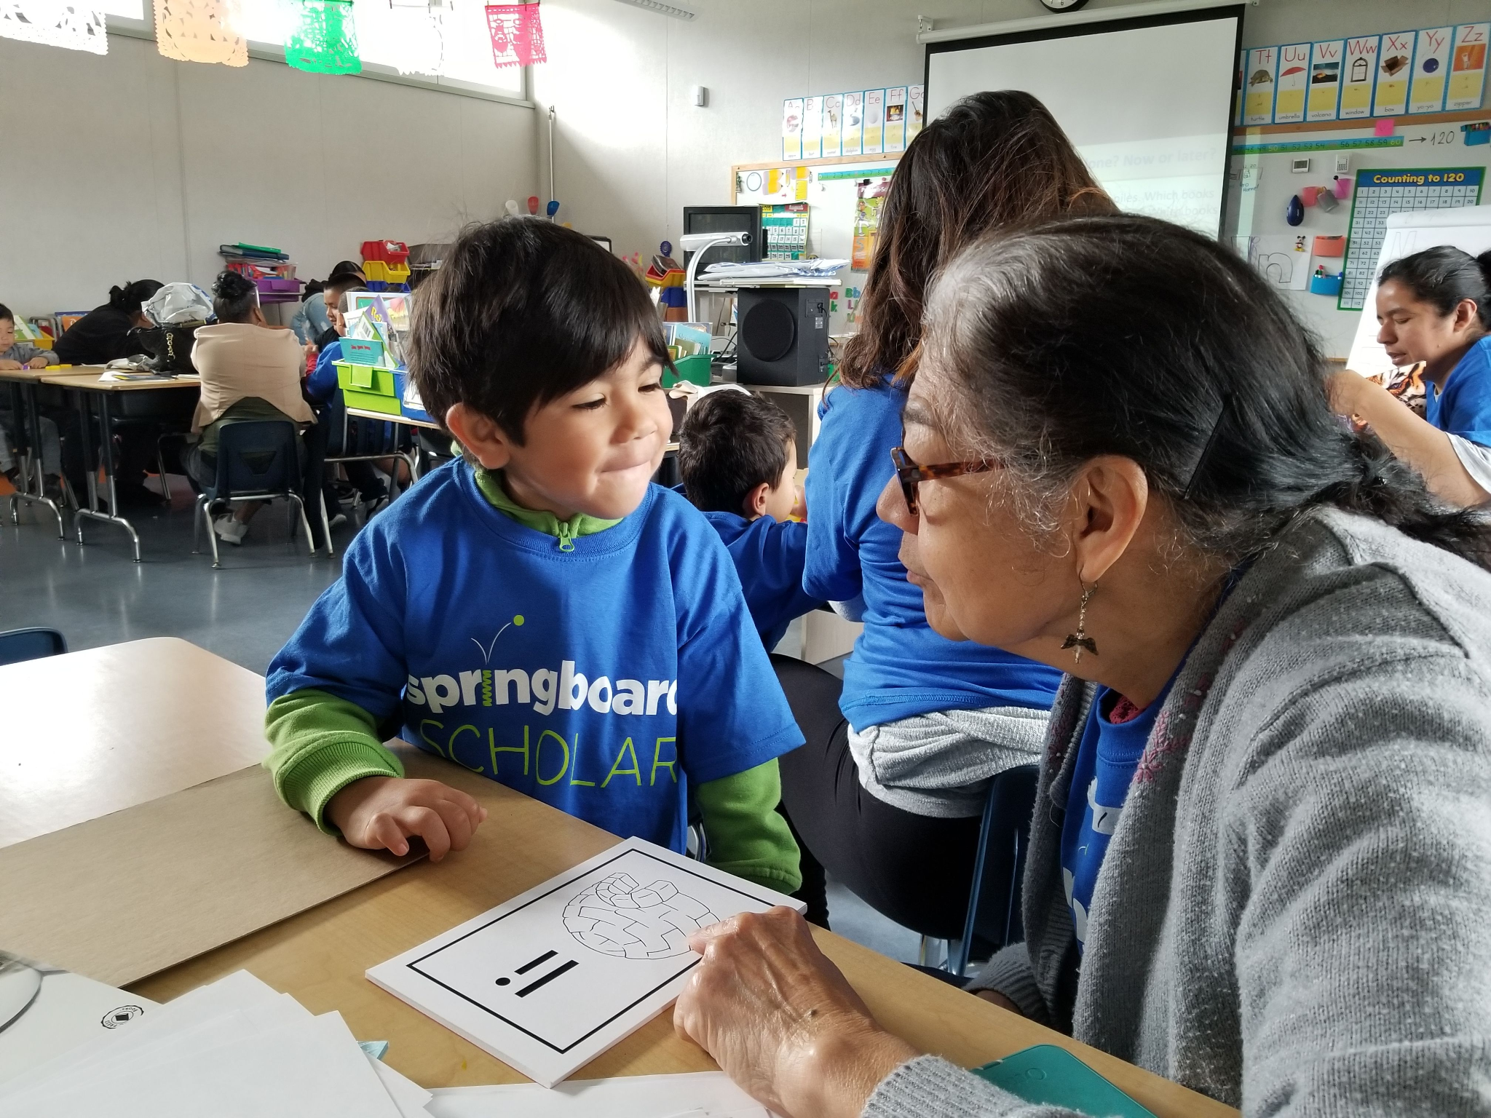
Site-Based Logistics
2025
Notes:
Facilitator Notes:
Welcome participants.
Possible script:
Today we will discuss relevant details for how the Springboard Collaborative program will look here! We will share relevant dates and processes as well as some resources for you to use throughout the program.

Slide 3
Warmup Chat!
What are you most excited about in the upcoming program?
Notes:
Facilitator Notes:
Prepare a model response for the warm up chat.

Slide 4
Who we are
Facilitator Note: Drop your site leadership team’s photos and roles on this slide.
Name
Role, Pronouns
Name
Role, Pronouns
Notes:
Facilitator Notes:
Update this slide with your photo and information prior to the training.
Introduce yourself.

Slide 5
Our Goals Today
Learn your site-specific information needed to successfully implement your FELA.
Confirm that you have access to systems and platforms.
Identify next steps.
Notes:
Facilitator Notes:
Review goals for this PD session.
Invite participants to think about where they are and to set their own intentions.
Possible Script
Let’s take a moment to discuss our learning goals for today’s session.
Can I get someone to read these objectives? As they read, think about which objective you’re most excited to learn more about; begin to set your own intentions around our time together today.
FACILITATOR NOTE: Participant reads objectives.

Slide 6
Agenda
Review logistics.
Discuss resources.
Engage in work time.
Notes:
Facilitator Notes
Review goals for this section of the PD session.
Invite participants to think about where they are, in terms of the goals, and to set their own intentions (this could be a quick show of hands or longer turn and talk)
Drop the verb in the chat. Ex) Learn, explore, identify, gain

Slide 7
Logistics
Notes:
Possible Script:
Now let’s move onto logistics for our site. In this next section, we will learn about what the program will look like for us.

Slide 8
Daily Schedule
Insert here.
Notes:
Facilitator Note:
Drop your daily schedule here.
Consider adding in arrival/dismissal.
Consider adding in breakfast/snack/lunch when appropriate.

Slide 9
Team-Building Huddle
Insert here.
Notes:
Facilitator Notes:
Include the dates Team-Building Huddles need to be completed by.
Consider including an updated number of % of Team-Building Huddles completed.
Are teachers getting paid? If so, what is the process for submitting pay?
Share how to log the Team-Building Huddle.
Are huddles 1:1? Small groups? What platform are you using? (Zoom, google meetings) What is the procedure for scheduling?
Add any other important logistics information.

Slide 10
Assessments
Insert here.
Notes:
Facilitator Notes:
Share what assessment you are using and any assessment specific logistics
Consider:
What is the plan for completing assessments?
Where can teachers find assessment materials?
How will you support teachers with completing assessments?
Add any additional assessment logistics

Slide 11
Family Workshops
Insert here.
Notes:
Facilitator Notes:
Use this slide to share information related to Family Workshops with your team
This may include:
The dates/times of Family Workshops
What does family outreach look like?
What does workshop make-ups look like? Who is responsible?
What platform are you using?
Remind teachers how to log Family Workshop attendance in Connect.

Slide 12
Student Instruction
Insert here.
Notes:
Facilitator Notes:
Use this slide to share information related to student instruction.
Share the student instruction schedule, which components your site will use, where to find links to lesson plans and materials. mClass Intervention materials can be accessed by going to mclass.amplify.com or by going to the Amplify Program Resource microsite (Amplify Microsite)

Slide 13
Family Communication
Insert here.
Notes:
Facilitator Notes:
Use this slide to share information related to family communication with your team
This may include:
What tool are you using to communicate with families? Exp. Connect, Remind me app, texts, calls, newsletter

Slide 14
Learning Celebration!
Insert here.
Notes:
Facilitator Notes:
Use this slide to share information related to learning celebration with your team
This may include:
When/where the Learning Bonus Celebration will occur
Things teachers need to do to prepare
Information about incentives and incentive distribution
You may want to include this information in a PLC closer to the LBC date

Slide 15
Materials
Insert here.
Notes:
Facilitator Notes:
Use this slide to share information related to materials with your team
This may include:
Any logistical information related to materials
What materials teachers are receiving, when they are arriving, how they will be organized
Accessing materials from the Program Resource Site
Procedure for books

Slide 16
Systems and Platforms
Have you logged in to…
Springboard Learn
Connect: Educator
Notes:
Facilitator Notes:
Check in to ensure that everyone has access to Springboard Learn and Connect: Educator.

Slide 17
Questions?
Notes:
Facilitator Notes:
Open question and answer session

Slide 18
Key Take-aways
Insert
[Supporting content]
Insert
[Supporting content]
Insert
[Supporting content]
Insert
[Supporting content]
Notes:
Facilitator Notes:
Add key take-aways.

Slide 19
Next Steps
Insert
[Supporting content]
Insert
[Supporting content]
Insert
[Supporting content]
Insert
[Supporting content]
Notes:
Facilitator Notes:
Add next steps

Slide 20
Work Time
Notes:
Possible Script:
Soon, you will work on preparation tasks. The next slide will help you know what you need to do.

Slide 21
Work Time
Insert here.
Notes:
Facilitator Notes:
Include a list of tasks for work time.

Slide 22
Helping coach educators and family members to help kids learn to read.

