Slide 1

Tango Review Slides for Families
Add these slides to Orientation and/or Family Workshop decks. Feel free to personalize! We want students and families to be excited!
Helping 100,000 students reach reading goals and 30,000 students read on grade level by 2023

Slide 2
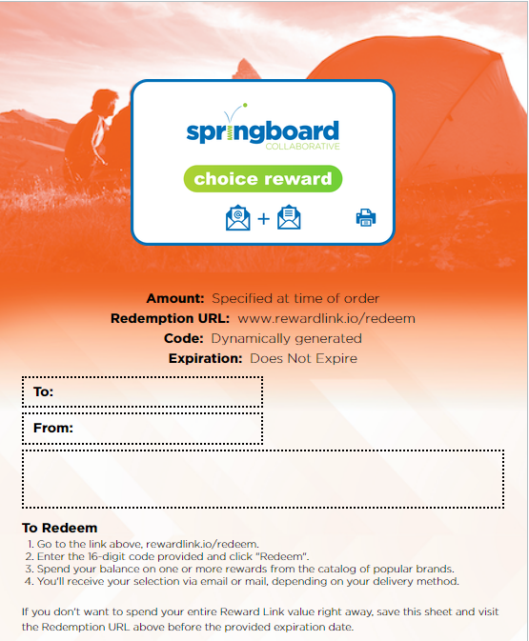
Programming Rewards will be Tango!
You will receive a physical brochure from us [at/2 weeks after the Learning Bonus Celebration].
Brochures contain a unique code which can be used at the website www.rewardlink.io/redeem to access your reward amount and redeem it for gift cards.
Please let us know if you do not have an email, physical mailing address, or smart device (phone, laptop, computer) to redeem your reward.
This will reflect your reward amount and code.
Your brochure will look like this:
Notes:
Note for PLs/SS: Update this slide to reflect your

Slide 3
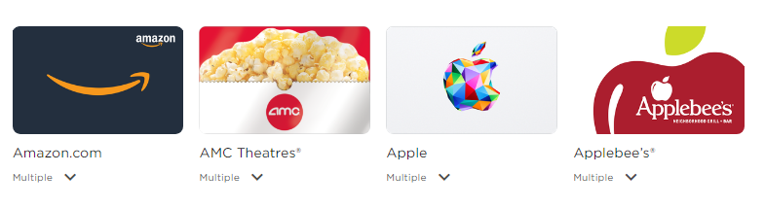
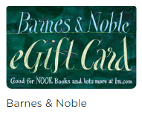
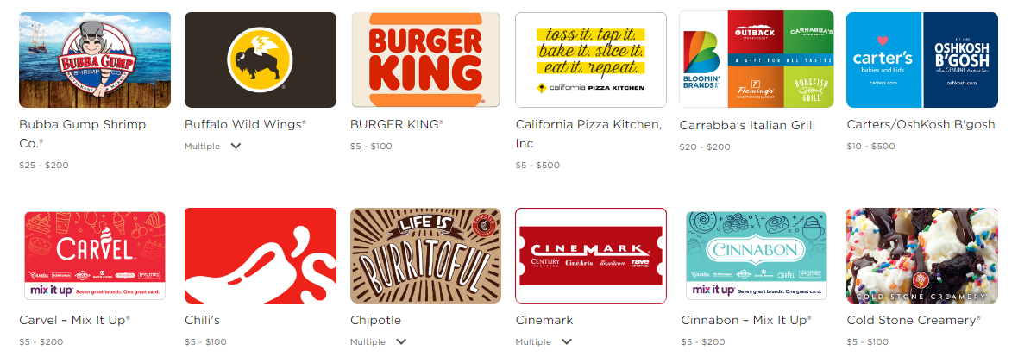
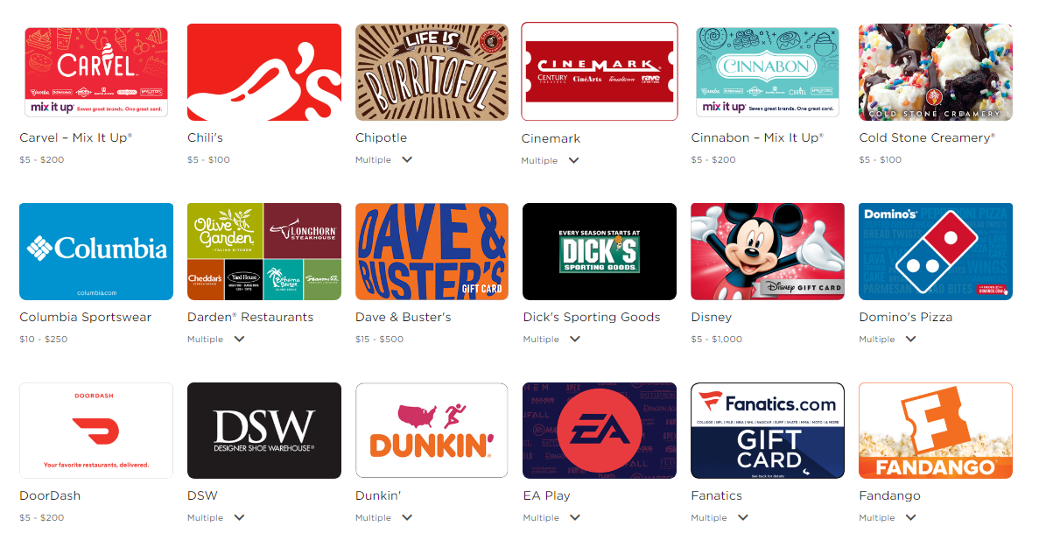
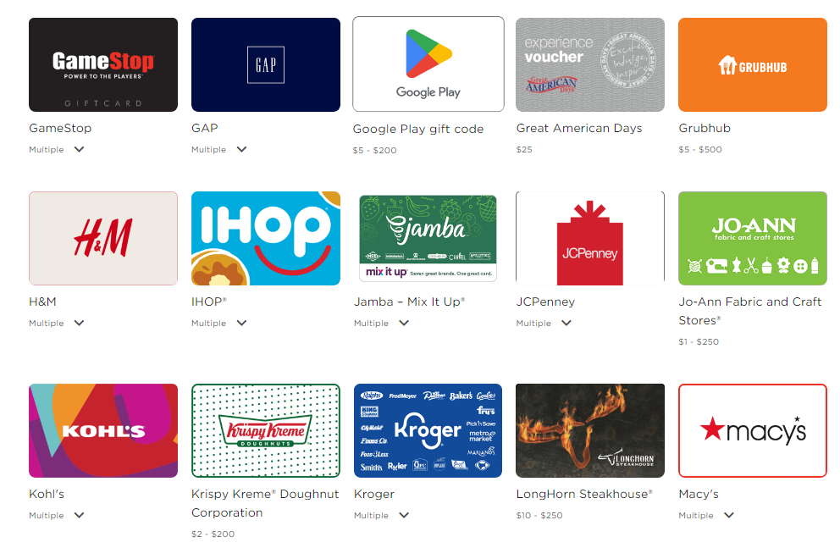
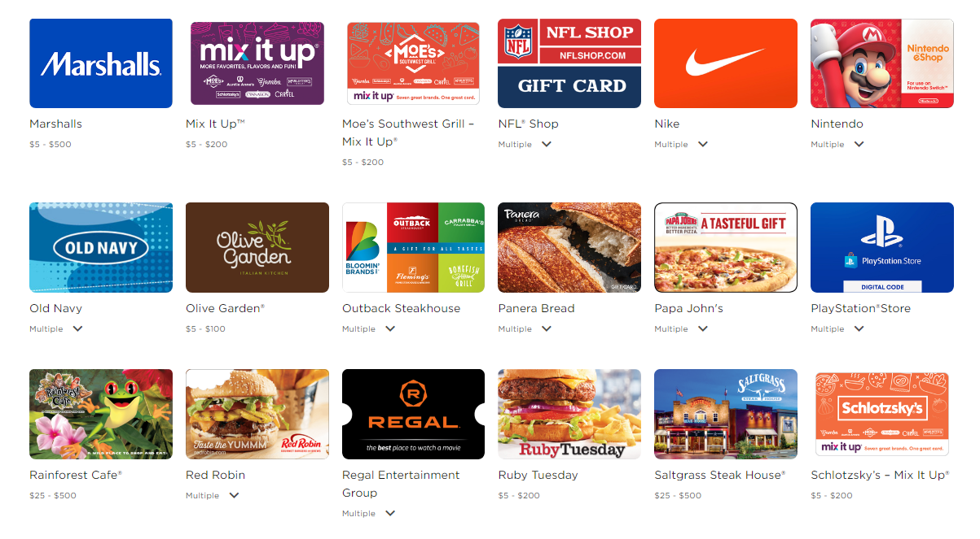
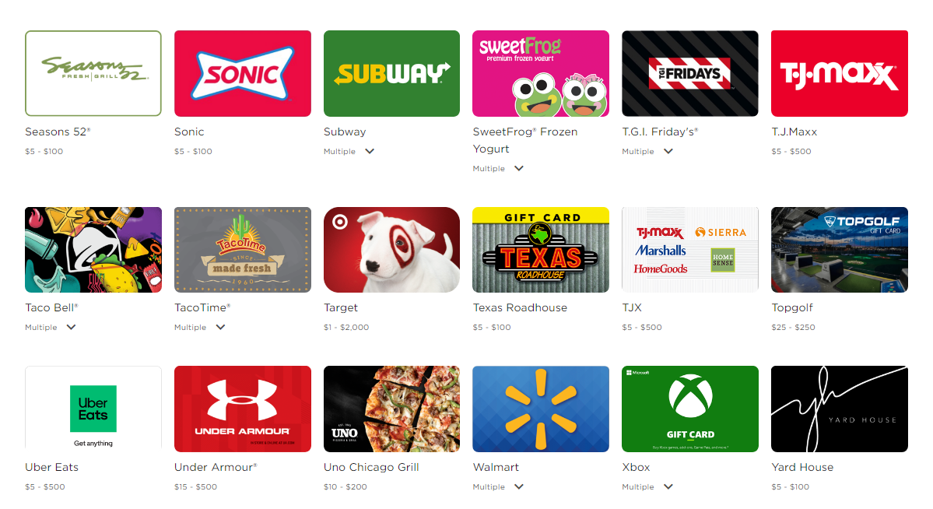
Tango is a website where you can redeem your student’s Springboard reward for different gift cards. See any you recognize?
Notes:
JM

Slide 4
Tango has multiple gift cards from retail and online stores and restaurants! See below for a general list!
Restaurants: Applebee’s, Auntie Anne’s,Buffalo Wild Wings, Burger King, Carvel, Chili, Chipotle, Cinnabon, Coldstone, Domino’s, Dunkin, iHop, Krispy Kreme, LongHorn Steakhouse, Olive Garden, Panera Bread, Papa John’s, Red Robin, Sonic, Subway, TGI Fridays, Taco Bell, Texas Roadhouse
Retail: Amazon, Boscov’s, Best Buy, Walmart, JCPenney, GAP, Old Navy, Target, Macy’s Nike, TJMaxx, Marshalls, H&M, Barnes & Noble, Kohl’s, Carter’s, OshKosh B’Gosh
Apps, Games, and Technology: Amazon, Google Play, Grubhub, Apple Store, Nintendo, PlayStation, XBox, GameStop
Movie Theaters and Arcades: Cinemark, AMC, Regal, Dave and Busters

Slide 5

How does Tango work?
Follow along with the video and try it yourself!
Visit the link: tangocard.com/awesome-to-receive
Notes:
Tip: add a QR code for families to scan. Please note that the demo version contains Tango branding and a different list of gift card vendors than what families will receive. Families who receive rewards will receive a link to a webpage with Tango branding. Additionally, please encourage families to redeem within 3 months.

