Slide 1
Springboard Tango Overview:
Transition to digital incentives
Helping 100,000 students reach reading goals and 30,000 students read on grade level by 2023

Slide 2
Why Tango?
Over the 2023-24 school year, Springboard is transitioning to Tango as our standard incentives for families instead of our current hard goods incentives (school supplies, Springboard book bags, etc.). We’re excited for this transition because it satisfies improvement needs to our programs in the following ways:
Families and Springboard leaders and educators have asked for more choice in incentives (particularly returning families & partners)
Hard goods incentives can be costly in terms of time and money for our partners and up to 30% of parents report never using them
Families and Springboard staff have given positive feedback on the experience and usability in initial tests starting summer ‘23

Slide 3
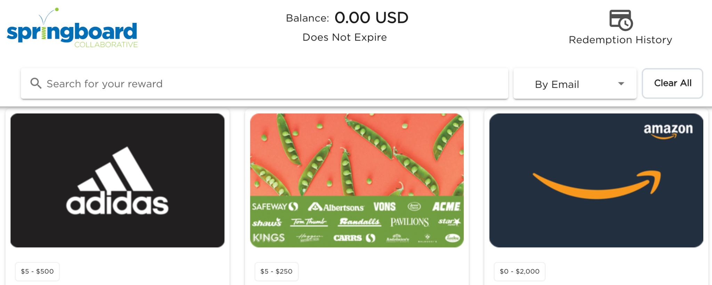
What is Tango?
Tango is an online rewards platform where recipients can redeem a $ amount to 90+ vendors across the U.S. Based on the tier Springboard families earn in programming, they will digitally receive the according $ amount via email. Families can then redeem that amount for digital gift cards (click here to see a list of gift card vendors).

Slide 4
What is Tango?
Please Note: Reward links and codes will be printed on the brochures for families to access their Tango Reward online.

Slide 5
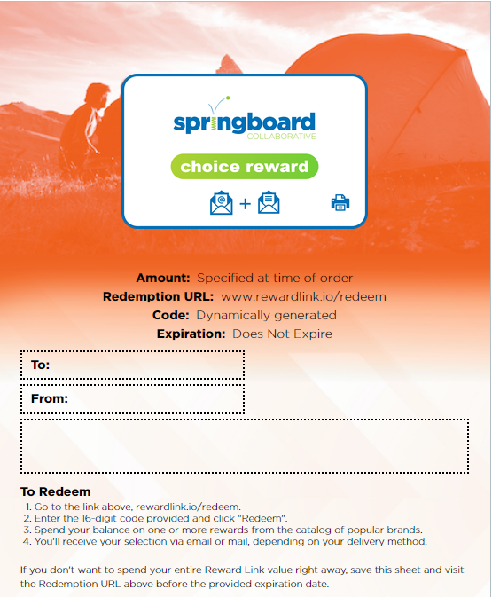
How does Tango work in Springboard programming?
Springboard sites will have two options for using Tango in their Springboard programming.
Option 1: Sites can purchase the exact amount of tiers of rewards (up to two) earned by families. Tango brochures will arrive 2-3 weeks after the Learning Celebration (excluding school breaks), and be distributed to families based on the tier earned.
Option 2: Sites can purchase a single tier of rewards for all students enrolled in their programming to arrive by the Learning Bonus Celebration. Tango brochures can be distributed to students during the celebration at a site’s discretion.
Families will have 3 months to click on those links to redeem for gift cards. We encourage families to redeem rewards with their children; this guidance is in the rewards emails.
Brochures will contain the amount of the student’s reward (reflecting tier), their unique code, reward expiration date, and the redemption URL: www.rewardlink.io/redeem

Slide 6
What are families saying about Tango?
Ease of Use
Motivation & Joy
It was pretty simple and straightforward how we would receive it and how we would redeem it.
The prizes are a great encouragement to try hard in the program... My daughter struggled with reading before and now all she wants to do is read. Tango was another “boost” to get after the program.
Choice & Agency
My daughter is excited about the choice and loves the options. She usually follows her older brother for things she wants but this gives her her own voice to decide what she wants which is really great for her.
100% of families we’ve spoken to in focus groups have reported POSITIVE satisfaction with Tango.

Slide 7
Tango FAQs
Question: Are there resources for sending communications to families?
Answer: Yes! We have created template Connect messages site teams can send via the Connect “Group Message” feature. We also have guides for Program Leaders. Your Program Director will provide those.
Question: Are family resources translated into other languages?
Answer: Yes! In the Tango rewards email sent to families, there will be links to guides families can click on in: Spanish, Russian, Urdu, Haitian Creole, Portuguese, and Vietnamese. We will be adding more Springboard family frequently spoken languages added over the next few months. We are also in the process of translating the Connect message templates.
Question: How will we track which students have received a brochure?
Answer: Springboard recommends navigating to the Awards & Incentives tab of your site’s Connect Educator portal. Click on the green “Export Table” button to download a spreadsheet of all student’s names and tier earned. Use this spreadsheet to distribute rewards.

