Slide 1
Springboard Tango Overview:
Transition to digital incentives
Helping 100,000 students reach reading goals and 30,000 students read on grade level by 2023

Slide 2
Why Tango?
Over the 2023-24 school year, Springboard is transitioning to Tango as our standard incentives for families instead of our current hard goods incentives (school supplies, Springboard book bags, etc.). We’re excited for this transition because it satisfies improvement needs to our programs in the following ways:
Families and Springboard leaders and educators have asked for more choice in incentives (particularly returning families & partners)
Hard goods incentives can be costly in terms of time and money for our partners (receiving, storing and distributing goods)
Families and Springboard staff have given positive feedback on the experience and usability in initial tests starting summer ‘23

Slide 3
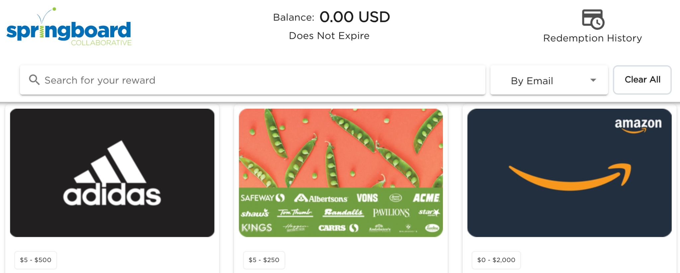
What is Tango?
Tango is an online rewards platform where recipients can redeem a $ amount to 90+ vendors across the U.S. Based on the tier Springboard families earn in programming, they will digitally receive the according $ amount via email. Families can then redeem that amount for digital gift cards (click here to see a list of gift card vendors).
Notes:
JM

Slide 4
What is Tango?
Notes:
JM

Slide 5
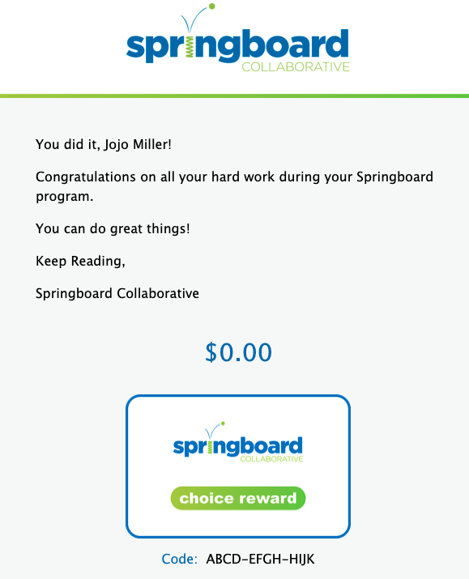
How does Tango work in Springboard programming?
Site teams ensure all family emails are up-to-date in Connect: Educator and direct families to their emails to receive Tango rewards
Once data is complete in Connect at the end of programming, the Springboard Project Manager will export incentives earnings data and upload to Tango.
Tango will email each family a Springboard-templated rewards email rewards amounts based on the tier earned. There may be additional joint troubleshooting for bounced rewards emails.
Families will have 3 months to click on those links to redeem for gift cards. We encourage families to redeem rewards with their children, which guidance is in the rewards emails.
Amount will reflect earned tier

Slide 6
What are families saying about Tango?
Ease of Use
Motivation & Joy
It was pretty simple and straightforward how we would receive it and how we would redeem it.
The prizes are a great encouragement to try hard in the program... My daughter struggled with reading before and now all she wants to do is read. Tango was another “boost” to get after the program.
Choice & Agency
My daughter is excited about the choice and loves the options. She usually follows her older brother for things she wants but this gives her her own voice to decide what she wants which is really great for her.
100% of families we’ve spoken to in focus groups have reported POSITIVE satisfaction with Tango.

Slide 7
Tango FAQs
Question: Are there resources for sending communications to families?
Answer: Yes! We have created template Connect messages site teams can send via the Connect “Group Message” feature. We also have guides for Program Leaders. Your Program Director will provide those.
Question: Are family resources translated into other languages?
Answer: Yes! In the Tango rewards email sent to families, there will be links to guides families can click on in: Spanish, Russian, Urdu, and Haitian Creole. We will be adding more Springboard family frequently spoken languages added over the next few months. We are also in the process of translating the Connect message templates.
Question: What about families who can’t receive Tango by email?
Answer: Our Project Managers have an alternative process to provide sites with printable rewards sheets. However, this will take additional time and coordination so we want to rely on email as much as possible.

