Slide 1
Workshop guide
Facilitator:
Read notes to prepare. Amend slides if needed.
Practice the script aloud. Change as needed.
Ready the family-facing materials.
Display slide 2 as families arrive.
Feeling Frustrated? That’s Ok!
Notes:
Copyright 2022 Springboard Collaborative, all rights reserved.
Overview and rationale:
This workshop focused on the reading skill of engage and enjoy. In this workshop, families learn the importance of building self-reflection skills while reading. Understanding when moments of frustration occur during reading can help children overcome these feelings. Families learn about the importance of specific praise, how to use a calming technique, and how to encourage children to check in with themselves and problem-solve. These steps help lower frustration, which is important for struggling readers.
Materials
Corresponding reading tip sheet (in the languages the families need)
Family workshop feedback form (paper or digital form)
Books for families to use during the reading tip explanation and practice time. This strategy works with both fiction and nonfiction texts.
Projector to display slides
Empty envelope for families to put feedback form in (optional but highly recommended)
Name tags (optional but highly recommended)
Icebreaker materials (optional; see the “Welcome” slide note)
Facilitation notes
To prepare
In this workshop, you will model how to minimize frustration in a variety of ways.
Preview the light blue slides and choose the ones that are appropriate for your context (virtual vs. in-person, needs of the families, grade level).
Study the slides in the reading tip section. Think through how you will model and guide practice for each step of the tip.
You may want to practice the breathing strategy whole group. It is best to learn this before students get frustrated and need to take a breath.
Be sure to familiarize yourself with the content of the presentation so you can talk with families, not at them.
Post directions for the icebreaker (optional). See the “Welcome” slide.
If this is the first family workshop, consider playing a video entitled: “Introducing the Springboard family workshops” (available on Springboard’s Youtube channel)
During workshop
Take time to build rapport as a group and individually with families. Little things, like learning family members’ names and greeting them at the door, go a long way.
Keep pace so that families have time to practice the tip and also reflect. Being able to practice and reflect helps families internalize the strategy.
Circulate and check-in with families individually during practice time. See the “Practice time” slide for more specific suggestions.
Ideas to differentiate
Be sure the book you use to model matches the reading abilities of the children in the workshop. Consider modeling with one or two pages from books with differing difficulty.
Many online libraries have multiple versions of the same text. As a scaffold, children can start on the less complex version and then keep reading more complex versions. While they are not getting new content, they will get practice with more complex words and sentences.
If teaching this workshop to families with younger readers:
Choose the appropriate “Reading = conversation” slide.
Remind families that reading a text aloud to their child, as their child follows along, can minimize frustration. Another bonus is that reading aloud helps their child be exposed to more complex sentences and words.
If teaching this workshop to families with older readers:
Choose the appropriate “Reading = conversation” slide.
Remind families that being exposed to and reading grade level texts is important for all children, and that productive struggle – that is, a child reading a book that is just beyond their current abilities – can be effective. But if a book is really too hard, it can be detrimental to the child’s motivation. As parents, they know their child best and should monitor for when their child becomes overly frustrated. Parents should feel empowered to lessen the reading burden by either reading in smaller chunks, rereading when needed reading a difficult (but still on grade-level text) aloud to their child.
If teaching this workshop to ELL families:
Be sure to impart to parents the importance of patience and encouragement in this process. Frustration can be a formidable barrier for children who are learning a new language in addition to learning how to read.
Assure them that if their child needs to take frequent breaks, that’s ok.
Model trying to do things in English (or another language they’re less familiar with) themselves will be helpful.
Remind families that reading skills from the child’s home language will transfer to their reading in English with time.
Encourage families to use books with an audio feature so children can listen to particularly challenging parts before they attempt to read them.
If families are familiar with this workshop, consider how you might leverage their experience. Ask families to share how they helped their child internalize the steps. Invite them (ahead of time) to model one or more steps if appropriate.
Considerations for workshops in a virtual setting
If you’re hosting a virtual family workshop consider amending the following slides:
Welcome: Edit so participants answer a warm-up question. (See sample icebreaker questions in the in-person “Welcome” slide.)
Find your materials: Decide what materials you expect families to have in front of them for the workshop. Consider texting an image of the reading tip sheet before the workshop.
Kids A-Z: If you want families to use e-books to practice any part of the reading tip, consider moving this slide up to the beginning of the workshop.
Practice time: Consider removing or amending this slide as you will likely not have extended practice time. Prioritize opportunities for families to practice parts of the reading tip as you go through slides in the reading tip section. Remember, modeling the reading tip and providing opportunities to practice are the most important parts of the family workshop. If you’re sharing the screen to show the slides, be sure you stop sharing the screen, turn on your camera, and model at specific points.
Feedback, please: In lieu of the paper feedback form in the family workshop notetaker, create an electronic feedback form. Use this link to help you create one: https://docs.google.com/forms/d/1jFERb5G_Q-LFl2xRq6k1DN7roAaaQSJeRsuDmsND2R8/copy. Include a QR code or link on the slide for families to complete the electronic form.
Timing considerations for a 60 min workshop
10-15 mins for Welcome (slides 2-10, including ice-breaker, agenda, orienting to family workshop)
15-20 mins for Reading tip (slides 11-17, including introducing tip, modeling and guided practice)
15-20 mins for Practice (slide 18, including quick review and practice)
10-15 mins for Reflection and updates (slides 19+, including time for participant questions, reflection, and feedback)
After you use these materials, we want to hear your feedback! Fill out the family workshop facilitator feedback form at https://www.tfaforms.com/4732928.

Slide 2
হতাশ লাগছে? ঠিক আছে!

Slide 3
আলোচ্যসূচি
স্বাগতম
পড়ার কৌশল
“আমি শিখেছি কীভাবে শক্ত শব্দকে প্রতিহত করতে হয়”
অনুশীলনের সময়
প্রতিফলন এবং আপডেট

Slide 4
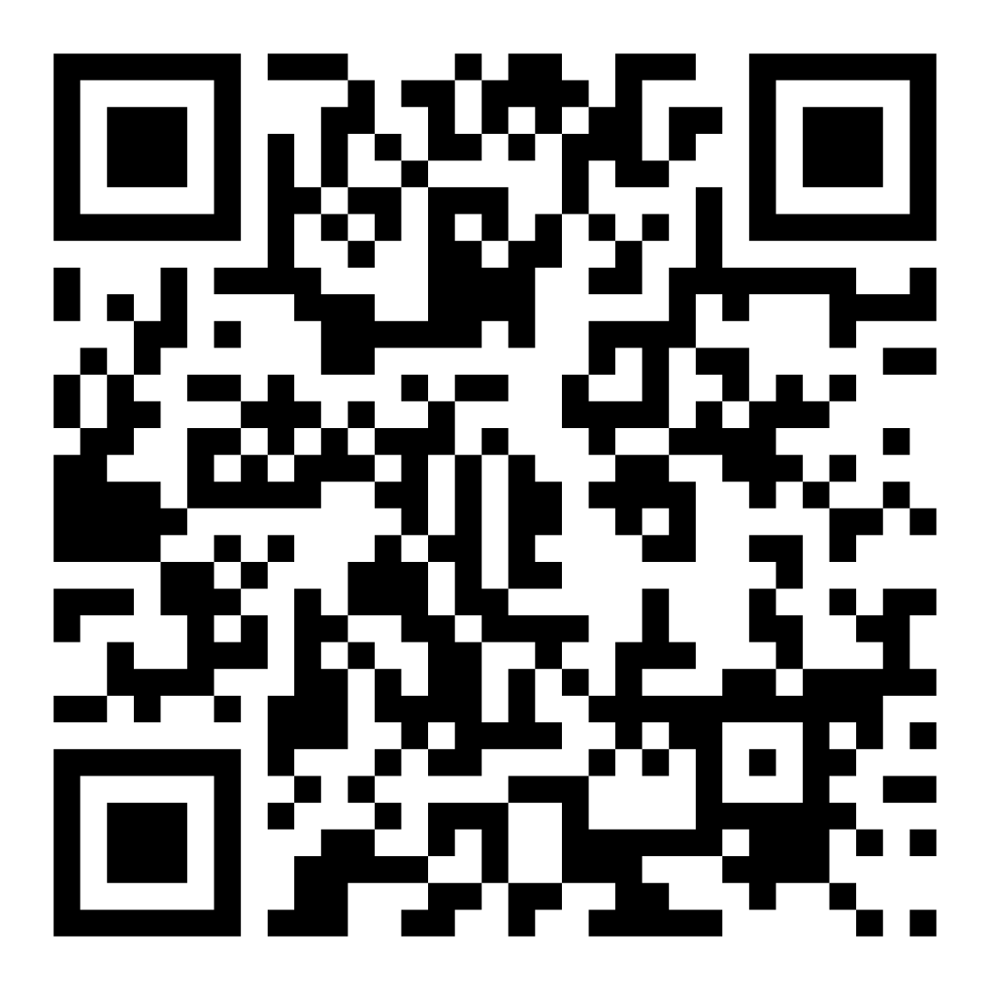
পরিবারের আত্মবিশ্বাসের সার্ভে
আপনার সন্তানের সাথে পড়তে আপনি কেমন অনুভব করছেন তা শেয়ার করতে এই কোডটি স্ক্যান করুন।

Slide 5
ওয়ার্কশপের নির্দেশনা
প্রস্তুত হন।
উপস্থিত থাকুন।
বিনয়ী হন।
প্রশ্ন জিজ্ঞাসা করুন

Slide 6
হতাশ লাগছে? ঠিক আছে!
1
2
3
4
দীর্ঘ শ্বাস নিন
সাফল্যা উদযাপন করুন।
চেক ইন করুন।
এইসব ধাপ অনুসরণ করে হতাশা কম করুন!
পদক্ষেপ নিন।

Slide 7
সাহিত্যিক টার্মগুলো দেখুন

Slide 8
দীর্ঘ শ্বাস নিন
4-3-4 কৌশল
চার গুণে শ্বাস নিন।
তিন গুণে ধরে রাখুন।
চার গুণে শ্বাস ছাড়ুন।

Slide 9
সাফল্য উদযাপন করুন
হতাশার এই সময়ে, আপনার সন্তানের সফলতা উদযাপনের জন্য আলাদাভাবে প্রশংসা করুন।
এর পরিবর্তে…. "দারুণ পড়া!"
চেষ্টা করুন…"আমি সত্যিই পছন্দ করেছি যে আপনি কীভাবে এই শব্দটি নিয়ে লেগে ছিলেন এবং হাল ছেড়ে দেননি!"

Slide 10
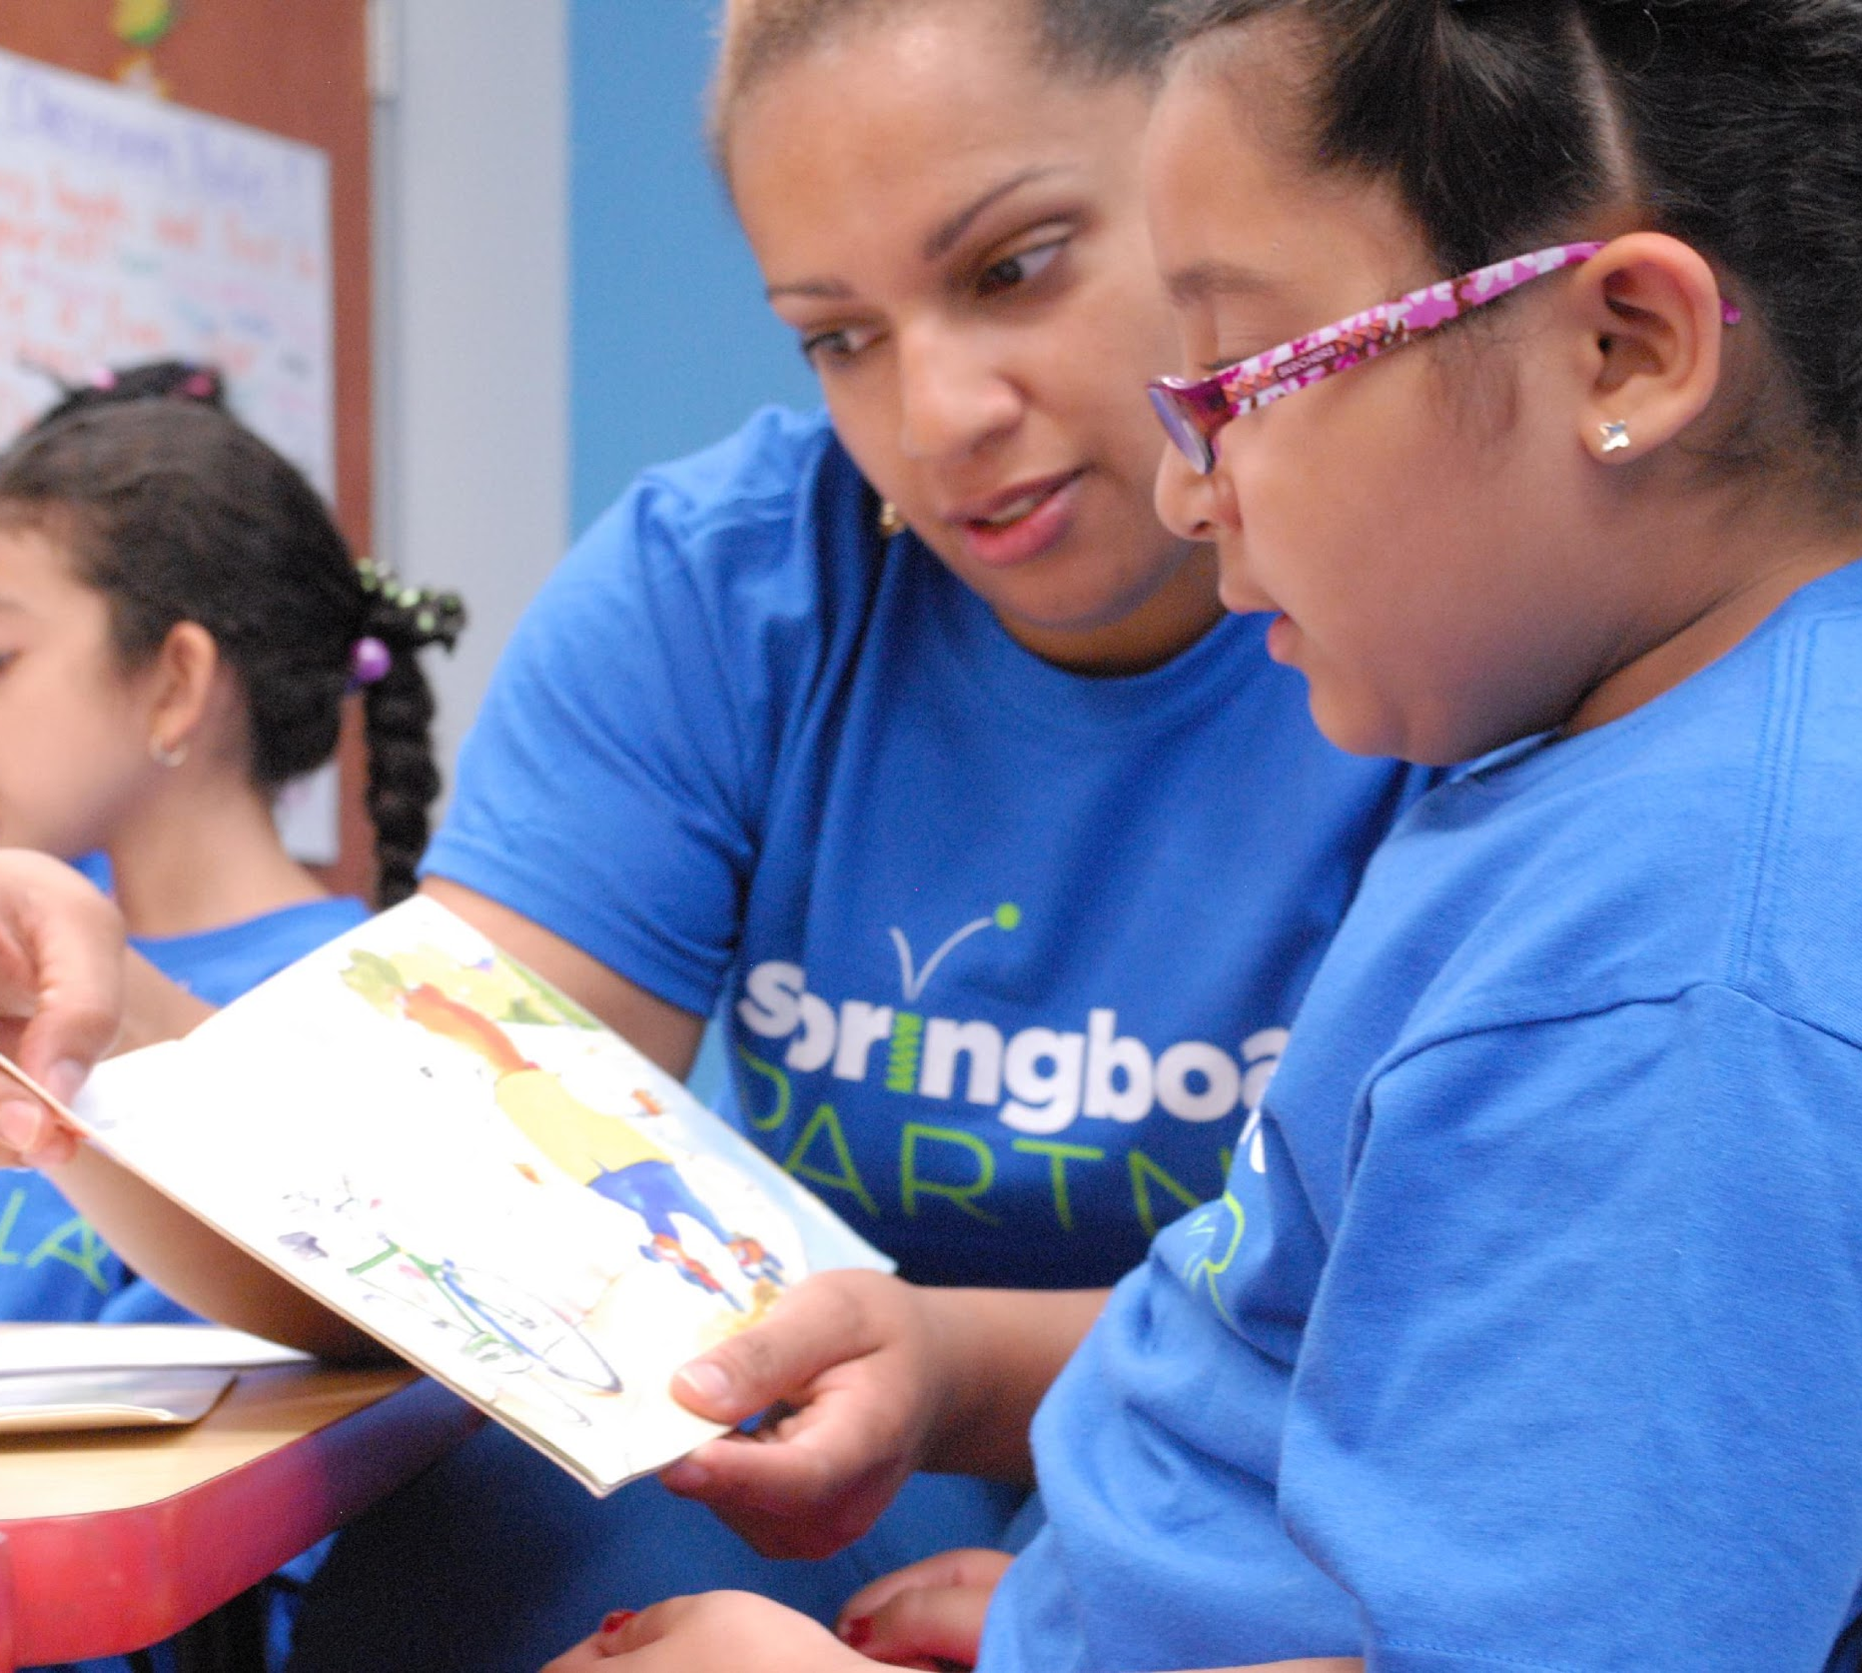
চেক ইন করুন
জিজ্ঞাসা করে আত্ম-প্রতিফলনকে উৎসাহিত করুন:
এখন যখন আপনি পড়ছেন আপনি কেমন অনুভব করছেন? আপনার শরীর কেমন অনুভব করছে?
আপনি যে হতাশ হয়ে যাচ্ছেন সেটা লক্ষ্য করেছেন?
হতাশা কম অনুভব করাতে আপনাকে এখন কী সহযোগিতা করতে পারে?

Slide 11
পদক্ষেপ নিন
যদি আপনার সন্তান…
একটি পৃষ্ঠায় একাধিক শব্দের সাথে পরিশ্রম করে
ধীরে এবং কাটা কাটাভাবে পড়ুন
বইতে ফোকাস করতে খুব কষ্ট হচ্ছে
তারপর বিবেচনা করুন…
বইটি পরিবর্তন করা হচ্ছে
পৃষ্ঠা বা লাইনটা আবার পড়া হচ্ছে
একটি বিরতি নিচ্ছি

Slide 12
পড়া = কথোপকথন (K-1)
মনে হচ্ছে আপনি হতাশ। এটা কী বই নাকি অন্য কিছু?
আসুন নিজেদেরকে মনে করিয়ে দেই, এই বর্ণ সম্পর্কে আমরা কী জানি?
চলুন এই বাক্যটি আবার শুরু করার আগে একটু সময় এবং শ্বাস নিই।
এটা সমাধান করতে পারে এমন্য অন্য কৌশল কী?

Slide 13
পড়া = কথোপকথন)(2-3)
আপনার কি এখনই একটু বিরতি নেওয়া প্রয়োজন?
আপনি এই বাক্যে অনেক পরিশ্রম করেছেন! চলুন শান্তভাবে এটি আবার পড়ি।
আপনি কি মনে করেন আপনার বই পরিবর্তন করা প্রয়োজন? আপনি আর কী পড়তে পছন্দ করেন?

Slide 14
বহুভাষিক পরিবার
পড়ার দক্ষতা তৈরি করতে সাহায্য করার জন্য অনেক অনুপ্রেরণা প্রদান করুন।
অন্য যেকোনও ভাষার বইয়ের সাথে এটি মিলিয়ে দেখুন।
একটি অডিওবুকের সাথে পড়ুন।

Slide 15
অনুশীলনের সময়
1
একটি বই পছন্দ করুন।
যখন কোন প্রশ্ন থাকে আমাকে ডাকুন!
2
হতাশার লক্ষণ সন্ধান করুন এবং পরামর্শগুলো অনুসরণ করুন (গভীর শ্বাস নিন, উদযাপন করুন, চেক ইন করুন, পদক্ষেপ নিন)।
Notes:
Part 3: Practice time
Timing: 20-25 minutes (1 slide)
Note: Practice time should be most of the remaining time. Leave 10 minutes or so at the end for reflection.
Summarize the tip and remind families to repeat these steps during practice time.
Take a moment to explain that you’ll be circulating around while they practice (to provide 1:1 support and answer any questions).
►ELL parents in particular often come with feelings of self-consciousness that can be overcome when they know why they're being observed.
Remind families to ask questions/use prompts as they use the tip.
There are sample questions on the reading tip sheet.
To support families, consider underlining two high leverage questions/prompts on the reading tip sheet as you circulate.
Remind families they can always work on their action plan or other strategies during practice time, especially if they have questions or want some help with it.
Circulate and work with families. Here are some suggestions:
Walk over to a family. Ask, “Do you have any questions about the reading tip?”
If yes, answer question.
If no, say, “May I listen in for a moment?
Listen for a full minute.
Compliment the family on something they did well and then leave them with one suggestion (if needed).
Walk over to a family and ask, “Can I try this reading tip with your child?”
After you’ve modeled it, ask the adult, “What did you notice me doing?” or say “Did you notice that I…”
Gather “glows”(things that families did that you want to lift up to the group) and “grows” (things families do that you want to stop and correct/clarify for the whole group).
Share the “glows” and “grows” at 10 mins into practice time or wait until the end.
Keeps “grows” anonymous, but congratulate specific families on “glows.”

Slide 16
চিন্তা করুন
রিডিং টিপ সম্পর্কে কোন প্রশ্ন আছে?
ঘুরুন এবং আপনার শিশুর সঙ্গে কথা বলুন: আপনি কি বাড়িতে এই রিডিং টিপ চেষ্টা করার জন্য প্রস্তুত অনুভব করছেন?
আপনি বাড়িতে এটা কীভাবে ব্যবহার করবেন তা শেয়ার করুন।
আপনার প্রশ্ন রুমে অন্য কাউকে সহায়তা করবে!

Slide 17
দয়া করে ফিডব্যাক দিন
আপনার তথ্য আমাদের সময়কে একত্রে উন্নত করে!

