Slide 1
Workshop guide
Facilitator:
  Read notes to prepare. Amend slides if needed.
  Practice the script aloud. Change as needed.
  Ready the family-facing materials.
  Display slide 2 as families arrive.
Bienvenido entrenador de lectura en casa
(Welcome At-Home Reading Coach)
Notes:
Copyright 2022 Springboard Collaborative, all rights reserved.
Overview and rationale
This workshop sets the foundation for a successful series of Family Workshops. In this workshop:
Families walk through the routines and the materials of a Family Workshop.
Teachers and families build common understanding about what it means to “read well” and what an at-home reading coach does.
Families learn and practice the coaching technique of all Family Workshops—asking questions to support their child to develop the four reading skills.
Materials
Corresponding Reading Tip Sheet (in the languages the families need)
Family Workshop Feedback Form (paper or digital form)
Books for families to use during the reading tip explanation and practice time. This strategy works with both fiction and nonfiction texts.
A short book to model with (either projected or large enough for families to see)
Projector to display slides
Empty envelope for families to put the feedback form in (optional but highly recommended)
Name tags (optional but highly recommended)
Facilitation notes
To prepare
In this workshop, you present a lot of information. Make sure to practice slides in the Welcome section specifically so you can say the information succinctly. Remember to ask questions to gauge how well families are understanding the information.
Consider showing a video of a child reading fluently so families can get a sense of what it sounds like when their child is reading on grade level. GreatSchools.org has many examples in their Milestone video series.
Study the slides in the reading tip section. Think through how you will model and guide practice for asking questions.
Choose a very short book to read aloud so you can lead families through guided practice of asking questions for each reading skill.
If this is the first Family Workshop, consider playing a video entitled “Springboard Collaborative Family Workshops” (available on Springboard’s Youtube channel).
During workshop
Take time to build rapport as a group and individually with families. Little things, like learning family members’ names and greeting them at the door, go a long way.
Keep pace so that families have time to practice the tip and also reflect. Being able to practice and reflect helps families internalize the strategy.
Circulate and check in with families individually during practice time. See the “Practice time” slide for more specific suggestions.
Ideas to differentiate
Be sure the book you use to model matches the reading abilities of the children in the workshop. Consider modeling with one or two pages from books with differing difficulty.
Preview the “Check in on literacy terms” slide and adjust terms or definitions as needed.
If teaching this workshop to families with younger readers:
Choose the appropriate “Reading = conversation” slide.
Consider amending the questions on the slides to be more appropriate for younger readers. (Do you think this is a storybook or an informational text? Can you tell me one of the characters in the book? The setting? Can you tell me the main topic of the book so far (what the book is mostly about)? What happened at the beginning of the story? What happened in the middle (next)? What happened at the end?; What was this book mostly about/ what was the main topic? What is the first letter of this word? What sound does it make?)
If teaching this workshop to families with older readers:
Choose the appropriate “Reading = conversation” slide.
Stress the importance of asking your child to give text-based evidence.
If teaching this workshop to Multilingual families:
Preview and adjust the “Multilingual families” slide, as needed.
Some families may not be comfortable reading with their child. Brainstorm reasons it’s important to have an adult read with a child and ways to make it more comfortable (ie, listening to audiobooks together, reading a book in a language other than English).
In addition, some families come from a culture where the interactions and expectations around the working relationship of teachers and families are very different. You may find it useful to make a list together of expectations they have experience with (monitoring reading at home) and expectations that may be new to them (telling the teacher when their child is struggling with a reading tip).
Finally, some families who have recently immigrated to your area may not be aware of the literacy resources in your community. Consider bringing library card applications or other information.
If families are familiar with this workshop, consider how you might leverage their experience. Ask families to share how they helped their child internalize the steps. Invite them (ahead of time) to model one or more steps if appropriate.
Timing considerations for a 60 min workshop
Welcome: 10 mins
Reading tip: 15-20 mins
Practice: 15-20 mins
Reflection and updates: 10 mins
After you use these materials, we want to hear your feedback! Fill out the Family Workshop facilitator feedback form at https://bit.ly/SBCfeedbackform.

Slide 2
Bienvenido entrenador de lectura
en casa
Notes:
Part 1: Welcome
Formally welcome families, and tell them the title of today’s workshop. Do not go into specific steps of the reading tip at this point.
Ensure families have the materials they need and are sitting with their children.

Slide 3

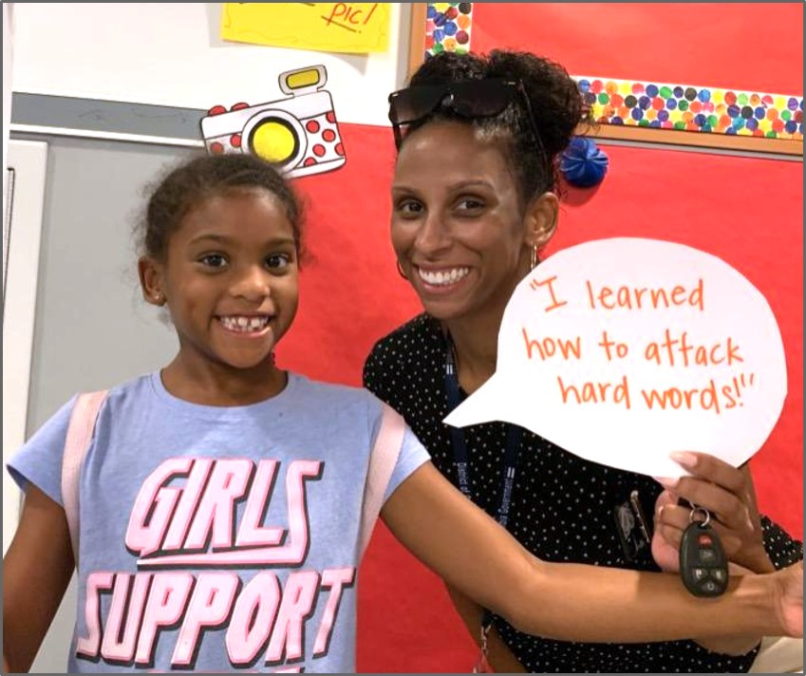



Agenda
Bienvenida
Consejo de lectura
Tiempo de práctica
Reflexión y actualizaciones
Notes:
Provide an overview of what families will be doing today (and at every Family Workshop).
If this is the first Family Workshop in a series, explain that the icons for each of the four parts of the Family Workshop also run along the bottom of slides. ​
If this is not the first workshop, move quickly through this slide. ​
Sample script
Here is our plan for today. You can see each part of our agenda has an icon [point to the icons]. You can also find each icon along the bottom of each slide [point to bottom] so you can see where we are in the agenda. First, we’ll review a couple of things, then we’ll get right to the reading tip. Most of our time will be spent on practice time so we can all try out the reading tip. Then we’ll reflect and talk about some updates.
Please speak up with questions, concerns, or anything you’d like to share. We’re here together for one hour, and need to maximize the time. Every child learns to read in a different way, but putting our heads together helps our shared cause: to give kids a reading boost and cultivate a the joy of reading.
Sample script in Spanish
Aquí tenemos el plan para hoy. Se puede ver que cada parte de la agenda tiene un ícono [point to the icons]. También se encuentran en el final de cada diapositiva [point to bottom] para que puedan saber en qué parte estamos. Primero, vamos a repasar algunas cosas. Luego vamos a empezar con el consejo de la lectura. La mayoría del tiempo vamos a pasar aquí, en la práctica, para probar el consejo de la lectura juntos. Luego, vamos a reflexionar y hablar sobre algunas novedades.
En cualquier momento, pueden hacer preguntas, compartir preocupaciones, o cualquier otra cosa que quieren compartir. Vamos a estar juntos por una hora y queremos aprovechar del tiempo que tenemos. Cada niño aprende a leer de una manera diferente. Estamos aquí para trabajar en la misma causa: ayudarles a los niños a mejorar en la lectura y llegar a disfrutarla.

Slide 4




Las normas de los talleres
Estar preparado.
Estar presente.
Ser cortés.
Haga preguntas.
Notes:
Briefly explain the guidelines or “the rules we all agree to follow so that we can all have an enjoyable and an effective workshop.”
If this is the first workshop, briefly explain each of the guidelines.
Alternatively, a family volunteer may read or summarize this slide if they’ve attended the previous workshop. ​
Consider putting these on chart paper and inviting the group to add to the list. If you do this, be sure to change this slide in subsequent workshops.​
Emphasize these guidelines are for everyone, including you, the facilitator, and pledge to be prepared, present, courteous, and ask questions.
Emphasize the last point and specifically invite families to ask lots of questions.

Slide 5


Leer en casa ayuda
Leer en casa aumenta la cantidad de tiempo que su hijo practicando.
Leer con USTED significa que su hijo obtiene una mejor práctica de lectura.
Notes:
Explain to families that reading at school is not enough practice for most children to learn to read well.
Children also need to practice at home, which increases both the quantity (when they read alone) and quality (when they read with an adult) of practice they get.
The at-home reading coach reads with their child and helps their child read on their own.
►Be sensitive to the fact that for many families, reading at home with an adult may be a foreign practice.
You may share or invite others to share a personal example of reading with a child at home or being read to as a child.
►This is a good time to discuss oral storytelling practices.
This will validate some of things that families may already be doing and will give parents and teachers alternative ways of approaching the subject of comprehension: a child that understands a story is able to retell it accurately and (hopefully) even provide critical and analytical interpretations.
Sample script:
How will we work on the skills of reading? By practice! By reading at home, you increase the amount of time your child is practicing and the quality of that practice time. Because your child will be reading at home, they need someone to make the most of that time. That someone is you! As the coach, you make sure your child gets lots of practice—by reading alone and reading with you. You also make sure they feel safe to try new things and make mistakes. Making reading mistakes is part of learning. Just like a sports coach may give their players free throw or running drills, you help your child get specific practice on particular reading skills with you. Don’t worry if you don’t know what to do—that’s why you’re here, to learn and try new things.
Now for some of us, reading with our child might be new and a little uncomfortable. That’s fine! You probably already tell stories with your child—family stories, things that happened in their day, things that happened in the news. That’s a great start! Now we have these workshops so that you’ll know exactly what to do when you read with your child. Does anyone have any experience with reading at home? What have you found successful? What are some things that make it difficult? How do you make it fun and low risk for your child?
Sample script in Spanish:
¿Cómo vamos a trabajar en las destrezas de la lectura? Con la práctica. Con leer en casa, va a incrementar cuánto tiempo su hijo pasa practicando y la calidad de dicho tiempo. Como su hijo estará leyendo en casa, necesitará a alguien que le ayude a aprovechar ese tiempo. ¡Este alguien es usted! Como el entrenador, usted se asegura de que su hijo tenga mucha práctica - leyendo independientemente o con usted. También se asegura de que él o ella se sienta seguro para probar nuevas cosas y cometer errores. Cometer errores es parte del aprendizaje. Justo como un entrenador de deportes tal vez les dé ejercicios de correr o de tiros libres, usted le ayuda a su hijo a practicar específicamente en una habilidad específica de lectura. No se preocupe si no sabe qué hacer - por eso está aqui, para aprender y probar nuevas cosas.
Ahora para algunos de nosotros, leer con nuestro hijo podría ser nuevo e incómodo. ¡Está bien! Usted probablemente ya cuenta historias con su hijo - historias de la familia, cosas que pasaron en el pasado, cosas que acontecen en las noticias. ¡Es un buen comienzo! Ahora tenemos talleres para que sepa exactamente qué hacer cuando lee con su hijo. ¿Alguien ya tiene experiencia con leer en casa? ¿Qué le ha ido bien? ¿Qué son algunas cosas que son más difíciles? ¿Cómo lo hace divertido y de bajo riesgo para su hijo?

Slide 6
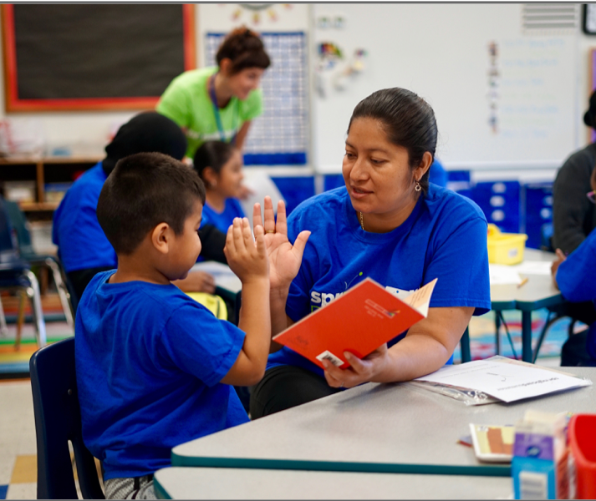
Recursos para usted
Tangible:
Springboard Connect o plan de acción del estudiante
Libros
Recordatorios de lo que aprendan aquí
Intangible:
Apoyo de esta comunidad
Relación de trabajo con el maestro de su hijo
Práctica apoyada
Notes:
This slide is very important!
Be aware that many families may not have had a working relationship or even a positive interaction with a teacher before, so they may not immediately view this as a tangible resource.
Take time to reinforce that this is another reason workshops exist—to help families and teachers work together better.
►This is an excellent time to explore the parents’ previous experiences and to introduce the nature of teacher/parent relationships in the U.S. (or at least what we strive for).
Doing this will give facilitators an idea of parents' backgrounds and will help guide the discussions and inform the planning for future workshops.
Because this conversation will depend on your context, no sample script is given, but you may find the following suggestions useful:
Start by asking families about what they think the word coach means and how it could apply to their child’s reading.
► For some families, this idea of parent as “coach” or “teacher” may be unfamiliar.
If this is the first or second workshop in a series, take some time to define terms and compare how parenting roles may differ across cultures and generations.
Reinforce the idea that parents may play many roles in their children’s lives.
Go over tangible resources. You may say something like:
Remind families of Springboard Connect and the way it gives them a specific strategies to help them know what to do when they read with their child.
Where can we get books in our community? You may discuss the library, online resource such as RAZ-Kids, free book drives, the classroom library, etc. Get specific. Talk about how one gets a library card, for example.
Show families the notetaker and the Reading Tip Sheet. Explain that they will get them every workshop and they are for them to use as they find helpful.
If you’re providing books as part of the Family Workshop, talk about how that will work.
Move on to the intangible resources. You may say something like:
We have a roomful of child experts here and we can help each other. For example, who has found a good way to motivate their child to read at home? Who has had success with finding a book their child enjoys?
Your relationship with your child’s teacher is really important. Your teacher (or I) needs to hear how reading is going at home so they can better instruct your child. And then we’ll be sharing what we know about reading and what can help your child. What do we mean by a “working relationship”? What does that look like in your mind? How might that be different than what you’re used to?
In every Family Workshop, you’ll have a chance to practice with your child. If you’re having trouble, let me know so I can help.

Slide 7

Bienvenido entrenador de lectura
en casa
1
2
3
4
Haga preguntas para que se entusiasmen con el libro
Haga preguntas sobre las palabras del libro.
Haga preguntas sobre lo que sucede en el libro.
¡Simplemente teniendo conversaciones es una técnica comprobada para aumentar el vocabulario de su hijo!
Haga preguntas sobre cómo leer el libro como un narrador.
Notes:
Part 2: Reading tip
Introduce the reading tip for today: asking questions and the importance of conversation.
►For Multilingual families specifically: An additional question you might add for language learning students is “How do you feel about reading this in English?”
Multilingual students usually feel anxious about reading in English. To lower the level of anxiety it would be prudent to ask Multilingual students how they feel about reading in English and, in particular, how they feel about reading the selected material.
Doing this will not only help lower affective filter barriers, but also has the potential of strengthening the bonds of trust between parent and child; this is something that has been proven to be conducive to higher levels of academic achievement.
Sample script
Now we’re ready for today’s reading tip which can be summed up as: Ask questions. As I said, this is the main coaching technique you will use in each workshop, so today we’re going to focus just on this. You, as a reading coach, can ask questions to get your child excited about the book. You can ask questions about the words in the book–including how to read them and what they mean. You can ask questions about what happens in the book and finally, ask questions about how to read the book like a storyteller.
We’re going to do this together and then you’ll do it with your child.
What kinds of conversations do you have with your child already about books? How do you talk to your child about books? (solicit answers)
These conversations are really important. Important research has shown that just having these conversations can really increase our children’s vocabulary.
Do you ever ask your child about how they feel about reading (in English) or how they feel about reading this type of book? Knowing what kind of reading is challenging or more pleasurable for your child will help you be a better coach.
Sample script in Spanish
Ahora estamos listos para el consejo de lectura de hoy, que se puede resumir como: Hacer preguntas. Como ya mencioné, esta es la técnica principal que usarán en cada taller, así que hoy vamos a enfocarnos solamente en esto. Usted, como entrenador de lectura en casa, puede hacer preguntas para entusiasmar a su hijo con el libro. Puede hacer preguntas sobre las palabras en el libro - incluyendo cómo leerlas y qué significan. Puede hacer preguntas sobre lo que pasa en el libro y finalmente, hacer preguntas sobre cómo sonar como un narrador.
Vamos a hacer esto juntos y luego usted lo hará con su hijo.
¿Qué tipo de conversaciones ya tiene con su hijo sobre libros? ¿Cómo habla con su hijo sobre libros? (solicit answers)
Estas conversaciones son muy importantes. Unas investigaciones muy importantes han demostrado que el simple acto de tener estas conversaciones realmente puede aumentar el vocabulario de nuestros hijos.
¿Usted le hace preguntas a su hijo sobre cómo se siente sobre la lectura (en inglés) o cómo se siente sobre leer este tipo de libro? Sabiendo qué tipo de lectura es más desafiante o más agradable para su hijo lo ayudará a usted a ser mejor entrenador de lectura.

Slide 8
Verifique los términos de
alfabetización
Sonar como un narrador
Leer a buen ritmo, leer palabras en frases y con fluidez, leer con emoción, leer como si estuvieras hablando.
Notes:
To make sure everyone has a common understanding, define some literacy terms as needed.

Slide 9

Haga preguntas para emocionarse con el libro
¿De qué crees que tratará este libro? ¿Qué en el libro te hace pensar eso?
¿Quién crees que será el personaje principal de este libro?
¿Qué es una cosa que puede suceder en este libro? ¿Por qué piensas eso?
Cuando piensas en lo que puede pasar en un libro, estás haciendo una predicción.
Para libros de no ficción, pregunte: ¿Qué crees que aprenderás?
Notes:
Display the cover of the book you intend to model with.
Bring a child or an adult to the front of the room.
Ask the volunteer the first question and model having a conversation with one or more of the children, pausing to explain what you're doing.
Invite the volunteer to take a seat.
Then, invite families to turn and ask their child the second or third question.
Sample script
Let’s start with the first type of questions we can ask–questions to get excited about the book. If our child can be engaged with a book, it will help them persevere when the reading gets tough. May I have a volunteer to help me with this part? Let’s first take a moment to look at the cover. [Insert things you notice and ask volunteer to do the same].
Let’s peek inside and read one page. [Read page aloud]. And now what do you think this book will be about? What in the book makes you think that? [Insert things you notice and ask volunteer to do the same].
Now, with your child, talk about how you would answer the next two questions. [Read slide].
Sample script in Spanish
Comencemos con el primer tipo de preguntas que podemos hacer: preguntas para que se emocionen con el libro. Si nuestro hijo puede involucrarse con un libro, lo ayudará a perseverar cuando la lectura se ponga difícil. ¿Puedo tener un voluntario que me ayude con esta parte? Primero tomemos un momento para mirar la portada. [Insert things you notice and ask volunteer to do the same].
Miremos adentro y leamos una página. [Lea la página en voz alta]. Y ahora, ¿de qué crees que tratará este libro? ¿Qué en el libro te hace pensar eso? [Insert things you notice and ask a volunteer to do the same].
Ahora, con su hijo, hable sobre cómo respondería las dos preguntas siguientes. [Read slide].

Slide 10
Haga preguntas sobre las palabras del libro.
Esta palabra tiene algunas de las letras y sonidos en las que hemos estado trabajando. ¿Qué ves en esta palabra?
Noté la palabra______. ¿Qué me puedes decir sobre esta palabra?
¿Qué crees que puede significar esta palabra?
Hablar de palabras es excelente para desarrollar vocabulario.
También puede hacer preguntas sobre palabras como "¿has escuchado esa palabra antes?"
Notes:
Read a few pages of the book.
Ask the children in the room the first question and model having a conversation with one or more of the children. Be sure and use the letter and sound patterns you are currently using in your classroom.
Pause to explain what you're doing as you model.
Then invite families to turn and ask their child the second or third question.
Depending on the reading abilities of the room, children may give the definition of the word, name the letter it what it starts with, name whether it repeats on the page, etc for the second question.
Sample script
The second type of questions we can ask are questions about the words in the book. Beginning readers are going to come across lots of of new words. We can help them by reminding them to look at the letters and the sounds to figure it out. So when there’s a tricky word, talk about how to sound it out. We can also talk about what words mean. The more words your child knows, the more words they’ll be able to read.
Let’s see how this might work. I’m going to read a few pages and when I come to a word I think we should talk about, I’m going to pause. [Read aloud]
Let’s look closely at this word. [Read the question on the slide and ask a child volunteer to answer].
Now, with your child, use the next two questions to talk about the words on the page. [Read slide].
Sample script in Spanish
El segundo tipo de preguntas que podemos hacer son preguntas sobre las palabras del libro. Los lectores principiantes encontrarán muchas palabras nuevas. Podemos ayudarlos recordándoles que miren las letras y los sonidos para descifrarlas. Entonces, cuando haya una palabra complicada, hablen sobre cómo pronunciarla. También podemos hablar sobre el significado de las palabras. Cuantas más palabras sepa su hijo, más palabras podrá leer.
Veamos cómo podría funcionar esto. Voy a leer algunas páginas y cuando llegue a una palabra sobre la que creo que deberíamos hablar, haré una pausa. [Read Aloud]
Miremos de cerca esta palabra.[Read the question on the slide and ask a child volunteer to answer.]
Ahora, con su hijo, use las siguientes dos preguntas para hablar sobre las palabras en la página. [Read slide].

Slide 11
Haga preguntas sobre lo que sucede en un libro.
¿De qué se trato este libro? ¿Por qué dices eso? Muéstrame en el libro.
Si estuvieras en esta historia, ¿qué harías? ¿Por qué?
¿Qué aprendiste de este libro? ¿Dónde aprendiste eso?
Hablar de libros es una excelente manera de ayudar a su hijo a convertirse en un mejor lector.
Continúe preguntando "¿Por qué?" para mantener la conversación.
Notes:
Read the rest of the book.
Bring a child or an adult to the front of the room.
Ask the volunteer the first question and model having a conversation with one or more of the children.
Pause to explain what you’re doing.
Referring to notes taken during the “before reading” discussion can be helpful at this point in confirming predictions.
Then, invite families to turn and ask their child the second or third question.
Sample script
The third type of questions we can ask are questions about what happened in the book. Remember we aren’t just reading words. We are reading to understand what we read! While you’re reading, pause and talk about what has happened so far. Reread things that are confusing. Talk about what the character is doing and why. When the book is over, talk about what happened or what you learned. Let’s try.
[Read the rest of the book]
Ok, can I have a volunteer to help me answer the first question? [Insert things you notice and ask volunteer to do the same].
Now, with your child, use the next two questions to talk about the words on the page. [Read slide].
Sample script in Spanish
El tercer tipo de preguntas que podemos hacer son preguntas sobre lo que sucedió en el libro. Recuerden que no solo estamos leyendo palabras. ¡Estamos leyendo para entender lo que leemos! Mientras lee, haga una pausa y hable sobre lo que ha sucedido hasta ahora. Vuelva a leer las cosas que son confusas. Hable acerca de lo que está haciendo el personaje y por qué. Cuando terminen el libro, hablen sobre lo que sucedió o lo que aprendieron. Intentemoslo.
[Read the rest of the book]
Bien, ¿puedo pedirle a un voluntario que me ayude a responder la primera pregunta?
Ahora, con su hijo, use las siguientes dos preguntas para hablar sobre las palabras en la página. [Read slide].

Slide 12
Haga preguntas sobre cómo leer como un narrador.
Ahora que sabes las palabras, ¿puedes volver a leerlas para que suenen más suaves?
¿Puedes volver a leer eso para que suene más como si estas hablando?
Escucha mientras vuelvo a leer esta parte. ¿Qué escuchas?
Leer como un narrador ayuda a su hijo a comprender lo que lee.
Notes:
Model rereading a page like a storyteller. Encourage families to model for children how to reread and make the sentences more smooth.
Sample script
Finally, the questions we can ask are questions to help your child read more like a storyteller. We want readers to develop reading fluency, or the ability to read aloud so they sound like they’re talking. So we can practice this by reading and reading the words smoothly and reading the sentences with expression.
Beginning readers often need someone to show them what this looks like. So I’m going to read this page one time through to make sure I know the words. [Read one page–not fluently]. Then I’m going to model rereading it with the emotion the author intended, at a good pace, and in phrases. [or insert what fluency looks like for the children in your classroom]. [Reread page]. I’m going to try that one more time. [Reread again].
Remember, you don’t have to be perfect at this to model it. Reading and rereading a few times is a great thing to show your child!
Sample script in Spanish
Finalmente, las preguntas que podemos hacer son preguntas para ayudar a su hijo a leer más como un narrador. Queremos que los lectores desarrollen fluidez en la lectura, o la habilidad de leer en voz alta para que suenen como si estuvieran hablando. Entonces podemos practicar esto leyendo y leyendo las palabras suavemente y leyendo las oraciones con expresión.
Los lectores principiantes muchas veces necesitan que alguien les muestre cómo es esto. Así que voy a leer esta página una vez para asegurarme de saber las palabras. [Lea una página, sin fluidez]. Luego voy a modelar lo que es leer lo de nuevo con la emoción que pretendía el autor, a buen ritmo y con frases. [or insert what fluency looks like for children in your classroom]. [Re-read the page]. Voy a intentarlo una vez más. [Reread].
Recuerden, no tienen que ser perfectos en esto para modelar. ¡Leer y releer un par de veces es una gran cosa para mostrarle a su hijo!

Slide 13



Multilingual families
Leer junto con un audiolibro
Usar esto con libros en cualquier idioma
Hablar sobre recursos de alfabetización en la comunidad
Notes:
Use this slide if families’ primary language is not English or they may have specific questions. Alternatively, if you have talked about accommodations throughout the reading tip explanation you may skip this slide or use it to briefly sum up.
Explain the tips on the slide. If you need more detail, see “Ideas to differentiate” in the Workshop Guide.

Slide 14
Leer = conversación (K-1)
¿De qué crees que se trata este libro? ¿Por qué?
¿Qué crees que pasará después? ¿Qué en el libro te hace pensar eso?
¿Con qué letra comienza esa palabra?
¿Puedes volver a contar lo que sucedió en esta página?
Notes:
Remind families that the at-home reading coach always asks questions!
► For Multilingual families specifically: Some families may come from a culture where asking questions and “coaching” their child may be an unfamiliar practice. Instead, they may be more used to being directive and having the answers​.
Encourage families to keep trying this coaching technique and assure them that the more they do it, the more comfortable it will become. ​
Although “parent as expert” and “parent as coach” are equally valid positions, asking questions and encouraging children to find the answer out for themselves instead of telling them an answer can help children internalize the learning in a different way.
This is a good time to remind parents that even though asking questions may not at present be a regular practice for them, this is an opportunity for them to acquire and practice new skills that will help their children. Cultural shifts are usually most effective when they're explicit.​
Use this slide to ensure that families have some questions they can ask during practice time.
Ask families to hold up the number of questions they already have written down or are prepared to use. If it looks like the room is prepared, you may skip this slide or ask families to share other questions they have written down throughout the workshop.
Share with families that there are also sample questions on the Reading Tip Sheet.
Sample script
At Springboard, the most important thing we want you to leave with is: to ALWAYS ASK QUESTIONS. You want to ask your child questions to help them figure out words, understand what they’re reading, sound more like a storyteller, and enjoy what they are reading. Today we’ve learned questions to help your child practice all the skills of reading! In future workshops we will learn more reading tips for each of these skills.
Sample script in Spanish
En Springboard, lo más importante con lo que queremos que se vaya es: QUE SIEMPRE HAGA PREGUNTAS. Quiere hacerle preguntas a su hijo para ayudarlo a descifrar palabras, comprender lo que está leyendo, sonar más como un narrador y disfrutar lo que está leyendo. Hoy hemos aprendido preguntas para ayudar a su hijo practicar las habilidades de lectura. En future talleres aprenderemos más consejos de lectura para cada una de estas habilidades.

Slide 15
Leer = conversación (2-3)
¿Qué crees que podrías aprender en este libro? ¿Por qué?
¿Ves alguna combinación de letras que conoces en esta palabra?
Volvamos a leerlo de nuevo. ¿Puedes leer las palabras en frases y un poco más rápido?
Notes:
Remind families that the at-home reading coach always asks questions!
► For Multilingual families specifically: Some families may come from a culture where asking questions and “coaching” their child may be an unfamiliar practice. Instead, they may be more used to being directive and having the answers​.
Encourage families to keep trying this coaching technique and assure them that the more they do it, the more comfortable it will become. ​
Although “parent as expert” and “parent as coach” are equally valid positions, asking questions and encouraging children to find the answer out for themselves instead of telling them an answer can help children internalize the learning in a different way.
This is a good time to remind parents that even though asking questions may not at present be a regular practice for them, this is an opportunity for them to acquire and practice new skills that will help their children. Cultural shifts are usually most effective when they're explicit.​
Use this slide to ensure that families have some questions they can ask during practice time.
Ask families to hold up the number of questions they already have written down or are prepared to use. If it looks like the room is prepared, you may skip this slide or ask families to share other questions they have written down throughout the workshop.
Share with families that there are also sample questions on the Reading Tip Sheet.
Sample script
At Springboard, the most important thing we want you to leave with is: to ALWAYS ASK QUESTIONS. You want to ask your child questions to help them figure out words, understand what they’re reading, sound more like a storyteller, and enjoy what they are reading. Today we’ve learned questions to help your child practice all the skills of reading! In later workshops we will go more deeply into each of these skills.
Sample script in Spanish
En Springboard, lo más importante con lo que queremos que se vaya es: QUE SIEMPRE HAGA PREGUNTAS. Quiere hacerle preguntas a su hijo para ayudarlo a descifrar palabras, comprender lo que está leyendo, sonar más como un narrador y disfrutar lo que está leyendo. Hoy hemos aprendido preguntas para ayudar a su hijo practicar las habilidades de lectura. En future talleres aprenderemos más consejos de lectura para cada una de estas habilidades.

Slide 16
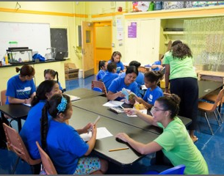
Tiempo de práctica
1
Haga preguntas para que se entusiasmen con el libro
¡Llámame cuando tengan una pregunta!
2
Haga preguntas sobre las palabras del libro.
3
Haga preguntas sobre lo que sucede en el libro.
4
Haga preguntas sobre cómo leer el libro como un narrador.
Notes:
Part 3: Practice time
Note: Practice time should be most of the remaining time. Leave 10 minutes or so at the end for reflection.
Summarize the tip, and remind families to repeat these steps during practice time.
Take a moment to explain that you’ll be circulating around while they practice (to provide 1:1 support and answer any questions).
►Multilingual parents in particular often come with feelings of self-consciousness that can be overcome when they know why they're being observed.
Remind families to ask questions as they use the tip.
There are also sample questions on the Reading Tip Sheet.
To support families, consider underlining two high leverage questions on the Reading Tip Sheet as you circulate.
Remind families they can always work on their action plan or other strategies during practice time, especially if they have questions or want some help with it.
Circulate and work with families. Here are some suggestions:
Walk over to a family. Ask, “Do you have any questions about the reading tip?”
If yes, answer question.
If no, say, “May I listen in for a moment?
Listen for a full minute.
Compliment the family on something they did well and then leave them with one suggestion (if needed)
Walk over to a family and ask, “Can I try this reading tip with your child?”
After you’ve modelled it, ask the adult, “What did you notice me doing?” or say “Did you notice that I…”
Gather “glows”(things that families did that you want to lift up to the group) and “grows” (things families do that you want to stop and correct/clarify for the whole group).
Share the “glows” and “grows” at 10 mins into practice time or wait until the end.
Keeps “grows” anonymous, but congratulate specific families on “glows.”

Slide 17

Reflejar
¿Alguna pregunta sobre el consejo de lectura?
Voltéese y hable con su hijo: ¿Nos sentimos listos para probar este consejo de lectura en casa?
Por favor, comparte cómo podrían usar esto en casa.
¡Su pregunta ayudará a alguien más en este espacio!
Notes:
Part 4: Reflection & updates
Invite participants to ask questions.
Give ample wait time for each question. ​
Remind families that when parents talk they make it safe for more hesitant parents to share. It builds community in the classroom. ​
Encourage other voices to share.
In addition, you could share some “glows” and “grows” you noticed while walking around and supporting families during practice time.
Check in on the goal of Family Workshops.​
Read “Any questions…”? and wait. Let this question hang and give ample wait time.​
Invite families who don’t yet feel equipped to do the reading tip on their own to raise their hand (or indicate in a more private way) so you can check in with them personally before they leave the workshop.
Invite a family volunteer to share how they will use the reading tip at home.
If time permits, you may do a whip-around share.
Invite families to each share one thing (in 30 seconds or less). This could be:
Something they learned
One thing they’re excited to try at home
One thing they found challenging about this tip
One step they will focus on this week.

Slide 18
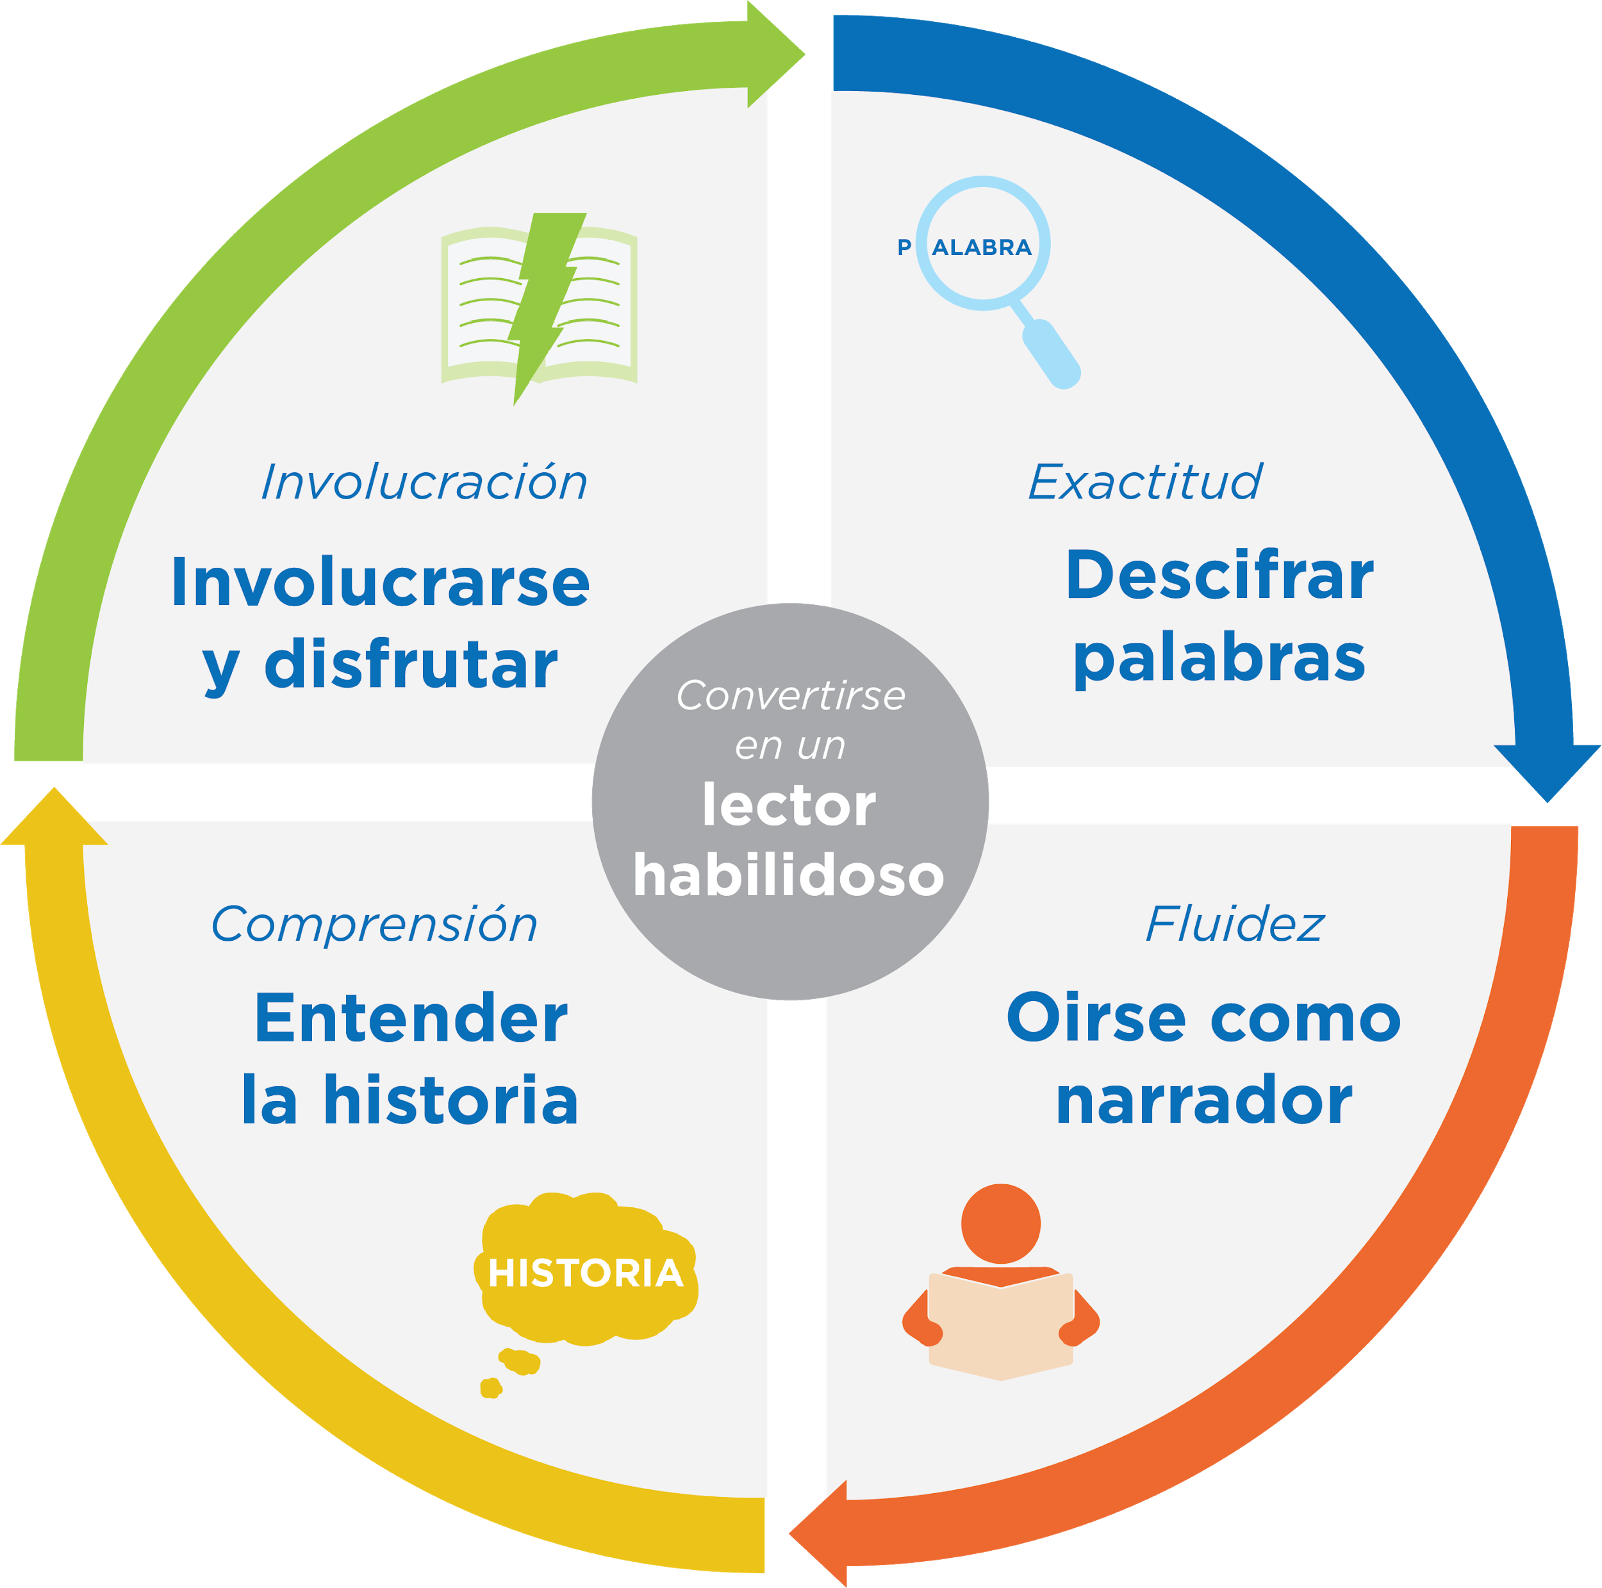
¿Qué significa leer bien?
¡El consejo de hoy y las preguntas que hacen ayudan a sus hijos a aprender las habilidades de la lectura!
Notes:
Remind families of the overall purpose of reading together and asking question—helping children read well.
Remind families what “reading well” means—developing the skills of reading.
Remind families that they are working on one of these skills as part of Springboard Connect.
Explain how today’s reading tip will help readers develop the skills they need.
Sample script:
Remember, the reason we ask questions is because that’s the best way to help our children develop the skills they need to read better. And when we say “read” better, we really mean they can figure out the words, sound like a storyteller, and understand the story. Also, in order to read better, children need to learn how to stay motivated and focused on what they’re reading. They need to engage and enjoy the book.
We learned to ask questions to help your child develop each of these skills.
Sample script in Spanish:
Acuerdense, la razón por qué hacemos preguntas es porque es la mejor manera de ayudarles a nuestros hijos a desarrollar las destrezas que necesitan para leer mejor. Cuando decimos “leer” mejor, queremos decir que pueden averiguar las palabras, sonar como una cuentista, y entender el cuento. También, para leer mejor, los niños necesitan aprender a mantener su motivación y enfoque mientras lean. Necesitan involucrarse y disfrutar del libro.
Aprendimos a hacer preguntas para ayudar a su hijo a desarrollar cada una de estas habilidades.

Slide 19
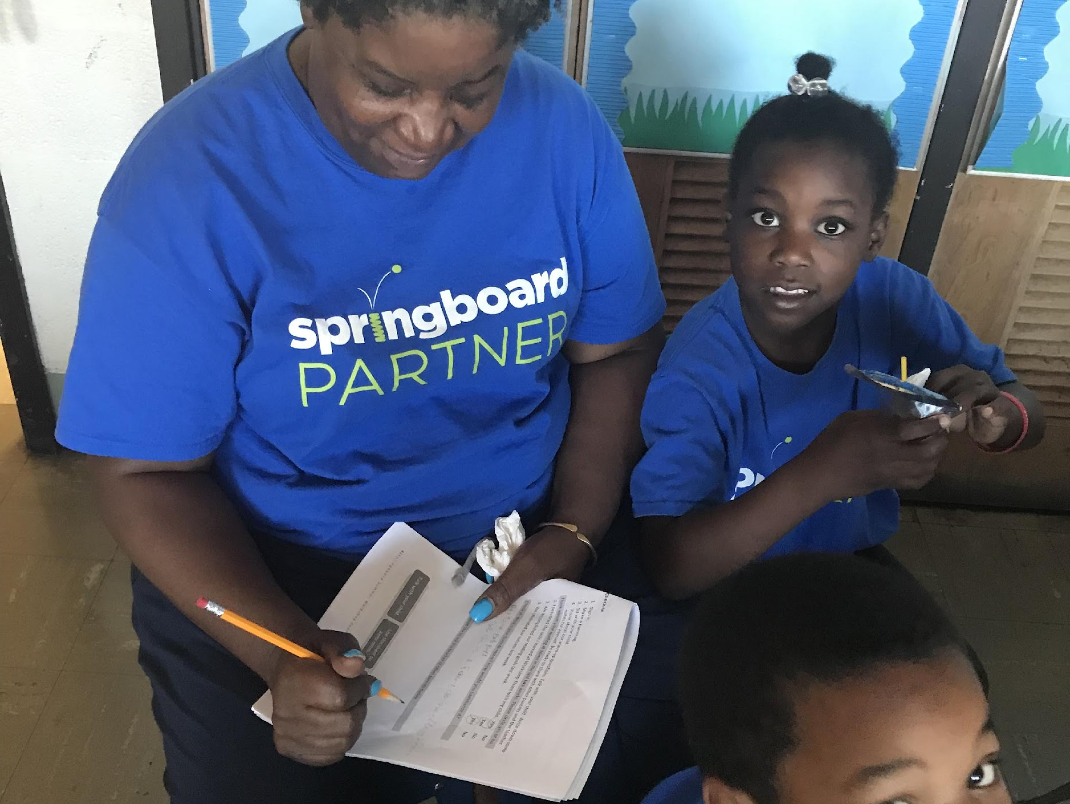

Comentarios, por favor
¡Su aporte y comentarios mejora nuestro tiempo juntos!
Notes:
Invite families to make a reading plan for the upcoming week.
Remind families that readers need “reading together” time and “reading alone” time.
Remind families that reading in workshops counts as “reading together time” and they should log it (if applicable).
Invite families to give you feedback so that you can facilitate a workshop that works for them!
Families can use the printed feedback form (if available) or a digital feedback form.
Invite families to give you more informal feedback. This could look like a thumbs up if they liked the reading tip or writing one thing they hope for the next workshop.
Use this time to meet individually with families as needed.
Sample script
And finally, I want to make sure I’m hosting a Family Workshop that works for you. Every workshop, you’ll have a chance to give me feedback, and I promise you that I will read it and do my best to incorporate it. Will you fill out the survey before you leave? If you’d rather talk about your suggestions, instead of writing them down, let me know. Thanks and see you at the next workshop!
Sample script in Spanish
Para cerrar, quiero asegurar que estoy dando un taller de familia que les sirve a ustedes. En cada taller, tendrán la oportunidad de proveer comentarios. Yo les prometo que los voy a leer y voy a hacer mi mejor esfuerzo para incorporar los consejos en el próximo taller. ¿Pueden contestar el sondeo antes de irse? Si prefieren platicar sobre sus ideas, en vez de escribirlas, avísenme. ¡Gracias y nos veremos en el próximo taller!

