Slide 1
Workshop guide
Facilitator:
Read notes to prepare. Amend slides if needed.
Practice the script aloud. Change as needed.
Ready the family-facing materials.
Display slide 2 as families arrive.
Jugar al BINGO de lectura
(Play Reading BINGO)
Notes:
Copyright 2022 Springboard Collaborative, all rights reserved.
Overview and rationale
This workshop focused on the reading skill of engage and enjoy. In this workshop, families learn a fun way to keep reading practice fresh. Families learn how to create a reading BINGO game, that offers multiple reading “challenges” each day. Providing choice in reading can help motivate children to practice their reading skills at home.
Materials
Corresponding Reading Tip Sheet (in the languages the families need)
Projector to display slides
Optional printed blank grids (BINGO boards) OR plain white paper
Writing utensils for each family for use in creating BINGO boards
Family Workshop Feedback Form (paper or digital form)
Empty envelope for families to put feedback form in (optional but highly recommended)
Name tags (optional but highly recommended)
Facilitation notes
To prepare
In this workshop, you will share ideas on how to provide fun, engaging reading options to children by creating reading BINGO boards.
Study the slides in the reading tip section.
Think of a reading BINGO square that can be completed in the classroom. See slide entitled “Decide on reading challenges.”
Be sure to familiarize yourself with the content of the presentation so you can talk with families, not at them.
If this is the first Family Workshop, consider playing a video entitled “Springboard Collaborative Family Workshops” (available on Springboard’s Youtube channel).
During workshop
Take time to build rapport as a group and individually with families. Little things, like learning family members’ names and greeting them at the door, go a long way.
Keep pace so that families have time to practice the tip and also reflect. Being able to practice and reflect helps families internalize the strategy.
Circulate and check-in with families individually during practice time. See “Practice time” slide for more specific suggestions.
Ideas to differentiate
Be sure the book you use to model matches the reading abilities of the children in the workshop. Consider modeling with one or two pages from books with differing difficulty.
Preview “Check in on literacy terms” and adjust terms or definitions, as needed.
If teaching this workshop to families with younger readers:
Choose the appropriate “Reading = conversation” slide.
Younger readers who are not yet independent readers may need different options for their challenges. For example, there may need to be additional opportunities for different family members/friends to read aloud to the student, or listen to an audio version of the book.
Younger readers may also need shorter time frames to earn their rewards. An option is to offer a reward with any 5 completed activities from the board, not necessarily in a row.
If teaching this workshop to families with older children:
Choose the appropriate “Reading = conversation” slide.
Older readers can be challenged with opportunities to experiment with genres like historical fiction or fantasy. Consider offering stamina-builders like “read two chapters” or “read for 40 minutes” as options for older readers’ boards. You may also choose to encourage them to complete additional challenges before earning their reward.
If teaching this workshop to Multilingual families:
Consider providing sentence stems for families who may be speaking in a group.
If appropriate, add a square that encourages children to be literate in another language (eg. read a book in Spanish, practice flashcards of Chinese characters for 10 mins)
If families are familiar with this workshop, consider how you might leverage their experience. Ask families to share how they helped their child internalize the steps. Invite them (ahead of time) to model one or more steps if appropriate.
Timing considerations for a 60 min workshop
Welcome: 10 mins
Reading tip: 15-20 mins
Practice: 15-20 mins
Reflection and updates: 10 mins
After you use these materials, we want to hear your feedback! Fill out the Family Workshop Facilitator Feedback Form at https://bit.ly/SBCfeedbackform.

Slide 2
Jugar al BINGO de lectura
Notes:
Part 1: Welcome
Formally welcome families and tell them the title of today’s workshop. Do not go into specific steps of the reading tip at this point.
Ensure families have the materials they need and are sitting with their children.

Slide 3
Agenda
Bienvenida
Consejo de lectura
Tiempo de práctica
Reflexión y actualizaciones
Notes:
Provide an overview of what families will be doing today (and at every Family Workshop).
If this is the first Family Workshop in a series, explain that the icons for each of the four parts of the Family Workshop also run along the bottom of slides. ​
If this is not the first workshop, move quickly through this slide. ​
Sample script
Here is our plan for today. You can see each part of our agenda has an icon [point to the icons]. You can also find each icon along the bottom of each slide [point to bottom] so you can see where we are in the agenda. First, we’ll review a couple of things, then we’ll get right to the reading tip. Most of our time will be spent on practice time so we can all try out the reading tip. Then we’ll reflect and talk about some updates.
Please speak up with questions, concerns, or anything you’d like to share. We’re here together for one hour, and need to maximize the time. Every child learns to read in a different way, but putting our heads together helps our shared cause: to give kids a reading boost and cultivate a the joy of reading.
Sample script in Spanish
Aquí tenemos el plan para hoy. Se puede ver que cada parte de la agenda tiene un ícono [point to the icons]. También se encuentran en el final de cada diapositiva [point to bottom] para que puedan saber en qué parte estamos. Primero, vamos a repasar algunas cosas. Luego vamos a empezar con el consejo de la lectura. La mayoría del tiempo vamos a pasar aquí, en la práctica, para probar el consejo de la lectura juntos. Luego, vamos a reflexionar y hablar sobre algunas novedades.
En cualquier momento, pueden hacer preguntas, compartir preocupaciones, o cualquier otra cosa que quieren compartir. Vamos a estar juntos por una hora y queremos aprovechar del tiempo que tenemos. Cada niño aprende a leer de una manera diferente. Estamos aquí para trabajar en la misma causa: ayudarles a los niños a mejorar en la lectura y llegar a disfrutarla.

Slide 4
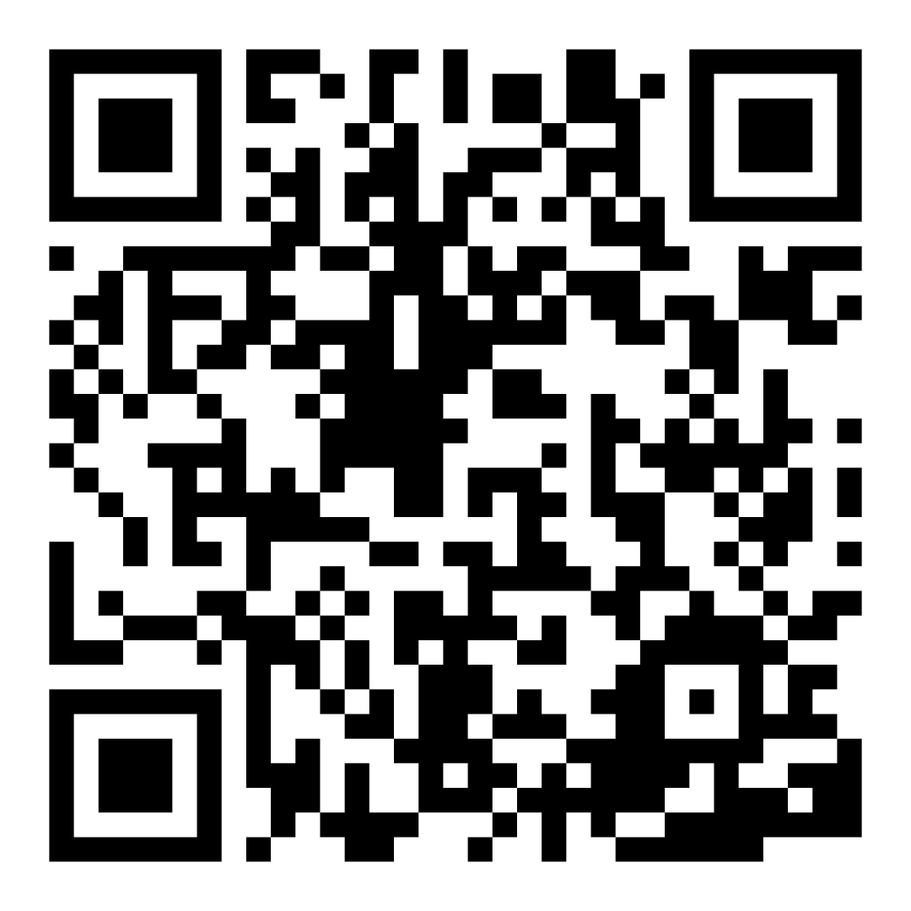
Encuesta de confianza familiar
Escaneen este código para compartir cómo se sienten acerca de la lectura con sus hijos. Los participantes serán inscritos en un sorteo para ganar una tarjeta de regalo de $15. Se elegirá un ganador por escuela después del primer y último taller.
bit.ly/3BUBxbx
Notes:
If this is not the first or last Family Workshop, please delete this slide from the slide deck.
If you are an LAUSD teacher or staff member, please delete this slide from ALL Family Workshop decks.
Families who fill out the survey will be asked to provide an email to be entered into the raffle.
One raffle winner will be selected by Springboard Collaborative’s Data & Evaluation team after the first and last workshop and sent a $15 e-gift card to the email they provided.
If you need print-out versions of the QR code survey in English or the other translated languages, you can find those here: https://drive.google.com/file/d/1zjxnM0C9aP4C9WJFbw2A8eFpjZ29wBWG/view?usp=sharing
If you want to send the survey directly to families, you can find the link to the survey here: bit.ly/3BUBxbx

Slide 5
Las normas de los talleres
Estar preparado.
Estar presente.
Ser cortés.
Haga preguntas.
Notes:
Briefly explain the guidelines or “the rules we all agree to follow so that we can all have an enjoyable and an effective workshop.”
If this is the first workshop, briefly explain each of the guidelines.
Alternatively, a family volunteer may read or summarize this slide if they’ve attended the previous workshop. ​
Consider putting these on chart paper and inviting the group to add to the list. If you do this, be sure to change this slide in subsequent workshops.​
Emphasize these guidelines are for everyone, including you, the facilitator, and pledge to be prepared, present, courteous, and ask questions.
Emphasize the last point and specifically invite families to ask lots of questions.

Slide 6
Jugar al BINGO de lectura
1
2
3
Crea tu tablero.
Seleccione el marco de tiempo.
Elige una recompensa.
¡Cuatro en fila hacia abajo o de un lado hacia el otro lado hace BINGO! ¡Cubre todo el tablero como desafío y “apagón” total !
Notes:
Part 2: Reading tip
Introduce the 3 parts of the reading tip.
Sample script
Today’s tip has three parts:
First, you will need to create your reading BINGO board. We will take some time to do this together today.
Then, you’ll want to decide on a time frame. Think about how often you’d like your child to complete the challenges and how many completed challenges would earn them a BINGO. You might offer a smaller reward for a row across or down and a larger reward for a full board “blackout”.
You’ll also want to decide together on an appropriate reward when your child completes a BINGO. This will serve as a motivator for your child’s practice each day.
Why?
Providing choice in reading can help your child feel empowered during at-home practice time. The reading BINGO game can motivate children to experiment with different text types and methods of reading to keep this time fresh and engaging.
Sample script in Spanish
El consejo de hoy tiene tres partes:
Primero, deberá crear su tablero de BINGO de lectura. Nos tomaremos un tiempo para hacer esto juntos hoy.
Luego, querrás decidir un marco de tiempo. Piense en la frecuencia con la que le gustaría que su hijo completara los desafíos y cuántos desafíos completados le otorgarían un BINGO. Puede ofrecer una recompensa más pequeña por una fila horizontal o hacia abajo y una recompensa mayor por un "apagón" de tabla completa.
También querrá decidir juntos una recompensa adecuada cuando su hijo complete un BINGO. Esto servirá como un motivador para la práctica de su hijo todos los días.
¿Por qué?
Brindarle opciones de lectura puede ayudar a su hijo a sentirse empoderado durante el tiempo de práctica en el hogar. El juego de lectura BINGO puede motivar a los niños a experimentar con diferentes tipos de texto y métodos de lectura para mantener este momento fresco y atractivo.

Slide 7
Verifique términos de alfabetización
Aguante para Lectura
La capacidad que tienen los lectores para concentrarse en leer por largos periodos de tiempos. Esto varía por edad e, interes, y crece con el transcurso del tiempo.
Notes:
To make sure everyone has a common understanding, define some literacy terms as needed.

Slide 8
Crea tu tablero
Cree una cuadrícula de 5x5 en una hoja de papel o use una versión imprimible.
Use el cuadrado central como un espacio "GRATIS".
Notes:
Review the steps to creating a BINGO board.
Note: An alternate option is to print out blank BINGO boards to fill in.
Supply paper, writing utensils and support families in creating their own BINGO boards.

Slide 9
Decidir sobre los desafíos de lectura
Escriba (o dibuje) un desafío de lectura diferente en cada cuadro.
Considere los lugares de lectura, las audiencias, los géneros, etc.
Notes:
On the white board or chart paper, generate ideas with families for reading challenges including:
Different reading locations like on the porch, in a fort, or even in the (empty) bath tub!
Different audiences like a grandparent on a video call, a stuffed animal, or the family dog
Different types of books like poetry, fiction, nonfiction, graphic novels, etc.
Support families in getting started filling out their boards with challenges. Be sure families have at least one challenge they can complete during practice time.

Slide 10
Seleccione el marco de tiempo.
¿Cuántos desafíos completamos cada semana?
¿Nuestro objetivo será una fila/columna o un apagón total?
Notes:
Explain that some children might choose to complete one challenge per day while others might be able to complete a few. Decide together if your goal will be to complete a row (across or down) or a full blackout (covering the entire board) before a reward is given.
Invite families to decide on the time frame for how they will complete the reading challenges.

Slide 11
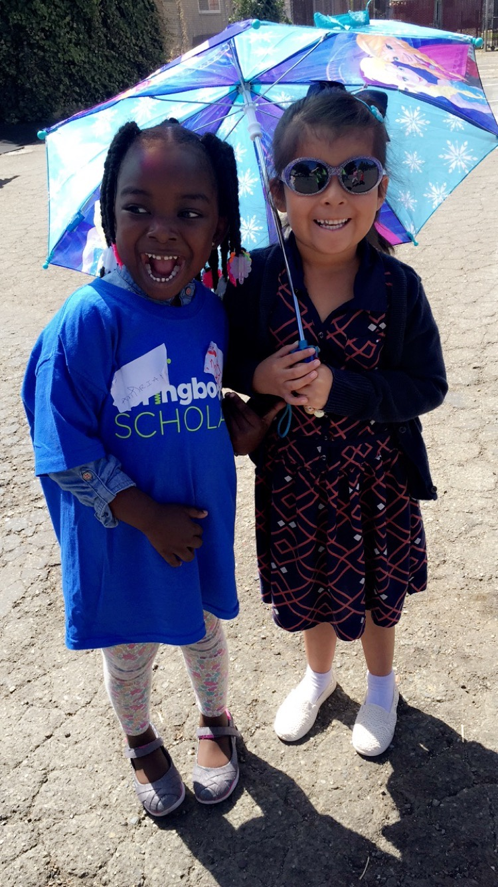
Elige una recompensa
Ir a caminar con un miembro de la familia
Salir y ir por un helado
Mirar tu película favorita
Jueguen un juego o rompecabezas juntos
Elige el menú de la cena o el restaurante
Comprar un libro nuevo
Pasar tiempo con una amigo
¡Celebre con algo pequeño cuando su hijo complete una fila o haga algo más grande con un "apagón completo"!
Notes:
Explain that rewards can be as big or small as they choose but should be given immediately after their child earns a BINGO.
It’s best to decide together on a reward idea before your child earns a BINGO so they have something they are working towards.
Invite families to discuss how they will reward their child for a reading BINGO.

Slide 12
Lectura = conversación (K-1)
¿Te gustaría leer afuera hoy o en otro lugar?
¿Qué reto te gustaría probar hoy?
¿Cómo te gustaría celebrar cuando llegues al BINGO?
¿Te gustaría leerle a un animal de peluche o un miembro de la familia?
Notes:
Remind families that the at-home reading coach always asks questions!
► For multilingual families specifically: Some families may come from a culture where asking questions and “coaching” their child may be an unfamiliar practice. Instead, they may be more used to being directive and having the answers​.
Encourage families to keep trying this coaching technique and assure them that the more they do it, the more comfortable it will become. ​
Although “parent as expert” and “parent as coach” are equally valid positions, asking questions and encouraging children to find the answer out for themselves instead of telling them an answer can help children internalize the learning in a different way.
This is a good time to remind parents that even though asking questions may not at present be a regular practice for them, this is an opportunity for them to acquire and practice new skills that will help their children. Cultural shifts are usually most effective when they're explicit.​
Use this slide to ensure that families have some questions they can ask during practice time.
Ask families to hold up the number of questions they already have written down or are prepared to use. If it looks like the room is prepared, you may skip this slide or ask families to share other questions they have written down throughout the workshop.
Share with families that there are also sample questions on the Reading Tip Sheet.
Sample script
At Springboard, the most important thing we want you to leave with is: to ALWAYS ASK QUESTIONS. You want to ask your child questions to help them figure out words, understand what they’re reading, sound more like a storyteller, and enjoy what they are reading. Today we’ve learned questions to help your child create and use a Reading BINGO game to keep them engaged and motivated to practice reading each day.
Sample script in Spanish
En Springboard, lo más importante con lo que queremos que se vaya es: QUE SIEMPRE HAGA PREGUNTAS. Quiere hacerle preguntas a su hijo para ayudarlo a descifrar palabras, comprender lo que está leyendo, sonar más como un narrador y disfrutar lo que está leyendo. Hoy hemos aprendido preguntas para ayudar a su hijo. Hoy hemos aprendido preguntas para ayudar a su hijo creer y usar un juego de lectura BINGO para mantenerlos comprometidos y motivados para practicar la lectura todos los días.

Slide 13
Lectura = conversación (2-3)
¿Te gustaría leer fantasía o poesía hoy?
¿Puedes leer un capítulo completo de tu libro hoy?
¿Preferirías leer con una linterna hoy o en una videollamada con un familiar?
Notes:
Remind families that the at-home reading coach always asks questions!
► For multilingual families specifically: Some families may come from a culture where asking questions and “coaching” their child may be an unfamiliar practice. Instead, they may be more used to being directive and having the answers​.
Encourage families to keep trying this coaching technique and assure them that the more they do it, the more comfortable it will become. ​
Although “parent as expert” and “parent as coach” are equally valid positions, asking questions and encouraging children to find the answer out for themselves instead of telling them an answer can help children internalize the learning in a different way.
This is a good time to remind parents that even though asking questions may not at present be a regular practice for them, this is an opportunity for them to acquire and practice new skills that will help their children. Cultural shifts are usually most effective when they're explicit.​
Use this slide to ensure that families have some questions they can ask during practice time.
Ask families to hold up the number of questions they already have written down or are prepared to use. If it looks like the room is prepared, you may skip this slide or ask families to share other questions they have written down throughout the workshop.
Share with families that there are also sample questions on the Reading Tip Sheet.
Sample script
At Springboard, the most important thing we want you to leave with is: to ALWAYS ASK QUESTIONS. You want to ask your child questions to help them figure out words, understand what they’re reading, sound more like a storyteller, and enjoy what they are reading. Today we’ve learned questions to help your child create and use a Reading BINGO game to keep them engaged and motivated to practice reading each day.
Sample script in Spanish
En Springboard, lo más importante con lo que queremos que se vaya es: QUE SIEMPRE HAGA PREGUNTAS. Quiere hacerle preguntas a su hijo para ayudarlo a descifrar palabras, comprender lo que está leyendo, sonar más como un narrador y disfrutar lo que está leyendo. Hoy hemos aprendido preguntas para ayudar a su hijo creer y usar un juego de lectura BINGO para mantenerlos comprometidos y motivados para practicar la lectura todos los días.

Slide 14
Familias multilingües
Usar esto con libros en cualquier idioma
Dar muchos ánimos para apoyar el desarrollo de capacidades lectoras
Notes:
Use this slide if families’ primary language is not English or they may have specific questions. Alternatively, if you have talked about accommodations throughout the reading tip explanation you may skip this slide or use it to briefly sum up.
Explain the tips on the slide. If you need more detail, see “Ideas to differentiate” in the Workshop Guide.

Slide 15
Tiempo de práctica
1
Elija un desafío que a su hijo le gustaría completar hoy.
¡Llámame cuando tengan una pregunta!
2
Completa el desafío.
3
Cuando termines, ¡colorea el cuadrado!
Notes:
Part 3: Practice time
Note: Practice time should be most of the remaining time. Leave 10 minutes or so at the end for reflection.
Summarize the tip, and support families in using their own BINGO boards to choose their child’s first challenge.
Encourage families to choose a challenge they can complete during this time like “read with a family member” or “read a fiction book”.
Take a moment to explain that you’ll be circulating around while they practice (to provide 1:1 support and answer any questions).
►Multilingual parents in particular often come with feelings of self-consciousness that can be overcome when they know why they're being observed.
Circulate and work with families. Here are some suggestions:
Walk over to a family. Ask, “Do you have any questions about the reading tip?”
If yes, answer question.
If no, say, “May I listen in for a moment?
Listen for a full minute.
Compliment the family on something they did well and then leave them with one suggestion (if needed)
Walk over to a family and ask, “Can I try this reading tip with your child?”
After you’ve modelled it, ask the adult, “What did you notice me doing?” or say “Did you notice that I…”
Gather “glows”(things that families did that you want to lift up to the group) and “grows” (things families do that you want to stop and correct/clarify for the whole group).
Share the “glows” and “grows” at 10 mins into practice time or wait until the end.
Keeps “grows” anonymous, but congratulate specific families on “glows.”

Slide 16
Reflejar
¿Alguna pregunta sobre el consejo de lectura?
Voltéese y hable con su hijo: ¿Nos sentimos listos para probar este consejo de lectura en casa?
Por favor, comparte cómo podrían usar esto en casa.
¡Su pregunta ayudará a alguien más en este espacio!
Notes:
Part 4: Reflection & updates
Invite participants to ask questions.
Give ample wait time for each question. ​
Remind families that when parents talk they make it safe for more hesitant parents to share. It builds community in the classroom. ​
Encourage other voices to share.
In addition, you could share some “glows” and “grows” you noticed while walking around and supporting families during practice time.
Check in on the goal of Family Workshops.​
Read “Any questions…”? and wait. Let this question hang and give ample wait time.​
Invite families who don’t yet feel equipped to do the reading tip on their own to raise their hand (or indicate in a more private way) so you can check in with them personally before they leave the workshop.
Invite a family volunteer to share how they will use the reading tip at home.
If time permits, you may do a whip-around share.
Invite families to each share one thing (in 30 seconds or less). This could be:
Something they learned
One thing they’re excited to try at home
One thing they found challenging about this tip
One step they will focus on this week.

Slide 17
Comentarios, por favor
¡Su aporte y comentarios mejora nuestro tiempo juntos!
Notes:
Invite families to make a reading plan for the upcoming week.
Remind families that readers need “reading together” time and “reading alone” time.
Remind families that reading in workshops counts as “reading together time” and they should log it (if applicable).
Invite families to give you feedback so that you can facilitate a workshop that works for them!
Families can use the printed feedback form (if available) or a digital feedback form.
Invite families to give you more informal feedback. This could look like a thumbs up if they liked the reading tip or writing one thing they hope for the next workshop.
Use this time to meet individually with families as needed.
Sample script
And finally, I want to make sure I’m hosting a Family Workshop that works for you. Every workshop, you’ll have a chance to give me feedback, and I promise you that I will read it and do my best to incorporate it. Will you fill out the survey before you leave? If you’d rather talk about your suggestions, instead of writing them down, let me know. Thanks and see you at the next workshop!
Sample script in Spanish
Para cerrar, quiero asegurar que estoy dando un taller de familia que les sirve a ustedes. En cada taller, tendrán la oportunidad de proveer comentarios. Yo les prometo que los voy a leer y voy a hacer mi mejor esfuerzo para incorporar los consejos en el próximo taller. ¿Pueden contestar el sondeo antes de irse? Si prefieren platicar sobre sus ideas, en vez de escribirlas, avísenme. ¡Gracias y nos veremos en el próximo taller!

