Slide 1
Workshop guide
Facilitator:
Read notes to prepare. Amend slides if needed.
Practice the script aloud. Change as needed.
Ready the family-facing materials.
Display slide 2 as families arrive.
Pausa y observa los sonidos
(Pause and See the Sounds)
Notes:
Copyright 2022 Springboard Collaborative, all rights reserved.
Overview and rationale
This is a figure out the word workshop. A foundational skill of learning to read is phonemic awareness. This workshop gives families questions they can use during reading to help their child make explicit mind-body connections to the letters and their sounds. This will reinforce a child’s phonemic awareness and decoding skills. In this workshop, families learn to pause and see the sounds.
Materials
Corresponding Reading Tip Sheet (in the languages the families need)
Family Workshop Feedback Form (paper or digital form)
Small mirrors for families without phones
Books for families to use during the reading tip explanation and practice time. This strategy works with both fiction and nonfiction texts.
A copy of a page or paragraph from a text the children are currently reading with words highlighted (See the “Pause at a tricky word”)
Projector to display slides
Empty envelope for families to put feedback form in (optional but highly recommended)
Name tags (optional but highly recommended)
Facilitation notes
To prepare
In this workshop, you will model pause and see the sounds.
Familiarize yourself with the content of the presentation so you can talk with families, not at them.
Study the slides in the reading tip section. Think through how you will model and guide practice for pause and see the sounds.
Prepare a page or paragraph from a text the children are reading in your class
Familiarize yourself with the physical articulation of long and short vowels and some of the commonly confused consonants. Think through how to explain the basics to families. These videos may be helpful to you:
Vowels:
https://youtu.be/VIjS_DFq4Z8
https://youtu.be/kyMC4vAVL_k
All sounds
https://youtu.be/RkVbqGjJxBM
More scientific explanation
https://youtu.be/u7jQ8FELbIo
During workshop
Take time to build rapport as a group and individually with families. Little things, like learning family members’ names and greeting them at the door, go a long way.
Keep pace so that families have time to practice the tip and also reflect. Being able to practice and reflect helps families internalize the strategy.
Circulate and check-in with families individually during practice time. See the “Practice time” slide for more specific suggestions.
Ideas to differentiate
Consider changing the practice words on the slides to be more appropriately matched to the level of your students.
Preview the “Check in on literacy terms” slide and adjust terms or definitions as needed.
If teaching this workshop to families with younger readers:
Choose the appropriate “Reading = conversation” slide.
Put pictures on the “Practice watching your mouth” slide or invite families to use letters cards.
If teaching this workshop to families with older readers:
Choose the appropriate “Reading = conversation” slide.
Change the “Watch your mouth make each sound” slide to have more advanced word parts such as common blends, digraphs, and affixes. However, don’t discount the value of helping children who may have struggled with letter-sound correspondence make a specific mind-body connection with beginning sounds. This can be a breakthrough for some children.
If teaching this workshop to Multilingual families:
This is a difficult workshop for families new to the English language and is more appropriate for families with some familiarity with the language. To support families consider the following ideas:​
Explicitly discuss how letters and their sounds vary across languages and invite families to make comparisons and connections.
Remind families that learning to be literate in another language takes time and patience. Stress the important role they play in their child’s development, namely as someone who encourages them to keep trying and keep going. ​ Even if they don’t know the word the child is trying to read, they can encourage the child to keep persevering and trying different strategies. This is super valuable!​
Choosing words to practice on may be daunting for adults new to the English language. Consider photocopying more of the text and highlighting words with which families can practice the strategy. Then provide a translation of some of the words.​
Remind families that a dictionary, website or app (like www.wordreference.com) can help them check to make sure their child is getting the words.​
Depending on the first language of the families, you may want to briefly explain the concept of phonics and chunking out words to sound out. ​For romance languages (such as French and Spanish) this will likely be a familiar concept. ​
Consider distributing a pronunciation guide (such as the Spanish to English pronunciation chart at https://pin.it/vbvxj7nrnb5g57) for families to use.​
If families are familiar with this workshop, consider how you might leverage their experience. Ask families to share how they helped their child internalize the steps. Invite them (ahead of time) to model one or more steps if appropriate.
Timing considerations for a 60 min workshop
Welcome: 10 mins
Reading tip: 15-20 mins
Practice: 15-20 mins
Reflection and updates: 10 mins
After you use these materials, we want to hear your feedback! Fill out the Family Workshop Facilitator Feedback Form at https://bit.ly/SBCfeedbackform.

Slide 2
Pausa y observa los sonidos
Notes:
Part 1: Welcome
Formally welcome families, and tell them the title of today’s workshop. Do not go into specific steps of the reading tip at this point.
Ensure families have the materials they need and are sitting with their children.

Slide 3
Agenda
Bienvenida
Consejo de lectura
Tiempo de práctica
Reflexión y actualizaciones
Notes:
Provide an overview of what families will be doing today (and at every Family Workshop).
If this is the first Family Workshop in a series, explain that the icons for each of the four parts of the Family Workshop also run along the bottom of slides. ​
If this is not the first workshop, move quickly through this slide. ​
Sample script
Here is our plan for today. You can see each part of our agenda has an icon [point to the icons]. You can also find each icon along the bottom of each slide [point to bottom] so you can see where we are in the agenda. First, we’ll review a couple of things, then we’ll get right to the reading tip. Most of our time will be spent on practice time so we can all try out the reading tip. Then we’ll reflect and talk about some updates.
Please speak up with questions, concerns, or anything you’d like to share. We’re here together for one hour, and need to maximize the time. Every child learns to read in a different way, but putting our heads together helps our shared cause: to give kids a reading boost and cultivate a the joy of reading.
Sample script in Spanish
Aquí tenemos el plan para hoy. Se puede ver que cada parte de la agenda tiene un ícono [point to the icons]. También se encuentran en el final de cada diapositiva [point to bottom] para que puedan saber en qué parte estamos. Primero, vamos a repasar algunas cosas. Luego vamos a empezar con el consejo de la lectura. La mayoría del tiempo vamos a pasar aquí, en la práctica, para probar el consejo de la lectura juntos. Luego, vamos a reflexionar y hablar sobre algunas novedades.
En cualquier momento, pueden hacer preguntas, compartir preocupaciones, o cualquier otra cosa que quieren compartir. Vamos a estar juntos por una hora y queremos aprovechar del tiempo que tenemos. Cada niño aprende a leer de una manera diferente. Estamos aquí para trabajar en la misma causa: ayudarles a los niños a mejorar en la lectura y llegar a disfrutarla.

Slide 4
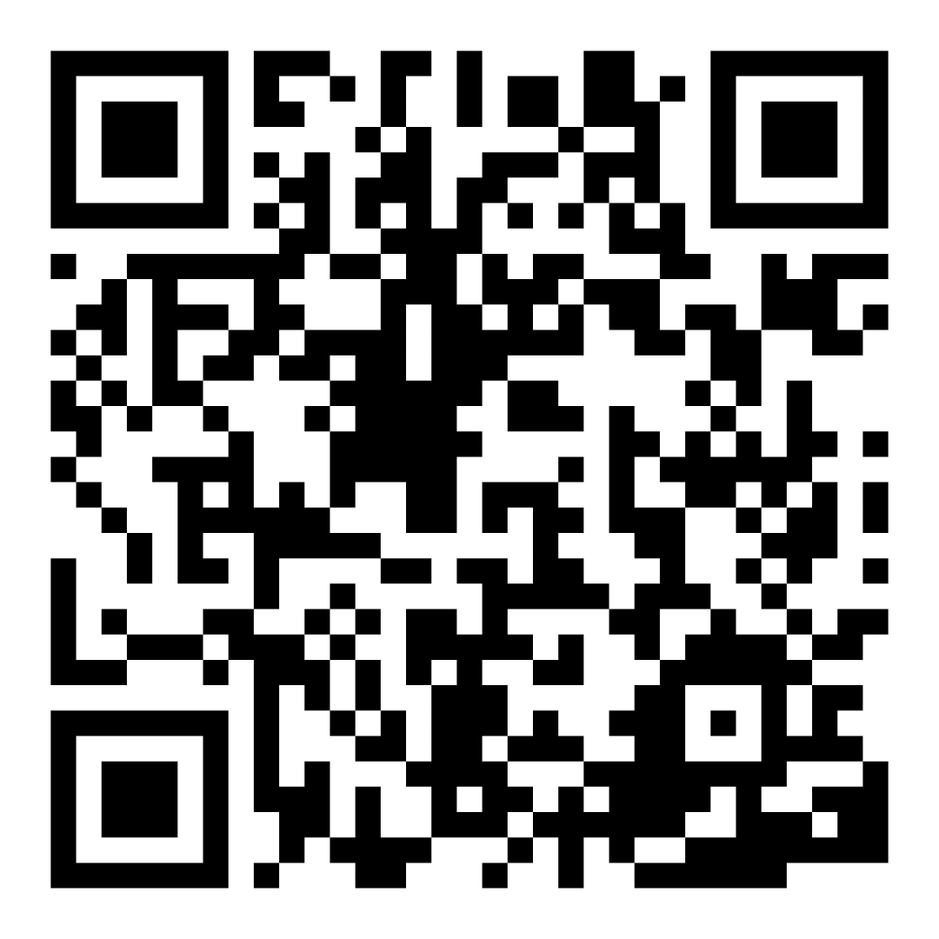
Encuesta de confianza familiar
Escaneen este código para compartir cómo se sienten acerca de la lectura con sus hijos. Los participantes serán inscritos en un sorteo para ganar una tarjeta de regalo de $15. Se elegirá un ganador por escuela después del primer y último taller.
bit.ly/3BUBxbx
Notes:
If this is not the first or last Family Workshop, please delete this slide from the slide deck.
If you are an LAUSD teacher or staff member, please delete this slide from ALL Family Workshop decks.
Families who fill out the survey will be asked to provide an email to be entered into the raffle.
One raffle winner will be selected by Springboard Collaborative’s Data & Evaluation team after the first and last workshop and sent a $15 e-gift card to the email they provided.
If you need print-out versions of the QR code survey in English or the other translated languages, you can find those here: https://drive.google.com/file/d/1zjxnM0C9aP4C9WJFbw2A8eFpjZ29wBWG/view?usp=sharing
If you want to send the survey directly to families, you can find the link to the survey here: bit.ly/3BUBxbx

Slide 5
Las normas de los talleres
Estar preparado.
Estar presente.
Ser cortés.
Haga preguntas.
Notes:
Briefly explain the guidelines or “the rules we all agree to follow so that we can all have an enjoyable and an effective workshop.”
If this is the first workshop, briefly explain each of the guidelines.
Alternatively, a family volunteer may read or summarize this slide if they’ve attended the previous workshop. ​
Consider putting these on chart paper and inviting the group to add to the list. If you do this, be sure to change this slide in subsequent workshops.​
Emphasize these guidelines are for everyone, including you, the facilitator, and pledge to be prepared, present, courteous, and ask questions.
Emphasize the last point and specifically invite families to ask lots of questions.

Slide 6
Pausa y observa los sonidos
1
2
3
Elige una palabra complicada.
Mira tu boca hacer cada sonido.
Junta la palabra.
La conexión de mente/cuerpo es importante para la lectura.
Notes:
Part 2: Reading tip
Introduce the 3 parts of the reading tip.
Sample script
Today’s tip is:
First we’ll talk about tricky words to choose. This is not a tip you do with every tricky word.
Then we’ll talk about how the mouth moves and feels differently with each sound.
Finally, you’ll remind your child to put it all together.
Why?
Slowing down and sounding out unfamiliar words is natural for readers. That's a good reading habit to develop and will help your child figure out harder and harder words. You can ask questions to help them remember to take time to think about how a word looks and “feels” in their mouth. That mind/body connection is important for beginning readers.
Sample script in Spanish
El consejo de hoy es:
Primero vamos a hablar sobre cuales palabras complicadas se debe de escoger. Este consejo no funciona con cualquier palabra complicada.
Luego vamos a hablar sobre cómo se mueve la boca y como se siente diferente con cada sonido.
Por ultimo, usted le va a recordar a su hijo que hay que juntar los sonidos de la palabra.
¿Por qué?
Ir despacio y decir cada sonido de una palabra poca conocida es natural para los lectores. Es un buen hábito de la lectura que su hijo debe de desarrollar. Le va a ayudar a su hijo cuando necesita descifrar palabras más y más difíciles. Usted puede hacerle preguntas para ayudarle a recordar que necesita tomar tiempo para pensar sobre cómo la palabra aparece y “se siente” en su boca. La conexión entre la mente y el cuerpo es importante para los lectores principiantes.

Slide 7
Verifique los términos de
alfabetización
Sonido de vocal larga
El sonido de la vocal larga se usa cuando dices el nombre de la vocal (a,e,i,o,u). Esto sucede la mayoría de las veces cuando la última letra de la palabra es una "e" como en las palabras lake, scene, kite, rode, cute, huge.
Los sonidos de las vocales cortas son diferentes para cada vocal (a,e,i,o,u) y son más rápidos o “cortados”. Esto sucede cuando la palabra termina en consonante como en cat, well, trip, cot, cut, pass, cuff
Sonido de vocal corta
Los patrones de vocales cortas y largas y sus ortografías avanzan de las reglas ortográficas de sonidos de letras simples a más complejas a medida que las palabras se hacen más largas (tienen más sílabas) y más complejas.
Notes:
To make sure everyone has a common understanding, define some literacy terms as needed.

Slide 8
Pausar cuando encuentre una palabra complicada
Consejos y trucos
Eligan una palabra:
que su hijo está leyendo usando los sonidos equivocados.
que su hijo va a ver de nuevo.
con varios sonidos que corresponden a las letras.
Adulto: Hum… aquí hay una palabra complicada.
La palabra= complex
Niño: C…oom…b...
Notes:
Use the slide page to model and explain why “complex” is a good word to try and coach through.
The child in this model is mixing up the sounds. They are saying the /ew/ (in “new”) instead of a short /o/ and the /b/ sounds for the /p/ sound.
Display a paragraph from the text the class is reading, and highlight 2 or 3 words you would choose to watch your mouth move.
The criteria you may share with families are:
It’s a word that your child is likely to see again.
If the children are older, stress the importance of academic vocabulary such as complex, summarize, and describe—words that we use in schools a lot.
If children are younger, you may want to talk about high frequency words or “sight words”.
It’s a longer word with lots of different sounds but is not too difficult because the sounds match the letters.
►Be sensitive to the fact that some multilingual families may not have the necessary schema to choose a word based on this criteria.
Take time to explicitly reassure them that this technique will work with any word.
If possible, reading with a translating tool (like Google Translate) or a dictionary handy will be helpful for them as the coach.
Remind them that if their child is struggling with many words on the page, the book may not be appropriate and they can choose another one.
Remind families that they don’t need to do this for every tricky word that their child encounters.
If the child if struggling with many words on the page, they may need to read a different book and come back to that one later.

Slide 9
Observar la boca mover con cada sonido
Vocales cortos
Vocales largos
Los sonidos que se confunden con más frecuencia
A E I O U
G/J
T/K
P/B
F/V
¿Cómo los sonidos se sienten y aparecen diferentes?
Notes:
Invite families to take out their phones and put their camera on selfie mode or distribute small mirrors.
Lead a short discussion (with practice) on the look and feel of both the short and long vowels and some of the commonly confused consonants.
Explain how it feels (see the “Main points” section below) and then invite families to practice the letters and describe what they see in the mirror.
If families are enjoying it, you may want to do more letters.
You may also want to revise this slide based on the needs of the students in your class. Older students may also talk about blends and digraphs.
Main points:
Short vowels sounds are made by passing air through a more relaxed mouth, while long vowels are made by passing air with a more constricted mouth. (This is especially easy to see in in “o” and “u.”)
G is made in the back of the throat (game), and J is made in the front of your mouth (jug)
T is made behind the teeth (tight), and K is made in back of the mouth (kite).
P is made with mainly air (pad), while B is made with a sound (bad). (Put your hand on your throat and you can feel it vibrate for B and not for P.)
F is made with mainly air through the lips (fat), and V is made with a similar mouth position but with a sound (vat). (Put your hand on your throat and you can feel it vibrate for V and not for F.)
►Especially for multilingual families. Instead of asking them to come up with the letter sound, clearly articulate it and say, “This is how we pronounce this letter in English. Does anyone want to explain how you pronounce this letter in another language?” Then, as a class, compare the different way the letter looks and feels in your mouth in different languages. Encourage families to do this exercise with their children. Being explicit about how languages are articulated differently helps children navigate the two languages more easily.

Slide 10
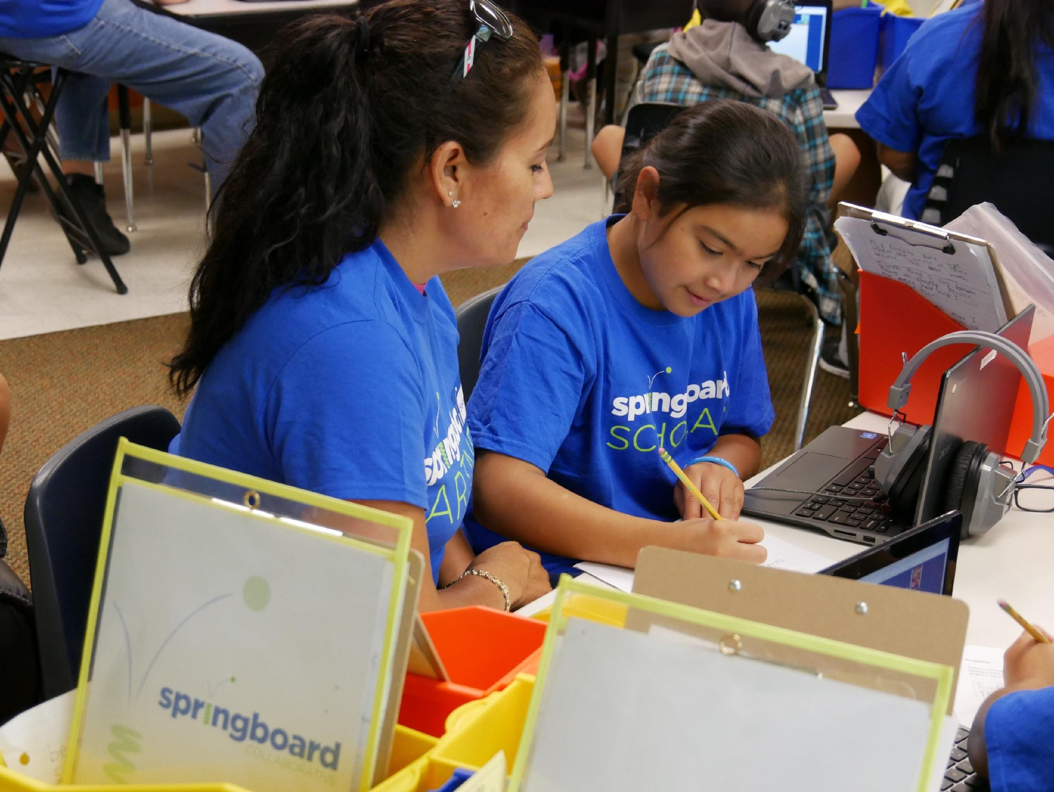
Práctica mirar tu boca
shop / ship
check / coat
volley / folly
peck / book
jig / gig
lean / let
¿Qué ves? Describe cómo se mueve la boca.
Notes:
Invite families to use the word list to practice watching their mouth move.
This may be done as a whole group, in small groups, or as pairs.
Debrief as a whole group or in small groups.
►Especially for multilingual families: Provide sentence stems to support multilingual families in participating in whole-group discussion.
Sample script:
I’m going to read “ship” and “shop” very slowly. What do you notice? How is my mouth moving differently? [Elicit response. ]
Notice how my mouth opens wider when I say the “o” in shop than when I say the “i” in ship. Now you try with your child. Read both words very slowly, sound-by-sound, and watch for how your mouth move differently.
[Wait for families to try.]
After your child has looked at the way their mouth moves for each sound in the tricky word, invite them to put it all together quickly. Say “ship” and “shop.”
[Wait for families to try.]
Now you’re going to do the rest of this list with your child and we’ll talk about what you and your child noticed in a few minutes.
[Debrief]
Sample script in Spanish:
Voy a leer “ship” (barco) y “shop” (tienda) muy lentamente. ¿Qué observa? ¿Como se mueve mi boca para cada palabra? [Elicit response]
Puede notar como mi boca se abre más cuando digo la “o” en “shop” comparado con cuando digo la “i” en “ship”. Ahora inténtelo con su hijo. Lea las dos palabras muy lentamente, sonido por sonido, y observe cómo se mueve la boca para cada palabra.
[Wait for families to try]
Después de que su hijo observe cómo se mueve su boca para cada sonido en una palabra complicada, debe de decir todos los sonidos juntos rápidamente. Diga “ship” y “shop”.
[Wait for families to try]
Ahora, va a hacer las palabras que quedan en la lista con su hijo y vamos a platicar sobre lo que usted y su hijo notan en algunos minutos.
[Debrief]

Slide 11
Juntar los sonidos
Consejos y trucos
Observa la boca mover más rápido mientras juntes los sonidos.
Lee la palabra varias veces. Cada vez, lee la palabra con más fluidez.
Adulto: Ahora junta el sonido.
La palabra= complex
Niño: Com…pl…ex
Notes:
Use the slide to model the last step—putting the sounds together in a word.

Slide 12
Leer = conversación (K-1)
¿Cómo se mueve tu boca cuando haces el sonido de esta letra?
Mira cómo se mueve tu boca cuando dices 'cat' y 'sat'.
¿Qué notas cuando dices las palabras ‘big’ y ‘rag’?
¿Cómo se mueve tu boca cuando haces el sonido de cada letra?
Notes:
Remind families that the at-home reading coach always asks questions!
► For multilingual families specifically: Some families may come from a culture where asking questions and “coaching” their child may be an unfamiliar practice. Instead, they may be more used to being directive and having the answers​.
Encourage families to keep trying this coaching technique and assure them that the more they do it, the more comfortable it will become. ​
Although “parent as expert” and “parent as coach” are equally valid positions, asking questions and encouraging children to find the answer out for themselves instead of telling them an answer can help children internalize the learning in a different way.
This is a good time to remind parents that even though asking questions may not at present be a regular practice for them, this is an opportunity for them to acquire and practice new skills that will help their children. Cultural shifts are usually most effective when they're explicit.​
Use this slide to ensure that families have some questions they can ask during practice time.
Ask families to hold up the number of questions they already have written down or are prepared to use. If it looks like the room is prepared, you may skip this slide or ask families to share other questions they have written down throughout the workshop.
Share with families that there are also sample questions on the Reading Tip Sheet.
Sample script
At Springboard, the most important thing we want you to leave with is: to ALWAYS ASK QUESTIONS. You want to ask your child questions to help them figure out words, understand what they’re reading, sound more like a storyteller, and enjoy what they are reading. Today we’ve learned questions to help your child make a mind/body connection with the letters and sounds they are reading.
Sample script in Spanish
En Springboard, lo más importante con lo que queremos que se vaya es: QUE SIEMPRE HAGA PREGUNTAS. Quiere hacerle preguntas a su hijo para ayudarlo a descifrar palabras, comprender lo que está leyendo, sonar más como un narrador y disfrutar lo que está leyendo. Hoy hemos aprendido preguntas para ayudar a su hijo a hacer una conexión mente/cuerpo con las letras y los sonidos que están leyendo.

Slide 13
Leer = conversación (2-3)
¿Cómo se mueve tu boca cuando dices cada sílaba de esta palabra?
¿Cómo estas dos palabras suenan igual o diferente?
Mira cómo se mueve la boca cuando dices cada sílaba de esta palabra. ¿Puedes poner todos los sonidos juntos?
Notes:
Remind families that the at-home reading coach always asks questions!
► For multilingual families specifically. Some families may come from a culture where asking questions and “coaching” their child may be an unfamiliar practice. Instead, they may be more used to being directive and having the answers​
Encourage families to keep trying this coaching technique and assure them that the more they do it, the more comfortable it will become. ​
Although “parent as expert” and “parent as coach” are equally valid positions, asking questions and encouraging children to find the answer out for themselves instead of telling them an answer can help children internalize the learning in a different way.
This is a good time to remind parents that even though asking questions may not at present be a regular practice for them, this is an opportunity for them to acquire and practice new skills that will help their children. Cultural shifts are usually most effective when they're explicit.​
Use this slide to ensure that families have some questions they can ask during practice time.
Ask families to hold up the number of questions they already have written down or are prepared to use. If it looks like the room is prepared, you may skip this slide and/or ask families to share other questions they have written down throughout the workshop.
There are also sample questions on the Reading Tip Sheet.
Sample script
At Springboard, the most important thing we want you to leave with is: to ALWAYS ASK QUESTIONS. You want to ask your child questions to help them figure out words, understand what they’re reading, sound more like a storyteller, and enjoy what they are reading. Today we’ve learned questions to help your child make a mind/body connection with the letters and sounds they are reading.
Sample script in Spanish
En Springboard, lo más importante con lo que queremos que se vaya es: QUE SIEMPRE HAGA PREGUNTAS. Quiere hacerle preguntas a su hijo para ayudarlo a descifrar palabras, comprender lo que está leyendo, sonar más como un narrador y disfrutar lo que está leyendo. Hoy hemos aprendido preguntas para ayudar a su hijo a hacer una conexión mente/cuerpo con las letras y los sonidos que están leyendo.

Slide 14
Familias Multilingües
Usar una guía de pronunciación o de sonidos vocálicos
Separar palabras para ayudar a decodificar palabras desconocidas
Comparar y hacer conexiones entre su lengua materna e inglés
Notes:
Use this slide if families’ primary language is not English or they may have specific questions. Alternatively, if you have talked about accommodations throughout the reading tip explanation you may skip this slide or use it to briefly sum up.
Explain the tips on the slide. If you need more detail, see “Ideas to differentiate” in the Workshop Guide.

Slide 15
Tiempo de práctica
1
¡Llamenme cuando tengan una pregunta!
Elige una palabra complicada.
2
Mira tu boca hacer cada sonido.
3
Junta la palabra.
Notes:
Part 3: Practice time
Note: Practice time should be most of the remaining time. Leave 10 minutes or so at the end for reflection.
Summarize the tip, and remind families to repeat these steps during practice time.
Take a moment to explain that you’ll be circulating around while they practice (to provide 1:1 support and answer any questions).
►Multilingual parents in particular often come with feelings of self-consciousness that can be overcome when they know why they're being observed.
Remind families to ask questions as they use the tip.
There are also sample questions on the Reading Tip Sheet.
To support families, consider underlining two high leverage questions on the Reading Tip Sheet as you circulate.
Remind families they can always work on their action plan or other strategies during practice time, especially if they have questions or want some help with it.
Circulate and work with families. Here are some suggestions:
Walk over to a family. Ask, “Do you have any questions about the reading tip?”
If yes, answer question.
If no, say, “May I listen in for a moment?
Listen for a full minute.
Compliment the family on something they did well and then leave them with one suggestion (if needed)
Walk over to a family and ask, “Can I try this reading tip with your child?”
After you’ve modelled it, ask the adult, “What did you notice me doing?” or say “Did you notice that I…”
Gather “glows”(things that families did that you want to lift up to the group) and “grows” (things families do that you want to stop and correct/clarify for the whole group).
Share the “glows” and “grows” at 10 mins into practice time or wait until the end.
Keeps “grows” anonymous, but congratulate specific families on “glows.”

Slide 16
Reflejar
¿Alguna pregunta sobre el consejo de lectura?
Voltéese y hable con su hijo: ¿Nos sentimos listos para probar este consejo de lectura en casa?
Por favor, comparte cómo podrían usar esto en casa.
¡Su pregunta ayudará a alguien más en este espacio!
Notes:
Part 4: Reflection & updates
Invite participants to ask questions.
Give ample wait time for each question. ​
Remind families that when parents talk they make it safe for more hesitant parents to share. It builds community in the classroom. ​
Encourage other voices to share.
In addition, you could share some “glows” and “grows” you noticed while walking around and supporting families during practice time.
Check in on the goal of Family Workshops.​
Read “Any questions…”? and wait. Let this question hang and give ample wait time.​
Invite families who don’t yet feel equipped to do the reading tip on their own to raise their hand (or indicate in a more private way) so you can check in with them personally before they leave the workshop.
Invite a family volunteer to share how they will use the reading tip at home.
If time permits, you may do a whip-around share.
Invite families to each share one thing (in 30 seconds or less). This could be:
Something they learned
One thing they’re excited to try at home
One thing they found challenging about this tip
One step they will focus on this week.

Slide 17
Comentarios, por favor
¡Su aporte y comentarios mejora nuestro tiempo juntos!
Notes:
Invite families to make a reading plan for the upcoming week.
Remind families that readers need “reading together” time and “reading alone” time.
Remind families that reading in workshops counts as “reading together time” and they should log it (if applicable).
Invite families to give you feedback so that you can facilitate a workshop that works for them!
Families can use the printed feedback form (if available) or a digital feedback form.
Invite families to give you more informal feedback. This could look like a thumbs up if they liked the reading tip or writing one thing they hope for the next workshop.
Use this time to meet individually with families as needed.
Sample script
And finally, I want to make sure I’m hosting a Family Workshop that works for you. Every workshop, you’ll have a chance to give me feedback, and I promise you that I will read it and do my best to incorporate it. Will you fill out the survey before you leave? If you’d rather talk about your suggestions, instead of writing them down, let me know. Thanks and see you at the next workshop!
Sample script in Spanish
Para cerrar, quiero asegurar que estoy dando un taller de familia que les sirve a ustedes. En cada taller, tendrán la oportunidad de proveer comentarios. Yo les prometo que los voy a leer y voy a hacer mi mejor esfuerzo para incorporar los consejos en el próximo taller. ¿Pueden contestar el sondeo antes de irse? Si prefieren platicar sobre sus ideas, en vez de escribirlas, avísenme. ¡Gracias y nos veremos en el próximo taller!

