Slide 1
Workshop guide
Facilitator:
Read notes to prepare. Amend slides if needed.
Practice the script aloud. Change as needed.
Ready the family-facing materials.
Display slide 2 as families arrive.
I Spy a Word
Notes:
Copyright 2022 Springboard Collaborative, all rights reserved.
Overview and rationale
This is a figure out the word workshop. In this workshop, adults learn questions to review words from the text. They give their child hints and then switch roles. This strategy helps readers build their vocabulary.
Objective
By the end of the workshop, families will be able to help their children read and understand words by asking questions while playing "I Spy a Word."
Materials
Corresponding Reading Tip Sheet (in the languages the families need)
Family Workshop Feedback Form (paper or digital form)
Books for families to use during the reading tip explanation and practice time. This strategy works with both fiction and nonfiction texts.
Projector to display slides
Empty envelope for families to put feedback form in (optional but highly recommended)
Name tags (optional but highly recommended)
Facilitation notes
To prepare
In this workshop, you will model how to play the game “I spy” with a word.
Be sure to familiarize yourself with the content of the presentation so you can talk with families, not at them.
Study the slides in the reading tip section. Think through how you will model and guide practice for choosing a word to play with and giving hints.
Identify the letter/letter combinations/sound patterns the children are working on in your classroom. Write these down for families and model giving hints using them.
During workshop
Take time to build rapport as a group and individually with families. Little things, like learning family members’ names and greeting them at the door, go a long way.
Keep pace so that families have time to practice the tip and also reflect. Being able to practice and reflect helps families internalize the strategy.
Circulate and check-in with families individually during practice time. See “Practice time” slide for more specific suggestions.
Ideas to differentiate
Preview the examples on the slides and change to match the needs of the children in your classroom.
Preview “Check in on literacy terms” and adjust terms or definitions, as needed.
If teaching this workshop to families with younger readers:
Choose the appropriate “Reading = conversation” slide.
For younger children, encourage families to give more sound and letter hints, to underline words in the text or write them down on a piece of paper so their child doesn’t have to skim the page to find the words. They should limit the words they discuss.
If teaching this workshop to families with older readers:
Choose the appropriate “Reading = conversation” slide.
For older children, encourage families to give more meaning hints (versus sound or letter hints), to challenge themselves to choose words that are central to the meaning of the story, and to discuss up to 10 words.
If teaching this workshop to Multilingual families:
This is a difficult workshop for families new to the English language and is more appropriate for families with some familiarity with the language. To support families consider the following ideas:​
Encourage families to keep track of words they’d like to review at the end by writing them down or underlining them in the text. Then encourage adults to model looking up the meaning and pronunciation of the words (if needed) before they or their child begin giving hints. They may want to go an additional step and try to use the words in their own sentence.
Remind families that a dictionary, app, or website (like www.wordreference.com) can help them. They include pronunciation features.
Choosing words to practice on may be daunting for adults new to the English language. Consider photocopying a text and highlighting words with which families can practice the strategy. Then provide a translation of some of the words.​
Encourage families to start a family dictionary of words or phrases they are learning more about.
If families are familiar with this workshop, consider how you might leverage their experience. Ask families to share how they helped their child internalize the steps. Invite them (ahead of time) to model one or more steps if appropriate.
Timing considerations for a 60 min workshop
Welcome: 10 mins
Reading tip: 15-20 mins
Practice: 15-20 mins
Reflection and updates: 10 mins
After you use these materials, we want to hear your feedback! Fill out the Family Workshop Facilitator Feedback form at https://bit.ly/SBCfeedbackform.

Slide 2
I Spy a Word
Notes:
Part 1: Welcome
Formally welcome families, and tell them the title of today’s workshop. Do not go into specific steps of the reading tip at this point.
Ensure families have the materials they need and are sitting with their children.

Slide 3
Agenda
Welcome
Reading tip
Practice time
Reflection & updates
Notes:
Provide an overview of what families will be doing today (and at every Family Workshop).
If this is the first Family Workshop in a series, explain that the icons for each of the four parts of the Family Workshop also run along the bottom of slides. ​
If this is not the first workshop, move quickly through this slide.
Sample script
Here is our plan for today. You can see each part of our agenda has an icon [point to the icons]. You can also find each icon along the bottom of each slide [point to bottom] so you can see where we are in the agenda. First, we’ll review a couple of things, then we’ll get right to the reading tip. Most of our time will be spent on practice time so we can all try out the reading tip. Then we’ll reflect and talk about some updates.
Please speak up with questions, concerns, or anything you’d like to share. We’re here together for one hour and need to maximize the time. Every child learns to read in a different way, but putting our heads together helps our shared cause: to give kids a reading boost and cultivate a the joy of reading.
Sample script in Spanish
Aquí tenemos el plan para hoy. Se puede ver que cada parte de la agenda tiene un ícono [point to the icons]. También se encuentran en el final de cada diapositiva [point to bottom] para que puedan saber en qué parte estamos. Primero, vamos a repasar algunas cosas. Luego vamos a empezar con el consejo de la lectura. La mayoría del tiempo vamos a pasar aquí, en la práctica, para probar el consejo de la lectura juntos. Luego, vamos a reflexionar y hablar sobre algunas novedades.
En cualquier momento, pueden hacer preguntas, compartir preocupaciones, o cualquier otra cosa que quieren compartir. Vamos a estar juntos por una hora y queremos aprovechar del tiempo que tenemos. Cada niño aprende a leer de una manera diferente. Estamos aquí para trabajar en la misma causa: ayudarles a los niños a mejorar en la lectura y llegar a disfrutarla.

Slide 4
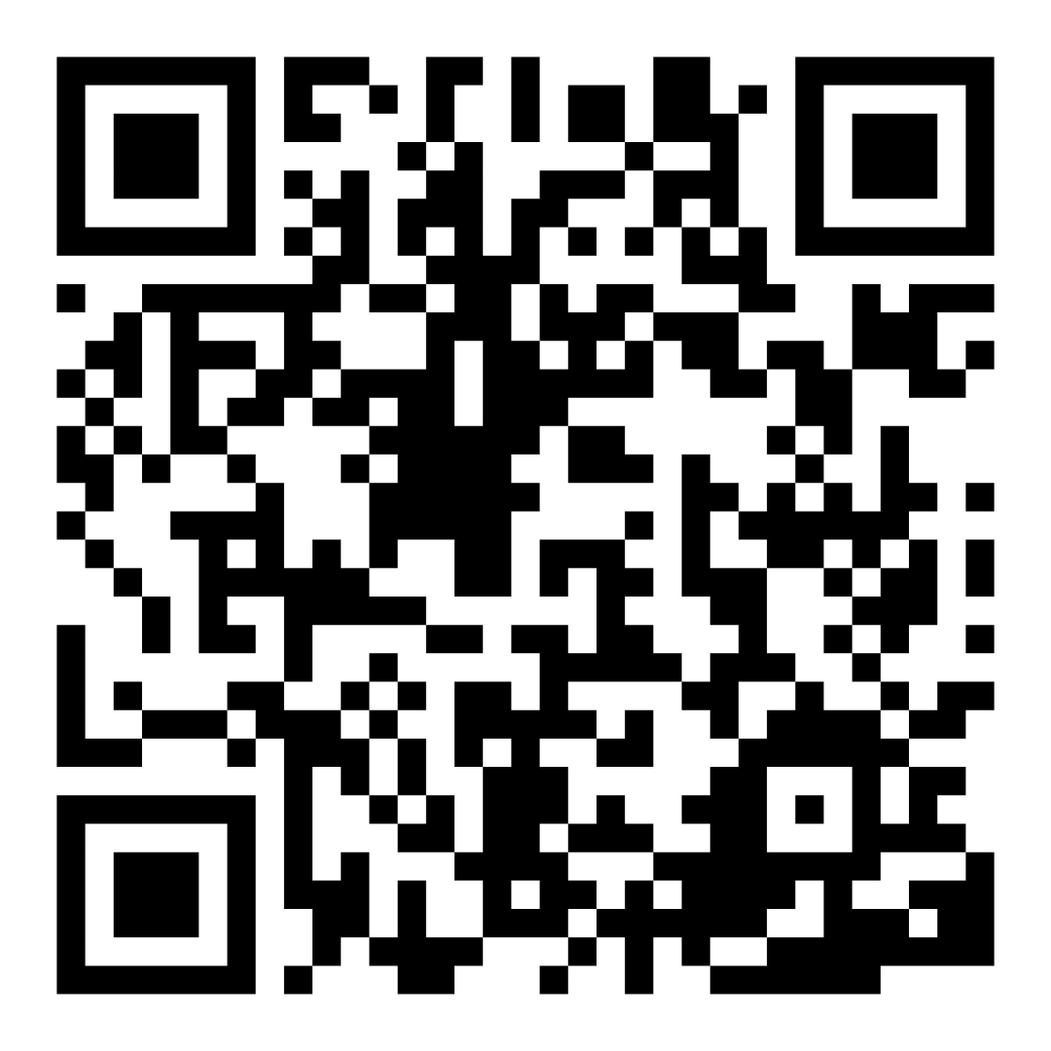
Family Confidence Survey
Scan this code to share how you’re feeling about reading with your child. Participants will be entered into a raffle for a $15 gift card. One winner per school will be drawn after the first and last workshops.
bit.ly/3BUBxbx
Notes:
If this is not the first or last Family Workshop, please delete this slide from the slide deck.
If you are an LAUSD teacher or staff member, please delete this slide from ALL Family Workshop decks.
Families who fill out the survey will be asked to provide an email to be entered into the raffle.
One raffle winner will be selected by Springboard Collaborative’s Data & Evaluation team after the first and last workshop and sent a $15 e-gift card to the email they provided.
If you need print-out versions of the QR code survey in English or the other translated languages, you can find those here: https://drive.google.com/file/d/1zjxnM0C9aP4C9WJFbw2A8eFpjZ29wBWG/view?usp=sharing
If you want to send the survey directly to families, you can find the link to the survey here: bit.ly/3BUBxbx

Slide 5
Workshop guidelines
Be prepared.
Be present.
Be courteous.
Ask questions.
Notes:
Briefly explain the guidelines or “the rules we all agree to follow so that we can all have an enjoyable and an effective workshop.”
If this is the first workshop, briefly explain each of the guidelines.
Alternatively, a family volunteer may read or summarize this slide if they’ve attended the previous workshop. ​
Consider putting these on chart paper and inviting the group to add to the list. If you do this, be sure to change this slide in subsequent workshops.​
Emphasize these guidelines are for everyone (including you, the facilitator) and pledge to be prepared, present, courteous, and ask questions.
Emphasize the last point and specifically invite families to ask lots of questions.

Slide 6
I spy a word that…
1
2
3
4
Pick a word and give hints.
Invite child to point and read it.
Switch.
Talking about words will build your child’s mental dictionary.
Repeat.
Notes:
Part 2: Reading tip
Introduce the 3 parts of the reading tip.
Sample script:
Today we will practice talking about words and building your child’s vocabulary after we’re done reading.
We will practice this by breaking it down into 4 steps:
First we’ll talk about how to choose a word and how to give hints for a word.
Then we’ll talk about what your child should do when they are trying out the word—point to it and read it.
Then we’ll switch roles. The child will give the adult a hint and the adult will try out the word.
And we’ll talk about how many words you could do this with.
Why? In order to grow as a reader, a child must be able to read and understand many words or expand their vocabulary. Talking about words is a great way to build your child’s vocabulary or the number of words they know and can use.
Sample script in Spanish:
Hoy vamos a practicar el acto de hablar sobre palabras y aumentar el vocabulario de su hijo después de terminar de leer.
Vamos a practicarlo en 4 pasos:
Vamos a hablar de cómo se puede elegir una palabra y luego dar pistas sobre la palabra.
Luego vamos a hablar sobre lo que su hijo debe de hacer mientras está adivinando la palabra - señalarla y leerla.
Luego vamos a trocar los papeles. El niño le va a dar una pista al adulto y el adulto va a adivinar la palabra.
Al final, hablaremos sobre la cantidad de palabras que se pueden usar así.
¿Por qué? Para crecer como un lector, un niño tiene que poder leer y entender muchas palabras o aumentar su vocabulario. Hablar sobre palabras es una muy buena manera de aumentar el vocabulario de su hijo o el número de palabras que conoce y puede usar.

Slide 7
Check in on literacy terms
Vocabulary
all the words your child knows
Sounds in a word
The sounds we hear when a word is read aloud. For example, the long “a” sound is found in words with the letter “a” but also with the letter combination “eigh”.
Notes:
To make sure everyone has a common understanding, define some literacy terms as needed.

Slide 8
Pick a word
and give hints
Tips and tricks
While you read, underline words that you want to review.
Use meaning hints and letter/sound hints.
I spy a word that means “confused.”
Can you find it?
I spy a word that has the /z/ sound in the middle. Can you find it?
I spy a word in this sentence that ends in “–ed.” Can you find it?
puzzled
fancy
Notes:
Explain and list some criteria for choosing words
My child struggled with the word when we read
I don’t think my child knows the definition
We talked about the word when we read it
The word is very important to the meaning of the text
The word is a word that I know my child is run into again
Explain some troubleshooting techniques
Write down the words as you read so that you can remember them
Or underline words in the text as you go along
Use bolded words (in non-fiction texts)
Model how to give hints for a word using the slide.
Consider inviting a family volunteer to name some hints for the second word
Consider writing some words on a whiteboard and model two or three more times.
►For Multilingual families more specifically: Remind families they don’t have to be the word expert but they can be the “looking up words” model for their children.
If possible, reading with a translating app or dictionary handy will be helpful for them as the coach.​
Also, collecting words into a family dictionary is a great way to revisit words they want to remember.
Sample script
Today’s tip is kinda like a game. You’re going to choose a word and then give your child hints so they can find it on the page.
Let’s pretend I want to go back to the word “puzzled.” When you give hints you want to give “meaning” hints like “I’m thinking of a word that means “confused.” Can you find it?” and also “letter/sound” hints like the other two examples here. Can someone read them for me?
So how do you decide what words to go back to in a text? [Elicit response and lead discussion].
Depending on the length of the text, it might be hard to find the words you want to talk about. One hint is to mark the words in the text or write them down as the child is reading. That way you can easily find them again.
Sample script in Spanish
El consejo de hoy es como un juego. Va a escoger una palabra y luego le va a dar pistas a su hijo para que la encuentre en la página.
Vamos a fingir que yo quiero regresar a la palabra “puzzled.” Las pistas se deben de tratar del significado como “Estoy pensando en una palabra que significa “confundida.” ¿La puedes encontrar?” - también se pueden tratar de pistas sobre las letras/los sonidos, como los otros ejemplos aquí. ¿Alguien quisiera leerlos para mi?
¿Entonces cómo se decide a cuáles palabras se debe de regresar a visitar en un texto? [Elicit response and lead discussion].
Cuando un texto es muy largo, encontrar las palabras de que quieres hablar puede ser difícil. Una pista es marcar las palabras en el texto o escribirlas en un papel mientras el niño está leyendo. De esa manera, las puede encontrar nuevamente fácilmente.

Slide 9
Pick a word
and give hints
agree
sure
fresh
proof
I spy a word that
starts with…
has the sound…
is spelled with…
means…
is related to the word…
has letters that don’t match the sounds...
“Can you find it?”
Notes:
Invite adults to practice giving hints to their child with the words on the slide
►For Multilingual families more specifically:
Be sensitive to the fact that some Multilingual may not know the definition of these words. If you believe it helpful, quickly go over their pronunciation and definition. Encourage them to repeat this practice with their children.
If possible, reading with a translating app or dictionary handy will be helpful for them as the coach.​
Also, collecting words into a family dictionary is a great way to revisit words they want to remember.
Invite adults to share out the hints they gave whole class, in small groups, with a partner.
Discuss the last hint “where the letters don’t match the sounds” and high frequency or phonetically irregular words.

Slide 10
Invite child to point and read
Tips and tricks
If your child struggled to read it, have them read the word sound by sound.
Child: Here it is. /p/-/u/-/z/-/l/-/d/. Puzzled.
Adult: I’m thinking of a word that means “confused.” Can you find it?
Notes:
Explain the last step: pointing and reading the words aloud. This reinforces the word for the child.

Slide 11
Switch
Tips and tricks
Be sure to model good reading habits.
Child: I’m thinking of a word with the /l/ and /k/ sound. Can you guess it?
Adult: Here it is:
/b/-/l/-/o/-/k/-/t/.
Blocked.
Notes:
Explain that families should switch roles.
Use the slide to quickly model and note that the adult says all the sounds in the word. It’s good to model the behavior we want from our children.

Slide 12
Child: Pick a word
and give hints
boat
fun
law
said
Hints:
It has the sound…
It means…
It’s related to the word…
“Can you find it?”
Notes:
Invite families to switch roles.
If needed, quickly go over the words and basic definition.
Read aloud the sentence stems.
Invite children to practice giving hints to their adult.
Invite children to share out the hints they gave whole class, in small groups, with a partner.
Discuss with families how many words they should review when they are done reading (this depends on age and reading ability of their child.)

Slide 13
Reading = conversation (K-1)
I see a word that starts with ___. Can you find it?
I’m thinking of a word that means ___.
I’m thinking of a word that has a ___ ending.
Let’s point and read the word again!
Notes:
Remind families that the at-home reading coach always asks questions!
► For Multilingual families specifically. Some families may come from a culture where asking questions and “coaching” their child may be an unfamiliar practice. Instead, they may be more used to being directive and having the answers​
Encourage families to keep trying this coaching technique and assure them that the more they do it, the more comfortable it will become. ​
Although “parent as expert” and “parent as coach” are equally valid positions, asking questions and encouraging children to find the answer out for themselves instead of telling them an answer can help children internalize the learning in a different way.
This is a good time to remind parents that even though asking questions may not at present be a regular practice for them, this is an opportunity for them to acquire and practice new skills that will help their children. Cultural shifts are usually most effective when they're explicit.​
Use this slide to ensure that families have some questions they can ask during practice time.
Ask families to hold up the number of questions they already have written down or are prepared to use. If it looks like the room is prepared, you may skip this slide and/or ask families to share other questions they have written down throughout the workshop.
There are also sample questions on the Reading Tip Sheet.
Sample script
At Springboard, the most important thing we want you to leave with is: to ALWAYS ASK QUESTIONS. You want to ask your child questions to help them figure out words, understand what they’re reading, sound more like a storyteller, and enjoy what they are reading. Today we’ve learned questions to help your child figure out the word.
Sample script in Spanish
En Springboard, lo más importante con lo que queremos que se vaya es: QUE SIEMPRE HAGA PREGUNTAS. Quiere hacerle preguntas a su hijo para ayudarlo a descifrar palabras, comprender lo que está leyendo, sonar más como un narrador y disfrutar lo que está leyendo. Hoy hemos aprendido preguntas para ayudar a su hijo a descifrar la palabra.

Slide 14
Reading = conversation (2-3)
I’m thinking of a word related to ___. Can you find it?
I’m thinking of a word with a syllable that sounds like ___.
I’m thinking of a word that is spelled with ___. Can you find it? Let’s read it again!
Notes:
Remind families that the at-home reading coach always asks questions!
► For Multilingual families specifically. Some families may come from a culture where asking questions and “coaching” their child may be an unfamiliar practice. Instead, they may be more used to being directive and having the answers​
Encourage families to keep trying this coaching technique and assure them that the more they do it, the more comfortable it will become. ​
Although “parent as expert” and “parent as coach” are equally valid positions, asking questions and encouraging children to find the answer out for themselves instead of telling them an answer can help children internalize the learning in a different way.
This is a good time to remind parents that even though asking questions may not at present be a regular practice for them, this is an opportunity for them to acquire and practice new skills that will help their children. Cultural shifts are usually most effective when they're explicit.​
Use this slide to ensure that families have some questions they can ask during practice time.
Ask families to hold up the number of questions they already have written down or are prepared to use. If it looks like the room is prepared, you may skip this slide and/or ask families to share other questions they have written down throughout the workshop.
There are also sample questions on the Reading Tip Sheet.
Sample script
At Springboard, the most important thing we want you to leave with is: to ALWAYS ASK QUESTIONS. You want to ask your child questions to help them figure out words, understand what they’re reading, sound more like a storyteller, and enjoy what they are reading. Today we’ve learned questions to help your child figure out the word.
Sample script in Spanish
En Springboard, lo más importante con lo que queremos que se vaya es: QUE SIEMPRE HAGA PREGUNTAS. Quiere hacerle preguntas a su hijo para ayudarlo a descifrar palabras, comprender lo que está leyendo, sonar más como un narrador y disfrutar lo que está leyendo. Hoy hemos aprendido preguntas para ayudar a su hijo a descifrar la palabra.

Slide 15
Multilingual families
Use a dictionary, app, or website to check the words.
Keep track of words to review and create a family dictionary of new words and phrases.
Notes:
Use this slide if families’ primary language is not English or they may have specific questions. Alternatively, if you have talked about accommodations throughout the reading tip explanation you may skip this slide or use it to briefly sum up.
Explain the tips on the slide. If you need more detail, see “Ideas to differentiate” in the Workshop Guide.

Slide 16
Practice time
1
Pick a word and give hints.
Call me over when you have a question!
2
Invite child to point and read it.
3
Switch.
4
Repeat.
Notes:
Part 3: Practice time
Note: Practice time should be most of the remaining time. Leave 10 minutes or so at the end for reflection.
Summarize the tip, and remind families to repeat these steps during practice time.
Take a moment to explain that you’ll be circulating around while they practice (to provide 1:1 support and answer any questions).
►Multilingual parents in particular often come with feelings of self-consciousness that can be overcome when they know why they're being observed.
Remind families to ask questions as they use the tip.
There are also sample questions on the Reading Tip Sheet.
To support families, consider underlining two high leverage questions on the Reading Tip Sheet as you circulate.
Remind families they can always work on their action plan or other strategies during practice time, especially if they have questions or want some help with it.
Circulate and work with families. Here are some suggestions:
Walk over to a family. Ask, “Do you have any questions about the reading tip?”
If yes, answer question.
If no, say, “May I listen in for a moment?
Listen for a full minute.
Compliment the family on something they did well and then leave them with one suggestion (if needed)
Walk over to a family and ask, “Can I try this reading tip with your child?”
After you’ve modelled it, ask the adult, “What did you notice me doing?” or say “Did you notice that I…”
Gather “glows” (things that families did that you want to lift up to the group) and “grows” (things families do that you want to stop and correct/clarify for the whole group).
Share the “glows” and “grows” at 10 mins into practice time or wait until the end.
Keeps “grows” anonymous, but congratulate specific families on “glows.”

Slide 17
Reflect
Any questions about the reading tip?
Turn and talk with your child: Do we feel ready to try this reading tip at home?
Please share how you might use this at home.
Your question will help someone else in the room!
Notes:
Part 4: Reflection & updates
Invite participants to ask questions.
Give ample wait time for each question. ​
Remind families that when parents talk they make it safe for more hesitant parents to share. It builds community in the classroom. ​
Encourage other voices to share.
In addition, you could share some “glows” and “grows” you noticed while walking around and supporting families during practice time.
Check in on the goal of Family Workshops.​
Read “Any questions…”? and wait. Let this question hang and give ample wait time.​
Invite families who don’t yet feel equipped to do the reading tip on their own to raise their hand (or indicate in a more private way) so you can check in with them personally before they leave the workshop.
Invite a family volunteer to share how they will use the reading tip at home.
If time permits, you may do a whip-around share.
Invite families to each share one thing (in 30 seconds or less). This could be:
Something they learned
One thing they’re excited to try at home
One thing they found challenging about this tip
One step they will focus on this week

Slide 18
Feedback, please
Your input improves our time together!
Notes:
Invite families to make a reading plan for the upcoming week.
Remind families that readers need “reading together” time and “reading alone” time.
Remind families that reading in workshops counts as “reading together time” and they should log it (if applicable).
Invite families to give you feedback so that you can facilitate a workshop that works for them!
Families can use the printed feedback form (if available) or a digital feedback form.
Invite families to give you more informal feedback. This could look like a thumbs up if they liked the reading tip or writing one thing they hope for the next workshop.
Use this time to meet individually with families as needed.
Sample script
And finally, I want to make sure I’m hosting a Family Workshop that works for you. Every workshop, you’ll have a chance to give me feedback, and I promise you that I will read it and do my best to incorporate it. Will you fill out the survey before you leave? If you’d rather talk about your suggestions instead of writing them down let me know. Thanks, and see you at the next workshop!
Sample script in Spanish
Para cerrar, quiero asegurar que estoy dando un taller de familia que les sirve a ustedes. En cada taller, tendrán la oportunidad de proveer comentarios. Yo les prometo que los voy a leer y voy a hacer mi mejor esfuerzo para incorporar los consejos en el próximo taller. ¿Pueden contestar el sondeo antes de irse? Si prefieren platicar sobre sus ideas, en vez de escribirlas, avísenme. ¡Gracias y nos veremos en el próximo taller!

