Slide 1
Workshop guide
Facilitator:
Read notes to prepare. Amend slides if needed.
Practice the script aloud. Change as needed.
Ready the family-facing materials.
Display slide 2 as families arrive.
Go on a Word Hunt
Notes:
Copyright 2022 Springboard Collaborative, all rights reserved.
Overview and rationale
This is a figure out the word workshop. In this workshop, adults learn a strategy they can use to increase the working vocabulary of their child. While they read, they prompt their child to go word hunting for new or unfamiliar words. This strategy is useful because vocabulary development and reading proficiency have a reciprocal relationship. The more words students know, the more words they can recognize when they’re reading, leading to higher reading comprehension. The more they read, the more children are exposed to new words, leading to a larger vocabulary.
Materials
Corresponding Reading Tip Sheet (in the languages the families need)
Family Workshop Feedback Form (paper or digital form)
Books for families to use during the reading tip explanation and practice time. This strategy works with both fiction and nonfiction texts.
A paragraph of a text to use during guided practice
Chart paper or a whiteboard to write down a list of words, generated by the group
Projector to display slides
Empty envelope for families to put feedback form in (optional but highly recommended)
Name tags (optional but highly recommended)
Facilitation notes
To prepare
In this workshop, you will model go on a word hunt.
Study the slides in the reading tip section. Think through how you will model and guide practice for choosing words and talking about them.
Be sure to familiarize yourself with the content of the presentation so you can talk with families, not at them.
During workshop
Take time to build rapport as a group and individually with families. Little things, like learning family members’ names and greeting them at the door, go a long way.
Keep pace so that families have time to practice the tip and also reflect. Being able to practice and reflect helps families internalize the strategy.
Circulate and check-in with families individually during practice time. See “Practice time” slide for more specific suggestions.
Ideas to differentiate
Be sure the paragraph you use to model matches the reading abilities of the children in the workshop. Consider modeling with one or two pages from books with differing difficulty.
Preview “Check in on literacy terms” and adjust terms or definitions, as needed.
If teaching this workshop to families with younger readers:
Choose the appropriate “Reading = conversation” slide.
Younger children may enjoy props such as a net or bag for “catching” the words they are hunting.
Younger children may also right down words with new spelling or letter patterns instead of just unknown definitions. Share a list of the letters or letter combinations you’re working on in class.
If teaching this workshop to families with older readers:
Choose the appropriate “Reading = conversation” slide.
Older kids may enjoy making a personal dictionary they can review from time to time.
Encourage children to use affixes, context clues, and/or other strategies to determine the meaning of unfamiliar words.
If teaching this workshop to Multilingual families:
This workshop provides a strategy that will not only help children who are newer to the English language but also their adult family members.
Remind families that a dictionary or online tool (like www.wordreference.com) can help them check to make sure their child is getting the words. They can use the features to hear how the words are pronounced in English.
Invite families to create their own family dictionary. Explain that when an adult models curiosity about a new language, it also helps the child. If helpful, families may want to expand their dictionary to include common grammatical patterns (adjective _noun), or common phrases or idioms.
Provide sentences stems to support families as they participate in whole group discussion. (We chose the word _______ because ______).
If families are familiar with this workshop, consider how you might leverage their experience. Ask families to share how they helped their child internalize the steps. Invite them (ahead of time) to model one or more steps if appropriate.
Timing considerations for a 60 min workshop
Welcome: 10 mins
Reading tip: 15-20 mins
Practice: 15-20 mins
Reflection and updates: 10 mins
After you use these materials, we want to hear your feedback! Fill out the Family Workshop Facilitator Feedback Form at https://bit.ly/SBCfeedbackform.

Slide 2
Go on a Word Hunt
Notes:
Part 1: Welcome
Formally welcome families, and tell them the title of today’s workshop. Do not go into specific steps of the reading tip at this point.
Ensure families have the materials they need and are sitting with their children.

Slide 3
Agenda
Welcome
Reading tip
Practice time
Reflection & updates
Notes:
Provide an overview of what families will be doing today (and at every Family Workshop).
If this is the first Family Workshop in a series, explain that the icons for each of the four parts of the Family Workshop also run along the bottom of slides. ​
If this is not the first workshop, move quickly through this slide.
Sample script
Here is our plan for today. You can see each part of our agenda has an icon [point to the icons]. You can also find each icon along the bottom of each slide [point to bottom] so you can see where we are in the agenda. First, we’ll review a couple of things, then we’ll get right to the reading tip. Most of our time will be spent on practice time so we can all try out the reading tip. Then we’ll reflect and talk about some updates.
Please speak up with questions, concerns, or anything you’d like to share. We’re here together for one hour and need to maximize the time. Every child learns to read in a different way, but putting our heads together helps our shared cause: to give kids a reading boost and cultivate a the joy of reading.
Sample script in Spanish
Aquí tenemos el plan para hoy. Se puede ver que cada parte de la agenda tiene un ícono [point to the icons]. También se encuentran en el final de cada diapositiva [point to bottom] para que puedan saber en qué parte estamos. Primero, vamos a repasar algunas cosas. Luego vamos a empezar con el consejo de la lectura. La mayoría del tiempo vamos a pasar aquí, en la práctica, para probar el consejo de la lectura juntos. Luego, vamos a reflexionar y hablar sobre algunas novedades.
En cualquier momento, pueden hacer preguntas, compartir preocupaciones, o cualquier otra cosa que quieren compartir. Vamos a estar juntos por una hora y queremos aprovechar del tiempo que tenemos. Cada niño aprende a leer de una manera diferente. Estamos aquí para trabajar en la misma causa: ayudarles a los niños a mejorar en la lectura y llegar a disfrutarla.

Slide 4
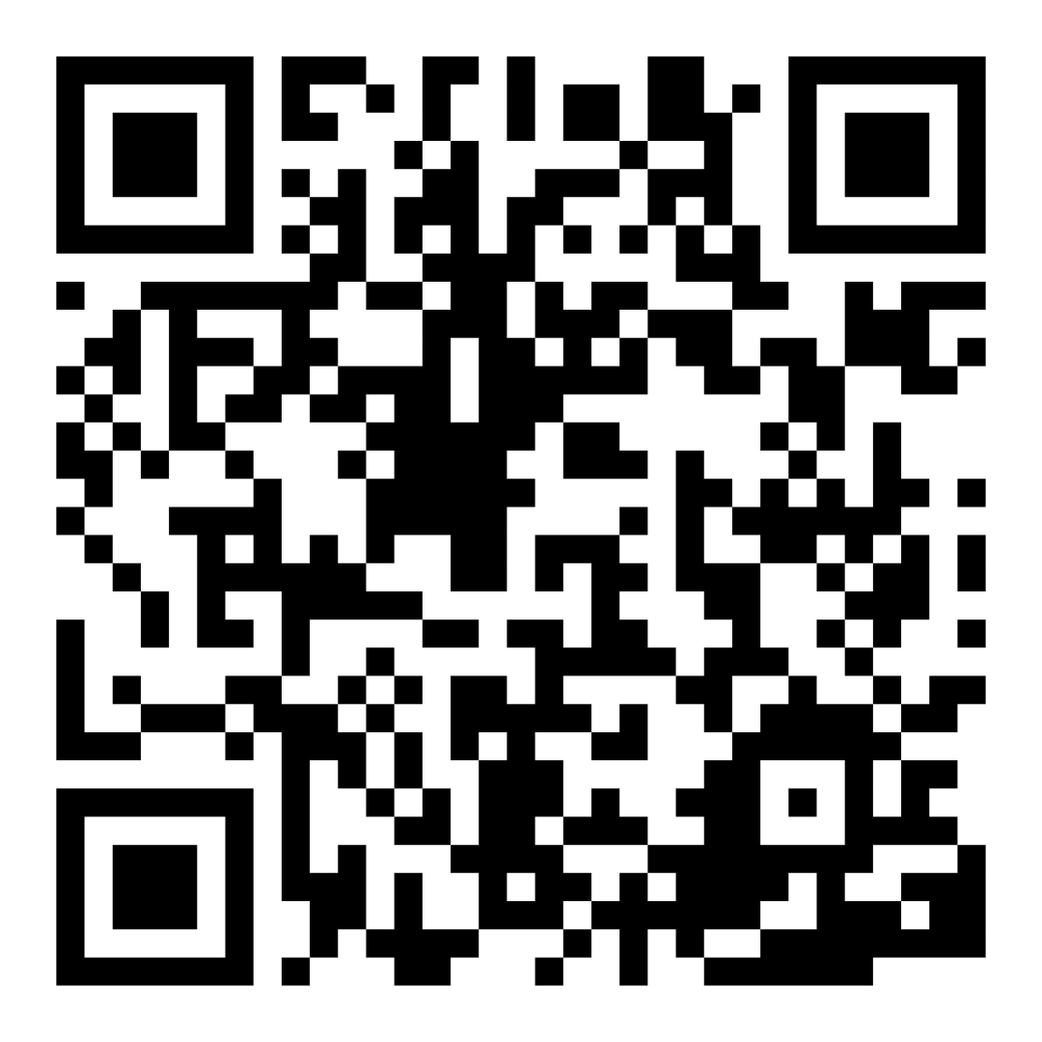
Family Confidence Survey
Scan this code to share how you’re feeling about reading with your child. Participants will be entered into a raffle for a $15 gift card. One winner per school will be drawn after the first and last workshops.
bit.ly/3BUBxbx
Notes:
If this is not the first or last Family Workshop, please delete this slide from the slide deck.
If you are an LAUSD teacher or staff member, please delete this slide from ALL Family Workshop decks.
Families who fill out the survey will be asked to provide an email to be entered into the raffle.
One raffle winner will be selected by Springboard Collaborative’s Data & Evaluation team after the first and last workshop and sent a $15 e-gift card to the email they provided.
If you need print-out versions of the QR code survey in English or the other translated languages, you can find those here: https://drive.google.com/file/d/1zjxnM0C9aP4C9WJFbw2A8eFpjZ29wBWG/view?usp=sharing
If you want to send the survey directly to families, you can find the link to the survey here: bit.ly/3BUBxbx

Slide 5
Workshop guidelines
Be prepared.
Be present.
Be courteous.
Ask questions.
Notes:
Briefly explain the guidelines or “the rules we all agree to follow so that we can all have an enjoyable and an effective workshop.”
If this is the first workshop, briefly explain each of the guidelines.
Alternatively, a family volunteer may read or summarize this slide if they’ve attended the previous workshop. ​
Consider putting these on chart paper and inviting the group to add to the list. If you do this, be sure to change this slide in subsequent workshops.​
Emphasize these guidelines are for everyone (including you, the facilitator) and pledge to be prepared, present, courteous, and ask questions.
Emphasize the last point and specifically invite families to ask lots of questions.

Slide 6
Go on a word hunt
1
2
3
Decide to go on a word hunt.
Write down words as you read.
Review words at the end.
Building vocabulary helps readers understand what they read.
Notes:
Part 2: Reading tip
Introduce the 3 parts of the reading tip, but do not go into details.
Sample script:
The reading tip for today is designed to help your child build their vocabulary or the words they know the meaning of. The more words your child knows, the more words they will be able to read and understand. And lucky for us, talking about words is an easy to way to help your child learn more words.
First, we’ll talk about how you start word hunting.
Then, we’ll talk about which words to write down.
Finally, we’ll learn some ways to review the words at the end.
Why? Talking about new and unfamiliar words as read will help your child build their vocabulary. The more words they know, the easier it is to read and understand new books.
Sample script in Spanish
El consejo de lectura de hoy fue diseñado para ayudarle a su hijo a aumentar su vocabulario o el número de palabras de que conoce el significado. Por cada palabra que su hijo conoce, es una palabra más que podrá leer y entender. Por suerte, hablar de las palabras es una manera fácil de ayudarles a los niños a aprender mas palabras.
Primero, vamos a hablar de cómo se inicia el acto de cazar palabras.
Luego, vamos a hablar sobre cuales palabras se debe de apuntar.
Por último, vamos a aprender algunas maneras de repasar las palabras al final.

Slide 7
Check in on literacy terms
Vocabulary
all the words your child knows.
Notes:
To make sure everyone has a common understanding, define some literacy terms as needed.

Slide 8
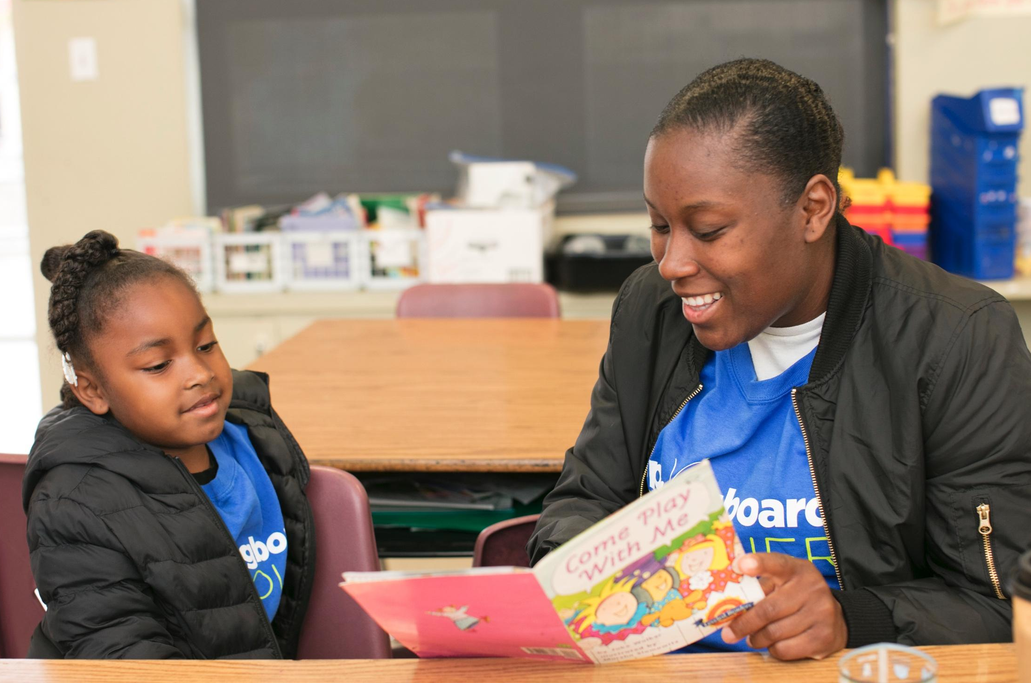
Decide to go on a word hunt
Set a goal for each page or for total time.
Let your child lead but take turns choosing words, if needed.
Decide where to write words.
Notes:
Explain the first step of the reading tip.
Explain that when families decide to go on a word hunt, there are a couple things to keep in mind.
The child is hunting for unfamiliar or totally new words.
They shouldn’t do this every time you read. But it’s a nice way to mix up reading time.
They should set a reasonable goal (i.e. one word per page or paragraph or five words total).
The child should pick words they don’t know very well. If they’re having trouble, the adult can choose words, too.
Mark words in the text or write them down. Either the adult or the child can write. (Distribute cardstock or paper for families to use to capture the words they’re hunting today).
►Remind Multilingual families that this a strategy they can use as a whole family to improve their English skills.
Contributing to their child’s word hunt or keeping their own dictionary that they share with their child is a wonderful way to model curiosity about words and explicit vocabulary development.
Encourage them to use the words they discuss during reading time in everyday conversation.
Writing them down on a post-it note or somewhere else easily accessible will remind them to use the words.

Slide 9
Write the words down
Maybe we should write down_____. What do you think?
You can take turns choosing words!
Notes:
Display a paragraph (or so) of a text. Tell families that you will read aloud and that they should hunt for two words and write them down.
Read the text aloud slowly and with expression.
Invite families to Think-Pair-Share with their child about words they want to discuss.
Remind them they don’t have to be words they don’t know. They can also just be words that are not familiar.
Then, generate a list of words as a whole class and write them down. Ask families to explain why they chose what they chose (children can just say they wanted to talk about the word or it was unfamiliar).
Remind families to let their children lead on choosing the words. If the adult needs to choose a word, they should keep some things in mind:
Look for words your child may encounter many times—a common but unknown word.
Choose words your child just struggled to read.
Select words that you don’t think your child knows.
►Be sensitive to the fact that some Multilingual families may not have the necessary schema to choose a word that their child will encounter many times.
Take time to explicitly reassure them that any word that their child wants to learn more about and remember is a good word.
Also, Multilingual children (and adults) may want to write down common grammatical patterns or common phrases, in addition to words. Provide examples.
Sample script:
Let’s practice this together. I’m going to read this passage aloud. [Distribute passage or project it on a white board so that it is visible for everyone].
While I’m reading, hunt for two words that you would like to write down. [Read the passage aloud].
Now, talk with your child about two words that you both think would be good to write down. Remember, let your child lead here.
As you write it down, talk about it.
[After a few minutes].
Can I have some volunteers to share the words they hunted? Let’s make a class list.
Sample script in Spanish:
Vamos a practicarlo juntos. Voy a leer un texto en voz alta. [Distribute passage or project it on a white board so that it is visible for everyone].
Mientras leo, caza dos palabras que le gustaría apuntar. [Read the passage aloud].
Ahora, habla con su hijo sobre dos palabras que los dos piensan que deben de apuntar. Acuerdese, su hijo debe de ser el líder aquí.
Mientras escriben, hable sobre las palabras.
[After a few minutes].
¿Algunos voluntarios quisieran compartir las palabras que cazaron? Vamos a hacer una lista.

Slide 10
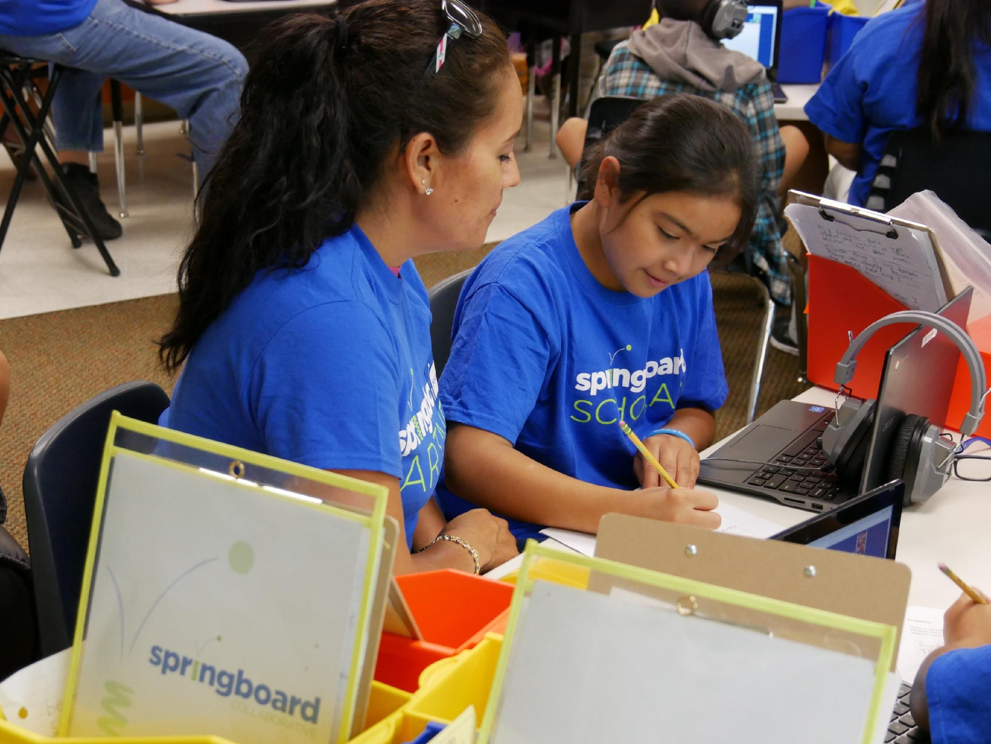
Review words at the end
Let’s talk about the words we chose.
What does this word mean? How do you know?
How would we use this word in a sentence?
If you speak another language, talk about how to translate the word.
Notes:
Invite a child volunteer to come up to the front of the room.
Using the list of words generated by the group in the previous slide, model having a discussion with the child about one of the words.
Use the questions on the slide and explain what you’re doing.
Consider modeling using a dictionary or online resource to find out more about the word.
Invite families to use the questions on the slide to discuss one or more words that the class listed with their child.
Circulate and support families.
Families can share out in small groups or for the whole class.
►Remind Multilingual families that there are many resources they can use to find out more about English words, including Google Translate, an online dictionary, or a paper dictionary. Also, it’s very useful for children (and adults) who speak more than one language to discuss how they might translate a word or concept into another language.

Slide 11
Reading = conversation (K-1)
Is there a word on this page that is new or unfamiliar?
What does this word mean? How do you know?
Let’s reread the sentence now that we’ve talked about the word!
What is another words that means close to the same thing?
Notes:
Remind families that the at-home reading coach always asks questions!
► For Multilingual families specifically: Some families may come from a culture where asking questions and “coaching” their child may be an unfamiliar practice. Instead, they may be more used to being directive and having the answers​.
Encourage families to keep trying this coaching technique and assure them that the more they do it, the more comfortable it will become. ​
Although “parent as expert” and “parent as coach” are equally valid positions, asking questions and encouraging children to find the answer out for themselves instead of telling them an answer can help children internalize the learning in a different way.
This is a good time to remind parents that even though asking questions may not at present be a regular practice for them, this is an opportunity for them to acquire and practice new skills that will help their children. Cultural shifts are usually most effective when they're explicit.​
Use this slide to ensure that families have some questions they can ask during practice time.
Ask families to hold up the number of questions they already have written down or are prepared to use. If it looks like the room is prepared, you may skip this slide or ask families to share other questions they have written down throughout the workshop.
There are also sample questions on the Reading Tip Sheet.
Sample script
At Springboard, the most important thing we want you to leave with is: to ALWAYS ASK QUESTIONS. You want to ask your child questions to help them figure out words, understand what they’re reading, sound more like a storyteller, and enjoy what they are reading. Today we’ve learned questions to help your child figure out the word.
Sample script in Spanish
En Springboard, lo más importante con lo que queremos que se vaya es: QUE SIEMPRE HAGA PREGUNTAS. Quiere hacerle preguntas a su hijo para ayudarlo a descifrar palabras, comprender lo que está leyendo, sonar más como un narrador y disfrutar lo que está leyendo. Hoy hemos aprendido preguntas para ayudar a su hijo a descifrar la palabra.

Slide 12
Reading = conversation (2-3)
Are there any word parts that you know?
How would we use this word in a sentence?
What does this word mean? Let’s look it up!
Notes:
Remind families that the at-home reading coach always asks questions!
► For Multilingual families specifically: Some families may come from a culture where asking questions and “coaching” their child may be an unfamiliar practice. Instead, they may be more used to being directive and having the answers​.
Encourage families to keep trying this coaching technique and assure them that the more they do it, the more comfortable it will become. ​
Although “parent as expert” and “parent as coach” are equally valid positions, asking questions and encouraging children to find the answer out for themselves instead of telling them an answer can help children internalize the learning in a different way.
This is a good time to remind parents that even though asking questions may not at present be a regular practice for them, this is an opportunity for them to acquire and practice new skills that will help their children. Cultural shifts are usually most effective when they're explicit.​
Use this slide to ensure that families have some questions they can ask during practice time.
Ask families to hold up the number of questions they already have written down or are prepared to use. If it looks like the room is prepared, you may skip this slide or ask families to share other questions they have written down throughout the workshop.
There are also sample questions on the Reading Tip Sheet.
Sample script
At Springboard, the most important thing we want you to leave with is: to ALWAYS ASK QUESTIONS. You want to ask your child questions to help them figure out words, understand what they’re reading, sound more like a storyteller, and enjoy what they are reading. Today we’ve learned questions to help your child figure out the word.
Sample script in Spanish
En Springboard, lo más importante con lo que queremos que se vaya es: QUE SIEMPRE HAGA PREGUNTAS. Quiere hacerle preguntas a su hijo para ayudarlo a descifrar palabras, comprender lo que está leyendo, sonar más como un narrador y disfrutar lo que está leyendo. Hoy hemos aprendido preguntas para ayudar a su hijo a descifrar la palabra.

Slide 13
Multilingual families
Keep track of words to review and create a family dictionary of new words and phrases.
Give a lot of encouragement to help build reading skills.
Compare and make connections between your home language and English.
Notes:
Use this slide if families’ primary language is not English or they may have specific questions. Alternatively, if you have talked about accommodations throughout the reading tip explanation you may skip this slide or use it to briefly sum up.
Explain the tips on the slide. If you need more detail, see “Ideas to differentiate” in the Workshop Guide.

Slide 14
Practice time
1
Decide to go on a word hunt.
Call me over when you have a question!
2
Write down words as you read.
Review words at the end.
3
Notes:
Part 3: Practice time
Note: Practice time should be most of the remaining time. Leave 10 minutes or so at the end for reflection.
Summarize the tip, and remind families to repeat these steps during practice time.
Take a moment to explain that you’ll be circulating around while they practice (to provide 1:1 support and answer any questions).
►Multilingual parents in particular often come with feelings of self-consciousness that can be overcome when they know why they're being observed.
Remind families to ask questions as they use the tip.
There are also sample questions on the Reading Tip Sheet.
To support families, consider underlining two high leverage questions on the Reading Tip Sheet as you circulate.
Remind families they can always work on their action plan or other strategies during practice time, especially if they have questions or want some help with it.
Circulate and work with families. Here are some suggestions:
Walk over to a family. Ask, “Do you have any questions about the reading tip?”
If yes, answer question.
If no, say, “May I listen in for a moment?
Listen for a full minute.
Compliment the family on something they did well and then leave them with one suggestion (if needed)
Walk over to a family and ask, “Can I try this reading tip with your child?”
After you’ve modelled it, ask the adult, “What did you notice me doing?” or say “Did you notice that I…”
Gather “glows” (things that families did that you want to lift up to the group) and “grows” (things families do that you want to stop and correct/clarify for the whole group).
Share the “glows” and “grows” at 10 mins into practice time or wait until the end.
Keeps “grows” anonymous, but congratulate specific families on “glows.”

Slide 15
Reflect
Any questions about the reading tip?
Turn and talk with your child: Do we feel ready to try this reading tip at home?
Please share how you might use this at home.
Your question will help someone else in the room!
Notes:
Part 4: Reflection & updates
Invite participants to ask questions.
Give ample wait time for each question. ​
Remind families that when parents talk they make it safe for more hesitant parents to share. It builds community in the classroom. ​
Encourage other voices to share.
In addition, you could share some “glows” and “grows” you noticed while walking around and supporting families during practice time.
Check in on the goal of Family Workshops.​
Read “Any questions…”? and wait. Let this question hang and give ample wait time.​
Invite families who don’t yet feel equipped to do the reading tip on their own to raise their hand (or indicate in a more private way) so you can check in with them personally before they leave the workshop.
Invite a family volunteer to share how they will use the reading tip at home.
If time permits, you may do a whip-around share.
Invite families to each share one thing (in 30 seconds or less). This could be:
Something they learned
One thing they’re excited to try at home
One thing they found challenging about this tip
One step they will focus on this week

Slide 16
Feedback, please
Your input improves our time together!
Notes:
Invite families to make a reading plan for the upcoming week.
Remind families that readers need “reading together” time and “reading alone” time.
Remind families that reading in workshops counts as “reading together time” and they should log it (if applicable).
Invite families to give you feedback so that you can facilitate a workshop that works for them!
Families can use the printed feedback form (if available) or a digital feedback form.
Invite families to give you more informal feedback. This could look like a thumbs up if they liked the reading tip or writing one thing they hope for the next workshop.
Use this time to meet individually with families as needed.
Sample script
And finally, I want to make sure I’m hosting a Family Workshop that works for you. Every workshop, you’ll have a chance to give me feedback, and I promise you that I will read it and do my best to incorporate it. Will you fill out the survey before you leave? If you’d rather talk about your suggestions instead of writing them down let me know. Thanks, and see you at the next workshop!
Sample script in Spanish
Para cerrar, quiero asegurar que estoy dando un taller de familia que les sirve a ustedes. En cada taller, tendrán la oportunidad de proveer comentarios. Yo les prometo que los voy a leer y voy a hacer mi mejor esfuerzo para incorporar los consejos en el próximo taller. ¿Pueden contestar el sondeo antes de irse? Si prefieren platicar sobre sus ideas, en vez de escribirlas, avísenme. ¡Gracias y nos veremos en el próximo taller!

