Slide 1
Workshop guide
Facilitator:
Read notes to prepare. Amend slides if needed.
Practice the script aloud. Change as needed.
Ready the family-facing materials.
Display slide 2 as families arrive.
Cover With Your Finger
Notes:
Copyright 2022 Springboard Collaborative, all rights reserved.
Overview and rationale
This is a figure out the word workshop. Through the workshop, families learn and practice questions that prompt their child to use their finger to decode unfamiliar words. This strategy helps readers because it turns the mental skill of figuring out a word syllable by syllable into a tangible, physical process. Once a word is broken into chunks, children can more easily figure out the word.
Materials
Corresponding Reading Tip Sheet (in the languages the families need)
Family Workshop Feedback Form (paper or digital form)
Books for families to use during practice time. This strategy works with both fiction and nonfiction texts.
Projector to display slides
Empty envelope for families to put feedback form in (optional but highly recommended)
Name tags (optional but highly recommended)
Facilitation notes
To prepare
In this workshop, you will model cover with your finger.
Preview the light blue slides and choose the ones that are appropriate for your context (needs of the families, grade level).
Familiarize yourself with the content of the presentation so you can talk with families not at them.
Study the slides in the reading tip section. Think through how you will model and guide practice for cover with your finger.
You may want to practice with additional sentences in the slide “Use your finger.” If this is the case, post the additional sentences on a whiteboard large enough for families to read.
During workshop
Take time to build rapport as a group and individually with families. Little things, like learning family members’ names and greeting them at the door, go a long way.
Keep pace so that families have time to practice the tip and also reflect. Practice and reflection help families internalize the strategy.
Circulate and check-in with families individually during practice time. See the “Practice time” slide for more specific suggestions.
Ideas to differentiate
Consider changing the passages on the slides to be more appropriately matched to the level of your students.
Preview the “Check in on literacy terms” slide and adjust terms or definitions as needed.
If teaching this workshop to families with younger readers:
Choose the appropriate “Reading = conversation” slide.
Concentrate on the first two points of the reading tip only; do not go into compound words. Be explicit that “word parts” can be letters.
If teaching this workshop to families with older readers:
Choose the appropriate “Reading = conversation” slide.
Introduce the concept of prefixes (un-, an-, dis-, pre-) and suffixes (-ed, -s, -ing, -tion) as "word parts" we can look for.
If teaching this workshop to Multilingual families: This is a difficult workshop for families new to the English language and is more appropriate for families with some familiarity with the language. To support families consider the following ideas:​
Remind families that learning to be literate in another language takes time and patience. Stress the important role they play in their child’s development—namely as someone who encourages them to keep trying and keep going.
Even if they don’t know the word the child is trying to read, they can encourage the child to keep persevering and trying different strategies. This is super valuable!
Choosing words to practice with may be daunting for adults new to the English language.
Consider photocopying a text and highlighting words that families can practice using the strategy on during practice time. Then provide a translation of the words.
Remind families that a dictionary or online tool (like www.wordreference.com) can help them check to make sure their child is getting the words. They can use the features to hear how the words are pronounced in English.
Depending on the first language of the families, you may want to briefly explain the concept of phonics and chunking out words to sound out.
For Latin-based languages (such as French and Spanish), this will likely be a familiar concept.
You may need to take some time to explain some basics of English phonics in particular. See https://www.colorincolorado.org/article/reading-101-english-language-learners as reference.
Consider distributing a pronunciation guide (such as the Spanish to English pronunciation chart at https://pin.it/vbvxj7nrnb5g57 or chart of vowel sounds like https://www.spanishdict.com/answers/233243/pronunciacin-de-las-consonantes-y-vocales-en-ingls for families to use for steps 2 and 3.
If families are familiar with this workshop, consider how you might leverage their experience. Ask families to share how they helped their child internalize the steps. Invite them (ahead of time) to model one or more steps if appropriate.
Timing considerations for a 60 min workshop
Welcome: 10 mins
Reading tip: 15-20 mins
Practice: 15-20 mins
Reflection and updates: 10 mins
After you use these materials, we want to hear your feedback! Fill out the Family Workshop Facilitator Feedback Form at https://bit.ly/SBCfeedbackform.

Slide 2
Cover With Your Finger
Notes:
Part 1: Welcome
Formally welcome families and tell them the title of today’s workshop. Do not go into specific steps of the reading tip at this point.
Ensure families have the materials they need and are sitting with their children.

Slide 3
Agenda
Welcome
Reading tip
Practice time
Reflection & updates
Notes:
Provide an overview of what families will be doing today (and at every Family Workshop).
If this is the first Family Workshop in a series, explain that the icons for each of the four parts of the Family Workshop also run along the bottom of slides. ​
If this is not the first workshop, move quickly through this slide.
Sample script
Here is our plan for today. You can see each part of our agenda has an icon [point to the icons]. You can also find each icon along the bottom of each slide [point to bottom] so you can see where we are in the agenda. First, we’ll review a couple of things, then we’ll get right to the reading tip. Most of our time will be spent on practice time so we can all try out the reading tip. Then we’ll reflect and talk about some updates.
Please speak up with questions, concerns, or anything you’d like to share. We’re here together for one hour and need to maximize the time. Every child learns to read in a different way, but putting our heads together helps our shared cause: to give kids a reading boost and cultivate a the joy of reading.
Sample script in Spanish
Aquí tenemos el plan para hoy. Se puede ver que cada parte de la agenda tiene un ícono [point to the icons]. También se encuentran en el final de cada diapositiva [point to bottom] para que puedan saber en qué parte estamos. Primero, vamos a repasar algunas cosas. Luego vamos a empezar con el consejo de la lectura. La mayoría del tiempo vamos a pasar aquí, en la práctica, para probar el consejo de la lectura juntos. Luego, vamos a reflexionar y hablar sobre algunas novedades.
En cualquier momento, pueden hacer preguntas, compartir preocupaciones, o cualquier otra cosa que quieren compartir. Vamos a estar juntos por una hora y queremos aprovechar del tiempo que tenemos. Cada niño aprende a leer de una manera diferente. Estamos aquí para trabajar en la misma causa: ayudarles a los niños a mejorar en la lectura y llegar a disfrutarla.

Slide 4
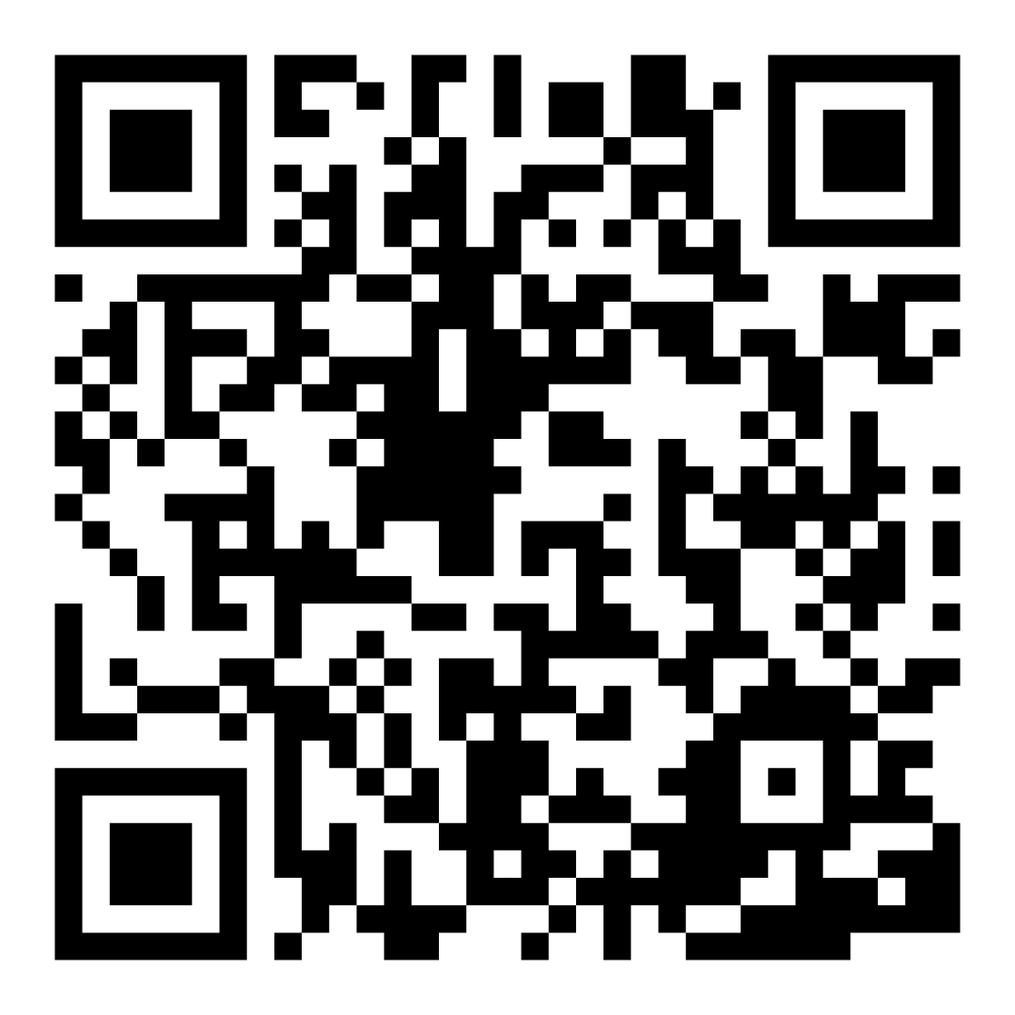
Family Confidence Survey
Scan this code to share how you’re feeling about reading with your child.
Notes:
If this is not the first or last Family Workshop, please delete this slide from the slide deck.
If you are an LAUSD teacher or staff member, please delete this slide from ALL Family Workshop decks.
If you need print-out versions of the QR code survey in English or the other translated languages, you can find those here: https://drive.google.com/file/d/1zjxnM0C9aP4C9WJFbw2A8eFpjZ29wBWG/view?usp=sharing
If you want to send the survey directly to families, you can find the link to the survey here: https://survey.alchemer.com/s3/7771344/Family-Confidence-Survey

Slide 5
Workshop guidelines
Be prepared.
Be present.
Be courteous.
Ask questions.
Notes:
Briefly explain the guidelines or “the rules we all agree to follow so that we can all have an enjoyable and an effective workshop.”
If this is the first workshop, briefly explain each of the guidelines.
Alternatively, a family volunteer may read or summarize this slide if they’ve attended the previous workshop. ​
Consider putting these on chart paper and inviting the group to add to the list. If you do this, be sure to change this slide in subsequent workshops.​
Emphasize these guidelines are for everyone (including you, the facilitator) and pledge to be prepared, present, courteous, and ask questions.
Emphasize the last point and specifically invite families to ask lots of questions.

Slide 6
Cover with your finger
1
2
3
Use your finger to find word parts.
Use your finger to find small words you know.
Use your finger to break apart compound words.
Using your finger can help you and your eyes keep track of the words on the page.
Notes:
Part 2: Reading tip
Introduce the 3 parts of the reading tip but do not go into details.
Sample script
Today we will practice thinking about the word as we are reading or “attacking” the word.
First, we will practice using our fingers to find little word parts. After we’ve read those parts, we can piece the word back together to solve and read it.
Then, we can practice finding small words to read first inside a bigger word.
Finally, for older students, we can break words apart into two separate words. This may not happen with every word but it’s a good tool to have or try, even if it doesn’t work.
Why?
We want readers to not be afraid to use their finger to break apart words so they become easier to read. Getting their fingers out of your pockets and using them to cover up parts of words will help children see words they know. Eventually they will do this with their eyes automatically.
To grow as a reader, a child should have multiple tools in their strategy toolbox to figure out tricky words. Selecting the tool to use can be challenging, which is why you can help guide them toward knowing the tools well enough to automatically pull them out and put them to use!
Sample script in Spanish
Hoy vamos a practicar el acto de pensar sobre el libro mientras estemos leyendo o “atacando” la palabra.
Primero, vamos a practicar el uso del dedo para encontrar “las partes chiquitas de la palabra”. Después de leer las partes, podemos juntar la palabra de nuevo para averiguarla y leerla.
Luego, vamos a buscar palabras pequeñas dentro de las palabras grandes, para leerlas primero.
Al final, para los estudiantes mayores, podemos romper las palabras en dos palabras diferentes. No se puede con todas las palabras, pero vale la pena intentarlo, a pesar de que no siempre funcione.
¿Por qué?
Queremos que los lectores no tengan miedo de usar su dedo de esta manera para romper las palabras para que sean más fáciles de leer. Sacar los dedos del bolsillo y usarlos para cubrir las partes de las palabras les va a ayudar a los niños para ver las palabras que conocen. Eventualmente lo harán con sus ojos automáticamente.
Para crecer como un lector, un niño debe de empezar a tener varias herramientas en su caja de estrategias para averiguar las palabras complicadas. Seleccionar la herramienta que necesita en cada momento puede ser desafiante. Por eso, usted necesita ayudarle. ¡Puede guiarlo para conocer las herramientas tan bien que pueda sacarlas y usarlas en cualquier momento!

Slide 7
Check in on literacy terms
Syllable
a small word part with one vowel sound
Compound word
a word made up of two words put together (e.g. sunshine)
Decode
when you break up the sounds in the word to help you read the word
Notes:
To make sure everyone has a common understanding, define some literacy terms as needed.

Slide 8
Use your finger to find word parts
Tips and tricks
If this is a new idea for your child, model with your fingers, then let your child try!
Adult:
“Do you see any word parts you know inside the tricky words?”
Child:
“I know |a| and |n| says ‘an’ so ‘p’ and ‘l’ and ‘an’ and ‘t’ says ‘plant’!”
Notes:
Model looking for small parts of words (such as -am, -et, -ag, -ud, -ip) that you know inside bigger words. The word parts could be prefixes (such as un-, mis-) or suffixes (such as -er, -less).
Use the small word parts to get started figuring out big words.
For smaller words, remind families that a letter is also a word part.
Click to animate the slide (hand will appear) or use your finger to cover up parts of the word to find the part “an” in the word “plant.”
Sample script
This first habit that readers rely on is using what we know about word parts.
When we start sounding out words, two letters can be “glued together” so that solving the rest of the word isn’t as tricky. (If I know “ag,” I know “tag.”) Students may also use word parts that mean something, like prefixes and suffixes, to solve a word. It’s important to encourage your child to USE this knowledge when figuring out longer words.
To help your child find a smaller word inside a bigger word, you may need to help him break the word into parts to see the small word. Here’s an example: I‘m trying to figure out this first word. I know “a” and “n” together say “an.” Then I can put it with the rest of the letters to read “plant.”
Sample script in Spanish
El primer hábito que los lectores necesitan es usar lo que SABEN de las partes de las palabras.
Cuando empezamos a decir las palabras en partes, se puede juntar dos letras en un grupo para simplificar el proceso de averiguar lo que queda de la palabra (si yo sé decir “ag”, yo sé “tag”). Los estudiantes también pueden usar partes de la palabra que tienen un significado, como prefijos y sufijos, para averiguar una palabra. Es importante que le diga a su hijo que USE su conocimiento para averiguar palabras más largas.
Para ayudarle a su hijo a encontrar una palabra pequeña dentro de una palabra más grande, hay que “romper” la palabra en partes para ver la palabra pequena. Por ejemplo: Quiero descifrar esta palabra. Yo sé que “a” junto con “n” dice “an”. Luego puedo poner las demas letras y leer “plant” (planta).

Slide 9
Use your finger to find little words
Adult:
“Do you see any little words you know inside the tricky word?”
Child:
“I see the word ‘pump.’ That gets me started! Now I can read the whole word - ‘pumpkin.’”
Notes:
Model looking for small words (like high-frequency words) that you know inside bigger words.
Click to animate the slide (hand will appear) or use your finger to cover up parts of the word to find the part “pump” in the word “pumpkin.”
Sample script
The next habit that good readers rely on is using what we know about words.
Your child has already learned a lot of words.
It’s important to encourage your child to USE that knowledge when figuring out longer words.
To help your child find a smaller word inside a bigger word, you may need to help him break the word into parts to see the small word.
For example, in this last word I see a word your child may have come across already— “pump.” I can use that to sound out the word: “pump—kin.”
Sample script in Spanish
El próximo hábito que buenos lectores necesitan es usar lo que SABEN de las palabras.
Su hijo ya ha aprendido muchas palabras.
Es importante que le diga a su hijo que USE su conocimiento para averiguar palabras más largas.
Para ayudarle a su hijo a encontrar una palabra pequeña dentro de una palabra más grande, hay que “romper” la palabra en partes para ver la palabra pequena.
Por ejemplo, en la ultima palabra yo veo una palabra que su hijo probablemente conoce - “pump”. Puedo usar esta palabrita para descifrar la palabra “pump--kin.”

Slide 10
Use your finger for compound words
Adult:
“Do you see any words you know inside the tricky word?”
Child:
“I see the word ‘sun’ and I see the word ‘rise.’ Together that makes the longer word, ‘sunrise.’”
Notes:
Model looking for small words that you know inside bigger words (compound words). Each of the words on the slide are compound words.
Click to animate the slide (hand will appear, move, and disappear) or use your finger to cover up parts of the word to find “sun” and “rise.”
Sample script
The next habit that good readers rely on is using what we know about words. This is very similar to the previous slide. Here we are finding longer words that are sometimes called compound words. These can be combined to be one word, then separated to be their own words individually.
In this example, I see the words “sun” and “rise.” Put it together and it’s “sunrise.”
It’s important to encourage your child to USE that knowledge when figuring out longer words.
Sample script in Spanish
El próximo hábito que buenos lectores necesitan es usar lo que SABEN de las palabras. Es muy similar a la diapositiva anterior. Aquí, encontramos palabras que a veces se llaman “palabras compuestas”. Se puede juntar las palabras para hacer una palabra, y luego separarlas para hacer palabras individuales.
Por ejemplo, en este ejemplo yo veo las palabras “sun” y “rise” (sol y levantar). Cuando se juntan, tenemos “sunrise” (amanecer).
Es importante que le diga a su hijo que USE su conocimiento para averiguar palabras más largas.

Slide 11
Use your finger
Is there a strategy you can use to figure out this word?
Notes:
Use this slide for guided practice.
Invite a volunteer to come and cover up part of the word.
Make sure you’ve previewed this with the volunteer beforehand. Consider using an adult as this word may be too hard for a child.
Talk through what they’re doing.
Sample script
Let’s practice together. Let’s pretend we have this sentence. I know a lot of the words but there is a longer, trickier word right at the end. Who would like to get their finger out to see if they can cover up some of the word and see if any words jump out at you?
Do we all see the word part “veg” at the beginning? If we start the word with that beginning—veg….looking at the picture, we can say “vegetables.”
Sample script in Spanish
Vamos a practicarlo juntos usando esta oración. Yo sé muchas palabras pero hay una palabra más larga y complicada aquí al final de la oración. ¿Quién quisiera usar su dedo para cubrir parte de la palabra y ver si alguna palabra le llama la atención?
¿Todos pueden ver la parte de la palabra al inicio, “veg”? Si empezamos la palabra al inicio -- veg… cuando vemos la imagen, podemos decir “vegetables.” (verduras)

Slide 12
Reading = conversation (K-1)
Can you break the word into two smaller parts?
Use your finger. Cover up part of the word. What’s left?
Do you see any letter clues to solve this word?
Use your finger and point to each part of the word as you sound it out.
Notes:
Remind families that the at-home reading coach always asks questions!
► For Multilingual families specifically: Some families may come from a culture where asking questions and “coaching” their child may be an unfamiliar practice. Instead, they may be more used to being directive and having the answers​.
Encourage families to keep trying this coaching technique and assure them that the more they do it, the more comfortable it will become. ​
Although “parent as expert” and “parent as coach” are equally valid positions, asking questions and encouraging children to find the answer out for themselves instead of telling them an answer can help children internalize the learning in a different way.
This is a good time to remind parents that even though asking questions may not at present be a regular practice for them, this is an opportunity for them to acquire and practice new skills that will help their children. Cultural shifts are usually most effective when they're explicit.​
Use this slide to ensure that families have some questions they can ask during practice time.
Ask families to hold up the number of questions they already have written down or are prepared to use. If it looks like the room is prepared, you may skip this slide or ask families to share other questions they have written down throughout the workshop.
Share with families that there are also sample questions on the Reading Tip Sheet.
Sample script
At Springboard, the most important thing we want you to leave with is to ALWAYS ASK QUESTIONS. You want to ask your child questions to help them figure out words, understand what they’re reading, sound more like a storyteller, and enjoy what they are reading. Today we’ve learned questions to help your child figure out the word.
Sample script in Spanish
En Springboard, lo más importante con lo que queremos que se vaya es: QUE SIEMPRE HAGA PREGUNTAS. Quiere hacerle preguntas a su hijo para ayudarlo a descifrar palabras, comprender lo que está leyendo, sonar más como un narrador y disfrutar lo que está leyendo. Hoy hemos aprendido preguntas para ayudar a su hijo descifrar la palabra.

Slide 13
Reading = conversation (2-3)
Do you see any smaller words inside that word?
What clues in the word can you use to solve this word?
Can you break the word into syllables? What sound does each syllable make?
Notes:
Remind families that the at-home reading coach always asks questions!
► For Multilingual families specifically: Some families may come from a culture where asking questions and “coaching” their child may be an unfamiliar practice. Instead, they may be more used to being directive and having the answers​.
Encourage families to keep trying this coaching technique and assure them that the more they do it, the more comfortable it will become. ​
Although “parent as expert” and “parent as coach” are equally valid positions, asking questions and encouraging children to find the answer out for themselves instead of telling them an answer can help children internalize the learning in a different way.
This is a good time to remind parents that even though asking questions may not at present be a regular practice for them, this is an opportunity for them to acquire and practice new skills that will help their children. Cultural shifts are usually most effective when they're explicit.​
Use this slide to ensure that families have some questions they can ask during practice time.
Ask families to hold up the number of questions they already have written down or are prepared to use. If it looks like the room is prepared, you may skip this slide or ask families to share other questions they have written down throughout the workshop.
Share with families that there are also sample questions on the Reading Tip Sheet.
Sample script
At Springboard, the most important thing we want you to leave with is to ALWAYS ASK QUESTIONS. You want to ask your child questions to help them figure out words, understand what they’re reading, sound more like a storyteller, and enjoy what they are reading. Today we’ve learned questions to help your child figure out the word.
Sample script in Spanish
En Springboard, lo más importante con lo que queremos que se vaya es: QUE SIEMPRE HAGA PREGUNTAS. Quiere hacerle preguntas a su hijo para ayudarlo a descifrar palabras, comprender lo que está leyendo, sonar más como un narrador y disfrutar lo que está leyendo. Hoy hemos aprendido preguntas para ayudar a su hijo descifrar la palabra.

Slide 14
Multilingual families
Use a pronunciation or vowel sound guide.
Use a dictionary, app, or website to check the words.
Chunk parts of words to help sound out unknown words.
Notes:
Use this slide if families’ primary language is not English or they may have specific questions. Alternatively, if you have talked about accommodations throughout the reading tip explanation you may skip this slide or use it to briefly sum up.
Explain the tips on the slide. If you need more detail, see “Ideas to differentiate” in the Workshop Guide.

Slide 15
Practice time
1
Use your finger to find word parts.
Call me over when you have a question!
Use your finger to find small words you know.
2
3
Use your finger to break apart compound words.
Notes:
Part 3: Practice time
Note: Practice time should be most of the remaining time. Leave 10 minutes or so at the end for reflection.
Summarize the tip, and remind families to repeat these steps during practice time.
Take a moment to explain that you’ll be circulating around while they practice to provide one-on-one support and answer any questions.
►Multilingual parents in particular often come with feelings of self-consciousness that can be overcome when they know why they're being observed.
Remind families to ask questions as they use the tip.
There are also sample questions on the Reading Tip Sheet.
To support families, consider underlining two high-leverage questions on the Reading Tip Sheet as you circulate.
Remind families they can always work on their action plan or other strategies during practice time, especially if they have questions or want some help with it.
Circulate and work with families. Here are some suggestions:
Walk over to a family. Ask, “Do you have any questions about the reading tip?”
If yes, answer question.
If no, say, “May I listen in for a moment?
Listen for a full minute.
Compliment the family on something they did well and then leave them with one suggestion (if needed)
Walk over to a family and ask, “Can I try this reading tip with your child?”
After you’ve modeled it, ask the adult, “What did you notice me doing?” or say “Did you notice that I…”
Gather “glows” (things that families did that you want to lift up to the group) and “grows” (things families do that you want to stop and correct/clarify for the whole group).
Share the “glows” and “grows” at 10 mins into practice time or wait until the end.
Keeps “grows” anonymous, but congratulate specific families on “glows.”

Slide 16
Reflect
Any questions about the reading tip?
Turn and talk with your child: Do we feel ready to try this reading tip at home?
Please share how you might use this at home.
Your question will help someone else in the room!
Notes:
Part 4: Reflection & updates
Invite participants to ask questions.
Give ample wait time for each question. ​
Remind families that when parents talk they make it safe for more hesitant parents to share. It builds community in the classroom. ​
Encourage other voices to share.
In addition, you could share some “glows” and “grows” you noticed while walking around and supporting families during practice time.
Check in on the goal of Family Workshops.​
Read “Any questions…”? and wait. Let this question hang and give ample wait time.​
Invite families who don’t yet feel equipped to do the reading tip on their own to raise their hand (or indicate in a more private way) so you can check in with them personally before they leave the workshop.
Invite a family volunteer to share how they will use the reading tip at home.
If time permits, you may do a whip-around share.
Invite families to each share one thing (in 30 seconds or less). This could be:
Something they learned
One thing they’re excited to try at home
One thing they found challenging about this tip
One step they will focus on this week

Slide 17
Feedback, please
Your input improves our time together!
Notes:
Invite families to make a reading plan for the upcoming week.
Remind families that readers need “reading together” time and “reading alone” time.
Remind families that reading in workshops counts as “reading together time” and they should log it (if applicable).
Invite families to give you feedback so that you can facilitate a workshop that works for them!
Families can use the printed feedback form (if available) or a digital feedback form.
Invite families to give you more informal feedback. This could look like a thumbs up if they liked the reading tip or writing one thing they hope for the next workshop.
Use this time to meet individually with families as needed.
Sample script
And finally, I want to make sure I’m hosting a Family Workshop that works for you. Every workshop, you’ll have a chance to give me feedback, and I promise you that I will read it and do my best to incorporate it. Will you fill out the survey before you leave? If you’d rather talk about your suggestions instead of writing them down let me know. Thanks, and see you at the next workshop!
Sample script in Spanish
Para cerrar, quiero asegurar que estoy dando un taller de familia que les sirve a ustedes. En cada taller, tendrán la oportunidad de proveer comentarios. Yo les prometo que los voy a leer y voy a hacer mi mejor esfuerzo para incorporar los consejos en el próximo taller. ¿Pueden contestar el sondeo antes de irse? Si prefieren platicar sobre sus ideas, en vez de escribirlas, avísenme. ¡Gracias y nos veremos en el próximo taller!

