Slide 1
Workshop guide
Facilitator:
Read notes to prepare. Amend slides if needed.
Practice the script aloud. Change as needed.
Ready the family-facing materials.
Display slide 2 as families arrive.
Scoop
Notes:
Copyright 2022 Springboard Collaborative, all rights reserved.
Overview and rationale
This is a sound like a storyteller workshop that focuses on the reading skill of fluency, or sounding like a storyteller. In this workshop, families learn a strategy for scooping the words into phrases as they read by physically scooping with their fingers and then visually scooping with their eyes to build reading fluency.
Materials:
Corresponding Reading Tip Sheet (in the languages the families need)
Family Workshop Feedback Form (paper or digital form)
Books for families to use during the reading tip explanation and practice time. This strategy works with both fiction and nonfiction texts.
Empty envelope for families to put feedback form in (optional but highly recommended)
Name tags (optional but highly recommended)
Facilitation notes:
To prepare:
In this workshop, you will model how to scoop words together into phrases, both with your fingers and with your eyes. Study the slides in the reading tip section. Think through how you will model and guide practice for the three steps of scooping.
You may want to practice with additional sentences. If this is the case, post them on a white board large enough for families to read.
Consider providing additional group practice after the “Put the scoops together” slide and before the video.
Preview the light blue slides and choose the ones that are appropriate for your context.
Be sure to familiarize yourself with the content of the presentation so you can talk with families, not “at” them.
Test video links and audio equipment for video. Video is available in English and Spanish on Springboard Collaborative’s YouTube channel.
During workshop
Take time to build rapport as a group and individually with families. Little things like learning family members’ names and greeting them at the door go a long way.
Keep pace so that families have time to practice the tip and also reflect. Being able to practice and reflect helps families internalize the strategy.
Circulate and check-in with families individually during practice time. See “Practice time” slide for more specific suggestions.
Ideas to differentiate
Be sure the book you use to model matches the reading abilities of the children in the workshop. Consider modeling with one or two pages from books with differing difficulty.
If teaching this workshop to younger readers:
Choose the appropriate “Reading = conversation” slide.
Use a shorter sentence that consists of one scooped phrase.
Encourage them to read the entire sentence as a phrase if you are presenting this workshop to families with young readers who are still reading books with very short sentences.
If teaching this workshop to families with older readers:
Choose the appropriate “Reading = conversation” slide.
Consider making a copy of a paragraph of text and using that to practice instead of just one sentence.
Remind families that rereading is valuable practice for building fluency.
If teaching this workshop to Multilingual families:
Explicitly talk about the rhythm of the English language and how English is a stress-timed language.
Ask for examples of how rhythm can change for different languages, or even for speakers from different regions of the same country.
You may wish to review common punctuation.
If families are familiar with this workshop, consider how you might leverage their experience. Ask families to share how they helped their child internalize the steps. Invite them (ahead of time) to model one or more steps, if appropriate.
Timing considerations for a 60 min workshop
Welcome: 10 mins
Reading tip: 15-20 mins
Practice: 15-20 mins
Reflection and updates: 10 mins
After you use these materials, we want to hear your feedback! Fill out the Family Workshop Facilitator Feedback Form at https://bit.ly/SBCfeedbackform.

Slide 2
Scoop
Notes:
Part 1: Welcome
Formally welcome families and tell them the title of today’s workshop. Do not go into specific steps of the reading tip at this point.
Ensure families have the materials they need and are sitting with their children.

Slide 3
Agenda
Welcome
Reading tip
Practice time
Reflection & updates
Notes:
Provide an overview of what families will be doing today (and at every Family Workshop).
If this is the first Family Workshop in a series, explain that the icons for each of the four parts of the Family Workshop also run along the bottom of slides. ​
If this is not the first workshop, move quickly through this slide.
Sample script
Here is our plan for today. You can see each part of our agenda has an icon [point to the icons]. You can also find each icon along the bottom of each slide [point to bottom] so you can see where we are in the agenda. First, we’ll review a couple of things, then we’ll get right to the reading tip. Most of our time will be spent on practice time so we can all try out the reading tip. Then we’ll reflect and talk about some updates.
Please speak up with questions, concerns, or anything you’d like to share. We’re here together for one hour and need to maximize the time. Every child learns to read in a different way, but putting our heads together helps our shared cause: to give kids a reading boost and cultivate a the joy of reading.
Sample script in Spanish
Aquí tenemos el plan para hoy. Se puede ver que cada parte de la agenda tiene un ícono [point to the icons]. También se encuentran en el final de cada diapositiva [point to bottom] para que puedan saber en qué parte estamos. Primero, vamos a repasar algunas cosas. Luego vamos a empezar con el consejo de la lectura. La mayoría del tiempo vamos a pasar aquí, en la práctica, para probar el consejo de la lectura juntos. Luego, vamos a reflexionar y hablar sobre algunas novedades.
En cualquier momento, pueden hacer preguntas, compartir preocupaciones, o cualquier otra cosa que quieren compartir. Vamos a estar juntos por una hora y queremos aprovechar del tiempo que tenemos. Cada niño aprende a leer de una manera diferente. Estamos aquí para trabajar en la misma causa: ayudarles a los niños a mejorar en la lectura y llegar a disfrutarla.

Slide 4
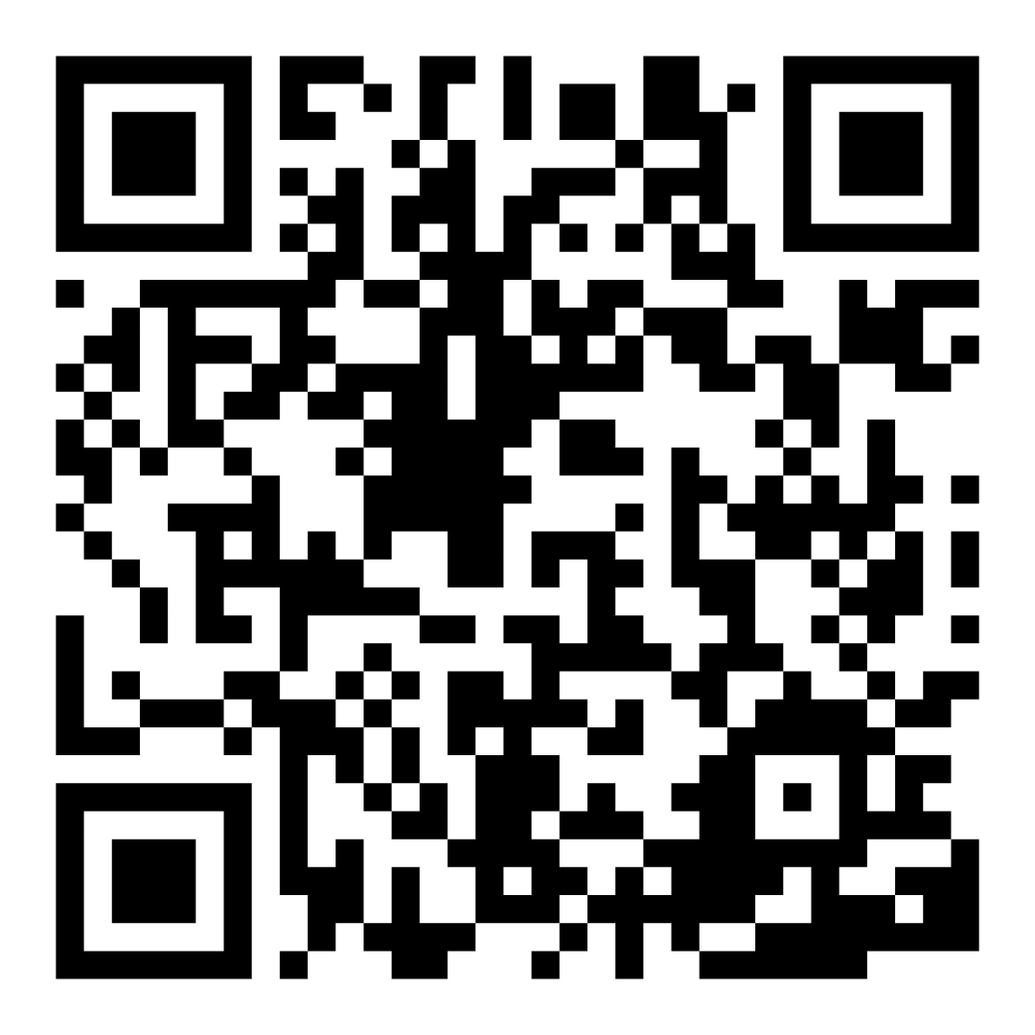
Family Confidence Survey
Scan this code to share how you’re feeling about reading with your child. Participants will be entered into a raffle for a $15 gift card. One winner per school will be drawn after the first and last workshops.
bit.ly/3BUBxbx
Notes:
If this is not the first or last Family Workshop, please delete this slide from the slide deck.
If you are an LAUSD teacher or staff member, please delete this slide from ALL Family Workshop decks.
Families who fill out the survey will be asked to provide an email to be entered into the raffle.
One raffle winner will be selected by Springboard Collaborative’s Data & Evaluation team after the first and last workshop and sent a $15 e-gift card to the email they provided.
If you need print-out versions of the QR code survey in English or the other translated languages, you can find those here: https://drive.google.com/file/d/1zjxnM0C9aP4C9WJFbw2A8eFpjZ29wBWG/view?usp=sharing
If you want to send the survey directly to families, you can find the link to the survey here: bit.ly/3BUBxbx

Slide 5
Workshop guidelines
Be prepared.
Be present.
Be courteous.
Ask questions.
Notes:
Briefly explain the guidelines or “the rules we all agree to follow so that we can all have an enjoyable and an effective workshop.”
If this is the first workshop, briefly explain each of the guidelines.
Alternatively, a family volunteer may read or summarize this slide if they’ve attended the previous workshop. ​
Consider putting these on chart paper and inviting the group to add to the list. If you do this, be sure to change this slide in subsequent workshops.​
Emphasize these guidelines are for everyone (including you, the facilitator) and pledge to be prepared, present, courteous, and ask questions.
Emphasize the last point and specifically invite families to ask lots of questions.

Slide 6
Scoop
1
2
3
Warm-up.
Scoop phrases.
Put the scoops together.
Reading in phrases helps us sound like storytellers.
Notes:
Part 2: Reading tip
Note: video embedded in “Let’s watch” reinforces these steps. You may go quickly through reading tip slides.
Introduce the 3 parts of the reading tip.
Sample script
Today’s tip has three parts:
First, we will pause and do a "practice." This is where we warm up to read like storytellers.
Second, we practice scooping our fingers under phrases of words rather than point our finger and read word-by-word like choppy robots.
Third, we put it all together and "go!" We read the sentence as smoothly as we can.
Don't worry about it being perfect the first time. We practice every time we read!
Why?
Reading word-by-word can be robotic and choppy.
Scooping allows us to move in the direction of smooth and fluent reading.
To scoop, we will learn to use our finger to scoop a few words together at a time to eventually put it all together like we are talking smoothly.
This helps us make more sense of the story or book we are reading.
Sample script in Spanish
El consejo de hoy tiene tres partes:
Primero, haremos una pausa y practiquemos. Aquí es donde nos calentamos para leer como narradores de historias.
Segundo, practicamos la acción de agrupar palabras en una frase en vez de señalar con el dedo y leer palabra-por-palabra como robots.
Tercero, lo ponemos todo junto y "¡listo!" Leemos la oración lo más suave como podamos y con fluidez.
-No se preocupe por que sea perfecto la primera vez. ¡Practicamos cada vez que leemos!
¿Por qué?
Leer palabra por palabra puede ser robótico y entrecortado.
Agrupando nos permite movernos en la dirección de una lectura suave y fluida.
Para agrupar, aprenderemos a usar nuestro dedo para juntar unas pocas palabras a la vez para finalmente juntarlas todas como si estuviéramos hablando sin problemas.
Esto nos ayuda a dar más sentido a la historia o el libro que estamos leyendo.

Slide 7
Check in on literacy terms
Phrase
A group of two or more words in a sentence that has meaning.
Notes:
To make sure everyone has a common understanding, define some literacy terms as needed.

Slide 8
Warm-up
Tips and tricks
Encourage slow and accurate reading of each word first.
Adult: Read this slowly so you can learn the words.
Child: (slowly)
"I…love…this… chocolate… cake!” Tim… yelled… happily.
Rushing to sounding like a storyteller on the first try can lead to many mistakes.
Notes:
Note: video linked in “Let’s watch” reinforces these steps. You may go quickly through the slides.
Use the sample conversation on the slide to model what a child sounds like when they read choppily. Then model slowing down and getting the words right first.
Alternatively you could ask a child volunteer to cold-read something without attending to fluency. Be sure to clear this with the child ahead of time.
Use the tips and tricks column to remind families that slow and accurate reading is an important first step and they shouldn’t rush through this.

Slide 9
Scoop phrases
Tips and tricks
Use your finger or the eraser end of a pencil to visually scoop the phrases together.
You’ve figured out the words, now: Scoop phrases!
"I love
this chocolate cake!”
Then try doing it with just your eyes.
Tim yelled happily.
Notes:
Note: video linked in “Let’s watch” reinforces these steps. You may go quickly through the slides.
Note: the scoop underlines are animated and will appear when screen/mouse clicks.
Use the sample sentence on the slide to model what it sounds like to scoop phrases together with your voice.
Alternatively you could ask a child volunteer to read the sentence by scooping together.
Use the tips and tricks column to remind families they can do this physically, with a finger, or just with their eyes.
Invite families to try reading the sentence in phrases and with expression.
Circulate and support. Bring everyone back after 45 sec–1 min.
Sample script:
Now that we have made sure you know the words, now we will go to the scooping!
Scooping is just like it sounds – it means we are scooping a few words together at a time in longer sentences before we put it all together. That is because we do that in real life. I don’t talk monotone when I’m speaking to you now – I pause and then continue. We are going to try this. First, you’ll watch me and then you’ll have a second to turn and talk with your child or other families.
First, I’m going to mark the phrases [Animate the slides to get the grey lines to appear]. You could do this with your finger or even with the eraser end of a pencil. Once your child has some practice with this, do it just with your eyes.
[Take your finger/pointer and underline the scooped blue lines underneath each phrase as you read the words].
“I love/ this chocolate cake/ Tim yelled happily.”
See how I paused slightly between scoops? I do that because I want the scooped phrases to go together smoothly so I pause between scoops to make sure I know where I am going. Here’s a secret: I push my eyes forward to the next scoop even when I’m finishing the first scoop.
Now take turns reading this sentence with your child.
Sample script in Spanish:
Ahora que nos aseguramos que conocen las palabras, vamos a agrupar las.
Agrupar es lo que parece - quiere decir agrupar algunas palabras juntas en oraciones más largas antes de juntar todo. Lo hacemos porque así hablamos en la vida normal. No hablo en monótono cuando hablo con ustedes ahora - tomo una pausa y luego sigo. Vamos a intentarlo. Primero, me van a observar y luego van a voltear y hablar con su hijo y otras familias.
Primero, voy a marcar las frases. [Animate the slides to get the grey lines to appear]. Puede hacerlo con el dedo o con el lado del borrador de una lápiz. Ya que su hijo lo haya practicado, lo puede hacer solamente con los ojos.
[Take your finger/pointer and underline the scooped blue lines underneath each phrase as you read the words].
“I love/ this chocolate cake/ Tim yelled happily.”
¿Observan como di una pausa entre los grupos? Lo hago porque quiero que las frases agrupadas se junten con fluidez entonces doy una pausa entre los grupos para asegurar que sepa hasta donde voy a llegar. Hay un secreto: Mis ojos están ya viendo un poco adelante para el próximo grupo cuando estoy terminando de leer el primer grupo. Tomen turnos para leer esta oración con su hijo.

Slide 10
Put the scoops together
"I love this chocolate cake!" Tim yelled happily.
Let’s practice!
Notes:
Note: video linked in “Let’s watch” reinforces these steps. You may go quickly through the slides.
Invite families to practice reading the sentence on the slide as fluently and with as much expression as they can.
Remind families to pay attention to phrasing and punctuation.
Invite a volunteer to read the sentence aloud fluently for the group.

Slide 11
Let’s watch
English
https://youtu.be/xPZ_bfwu4K8
Español
https://youtu.be/xZ_x0QEL_wg
Notes:
Play the video (4 min) and ask families to highlight some of the things they saw the mother doing.

Slide 12
Reading = conversation (K-1)
Let’s pause first and figure out the words.
Can you try putting the words in phrases?
Let’s scoop these two words together. Try it!
Let’s reread the sentence again, this time without your finger.
Notes:
Remind families that the at-home reading coach always asks questions!
► For Multilingual families specifically: Some families may come from a culture where asking questions and “coaching” their child may be an unfamiliar practice. Instead, they may be more used to being directive and having the answers​.
Encourage families to keep trying this coaching technique and assure them that the more they do it, the more comfortable it will become. ​
Although “parent as expert” and “parent as coach” are equally valid positions, asking questions and encouraging children to find the answer out for themselves instead of telling them an answer can help children internalize the learning in a different way.
This is a good time to remind parents that even though asking questions may not at present be a regular practice for them, this is an opportunity for them to acquire and practice new skills that will help their children. Cultural shifts are usually most effective when they're explicit.​
Use this slide to ensure that families have some questions they can ask during practice time.
Ask families to hold up the number of questions they already have written down or are prepared to use. If it looks like the room is prepared, you may skip this slide or ask families to share other questions they have written down throughout the workshop.
There are also sample questions on the Reading Tip Sheet.
Sample script
At Springboard, the most important thing we want you to leave with is: to ALWAYS ASK QUESTIONS. You want to ask your child questions to help them figure out words, understand what they’re reading, sound more like a storyteller, and enjoy what they are reading. Today we’ve learned questions to help your child scoop phrases together to read more fluently.
Sample script in Spanish
En Springboard, lo más importante con lo que queremos que se vaya es: QUE SIEMPRE HAGA PREGUNTAS. Quiere hacerle preguntas a su hijo para ayudarlo a descifrar palabras, comprender lo que está leyendo, sonar más como un narrador y disfrutar lo que está leyendo. Hoy hemos aprendido preguntas para ayudar a su hijo juntar frases para leer con más fluidez.

Slide 13
Reading = conversation (2-3)
Let’s first read it to figure out the words.
Great job! Now let’s scoop. What should the phrases be?
Let’s reread it again. Can you scoop more words together into longer phrases?
Notes:
Remind families that the at-home reading coach always asks questions!
► For Multilingual families specifically: Some families may come from a culture where asking questions and “coaching” their child may be an unfamiliar practice. Instead, they may be more used to being directive and having the answers​.
Encourage families to keep trying this coaching technique and assure them that the more they do it, the more comfortable it will become. ​
Although “parent as expert” and “parent as coach” are equally valid positions, asking questions and encouraging children to find the answer out for themselves instead of telling them an answer can help children internalize the learning in a different way.
This is a good time to remind parents that even though asking questions may not at present be a regular practice for them, this is an opportunity for them to acquire and practice new skills that will help their children. Cultural shifts are usually most effective when they're explicit.​
Use this slide to ensure that families have some questions they can ask during practice time.
Ask families to hold up the number of questions they already have written down or are prepared to use. If it looks like the room is prepared, you may skip this slide or ask families to share other questions they have written down throughout the workshop.
There are also sample questions on the Reading Tip Sheet.
Sample script
At Springboard, the most important thing we want you to leave with is: to ALWAYS ASK QUESTIONS. You want to ask your child questions to help them figure out words, understand what they’re reading, sound more like a storyteller, and enjoy what they are reading. Today we’ve learned questions to help your child scoop phrases together to read more fluently.
Sample script in Spanish
En Springboard, lo más importante con lo que queremos que se vaya es: QUE SIEMPRE HAGA PREGUNTAS. Quiere hacerle preguntas a su hijo para ayudarlo a descifrar palabras, comprender lo que está leyendo, sonar más como un narrador y disfrutar lo que está leyendo. Hoy hemos aprendido preguntas para ayudar a su hijo juntar frases para leer con más fluidez.

Slide 14
Multilingual families
Use a guide to review punctuation in English.
Discuss the “rhythm” or flow of the English language.
Notes:
Use this slide if families’ primary language is not English or they may have specific questions. Alternatively, if you have talked about accommodations throughout the reading tip explanation you may skip this slide or use it to briefly sum up.
Explain the tips on the slide. If you need more detail, see “Ideas to differentiate” in the Workshop Guide.

Slide 15
Practice time
1
Warm up.
Call me over when you have a question!
2
Scoop phrases.
3
Put the scoops together.
Notes:
Part 3: Practice time
Note: Practice time should be most of the remaining time. Leave 10 minutes or so at the end for reflection.
Summarize the tip, and remind families to repeat these steps during practice time.
Take a moment to explain that you’ll be circulating around while they practice (to provide 1:1 support and answer any questions).
►Multilingual parents in particular often come with feelings of self-consciousness that can be overcome when they know why they're being observed.
Remind families to ask questions as they use the tip.
There are also sample questions on the Reading Tip Sheet.
To support families, consider underlining two high leverage questions on the Reading Tip Sheet as you circulate.
Remind families they can always work on their action plan or other strategies during practice time, especially if they have questions or want some help with it.
Circulate and work with families. Here are some suggestions:
Walk over to a family. Ask, “Do you have any questions about the reading tip?”
If yes, answer question.
If no, say, “May I listen in for a moment?”
Listen for a full minute.
Compliment the family on something they did well and then leave them with one suggestion (if needed).
Walk over to a family and ask, “Can I try this reading tip with your child?”
After you’ve modeled it, ask the adult, “What did you notice me doing?” or say “Did you notice that I…”
Gather “glows”(things that families did that you want to lift up to the group) and “grows” (things families do that you want to stop and correct/clarify for the whole group).
Share the “glows” and “grows” at 10 mins into practice time or wait until the end.
Keeps “grows” anonymous, but congratulate specific families on “glows.”

Slide 16
Reflect
Any questions about the reading tip?
Turn and talk with your child: Do we feel ready to try this reading tip at home?
Please share how you might use this at home.
Your question will help someone else in the room!
Notes:
Part 4: Reflection & updates
Invite participants to ask questions.
Give ample wait time for each question. ​
Remind families that when parents talk they make it safe for more hesitant parents to share. It builds community in the classroom. ​
Encourage other voices to share.
In addition, you could share some “glows” and “grows” you noticed while walking around and supporting families during practice time.
Check in on the goal of Family Workshops.​
Read “Any questions…”? and wait. Let this question hang and give ample wait time.​
Invite families who don’t yet feel equipped to do the reading tip on their own to raise their hand (or indicate in a more private way) so you can check in with them personally before they leave the workshop.
Invite a family volunteer to share how they will use the reading tip at home.
If time permits, you may do a whip-around share.
Invite families to each share one thing (in 30 seconds or less). This could be:
Something they learned
One thing they’re excited to try at home
One thing they found challenging about this tip
One step they will focus on this week

Slide 17
Feedback, please
Your input improves our time together!
Notes:
Invite families to make a reading plan for the upcoming week.
Remind families that readers need “reading together” time and “reading alone” time.
Remind families that reading in workshops counts as “reading together time” and they should log it (if applicable).
Invite families to give you feedback so that you can facilitate a workshop that works for them!
Families can use the printed feedback form (if available) or a digital feedback form.
Invite families to give you more informal feedback. This could look like a thumbs up if they liked the reading tip or writing one thing they hope for the next workshop.
Use this time to meet individually with families as needed.
Sample script
And finally, I want to make sure I’m hosting a Family Workshop that works for you. Every workshop, you’ll have a chance to give me feedback, and I promise you that I will read it and do my best to incorporate it. Will you fill out the survey before you leave? If you’d rather talk about your suggestions instead of writing them down let me know. Thanks, and see you at the next workshop!
Sample script in Spanish
Para cerrar, quiero asegurar que estoy dando un taller de familia que les sirve a ustedes. En cada taller, tendrán la oportunidad de proveer comentarios. Yo les prometo que los voy a leer y voy a hacer mi mejor esfuerzo para incorporar los consejos en el próximo taller. ¿Pueden contestar el sondeo antes de irse? Si prefieren platicar sobre sus ideas, en vez de escribirlas, avísenme. ¡Gracias y nos veremos en el próximo taller!

