Slide 1
Workshop guide
Facilitator:
Read notes to prepare. Amend slides if needed.
Practice the script aloud. Change as needed.
Ready the family-facing materials.
Display slide 2 as families arrive.
Let’s Go Back
Notes:
Copyright 2022 Springboard Collaborative, all rights reserved.
Overview and rationale
This is a sound like a storyteller workshop. In this workshop, families learn questions to ask to help their child use strategies to figure out a tricky word. Families then learn to support their child as they reread and fluently incorporate the word into the sentence.
Objective
By the end of this workshop, families will be able to help their children read unknown words by asking questions and prompting them to re-read with expression.
Materials
Corresponding Reading Tip Sheet (in the languages the families need)
Family Workshop Feedback Form (paper or digital form)
Books for families to use during practice time. This strategy works with both fiction and nonfiction texts.
Projector to display slides
Empty envelope for families to put feedback form in (optional but highly recommended)
Name tags (optional but highly recommended)
Facilitation notes
To prepare
In this workshop, you will model how to reread the sentence or phrase with an unfamiliar word. Study the slides in the reading tip section. Think through how you will model and guide practice.
Brainstorm some strategies ahead of time to share with families in “Wait and praise.”
You may also choose to use a book from your classroom instead of the book page provided on the slides.
Preview the light blue slides and choose the ones that are appropriate for your context (needs of the families, grade level).
Be sure to familiarize yourself with the content of the presentation so you can talk with families, not at them.
During workshop
Take time to build rapport as a group and individually with families. Little things like learning family members’ names and greeting them at the door go a long way.
Keep pace so that families have time to practice the tip and also reflect. Being able to practice and reflect helps families internalize the strategy.
Circulate and check in with families individually during practice time. See “Practice time” slide for more specific suggestions.
Ideas to differentiate
Be sure the book you use to model matches the reading abilities of the children in the workshop. Consider modeling with one or two pages from books with differing difficulty.
Consider changing the passages on the slides to be more appropriately matched to the level of your students.
Preview “Check in on literacy terms” and adjust terms or definitions as needed.
Brainstorm some strategies ahead of time to share with families in “Wait and praise” that are differentiated for your classroom.
If teaching this workshop to families with younger readers:
Choose the appropriate “Reading = conversation” slide.
Explain that families may need to coach more in the “Wait and praise” slide. They should remind their child to look at the letters in the word and use what they know about letters and their sounds.
If teaching this workshop to families with older readers:
Choose the appropriate “Reading = conversation” slide.
Encourage families to reread longer passages, multiple times.
Ask questions: Is there a strategy you can use to help you figure out the tricky word?
Name the move or the action the reader took that helped them figure out the tricky word. Explain why we name the move—it helps readers make a connection between what they’re doing and how it helped them solve the word. Example: I noticed that you went back to the beginning of the sentence to reread because the words got a little mixed up when you read them aloud! Great job with using the rereading strategy!
If teaching this workshop to Multilingual families: This is a difficult workshop for families new to the English language and is more appropriate for families with some familiarity with the language. To support families consider the following ideas:​
Remind families that learning to be literate in another language takes time and patience. Stress the important role they play in their child’s development—namely as someone who encourages them to keep trying and keep going. ​
Even if they don’t know the word the child is trying to read, they can encourage the child to keep persevering and trying different strategies. This is super valuable!​
Choosing words to practice on may be daunting for adults new to the English language. Consider photocopying a text and highlighting words with which families can practice the strategy. Then provide a translation of some of the words.​
Remind families that a dictionary, app or website (like wordreference.com) can help them check to make sure their child is getting the words.​
If families are familiar with this workshop, consider how you might leverage their experience. Ask families to share how they helped their child internalize the steps. Invite them (ahead of time) to model one or more steps if appropriate.
Timing considerations for a 60 min workshop
Welcome: 10 mins
Reading tip: 15-20 mins
Practice: 15-20 mins
Reflection and updates: 10 mins
After you use these materials, we want to hear your feedback! Fill out the Family Workshop Facilitator Feedback Form at https://bit.ly/SBCfeedbackform.

Slide 2
Let’s Go Back
Notes:
Part 1: Welcome
Formally welcome families, and tell them the title of today’s workshop. Do not go into specific steps of the reading tip at this point.
Ensure families have the materials they need and are sitting with their children.

Slide 3
Agenda
Welcome
Reading tip
Practice time
Reflection & updates
Notes:
Provide an overview of what families will be doing today (and at every Family Workshop).
If this is the first Family Workshop in a series, explain that the icons for each of the four parts of the Family Workshop also run along the bottom of slides. ​
If this is not the first workshop, move quickly through this slide.
Sample script
Here is our plan for today. You can see each part of our agenda has an icon [point to the icons]. You can also find each icon along the bottom of each slide [point to bottom] so you can see where we are in the agenda. First, we’ll review a couple of things, then we’ll get right to the reading tip. Most of our time will be spent on practice time so we can all try out the reading tip. Then we’ll reflect and talk about some updates.
Please speak up with questions, concerns, or anything you’d like to share. We’re here together for one hour and need to maximize the time. Every child learns to read in a different way, but putting our heads together helps our shared cause: to give kids a reading boost and cultivate a the joy of reading.
Sample script in Spanish
Aquí tenemos el plan para hoy. Se puede ver que cada parte de la agenda tiene un ícono [point to the icons]. También se encuentran en el final de cada diapositiva [point to bottom] para que puedan saber en qué parte estamos. Primero, vamos a repasar algunas cosas. Luego vamos a empezar con el consejo de la lectura. La mayoría del tiempo vamos a pasar aquí, en la práctica, para probar el consejo de la lectura juntos. Luego, vamos a reflexionar y hablar sobre algunas novedades.
En cualquier momento, pueden hacer preguntas, compartir preocupaciones, o cualquier otra cosa que quieren compartir. Vamos a estar juntos por una hora y queremos aprovechar del tiempo que tenemos. Cada niño aprende a leer de una manera diferente. Estamos aquí para trabajar en la misma causa: ayudarles a los niños a mejorar en la lectura y llegar a disfrutarla.

Slide 4
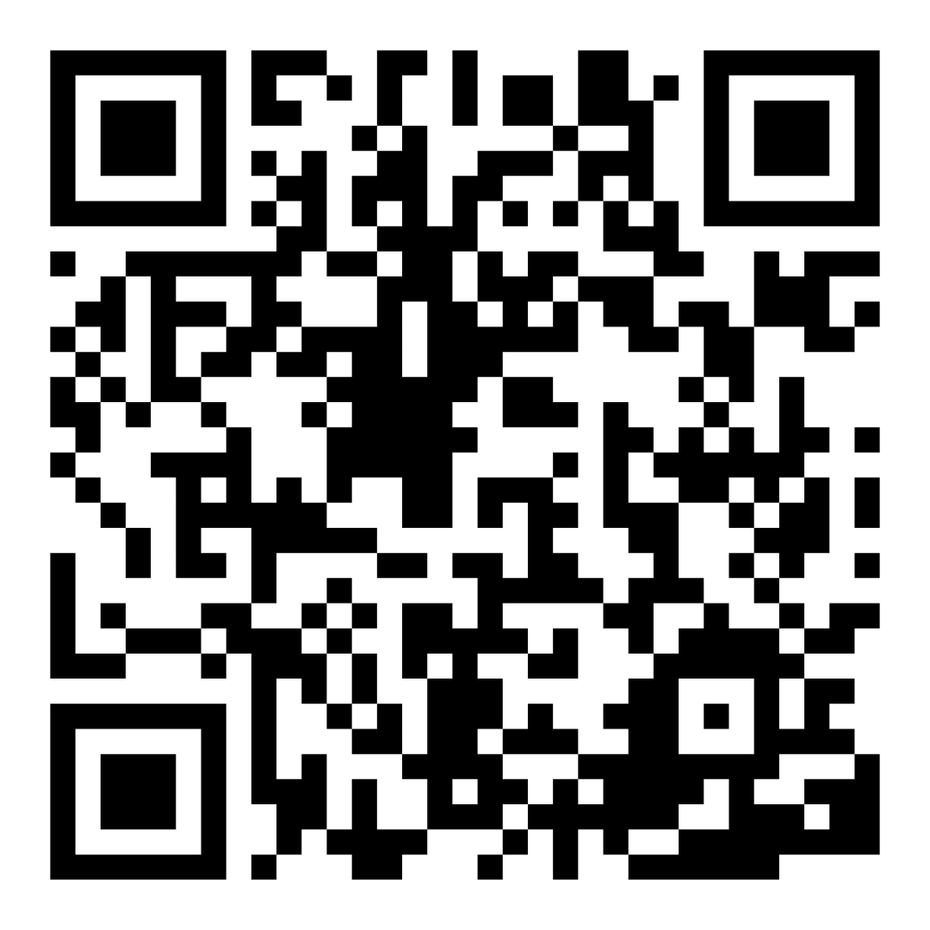
Family Confidence Survey
Scan this code to share how you’re feeling about reading with your child. Participants will be entered into a raffle for a $15 gift card. One winner per school will be drawn after the first and last workshops.
bit.ly/3BUBxbx
Notes:
If this is not the first or last Family Workshop, please delete this slide from the slide deck.
If you are an LAUSD teacher or staff member, please delete this slide from ALL Family Workshop decks.
Families who fill out the survey will be asked to provide an email to be entered into the raffle.
One raffle winner will be selected by Springboard Collaborative’s Data & Evaluation team after the first and last workshop and sent a $15 e-gift card to the email they provided.
If you need print-out versions of the QR code survey in English or the other translated languages, you can find those here: https://drive.google.com/file/d/1zjxnM0C9aP4C9WJFbw2A8eFpjZ29wBWG/view?usp=sharing
If you want to send the survey directly to families, you can find the link to the survey here: bit.ly/3BUBxbx

Slide 5
Workshop guidelines
Be prepared.
Be present.
Be courteous.
Ask questions.
Notes:
Briefly explain the guidelines or “the rules we all agree to follow so that we can all have an enjoyable and an effective workshop.”
If this is the first workshop, briefly explain each of the guidelines.
Alternatively, a family volunteer may read or summarize this slide if they’ve attended the previous workshop. ​
Consider putting these on chart paper and inviting the group to add to the list. If you do this, be sure to change this slide in subsequent workshops.​
Emphasize these guidelines are for everyone (including you, the facilitator) and pledge to be prepared, present, courteous, and ask questions.
Emphasize the last point and specifically invite families to ask lots of questions.

Slide 6
Let’s Go Back
1
2
3
Notice the tricky word.
Wait and praise.
Go back and reread with expression.
Rereading (and rereading) builds fluency.
Notes:
Part 2: Reading tip
Introduce the 3 parts of the reading tip.
Sample script:
Here is our tip for today:
First we will review what to do when your child is struggling with a tricky word.
Next, we will watch our reader to see what steps they take on their own to figure out the tricky word and praise their efforts.
Finally, we’ll talk about how to use those tricky words as a moment to build fluency or sound more like a storyteller.
Why? In order to grow as a reader, a child should reread to work on fluency or sounding like a storyteller. It also helps them to cement the tricky word in their minds.
Sample script in Spanish:
Aquí está el consejo de hoy:
Primero, vamos a repasar lo que se debe de hacer cuando su hijo está batallando con una palabra complicada.
Luego, vamos a observar el lector para ver cuáles pasos toma independientemente para averiguar la palabra complicada y elogiar sus esfuerzos.
Por ultimo, vamos a hablar sobre cómo se puede usar el proceso de averiguar las palabras complicadas como un momento para aumentar la fluidez o oírse más como un cuentista.
¿Por qué? Para crecer como un lector, un niño debe de volver a leer para mejorar su fluidez o oírse más como un cuentista. También le puede ayudar para aprender bien las palabras complicadas en su mente.

Slide 7
Check in on literacy terms
Tricky word
a hard word your child doesn’t know yet
Expression
When your voice is full of emotion, natural pauses, and an easy-to-listen-to speed.
Notes:
To make sure everyone has a common understanding, define some literacy terms as needed.

Slide 8
Notice the tricky word
Tips and tricks
Look for words:
your child will see again
your child struggled to read
if it’s been awhile since you reread
Adult: Hmm… here’s a good word.
Child: “Oh no…the fox…is … is scared… What is…a…c…
Notes:
Use the slide page to model and explain why “across” is a good word to talk about
The criteria you may share with families are:
It’s a word that your child is likely to see again.
If the children are older, stress the importance of academic vocabulary such as complex, summarize, describe—words that we use in schools a lot.
If children are younger, you may want to talk about sight words or high-frequency words.
It’s a word your child struggled to read, and they may have lost track of the overall meaning of the sentence.
It’s been awhile since you reread a word.
►Be sensitive to the fact that some Multilingual families may not have the necessary schema to choose a word based on this criteria.
Take time to explicitly reassure them that this technique will work with any word.
If possible, reading with a translating tool (like Google Translate) or a dictionary handy will be helpful for them as the coach.
Remind families that they don’t need to do this for every unknown word that their child encounters.
If the child if struggling with many words on the page, they may need to read a different book and come back to that one later.

Slide 9
Wait and praise
Use your finger and read it sound by sound.
Do you see any word parts you know inside the tricky words?
What word makes sense? Does that word match the letters here?
I’ll just wait.
Have you tried…
The word is…
That was a tricky one. Way to tackle it!
Notes:
Review with families the things they might do when their child encounters a tricky word.
Remind them that being patient and waiting is always the first option.
Then they can try coaching the child.
Ask families to volunteer some way they coach their child. Encourage families to jot down ideas.
Remind them that telling their child the word is also an option, especially if coaching has not worked.
Encourage families to be positive and encouraging ALWAYS.
Sample script
When readers encounters a word they don’t know, they may struggle a little bit. This is good practice. try to be patient as your child tries to sound out the word. If they are having trouble, or are just trying to guess the word, remind them to look at the letters and letter combinations and use what they know about those letter sounds. See the side panel here for some common strategies. You could also say–what would your teacher remind you to do? For example you might say, “You tried one sound for the letter combination “ea” but remember when we put “ea” together they can make another sound. Try another sound and see if that makes a work you know.”
If they get the word! Congratulate them and repeat the strategy that helped. For example, if they were struggling to read the word “kitchen” but they found the word “kit” first and then sounded out “chen” I would say–”Good job! When you found the word “kit” inside that larger word that helped you figure out the word.”
If they have tried a variety of things and they still don’t get the word, it’s fine. You can tell the word to them. If you don’t know it yourself, it’s fine to model looking it up in a dictionary or on your phone.
Either way–be sure to praise them for working on the tricky word!
Sample script in Spanish
Cuando los lectores encuentran una palabra que no conocen, pueden tener un poco de dificultad. Esta es una buena práctica. Trate de ser paciente mientras su hijo trata de pronunciar la palabra. Si tienen problemas o simplemente intentan adivinar la palabra, recuerden les que miren las letras y las combinaciones de letras y que usen lo que saben sobre los sonidos de las letras. Vea el panel se enseguida aquí para algunas estrategias comunes. También podrían decir les: ¿qué te recordaría tu profesor que hicieras? Por ejemplo, podría decir: "Probaste un sonido para la combinación de letras "ea", pero recuerda que cuando juntamos "ea" pueden formar otro sonido. Prueba con otro sonido y ve si eso crea una palabra que ya conoces.”
¡Si agarran la palabra! Felicítelos y repitan la estrategia que les ayudó. Por ejemplo, si tenían dificultades para leer la palabra "kitchen", pero primero encontraron la palabra "kit" y luego pronunciaron "chen", diría: "¡Buen trabajo! Cuando encontraste la palabra “kit” dentro de esa palabra más grande te ayudó a descifrar la palabra.”
Si han probado una variedad de cosas y todavía no entienden la palabra, está bien. Pueden decirles la palabra. Si no lo sabe usted mismo, está bien modelen buscándolo en un diccionario o en su teléfono.
De cualquier manera, ¡asegúrese de felicitarlos por trabajar en la palabra difícil!

Slide 10
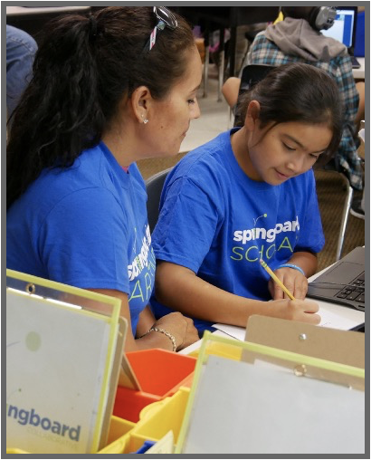
Go back and reread with expression
Adult: “Let’s go back and read that sentence again with expression.”
Child: “Oh no! The fox is scared. What is across the river?”
Your child may need to read it a few times. But don’t overdo it!
Notes:
Explain the third step—go back and reread with expression.
Model or invite a family to show what rereading with expression sounds like.
Sample script
After your child has figured out the tricky word, invite them to return to the beginning of the sentence (or phrase, if it’s a long sentence) and reread it. Remind them to focus on reading it with expression and smoothly integrating the tricky word. You may want to model it, or read it first, to help them. If it’s helpful, they can read it two or three times before moving on.
Sample script in Spanish
Después de que su hijo averigua la palabra complicada, debe de regresar al inicio de la oración (o frase, si es una oración larga) y leerla de nuevo. Hay que recordarle que debe de enfocarse en leerla con expresión y fluidez cuando incluye la palabra complicada. Podría modelarla, o leerla primero, para ayudarle. Si le ayuda, la puede leer dos o tres veces antes de continuar.

Slide 11
Reading = conversation (K-1)
Can you use your finger and read it sound by sound?
Use your finger. Cover up a part of the word. Do you see a part you know?
Good! Way to keep working on that word!
Let’s go back and reread this sentence from the beginning.
Notes:
Remind families that the at-home reading coach always asks questions!
► For Multilingual families specifically: Some families may come from a culture where asking questions and “coaching” their child may be an unfamiliar practice. Instead, they may be more used to being directive and having the answers​.
Encourage families to keep trying this coaching technique and assure them that the more they do it, the more comfortable it will become. ​
Although “parent as expert” and “parent as coach” are equally valid positions, asking questions and encouraging children to find the answer out for themselves instead of telling them an answer can help children internalize the learning in a different way.
This is a good time to remind parents that even though asking questions may not at present be a regular practice for them, this is an opportunity for them to acquire and practice new skills that will help their children. Cultural shifts are usually most effective when they're explicit.​
Use this slide to ensure that families have some questions they can ask during practice time.
Ask families to hold up the number of questions they already have written down or are prepared to use. If it looks like the room is prepared, you may skip this slide or ask families to share other questions they have written down throughout the workshop.
Share with families that there are also sample questions on the Reading Tip Sheet.
Sample script
At Springboard, the most important thing we want you to leave with is: to ALWAYS ASK QUESTIONS. You want to ask your child questions to help them figure out words, understand what they’re reading, sound more like a storyteller, and enjoy what they are reading. Today we’ve learned questions to help your child go back and reread after learning how to pronounce a tricky word.
Sample script in Spanish
En Springboard, lo más importante con lo que queremos que se vaya es: QUE SIEMPRE HAGA PREGUNTAS. Quiere hacerle preguntas a su hijo para ayudarlo a descifrar palabras, comprender lo que está leyendo, sonar más como un narrador y disfrutar lo que está leyendo. Hoy aprendido preguntas para ayudar a su hijo a volver atrás y releer después de aprender a pronunciar una palabra difícil.

Slide 12
Reading = conversation (2-3)
Does that word you said match the letters and sounds you see?
I’ll wait because I think you can do it.
Now that you know the word, let’s go back and reread from the beginning.
Notes:
Remind families that the at-home reading coach always asks questions!
► For Multilingual families specifically: Some families may come from a culture where asking questions and “coaching” their child may be an unfamiliar practice. Instead, they may be more used to being directive and having the answers​.
Encourage families to keep trying this coaching technique and assure them that the more they do it, the more comfortable it will become. ​
Although “parent as expert” and “parent as coach” are equally valid positions, asking questions and encouraging children to find the answer out for themselves instead of telling them an answer can help children internalize the learning in a different way.
This is a good time to remind parents that even though asking questions may not at present be a regular practice for them, this is an opportunity for them to acquire and practice new skills that will help their children. Cultural shifts are usually most effective when they're explicit.​
Use this slide to ensure that families have some questions they can ask during practice time.
Ask families to hold up the number of questions they already have written down or are prepared to use. If it looks like the room is prepared, you may skip this slide or ask families to share other questions they have written down throughout the workshop.
Share with families that there are also sample questions on the Reading Tip Sheet.
Sample script
At Springboard, the most important thing we want you to leave with is: to ALWAYS ASK QUESTIONS. You want to ask your child questions to help them figure out words, understand what they’re reading, sound more like a storyteller, and enjoy what they are reading. Today we’ve learned questions to help your child go back and reread after learning how to pronounce a tricky word.
Sample script in Spanish
En Springboard, lo más importante con lo que queremos que se vaya es: QUE SIEMPRE HAGA PREGUNTAS. Quiere hacerle preguntas a su hijo para ayudarlo a descifrar palabras, comprender lo que está leyendo, sonar más como un narrador y disfrutar lo que está leyendo. Hoy aprendido preguntas para ayudar a su hijo a volver atrás y releer después de aprender a pronunciar una palabra difícil.

Slide 13
Multilingual families
Use a dictionary, app, or website to check the words.
Give a lot of encouragement to help build reading skills.
Notes:
Use this slide if families’ primary language is not English or they may have specific questions. Alternatively, if you have talked about accommodations throughout the reading tip explanation you may skip this slide or use it to briefly sum up.
Explain the tips on the slide. If you need more detail, see “Ideas to differentiate” in the Workshop Guide.

Slide 14
Practice time
1
Notice the tricky word.
Call me over when you have a question!
2
Wait and praise.
3
Go back and reread with expression.
Notes:
Part 3: Practice time
Note: Practice time should be most of the remaining time. Leave 10 minutes or so at the end for reflection.
Summarize the tip and remind families to repeat these steps during practice time.
Take a moment to explain that you’ll be circulating around while they practice (to provide 1:1 support and answer any questions).
►Multilingual families in particular often come with feelings of self-consciousness that can be overcome when they know why they're being observed.
Remind families to ask questions as they use the tip.
There are also sample questions on the Reading Tip Sheet.
To support families, consider underlining two high leverage questions on the Reading Tip Sheet as you circulate.
Remind families they can always work on their action plan or other strategies during practice time, especially if they have questions or want some help with it.
Circulate and work with families. Here are some suggestions:
Walk over to a family. Ask, “Do you have any questions about the reading tip?”
If yes, answer question.
If no, say, “May I listen in for a moment?”
Listen for a full minute.
Compliment the family on something they did well and then leave them with one suggestion (if needed).
Walk over to a family and ask, “Can I try this reading tip with your child?”
After you’ve modeled it, ask the adult, “What did you notice me doing?” or say “Did you notice that I…”
Gather “glows”(things that families did that you want to lift up to the group) and “grows” (things families do that you want to stop and correct/clarify for the whole group).
Share the “glows” and “grows” at 10 mins into practice time or wait until the end.
Keeps “grows” anonymous, but congratulate specific families on “glows.”

Slide 15
Reflect
Any questions about the reading tip?
Turn and talk with your child: Do we feel ready to try this reading tip at home?
Please share how you might use this at home.
Your question will help someone else in the room!
Notes:
Part 4: Reflection & updates
Invite participants to ask questions.
Give ample wait time for each question. ​
Remind families that when parents talk they make it safe for more hesitant parents to share. It builds community in the classroom. ​
Encourage other voices to share.
In addition, you could share some “glows” and “grows” you noticed while walking around and supporting families during practice time.
Check in on the goal of Family Workshops.​
Read “Any questions…”? and wait. Let this question hang and give ample wait time.​
Invite families who don’t yet feel equipped to do the reading tip on their own to raise their hand (or indicate in a more private way) so you can check in with them personally before they leave the workshop.
Invite a family volunteer to share how they will use the reading tip at home.
If time permits, you may do a whip-around share.
Invite families to each share one thing (in 30 seconds or less). This could be:
Something they learned
One thing they’re excited to try at home
One thing they found challenging about this tip
One step they will focus on this week

Slide 16
Feedback, please
Your input improves our time together!
Notes:
Invite families to make a reading plan for the upcoming week.
Remind families that readers need “reading together” time and “reading alone” time.
Remind families that reading in workshops counts as “reading together time” and they should log it (if applicable).
Invite families to give you feedback so that you can facilitate a workshop that works for them!
Families can use the printed feedback form (if available) or a digital feedback form.
Invite families to give you more informal feedback. This could look like a thumbs up if they liked the reading tip or writing one thing they hope for the next workshop.
Use this time to meet individually with families as needed.
Sample script
And finally, I want to make sure I’m hosting a Family Workshop that works for you. Every workshop, you’ll have a chance to give me feedback, and I promise you that I will read it and do my best to incorporate it. Will you fill out the survey before you leave? If you’d rather talk about your suggestions instead of writing them down let me know. Thanks, and see you at the next workshop!
Sample script in Spanish
Para cerrar, quiero asegurar que estoy dando un taller de familia que les sirve a ustedes. En cada taller, tendrán la oportunidad de proveer comentarios. Yo les prometo que los voy a leer y voy a hacer mi mejor esfuerzo para incorporar los consejos en el próximo taller. ¿Pueden contestar el sondeo antes de irse? Si prefieren platicar sobre sus ideas, en vez de escribirlas, avísenme. ¡Gracias y nos veremos en el próximo taller!

