Slide 1
Workshop guide
Facilitator:
Read notes to prepare. Amend slides if needed.
Practice the script aloud. Change as needed.
Ready the family-facing materials.
Display slide 2 as families arrive.
Say the Sounds, Squish the Sounds
Notes:
Copyright 2022 Springboard Collaborative, all rights reserved.
Overview and rationale
This pre-reading workshop focuses on phonological awareness. Families learn to help their child notice word parts and orally blend them together to say the correct word. This strategy helps children identify all of the sounds in a word and eventually put those sounds together to either read or spell a word.
Materials
Corresponding Reading Tip Sheet (in the languages the families need)
Family Workshop Feedback Form (paper or digital form)
Optional: Legos or unifix cubes to show how you can use objects to signify the “squishing” (see “Squish them together” slide)
Word list for families to use during practice time (see Facilitation notes)
Projector to display slides
Empty envelope for families to put feedback form in (optional but highly recommended)
Name tags (optional but highly recommended)
Facilitation notes
To prepare
In this workshop, you will model how to help a child develop phonological awareness.
Preview the light blue slides and choose the ones that are appropriate for your context.
Be sure to familiarize yourself with the content of the presentation so you can talk with families, not at them.
Study the slides in the reading tip section. Think through how you will model and guide practice.
Prepare a list of two syllable words on chart paper or a white board. Families may will use the list during a guided practice on the “Say the word parts” slide and then again in the “Practice time.”
Consider adding additional words for families to use independently during practice time. See practice time slide.
If this is the last Family Workshop, plan how to celebrate!
During workshop
Take time to build rapport as a group and individually with families. Little things like learning family members’ names and greeting them at the door go a long way.
Keep pace so that families have time to practice the tip and also reflect. Being able to practice and reflect helps families internalize the strategy.
Circulate and check in with families individually during practice time. See “Practice time” slide for more specific suggestions.
Ideas to differentiate
Preview “Check in on literacy terms” and adjust terms or definitions as needed.
If teaching this workshop to families with older children, instead of squishing, or blending, two syllable words, older kids can blend words with more syllables (e.g., elephant or dinosaur) or for even more of a challenge, can blend together the onset and rime of one-syllable words (e.g., c/at, ch/in, wh/eel).
If teaching this workshop to Multilingual families: The same steps can be followed with words from a language other than English; students will still get to practice hearing the word parts and blending them together.
If families are familiar with this workshop, consider how you might leverage their experience. Ask families to share how they helped their child internalize the steps. Encourage them to practice with multisyllabic words (they can squish together their hands with their child’s hands). Families could also squish together various manipulatives.
Timing suggestion for a 35 min workshop*
Welcome: 5 mins
Reading tip: 8-10 mins
Practice: 5-10 mins
Reflection and updates: 10 mins
*Springboard Collaborative Family Workshops generally run 60 minutes. Because this is a pre-reading workshop, we suggest a 30-40 minute workshop instead.
After you use these materials, we want to hear your feedback! Fill out the Family Workshop Facilitator Feedback Form at https://bit.ly/SBCfeedbackform.

Slide 2
Say the Sounds, Squish the Sounds
Notes:
Part 1: Welcome
Formally welcome families and tell them the title of today’s workshop. Do not go into specific steps of the reading tip at this point.
Ensure families have the materials they need and are sitting with their children.

Slide 3
Agenda
Welcome
Reading tip
Practice time
Reflection & updates
Notes:
Provide an overview of what families will be doing today (and at every Family Workshop).
If this is the first or second Family Workshop in a series, explain that the icons for each of the four parts of the Family Workshop also run along the bottom of slides. ​
Sample script
Here is our plan for today. You can see each part of our agenda has an icon [point to the icons]. You can also find each icon along the bottom of each slide [point to bottom] so you can see where we are in the agenda. First, we’ll review a couple of things, then we’ll get right to the reading tip. Most of our time will be spent on practice time so we can all try out the reading tip. Then we’ll reflect and talk about some updates.
Please speak up with questions, concerns, or anything you’d like to share. We’re here together for one hour and need to maximize the time. Every child learns to read in a different way, but putting our heads together helps our shared cause: to give kids a reading boost and cultivate a joy of reading.
Sample script in Spanish
Aquí tenemos el plan para hoy. Se puede ver que cada parte de la agenda tiene un ícono [point to the icons]. También se encuentran en el final de cada diapositiva [point to bottom] para que puedan saber en qué parte estamos. Primero, vamos a repasar algunas cosas. Luego vamos a empezar con el consejo de la lectura. La mayoría del tiempo vamos a pasar aquí, en la práctica, para probar el consejo de la lectura juntos. Luego, vamos a reflexionar y hablar sobre algunas novedades.
En cualquier momento, pueden hacer preguntas, compartir preocupaciones, o cualquier otra cosa que quieren compartir. Vamos a estar juntos por una hora y queremos aprovechar del tiempo que tenemos. Cada niño aprende a leer de una manera diferente. Estamos aquí para trabajar en la misma causa: ayudarles a los niños a mejorar en la lectura y llegar a disfrutarla.

Slide 4
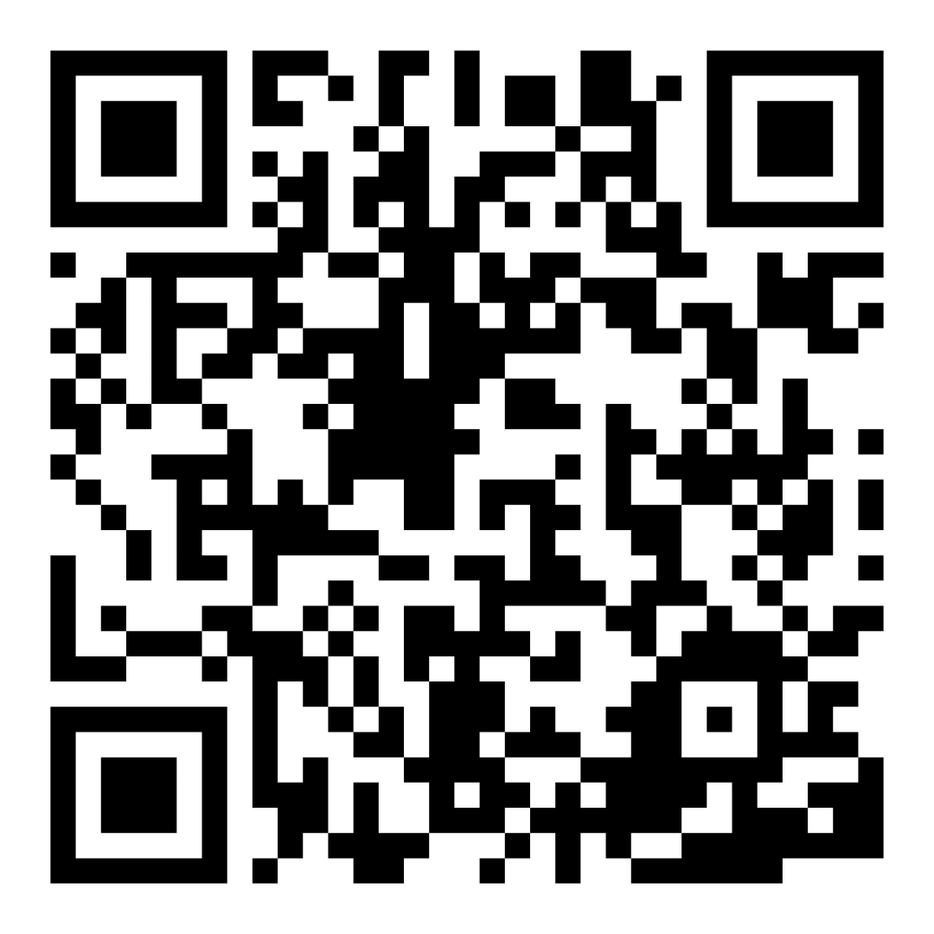
Family Confidence Survey
Scan this code to share how you’re feeling about reading with your child. Participants will be entered into a raffle for a $15 gift card. One winner per school will be drawn after the first and last workshops.
bit.ly/3BUBxbx
Notes:
If this is not the first or last Family Workshop, please delete this slide from the slide deck.
If you are an LAUSD teacher or staff member, please delete this slide from ALL Family Workshop decks.
Families who fill out the survey will be asked to provide an email to be entered into the raffle.
One raffle winner will be selected by Springboard Collaborative’s Data & Evaluation team after the first and last workshop and sent a $15 e-gift card to the email they provided.
If you need print-out versions of the QR code survey in English or the other translated languages, you can find those here: https://drive.google.com/file/d/1zjxnM0C9aP4C9WJFbw2A8eFpjZ29wBWG/view?usp=sharing
If you want to send the survey directly to families, you can find the link to the survey here: bit.ly/3BUBxbx

Slide 5
Workshop guidelines
Be prepared.
Be present.
Be courteous.
Ask questions.
Notes:
Briefly explain the guidelines or “the rules we all agree to follow so that we can all have an enjoyable and an effective workshop.”
If this is the first workshop, briefly explain each of the guidelines.
Alternatively, a family volunteer may read or summarize this slide if they’ve attended the previous workshop. ​
Consider putting these on chart paper and inviting the group to add to the list. If you do this, be sure to change this slide in subsequent workshops.​
Emphasize these guidelines are for everyone–including you, the facilitator–and pledge to be prepared, present, courteous, and ask questions.
Emphasize the last point and specifically invite families to ask lots of questions.

Slide 6
Say the sounds, squish the sounds
1
2
3
Say the word parts.
Squish them together.
Hearing parts of a word and then putting them together helps your child prepare to blend the sounds in a word when they try to read it.
Say the word.
Notes:
Part 2: Reading tip
Introduce the 3 parts of the reading tip.
Sample script
Here is our reading tip today:
First, you will choose a spoken word with more than one syllable and say the word parts.
Then, you will use your hands (or other body part) to “squish” the sounds back together.
Last, you will say the whole word.
Why is this an important reading tip?
Phonological awareness is the awareness of the different sound structures of words. The goal of “Sound and squish” is to help your child notice word parts and blend them together to say the correct word. This skill will help your child later when they are learning how to identify all of the sounds in a word and put those sounds together to either read or spell a word.
Sample script in Spanish:
Hoy el consejo de lectura es:
Primero, escoger una palabra con más de una sílaba y decir las partes de la palabra.
Luego, usar las manos (o alguna otra parte del cuerpo) para “juntar” los sonidos por apretarlas.
Finalmente, decir la palabra entera.
¿Por qué este consejo es importante?
El conocimiento de la fonética, conocido como “phonological awareness” en inglés, se trata de entender las diferentes estructuras de los sonidos de palabras. La meta de “Decir los sonidos y apretarlos” es ayudarle a su hijo a darse cuenta de las partes de las palabras y juntarlas para decir la palabra correcta. Esta destreza le va a ayudar a su hijo después cuando está aprendiendo cómo identificar todos los sonidos de una palabra y juntar los sonidos para leer o escribir una palabra.

Slide 7
Check in on literacy terms
Phonological awareness
an awareness that different sounds and sound structures make up words.
Notes:
To make sure everyone has a common understanding, define some literacy terms as needed.

Slide 8
Say the word parts
Tips and tricks
Tell your child the two parts of the word, but don’t squish them together yet!
Snow
Ball
Notes:
Model step 1: Say the word parts.
Demonstrate by saying “snow” while holding out your left hand to your side, palm up, and then “ball” while holding out your right hand, palm up.
Point families to words on chart paper (or a white board) and practice breaking up a few more words into parts.
Sample script
First choose a two-syllable word like “chicken” or “snowball.” Tell your child the two parts, but don’t squish them together yet. You might want to use your hands to demonstrate the two parts before you squish them together. Let’s practice as a group. [Use the words posted on chart paper].
Sample script in Spanish
Primero van a escoger una palabra de dos sílabas, como “chicken” o “snowball.” Van a decir las dos partes por separado. Recomiendo que usen las manos para demostrar las dos partes antes de juntarlas. Vamos a practicarlo en grupo. [Use las palabras que las familias escribieron en la cartulina].

Slide 9
Squish them together
You can also use objects or other parts of your body to squish the sounds together.
Snowball
Notes:
Model step 2: Squish them together.
Demonstrate by squishing/clapping your hands together and saying “snowball.”
Sample script
Then take your two hands and squish (slap) them together and say the two parts again, together.
You can also use objects or other parts of your body to show how the two parts squish together. You might use two blocks that snap together [demonstrate with Lego or unifix cubes or other objects] or you can do it with a partner [demonstrate with a partner by each saying a part and then squishing together].
Sample script in Spanish
Luego van a apretar las manos (batirlas) y decir las dos partes de nuevo, pero ahora las van a decir juntas.
También se puede usar objetos o otras partes del cuerpo para mostrar cómo las dos partes de juntan. Podría usar dos bloques que dan un chasquido cuando se juntan [demostrar con Lego o cubos de unifix cubes o algún otro objeto] o se puede hacer en parejas [demostrar con alguien más: cada uno dice una parte y luego se abrazan].

Slide 10
Say the word
Tips and tricks
You might do this a few times for each word.
Child: Snowball!
Adult: What’s the word?
Notes:
Reinforce that we want the child to say the word in parts and also put together.
Sample script
Then have your child say the whole word again: snowball. You might do this a few times for each word.
Sample script in Spanish
Luego su hijo debe de decir la palabra entera de nuevo: snowball. Sería bueno repetir este proceso varias veces para cada palabra.

Slide 11
Let’s practice
Say the word parts.
Squish them together.
Say the word.
drumstick
chicken
Notes:
Demonstrate the whole process one more time:
Left hand out to side with palm up: say “drum”
Right hand out to side with palm up: say “stick”
Squish/clap hands together: say “drumstick”
Lead the group through the process with the word “chicken” (on the slide) and the words posted on the chart paper.

Slide 12
Multilingual families
Use this with books in any language.
Notes:
Use this slide if families’ primary language is not English or they may have specific questions. Alternatively, if you have talked about accommodations throughout the reading tip explanation you may skip this slide or use it to briefly sum up.
Explain the tips on the slide. If you need more detail, see “Ideas to differentiate” in the Workshop Guide.

Slide 13
Reading = conversation
What are the two parts of this word?
What word does it make when we squish these parts together?
Let’s break this word apart. If I say “snowball,” what are the two parts?
Notes:
Remind families that the at-home reading coach always asks questions!
The questions you learn today will help you ask questions before your child begins to read on their own so you can help them build important foundational skills.
► For Multilingual families specifically: Some families may come from a culture where asking questions and “coaching” their child may be an unfamiliar practice. Instead, they may be more used to being directive and having the answers​.
Encourage families to keep trying this coaching technique and assure them that the more they do it, the more comfortable it will become. ​
Although “parent as expert” and “parent as coach” are equally valid positions, asking questions and encouraging children to find the answer out for themselves instead of telling them an answer can help children internalize the learning in a different way.
This is a good time to remind parents that even though asking questions may not at present be a regular practice for them, this is an opportunity for them to acquire and practice new skills that will help their children. Cultural shifts are usually most effective when they're explicit.​
Use this slide to ensure that families have some questions they can ask during practice time.
Ask families to hold up the number of questions they already have written down or are prepared to use. If it looks like the room is prepared, you may skip this slide or ask families to share other questions they have written down throughout the workshop.
Share with families that there are also sample questions on the Reading Tip Sheet.
Sample script
At Springboard, the most important thing we want you to leave with is: to ALWAYS ASK QUESTIONS. You want to ask your child questions to help them think about words and sounds, understand what you’re reading together, and enjoy books and stories. And remember—we can have these playful conversations even without a book! You can work them into your day whenever and wherever—at the grocery store, before bedtime, at bath time, etc. These questions will help your child practice speaking the language they will soon be reading!
Today we’ve learned questions to help your child build phonological awareness that will later help them to read words on their own.
Sample script in Spanish
En Springboard, lo más importante con lo que queremos que se vaya es: QUE SIEMPRE HAGA PREGUNTAS. Quiere hacerle preguntas a su hijo que le hagan pensar en palabras y sonidos, entender lo que están leyendo juntos, y disfrutar libros y cuentos. Y acuérdense – podemos tener estas conversaciones divertidas sin un libro. Puede tenerlas en cualquier momento, en donde sea – en el supermercado, antes de dormir, etc. ¡Las preguntas le ayudarán a su hijo practicar cómo hablar el idioma para poder leer en poco tiempo!
Hoy hemos aprendido preguntas para fomentar un conocimiento fonológico que les ayudarán a sus hijos para leer las palabras independientemente en el futuro.

Slide 14
Practice time
1
Say the word parts.
Call me over when you have a question!
baseball
lion
water
pancake
puppy
2
Squish them together.
3
Say the word.
Notes:
Part 3: Practice time
Note: Practice time should be most of the remaining time. Leave 10 minutes or so at the end for reflection.
Summarize the tip and remind families to repeat these steps during practice time.
Take a moment to explain that you’ll be circulating around while they practice (to provide 1:1 support and answer any questions).
►Multilingual parents in particular often come with feelings of self-consciousness that can be overcome when they know why they're being observed.
Remind families to ask questions as they use the tip.
There are also sample questions on the Reading Tip Sheet.
To support families, consider underlining two high-leverage questions on the Reading Tip Sheet as you circulate.
Remind families they can always work on their action plan or other strategies during practice time, especially if they have questions or want some help with it.
Circulate and work with families. Here are some suggestions:
Walk over to a family. Ask, “Do you have any questions about the reading tip?”
If yes, answer question.
If no, say, “May I listen in for a moment?”
Listen for a full minute.
Compliment the family on something they did well and then leave them with one suggestion (if needed).
Walk over to a family and ask, “Can I try this reading tip with your child?”
After you’ve modeled it, ask the adult, “What did you notice me doing?” or say “Did you notice that I…”
Gather “glows” (things that families did that you want to lift up to the group) and “grows” (things families do that you want to stop and correct/clarify for the whole group).
Share the “glows” and “grows” at 10 mins into practice time or wait until the end.
Keeps “grows” anonymous, but congratulate specific families on “glows.”

Slide 15
Reflect
Any questions about the reading tip?
Turn and talk with your child: Do we feel ready to try this reading tip at home?
Please share how you might use this at home.
Your question will help someone else in the room!
Notes:
Part 4: Reflection & updates
Invite participants to ask questions.
Give ample wait time for each question. ​
Remind families that when parents talk they make it safe for more hesitant parents to share. It builds community in the classroom. ​
Encourage other voices to share.
In addition, you could share some “glows” and “grows” you noticed while walking around and supporting families during practice time.
Check in on the goal of Family Workshops.​
Read “Any questions…”? and wait. Let this question hang and give ample wait time.​
Invite families who don’t yet feel equipped to do the reading tip on their own to raise their hand (or indicate in a more private way) so you can check in with them personally before they leave the workshop.
Invite a family volunteer to share how they will use the reading tip at home.
If time permits, you may do a whip-around share.
Invite families to each share one thing (in 30 seconds or less). This could be:
Something they learned
One thing they’re excited to try at home
One thing they found challenging about this tip
One step they will focus on this week

Slide 16
Purposeful play -> learning
Questions and meaningful conversations build the foundation of reading!
Notes:
Remind families of the importance of play at this age and how playing with words, letters, sounds, books, etc. is the most effective way to build a foundation of reading.
Explain how today’s reading tip will help readers develop the skills they need to read well.
Sample script
Remember, our overall goal is to help your child build a foundation of reading. When your child starts to learn how to read, they will need to:
Be able to figure out the words they are reading. All the fun and playful things we do to help your child learn the sounds in words and to learn new words build toward this skill. Remember, you can do this without a book by just talking and listening to each other.
Be able to understand the story. All the reading and conversations you have will help your child be able to understand a story on their own. Encouraging their imaginations and ability to tell their own stories will help here, too!
And of course, we are helping our child learn how to engage and enjoy in a story every time we tell stories or read books.
Being able to sound like a storyteller is a skill your child will develop a little later.
Saying the sounds in a word and then squishing them together will help your child figure out the words when they start reading.
Sample script in Spanish
Recuérdense, nuestra meta en general es ayudarles a sus hijos a construir una base para la lectura. Cuando sus hijos empiezan a leer, tienen que:
Descifrar las palabras que están leyendo. La diversión y los juegos que hacemos para ayudarles a aprender los sonidos de las palabras y palabras nuevas les lleva a esta destreza. Recuérdense, se puede hacer sin un libro por simplemente hablar juntos y escuchar uno al otro.
Comprender un cuento. Toda la lectura y las conversaciones que tienen ayudarán a sus hijos para entender el cuento independientemente. Animarlos a usar sus imaginaciones y contar sus propios cuentos les ayudarán con eso también.
Y por supuesto, estamos ayudando a nuestros hijos a involucrarse con y disfrutar un cuento cada vez que contamos historias o leemos libros.
La destreza de sonar como un cuentista es una habilidad que su hijos desarrollarán cuando sean más grandes.
Decir los sonidos de una palabra y luego juntarlos le ayudará a su hijo para descifrar las palabras cuando empiece a leer.

Slide 17
Feedback, please
Your input improves our time together!
Notes:
Invite families to make a reading plan for the upcoming week.
Remind families that readers need “reading together” time and “reading alone” time.
Remind families that reading in workshops counts as “reading together time” and they should log it (if applicable).
Invite families to give you feedback so that you can facilitate a workshop that works for them!
Families can use the printed feedback form (if available) or a digital feedback form.
Invite families to give you more informal feedback. This could look like a thumbs up if they liked the reading tip or writing one thing they hope for the next workshop.
Use this time to meet individually with families as needed.
Sample script
And finally, I want to make sure I’m hosting a Family Workshop that works for you. Every workshop you’ll have a chance to give me feedback, and I promise you that I will read it and do my best to incorporate it. Will you fill out the survey before you leave? If you’d rather talk about your suggestions instead of writing them down, let me know. Thanks and see you at the next workshop!
Sample script in Spanish
Para cerrar, quiero asegurar que estoy dando un taller de familia que les sirve a ustedes. En cada taller, tendrán la oportunidad de proveer comentarios. Yo les prometo que los voy a leer y voy a hacer mi mejor esfuerzo para incorporar los consejos en el próximo taller. ¿Pueden contestar el sondeo antes de irse? Si prefieren platicar sobre sus ideas, en vez de escribirlas, avísenme. ¡Gracias y nos veremos en el próximo taller!

