Slide 1
Workshop guide
Facilitator:
Read notes to prepare. Amend slides if needed.
Practice the script aloud. Change as needed.
Ready the family-facing materials.
Display slide 2 as families arrive.
Say and Count Syllables
Notes:
Copyright 2022 Springboard Collaborative, all rights reserved.
Overview and rationale
This pre-reading workshop focuses on counting syllables in a spoken word. Families learn that a syllable is a beat in a word. A child’s ability to break apart a word into its syllables, or beats, helps develop an awareness of sounds in words, which will later lead to stronger decoding of words when they are ready to start reading. Families learn an easy way to support their child as they count syllables.
Materials
Corresponding Reading Tip Sheet (in the languages the families need)
Family Workshop Feedback Form (paper or digital form)
Books or word lists for families to use during practice time. This strategy works with both fiction and nonfiction texts.
Projector to display slides
Empty envelope for families to put feedback form in (optional but highly recommended)
Name tags (optional but highly recommended)
Facilitation notes
To prepare
In this workshop, you will model clapping out syllables in spoken words.
Preview the light blue slides and choose the ones that are appropriate for your context.
Be sure to familiarize yourself with the content of the presentation so you can talk with families, not at them.
Study the slides in the reading tip section. Think through how you will model and guide practice.
The model word is “zebra.” Consider adding additional words.
Families need words for practice time. Provide a word list (see ”Ideas to differentiate”) or books for families to find words in during practice time.
During workshop
Take time to build rapport as a group and individually with families. Little things like learning family members’ names and greeting them at the door go a long way.
Keep pace so that families have time to practice the tip and also reflect. Being able to practice and reflect helps families internalize the strategy.
Circulate and check in with families individually during practice time. See “Practice time” slide for more specific suggestions.
Ideas to differentiate
Preview “Check in on literacy terms” and adjust terms or definitions, as needed.
If teaching this workshop to families with older children add more multisyllabic words.
If teaching this workshop to Multilingual families: Be mindful that different languages may have different stresses on beats/syllables and levels of complexity of syllables in words that are different than English, so identifying syllables may be challenging for some. To support families consider the following ideas:​
Encourage families to practice this strategy with words in the language they are most comfortable with.
Provide a list of words that are already broken up into syllables.
Remind families that learning to be literate in another language takes time and patience. Stress the important role they play in their child’s development—namely as someone who encourages them to keep trying and keep going.
If families are familiar with this workshop, consider how you might leverage their experience. Ask families to share how they helped their child internalize the steps. Provide longer words for these families to practice with.
Timing suggestion for a 35 min workshop*
Welcome: 5 mins
Reading tip: 8-10 mins
Practice: 5-10 mins
Reflection and updates: 10 mins
*Springboard Collaborative Family Workshops generally run 60 minutes. Because this is a pre-reading workshop, we suggest a 30-40 minute workshop instead.
After you use these materials, we want to hear your feedback! Fill out the Family Workshop Facilitator Feedback Form at https://bit.ly/SBCfeedbackform.

Slide 2
Say and Count Syllables
Notes:
Part 1: Welcome
Formally welcome families and tell them the title of today’s workshop. Do not go into specific steps of the reading tip at this point.
Ensure families have the materials they need and are sitting with their children.

Slide 3
Agenda
Welcome
Reading tip
Practice time
Reflection & updates
Notes:
Provide an overview of what families will be doing today (and at every Family Workshop).
If this is the first or second Family Workshop in a series, explain that the icons for each of the four parts of the Family Workshop also run along the bottom of slides. ​
Sample script
Here is our plan for today. You can see each part of our agenda has an icon [point to the icons]. You can also find each icon along the bottom of each slide [point to bottom] so you can see where we are in the agenda. First, we’ll review a couple of things, then we’ll get right to the reading tip. Most of our time will be spent on practice time so we can all try out the reading tip. Then we’ll reflect and talk about some updates.
Please speak up with questions, concerns, or anything you’d like to share. We’re here together for one hour and need to maximize the time. Every child learns to read in a different way, but putting our heads together helps our shared cause: to give kids a reading boost and cultivate a joy of reading.
Sample script in Spanish
Aquí tenemos el plan para hoy. Se puede ver que cada parte de la agenda tiene un ícono [point to the icons]. También se encuentran en el final de cada diapositiva [point to bottom] para que puedan saber en qué parte estamos. Primero, vamos a repasar algunas cosas. Luego vamos a empezar con el consejo de la lectura. La mayoría del tiempo vamos a pasar aquí, en la práctica, para probar el consejo de la lectura juntos. Luego, vamos a reflexionar y hablar sobre algunas novedades.
En cualquier momento, pueden hacer preguntas, compartir preocupaciones, o cualquier otra cosa que quieren compartir. Vamos a estar juntos por una hora y queremos aprovechar del tiempo que tenemos. Cada niño aprende a leer de una manera diferente. Estamos aquí para trabajar en la misma causa: ayudarles a los niños a mejorar en la lectura y llegar a disfrutarla.

Slide 4
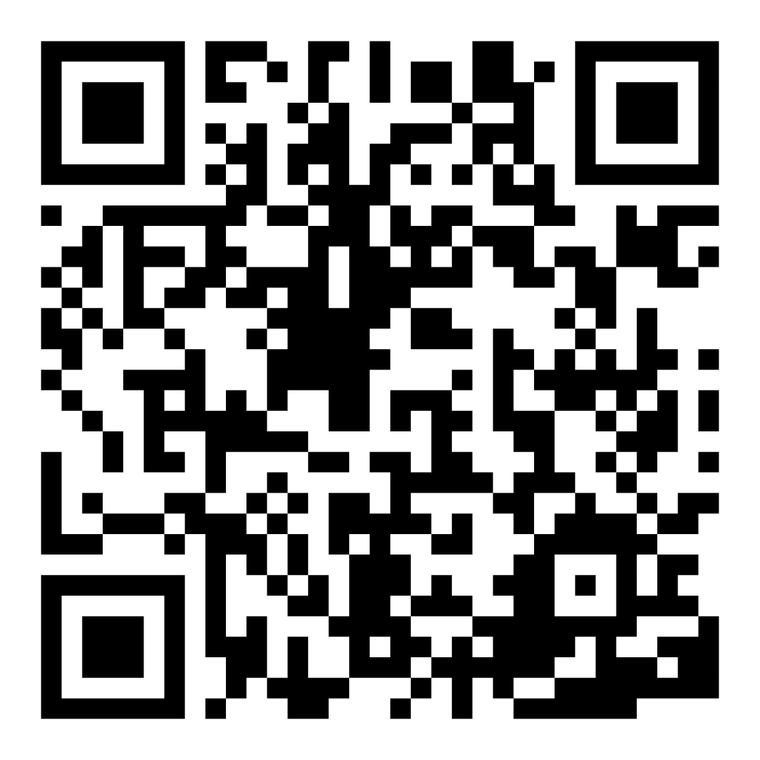
Family Confidence Survey
Scan this code to share how you’re feeling about reading with your child. Participants will be entered into a raffle for a $15 gift card. One winner per school will be drawn after the first and last workshops.
bit.ly/3BUBxbx
Notes:
If this is not the first or last Family Workshop, please delete this slide from the slide deck.
If you are an LAUSD teacher or staff member, please delete this slide from ALL Family Workshop decks.
Families who fill out the survey will be asked to provide an email to be entered into the raffle.
One raffle winner will be selected by Springboard Collaborative’s Data & Evaluation team after the first and last workshop and sent a $15 e-gift card to the email they provided.
If you need print-out versions of the QR code survey in English or the other translated languages, you can find those here: https://drive.google.com/file/d/1zjxnM0C9aP4C9WJFbw2A8eFpjZ29wBWG/view?usp=sharing
If you want to send the survey directly to families, you can find the link to the survey here: bit.ly/3BUBxbx

Slide 5
Workshop guidelines
Be prepared.
Be present.
Be courteous.
Ask questions.
Notes:
Briefly explain the guidelines or “the rules we all agree to follow so that we can all have an enjoyable and an effective workshop.”
If this is the first workshop, briefly explain each of the guidelines.
Alternatively, a family volunteer may read or summarize this slide if they’ve attended the previous workshop. ​
Consider putting these on chart paper and inviting the group to add to the list. If you do this, be sure to change this slide in subsequent workshops.​
Emphasize these guidelines are for everyone–including you, the facilitator–and pledge to be prepared, present, courteous, and ask questions.
Emphasize the last point and specifically invite families to ask lots of questions.

Slide 6
Say and count syllables
1
2
3
Hear a word.
Say the word.
Hear and feel the syllables in the word to count them.
This helps your child hear sounds in words–an important part of decoding!
Notes:
Part 2: Reading tip
Introduce the 3 parts of the reading tip.
Sample script
Here is our tip for the day:
First, we will pick a word you and your child have heard recently. Start with a shorter word that has only 1 or 2 syllables, or beats, like the word "bird" or "bubble.”
Then, we say the word.
Finally, you will help your child “feel” the syllables, or beats, in the word by doing something with their body.
Why?
A syllable is a beat in a word. A child’s ability to break apart a word into its syllables, or beats, helps them develop an awareness of sounds in words. Then later when they are trying to figure out how to read a new word sound by sound (we call this “decoding” the words), they will have an easier time focusing on the individual sounds.
Sample script in Spanish
Aquí está nuestro consejo de lectura:
Primero, vamos a escoger una palabra que usted y su hijo han escuchado recientemente. Empezar con una palabra corta, con solamente una o dos sílabas, es una buena idea, como las palabras “sí” o “gato”.
Luego, van a decir la palabra.
Finalmente, pueden ayudarles a sus hijos a “sentir” las sílabas en la palabra por mostrar el ritmo con su cuerpo.
¿Por qué?
Las sílabas muestran el ritmo de una palabra. Cuando un niño separa una palabra en sílabas, desarrolla un conocimiento de los sonidos de las palabras. Luego, cuando intenta leer una palabra nueva, sonido por sonido (que también se llama “descifrar” las palabras) será más fácil enfocar en los sonidos individuales.

Slide 7
Check in on literacy terms
Syllable
a “beat” in a word.
Notes:
To make sure everyone has a common understanding, define some literacy terms as needed.

Slide 8
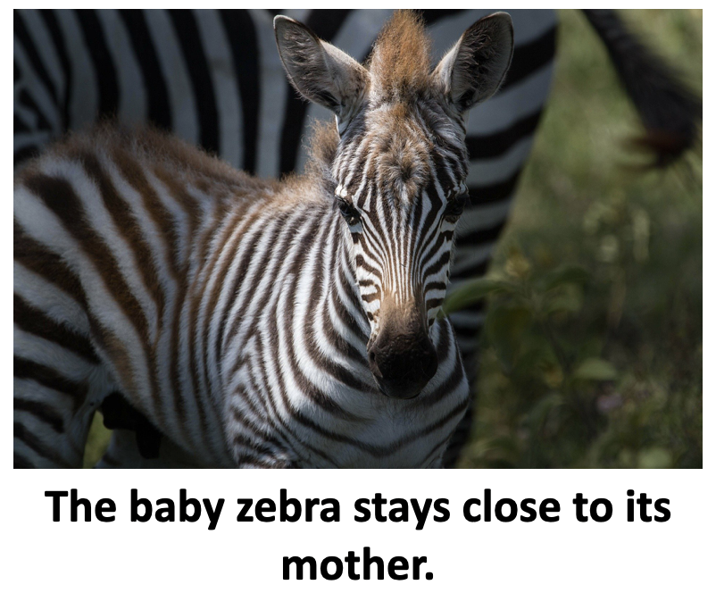
Hear a word
Tips and tricks
To start, choose the name of a friend or family member.
Let your child choose the word!
Notes:
Model for families how to pick a word from a book.
Feel free to choose a different word or name to use for modeling purposes throughout the steps. Be sure to update in the slides.
Sample script
First, you and your child will identify a word that you have heard in a book or in conversation. For example, you might read the word “zebra” in a book about the zoo. Or you might want to work with your child’s name and the names of friends and family members.
You might want to begin with shorter words with only 1 or 2 syllables, then move on to longer words with 3 or more syllables when your child is ready.
Sample script in Spanish
Primero, ustedes y sus hijos van a identificar una palabra que han escuchado en un libro o una conversación. Por ejemplo, pueden leer la palabra “cebra” en un libro sobre el zoológico. O tal vez quieren usar el nombre de su hijo o los nombres de amigos y familiares.
Sería bueno empezar con palabras más cortas con solamente 1 o 2 sílabas, y luego usar palabras más largas con 3 o más sílabas cuando su hijo está listo.

Slide 9
Say a word
Tips and tricks
Child: Zebra.
Adult: Let’s play with ‘zebra.’ Did you hear it? Can you say ‘zebra’?
Remember, we are working with spoken words, not written words.
Notes:
Model for families how to prompt their child to say the word.
Make sure parents understand that the focus should be on spoken, not printed, words (even if you choose a word from a book you are reading).
Sample script
Then, have your child say the word. If you’re using a book, remember, you’re not pointing to the letters or word at this point. This is an about helping your child listen and repeat the word. If it helps, you might ask your child to watch your mouth as you say the word. Then they can say the word back to you.
Sample script in Spanish
Luego, su hijo va a decir la palabra. Si está usando un libro, en este momento no va a señalar las letras o las palabras. Se trata de ayudarle a su hijo a escuchar y repetir la palabra. Puede ayudarle a observar su boca mientras dice la palabra. Luego puede repetir la palabra.

Slide 10
Hear and feel the syllables in the word to count them
Tips and tricks
ze/bra
Use your body to “feel” the beats in the word.
You can clap, stomp, or snap. Be creative!
Notes:
Model for families how to prompt their child to clap the syllables.
Sample script
The last step is to guide your child to “feel” the syllables in the word by clapping, stomping, or snapping (be creative!) out the beats as they segment the word into syllable parts. Count the syllables as you “feel” them together.
Sample script in Spanish
El último paso es guiar su hijo a “sentir” las sílabas en la palabra por batir las palmas, pisar fuerte, o chasquear los dedos (¡sean creativos!) para separar la palabras en sílabas. Pueden contar las sílabas mientras las “sienten” juntos.

Slide 11
Let’s practice
Tips and tricks
Place your hand under your chin. As you say the word, notice each time your chin drops. That’s a syllable!
bubble
chicken
apple
car
umbrella
your child’s name
Notes:
Lead a guided practice for families with the words on the slide.
Sample script
Let’s practice together. Notice there are pictures on this slide. Remember, we aren’t asking our children to read the written words yet. But they can use these pictures to know the words we’re working on. We’re really focusing on hearing the sounds and breaking apart the beats or syllables in the word.
Let’s start with your child’s name. Who would like to volunteer? [With the volunteer’s name, clap out the syllables as a group]. Now you try with your child’s name.
Who would like to show us how to clap their child’s name? [Elicit response].
Now, everyone start with bubble. Hear it? Now let’s say it together [say ‘bubble’]. Now let’s clap it [say bub-ble and clap twice].
Alright, do the next 4 on your own with your child.
How did that go? [Elicit responses].
If you’re unsure how many syllables something has here are some tips. [Direct them to the tip on the slide]. Another way to determine syllables is to identify the vowel SOUNDS in a word. Each syllable in English must have a vowel sound. Keep in mind, though, that the sound might be made by a consonant (like the "y" in baby). So chicken has two vowels sounds (i and e) and two syllables. Umbrella has three vowel sounds and three beats. Once again, this is just for you, the adult, to know. We want children to be able to hear the syllables and not just guess based on the letters they see.
Sample script in Spanish
Vamos a practicar juntos. Pueden ver que hay dibujos con las palabras porque los niños no están leyendo las palabras escritas, todavía. Pueden usar los dibujos para saber en cuales palabras estamos trabajando. Estamos enfocados en escuchar los sonidos y separar las sílabas en la palabra.
Vamos a empezar con el nombre de uno de los niños aquí. ¿Tenemos un voluntario? [Usando el nombre del voluntario, separa el nombre en sílabas en grupo por batir las palmas]. Ahora lo pueden intentar por su parte con el nombre de su hijo.
¿Alguien quisiera mostrarnos cómo separaron el nombre de su hijo en sílabas? [Busque un voluntario].
Ahora, vamos a intentar con “bubble”. ¿Lo escuchan? Vamos a decirlo juntos [diga “bubble”]. Ahora con las manos [diga “bub-ble” y bata palmas dos veces].
Muy bien. Hagan los próximos 4 con sus hijos.
¿Cómo les fue? [Espere para respuestas].
Si no está seguro del número de sílabas, tengo algunos consejos y trucos. [Muestrelo en la diapositiva]. Una manera de saber cuántas sílabas hay es identificar los SONIDOS de vocales. Cada sílaba en inglés tiene un sonido de vocal. Hay que tener en mente que el sonido puede ser hecho por un consonante (como la “y” en “baby”). Chicken, que es pollo en español, tiene dos sonidos de vocales (i y e) y dos sílabas. Umbrella tiene tres sonidos de vocales y tres sílabas. De nuevo, es información que usted, como el adulto, necesita saber. Queremos que los niños escuchen las sílabas y no adivinen algo por lo que ven con las letras.

Slide 12
Multilingual families
Use this with books in any language.
Give a lot of encouragement to help build reading skills.
Notes:
Use this slide if families’ primary language is not English or they may have specific questions. Alternatively, if you have talked about accommodations throughout the reading tip explanation you may skip this slide or use it to briefly sum up.
Explain the tips on the slide. If you need more detail, see “Ideas to differentiate” in the Workshop Guide.

Slide 13
Reading = conversation
How many syllables does your name have?
Can you clap/snap/stomp out the syllables?
Can you listen very closely for the beats in the word?
Notes:
Remind families that the at-home reading coach always asks questions!
The questions you learn today will help you ask questions before your child begins to read on their own so you can help them build important foundational skills.
► For Multilingual families specifically: Some families may come from a culture where asking questions and “coaching” their child may be an unfamiliar practice. Instead, they may be more used to being directive and having the answers​.
Encourage families to keep trying this coaching technique and assure them that the more they do it, the more comfortable it will become. ​
Although “parent as expert” and “parent as coach” are equally valid positions, asking questions and encouraging children to find the answer out for themselves instead of telling them an answer can help children internalize the learning in a different way.
This is a good time to remind parents that even though asking questions may not at present be a regular practice for them, this is an opportunity for them to acquire and practice new skills that will help their children. Cultural shifts are usually most effective when they're explicit.​
Use this slide to ensure that families have some questions they can ask during practice time.
Ask families to hold up the number of questions they already have written down or are prepared to use. If it looks like the room is prepared, you may skip this slide or ask families to share other questions they have written down throughout the workshop.
Share with families that there are also sample questions on the Reading Tip Sheet.
Sample script
At Springboard, the most important thing we want you to leave with is: to ALWAYS ASK QUESTIONS. You want to ask your child questions to help them think about words and sounds, understand what you’re reading together, and enjoy books and stories. And remember—we can have these playful conversations even without a book! You can work them into your day whenever and wherever—at the grocery store, before bedtime, at bath time, etc.. These questions will help your child practice speaking the language they will soon be reading!
Today we’ve learned questions to help your child build phonological awareness, or the ability to hear and identify the sounds in words, that will later help them to read words on their own.
Sample script in Spanish
En Springboard, lo más importante con lo que queremos que se vaya es: QUE SIEMPRE HAGA PREGUNTAS. Quiere hacerle preguntas a su hijo que le hagan pensar en palabras y sonidos, entender lo que están leyendo juntos, y disfrutar libros y cuentos. Y acuérdense – podemos tener estas conversaciones divertidas sin un libro. Puede tenerlas en cualquier momento, en donde sea – en el supermercado, antes de dormir, etc. ¡Las preguntas le ayudarán a su hijo practicar cómo hablar el idioma para poder leer en poco tiempo!
Hoy hemos aprendido preguntas para ayudar a su hijo para fomentar un conocimiento fonológico. Es decir, la habilidad de escuchar e identificar los sonidos en las palabras. Esto les ayudarán a sus hijos para leer las palabras independientemente en el futuro.

Slide 14
Practice time
1
Hear a word and say the word.
Call me over when you have a question!
2
Hear and feel the syllables in the word to count them.
3
Congratulate your child when they keep trying!
Notes:
Note: Practice time should be most of the remaining time. Leave 10 minutes or so at the end for reflection.
Summarize the tip, and remind families to repeat these steps during practice time.
Take a moment to explain that you’ll be circulating around while they practice (to provide 1:1 support and answer any questions).
►Multilingual parents in particular often come with feelings of self-consciousness that can be overcome when they know why they're being observed.
Remind families to ask questions as they use the tip.
There are also sample questions on the Reading Tip Sheet.
To support families, consider underlining two high leverage questions on the Reading Tip Sheet as you circulate.
Remind families they can always work on their action plan or other strategies during practice time, especially if they have questions or want some help with it.
Circulate and work with families. Here are some suggestions:
Walk over to a family. Ask, “Do you have any questions about the reading tip?”
If yes, answer question.
If no, say, “May I listen in for a moment?”
Listen for a full minute.
Compliment the family on something they did well and then leave them with one suggestion (if needed).
Walk over to a family and ask, “Can I try this reading tip with your child?”
After you’ve modeled it, ask the adult, “What did you notice me doing?” or say “Did you notice that I…”
Gather “glows” (things that families did that you want to lift up to the group) and “grows” (things families do that you want to stop and correct/clarify for the whole group).
Share the “glows” and “grows” at 10 mins into practice time or wait until the end.
Keeps “grows” anonymous, but congratulate specific families on “glows.”

Slide 15
Reflect
Any questions about the reading tip?
Turn and talk with your child: Do we feel ready to try this reading tip at home?
Please share how you might use this at home.
Your question will help someone else in the room!
Notes:
Part 4: Reflection & updates
Invite participants to ask questions.
Give ample wait time for each question. ​
Remind families that when parents talk they make it safe for more hesitant parents to share. It builds community in the classroom. ​
Encourage other voices to share.
In addition, you could share some “glows” and “grows” you noticed while walking around and supporting families during practice time.
Check in on the goal of Family Workshops.​
Read “Any questions…”? and wait. Let this question hang and give ample wait time.​
Invite families who don’t yet feel equipped to do the reading tip on their own to raise their hand (or indicate in a more private way) so you can check in with them personally before they leave the workshop.
Invite a family volunteer to share how they will use the reading tip at home.
If time permits, you may do a whip-around share.
Invite families to each share one thing (in 30 seconds or less). This could be:
Something they learned
One thing they’re excited to try at home
One thing they found challenging about this tip
One step they will focus on this week

Slide 16
Purposeful play -> learning
Questions and meaningful conversations build the foundation of reading!
Notes:
Remind families of the importance of play at this age and how playing with words, letters, sounds, books, etc. is the most effective way to build a foundation of reading.
Explain how today’s reading tip will help readers develop the skills they need to read well.
Sample script
Remember, our overall goal is to help your child build a foundation of reading. When your child starts to learn how to read, they will need to:
Be able to figure out the words they are reading. All the fun and playful things we do to help your child learn the sounds in words and to learn new words build toward this skill. Remember, you can do this without a book by just talking and listening to each other.
Be able to understand the story. All the reading and conversations you have will help your child be able to understand a story on their own. Encouraging their imaginations and ability to tell their own stories will help here, too!
And of course, we are helping our child learn how to engage and enjoy a story every time we tell stories or read books.
Being able to sound like a storyteller is a skill your child will develop a little later.
Saying and counting the syllables will eventually help your child figure out the word.
Sample script in Spanish
Recuérdense, nuestra meta en general es ayudarles a sus hijos a construir una base para la lectura. Cuando sus hijos empiezan a leer, tienen que:
Descifrar las palabras que están leyendo. La diversión y los juegos que hacemos para ayudarles a aprender los sonidos de las palabras y palabras nuevas les lleva a esta destreza. Recuérdense, se puede hacer sin un libro por simplemente hablar juntos y escuchar uno al otro.
Comprender un cuento. Toda la lectura y las conversaciones que tienen ayudarán a sus hijos para entender el cuento independientemente. Animarlos a usar sus imaginaciones y contar sus propios cuentos les ayudarán con eso también.
Y por supuesto, estamos ayudando a nuestros hijos a involucrarse con y disfrutar un cuento cada vez que contamos historias o leemos libros.
La destreza de sonar como un cuentista es una habilidad que su hijos desarrollarán cuando sean más grandes.
Decir y contar las sílabas le va a ayudar a su hijo a descifrar las palabras eventualmente.

Slide 17
Feedback, please
Your input improves our time together!
Notes:
Invite families to make a reading plan for the upcoming week.
Remind families that readers need “reading together” time and “reading alone” time.
Remind families that reading in workshops counts as “reading together time” and they should log it (if applicable).
Invite families to give you feedback so that you can facilitate a workshop that works for them!
Families can use the printed feedback form (if available) or a digital feedback form.
Invite families to give you more informal feedback. This could look like a thumbs up if they liked the reading tip or writing one thing they hope for the next workshop.
Use this time to meet individually with families as needed.
Sample script
And finally, I want to make sure I’m hosting a Family Workshop that works for you. Every workshop you’ll have a chance to give me feedback, and I promise you that I will read it and do my best to incorporate it. Will you fill out the survey before you leave? If you’d rather talk about your suggestions instead of writing them down, let me know. Thanks and see you at the next workshop!
Sample script in Spanish
Para cerrar, quiero asegurar que estoy dando un taller de familia que les sirve a ustedes. En cada taller, tendrán la oportunidad de proveer comentarios. Yo les prometo que los voy a leer y voy a hacer mi mejor esfuerzo para incorporar los consejos en el próximo taller. ¿Pueden contestar el sondeo antes de irse? Si prefieren platicar sobre sus ideas, en vez de escribirlas, avísenme. ¡Gracias y nos veremos en el próximo taller!

