Slide 1
Workshop guide
Facilitator:
Read notes to prepare. Amend slides if needed.
Practice the script aloud. Change as needed.
Ready the family-facing materials.
Display slide 2 as families arrive.
Vamos a cantar los sonidos (Let's Sing our Sounds)
Notes:
Copyright 2022 Springboard Collaborative, all rights reserved.
Overview and rationale: This pre-reading workshop focuses on phonological and phonemic awareness. Families learn a working definition of phonological awareness (an awareness of the different sound structures in words) and that hearing and manipulating, or playing, with the different sounds in words helps children build phonological awareness. Families then review and practice different songs that help children build phonological awareness--a very important pre-reading skill! Songs can and should be adapted to fit the community of families.
Materials
Corresponding Reading Tip Sheet (in the languages the families need)
Family Workshop Feedback Form (paper or digital form)
Projector to display slides
Empty envelope for families to put feedback form in (optional but highly recommended)
Name tags (optional but highly recommended)
Facilitation notes
To prepare
In this workshop, you will model “singing our sounds.”
Preview the light blue slides and choose the ones that are appropriate for your context.
Be sure to familiarize yourself with the content of the presentation so you can talk with families, not at them.
Study the slides in the reading tip section. Think through how you will model and guide practice.
Two example songs are included, along with video links for the facilitator to familiarize themselves with the song and practice prior to facilitation. Please note that Springboard does not have permission to show these videos during the training, so familiarize yourself with the songs, or choose another similar song(s) that you prefer that serves the same purpose in the training.
Songs: “The Name Game”: https://www.youtube.com/watch?v=AnafX_yUnMo, “I Like to Eat Apples and Bananas”: https://www.youtube.com/watch?v=kxVVci0lZ2g
There are different versions of the suggested songs. Edit the slides if you prefer a different version.
Decide if you would like to use the chosen songs or songs from your own experiences. Revise slides as needed to reflect the change(s).
For this session, there will be no adult/child practice. Instead, the families will practice with each step. Children are encouraged to sing along.
During workshop
Take time to build rapport as a group and individually with families. Little things like learning family members’ names and greeting them at the door go a long way.
Keep pace so that families have time to practice the tip and also reflect. Being able to practice and reflect helps families internalize the strategy.
Circulate and check-in with families individually during practice time. See “Practice time” slide for more specific suggestions.
Ideas to differentiate
Preview “Check in on literacy terms” and adjust terms or definitions, as needed.
If teaching this workshop to families with older children, focus on asking kids to produce rhyming words when singing the Name Game song.
If teaching this workshop to Multilingual families: It is not important that the songs used be in English; what is important is that the child is manipulating and playing with the phonemes, or sounds, in words, through a fun song or rhyme. Encourage Multilingual families to use songs in their preferred language at home (or share with the group during the session if they are comfortable).
If families are familiar with this workshop, consider having families who are familiar with the songs take a more active role in explaining them. Bring in additional nursery rhymes or songs.
Timing suggestion for a 35 min workshop*
Welcome: 5 mins
Reading tip: 8-10 mins
Practice: 5-10 mins
Reflection and updates: 10 mins
*Springboard Collaborative Family Workshops generally run 60 minutes. Because this is a pre-reading workshop, we suggest a 30-40 minute workshop instead.
After you use these materials, we want to hear your feedback! Fill out the Family Workshop Facilitator Feedback Form at https://bit.ly/SBCfeedbackform.

Slide 2
Vamos a cantar los sonidos
Notes:
Part 1: Welcome
Formally welcome families and tell them the title of today’s workshop. Do not go into specific steps of the reading tip at this point.
Ensure families have the materials they need and are sitting with their children.

Slide 3
Agenda
Bienvenida
Consejo de lectura
Tiempo de práctica
Reflexión y actualizaciones
Notes:
Provide an overview of what families will be doing today (and at every Family Workshop).
If this is the first or second Family Workshop in a series, explain that the icons for each of the four parts of the Family Workshop also run along the bottom of slides. ​
Sample script
Here is our plan for today. You can see each part of our agenda has an icon [point to the icons]. You can also find each icon along the bottom of each slide [point to bottom] so you can see where we are in the agenda. First, we’ll review a couple of things, then we’ll get right to the reading tip. Most of our time will be spent on practice time so we can all try out the reading tip. Then we’ll reflect and talk about some updates.
Please speak up with questions, concerns, or anything you’d like to share. We’re here together for one hour, and need to maximize the time. Every child learns to read in a different way, but putting our heads together helps our shared cause: to give kids a reading boost and cultivate a the joy of reading.
Sample script in Spanish
Aquí tenemos el plan para hoy. Se puede ver que cada parte de la agenda tiene un ícono [point to the icons]. También se encuentran en el final de cada diapositiva [point to bottom] para que puedan saber en qué parte estamos. Primero, vamos a repasar algunas cosas. Luego vamos a empezar con el consejo de la lectura. La mayoría del tiempo vamos a pasar aquí, en la práctica, para probar el consejo de la lectura juntos. Luego, vamos a reflexionar y hablar sobre algunas novedades.
En cualquier momento, pueden hacer preguntas, compartir preocupaciones, o cualquier otra cosa que quieren compartir. Vamos a estar juntos por una hora y queremos aprovechar del tiempo que tenemos. Cada niño aprende a leer de una manera diferente. Estamos aquí para trabajar en la misma causa: ayudarles a los niños a mejorar en la lectura y llegar a disfrutarla.

Slide 4
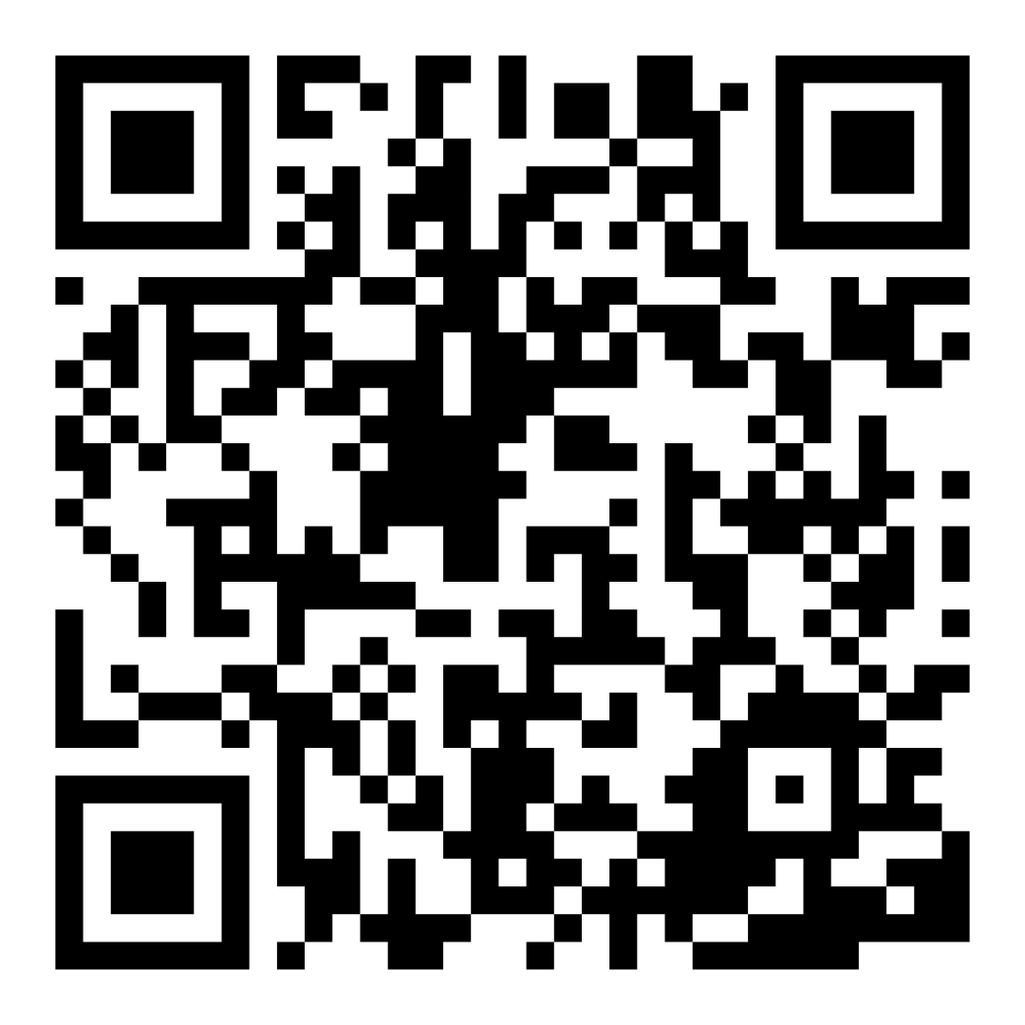
Encuesta de confianza familiar
Escaneen este código para compartir cómo se sienten acerca de la lectura con sus hijos. Los participantes serán inscritos en un sorteo para ganar una tarjeta de regalo de $15. Se elegirá un ganador por escuela después del primer y último taller.
bit.ly/3BUBxbx
Notes:
If this is not the first or last Family Workshop, please delete this slide from the slide deck.
If you are an LAUSD teacher or staff member, please delete this slide from ALL Family Workshop decks.
Families who fill out the survey will be asked to provide an email to be entered into the raffle.
One raffle winner will be selected by Springboard Collaborative’s Data & Evaluation team after the first and last workshop and sent a $15 e-gift card to the email they provided.
If you need print-out versions of the QR code survey in English or the other translated languages, you can find those here: https://drive.google.com/file/d/1zjxnM0C9aP4C9WJFbw2A8eFpjZ29wBWG/view?usp=sharing
If you want to send the survey directly to families, you can find the link to the survey here: bit.ly/3BUBxbx

Slide 5
Las normas de los talleres
Estar preparado.
Estar presente.
Ser cortés.
Haga preguntas.
Notes:
Briefly explain the guidelines or “the rules we all agree to follow so that we can all have an enjoyable and an effective workshop.”
If this is the first workshop, briefly explain each of the guidelines.
Alternatively, a family volunteer may read or summarize this slide if they’ve attended the previous workshop. ​
Consider putting these on chart paper and inviting the group to add to the list. If you do this, be sure to change this slide in subsequent workshops.​
Emphasize these guidelines are for everyone, including you, the facilitator, and pledge to be prepared, present, courteous, and ask questions.
Emphasize the last point and specifically invite families to ask lots of questions.

Slide 6
Vamos a cantar los sonidos
1
2
Cantar una canción divertida.
¡Jugar con las palabras!
Escuchar y jugar con los sonidos diferentes en las palabras le ayuda a su hijo a aprender que las palabras están hechas de sonidos diferentes.
Notes:
Part 2: Reading tip
Introduce the 2 parts of the reading tip.
Sample script:
Here is the reading tip for today:
First, we will choose a fun song and sing it!
Then, we will play with the words in the song so your child can practice manipulating, or changing, the sounds in words that they hear.
Why is this tip important?
Hearing and playing around with different sounds in language helps your child understand that words are made up of different sounds. We call this phonological awareness. It’s a very important pre-reading skill!
Sample script in Spanish
Hoy el consejo de lectura es:
Primero, ¡escogemos una canción divertida y la cantamos!
Luego, jugamos con las palabras en la canción. Así su hijo puede practicar como manipular, o cambiar, los sonidos de las palabras que escucha.
¿Por qué este consejo es tan importante?
Escuchar y jugar con los sonidos del idioma le muestra a su hijo que las palabras están hechas de sonidos diferentes.
En inglés, se llama “phonological awareness”. Es el conocimiento de la fonética. ¡Es una destreza muy importante para antes de leer!

Slide 7
Verifique los términos de alfabetización
Conocimiento fonológico
Conocimiento de que diferentes sonidos y estructuras de sonido forman palabras.
Notes:
To make sure everyone has a common understanding, define some literacy terms as needed.

Slide 8
Cantar una canción divertida
I like to eat, eat, eat apples and bananas
I like to ote, ote, ote, opples and bononos
Notes:
Explain the song “I Like to Eat Apples and Bananas” to families.
Sample script:
First, choose a fun song! We have chosen one that many of you may know: I Like to Eat Apples and Bananas. We chose this song because each time you sing a new verse, you switch out the vowel sounds in the words to make new, silly, versions of each word.
Who knows this song? [wait for responses]
Great! The basic idea is that we are going to the same thing “I like to eat, eat, eat, apples and bananas” each verse but we are going to change the vowel sounds. For example, in the verse that goes “I like to ote, ote, ote, opples and bononos” I have put the long “o” sound into these 5 five words.
Sample script in Spanish
Primero, ¡escoge una canción divertida! Escogimos una que muchos de ustedes probablemente conocen: Me gusta comer manzanas y plátanos. Escogimos esta canción porque cada vez que cantas un verso nuevo, cambias el sonido del vocal en las palabras para crear una versión nueva y divertida de cada palabra.
¿Alguien ya conoce esta canción? [espera las respuestas]
¡Excelente! La idea es que vamos a cantar la misma cosa “I like to eat, eat, eat, apples and bananas” cada verso pero vamos a cambiar el sonido del vocal. Por ejemplo, en el verso que dice “I like to ote, ote, ote, opples and bononos” usé el sonido del “o” en las cinco palabras.

Slide 9
Jugar con las palabras
Consejos y trucos
En cada verso, cambiamos el sonido del vocal. Así su hijo aprende los sonidos de los vocales.
I like to eat, eat, eat…
I like to ote, ote, ote…
I like to ate, ate, ate…
I like to ute, ute, ute…
I like to ite, ite, ite…
¡Vamos a practicar ahora mismo!
Notes:
Lead a group practice of the song “I Like to Eat Apples and Bananas.”
Encourage the group to join you as they catch on or if they already know the song.
Sample script:
The vowel letters in the English language are the letters a, e, i, o, and u. Each time we sing a new verse in this song, we pronounce the new silly words with the long vowel sound, just like “o” on the previous slide, for each vowel (that means the vowel sound is saying its own name).
Let me show you how it works. And those of you who know it, please join in!
Sample script in Spanish
Las letras vocales en el inglés son las letras a, e, i, o, y u. Cada vez que cantamos un verso nuevo de la canción, pronunciamos las palabras absurdas con el sonido largo del vocal, como la “o” en la diapositiva previa, para cada vocal. En inglés, las vocales tienen más que un sonido. (Para esta canción, cantamos con el sonido que del vocal que es igual a decir el nombre del vocal.)
Voy a cantarla ahora. Para los que conocen la canción, por favor, ¡que me acompañen!

Slide 10
Cantar una canción divertida
Anna, Anna bo- banna
banana fana fo fanna,
me mi mo, manna – ANNA!
[Con el nombre de su hijo]
Rimar es una destreza importante del conocimiento fonológico para pre-lectores.
Notes:
Part 3: Practice time
Explain and model “Name Game” to families.
Demonstrate with your name or the name of a participant (change in the slide as needed).
Encourage participants to try it with their name or the name of their child.
Sample script
Let’s do another one. This song is called the “Name Game.” We chose this one because, again, you can play around with the sounds in a word. In this one, you get to use your child’s name and any other family or friend name you want.
This song also includes rhyming words. You can ask your child to come up with more silly rhyming words. Identifying and producing rhyming words is an important phonological awareness skill for pre-readers.
Spanish script in Spanish
Vamos a cantar otra. Esta canción se llama “El juego de los nombres.” Escogemos esta porque, de nuevo, pueden jugar con los sonidos de una palabra. Pueden usar cualquier nombre. Puede ser de sus hijos, de un familiar o de algún amigo.
La canción incluye palabras que riman. Pueden pedirles a sus hijos que inventen más palabras absurdas que riman. Identificar y producir palabras que riman es una destreza importante para el conocimiento de la fonética que los niños necesitan antes de poder leer

Slide 11
Jugar con las palabras
¡Escoger un nombre!
de un amigo
de un miembro de la familia
de una mascota
Cuando su hijo aprende a rimar, puede inventar palabras. ¡No hay problema!
Notes:
Lead a group practice of the “Name Game.”
Families can also try it on their own.
As an extension: Ask a participant to come up with another word that rhymes with the series of rhyming words in the song (e.g., lanna or blanna with “Anna” from the example)
►Multilingual parents or other parents for whom these songs are new, will benefit from posted sentence stems such as:
[Name], [name] bo-[name]
Banana, fana fo-[name],
Me mi mo-[name]
[Name]

Slide 12
¿Tienen una canción?
Consejos y trucos
Canciones divertidas son una manera buenísima de aprender sobre rimas y sonidos.
¿Cuáles canciones de cuna cantan en su casa?
¡Rimar en otros idiomas también ayuda!
Notes:
Invite families to share songs with the group.
If possible, learn and practice them together.
If possible, discuss the way these songs help children learn that words are made up of sounds and sounds can be manipulated.

Slide 13
Reflejar
¿Alguna pregunta sobre el consejo de lectura?
Voltéese y hable con su hijo: ¿Nos sentimos listos para probar este consejo de lectura en casa?
Por favor, comparte cómo podrían usar esto en casa.
¡Su pregunta ayudará a alguien más en este espacio!
Notes:
Part 4: Reflection & updates
Invite participants to ask questions.
Give ample wait time for each question. ​
Remind families that when parents talk they make it safe for more hesitant parents to share. It builds community in the classroom. ​
Encourage other voices to share.
In addition, you could share some “glows” and “grows” you noticed while walking around and supporting families during practice time.
Check in on the goal of Family Workshops.​
Read “Do you feel ready…”? and wait. Let this question hang and give ample wait time.​
Invite families who don’t yet feel equipped to do the reading tip on their own to raise their hand (or indicate in a more private way) so you can check in with them personally before they leave the workshop.
Invite a family volunteer to sum up the steps of the reading tip and share how they will use the reading tip at home.
If time permits, you may do a whip-around share.
Invite families to each share one thing (in 30 seconds or less). This could be:
Something they learned
One thing they’re excited to try at home
One thing they found challenging about this tip
One step they will focus on this week

Slide 14
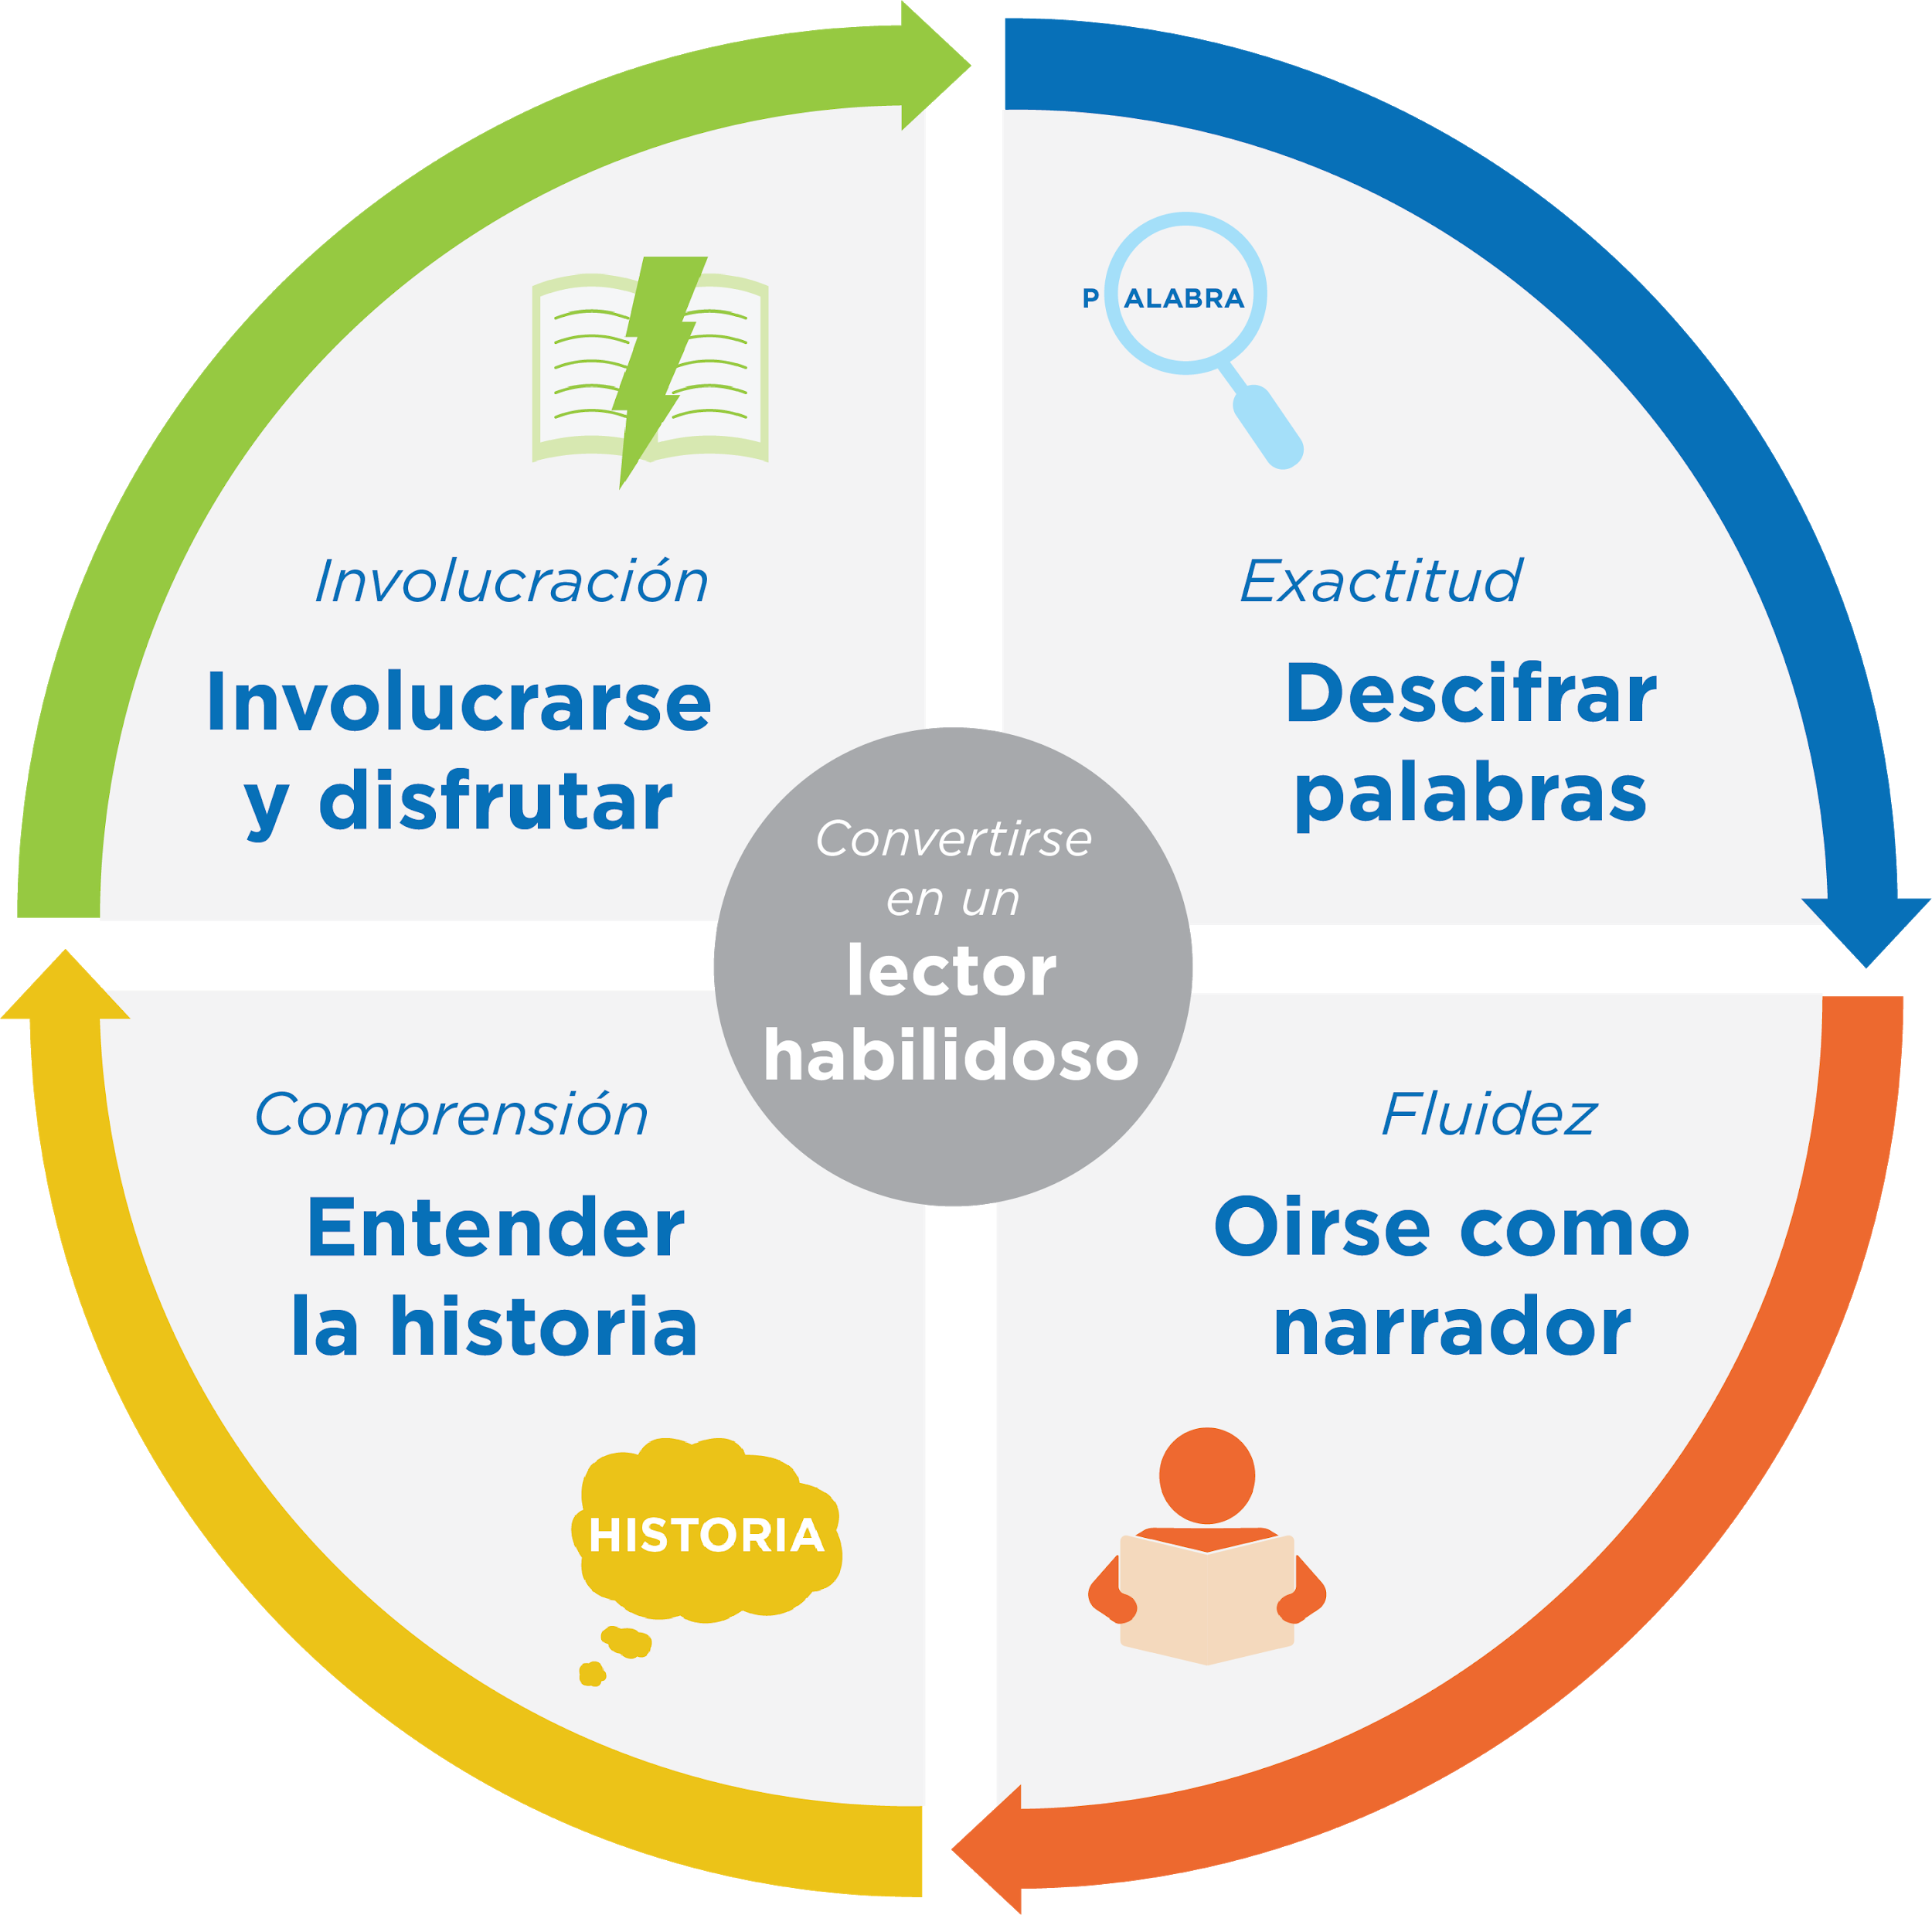
Jugar con propósito -> el aprendizaje
¡Las preguntas y las conversaciones significativas son gran parte de construir la base de lectura!
Notes:
Remind families of the importance of play at this age and how playing with words, letters, sounds, books, etc. is the most effective way to build a foundation of reading.
Explain how today’s reading tip will help readers develop the skills they need to read well.
Sample script
Remember, our overall goal is to help your child build a foundation of reading. When your child starts to learn how to read, they will need to:
Be able to figure out the words they are reading. All the fun and playful things we do to help your child learn the sounds in words, and new words build toward this skill. Remember, you can do this without a book by just talking and listening to each other.
Be able to understand the story. All the reading and conversations you have will help your child be able to understand a story on their own. Encouraging their imaginations and ability to tell their own stories will help here, too!
And of course, we are helping our child learn how to engage and enjoy in a story every time we tell stories or read books.
Being able to sound like a storyteller is a skill your child will develop a little later.
Singing silly songs will help your child learn the sounds in words and this will help them figure out the words when they begin reading.
Sample script in Spanish
Recuérdense, nuestra meta en general es ayudarles a sus hijos a construir una base para la lectura. Cuando sus hijos empiezan a leer, tienen que:
Descifrar las palabras que están leyendo. La diversión y los juegos que hacemos para ayudarles a aprender los sonidos de las palabras y palabras nuevas les lleva a esta destreza. Recuérdense, se puede hacer sin un libro por simplemente hablar juntos y escuchar uno al otro.
Comprender un cuento. Toda la lectura y las conversaciones que tienen ayudarán a sus hijos para entender el cuento independientemente. Animarlos a usar sus imaginaciones y contar sus propios cuentos les ayudarán con eso también.
Y, por supuesto, estamos ayudando a nuestros hijos a involucrarse con y disfrutar un cuento cada vez que contamos historias o leemos libros.
La destreza de sonar como un cuentista es una habilidad que su hijos desarrollarán cuando sean más grandes.
El consejo de lectura de hoy les ayudarán a sus hijos para entender como un libro funciona – el primer paso de involucrarse con un libro independientemente.
Cantar canciones divertidas le ayudará a su hijo a aprender los sonidos de las palabras para poder descifrarlas cuando empiece a leer.

Slide 15
Comentarios, por favor
¡Su aporte y comentarios mejora nuestro tiempo juntos!
Notes:
Invite families to make a reading plan for the upcoming week.
Remind families that readers need “reading together” time and “reading alone” time.
Remind families that reading in workshops counts as “reading together time” and they should log it (if applicable).
Invite families to give you feedback so that you can facilitate a workshop that works for them!
Families can use the printed feedback form (if available) or a digital feedback form.
Invite families to give you more informal feedback. This could look like a thumbs up if they liked the reading tip or writing one thing they hope for the next workshop.
Use this time to meet individually with families as needed.
Sample script
And finally, I want to make sure I’m hosting a Family Workshop that works for you. Every workshop, you’ll have a chance to give me feedback, and I promise you that I will read it and do my best to incorporate it. Will you fill out the survey before you leave? If you’d rather talk about your suggestions, instead of writing them down, let me know. Thanks and see you at the next workshop!
Sample script in Spanish
Para cerrar, quiero asegurar que estoy dando un taller de familia que les sirve a ustedes. En cada taller, tendrán la oportunidad de proveer comentarios. Yo les prometo que los voy a leer y voy a hacer mi mejor esfuerzo para incorporar los consejos en el próximo taller. ¿Pueden contestar el sondeo antes de irse? Si prefieren platicar sobre sus ideas, en vez de escribirlas, avísenme. ¡Gracias y nos veremos en el próximo taller!

