Slide 1
Workshop guide
Facilitator:
Read notes to prepare. Amend slides if needed.
Practice the script aloud. Change as needed.
Ready the family-facing materials.
Display slide 2 as families arrive.
Go on a Treasure Hunt
Notes:
Copyright 2022 Springboard Collaborative, all rights reserved.
Overview and rationale
This pre-reading workshop focuses on early fluency and vocabulary development. In order to read, a child needs to see a letter and say the sound quickly. This reading tip helps families prompt children to practice saying the names of objects quickly. With practice, children will eventually be able to do it with letters and words. And there’s an added bonus to this reading tip--children will also help build their vocabulary.
Materials
Corresponding Reading Tip Sheet (in the languages the families need)
Family Workshop Feedback Form (paper or digital form)
A collection of objects for students to use for practice. See facilitation notes. If you are doing this workshop virtually, children may hunt for objects in their home.
Projector to display slides
Empty envelope for families to put feedback form in (optional but highly recommended)
Name tags (optional but highly recommended)
Facilitation notes
To prepare
In this workshop, you will model helping children rapidly recall the name of objects.
Preview the light blue slides and choose the ones that are appropriate for your context.
Be sure to familiarize yourself with the content of the presentation so you can talk with families, not at them.
Study the slides in the reading tip section. Think through how you will model and guide practice.
You want objects for one child to find in a small treasure hunt in your classroom while you explain and model the reading tip. (see reading tip slides)
If possible, families can also do a small treasure hunt in your classroom during practice time. If possible, have different groups of children find different types of objects to minimize the competition.
Keep in mind that students will be asked to find a collection of items that fit certain criteria (e.g., big items, blue items, items found outside, etc.). So be sure to choose objects that will fit into a given category. These objects might include attribute blocks, various collections of toys (e.g., toy cars, toy dinosaurs, etc.), objects from nature, or utensils.
Based on the objects you have available for the treasure hunt, predetermine several categories or goals for a treasure hunt that could be done with the objects. These predetermined categories will be assigned to children/families when they practice the treasure hunt (e.g., animals, round objects, art materials, etc.).
If this is the last Family Workshop, plan how to celebrate!
During workshop
Take time to build rapport as a group and individually with families. Little things like learning family members’ names and greeting them at the door go a long way.
Keep pace so that families have time to practice the tip and also reflect. Being able to practice and reflect helps families internalize the strategy.
Circulate and check in with families individually during practice time. See “Practice time” slide for more specific suggestions.
Ideas to differentiate
Preview “Check in on literacy terms” and adjust terms or definitions as needed.
If teaching this workshop to families with younger children, possibly skip the last step (or work up to it).
If teaching this workshop to families with older children, see extension ideas in the reading tip section (see ”Mix it up” slide).
If teaching this workshop to Multilingual families: Doing this activity in the child’s or parent’s preferred language will still meet the goal of rapid naming of objects, so encourage parents to do this in any language they choose.​
If families are familiar with this workshop, consider how you might leverage their experience. Ask families to share how they helped their child internalize the steps. Invite them (ahead of time) to model one or more steps if appropriate. Encourage families who are ready to try different types of treasure hunts (i.e. outside their home) and to do the extensions.
Timing suggestion for a 35 min workshop*
Welcome: 5 mins
Reading tip: 8-10 mins
Practice: 5-10 mins
Reflection and updates: 10 mins
*Springboard Collaborative Family Workshops generally run 60 minutes. Because this is a pre-reading workshop, we suggest a 30-40 minute workshop instead.
After you use these materials, we want to hear your feedback! Fill out the Family Workshop Facilitator Feedback Form at https://bit.ly/SBCfeedbackform.

Slide 2
Go on a Treasure Hunt
Notes:
Part 1: Welcome
Formally welcome families and tell them the title of today’s workshop. Do not go into specific steps of the reading tip at this point.
Ensure families have the materials they need and are sitting with their children.

Slide 3
Agenda
Welcome
Reading tip
Practice time
Reflection & updates
Notes:
Provide an overview of what families will be doing today (and at every Family Workshop).
If this is the first or second Family Workshop in a series, explain that the icons for each of the four parts of the Family Workshop also run along the bottom of slides. ​
Sample script
Here is our plan for today. You can see each part of our agenda has an icon [point to the icons]. You can also find each icon along the bottom of each slide [point to bottom] so you can see where we are in the agenda. First, we’ll review a couple of things, then we’ll get right to the reading tip. Most of our time will be spent on practice time so we can all try out the reading tip. Then we’ll reflect and talk about some updates.
Please speak up with questions, concerns, or anything you’d like to share. We’re here together for one hour and need to maximize the time. Every child learns to read in a different way, but putting our heads together helps our shared cause: to give kids a reading boost and cultivate a joy of reading.
Sample script in Spanish
Aquí tenemos el plan para hoy. Se puede ver que cada parte de la agenda tiene un ícono [point to the icons]. También se encuentran en el final de cada diapositiva [point to bottom] para que puedan saber en qué parte estamos. Primero, vamos a repasar algunas cosas. Luego vamos a empezar con el consejo de la lectura. La mayoría del tiempo vamos a pasar aquí, en la práctica, para probar el consejo de la lectura juntos. Luego, vamos a reflexionar y hablar sobre algunas novedades.
En cualquier momento, pueden hacer preguntas, compartir preocupaciones, o cualquier otra cosa que quieren compartir. Vamos a estar juntos por una hora y queremos aprovechar del tiempo que tenemos. Cada niño aprende a leer de una manera diferente. Estamos aquí para trabajar en la misma causa: ayudarles a los niños a mejorar en la lectura y llegar a disfrutarla.

Slide 4
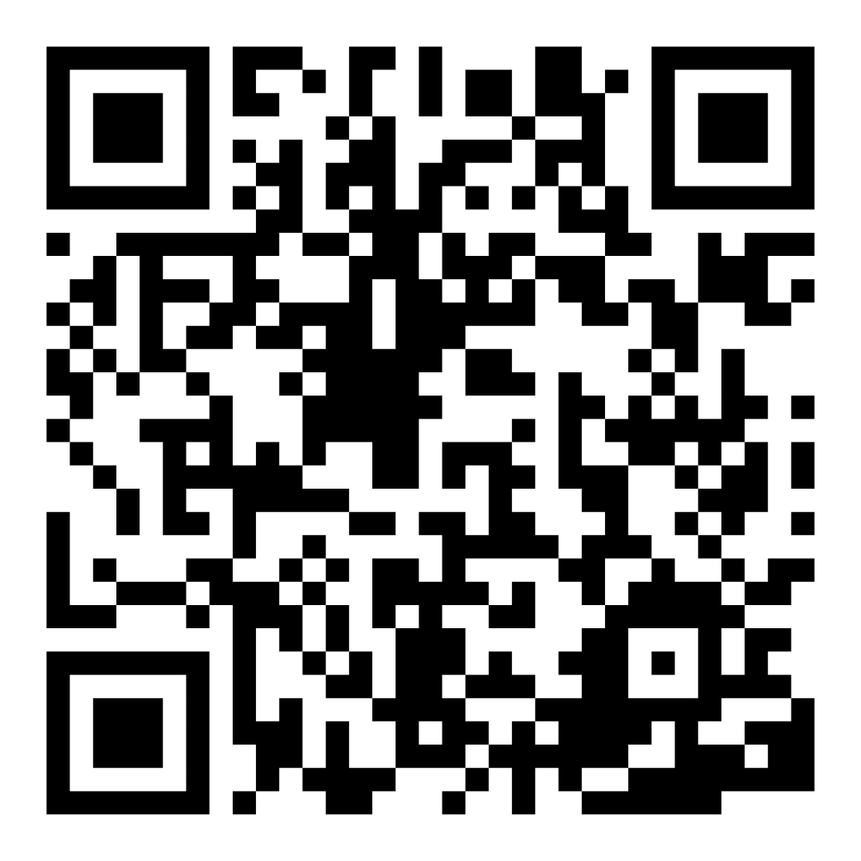
Family Confidence Survey
Scan this code to share how you’re feeling about reading with your child. Participants will be entered into a raffle for a $15 gift card. One winner per school will be drawn after the first and last workshops.
bit.ly/3BUBxbx
Notes:
If this is not the first or last Family Workshop, please delete this slide from the slide deck.
If you are an LAUSD teacher or staff member, please delete this slide from ALL Family Workshop decks.
Families who fill out the survey will be asked to provide an email to be entered into the raffle.
One raffle winner will be selected by Springboard Collaborative’s Data & Evaluation team after the first and last workshop and sent a $15 e-gift card to the email they provided.
If you need print-out versions of the QR code survey in English or the other translated languages, you can find those here: https://drive.google.com/file/d/1zjxnM0C9aP4C9WJFbw2A8eFpjZ29wBWG/view?usp=sharing
If you want to send the survey directly to families, you can find the link to the survey here: bit.ly/3BUBxbx

Slide 5
Workshop guidelines
Be prepared.
Be present.
Be courteous.
Ask questions.
Notes:
Briefly explain the guidelines or “the rules we all agree to follow so that we can all have an enjoyable and an effective workshop.”
If this is the first workshop, briefly explain each of the guidelines.
Alternatively, a family volunteer may read or summarize this slide if they’ve attended the previous workshop. ​
Consider putting these on chart paper and inviting the group to add to the list. If you do this, be sure to change this slide in subsequent workshops.​
Emphasize these guidelines are for everyone–including you, the facilitator–and pledge to be prepared, present, courteous, and ask questions.
Emphasize the last point and specifically invite families to ask lots of questions.

Slide 6
Go on a treasure hunt
1
2
3
4
Identify a goal for the treasure hunt.
Go on a treasure hunt!
Tell about the treasure.
Quickly naming objects can help your child quickly name letter sounds and words later.
Mix it up.
Notes:
Introduce the 4 parts of the reading tip.
Sample script
Your kids are going to go on a treasure hunt! The goal of the treasure hunt is to work on your child’s ability to quickly recall and say the name of something--it could be an object, a letter, or name, for example.
First, you tell your child the type of object you want them to find.
Then, you invite your child to go find the object or objects.
Then, you will ask your child to tell you the word for each object.
After your child has named the objects, mix them up and have them name the objects again as fast as they can.
Why is this reading tip important?
This skill can eventually help readers to quickly remember letter sounds in a word so they can read the word automatically, or very quickly. When kids can read single words automatically, then they will read sentences and books more fluently later on. This activity will also help to build vocabulary. A strong vocabulary is important not only for speaking, but also because it builds knowledge–both will be important as your child begins to read and spell, and even now as they work to understand books that you read to them.
Sample script in Spanish
¡Sus hijos van a buscar un tesoro! La meta de la búsqueda del tesoro es mejorar la habilidad de su hijo de recordar algo rápidamente y decir su nombre -- podría ser un objeto, una carta, o un nombre, por ejemplo.
Primero, hay que decirle a su hijo el tipo de objeto que tiene que buscar.
Luego, su hijo va a buscar el objeto o los objetos.
Luego, le vas a pedir a su hijo que le diga el nombre del objeto.
Después de nombrar todos los objetos, los van a mezclar y su hijo los nombrará lo más rápido posible.
¿Por qué este consejo es importante?
Eventualmente, esta destreza puede ayudarles a los lectores a recordar los nombres de las letras rápidamente en una palabra para poder leer la palabra automáticamente o rápidamente. Cuando los niños pueden leer palabras singulares automáticamente, están en el camino de leer oraciones y libros con más fluidez en el futuro. Esta actividad también les ayudarán a incrementar su vocabulario. Un vocabulario extensivo es importante para mucho más que hablar. Ayuda a construir el conocimiento. Los dos serán importantes mientras el niño empieza a leer y deletrear en el futuro, pero también ahora porque están esforzandose para entender los libros que ustedes leen para ellos.

Slide 7
Check in on literacy terms
Your child’s vocabulary
The number of words your child knows. This is growing! Hearing words, using words, and talking about words helps it grow more.
Notes:
To make sure everyone has a common understanding, define some literacy terms as needed.

Slide 8
Identify the goal for the treasure hunt
Possible goals:
Soft objects
Objects shaped like a square
Shiny objects
Different animals
Things you wear on your body
Child: I’ll go on a treasure hunt!
Adult: Can you find me 7 red objects?
Notes:
Explain the first step, identifying a goal for the treasure hunt.
Brainstorm with families some treasure hunts that may work at home.
Sample script
Kids love a treasure hunt! When you send them off to search for treasure, think about a goal you can give them. For example, you might ask them to find some big objects or some small objects. Or maybe identify a certain number of objects to find. Or you might even ask them to find some things that make them smile or make them feel a certain way.
Sample script in Spanish
¡A los niños les encantan las búsquedas de tesoro! Cuando los mandan a buscar el tesoro, piensen en la meta que les dan. Algunos ejemplos son: buscar un objeto grande o un objeto pequeño, buscar algún número específico de objetos, o buscar cosas que los hacen sonreir o que los hacen sentirse de alguna manera.

Slide 9
Go on a treasure hunt
Tips and tricks
Do a treasure hunt anywhere– at home, at the grocery store, or at the park.
Support your child as they look for things.
Ask questions about the objects.
Notes:
Ask for a volunteer to model going on a small treasure hunt in the classroom.
Give the child (or adult) the goal and encourage them to find 3 objects that fit that treasure hunt theme (e.g. Things to write with).
Other children can point to objects to help the volunteer.
Model what support may look like (e.g. encouragement, pointing to an area where it can be found).
Brainstorm with families some treasure hunts that may work at places outside of the home—like finding objects shaped like a circle. They could take a picture of objects with their phone and then review them at home.
Sample script
Once you have identified the goal of the treasure hunt, you can send them off to find the objects! You might want to guide them along the way, asking them questions about why they are choosing a certain object. Let’s try it right now. Can I have a volunteer? [Model with volunteer].
Sample script in Spanish
Después de identificar la meta de la búsqueda de tesoro, pueden mandarlos a buscar los objetos. Puede servir de ayuda que les guíen por hacer preguntas sobre su razonamiento por escoger algunos objetos. Vamos a intentarlo ahora. ¿Alguien quisiera ser el voluntario? [Demostrar con un voluntario].

Slide 10
Tell about the treasure
Ask: “What is this object called?”
Say the names a few times.
Encourage them to say the names as quickly as they can.
Help your child with the names of the objects if they need it.
Notes:
With a child volunteer, model step 3: asking the child about the treasure.
Follow the steps on the slide.
►Remind Multilingual parents their children can name the object in English or another language. If they want their child to name it in English but aren’t sure what it is called, look it up together! Being curious and trying out a new word is a wonderful thing to model for children.
Sample script
Once they have gathered their treasures, ask your child to tell you the word for each object. Help them to identify the name of each object as needed. Ask them to go through the objects a few times, encouraging them to name them as quickly as they can. Let’s see how this might work. [Model with volunteer].
Sample script in Spanish
Después de juntar los tesoros, pueden pedirles a sus hijos que nombren cada objeto. Pueden ayudarles a identificar el nombre de cada objeto si lo necesitan. Revisen los objetos varias veces, con la intención de decirlo más rápido cada vez. Vamos a ver como sería. [Demostrar con un voluntario].

Slide 11
Mix it up
Tips and tricks
If your child can’t name the objects quickly, keep the same objects for a few days.
Mix up the objects.
Have your child name them again as fast as they can.
When your child is ready, combine treasure hunts. Your child could sort them in different ways.
Notes:
Explain the extensions for this reading tip.
If a child is naming the objects quickly in a particular order, switch up the order (Model with a volunteer if possible).
If a child is having difficulty rapidly naming the objects, keep the same objects for a few days and name them (see side bar).
If a child has completed a few treasure hunts, combine the objects and mix them up and ask your child to sort them.
Sample script
After your child knows and has practiced the names of each item, mix them up and have them name the objects again as fast as they can.
Another idea is to do another treasure hunt with a different goal. Follow the same step, then mix up all of the objects and have the child name them all. Or have your child sort the objects by another attribute (e.g. size, shape, category) and explain their reasoning.
If your child is having trouble naming objects quickly, you might keep the same objects for several days.
Sample script in Spanish
Cuando su hijo ya conoce los nombres de cada objeto y los ha practicado, debe de juntar los objetos de búsquedas diferentes y luego pedir que los nombre lo más rápido posible.
Una otra idea es hacer la búsqueda de tesoro con una meta diferente. Puede juntar todos los objetos, cambiarlos de lugar, y pedir que su hijo las nombre. O su hijo puede clasificar los objetos por algún atributo (e.g. tamaño, forma, categoría) y explicar su razonamiento.
Si le dificulta a su hijo nombrar los objetos con rapidez, puede usar los mismo objetos por varios días.

Slide 12
Multilingual families
Use this with books in any language.
Notes:
Use this slide if families’ primary language is not English or they may have specific questions. Alternatively, if you have talked about accommodations throughout the reading tip explanation you may skip this slide or use it to briefly sum up.
Explain the tips on the slide. If you need more detail, see “Ideas to differentiate” in the Workshop Guide.

Slide 13
Reading = conversation
What do you call this object?
Why did you choose this object?
I’m going to point to an object and you are going to say the name as fast as you can. Ready?
Notes:
Remind families that the at-home reading coach always asks questions!
The questions you learn today will help you ask questions before your child begins to read on their own so you can help them build important foundational skills.
► For Multilingual families specifically: Some families may come from a culture where asking questions and “coaching” their child may be an unfamiliar practice. Instead, they may be more used to being directive and having the answers​.
Encourage families to keep trying this coaching technique and assure them that the more they do it, the more comfortable it will become. ​
Although “parent as expert” and “parent as coach” are equally valid positions, asking questions and encouraging children to find the answer out for themselves instead of telling them an answer can help children internalize the learning in a different way.
This is a good time to remind parents that even though asking questions may not at present be a regular practice for them, this is an opportunity for them to acquire and practice new skills that will help their children. Cultural shifts are usually most effective when they're explicit.​
Use this slide to ensure that families have some questions they can ask during practice time.
Ask families to hold up the number of questions they already have written down or are prepared to use. If it looks like the room is prepared, you may skip this slide or ask families to share other questions they have written down throughout the workshop.
Share with families that there are also sample questions on the Reading Tip Sheet.
Sample script
At Springboard, the most important thing we want you to leave with is: to ALWAYS ASK QUESTIONS. You want to ask your child questions to help them think about words and sounds, understand what you’re reading together, and enjoy books and stories. And remember—we can have these playful conversations even without a book! You can work them into your day whenever and wherever—at the grocery store, before bedtime, at bath time, etc.. These questions will help your child practice speaking the language they will soon be reading!
In order to read, your child needs to see a letter and say the letter sound quickly! This reading tip helps your child practice saying the name of objects quickly. If your child can do this, eventually they’ll be able to do it with letters and words. And there’s an added bonus to the activities: they will also help build their vocabulary.
Sample script in Spanish
En Springboard, lo más importante con lo que queremos que se vaya es: QUE SIEMPRE HAGA PREGUNTAS. Quiere hacerle preguntas a su hijo que le hagan pensar en palabras y sonidos, entender lo que están leyendo juntos, y disfrutar libros y cuentos. Y acuérdense – podemos tener estas conversaciones divertidas sin un libro. Puede tenerlas en cualquier momento, en donde sea – en el supermercado, antes de dormir, etc. ¡Las preguntas le ayudarán a su hijo practicar cómo hablar el idioma para poder leer en poco tiempo!
Para poder leer, sus hijos necesitan poder decir el nombre de una letra pronto después de verla. Este consejo de lectura se trata de nombrar objetos rápidamente. Con esta habilidad, sus hijos podrán hacer lo mismo con letras y palabras, eventualmente. Además, ellos van a incrementar su vocabulario.

Slide 14
Practice time
1
Identify the goal of the treasure hunt.
Call me over when you have a question!
2
Child: Go on the treasure hunt! Find 4 objects.
3
Child: Tell the grown-up about the treasure.
4
Mix it up.
Notes:
Part 3: Practice time
Note: Practice time should be most of the remaining time. Leave 10 minutes or so at the end for reflection.
Summarize the tip and remind families to repeat these steps during practice time.
If you are doing this workshop virtually, children can hunt at their house.
If you are doing this workshop in the classroom, plan different treasure hunts for different groups of children so they can easily find objects.
Take a moment to explain that you’ll be circulating around while they practice (to provide 1:1 support and answer any questions).
►Multilingual parents in particular often come with feelings of self-consciousness that can be overcome when they know why they're being observed.
Remind families to ask questions as they use the tip.
There are also sample questions on the Reading Tip Sheet.
To support families, consider underlining two high leverage questions on the Reading Tip Sheet as you circulate.
Remind families they can always work on their action plan or other strategies during practice time, especially if they have questions or want some help with it.
Circulate and work with families. Here are some suggestions:
Walk over to a family. Ask, “Do you have any questions about the reading tip?”
If yes, answer question.
If no, say, “May I listen in for a moment?”
Listen for a full minute.
Compliment the family on something they did well and then leave them with one suggestion (if needed).
Walk over to a family and ask, “Can I try this reading tip with your child?”
After you’ve modeled it, ask the adult, “What did you notice me doing?” or say “Did you notice that I…”
Gather “glows” (things that families did that you want to lift up to the group) and “grows” (things families do that you want to stop and correct/clarify for the whole group).
Share the “glows” and “grows” at 10 mins into practice time or wait until the end.
Keeps “grows” anonymous, but congratulate specific families on “glows.”

Slide 15
Reflect
Any questions about the reading tip?
Turn and talk with your child: Do we feel ready to try this reading tip at home?
Please share how you might use this at home.
Your question will help someone else in the room!
Notes:
Part 4: Reflection & updates
Invite participants to ask questions.
Give ample wait time for each question. ​
Remind families that when parents talk they make it safe for more hesitant parents to share. It builds community in the classroom. ​
Encourage other voices to share.
In addition, you could share some “glows” and “grows” you noticed while walking around and supporting families during practice time.
Check in on the goal of Family Workshops.​
Read “Any questions…”? and wait. Let this question hang and give ample wait time.​
Invite families who don’t yet feel equipped to do the reading tip on their own to raise their hand (or indicate in a more private way) so you can check in with them personally before they leave the workshop.
Invite a family volunteer to share how they will use the reading tip at home.
If time permits, you may do a whip-around share.
Invite families to each share one thing (in 30 seconds or less). This could be:
Something they learned
One thing they’re excited to try at home
One thing they found challenging about this tip
One step they will focus on this week

Slide 16
Purposeful play -> learning
Questions and meaningful conversations build the foundation of reading!
Notes:
Remind families of the importance of play at this age and how playing with words, letters, sounds, books, etc. is the most effective way to build a foundation of reading.
Explain how today’s reading tip will help readers develop the skills they need to read well.
Sample script
Remember, our overall goal is to help your child build a foundation of reading. When your child starts to learn how to read, they will need to:
Be able to figure out the words they are reading. All the fun and playful things we do to help your child learn the sounds in words and to learn new words build toward this skill. Remember, you can do this without a book by just talking and listening to each other.
Be able to understand the story. All the reading and conversations you have will help your child be able to understand a story on their own. Encouraging their imaginations and ability to tell their own stories will help here, too!
And of course, we are helping our child learn how to engage and enjoy in a story every time we tell stories or read books.
Being able to sound like a storyteller is a skill your child will develop a little later.
Going on a treasure hunt will help your child rapidly name objects and this will help them read more fluently later on.
Sample script in Spanish
Recuérdense, nuestra meta en general es ayudarles a sus hijos a construir una base para la lectura. Cuando sus hijos empiezan a leer, tienen que:
Descifrar las palabras que están leyendo. La diversión y los juegos que hacemos para ayudarles a aprender los sonidos de las palabras y palabras nuevas les lleva a esta destreza. Recuérdense, se puede hacer sin un libro por simplemente hablar juntos y escuchar uno al otro.
Comprender un cuento. Toda la lectura y las conversaciones que tienen ayudarán a sus hijos para entender el cuento independientemente. Animarlos a usar sus imaginaciones y contar sus propios cuentos les ayudarán con eso también.
Y por supuesto, estamos ayudando a nuestros hijos a involucrarse con y disfrutar un cuento cada vez que contamos historias o leemos libros.
La destreza de sonar como un cuentista es una habilidad que su hijos desarrollarán cuando sean más grandes.
Hacer una busqueda de tesoro les ayudará a sus hijos a nombrar los objetos rápidamente, lo que les ayudará a leer con más fluidez en el futuro.

Slide 17
Feedback, please
Your input improves our time together!
Notes:
Invite families to make a reading plan for the upcoming week.
Remind families that readers need “reading together” time and “reading alone” time.
Remind families that reading in workshops counts as “reading together time” and they should log it (if applicable).
Invite families to give you feedback so that you can facilitate a workshop that works for them!
Families can use the printed feedback form (if available) or a digital feedback form.
Invite families to give you more informal feedback. This could look like a thumbs up if they liked the reading tip or writing one thing they hope for the next workshop.
Use this time to meet individually with families as needed.
Sample script
And finally, I want to make sure I’m hosting a Family Workshop that works for you. Every workshop you’ll have a chance to give me feedback, and I promise you that I will read it and do my best to incorporate it. Will you fill out the survey before you leave? If you’d rather talk about your suggestions instead of writing them down, let me know. Thanks and see you at the next workshop!
Sample script in Spanish
Para cerrar, quiero asegurar que estoy dando un taller de familia que les sirve a ustedes. En cada taller, tendrán la oportunidad de proveer comentarios. Yo les prometo que los voy a leer y voy a hacer mi mejor esfuerzo para incorporar los consejos en el próximo taller. ¿Pueden contestar el sondeo antes de irse? Si prefieren platicar sobre sus ideas, en vez de escribirlas, avísenme. ¡Gracias y nos veremos en el próximo taller!

