Slide 1
Workshop guide
Facilitator:
Read notes to prepare. Amend slides if needed.
Practice the script aloud. Change as needed.
Ready the family-facing materials.
Display slide 2 as families arrive.
Sea mi ayudante (Be My Helper)
Notes:
Copyright 2022 Springboard Collaborative, all rights reserved.
Overview and rationale
This pre-reading workshop focuses on concept of print. This workshop gives families shared language around the term concepts of print and ideas for how they can engage pre-readers in book handling and concepts of print as they read together. Parents might be accustomed to practicing all of the steps at once during a workshop. For this workshop, we will walk through each step, but only practice the first one. Families should begin with the first step at home and continue for 1-2 weeks until their child is ready for the next step.
Materials
Corresponding Reading Tip Sheet (in the languages the families need)
Family Workshop Feedback Form (paper or digital form)
Books for families to use during the reading tip explanation and practice time. This strategy works with both fiction and nonfiction texts.
Consider using a big book and a colorful pointer for modeling.
Projector to display slides
Empty envelope for families to put feedback form in (optional but highly recommended)
Name tags (optional but highly recommended)
Facilitation notes
To prepare
In this workshop, you will model how to help a child learn the concepts of print.
Preview the light blue slides and choose the ones that are appropriate for your context.
Be sure to familiarize yourself with the content of the presentation so you can talk with families, not at them.
Study the slides in the reading tip section. Think through how you will model and guide practice.
Choose a book with which you can model each of the steps.
Remember that families will only practice the first step in this workshop. In subsequent workshops, follow up and remind them to move to steps 2 and 3 as their child is ready.
If this is the first Family Workshop, consider playing a video entitled “Introducing the Springboard Family Workshops” (available on Springboard’s Youtube channel).
During workshop
Take time to build rapport as a group and individually with families. Little things like learning family members’ names and greeting them at the door go a long way.
Keep pace so that families have time to practice the tip and also reflect. Being able to practice and reflect helps families internalize the strategy.
Circulate and check in with families individually during practice time. See “Practice time” slide for more specific suggestions.
Ideas to differentiate
Preview “Check in on literacy terms” and adjust terms or definitions as needed.
If teaching this workshop to families with older children: Consider starting with Step 2 (or just do a quick review of Step 1).
If teaching this workshop to Multilingual families: Keep in mind that some languages do not follow the same concepts of print as English (e.g. Arabic sentences go from right to left instead of left to right). So some parents might need to get comfortable with the English concepts of print as well. Take extra time with this as needed.
If families are familiar with this workshop, consider how you might leverage their experience.
Ask families to share how they helped their child internalize the steps.
Encourage them to practice step 3 during practice time. They could also extend the learning by pretending to not know how a book works and asking their child to explain it to them.
Timing suggestion for a 35 min workshop*
Welcome: 5 mins
Reading tip: 8-10 mins
Practice: 5-10 mins
Reflection and updates: 10 mins
*Springboard Collaborative Family Workshops generally run 60 minutes. Because this is a pre-reading workshop, we suggest a 30-40 minute workshop instead.
After you use these materials, we want to hear your feedback! Fill out the Family Workshop Facilitator Feedback Form at https://bit.ly/SBCfeedbackform.

Slide 2
Sea mi ayudante
Notes:
Part 1: Welcome
Formally welcome families, and tell them the title of today’s workshop. Do not go into specific steps of the reading tip at this point.
Ensure families have the materials they need and are sitting with their children.

Slide 3
Agenda
Bienvenida
Consejo de lectura
Tiempo de práctica
Reflexión y actualizaciones
Notes:
Provide an overview of what families will be doing today (and at every Family Workshop).
If this is the first or second Family Workshop in a series, explain that the icons for each of the four parts of the Family Workshop also run along the bottom of slides. ​
Sample script
Here is our plan for today. You can see each part of our agenda has an icon [point to the icons]. You can also find each icon along the bottom of each slide [point to bottom] so you can see where we are in the agenda. First, we’ll review a couple of things, then we’ll get right to the reading tip. Most of our time will be spent on practice time so we can all try out the reading tip. Then we’ll reflect and talk about some updates.
Please speak up with questions, concerns, or anything you’d like to share. We’re here together for one hour, and need to maximize the time. Every child learns to read in a different way, but putting our heads together helps our shared cause: to give kids a reading boost and cultivate a the joy of reading.
Sample script in Spanish
Aquí tenemos el plan para hoy. Se puede ver que cada parte de la agenda tiene un ícono [point to the icons]. También se encuentran en el final de cada diapositiva [point to bottom] para que puedan saber en qué parte estamos. Primero, vamos a repasar algunas cosas. Luego vamos a empezar con el consejo de la lectura. La mayoría del tiempo vamos a pasar aquí, en la práctica, para probar el consejo de la lectura juntos. Luego, vamos a reflexionar y hablar sobre algunas novedades.
En cualquier momento, pueden hacer preguntas, compartir preocupaciones, o cualquier otra cosa que quieren compartir. Vamos a estar juntos por una hora y queremos aprovechar del tiempo que tenemos. Cada niño aprende a leer de una manera diferente. Estamos aquí para trabajar en la misma causa: ayudarles a los niños a mejorar en la lectura y llegar a disfrutarla.

Slide 4
Las normas de los talleres
Estar preparado.
Estar presente.
Ser cortés.
Haga preguntas.
Notes:
Briefly explain the guidelines or “the rules we all agree to follow so that we can all have an enjoyable and an effective workshop.”
If this is the first workshop, briefly explain each of the guidelines.
Alternatively, a family volunteer may read or summarize this slide if they’ve attended the previous workshop. ​
Consider putting these on chart paper and inviting the group to add to the list. If you do this, be sure to change this slide in subsequent workshops.​
Emphasize these guidelines are for everyone, including you, the facilitator, and pledge to be prepared, present, courteous, and ask questions.
Emphasize the last point and specifically invite families to ask lots of questions.

Slide 5
Sea mi ayudante
1
2
3
Sostén el libro para mi.
Señala las palabras conmigo.
Muéstrame una letra y una palabra.
Los pre-lectores tienen que entender cómo los libros (y las palabras en los libros) funcionan.
Notes:
Part 2: Reading tip
Introduce the 3 parts of the reading tip.
Sample script:
The reading tip will be a little different. I will explain all the parts of the reading tip but you will practice only the first step this week.
First, we will show your child how to help you hold a book the right way as you are reading together.
Then, your child will help you point to the words as you read them.
Finally, your child will learn the difference between a letter and a word and will point to each one in a book you are reading together.
Why is this reading tip important?
When your child is ready to start reading books on their own, they will need to know how to hold the book the right way, where to begin when reading a page of words, and how to follow the words on a page. We also want readers to understand how words work in a book- that they are made up of letters and that they have meaning.
Sample script in Spanish:
Este consejo de lectura será un poco diferente. Voy a explicar todos los pasos pero hoy van a practicar solamente el primer paso.
Primero, vamos a mostrarle a su hijo como sostener el libro de la manera correcta mientras lean juntos.
Luego, su hijo va a ayudarle por señalar las palabras mientras usted las lea.
Finalmente, su hijo va a aprender la diferencia entre una letra y una palabra. Va a mostrarle cada uno en un libro que están leyendo juntos.
¿Por qué este consejo de lectura es importante?
Cuando su hijo está listo para empezar a leer libros independientemente, van a necesitar saber cómo sostener el libro de la manera correcta, dónde empezar a leer una página de palabras y cómo seguir las palabras en la página. También queremos que los lectores entienden cómo las palabras funcionan en un libro – que están compuestas de letras y que tienen significado.

Slide 6
Verifique los términos de alfabetización
Concepto básico de la lectura
Una comprensión de cómo “funcionan” las palabras escritas y los libros o qué reglas siguen.
Notes:
To make sure everyone has a common understanding, define some literacy terms as needed.

Slide 7
Sostén el libro para mi
Adulto: Sostén el libro para que los dos puedan ver las imágenes y las palabras.
Puede ayudarle a su hijo a voltear las páginas del lado izquierdo al lado derecho.
Continúe practicando esta destreza hasta que su hijo lo pueda hacer solo.
Notes:
Model and think aloud for families how to support their child in learning how a book works.
Families will practice this during practice time so ask a volunteer to help you model it for the group.
Sample script:
Your child can be your helper when you read a book together. You can sit side-by-side or she can sit in your lap, holding the book up while you read the words and turning the pages as you finish each page.
The most basic skill we will start with is holding the book correctly, with the front cover facing us. Then you turn the pages from the beginning of the book to the end like this [demonstrate].
Make sure that they are turning the pages from left to right and that the book is not upside down [demonstrate]. You will want to work on this skill for about 1-2 weeks. When your child seems very comfortable with it, you can add the next step to your reading time routine.
May I have a volunteer? [invite volunteer to help you].
First I hand my child the book. And then I can ask them a few questions. If they don’t know the answer—that’s fine. We can talk about it.
How do we hold books? [Correct or congratulate volunteer as needed].
Where’s the front cover? [Correct or congratulate volunteer as needed].
Where’s the back? [Correct or congratulate volunteer as needed].
Can you turn the pages while I read? [Read two pages. Correct or congratulate volunteer as needed]
Thanks [volunteer] for being my helper!
Remember, you’re going to do this for awhile, maybe even 2 weeks. Just keep reading aloud to your child and helping your child see how books work.
Sample script in Spanish
Su hijo puede ser su ayudante cuando leen un libro juntos. Pueden sentarse juntos o su hijo puede sentarse en su regazo, sosteniendo el libro y volteando las páginas mientras usted lea las palabras.
La destreza más básica para empezar es sostener el libro de la manera correcta, viendo la portada. Luego hay que voltear las páginas desde el inicio del libro hasta el final, así [demuéstralo].
Hay que voltear las páginas desde el lado izquierdo hasta el lado derecho y el libro no debe de estar boca abajo [demuéstralo]. Deben de trabajar en esta destreza por 7 a 14 días. Cuando su hijo lo haya dominado, se puede continuar con el próximo paso en su rutina.
¿Alguien quisiera modelarlo? [Invitar un voluntario para ayudarle].
Primero, paso el libro al niño. Luego le hago algunas preguntas. Si no responde - esta bien. Podemos platicarlo.
¿Cómo sostenemos el libro? [Corregir o felicitar el voluntario como sea relevante].
¿Dónde está la portada? [Corregir o felicitar el voluntario como sea relevante].
¿Dónde está la contraportada? [Corregir o felicitar el voluntario como sea relevante].
¿Puede voltear las páginas mientras yo leo? [Leer dos páginas. Corregir o felicitar el voluntario como sea relevante]
¡Gracias [nombre del voluntario] por ayudarme!
Acuérdese, van a hacer esta destreza por mucho tiempo, tal vez hasta 2 semanas. Sigue leyendo en voz alta con su hijo para que entienda como un libro funciona.

Slide 8
Señala las palabras conmigo
Consejos y trucos
Adulto: ¿Dónde en la pagina deben de empezar nuestros ojos?
Ayúdele a su hijo a comenzar con la parte de arriba del lado izquierdo de la página. Luego mueva su dedo del izquierdo a la derecha, desde arriba hasta abajo.
Ayúdele a su hijo a deslizar el dedo en la página o a señalar cada palabra mientras usted lea
Notes:
Explain and think aloud for families how to support their child learn specifics concepts of print—namely that words run left to right and top to bottom on a page.
Sample script:
Once your child is comfortable with holding the book correctly and turning the pages, they will be ready to work on pointing to words on the page as you read them.
At first, they might just point to the first word and slide their finger across the page from left to right and top to bottom like this (demonstrate), not necessarily pointing to each word correctly as you read it. And that’s OK! What you want them to get out of this practice is the idea that words on the page go from left to right and top to bottom.
If you have a book that they have memorized, then they might, eventually, be able to actually point to each individual word as you read it.
Like the first step, keep working on this one until your child is comfortable. Then, you can add the last step (show me a letter, show me a word) to your routine.
Sample script in Spanish
Ya que su hijo se siente bien con sostener el libro y voltear las páginas, va a estar listo para empezar a señalar las palabras en las páginas mientras usted las lea.
Al principio, es probable que su hijo señale la primera palabra y desliza el dedo por la página desde el lado izquierdo hasta el lado derecho y desde arriba hasta abajo (puede mostrarlo con su dedo). Probablemente no va a señalar cada palabra correctamente mientras usted lea. Y está bien. Lo que usted quiere que aprenda de la práctica es la idea que las palabras en la página van del lado izquierdo al lado derecho, desde arriba hasta abajo.
Si tiene un libro que su hijo ha memorizado, entonces es más probable que, eventualmente, podrá señalar cada palabra mientras usted lee.
Como en el primer paso, continúe trabajando en este paso hasta que su hijo se siente cómodo. Luego, puede añadir el último paso a su rutina (muéstrame una letra y una palabra).

Slide 9
Muéstrame una letra y una palabra
Adulto: ¿Puede usar su dedo para subrayar o hacer un círculo alrededor de una letra en el libro?
Adulto: Ahora, use el dedo para subrayar o hacer un círculo alrededor de una palabra en el libro.
Explique para su hijo que las letras trabajan juntos para crear palabras.
Notes:
Explain and think aloud for families how to support their child learn the difference between letters and words.
Sample script:
This last concept of print skill we’ll talk about, which is more complex than the first two: the ability to tell the difference between a word and a letter.
As you read a book, you can begin by asking your child to point to, or circle with their finger, a specific letter, possibly the first letter of their name or another familiar letter. If they are familiar with any letters, you can show them one in the book, name it, and then ask them to find more that look just like it [demonstrate using the image on the slide].
Sample script in Spanish
El último concepto básico de la lectura que vamos a mencionar es más complejo que los primeros dos: la habilidad de diferenciar entre una palabra y una letra.
Mientras leen, pueden empezar por pedirles a sus hijos que les señalen, o hagan un círculo con el dedo, una letra específica, como la primera letra del nombre o alguna otra letra conocida. Si ya conocen algunas letras, pueden mostrarles una letra en un libro, nombrarlas, y luego pedirles que busquen más que parecen iguales [pueden mostrarlo usando la imagen en la diapositiva].

Slide 10
Un paso a la vez
Tome todo el tiempo necesario con cada paso antes de avanzar al próximo paso.
Notes:
Explain to families that these steps build over time. At the end of a few weeks they should be doing all 3 steps when they read together.
Sample script:
Unlike other reading tips that are usually done all at one time, you should take your time with each step of “Be my helper.”
For example, make sure your child is really comfortable with holding the book the right way and turning the pages before you ask them to start pointing to the words. This might take a couple hours or it might take a couple of weeks, depending on the age and developmental stage of your child.
Sample script in Spanish
A diferencia de otros consejos de lectura, que se hacen todo de una vez, deben de tomar su tiempo con cada paso de “Sea mi ayudante.”
Por ejemplo, un niño debe de tener confianza asegurando un libro de la manera correcta y volteando las páginas antes de empezar a señalar las palabras. Aprender cada destreza puede requerir algunas horas o algunas semanas. Depende de la edad y el etapa de desarrollo del niño.

Slide 11
Familias multilingües
Comparar y hacer conexiones entre su lengua materna e inglés
Notes:
Use this slide if families’ primary language is not English or they may have specific questions. Alternatively, if you have talked about accommodations throughout the reading tip explanation you may skip this slide or use it to briefly sum up.
Explain the tips on the slide. If you need more detail, see “Ideas to differentiate” in the Workshop Guide.

Slide 12
Lectura=conversación
Cuando termino esta línea, ¿a dónde van a mirar mis ojos?
¿Puedes acompañar las palabras con el dedo?
¿Ves esta letra? Es la letra “t.” ¿Ves alguna otra “t” en la página?
Notes:
Remind families that the at-home reading coach always asks questions!
The questions you learn today will help you ask questions before your child begins to read on their own so you can help them build important foundational skills.
► For Multilingual families specifically: Some families may come from a culture where asking questions and “coaching” their child may be an unfamiliar practice. Instead, they may be more used to being directive and having the answers​.
Encourage families to keep trying this coaching technique and assure them that the more they do it, the more comfortable it will become. ​
Although “parent as expert” and “parent as coach” are equally valid positions, asking questions and encouraging children to find the answer out for themselves instead of telling them an answer can help children internalize the learning in a different way.
This is a good time to remind parents that even though asking questions may not at present be a regular practice for them, this is an opportunity for them to acquire and practice new skills that will help their children. Cultural shifts are usually most effective when they're explicit.​
Use this slide to ensure that families have some questions they can ask during practice time.
Ask families to hold up the number of questions they already have written down or are prepared to use. If it looks like the room is prepared, you may skip this slide or ask families to share other questions they have written down throughout the workshop.
Share with families that there are also sample questions on the Reading Tip Sheet.
Sample script
At Springboard, the most important thing we want you to leave with is: to ALWAYS ASK QUESTIONS. You want to ask your child questions to help them think about words and sounds, understand what you’re reading together, and enjoy books and stories. And remember—we can have these playful conversations even without a book! You can work them into your day whenever and wherever—at the grocery store, before bedtime, at bath time, etc.. These questions will help your child practice speaking the language they will soon be reading!
Today we’ve learned questions to help your child learn the concepts of print.
Sample script in Spanish
En Springboard, lo más importante con lo que queremos que se vaya es: QUE SIEMPRE HAGA PREGUNTAS. Quiere hacerle preguntas a su hijo que le hagan pensar en palabras y sonidos, entender lo que están leyendo juntos, y disfrutar libros y cuentos. Y acuérdense – podemos tener estas conversaciones divertidas sin un libro. Puede tenerlas en cualquier momento, en donde sea – en el supermercado, antes de dormir, etc. ¡Las preguntas le ayudarán a su hijo practicar cómo hablar el idioma para poder leer en poco tiempo!
Hoy hemos aprendido preguntas para ayudar a su hijo a aprender concepto básico de la lectura.

Slide 13
Tiempo de practica
1
Entregue a su hijo un libro
¡Llámame cuando tengas una pregunta!
2
Pregúntales:
¿Cómo sujetamos los libros?
¿Dónde está la portada?
¿Dónde está la parte de atrás?
¿Puedes pasar la páginas mientras leo?
3
¡Gracias a tu hijo pa ser tu ayudante!
Notes:
Part 3: Practice time
Note: Practice time should be most of the remaining time. Leave 10 minutes or so at the end for reflection.
Summarize the tip, and remind families to repeat these steps during practice time.
Take a moment to explain that you’ll be circulating around while they practice (to provide 1:1 support and answer any questions).
►Multilingual parents in particular often come with feelings of self-consciousness that can be overcome when they know why they're being observed.
Remind families to ask questions as they use the tip.
There are also sample questions on the Reading Tip Sheet.
To support families, consider underlining two high leverage questions on the Reading Tip Sheet as you circulate.
Remind families they can always work on their action plan or other strategies during practice time, especially if they have questions or want some help with it.
Circulate and work with families. Here are some suggestions:
Walk over to a family. Ask, “Do you have any questions about the reading tip?”
If yes, answer question.
If no, say, “May I listen in for a moment?
Listen for a full minute.
Compliment the family on something they did well and then leave them with one suggestion (if needed)
Walk over to a family and ask, “Can I try this reading tip with your child?”
After you’ve modelled it, ask the adult, “What did you notice me doing?” or say “Did you notice that I…”
Gather “glows”(things that families did that you want to lift up to the group) and “grows” (things families do that you want to stop and correct/clarify for the whole group).
Share the “glows” and “grows” at 10 mins into practice time or wait until the end.
Keeps “grows” anonymous, but congratulate specific families on “glows.”

Slide 14
Reflejar
¿Alguna pregunta sobre el consejo de lectura?
Voltéese y hable con su hijo: ¿Nos sentimos listos para probar este consejo de lectura en casa?
Por favor, comparte cómo podrían usar esto en casa.
¡Su pregunta ayudará a alguien más en este espacio!
Notes:
Part 4: Reflection & updates
Invite participants to ask questions.
Give ample wait time for each question. ​
Remind families that when parents talk they make it safe for more hesitant parents to share. It builds community in the classroom. ​
Encourage other voices to share.
In addition, you could share some “glows” and “grows” you noticed while walking around and supporting families during practice time.
Check in on the goal of Family Workshops.​
Read “Do you feel ready…”? and wait. Let this question hang and give ample wait time.​
Invite families who don’t yet feel equipped to do the reading tip on their own to raise their hand (or indicate in a more private way) so you can check in with them personally before they leave the workshop.
Invite a family volunteer to sum up the steps of the reading tip and share how they will use the reading tip at home.
If time permits, you may do a whip-around share.
Invite families to each share one thing (in 30 seconds or less). This could be:
Something they learned
One thing they’re excited to try at home
One thing they found challenging about this tip
One step they will focus on this week

Slide 15
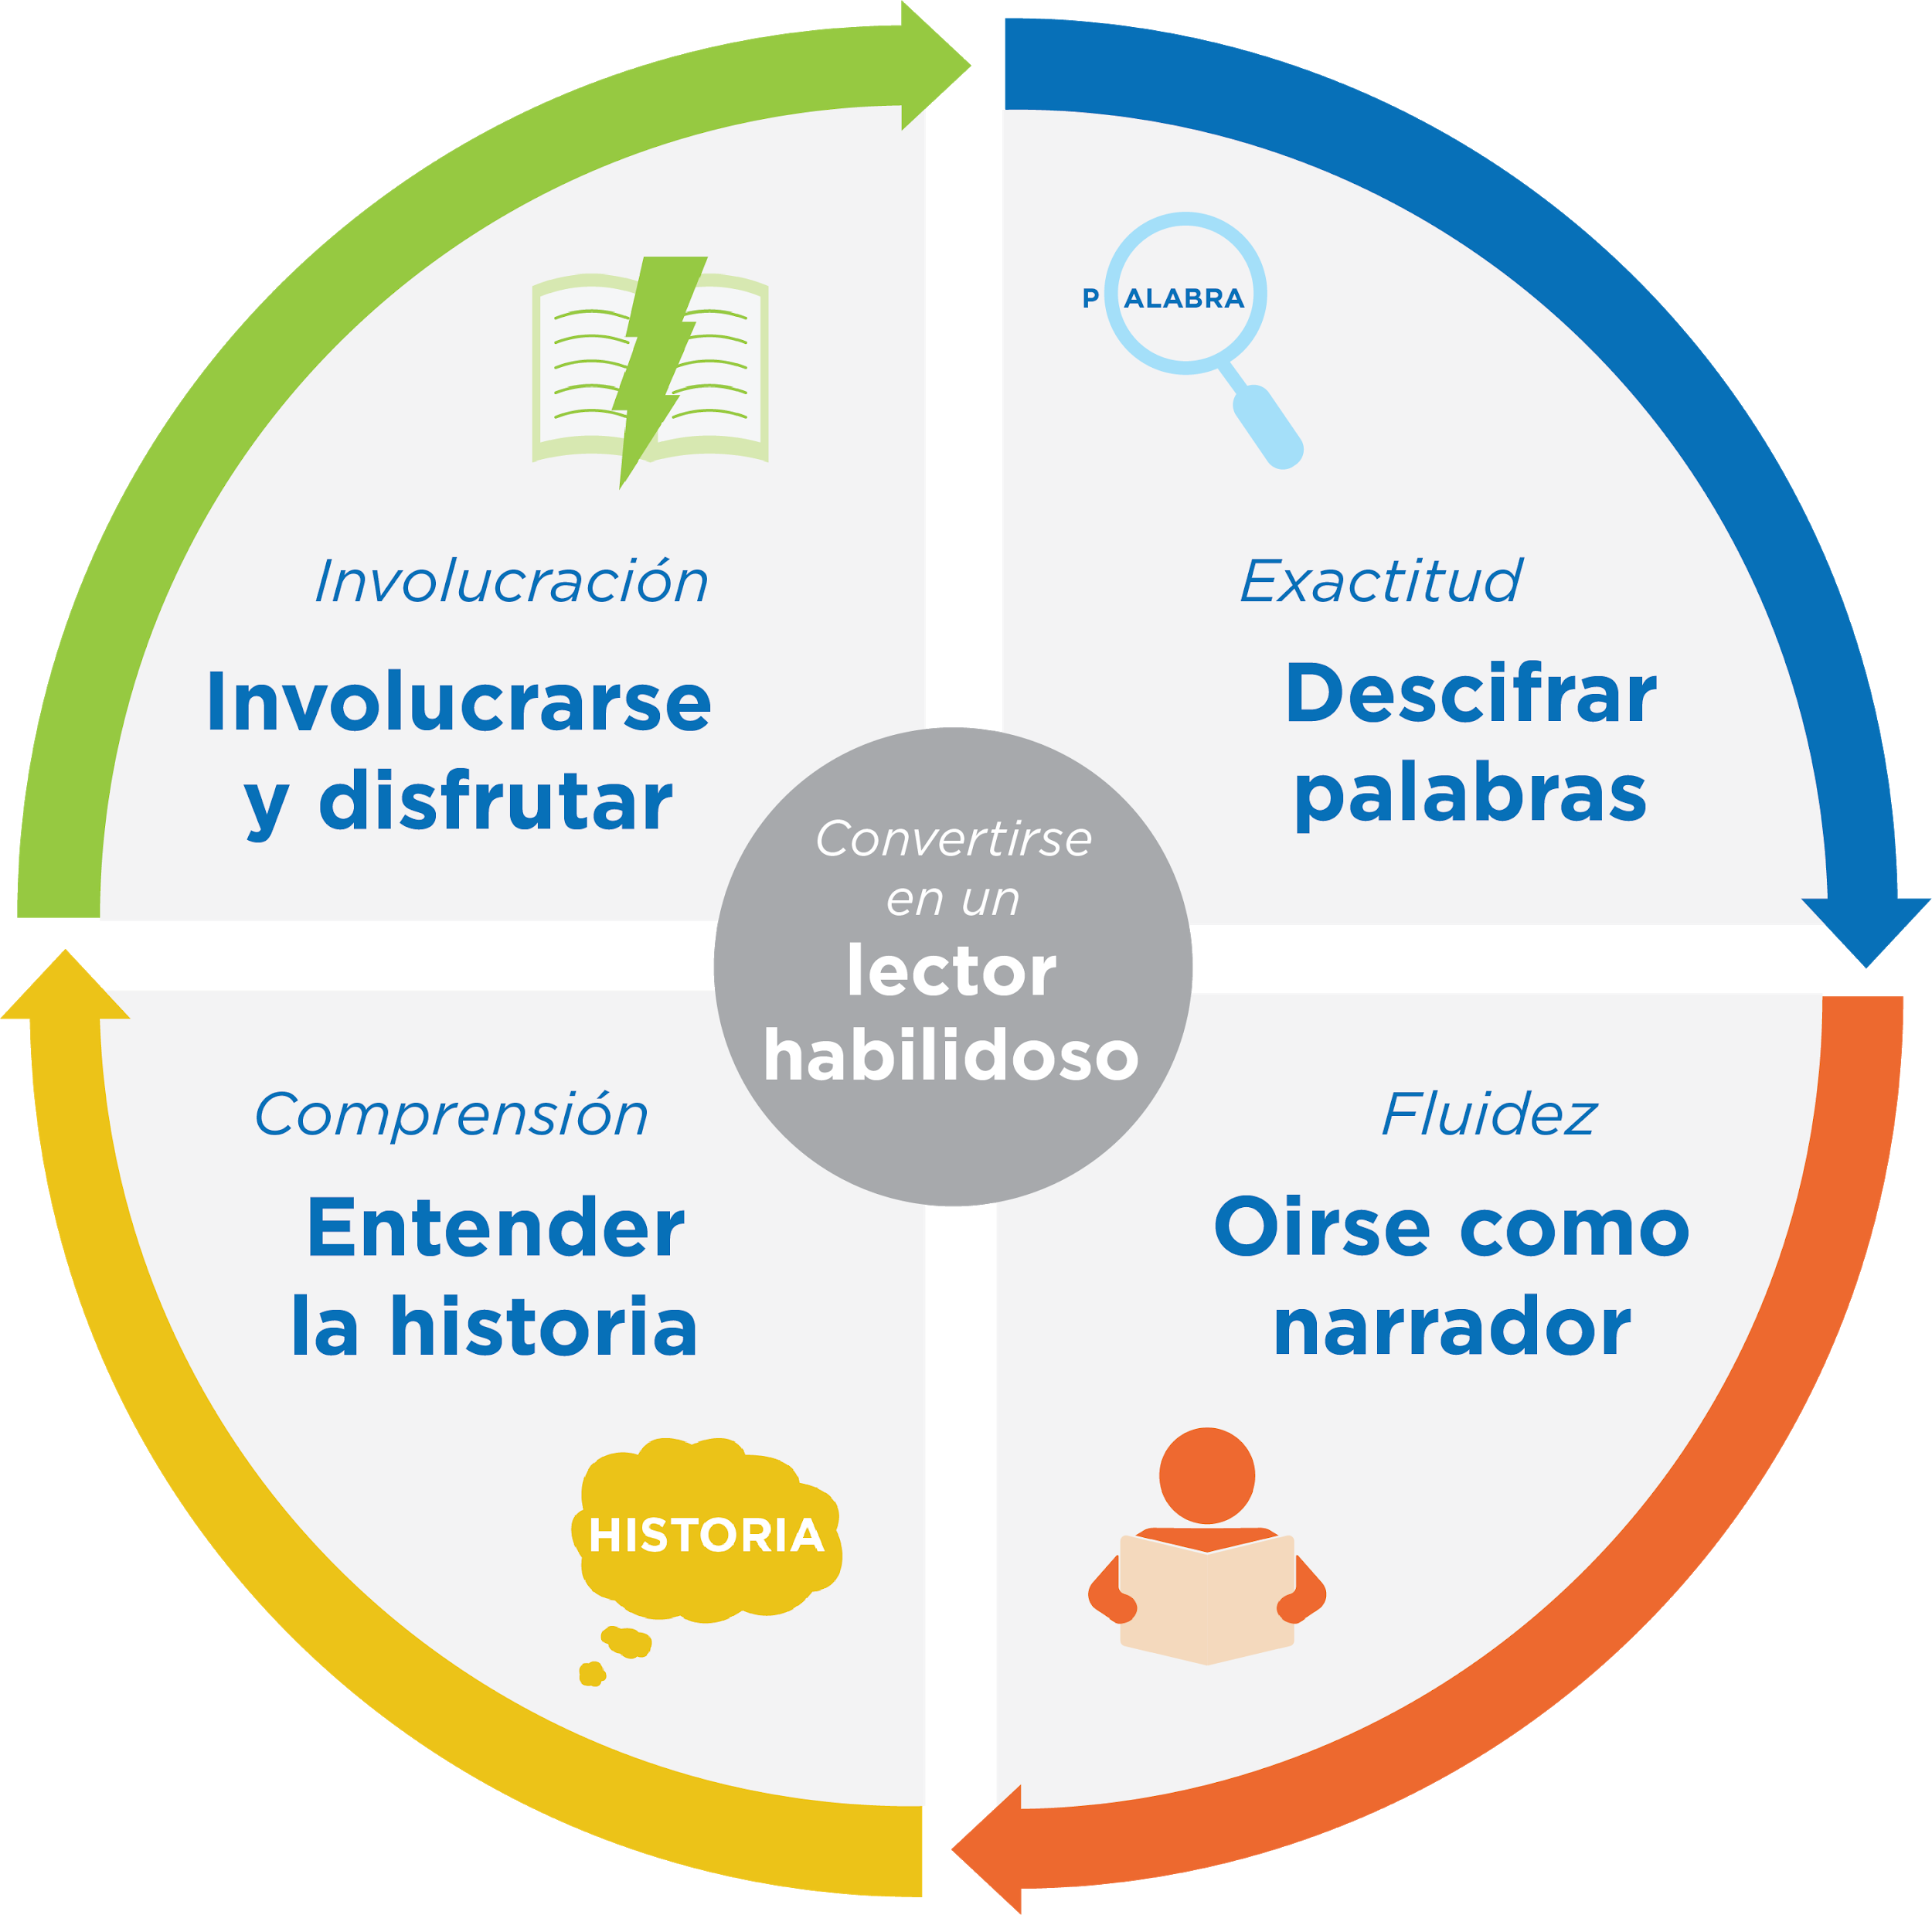
Jugar con propósito -> el aprendizaje
¡Las preguntas y las conversaciones significativas son gran parte de construir la base de lectura!
Notes:
Remind families of the importance of play at this age and how playing with words, letters, sounds, books, etc. is the most effective way to build a foundation of reading.
Explain how today’s reading tip will help readers develop the skills they need to read well.
Sample script
Remember, our overall goal is to help your child build a foundation of reading. When your child starts to learn how to read, they will need to:
Be able to figure out the words they are reading. All the fun and playful things we do to help your child learn the sounds in words and to learn new words build toward this skill. Remember, you can do this without a book by just talking and listening to each other.
Be able to understand the story. All the reading and conversations you have will help your child be able to understand a story on their own. Encouraging their imaginations and ability to tell their own stories will help here, too!
And of course, we are helping our child learn how to engage and enjoy in a story every time we tell stories or read books.
Being able to sound like a storyteller is a skill your child will develop a little later.
Today’s reading tip helps your child understand how a book works-–the first step to engaging with a book on their own!
Sample script in Spanish
Recuérdense, nuestra meta en general es ayudarles a sus hijos a construir una base para la lectura. Cuando sus hijos empiezan a leer, tienen que:
Descifrar las palabras que están leyendo. La diversión y los juegos que hacemos para ayudarles a aprender los sonidos de las palabras y palabras nuevas les lleva a esta destreza. Recuérdense, se puede hacer sin un libro por simplemente hablar juntos y escuchar uno al otro.
Comprender un cuento. Toda la lectura y las conversaciones que tienen ayudarán a sus hijos para entender el cuento independientemente. Animarlos a usar sus imaginaciones y contar sus propios cuentos les ayudarán con eso también.
Y, por supuesto, estamos ayudando a nuestros hijos a involucrarse con y disfrutar un cuento cada vez que contamos historias o leemos libros.
La destreza de sonar como un cuentista es una habilidad que su hijos desarrollarán cuando sean más grandes.
El consejo de lectura de hoy les ayudarán a sus hijos para entender como un libro funciona – el primer paso de involucrarse con un libro independientemente.

Slide 16
Comentarios, por favor
¡Su aporte y comentarios mejora nuestro tiempo juntos!
Notes:
Invite families to make a reading plan for the upcoming week.
Remind families that readers need “reading together” time and “reading alone” time.
Remind families that reading in workshops counts as “reading together time” and they should log it (if applicable).
Invite families to give you feedback so that you can facilitate a workshop that works for them!
Families can use the printed feedback form (if available) or a digital feedback form.
Invite families to give you more informal feedback. This could look like a thumbs up if they liked the reading tip or writing one thing they hope for the next workshop.
Use this time to meet individually with families as needed.
Sample script
And finally, I want to make sure I’m hosting a Family Workshop that works for you. Every workshop, you’ll have a chance to give me feedback, and I promise you that I will read it and do my best to incorporate it. Will you fill out the survey before you leave? If you’d rather talk about your suggestions, instead of writing them down, let me know. Thanks and see you at the next workshop!
Sample script in Spanish
Para cerrar, quiero asegurar que estoy dando un taller de familia que les sirve a ustedes. En cada taller, tendrán la oportunidad de proveer comentarios. Yo les prometo que los voy a leer y voy a hacer mi mejor esfuerzo para incorporar los consejos en el próximo taller. ¿Pueden contestar el sondeo antes de irse? Si prefieren platicar sobre sus ideas, en vez de escribirlas, avísenme. ¡Gracias y nos veremos en el próximo taller!

