Slide 1
Workshop guide
Facilitator:
Read notes to prepare. Amend slides if needed.
Practice the script aloud. Change as needed.
Ready the family-facing materials.
Display slide 2 as families arrive.
Tell Me a Story
Notes:
Copyright 2022 Springboard Collaborative, all rights reserved.
Overview and rationale
This is an understand the story workshop. Retelling a story is a challenging task for beginning readers. They may struggle with understanding the parts of a story and sequencing the events in a plot. Oral storytelling is a fun and engaging way to work on this skill. Families learn questions they can ask to help their child tell a story they know from beginning to end.
Objective
By the end of this workshop, families will be able to name the parts of a story by telling a story with a clear beginning, middle, and end.
Materials
Corresponding Reading Tip Sheet (in the languages the families need)
Family Workshop Feedback Form (paper or digital form)
Projector to display slides
Empty envelope for families to put feedback form in (optional but highly recommended)
Name tags (optional but highly recommended)
Facilitation notes
To prepare
In this workshop, you will model how to tell a story from beginning to end. Study the slides in the reading tip section. Think through how you will model and guide practice for telling the beginning, middle, and end of a simple story.
Think of a culturally appropriate story from your own life to use as a module. You may also choose to use a well-known movie or fairytale.
Preview the light blue slides and choose the ones that are appropriate for your context (needs of the families, grade level).
Be sure to familiarize yourself with the content of the presentation so you can talk with families, not at them.
During workshop
Take time to build rapport as a group and individually with families. Little things, like learning family members’ names and greeting them at the door, go a long way.
Keep pace so that families have time to practice the tip and also reflect. Being able to practice and reflect helps families internalize the strategy.
Circulate and check-in with families individually during practice time. See “Practice time” slide for more specific suggestions.
Ideas to differentiate
Preview “Check in on literacy terms” and adjust terms or definitions, as needed.
If teaching this workshop to families with younger readers:
Choose the appropriate “Reading = conversation” slide.
Encourage families to use a simple story with a few plot points (like a fable) and build up to a more complex story (like a Disney movie).
If teaching this workshop to families with older children:
Choose the appropriate “Reading = conversation” slide.
Encourage families to support their children to use additional terms to talk about a story–like mood, rising action, conflict, falling action, resolution, moral, etc…
If teaching this workshop to Multilingual families:
Encourage families to use stories from their family life or cultural background. This reading tip is especially suited for adults who may not be literate in English (or any language).
Consider providing sentence stems for families who may be speaking in a group.
For children with language difficulties, such as students learning English, storytelling can be a challenging task. They may have a harder time explaining the sequence the events, and using appropriate language. Consider providing sentence stems for children to use when talking about the beginning, middle, and ending of the story.
If families are familiar with this workshop, consider how you might leverage their experience. Ask families to share how they helped their child internalize the steps. Invite them (ahead of time) to model one or more steps if appropriate.
Timing considerations for a 60 min workshop
Welcome: 10 mins
Reading tip: 15-20 mins
Practice: 15-20 mins
Reflection and updates: 10 mins
After you use these materials, we want to hear your feedback! Fill out the Family Workshop Facilitator Feedback Form at https://bit.ly/SBCfeedbackform.

Slide 2
Tell Me a Story
Notes:
Part 1: Welcome
Formally welcome families and tell them the title of today’s workshop. Do not go into specific steps of the reading tip at this point.
Ensure families have the materials they need and are sitting with their children.

Slide 3
Agenda
Welcome
Reading tip
Practice time
Reflection & updates
Notes:
Provide an overview of what families will be doing today (and at every Family Workshop).
If this is the first Family Workshop in a series, explain that the icons for each of the four parts of the Family Workshop also run along the bottom of slides. ​
If this is not the first workshop, move quickly through this slide.
Sample script
Here is our plan for today. You can see each part of our agenda has an icon [point to the icons]. You can also find each icon along the bottom of each slide [point to bottom] so you can see where we are in the agenda. First, we’ll review a couple of things, then we’ll get right to the reading tip. Most of our time will be spent on practice time so we can all try out the reading tip. Then we’ll reflect and talk about some updates.
Please speak up with questions, concerns, or anything you’d like to share. We’re here together for one hour and need to maximize the time. Every child learns to read in a different way, but putting our heads together helps our shared cause: to give kids a reading boost and cultivate a the joy of reading.
Sample script in Spanish
Aquí tenemos el plan para hoy. Se puede ver que cada parte de la agenda tiene un ícono [point to the icons]. También se encuentran en el final de cada diapositiva [point to bottom] para que puedan saber en qué parte estamos. Primero, vamos a repasar algunas cosas. Luego vamos a empezar con el consejo de la lectura. La mayoría del tiempo vamos a pasar aquí, en la práctica, para probar el consejo de la lectura juntos. Luego, vamos a reflexionar y hablar sobre algunas novedades.
En cualquier momento, pueden hacer preguntas, compartir preocupaciones, o cualquier otra cosa que quieren compartir. Vamos a estar juntos por una hora y queremos aprovechar del tiempo que tenemos. Cada niño aprende a leer de una manera diferente. Estamos aquí para trabajar en la misma causa: ayudarles a los niños a mejorar en la lectura y llegar a disfrutarla.

Slide 4
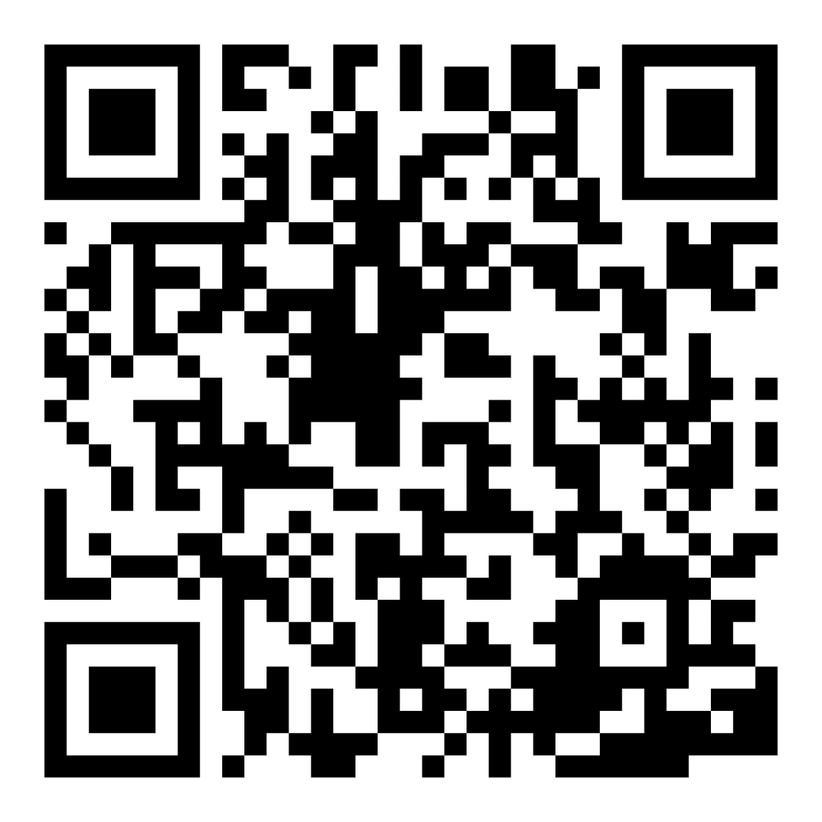
Family Confidence Survey
Scan this code to share how you’re feeling about reading with your child. Participants will be entered into a raffle for a $15 gift card. One winner per school will be drawn after the first and last workshops.
bit.ly/3BUBxbx
Notes:
If this is not the first or last Family Workshop, please delete this slide from the slide deck.
If you are an LAUSD teacher or staff member, please delete this slide from ALL Family Workshop decks.
Families who fill out the survey will be asked to provide an email to be entered into the raffle.
One raffle winner will be selected by Springboard Collaborative’s Data & Evaluation team after the first and last workshop and sent a $15 e-gift card to the email they provided.
If you need print-out versions of the QR code survey in English or the other translated languages, you can find those here: https://drive.google.com/file/d/1zjxnM0C9aP4C9WJFbw2A8eFpjZ29wBWG/view?usp=sharing
If you want to send the survey directly to families, you can find the link to the survey here: bit.ly/3BUBxbx

Slide 5
Workshop guidelines
Be prepared.
Be present.
Be courteous.
Ask questions.
Notes:
Briefly explain the guidelines or “the rules we all agree to follow so that we can all have an enjoyable and an effective workshop.”
If this is the first workshop, briefly explain each of the guidelines.
Alternatively, a family volunteer may read or summarize this slide if they’ve attended the previous workshop. ​
Consider putting these on chart paper and inviting the group to add to the list. If you do this, be sure to change this slide in subsequent workshops.​
Emphasize these guidelines are for everyone (including you, the facilitator) and pledge to be prepared, present, courteous, and ask questions.
Emphasize the last point and specifically invite families to ask lots of questions.

Slide 6
Tell me a story
1
2
3
4
Think of a story.
Tell me the beginning.
Tell me the middle.
This tip helps your child understand the way stories are organized.
Tell me the end.
Notes:
Part 2: Reading tip
Introduce the 4 parts of the reading tip.
Sample script
Today’s tip has four parts:
First, think of a story. Be creative! Think of something you are most interested in.
Then, introduce the story by telling me what happens in the beginning of the story.
Next, tell me how the story turns by explaining the middle of the story.
Finally, tell me how the story ends.
Why?
This tip helps your child understand the structure or organization of a story. Every story has a beginning, middle, and end. Being able to track the most important event from the beginning, middle, and end of the story helps a reader identify the plot or sequence of events.
Sample script in Spanish
El consejo de hoy tiene cuatro partes:
Primero, piensa en un cuento. ¡Sé creativo! Piensa en algo que más te interesa.
Luego, presenta la historia diciéndome qué es lo que pasa al principio del cuento.
Después, dime cómo cambia la historia, explicando el medio del cuento.
Finalmente, dime cómo termina la historia.
¿Por qué?
Este consejo le ayuda a su hijo a entender la estructura o la organización de un cuento. Cada cuento tiene un principio, un medio y un final. El poder seguir el evento más importante desde el principio, medio y final del cuento le ayuda al lector a identificar la trama o la secuencia de eventos.

Slide 7
Check in on literacy terms
Structure
how a text is organized. A story has a beginning, middle, and an end.
Plot
the sequence of events in a story.
Setting
when and where a story takes place.
Character
someone (or something) that is thinking, feeling, talking, and acting in a story.
Notes:
To make sure everyone has a common understanding, define some literacy terms as needed.

Slide 8
Think of a story
Ask your child to think of a story.
The story could be:
from your family life or culture
a story you know from a book, game, or movie.
a made-up story about something they are interested in, such as dinosaurs or a favorite stuffed animal.
Think of a story. Be creative!
Notes:
Explain the first step.
Sample script
The goal of today’s workshop is to help increase understanding of stories. First, let’s think of a story we would like to tell. The story could be from your family life–like a story you tell over and over again. It could be from your favorite book or your favorite movie. Or it could be a completely made up story about your favorite toy or pet.
For example, I would like to tell the story of how I learned to ride a bike [or your own story.]
Sample script in Spanish
La meta del taller de hoy es ayudar a incrementar la comprensión de cuentos. Primero, pensemos en una historia que nos gustaría contar. La historia podría ser de su vida familiar - como un cuento que cuentan una y otra vez. Podría ser de su libro o película favorita. O podría ser un cuento inventado sobre su juguete favorito o mascota.
Por ejemplo, me gustaría contar la historia sobre cómo aprendí a montar en bicicleta [or your own story.]

Slide 9
Tell me the beginning
When and where does this story take place? We call that the setting.
Be sure to introduce the character(s) or who was involved in the story.
[For older kids] Does the story have a mood?
What happens in the beginning of the story?
Notes:
Model telling the beginning of a story.
Sample script
Now that we thought of the story we want to tell, let’s get into the details. We’ll start with the beginning – it is the first part of the story. It is where the writer captures the reader’s attention with a detailed description of the character(s) and setting of the story. The beginning will also set the mood for the reader; will it be happy and exciting, dark and mysterious, or silly and entertaining? A good beginning makes you want to read, or in this case- listen, more.
The first part of my story would be that it was sunny, summer day in the front yard of my childhood home. My bike was pretty and pink, and I could not wait to learn to ride it. My dad carried my bike out to the sidewalk and put down the kickstand. I was feeling nervous and excited. My little sister was watching. She was always interested in what I was doing. And my dad had just gotten off of work so he was wearing his coveralls. I sat on the bike and wobbled a little as I began peddling. My dad was behind me, holding the seat and encouraging me to go faster.
Sample script in Spanish
Ahora que pensamos en la historia que queremos contar, entremos en los detalles. Vamos a empezar con el principio - es la primera parte del cuento. Es donde el escritor capta la atención del lector con una descripción detallada de los personajes y el escenario de la historia. El principio también establece el tono para el lector; ¿será feliz y emocionante, oscuro y misterioso, o chistoso y entretenido? Un buen comienzo te hace querer leer, o en este caso - escuchar, más.
La primera parte de mi cuento sería que era un día soleado del verano en el jardín delantero del hogar de mi infancia. Mi bicicleta era bonita y rosada, y estaba ansiosa por aprender a montarla. Mi papá llevó la bicicleta hasta la acera y bajó la pata de cabra. Yo me sentía nerviosa y emocionada. Mi hermana menor estaba mirando. A ella siempre le interesaba lo que yo hacía. Y mi papá justo se había salido del trabajo, así que todavía tenía puesto su oberol. Me senté en la bici y me bamboleaba un poco mientras empezaba a pedalear. Mi papá andaba detrás de mí, agarrando la silla y animándome a ir más rápido.

Slide 10
Tell me the middle
Give details about what the character did or how they reacted to events in the story.
Maybe the character faced some challenges. How did they overcome those challenges?
What happens in the middle of the story?
Notes:
Model telling the middle.
Sample script
Let’s move to the middle of a story. The middle is where the bulk of the action of the story happens. It gives important key details, and holds the reader’s attention. Here, we read, or talk, about how the character(s) faces or overcomes those challenges.
The middle of my story would include me falling down a bunch of times. I scraped my left knee, and I still have that scar to this very day. My dad ran inside the house to grab first-aid materials and bandaged my wound. He asked if I still wanted to give bike riding a try. I said ‘Of course!’ We continued to ride. My sister kept running alongside me and encouraging me.
Sample script in Spanish
Movamos al medio de una historia. El medio es donde pasa la mayoría de la acción del cuento. Da detalles importantes claves, y sostiene la atención del lector. Aquí leemos, o hablamos, sobre cómo el personaje enfrenta o supera estos retos.
El medio de mi cuento incluye que me caí varias veces. Me raspé la rodilla izquierda, y todavía tengo la cicatriz hoy en día. Mi papá corrió a la casa para agarrar materiales de primeros auxilios y vendó mi herida. Me preguntó si yo todavía quería intentar montar en bicicleta. Dije “¡Claro que sí! Seguimos montando. Mi hermana seguía corriendo a mi lado y animándome.

Slide 11
Tell me the end
Describe how the challenge is resolved and how the story ends.
Does the character learn a lesson from what happened in the story?
What lesson can the listener learn from the story? We call this the moral of the story.
What happens at the end of the story?
Notes:
Model how to tell the end.
Sample script
Let’s wrap the story up. The end – this is where the story comes to a close, it is the conclusion and solution to the problem. It is where the character learns a lesson or comes to terms with the events of what happened.
The ending of my story includes me sticking it out, for a full two hours, until I learned to ride. My dad let his hands go from the seat of my bike. I had no idea that he had let go until my sister started squealing and telling me–you’re doing it! I was riding all on my own! It was the best feeling ever!
What moral or lesson can we learn from this story?
Sample script in Spanish
Cerremos esta historia. El final - es donde se cierra el cuento, es la conclusión y la solución al problema. Es donde el personaje aprende una lección o acepta lo que pasó.
El final de mi cuento incluye que yo me aguanté, durante dos horas enteras, hasta que aprendí a montar. Mi papá se quitó las manos de la silla de mi bici. Yo ni sabía que la había suelto hasta que mi hermana empezó a chillar y decirme - ¡lo estás haciendo! Yo estaba montando sóla. ¡Era el mejor sentimiento del mundo!
¿Qué moraleja o lección podemos aprender de esta historia?

Slide 12
Reading = conversation (K-1)
Where does the story take place?
What characters are in the story?
What caused the character to make the decision they did?
What does the character want? Do they face any problems?
Notes:
Remind families that the at-home reading coach always asks questions!
► For Multilingual families specifically: Some families may come from a culture where asking questions and “coaching” their child may be an unfamiliar practice. Instead, they may be more used to being directive and having the answers​.
Encourage families to keep trying this coaching technique and assure them that the more they do it, the more comfortable it will become. ​
Although “parent as expert” and “parent as coach” are equally valid positions, asking questions and encouraging children to find the answer out for themselves instead of telling them an answer can help children internalize the learning in a different way.
This is a good time to remind parents that even though asking questions may not at present be a regular practice for them, this is an opportunity for them to acquire and practice new skills that will help their children. Cultural shifts are usually most effective when they're explicit.​
Use this slide to ensure that families have some questions they can ask during practice time.
Ask families to hold up the number of questions they already have written down or are prepared to use. If it looks like the room is prepared, you may skip this slide or ask families to share other questions they have written down throughout the workshop.
Share with families that there are also sample questions on the Reading Tip Sheet.
Sample script
At Springboard, the most important thing we want you to leave with is: to ALWAYS ASK QUESTIONS. You want to ask your child questions to help them figure out words, understand what they’re reading, sound more like a storyteller, and enjoy what they are reading. Today we’ve learned questions to help your child improve reading comprehension through storytelling.
Sample script in Spanish
En Springboard, lo más importante con lo que queremos que se vaya es: QUE SIEMPRE HAGA PREGUNTAS. Quiere hacerle preguntas a su hijo para ayudarlo a descifrar palabras, comprender lo que está leyendo, sonar más como un narrador y disfrutar lo que está leyendo. Hoy hemos aprendido preguntas para ayudar a su hijo a mejorar su comprensión lectora mediante la narración.

Slide 13
Reading = conversation (2-3)
What is the story’s setting? Who are the character(s)?
Why do the character(s) face certain challenges?
How does the story end? How do the character(s) overcome the problem?
Notes:
Remind families that the at-home reading coach always asks questions!
► For Multilingual families specifically. Some families may come from a culture where asking questions and “coaching” their child may be an unfamiliar practice. Instead, they may be more used to being directive and having the answers​
Encourage families to keep trying this coaching technique and assure them that the more they do it, the more comfortable it will become. ​
Although “parent as expert” and “parent as coach” are equally valid positions, asking questions and encouraging children to find the answer out for themselves instead of telling them an answer can help children internalize the learning in a different way.
This is a good time to remind parents that even though asking questions may not at present be a regular practice for them, this is an opportunity for them to acquire and practice new skills that will help their children. Cultural shifts are usually most effective when they're explicit.​
Use this slide to ensure that families have some questions they can ask during practice time.
Ask families to hold up the number of questions they already have written down or are prepared to use. If it looks like the room is prepared, you may skip this slide and/or ask families to share other questions they have written down throughout the workshop.
There are also sample questions on the Reading Tip Sheet.
Sample script:
At Springboard, the most important thing we want you to leave with is: to ALWAYS ASK QUESTIONS. You want to ask your child questions to help them figure out words, understand what they’re reading, sound more like a storyteller, and enjoy what they are reading. Today we’ve learned questions to help your child improve reading comprehension through storytelling.
Sample script in Spanish
En Springboard, lo más importante con lo que queremos que se vaya es: QUE SIEMPRE HAGA PREGUNTAS. Quiere hacerle preguntas a su hijo para ayudarlo a descifrar palabras, comprender lo que está leyendo, sonar más como un narrador y disfrutar lo que está leyendo. Hoy hemos aprendido preguntas para ayudar a su hijo a mejorar su comprensión lectora mediante la narración.

Slide 14
Multilingual families
Use stories from your family or culture.
Use this with books in any language.
Notes:
Use this slide if families’ primary language is not English or they may have specific questions. Alternatively, if you have talked about accommodations throughout the reading tip explanation you may skip this slide or use it to briefly sum up.
Explain the tips on the slide. If you need more detail, see “Ideas to differentiate” in the Workshop Guide.

Slide 15
Practice time
1
Call me over when you have a question!
Think of a story.
2
Tell me the beginning.
3
Tell me the middle.
4
Tell me the end.
Notes:
Part 3: Practice time
Note: Practice time should be most of the remaining time. Leave 10 minutes or so at the end for reflection.
Summarize the tip, and remind families to repeat these steps during practice time.
Take a moment to explain that you’ll be circulating around while they practice (to provide 1:1 support and answer any questions).
►Multilingual parents in particular often come with feelings of self-consciousness that can be overcome when they know why they're being observed.
Remind families to ask questions as they use the tip.
There are also sample questions on the Reading Tip Sheet.
To support families, consider underlining two high leverage questions on the Reading Tip Sheet as you circulate.
Remind families they can always work on their action plan or other strategies during practice time, especially if they have questions or want some help with it.
Circulate and work with families. Here are some suggestions:
Walk over to a family. Ask, “Do you have any questions about the reading tip?”
If yes, answer question.
If no, say, “May I listen in for a moment?
Listen for a full minute.
Compliment the family on something they did well and then leave them with one suggestion (if needed)
Walk over to a family and ask, “Can I try this reading tip with your child?”
After you’ve modelled it, ask the adult, “What did you notice me doing?” or say “Did you notice that I…”
Gather “glows”(things that families did that you want to lift up to the group) and “grows” (things families do that you want to stop and correct/clarify for the whole group).
Share the “glows” and “grows” at 10 mins into practice time or wait until the end.
Keeps “grows” anonymous, but congratulate specific families on “glows.”

Slide 16
Reflect
Any questions about the reading tip?
Turn and talk with your child: Do we feel ready to try this reading tip at home?
Please share how you might use this at home.
Your question will help someone else in the room!
Notes:
Part 4: Reflection & updates
Invite participants to ask questions.
Give ample wait time for each question. ​
Remind families that when parents talk they make it safe for more hesitant parents to share. It builds community in the classroom. ​
Encourage other voices to share.
In addition, you could share some “glows” and “grows” you noticed while walking around and supporting families during practice time.
Check in on the goal of Family Workshops.​
Read “Any questions…”? and wait. Let this question hang and give ample wait time.​
Invite families who don’t yet feel equipped to do the reading tip on their own to raise their hand (or indicate in a more private way) so you can check in with them personally before they leave the workshop.
Invite a family volunteer to share how they will use the reading tip at home.
If time permits, you may do a whip-around share.
Invite families to each share one thing (in 30 seconds or less). This could be:
Something they learned
One thing they’re excited to try at home
One thing they found challenging about this tip
One step they will focus on this week

Slide 17
Feedback, please
Your input improves our time together!
Notes:
Invite families to make a reading plan for the upcoming week.
Remind families that readers need “reading together” time and “reading alone” time.
Remind families that reading in workshops counts as “reading together time” and they should log it (if applicable).
Invite families to give you feedback so that you can facilitate a workshop that works for them!
Families can use the printed feedback form (if available) or a digital feedback form.
Invite families to give you more informal feedback. This could look like a thumbs up if they liked the reading tip or writing one thing they hope for the next workshop.
Use this time to meet individually with families as needed.
Sample script
And finally, I want to make sure I’m hosting a Family Workshop that works for you. Every workshop, you’ll have a chance to give me feedback, and I promise you that I will read it and do my best to incorporate it. Will you fill out the survey before you leave? If you’d rather talk about your suggestions instead of writing them down let me know. Thanks, and see you at the next workshop!
Sample script in Spanish
Para cerrar, quiero asegurar que estoy dando un taller de familia que les sirve a ustedes. En cada taller, tendrán la oportunidad de proveer comentarios. Yo les prometo que los voy a leer y voy a hacer mi mejor esfuerzo para incorporar los consejos en el próximo taller. ¿Pueden contestar el sondeo antes de irse? Si prefieren platicar sobre sus ideas, en vez de escribirlas, avísenme. ¡Gracias y nos veremos en el próximo taller!

