Slide 1
Workshop guide
Facilitator:
Read notes to prepare. Amend slides if needed.
Practice the script aloud. Change as needed.
Ready the family-facing materials.
Display slide 2 as families arrive.
Comparte el cuento
(Share the Story)
Notes:
Copyright 2022 Springboard Collaborative, all rights reserved.
Overview and rationale:
This is an understand the story workshop. In this workshop, families learn questions to ask to help their their child summarize a story by using their hand and the prompt “someone-wanted-but-so-then.” This is a useful strategy because young readers often have trouble identifying and focusing on the major elements of a story. This strategy helps readers organize their thinking and summarize a story—thus leading to a better understanding of the story.
Materials:
Corresponding Reading Tip Sheet (in the languages the families need)
Family Workshop Feedback Form (paper or digital form)
Books for families to use during practice time. This workshop works best with fiction books.
A short text to provide guided practice with (printed or projected large enough for families to see)
Projector to display slides
Empty envelope for families to put feedback form in (optional but highly recommended)
Name tags (optional but highly recommended. Using names is an important practice for building community)
Audio equipment (if using the video)
Facilitation notes:
To prepare:
In this workshop, you will model how children can do a quick summary using their hand when they finish reading a book.
Study the slides in the reading tip section. Choose a short picture book to read to families and guide them, as a group, to practice summarizing in the “Use your hand” slide. Choose a book that has very clear story elements. If time is short, consider using a common movie or cartoon, but think about if all families have the same schema.
There is a modeling video in English available on Springboard Collaborative’s YouTube and Vimeo channels. Decide if you will play the video in addition to or in lieu of the live model.
Keep pace and protect practice time.
Check audio connections beforehand.
Preview the light blue slides and choose the ones that are appropriate for your context (needs of the families, grade level).
Be sure to familiarize yourself with the content of the presentation so you can talk with families, not at them.
Test video links and audio equipment for video. The video is available in English on Springboard Collaborative’s YouTube channel.
During workshop
Take time to build rapport as a group and individually with families. Little things, like learning family members’ names and greeting them at the door, go a long way.
Keep pace so that families have time to practice the tip and also reflect. Being able to practice and reflect helps families internalize the strategy.
Circulate and check-in with families individually during practice time. See “Practice time” slide for more specific suggestions.
Ideas to differentiate
Regardless of the reading abilities of the children, consider choosing a short but engaging read aloud book to practice with in the “Use your hand” slide. It’s important to practice summarizing and a book that is easily understood will keep the focus on the process instead of deciphering the text.
Preview the “Check in on literacy terms” slide and adjust terms or definitions, as needed.
If teaching this workshop to families with younger readers:
Choose the appropriate “Reading = conversation” slide.
Focus on the “Somebody-wanted-but” steps only.
Encourage families to use picture books or other books they read aloud to their children to practice this strategy. Children could point to the pictures as textual evidence.
If teaching this workshop to families with older readers:
Choose the appropriate “Reading = conversation” slide.
Remind families to ask for textual evidence by following up with questions like “How do you know? Show me the words and phrases in the book that prove that.”
Encourage families to use this as a strategy to discuss the reading their child does independently.
Explain how it can be used to summarize longer sections of the book or chapters.
Explain that as children learn more complicated books, there may be an overarching conflict and also smaller conflicts/problems to overcome.
If teaching this workshop to Multilingual families:
Encourage families to share the story in whatever language feels the most comfortable.
Choose a read-aloud book in the dominant language of the families (instead of English) to share. You want families to practice summarizing and not get stuck on constructing meaning from the text.
Consider changing the example in the “Share the story” slide to a more culturally relevant fairy tale or fable. If you don’t know, ask! Invite families to tell you a common fable from their culture and work from their example.
If families are familiar with this workshop, consider how you might leverage their experience. Ask families to share how they helped their child internalize the steps. Invite them (ahead of time) to model one or more steps, if appropriate. Encourage families to help their child move toward independence by providing less support as their child summarizes the story.
Timing considerations for a 60 min workshop
Welcome: 10 mins
Reading tip: 15-20 mins
Practice: 15-20 mins
Reflection and updates: 10 mins
After you use these materials, we want to hear your feedback! Fill out the Family Workshop Facilitator Feedback Form at https://bit.ly/SBCfeedbackform.

Slide 2
Comparte el cuento
Notes:
Part 1: Welcome
Formally welcome families, and tell them the title of today’s workshop. Do not go into specific steps of the reading tip at this point.
Ensure families have the materials they need and are sitting with their children.

Slide 3
Agenda
Bienvenida
Consejo de lectura
Tiempo de práctica
Reflexión y actualizaciones
Notes:
Provide an overview of what families will be doing today (and at every Family Workshop).
If this is the first Family Workshop in a series, explain that the icons for each of the four parts of the Family Workshop also run along the bottom of slides. ​
If this is not the first workshop, move quickly through this slide. ​
Sample script
Here is our plan for today. You can see each part of our agenda has an icon [point to the icons]. You can also find each icon along the bottom of each slide [point to bottom] so you can see where we are in the agenda. First, we’ll review a couple of things, then we’ll get right to the reading tip. Most of our time will be spent on practice time so we can all try out the reading tip. Then we’ll reflect and talk about some updates.
Please speak up with questions, concerns, or anything you’d like to share. We’re here together for one hour, and need to maximize the time. Every child learns to read in a different way, but putting our heads together helps our shared cause: to give kids a reading boost and cultivate a the joy of reading.
Sample script in Spanish
Aquí tenemos el plan para hoy. Se puede ver que cada parte de la agenda tiene un ícono [point to the icons]. También se encuentran en el final de cada diapositiva [point to bottom] para que puedan saber en qué parte estamos. Primero, vamos a repasar algunas cosas. Luego vamos a empezar con el consejo de la lectura. La mayoría del tiempo vamos a pasar aquí, en la práctica, para probar el consejo de la lectura juntos. Luego, vamos a reflexionar y hablar sobre algunas novedades.
En cualquier momento, pueden hacer preguntas, compartir preocupaciones, o cualquier otra cosa que quieren compartir. Vamos a estar juntos por una hora y queremos aprovechar del tiempo que tenemos. Cada niño aprende a leer de una manera diferente. Estamos aquí para trabajar en la misma causa: ayudarles a los niños a mejorar en la lectura y llegar a disfrutarla.

Slide 4
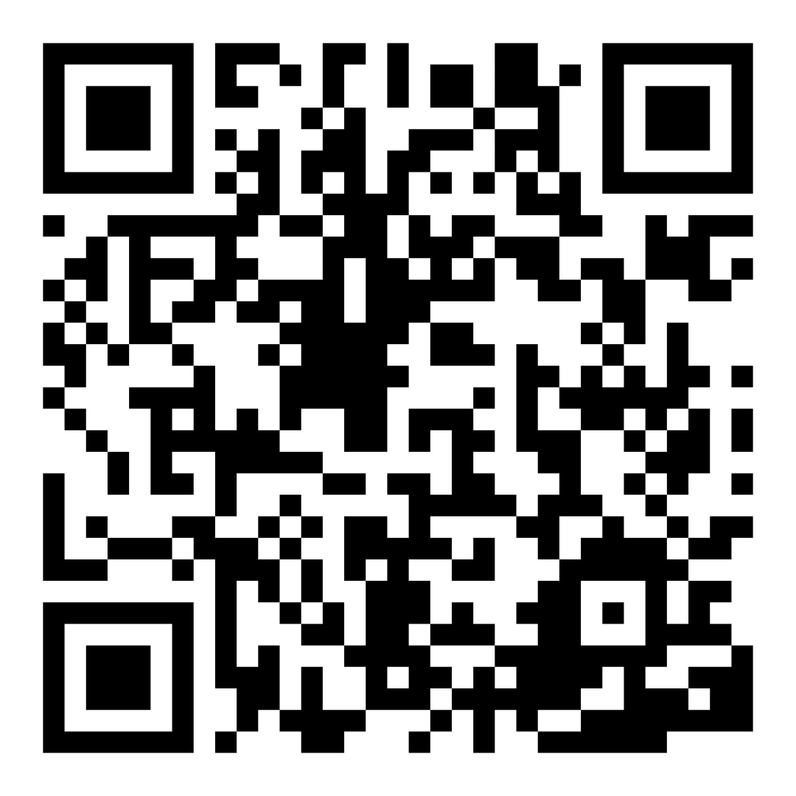
Encuesta de confianza familiar
Escaneen este código para compartir cómo se sienten acerca de la lectura con sus hijos. Los participantes serán inscritos en un sorteo para ganar una tarjeta de regalo de $15. Se elegirá un ganador por escuela después del primer y último taller.
bit.ly/3BUBxbx
Notes:
If this is not the first or last Family Workshop, please delete this slide from the slide deck.
If you are an LAUSD teacher or staff member, please delete this slide from ALL Family Workshop decks.
Families who fill out the survey will be asked to provide an email to be entered into the raffle.
One raffle winner will be selected by Springboard Collaborative’s Data & Evaluation team after the first and last workshop and sent a $15 e-gift card to the email they provided.
If you need print-out versions of the QR code survey in English or the other translated languages, you can find those here: https://drive.google.com/file/d/1zjxnM0C9aP4C9WJFbw2A8eFpjZ29wBWG/view?usp=sharing
If you want to send the survey directly to families, you can find the link to the survey here: bit.ly/3BUBxbx

Slide 5
Las normas de los talleres
Estar preparado.
Estar presente.
Ser cortés.
Haga preguntas.
Notes:
Briefly explain the guidelines or “the rules we all agree to follow so that we can all have an enjoyable and an effective workshop.”
If this is the first workshop, briefly explain each of the guidelines.
Alternatively, a family volunteer may read or summarize this slide if they’ve attended the previous workshop. ​
Consider putting these on chart paper and inviting the group to add to the list. If you do this, be sure to change this slide in subsequent workshops.​
Emphasize these guidelines are for everyone, including you, the facilitator, and pledge to be prepared, present, courteous, and ask questions.
Emphasize the last point and specifically invite families to ask lots of questions.

Slide 6
Comparte el cuento
1
2
3
Alguien-quería
Pero
Así que-luego
Resumir el cuento nos ayuda a entender mejor.
Notes:
Part 2: Reading tip
Introduce the 3 parts of the reading tip but do not go into details.
Tell families that they can use this strategy with books that their child reads with them and with books their child reads on their own.
Sample script
Sharing stories is a common reading strategy that we all do—without even realizing. Why? Because when we enjoyed a story, we like to talk about it! The strategy we’ll learn today gives children an easy to way to talk about what the book is about. When we try to sum up or tell someone else what happened in a story, it helps us understand it better ourselves.
Sample script in Spanish
Compartir un cuento es una estrategia de lector común que todos hacemos - sin darnos cuenta. ¿Por qué? Porque cuando nos gusta un cuento, ¡nos gusta hablar sobre el cuento! La estrategia que aprenderemos hoy provee una manera fácil para que los niños aprendan cómo hablar sobre el contenido del libro. Cuando intentamos resumir o contarle a alguien más lo que está pasando en un cuento, nos ayuda para mejor entenderlo para nosotros mismos.

Slide 7
Verifique términos de alfabetización
Resumen
Contar una breve declaración de los puntos principales en la historia.
Notes:
To make sure everyone has a common understanding, define some literacy terms as needed.

Slide 8
Resúmenes de ficción
Resumen Largo
titulo
resumen
personajes
escenario
principio
medio
final
muchos detalles
proposito del autor
conexión personal
Resumen Corto
Titulo
personaje principal
problema (o conflicto)
Solucion
Cuenten la historia como si estuvieran contando la trama de una película
Notes:
Explain the difference between giving a long summary (something that their child is often asked to do in school) and giving a short summary—the way we talk about books when we share them with each other.
Invite a volunteer to read each list.
These informal, short summaries are what we’ll work on today.
A good way to think about it is if you watch a good movie and can’t wait to tell someone about it, these are the things you might tell them.

Slide 9
Alguien-quería-pero-así que-luego
Consejos y trucos
Alguien = personaje personal
Quería/pero = problema (or conflicto)
Así que/luego= solución (o resolución)
pero
así que
quería
luego
Alguien
Notes:
Explain to families that using our hands is a good way to remember the important elements of a short summary.
Sample script
Often the hardest part of summarizing a story is knowing what parts of a story to include. You can see the basic parts of a short summary here—character, problem, and solution Using your hand and this sentence prompt—”someone-wanted-but-so-then” helps us organize and focus on the important parts of a summary.
Sample script in Spanish
Con frecuencia, la parte más difícil de resumir un cuento es saber cuáles eventos se debe incluir. Se puede ver las partes básicas de un resumen corto aquí - personaje, problema, y solución. Usando la mano y esta guia - alguien-quería-pero-así que-luego - nos ayuda para organizarnos y enfocarnos en las partes importantes del resumen.

Slide 10
1. Alguien-quería
querían comer el pasto verde del otro lado del puente.
Alguien… Tres cabras
Las tres cabras bruscas
Notes:
Provide families with a quick model using a commonly known story.
Note: This slide can be used instead of or in addition to the modeling video (if applicable)
►Multilingual families more specifically: Consider changing this slide ahead of time to be more culturally relevant to your families.

Slide 11
2. Pero
pero un duende feo los detuvo.
Las tres cabras bruscas
Notes:
Provide families with a quick model using a commonly known story.
Note: This slide can be used instead of or in addition to the modeling video (if applicable)
►Multilingual families more specifically: Consider changing this slide ahead of time to be more culturally relevant to your families.

Slide 12
3. Asi que-luego
Así que la cabra brusca más grande córneo el duende hasta caerse del puente.
Luego podían cruzar el puente y comer el pasto en paz.
Las tres cabras bruscas
Notes:
Provide families with a quick model using a commonly known story.
Note: This slide can be used instead of or in addition to the modeling video (if applicable)
►Multilingual families more specifically: Consider changing this slide ahead of time to be more culturally relevant to your families.

Slide 13
Vamos a ver
English
https://youtu.be/2a5BdQr2O2Q
Español
proximamente
Notes:
Play the video (4 min) and ask families to highlight some of the things they saw the father doing.
Note: Video is available in English only.

Slide 14
Usar la mano
Consejos y trucos
¡Los niños mayores pueden resumir un capítulo o una parte del libro en vez del libro entero!
pero
así que
quería
luego
Alguien
Notes:
Lead guided practice.
Read a short book aloud or brainstorm a story or movie the group knows well.
Invite families to practice with their child (or their table group) using their hand to summarize. Debrief as a group after each finger (or after the whole hand)
If applicable, explain how this tip can work with longer books. (see side panel)

Slide 15
Lectura = conversación (K-1)
¿Quien es el personaje principal?
¿Que quiere el personaje? Apunta a las palabras/fotos que te ayudaron a saber.
¿Por que el personaje no puede obtener lo que quiere? ¿Como lo sabes?
¿Que paso al final del cuento? Ensename donde en el cuento.
Notes:
Remind families that the at-home reading coach always asks questions!
► For multilingual families specifically. Some families may come from a culture where asking questions and “coaching” their child may be an unfamiliar practice. Instead, they may be more used to being directive and having the answers​
Encourage families to keep trying this coaching technique and assure them that the more they do it, the more comfortable it will become. ​
Although “parent as expert” and “parent as coach” are equally valid positions, asking questions and encouraging children to find the answer out for themselves instead of telling them an answer can help children internalize the learning in a different way.
This is a good time to remind parents that even though asking questions may not at present be a regular practice for them, this is an opportunity for them to acquire and practice new skills that will help their children. Cultural shifts are usually most effective when they're explicit.​
Use this slide to ensure that families have some questions they can ask during practice time.
Ask families to hold up the number of questions they already have written down or are prepared to use. If it looks like the room is prepared, you may skip this slide and/or ask families to share other questions they have written down throughout the workshop.
There are also sample questions on the Reading Tip Sheet.
Sample script
At Springboard, the most important thing we want you to leave with is: to ALWAYS ASK QUESTIONS. You want to ask your child questions to help them figure out words, understand what they’re reading, sound more like a storyteller, and enjoy what they are reading. Today we’ve learned questions to help your child summarize the story by using their hand to understand how parts fit together.
Sample script in Spanish
En Springboard, lo más importante con lo que queremos que se vaya es: QUE SIEMPRE HAGA PREGUNTAS. Quiere hacerle preguntas a su hijo para ayudarlo a descifrar palabras, comprender lo que está leyendo, sonar más como un narrador y disfrutar lo que está leyendo. Hoy hemos aprendido preguntas para ayudar a su hijo hacer un sumario del cuento usando su mano para entender cómo las partes se complementan juntas.

Slide 16
Lectura = conversación (2-3)
¿Quien es el personaje principal? ¿Qué es lo que quiere? ¿Como lo sabes?
¿Cual es el problema del personaje? Enséñame cómo lo sabes.
¿Y luego que paso? ¿Cómo resolvió el problema el personaje? ¿En que pagina paso esto?
Notes:
Remind families that the at-home reading coach always asks questions!
► For multilingual families specifically. Some families may come from a culture where asking questions and “coaching” their child may be an unfamiliar practice. Instead, they may be more used to being directive and having the answers​
Encourage families to keep trying this coaching technique and assure them that the more they do it, the more comfortable it will become. ​
Although “parent as expert” and “parent as coach” are equally valid positions, asking questions and encouraging children to find the answer out for themselves instead of telling them an answer can help children internalize the learning in a different way.
This is a good time to remind parents that even though asking questions may not at present be a regular practice for them, this is an opportunity for them to acquire and practice new skills that will help their children. Cultural shifts are usually most effective when they're explicit.​
Use this slide to ensure that families have some questions they can ask during practice time.
Ask families to hold up the number of questions they already have written down or are prepared to use. If it looks like the room is prepared, you may skip this slide and/or ask families to share other questions they have written down throughout the workshop.
There are also sample questions on the Reading Tip Sheet.
Sample script
At Springboard, the most important thing we want you to leave with is: to ALWAYS ASK QUESTIONS. You want to ask your child questions to help them figure out words, understand what they’re reading, sound more like a storyteller, and enjoy what they are reading. Today we’ve learned questions to help your child summarize the story by using their hand to understand how parts fit together.
Sample script in Spanish
En Springboard, lo más importante con lo que queremos que se vaya es: QUE SIEMPRE HAGA PREGUNTAS. Quiere hacerle preguntas a su hijo para ayudarlo a descifrar palabras, comprender lo que está leyendo, sonar más como un narrador y disfrutar lo que está leyendo. Hoy hemos aprendido preguntas para ayudar a su hijo hacer un sumario del cuento usando su mano para entender cómo las partes se complementan juntas.

Slide 17
Familias multilingües
Hacer preguntas y hablar sobre libros en cualquier idioma.
Usar esto con libros en cualquier idioma.
Notes:
Use this slide if families’ primary language is not English or they may have specific questions. Alternatively, if you have talked about accommodations throughout the reading tip explanation you may skip this slide or use it to briefly sum up.
Explain the tips on the slide. If you need more detail, see “Ideas to differentiate” in the Workshop Guide.

Slide 18
Tiempo de práctica
1
!Hablame cuando tengas una pregunta!
Alguien-quería
Pero
2
3
Asi que-luego
Notes:
Part 3: Practice time
Note: Practice time should be most of the remaining time. Leave 10 minutes or so at the end for reflection.
Summarize the tip, and remind families to repeat these steps during practice time.
Take a moment to explain that you’ll be circulating around while they practice (to provide 1:1 support and answer any questions).
►Multilingual parents in particular often come with feelings of self-consciousness that can be overcome when they know why they're being observed.
Remind families to ask questions as they use the tip.
There are also sample questions on the Reading Tip Sheet.
To support families, consider underlining two high leverage questions on the Reading Tip Sheet as you circulate.
Remind families they can always work on their action plan or other strategies during practice time, especially if they have questions or want some help with it.
Circulate and work with families. Here are some suggestions:
Walk over to a family. Ask, “Do you have any questions about the reading tip?”
If yes, answer question.
If no, say, “May I listen in for a moment?
Listen for a full minute.
Compliment the family on something they did well and then leave them with one suggestion (if needed)
Walk over to a family and ask, “Can I try this reading tip with your child?”
After you’ve modelled it, ask the adult, “What did you notice me doing?” or say “Did you notice that I…”
Gather “glows”(things that families did that you want to lift up to the group) and “grows” (things families do that you want to stop and correct/clarify for the whole group).
Share the “glows” and “grows” at 10 mins into practice time or wait until the end.
Keeps “grows” anonymous, but congratulate specific families on “glows.”

Slide 19
Reflejar
¿Alguna pregunta sobre el consejo de lectura?
Voltéese y hable con su hijo: ¿Nos sentimos listos para probar este consejo de lectura en casa?
Por favor, comparte cómo podrían usar esto en casa.
¡Su pregunta ayudará a alguien más en este espacio!
Notes:
Part 4: Reflection & updates
Invite participants to ask questions.
Give ample wait time for each question. ​
Remind families that when parents talk they make it safe for more hesitant parents to share. It builds community in the classroom. ​
Encourage other voices to share.
In addition, you could share some “glows” and “grows” you noticed while walking around and supporting families during practice time.
Check in on the goal of Family Workshops.​
Read “Any questions…”? and wait. Let this question hang and give ample wait time.​
Invite families who don’t yet feel equipped to do the reading tip on their own to raise their hand (or indicate in a more private way) so you can check in with them personally before they leave the workshop.
Invite a family volunteer to share how they will use the reading tip at home.
If time permits, you may do a whip-around share.
Invite families to each share one thing (in 30 seconds or less). This could be:
Something they learned
One thing they’re excited to try at home
One thing they found challenging about this tip
One step they will focus on this week.

Slide 20
Comentarios, por favor
¡Su aporte y comentarios mejora nuestro tiempo juntos!
Notes:
Invite families to make a reading plan for the upcoming week.
Remind families that readers need “reading together” time and “reading alone” time.
Remind families that reading in workshops counts as “reading together time” and they should log it (if applicable).
Invite families to give you feedback so that you can facilitate a workshop that works for them!
Families can use the printed feedback form (if available) or a digital feedback form.
Invite families to give you more informal feedback. This could look like a thumbs up if they liked the reading tip or writing one thing they hope for the next workshop.
Use this time to meet individually with families as needed.
Sample script
And finally, I want to make sure I’m hosting a Family Workshop that works for you. Every workshop, you’ll have a chance to give me feedback, and I promise you that I will read it and do my best to incorporate it. Will you fill out the survey before you leave? If you’d rather talk about your suggestions, instead of writing them down, let me know. Thanks and see you at the next workshop!
Sample script in Spanish
Para cerrar, quiero asegurar que estoy dando un taller de familia que les sirve a ustedes. En cada taller, tendrán la oportunidad de proveer comentarios. Yo les prometo que los voy a leer y voy a hacer mi mejor esfuerzo para incorporar los consejos en el próximo taller. ¿Pueden contestar el sondeo antes de irse? Si prefieren platicar sobre sus ideas, en vez de escribirlas, avísenme. ¡Gracias y nos veremos en el próximo taller!

