Slide 1
Workshop guide
Facilitator:
Read notes to prepare. Amend slides if needed.
Practice the script aloud. Change as needed.
Ready the family-facing materials.
Display slide 2 as families arrive.
¡A demostrarlo! [Prove It]
Notes:
Copyright 2022 Springboard Collaborative, all rights reserved.
Overview and rationale:
This is an understand the story workshop. An important part of reading comprehension is being able to cite textual evidence. This workshop gives families questions they can ask to prompt their child to practice giving specific evidence from the text to support their thinking.
Materials:
Corresponding Reading Tip Sheet (in the languages the families need)
Family Workshop Feedback Form (paper or digital form)
Books for families to use during the reading tip explanation and practice time. This strategy works with both fiction and nonfiction texts.
Projector to display slides
Empty envelope for families to put feedback form in (optional but highly recommended)
Name tags (optional but highly recommended)
Audio equipment for the video (if needed)
Facilitation notes:
To prepare:
In this workshop, you will model how to provide evidence from the text to support your thinking.
Preview the light blue slides and choose the ones that are appropriate for your context (needs of the families, grade level).
Be sure to familiarize yourself with the content of the presentation so you can talk with families, not at them.
Study the slides in the reading tip section. Think through how you will model and guide practice.
You may want to use the text on the “Tell me your idea” slide to model the three parts with a student or adult volunteer and then use the example on subsequent slides to reinforce what you did.
You may also choose to model with a book from your classroom and use the slide as an example to tell rather than lead guided practice from the text on the slide. A live model is the best way to demonstrate the tip.
In addition there is a modeling video (in English only). You may want to use it at the end of the Reading tip section instead of at the beginning.
Test video links and audio equipment for video. Video is available in English and Spanish on Springboard Collaborative’s YouTube channel.
During workshop
Take time to build rapport as a group and individually with families. Little things like learning family members’ names and greeting them at the door go a long way.
Keep pace so that families have time to practice the tip and also reflect. Being able to practice and reflect helps families internalize the strategy.
Circulate and check-in with families individually during practice time. See “Practice time” slide for more specific suggestions.
Ideas to differentiate
Be sure the books available for this workshop match the reading ability of the children in the workshop.
If you have different reading abilities in your classroom, make sure you have different texts available for parents to practice with.
Shorter texts work best for this strategy.
Consider changing the passages on the slides to be more appropriately matched to the level of your students.
If teaching this workshop to families with younger readers:
Choose the appropriate “Reading = conversation” slide.
Remind families that students can point to specific parts of pictures as evidence instead of giving words or phrases.
If teaching this workshop to families with older readers:
Choose the appropriate “Reading = conversation” slide.
“Tell your idea” slide, you might give families more specific, higher-level thinking prompts such as:
What are your ideas about what the problem or the conflict of this story is?
What is your idea about how the character is reacting?
What are your ideas about how the characters are reacting to each other?
If teaching this workshop to Multilingual families:
Remind families that this strategy can be practiced with books in any language.
When explaining the 3 steps be explicit about why this strategy is important.
In the schooling system in the United States and on many standardized tests, student are asked to not just have an opinion about a text but also to provide text-based evidence for their opinion.
Even if the parent or family member does not fully understand the text, they can ask their student to provide evidence for their opinion and explain their thinking thoroughly.
Remind families to keep asking “Why?” and “Can you show me more in the book?” until the explanation makes sense.
If families are familiar with this workshop, consider how you might leverage their experience. Ask families to share how they helped their child internalize the steps. Invite them (ahead of time) to model one or more steps, if appropriate.
Timing considerations for a 60 min workshop
Welcome: 10 mins
Reading tip: 15-20 mins
Practice: 15-20 mins
Reflection and updates: 10 mins
After you use these materials, we want to hear your feedback! Fill out the Family Workshop Facilitator Feedback Form at https://bit.ly/SBCfeedbackform.

Slide 2
¡A demostrarlo!
Notes:
Part 1: Welcome
Formally welcome families, and tell them the title of today’s workshop. Do not go into specific steps of the reading tip at this point.
Ensure families have the materials they need and are sitting with their children.

Slide 3
Agenda
Bienvenida
Consejo de lectura
Tiempo de práctica
Reflexión y actualizaciones
Notes:
Provide an overview of what families will be doing today (and at every Family Workshop).
If this is the first Family Workshop in a series, explain that the icons for each of the four parts of the Family Workshop also run along the bottom of slides. ​
If this is not the first workshop, move quickly through this slide. ​
Sample script
Here is our plan for today. You can see each part of our agenda has an icon [point to the icons]. You can also find each icon along the bottom of each slide [point to bottom] so you can see where we are in the agenda. First, we’ll review a couple of things, then we’ll get right to the reading tip. Most of our time will be spent on practice time so we can all try out the reading tip. Then we’ll reflect and talk about some updates.
Please speak up with questions, concerns, or anything you’d like to share. We’re here together for one hour, and need to maximize the time. Every child learns to read in a different way, but putting our heads together helps our shared cause: to give kids a reading boost and cultivate a the joy of reading.
Sample script in Spanish
Aquí tenemos el plan para hoy. Se puede ver que cada parte de la agenda tiene un ícono [point to the icons]. También se encuentran en el final de cada diapositiva [point to bottom] para que puedan saber en qué parte estamos. Primero, vamos a repasar algunas cosas. Luego vamos a empezar con el consejo de la lectura. La mayoría del tiempo vamos a pasar aquí, en la práctica, para probar el consejo de la lectura juntos. Luego, vamos a reflexionar y hablar sobre algunas novedades.
En cualquier momento, pueden hacer preguntas, compartir preocupaciones, o cualquier otra cosa que quieren compartir. Vamos a estar juntos por una hora y queremos aprovechar del tiempo que tenemos. Cada niño aprende a leer de una manera diferente. Estamos aquí para trabajar en la misma causa: ayudarles a los niños a mejorar en la lectura y llegar a disfrutarla.

Slide 4
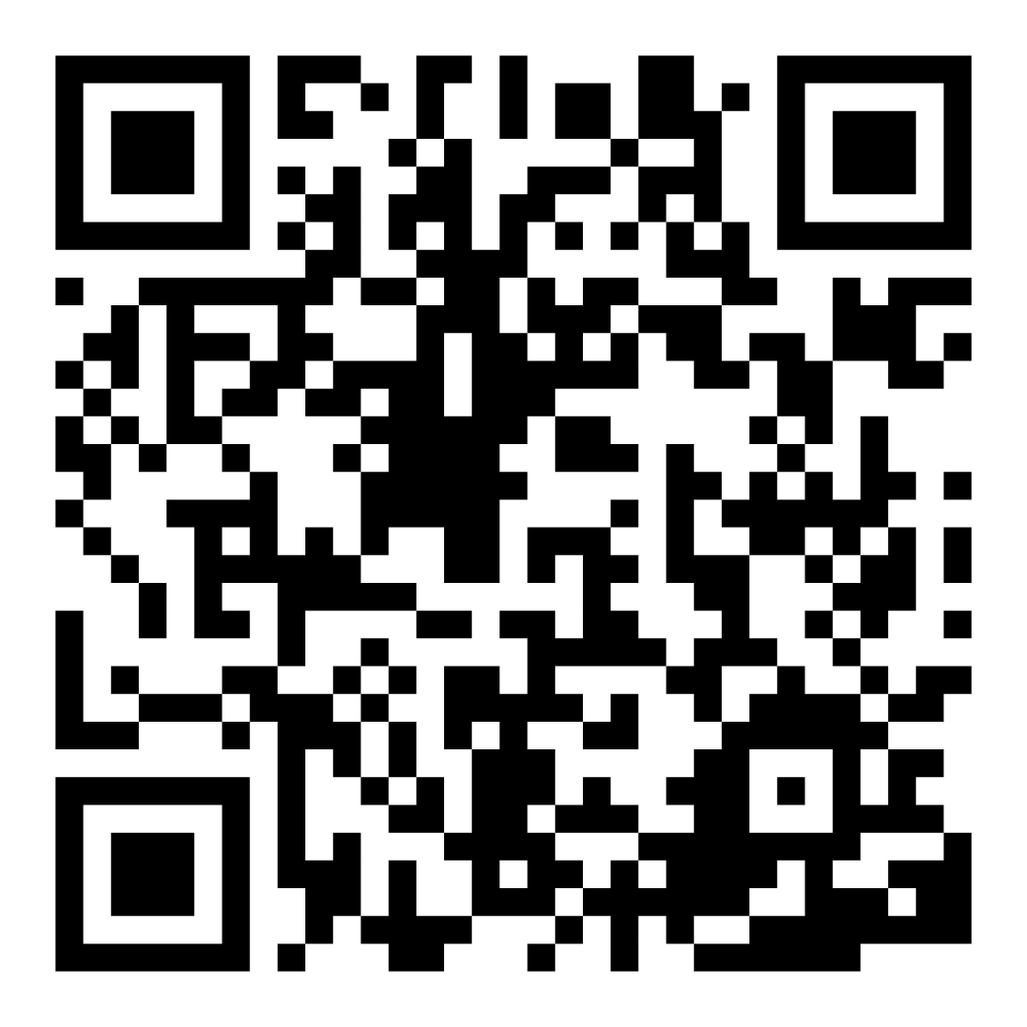
Family Confidence Survey
Scan this code to share how you’re feeling about reading with your child. Participants will be entered into a raffle for a $15 gift card. One winner per school will be drawn after the first and last workshops.
bit.ly/3BUBxbx
Notes:
If this is not the first or last Family Workshop, please delete this slide from the slide deck.
If you are an LAUSD teacher or staff member, please delete this slide from ALL Family Workshop decks.
Families who fill out the survey will be asked to provide an email to be entered into the raffle.
One raffle winner will be selected by Springboard Collaborative’s Data & Evaluation team after the first and last workshop and sent a $15 e-gift card to the email they provided.
If you need print-out versions of the QR code survey in English or the other translated languages, you can find those here: https://drive.google.com/file/d/1zjxnM0C9aP4C9WJFbw2A8eFpjZ29wBWG/view?usp=sharing
If you want to send the survey directly to families, you can find the link to the survey here: bit.ly/3BUBxbx

Slide 5
Las normas de los talleres
Estar preparado.
Estar presente.
Ser cortés.
Haga preguntas.
Notes:
Briefly explain the guidelines or “the rules we all agree to follow so that we can all have an enjoyable and an effective workshop.”
If this is the first workshop, briefly explain each of the guidelines.
Alternatively, a family volunteer may read or summarize this slide if they’ve attended the previous workshop. ​
Consider putting these on chart paper and inviting the group to add to the list. If you do this, be sure to change this slide in subsequent workshops.​
Emphasize these guidelines are for everyone, including you, the facilitator, and pledge to be prepared, present, courteous, and ask questions.
Emphasize the last point and specifically invite families to ask lots of questions.

Slide 6
¡A demostrarlo!
1
2
3
Di tu idea.
Di detalles que coinciden con tu idea.
Encuentra imágenes o palabras en el libro que demuestran y prueban tu idea.
¡Este consejo ayuda a los niños a mantener sus ideas basadas en lo que dice el libro en lugar de inventar cosas o salirse del tema!
Notes:
Introduce the 3 parts of the reading tip but don’t go into details at this point.
Sample script:
Today we will practice proving our ideas as we read and after we finish a book. We will practice this by breaking it down into 3 steps.
The first is to get the reader to tell their idea.
Second, we want to encourage the reader to tell more details that goes with or matches their idea.
Third, and most importantly, remind the reader to find and point to picture or words in the book that prove their thinking or learning.
Why?
We want our children to understand the story and this includes being able to think about the story and point out what in the book proves their thinking. Children can do this by pointing to words and phrases or pictures. Finding evidence is not just a reading skill—it’s a life skill!
Sample script in Spanish:
Hoy vamos a practicar el acto de comprobar nuestras ideas mientras leer y después de terminar un libro. Vamos a practicarlo en tres pasos.
En la primera, el lector cuenta su idea.
En la segunda, el lector cuenta más detalles que combinan con su idea.
En la tercera, y la mas importante, el lector señala cuáles imágenes o palabras del libro demuestran lo que está pasando o aprendiendo.
¿Por qué?
Queremos que nuestros hijos entiendan el cuento. Eso incluye pensar sobre el cuento y mostrar que el libro comprueba lo que están pensando. Los niños pueden hacerlo por señalar palabras y frases o imágenes. Encontrar evidencia no es simplemente un destreza de la lectura --- ¡es una destreza para la vida!

Slide 7
Verifique los términos de
alfabetización
Evidencia
Prueba que demuestra que algo es cierto.
Detalle
Una pequeña porción del texto, como ejemplos o hechos.
Notes:
To make sure everyone has a common understanding, define some literacy terms as needed.

Slide 8
Vamos a mirar
Spanish
Coming soon…
Notes:
Play the video (4 min) https://youtu.be/6yrEOI8RRJw
Ask families to identify some of the things they saw the mother doing to help her child prove her thinking (with a partner, as a table, or whole group)
Sample script:
To start, let’s watch a mother helping her child prove her thinking. Notice the questions she asks and things she does to help her child think about what she’s reading and back up her thinking with evidence from the book.
Sample script in Spanish:
Para empezar, vamos a ver una madre ayudarle a su hijo a comprobar lo que está pensando. Puede notar las preguntas y las cosas que hace para ayudarle a su hija a pensar en lo que ella está leyendo y para respaldar lo que está pensando con evidencia del libro.

Slide 9
Di tu idea
Si su hijo tiene problemas para pensar en una idea, puede ayudar con modelando una. Luego pídale detalles y evidencia.
¿Qué piensas después de haber leído estas páginas?
Notes:
Model (with a child volunteer) the three parts of the reading tip.
Make sure you’ve previewed this with the student model beforehand.
Ask the child what they’re thinking after reading the pages.
Be sure to ask for more details and textual evidence.
Take a moment to explain why you’re asking for evidence and what to do if your child has no idea (see sample script below).
Sample script:
Let’s try this together. Can I have a volunteer?
[Model reading aloud with a child and asking them the question on the slide]
Did you see how I asked the child what they were thinking? You can do this while you’re reading and not just at the end. Asking the child about what ideas or thoughts they are having throughout the book will help them come to a stronger understanding at the end of the book.
Hearing their idea gives us information on whether or not they are understanding what is going on in the book. This can help you know if you should have them reread or continue. If they are incorrect, either slightly or way off track, having them prove their thinking will likely steer them back on track.
If you child is having trouble coming up with an idea (see side bar) you can say one first and then ask them for some details. For example, I could’ve said, “I think this story will mostly be about Web.” Then [insert name of student] could’ve found details and evidence for that.
Sample script in Spanish:
Vamos a intentarlo juntos. ¿Tenemos un voluntario?
[Modele leer en alta voz con su hijo, preguntando preguntas de la presentación]
¿Notaron como le pregunte al niño sobre lo que estaba pensando? Lo pueden hacer mientras lean, no solamente al final. Hacerle preguntas al niño sobre sus ideas y pensamientos que tiene mientras está leyendo le va a ayudar a mejor entender el libro entero.
Escuchar su idea le da información para saber si está entendiendo lo que pasa en el libro. Eso le ayuda saber si debe de leer de nuevo o continuar. Si están equivocados, por poco o por mucho, deben de comprobara lo que están pensando. Esta actividad les va a ayudar a regresar al tema.
Si su hijo tiene dificultad para que le ocurre una idea, puede darle un ejemplo y luego pedirle más detalles. Por ejemplo, yo pude haber dicho, - Yo creo que el cuento tiene que ver, mas que nada, con Web. - Luego [inserta el nombre del estudiante] puedo haber encontrado detalles y evidencia relacionado.

Slide 10
Di los detalles que coincidan con tu idea
Ejemplo
Niño: “Sé por qué el libro se llama “El ganso que le gusta nadar”.
Adulto: "¡Estupendo! Cuéntame más sobre eso."
Pedirle a su hijo que diga los detalles lo ayuda a comprender cómo las partes del texto van juntas.
Eso es interesante. ¿Como sabes eso?
Di más.
Esa es una gran idea. ¿Cuáles son algunos detalles que te hicieron pensar en esa idea?
Niño: “Bueno, a Web le gusta nadar. Así que debe ser sobre Web”.
Notes:
Remind families that asking for details is an important step.
First of all—most children’s ideas are limited to begin with so asking for details helps them expand the idea.
The details help children recall things they can use to prove their thinking (in the next step).
And, if their idea is off track, asking for details can help you see what parts they are misunderstanding.
Sample script:
Let’s continue the model. Here is an example of what one child notices. [Read side bar example]
So [insert] name said [insert]. I’d like to get some more details on that thinking.
[Model asking the child to provide details, asking them the questions on the slide]
Did you see how I asked the child to give me details about the idea? When your child gives an idea it will likely be short, maybe even just two or three words. Like maybe your child would say, “Web seems different than the rest of the geese.” Asking for details can help them think it through and expand it. So you can ask, “Why do you think Web is different?”
Also, it helps you see what your child is noticing in the story, and in some cases, misunderstanding. For example, if your child says, “I think the geese are going to fly away for the winter,” asking for details will help you see where your child got off track. Then you can reread that page or say something like, “Let’s look closer at this part. I’ll read it and let’s talk about it.”
Sample script in Spanish:
Vamos a continuar con el modelo. Aquí hay un ejemplo de lo que el niño observa. [Leer ejemplo de barra lateral]
Entonces [inserte nombre] dijo [inserte]. Me gustaría tener algunos detalles adicionales sobre eso. [Modele preguntando a su hijo que provea detalles, haciéndole preguntas de la presentación]
¿Notaron como hice preguntas para conversar sobre los detalles? Cuando su hijo ofrece una idea, probablemente será corta, tal vez solamente dos o tres palabras. Podria decir, - Web parece ser diferente a los demás de los gansos. - Pedir detalles puede ayudarle a su hijo a pensar en el cuento de nuevo y expandir su respuesta. Puede preguntarle, - ¿Por qué piensas que Web es diferente? -
Ademas, le ayuda a usted saber lo que su hijo nota en el cuento. En algunos casos, su hijo tendrá un malentendido. Por ejemplo, si su hijo dice, - Creo que los gansos van a volar a algún otro sitio para el invierno - usted puede pedir más detalles para ayudarle a ver donde su hijo se confundió. Luego usted puede leer la página o decir algo como, - Vamos a verlo de nuevo. Voy a leerlo y luego lo vamos a discutir. -

Slide 11
Encontrar imágenes o palabras
Adulto: “¿Puedes demostrarlo? Muéstrame en el libro de donde agarraste la idea”.
Niño: “Dice que a Web le gusta nadar justo aquí, en esta oración”.
Adulto: “Me pregunto qué ganso bebé es Web. Me pregunto si nadará en ese charco. Sigamos leyendo.”
Pedirle a su hijo que lo demuestre con imágenes o palabras de la historia puede ayudarlo a retomar el rumbo.
Notes:
Remind families the last step of the reading tip, finding evidence to prove their thinking, is really important. ​
Encourage the child to point to parts of the picture or specific words.
If the child is understanding the story, their idea will be easy to prove. ​
If they’re slightly off track, finding evidence may help them correct their idea. ​
If it doesn’t help, then you can jump in and help them reread a part of the text that will help them understand the story.​
If you use this “during reading” instead of “after reading” helping them get back on track mid-story will help them understand the whole story in the end. ​
Remind families that the evidence they find will depend on their age. ​
Younger kids can use pictures as evidence while older kids should find words or phrases. ​
► For multilingual families specifically: Even if the parent or family member does not fully understand the text, they can ask their student to provide evidence for their opinion and explain their thinking thoroughly. ​
Remind families to keep asking “why” and “Show me where in the book” until the explanation makes sense.
Sample script:
We’re on the last step. Let’s look at the example on the slide.
So [insert] name said [insert]. I’d like to them to find some evidence, so we’ll go back to the book.
[Model going back to the text and finding evidence. You may need to return to previous slides for the text]
Did you see how I asked the child to point to specific words and phrases? Then I asked [insert name] how it proved their thinking. That’s giving evidence!
Sample script in Spanish:
Este es el último paso. Vamos a ver el ejemplo en la diapositiva.
Entonces [inserte nombre] dijo [inserta]. Quisiera que encuentre evidencia, entonces vamos a regresar al libro.
[Modele regresar al texto y encuentre evidencias. Tal vez necesitará regresar a las presentaciones anteriores para el texto]
¿Notaron como pedí al niño que señale palabras y frases específicas? Luego le pregunté a [inserta el nombre] si podía comprobar sus pensamientos. ¡Eso es dar evidencia!

Slide 12
Leer = conversación (K-1)
¿Cuáles son tus pensamientos acerca de esta historia?
¿Me puedes dar un ejemplo de la historia que prueba que sucedió?
Señala la imagen donde lo demuestra.
Claramente conectaste alguna prueba a tu explicación. ¡Buen trabajo!
Notes:
Remind families that the at-home reading coach always asks questions!
► For multilingual families specifically: Some families may come from a culture where asking questions and “coaching” their child may be an unfamiliar practice. Instead, they may be more used to being directive and having the answers​.
Encourage families to keep trying this coaching technique and assure them that the more they do it, the more comfortable it will become. ​
Although “parent as expert” and “parent as coach” are equally valid positions, asking questions and encouraging children to find the answer out for themselves instead of telling them an answer can help children internalize the learning in a different way.
This is a good time to remind parents that even though asking questions may not at present be a regular practice for them, this is an opportunity for them to acquire and practice new skills that will help their children. Cultural shifts are usually most effective when they're explicit.​
Use this slide to ensure that families have some questions they can ask during practice time.
Ask families to hold up the number of questions they already have written down or are prepared to use. If it looks like the room is prepared, you may skip this slide or ask families to share other questions they have written down throughout the workshop.
Share with families that there are also sample questions on the Reading Tip Sheet.
Sample script
At Springboard, the most important thing we want you to leave with is: to ALWAYS ASK QUESTIONS. You want to ask your child questions to help them figure out words, understand what they’re reading, sound more like a storyteller, and enjoy what they are reading. Today we’ve learned questions to help your child look back in the story for evidence or examples to prove their understanding of the text.
Sample script in Spanish
En Springboard, lo más importante con lo que queremos que se vaya es: QUE SIEMPRE HAGA PREGUNTAS. Quiere hacerle preguntas a su hijo para ayudarlo a descifrar palabras, comprender lo que está leyendo, sonar más como un narrador y disfrutar lo que está leyendo. Hoy hemos aprendido preguntas para ayudar a su hijo a repasar la historia en busca de pruebas o ejemplos que demuestren su comprensión del texto.

Slide 13
Leer = conversación (2-3)
¿Cuáles son tus pensamientos después de leer esto? Cuéntame más sobre eso.
¿Qué dijo o hizo el personaje para hacerte pensar eso? ¿Cuándo?
¿Qué piensas sobre el problema o el conflicto de esta historia? ¿Qué evidencia del texto respalda tus ideas?
Notes:
Remind families that the at-home reading coach always asks questions!
► For multilingual families specifically: Some families may come from a culture where asking questions and “coaching” their child may be an unfamiliar practice. Instead, they may be more used to being directive and having the answers​.
Encourage families to keep trying this coaching technique and assure them that the more they do it, the more comfortable it will become. ​
Although “parent as expert” and “parent as coach” are equally valid positions, asking questions and encouraging children to find the answer out for themselves instead of telling them an answer can help children internalize the learning in a different way.
This is a good time to remind parents that even though asking questions may not at present be a regular practice for them, this is an opportunity for them to acquire and practice new skills that will help their children. Cultural shifts are usually most effective when they're explicit.​
Use this slide to ensure that families have some questions they can ask during practice time.
Ask families to hold up the number of questions they already have written down or are prepared to use. If it looks like the room is prepared, you may skip this slide or ask families to share other questions they have written down throughout the workshop.
Share with families that there are also sample questions on the Reading Tip Sheet.
Sample script
At Springboard, the most important thing we want you to leave with is: to ALWAYS ASK QUESTIONS. You want to ask your child questions to help them figure out words, understand what they’re reading, sound more like a storyteller, and enjoy what they are reading. Today we’ve learned questions to help your child look back in the story for evidence or examples to prove their understanding of the text.
Sample script in Spanish
En Springboard, lo más importante con lo que queremos que se vaya es: QUE SIEMPRE HAGA PREGUNTAS. Quiere hacerle preguntas a su hijo para ayudarlo a descifrar palabras, comprender lo que está leyendo, sonar más como un narrador y disfrutar lo que está leyendo. Hoy hemos aprendido preguntas para ayudar a su hijo a repasar la historia en busca de pruebas o ejemplos que demuestren su comprensión del texto.

Slide 14
Familias Multilingües
Señalar la página o el párrafo con la evidencia. Digan “muéstrame dónde” o “¿por qué?”
Usar esto con libros en cualquier idioma.
Notes:
Use this slide if families’ primary language is not English or they may have specific questions. Alternatively, if you have talked about accommodations throughout the reading tip explanation you may skip this slide or use it to briefly sum up.
Explain the tips on the slide. If you need more detail, see “Ideas to differentiate” in the Workshop Guide.

Slide 15
Tiempo de práctica
1
Di tu idea.
¡Llamenme cuando tengan una pregunta!
2
Di detalles que coinciden con tu idea.
3
Encuentra imágenes o palabras en el libro que demuestran y prueban tu idea.
Notes:
Note: Practice time should be most of the remaining time. Leave 10 minutes or so at the end for reflection.
Summarize the tip, and remind families to repeat these steps during practice time.
Take a moment to explain that you’ll be circulating around while they practice (to provide 1:1 support and answer any questions).
►Multilingual parents in particular often come with feelings of self-consciousness that can be overcome when they know why they're being observed.
Remind families to ask questions as they use the tip.
There are also sample questions on the Reading Tip Sheet.
To support families, consider underlining two high leverage questions on the Reading Tip Sheet as you circulate.
Remind families they can always work on their action plan or other strategies during practice time, especially if they have questions or want some help with it.
Circulate and work with families. Here are some suggestions:
Walk over to a family. Ask, “Do you have any questions about the reading tip?”
If yes, answer question.
If no, say, “May I listen in for a moment?
Listen for a full minute.
Compliment the family on something they did well and then leave them with one suggestion (if needed)
Walk over to a family and ask “Can I try this reading tip with your child?”
After you’ve modelled it, ask the adult, “What did you notice me doing?” or say “Did you notice that I…”
Gather “glows”(things that families did that you want to lift up to the group) and “grows” (things families do that you want to stop and correct/clarify for the whole group).
Share the “glows” and “grows” at 10 mins into practice time or wait until the end.
Keeps “grows” anonymous, but congratulate specific families on “glows.”

Slide 16
Reflejar
¿Alguna pregunta sobre el consejo de lectura?
Voltéese y hable con su hijo: ¿Nos sentimos listos para probar este consejo de lectura en casa?
Por favor, comparte cómo podrían usar esto en casa.
¡Su pregunta ayudará a alguien más en este espacio!
Notes:
Part 4: Reflection & updates
Invite participants to ask questions.
Give ample wait time for each question. ​
Remind families that when parents talk they make it safe for more hesitant parents to share. It builds community in the classroom. ​
Encourage other voices to share.
In addition, you could share some “glows” and “grows” you noticed while walking around and supporting families during practice time.
Check in on the goal of Family Workshops.​
Read “Any questions…”? and wait. Let this question hang and give ample wait time.​
Invite families who don’t yet feel equipped to do the reading tip on their own to raise their hand (or indicate in a more private way) so you can check in with them personally before they leave the workshop.
Invite a family volunteer to share how they will use the reading tip at home.
If time permits, you may do a whip-around share.
Invite families to each share one thing (in 30 seconds or less). This could be:
Something they learned
One thing they’re excited to try at home
One thing they found challenging about this tip
One step they will focus on this week.

Slide 17
Comentarios, por favor
¡Su aporte y comentarios mejora nuestro tiempo juntos!
Notes:
Invite families to make a reading plan for the upcoming week.
Remind families that readers need “reading together” time and “reading alone” time.
Remind families that reading in workshops counts as “reading together time” and they should log it (if applicable).
Invite families to give you feedback so that you can facilitate a workshop that works for them!
Families can use the printed feedback form (if available) or a digital feedback form.
Invite families to give you more informal feedback. This could look like a thumbs up if they liked the reading tip or writing one thing they hope for the next workshop.
Use this time to meet individually with families as needed.
Sample script
And finally, I want to make sure I’m hosting a Family Workshop that works for you. Every workshop, you’ll have a chance to give me feedback, and I promise you that I will read it and do my best to incorporate it. Will you fill out the survey before you leave? If you’d rather talk about your suggestions, instead of writing them down, let me know. Thanks and see you at the next workshop!
Sample script in Spanish
Para cerrar, quiero asegurar que estoy dando un taller de familia que les sirve a ustedes. En cada taller, tendrán la oportunidad de proveer comentarios. Yo les prometo que los voy a leer y voy a hacer mi mejor esfuerzo para incorporar los consejos en el próximo taller. ¿Pueden contestar el sondeo antes de irse? Si prefieren platicar sobre sus ideas, en vez de escribirlas, avísenme. ¡Gracias y nos veremos en el próximo taller!

