Slide 1
Workshop guide
Facilitator:
Read notes to prepare. Amend slides if needed.
Practice the script aloud. Change as needed.
Ready the family-facing materials.
Display slide 2 as families arrive.
Let’s Talk Character Traits
Notes:
Copyright 2022 Springboard Collaborative, all rights reserved.
Overview and rationale:
This is an understand the story workshop. When students better understand the characters they read about, reading becomes more fun. When reading fiction stories, it’s important to understand the character(s) and who they are to better understand the whole story. This workshop gives families questions they can use to help their child examine character traits and give textual evidence to better understand the story.
Materials
Corresponding Reading Tip Sheet (in the languages the families need)
Family Workshop Feedback Form (paper or digital form)
Books for families to use during the reading tip explanation and practice time. This workshop works best with fiction.
Projector to display slides
Empty envelope for families to put feedback form in (optional but highly recommended)
Name tags (optional but highly recommended)
Facilitation notes:
To prepare
In this workshop, you will model how to identify character traits.
Preview the light blue slides and choose the ones that are appropriate for your context (needs of the families, grade level).
Be sure to familiarize yourself with the content of the presentation so you can talk with families, not at them.
Study the slides in the reading tip section. Think through how you will model and guide practice for finding textual evidence to identify character traits.
Consider using a short read aloud text that your students are familiar with instead of/in addition to the model on the slide.
During workshop
Take time to build rapport as a group and individually with families. Little things like learning family members’ names and greeting them at the door go a long way.
Keep pace so that families have time to practice the tip and also reflect. Being able to practice and reflect helps families internalize the strategy.
Circulate and check-in with families individually during practice time. See “Practice time” slide for more specific suggestions.
Ideas to differentiate
Be sure the book you use to model matches the reading abilities of the children in the workshop. Consider modeling with one or two pages from books with differing difficulty.
Consider changing the passages on the slides to be more appropriately matched to the level of your students.
Preview “Check in on literacy terms” and adjust terms or definitions, as needed.
If teaching this workshop to families with younger readers:
Choose the appropriate “Reading = conversation” slide.
Encourage families to do this with read aloud books.
Edit the list of common character traits to be smaller and more focused. Edit the model on the slide.
Remind families that easier books have less complex characters which will likely only have one character trait.
Be sure to name the difference between physical characteristics and character traits.
If teaching this workshop to families with older readers:
Choose the appropriate “Reading = conversation” slide.
Remind families that they can discuss character traits after a chapter or smaller section of a book. Also, multiple books in a series are a good opportunity to identify and find evidence for character traits.
Encourage children to use a note-catcher to find specific words and phrases as textual evidence.
Some characters’ traits change by the end of the story/text because of an event or lesson learned.
Support students thinking by helping them to notice the characters’ behavior, thoughts, and dialogue that reveal their traits.
If teaching this workshop to Multilingual families:
Remind families that as a coach their role is to remind children to practice the strategy. Even if they aren’t sure what the book is about or what the characters did, they can remind their child to give evidence to back up their thinking.
A way to check their child’s thinking is to ask them to identify words or phrases in the text that helped them identify the character traits and then ask them to explain why it proves their thinking.
Encourage families to practice this strategy with stories or movies that they are familiar with.
If families are familiar with this workshop, consider how you might leverage their experience. Ask families to share how they helped their child internalize the steps. Invite them (ahead of time) to model one or more steps, if appropriate.
Timing considerations for a 60 min workshop
Welcome: 10 mins
Reading tip: 15-20 mins
Practice: 15-20 mins
Reflection and updates: 10 mins
After you use these materials, we want to hear your feedback! Fill out the Family Workshop Facilitator Feedback Form at https://bit.ly/SBCfeedbackform.

Slide 2
Let’s Talk Character Traits
Notes:
Part 1: Welcome
Formally welcome families and tell them the title of today’s workshop. Do not go into specific steps of the reading tip at this point.
Ensure families have the materials they need and are sitting with their children.

Slide 3
Agenda
Welcome
Reading tip
Practice time
Reflection & updates
Notes:
Provide an overview of what families will be doing today (and at every Family Workshop).
If this is the first Family Workshop in a series, explain that the icons for each of the four parts of the Family Workshop also run along the bottom of slides. ​
If this is not the first workshop, move quickly through this slide.
Sample script
Here is our plan for today. You can see each part of our agenda has an icon [point to the icons]. You can also find each icon along the bottom of each slide [point to bottom] so you can see where we are in the agenda. First, we’ll review a couple of things, then we’ll get right to the reading tip. Most of our time will be spent on practice time so we can all try out the reading tip. Then we’ll reflect and talk about some updates.
Please speak up with questions, concerns, or anything you’d like to share. We’re here together for one hour and need to maximize the time. Every child learns to read in a different way, but putting our heads together helps our shared cause: to give kids a reading boost and cultivate a the joy of reading.
Sample script in Spanish
Aquí tenemos el plan para hoy. Se puede ver que cada parte de la agenda tiene un ícono [point to the icons]. También se encuentran en el final de cada diapositiva [point to bottom] para que puedan saber en qué parte estamos. Primero, vamos a repasar algunas cosas. Luego vamos a empezar con el consejo de la lectura. La mayoría del tiempo vamos a pasar aquí, en la práctica, para probar el consejo de la lectura juntos. Luego, vamos a reflexionar y hablar sobre algunas novedades.
En cualquier momento, pueden hacer preguntas, compartir preocupaciones, o cualquier otra cosa que quieren compartir. Vamos a estar juntos por una hora y queremos aprovechar del tiempo que tenemos. Cada niño aprende a leer de una manera diferente. Estamos aquí para trabajar en la misma causa: ayudarles a los niños a mejorar en la lectura y llegar a disfrutarla.

Slide 4
Workshop guidelines
Be prepared.
Be present.
Be courteous.
Ask questions.
Notes:
Briefly explain the guidelines or “the rules we all agree to follow so that we can all have an enjoyable and an effective workshop.”
If this is the first workshop, briefly explain each of the guidelines.
Alternatively, a family volunteer may read or summarize this slide if they’ve attended the previous workshop. ​
Consider putting these on chart paper and inviting the group to add to the list. If you do this, be sure to change this slide in subsequent workshops.​
Emphasize these guidelines are for everyone (including you, the facilitator) and pledge to be prepared, present, courteous, and ask questions.
Emphasize the last point and specifically invite families to ask lots of questions.

Slide 5
Let’s talk character traits
1
2
3
Review character traits.
Identify the character traits you see in a character.
Give an example of what the character says or does.
Characters are important to enjoying and understanding our stories.
Notes:
Part 2: Reading tip
Introduce the 3 parts of the reading tip.
Sample script:
Here are the steps of the reading tip for today.
First, we’ll review character traits.
Then we’ll practice identifying character traits and giving examples of what the character says or does that back up our thinking.
For example, if we take a classic fairy tale story like Little Red Riding Hood, I could say Little Red Riding Hood was kind (step 2) because she set off into the forest to deliver a basket of food for her grandmother. That’s an example of something the character did which is step 3.
Why do we do this reading tip?
Talking about character traits is one way to help your child understand the story better.
Sample script in Spanish:
Aquí están los pasos del consejo de lectura de hoy.
Primero, vamos a repasar algunos rasgos de carácter
Luego vamos a practicar cómo identificar los rasgos de carácter y dar ejemplos de lo que un personaje dice o hace que respalda lo que estamos pensando.
Por ejemplo, si pensamos en el cuento de hadas “La Caperucita Roja”, yo podría decir que ella es simpatica (paso 2) porque ella anduvo por el bosque para entregar una canasta de comida a su abuelita (el paso 3 - dar un ejemplo de algo que el personaje hizo.)
¿Por qué este consejo de lectura es importante?
Hablar sobre los rasgos de carácter es una manera de ayudarle a su hijo para mejor entender el cuento.

Slide 6
Check in on literacy terms
Trait
A word that describes a specific quality of a character.
Notes:
To make sure everyone has a common understanding, define some literacy terms as needed.

Slide 7
Review common character traits
brave
grumpy
mischievous
stubborn
fearful
creative
lazy
shy
hardworking
responsible
patient
careless
kind
cheerful
What other character traits do you discuss with your child?
Notes:
Note: The slide is animated to list the words one by one.
Read and go over each word as they appear.
Involve families by having them read it/shout it out as they appear.
Spend about 20 seconds on each one but summarize their meaning.
Remind families that a character trait is not what someone does or likes. It's a personal quality.
Example discussion points:
Brave – shows courage, ready to face danger
Grumpy – a little angry, mopey, not very nice or friendly, sees the negative side of most things
Mischievous – causing or showing a fondness/linking for causing trouble in a playful way
Stubborn – doesn’t like to change and sticks to one stance on something
Fearful – afraid of things, nervous
Creative – creating things with unique imagination or original ideas
Lazy – unwilling to work or use energy
Shy – bashful or easily embarrassed
Hardworking – works hard on most things, doesn’t give up, keeps going until something is finished, dedicated
Responsible – care for someone or something, gets the job done, shows up and meets commitments
Patient – waits calmly for things, accepts delays or problems without suffering or getting annoyed
Careless – makes mistakes easily, doesn’t think things through
Kind – friendly and considerate to others
Cheerful – happy or optimistic

Slide 8
Being precise (an example)
Nice | Mean
kind | unkind
caring | thoughtless
supportive | cruel
friendly | cold
selfless | selfish
polite | rude
generous | stingy
Find examples in the book that will help your child be more precise.
Notes:
Explain that children often need help being precise when they identify a character trait. Here are two examples of common general traits that children may identify.
The chart shows some different ways to describe “nice” and ”mean.” When we identify character traits we want to go beyond general terms like “nice” and ”mean” and help our child be more precise.
Explain that text-based evidence can help here. For example, if the child says the character was nice, we might ask them to give an example. If they say that the character smiled and asked the new kid to sit with them at lunch then we can point them to a word like “friendly.” Then we might be able to find more examples of the character being “friendly.”
Ask families to give examples of the different traits on the chart. Multilingual families may want to translate or compare terms to another language.
Remind families that a character trait is not what someone does or likes or an emotion. It's a personal quality. What the character does can help us determine their traits.

Slide 9
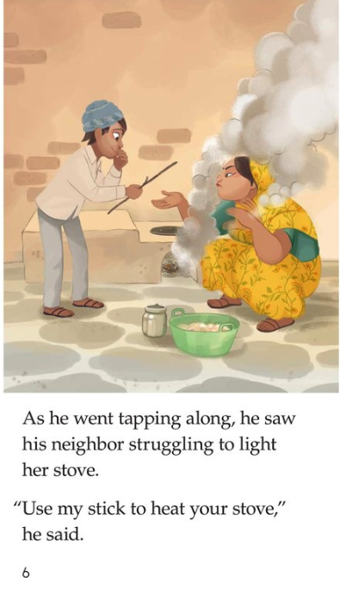
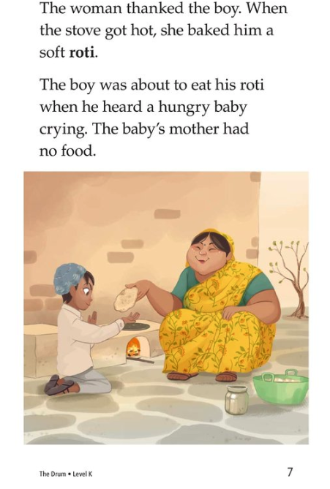
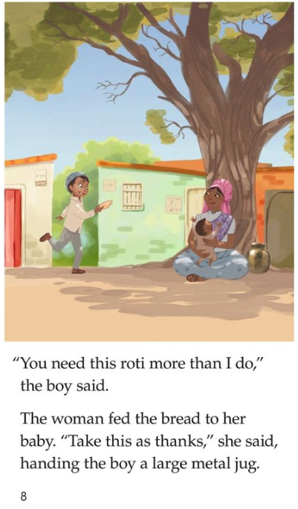
Let's identify some character traits
Notes:
Read the pages aloud (or invite a volunteer to read them)
Set the purpose for families before reading. Explain that while you’re reading the pages, they should be thinking about the personality or character trait of the main character (the boy, in this case).
You may also choose to read a book from your classroom.

Slide 10
Try it! Identify traits and give examples
Tips and tricks
If it’s a short book, do it at the end of the book.
If it’s longer, do this at the end of a chapter or section.
Now that we’ve read a bit about this character, how would you describe them?
How do you know? What did the character say or do?
Notes:
Invite families to discuss questions in pairs or small groups.
Circulate to support.
Remind families that a character trait is not an action. It's the personal quality behind the action.
Invite participants to share out.
Families should pinpoint that the character (little boy) is kind, generous, or thoughtful because of his actions of giving things away to others in need.

Slide 11
Reading = conversation (K-1)
What is a character trait? One example is determined. Can you think of another?
What did the character do when (event)?
What word would you use to describe this character? Why?
What else can you say about this character? Show me how you know.
Notes:
Remind families that the at-home reading coach always asks questions!
► For Multilingual families specifically: Some families may come from a culture where asking questions and “coaching” their child may be an unfamiliar practice. Instead, they may be more used to being directive and having the answers​.
Encourage families to keep trying this coaching technique and assure them that the more they do it, the more comfortable it will become. ​
Although “parent as expert” and “parent as coach” are equally valid positions, asking questions and encouraging children to find the answer out for themselves instead of telling them an answer can help children internalize the learning in a different way.
This is a good time to remind parents that even though asking questions may not at present be a regular practice for them, this is an opportunity for them to acquire and practice new skills that will help their children. Cultural shifts are usually most effective when they're explicit.​
Use this slide to ensure that families have some questions they can ask during practice time.
Ask families to hold up the number of questions they already have written down or are prepared to use. If it looks like the room is prepared, you may skip this slide or ask families to share other questions they have written down throughout the workshop.
Share with families that there are also sample questions on the Reading Tip Sheet.
Sample script
At Springboard, the most important thing we want you to leave with is: to ALWAYS ASK QUESTIONS. You want to ask your child questions to help them figure out words, understand what they’re reading, sound more like a storyteller, and enjoy what they are reading. Today we’ve learned questions to help your child identify character traits which will help them understand the story.
Sample script in Spanish
En Springboard, lo más importante con lo que queremos que se vaya es: QUE SIEMPRE HAGA PREGUNTAS. Quiere hacerle preguntas a su hijo para ayudarlo a descifrar palabras, comprender lo que está leyendo, sonar más como un narrador y disfrutar lo que está leyendo. Hoy hemos aprendido preguntas para ayudar a su hijo identificar los rasgos de los personajes que les ayudarán a entender la historia.

Slide 12
Reading = conversation (2-3)
What are this character’s strengths? Weaknesses? How do you know?
What did the character DO or SAY to make you think that? Show me in the book.
Can you relate to this character? Do you have any of the same traits? Opposite traits? Give me an example.
Notes:
Remind families that the at-home reading coach always asks questions!
► For Multilingual families specifically: Some families may come from a culture where asking questions and “coaching” their child may be an unfamiliar practice. Instead, they may be more used to being directive and having the answers​.
Encourage families to keep trying this coaching technique and assure them that the more they do it, the more comfortable it will become. ​
Although “parent as expert” and “parent as coach” are equally valid positions, asking questions and encouraging children to find the answer out for themselves instead of telling them an answer can help children internalize the learning in a different way.
This is a good time to remind parents that even though asking questions may not at present be a regular practice for them, this is an opportunity for them to acquire and practice new skills that will help their children. Cultural shifts are usually most effective when they're explicit.​
Use this slide to ensure that families have some questions they can ask during practice time.
Ask families to hold up the number of questions they already have written down or are prepared to use. If it looks like the room is prepared, you may skip this slide or ask families to share other questions they have written down throughout the workshop.
Share with families that there are also sample questions on the Reading Tip Sheet.
Sample script
At Springboard, the most important thing we want you to leave with is: to ALWAYS ASK QUESTIONS. You want to ask your child questions to help them figure out words, understand what they’re reading, sound more like a storyteller, and enjoy what they are reading. Today we’ve learned questions to help your child identify character traits which will help them understand the story.
Sample script in Spanish
En Springboard, lo más importante con lo que queremos que se vaya es: QUE SIEMPRE HAGA PREGUNTAS. Quiere hacerle preguntas a su hijo para ayudarlo a descifrar palabras, comprender lo que está leyendo, sonar más como un narrador y disfrutar lo que está leyendo. Hoy hemos aprendido preguntas para ayudar a su hijo identificar los rasgos de los personajes que les ayudarán a entender la historia.

Slide 13
Multilingual families
Find words or phrases in the book that prove your thinking and explain why.
Practice this strategy by using movies or tv shows you already know.
Notes:
Use this slide if families’ primary language is not English or they may have specific questions. Alternatively, if you have talked about accommodations throughout the reading tip explanation you may skip this slide or use it to briefly sum up.
Explain the tips on the slide. If you need more detail, see “Ideas to differentiate” in the Workshop Guide.

Slide 14
Practice time
1
Review character traits.
Call me over when you have a question!
Identify the character traits you see in a character.
2
Give an example of what the character says or does.
3
Notes:
Part 3: Practice time
Note: Practice time should be most of the remaining time. Leave 10 minutes or so at the end for reflection.
Summarize the tip and remind families to repeat these steps during practice time.
Take a moment to explain that you’ll be circulating around while they practice (to provide 1:1 support and answer any questions).
►Multilingual parents in particular often come with feelings of self-consciousness that can be overcome when they know why they're being observed.
Remind families to ask questions as they use the tip.
There are also sample questions on the Reading Tip Sheet.
To support families, consider underlining two high-leverage questions on the Reading Tip Sheet as you circulate.
Remind families they can always work on their action plan or other strategies during practice time, especially if they have questions or want some help with it.
Circulate and work with families. Here are some suggestions:
Walk over to a family. Ask, “Do you have any questions about the reading tip?”
If yes, answer question.
If no, say, “May I listen in for a moment?”
Listen for a full minute.
Compliment the family on something they did well and then leave them with one suggestion (if needed).
Walk over to a family and ask “Can I try this reading tip with your child?”
After you’ve modelled it, ask the adult, “What did you notice me doing?” or say “Did you notice that I…”
Gather “glows”(things that families did that you want to lift up to the group) and “grows” (things families do that you want to stop and correct/clarify for the whole group).
Share the “glows” and “grows” at 10 mins into practice time or wait until the end.
Keeps “grows” anonymous, but congratulate specific families on “glows.”

Slide 15
Reflect
Any questions about the reading tip?
Turn and talk with your child: Do we feel ready to try this reading tip at home?
Please share how you might use this at home.
Your question will help someone else in the room!
Notes:
Part 4: Reflection & updates
Invite participants to ask questions.
Give ample wait time for each question. ​
Remind families that when parents talk they make it safe for more hesitant parents to share. It builds community in the classroom. ​
Encourage other voices to share.
In addition, you could share some “glows” and “grows” you noticed while walking around and supporting families during practice time.
Check in on the goal of Family Workshops.​
Read “Any questions…”? and wait. Let this question hang and give ample wait time.​
Invite families who don’t yet feel equipped to do the reading tip on their own to raise their hand (or indicate in a more private way) so you can check in with them personally before they leave the workshop.
Invite a family volunteer to share how they will use the reading tip at home.
If time permits, you may do a whip-around share.
Invite families to each share one thing (in 30 seconds or less). This could be:
Something they learned
One thing they’re excited to try at home
One thing they found challenging about this tip
One step they will focus on this week

Slide 16
Feedback, please
Your input improves our time together!
Notes:
Invite families to make a reading plan for the upcoming week.
Remind families that readers need “reading together” time and “reading alone” time.
Remind families that reading in workshops counts as “reading together time” and they should log it (if applicable).
Invite families to give you feedback so that you can facilitate a workshop that works for them!
Families can use the printed feedback form (if available) or a digital feedback form.
Invite families to give you more informal feedback. This could look like a thumbs up if they liked the reading tip or writing one thing they hope for the next workshop.
Use this time to meet individually with families as needed.
Sample script
And finally, I want to make sure I’m hosting a Family Workshop that works for you. Every workshop, you’ll have a chance to give me feedback, and I promise you that I will read it and do my best to incorporate it. Will you fill out the survey before you leave? If you’d rather talk about your suggestions instead of writing them down let me know. Thanks, and see you at the next workshop!
Sample script in Spanish
Para cerrar, quiero asegurar que estoy dando un taller de familia que les sirve a ustedes. En cada taller, tendrán la oportunidad de proveer comentarios. Yo les prometo que los voy a leer y voy a hacer mi mejor esfuerzo para incorporar los consejos en el próximo taller. ¿Pueden contestar el sondeo antes de irse? Si prefieren platicar sobre sus ideas, en vez de escribirlas, avísenme. ¡Gracias y nos veremos en el próximo taller!

