Slide 1
Workshop guide
Facilitator:
Read notes to prepare. Amend slides if needed.
Practice the script aloud. Change as needed.
Ready the family-facing materials.
Display slide 2 as families arrive.
Become an Expert
Notes:
Copyright 2022 Springboard Collaborative, all rights reserved.
Overview and rationale
This is an understand the story workshop. Children build new knowledge and understandings based on their existing schema. In order to build content knowledge, students must read and engage with texts to learn about a topic. In this workshop, families learn to help their child activate and then build the background and content knowledge that is essential to reading comprehension.
Materials
Corresponding Reading Tip Sheet (in the languages the families need)
Books for families to use during practice time. This strategy works best with nonfiction texts.
Projector to display slides
Chart paper or whiteboard to generate a list of topics and questions
Family Workshop Feedback Form (paper or digital form)
Empty envelope for families to put feedback form in (optional but highly recommended)
Name tags (optional but highly recommended)
Facilitation notes
To prepare
In this workshop, you will model how to choose a topic and generate questions to answer.
Study the slides in the reading tip section. Think through how you will model and guide practice for choosing a topic.
You may want to gather nonfiction books and other texts on a variety of topics for families to use during practice time. Alternatively, you might show families how to search Raz kids for books by topic.
Preview the light blue slides and choose the ones that are appropriate for your context (needs of the families, grade level).
Be sure to familiarize yourself with the content of the presentation so you can talk with families, not at them.
During workshop
Take time to build rapport as a group and individually with families. Little things, like learning family members’ names and greeting them at the door, go a long way.
Keep pace so that families have time to practice the tip and also reflect. Being able to practice and reflect helps families internalize the strategy.
Circulate and check-in with families individually during practice time. See “Practice time” slide for more specific suggestions.
Ideas to differentiate
Preview “Check in on literacy terms” and adjust terms or definitions, as needed.
If teaching this workshop to families with younger readers:
Choose the appropriate “Reading = conversation” slide.
You may want to begin by choosing a few categories for the class to choose from. This way you can preselect some books for families to use during practice time.
If teaching this workshop to families with older children:
Choose the appropriate “Reading = conversation” slide.
Help families create a graphic organizer such as a KWL (Know/Want to know/Learn) chart for children to think about the topic.
Encourage the use of multimedia, such as websites and YouTube.
If teaching this workshop to Multilingual families:
Consider providing sentence stems for families who may be speaking in a group.
Assure families that each of these types of questions and the resulting conversations can be held in whatever language they feel most comfortable communicating in.
They may also choose additional sources in whatever language they feel comfortable in (they may watch a documentary in Spanish, for example). Children should read at least two books in English to learn the domain specific vocabulary in English. The adult may help them make connections with the domain specific vocabulary in another language.
If families are familiar with this workshop, consider how you might leverage their experience. Ask families to share how they helped their child internalize the steps. Invite them (ahead of time) to model one or more steps if appropriate.
Timing considerations for a 60 min workshop
Welcome: 10 mins
Reading tip: 15-20 mins
Practice: 15-20 mins
Reflection and updates: 10 mins
After you use these materials, we want to hear your feedback! Fill out the Family Workshop Facilitator Feedback Form at https://bit.ly/SBCfeedbackform.

Slide 2
Hazte experto
Notes:
Part 1: Welcome
Formally welcome families and tell them the title of today’s workshop. Do not go into specific steps of the reading tip at this point.
Ensure families have the materials they need and are sitting with their children.

Slide 3
Agenda
Bienvenida
Consejo de lectura
Tiempo de práctica
Reflexión y actualizaciones
Notes:
Provide an overview of what families will be doing today (and at every Family Workshop).
If this is the first Family Workshop in a series, explain that the icons for each of the four parts of the Family Workshop also run along the bottom of slides. ​
If this is not the first workshop, move quickly through this slide. ​
Sample script
Here is our plan for today. You can see each part of our agenda has an icon [point to the icons]. You can also find each icon along the bottom of each slide [point to bottom] so you can see where we are in the agenda. First, we’ll review a couple of things, then we’ll get right to the reading tip. Most of our time will be spent on practice time so we can all try out the reading tip. Then we’ll reflect and talk about some updates.
Please speak up with questions, concerns, or anything you’d like to share. We’re here together for one hour, and need to maximize the time. Every child learns to read in a different way, but putting our heads together helps our shared cause: to give kids a reading boost and cultivate a the joy of reading.
Sample script in Spanish
Aquí tenemos el plan para hoy. Se puede ver que cada parte de la agenda tiene un ícono [point to the icons]. También se encuentran en el final de cada diapositiva [point to bottom] para que puedan saber en qué parte estamos. Primero, vamos a repasar algunas cosas. Luego vamos a empezar con el consejo de la lectura. La mayoría del tiempo vamos a pasar aquí, en la práctica, para probar el consejo de la lectura juntos. Luego, vamos a reflexionar y hablar sobre algunas novedades.
En cualquier momento, pueden hacer preguntas, compartir preocupaciones, o cualquier otra cosa que quieren compartir. Vamos a estar juntos por una hora y queremos aprovechar del tiempo que tenemos. Cada niño aprende a leer de una manera diferente. Estamos aquí para trabajar en la misma causa: ayudarles a los niños a mejorar en la lectura y llegar a disfrutarla.

Slide 4
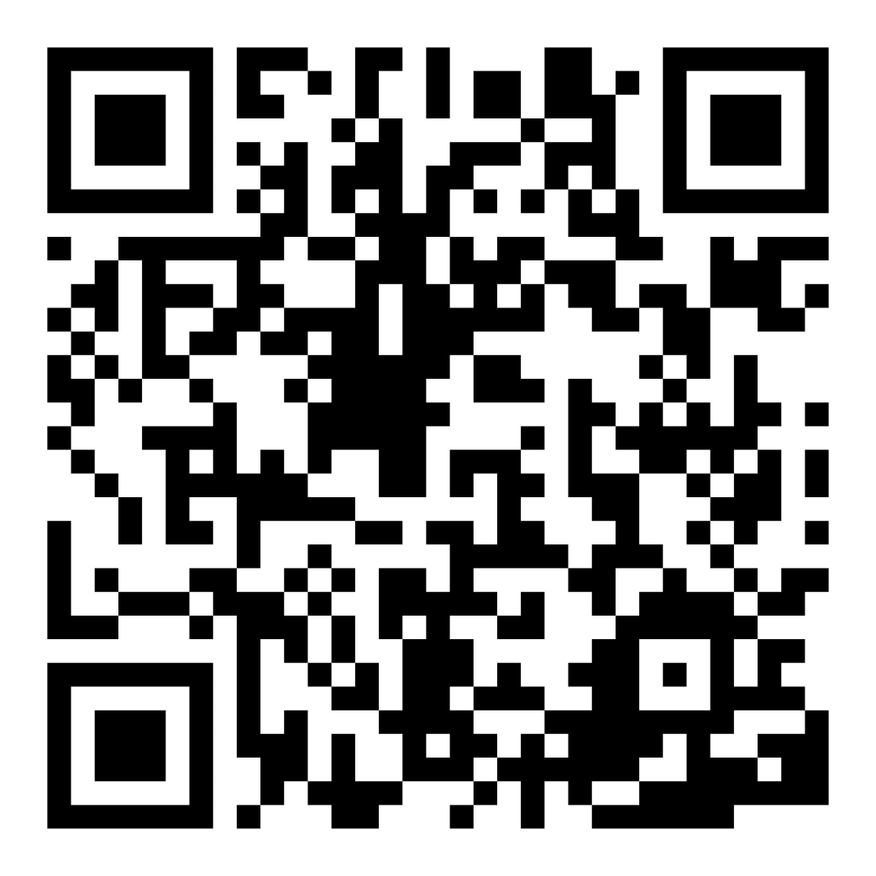
Encuesta de confianza familiar
Escaneen este código para compartir cómo se sienten acerca de la lectura con sus hijos. Los participantes serán inscritos en un sorteo para ganar una tarjeta de regalo de $15. Se elegirá un ganador por escuela después del primer y último taller.
bit.ly/3BUBxbx
Notes:
If this is not the first or last Family Workshop, please delete this slide from the slide deck.
If you are an LAUSD teacher or staff member, please delete this slide from ALL Family Workshop decks.
Families who fill out the survey will be asked to provide an email to be entered into the raffle.
One raffle winner will be selected by Springboard Collaborative’s Data & Evaluation team after the first and last workshop and sent a $15 e-gift card to the email they provided.
If you need print-out versions of the QR code survey in English or the other translated languages, you can find those here: https://drive.google.com/file/d/1zjxnM0C9aP4C9WJFbw2A8eFpjZ29wBWG/view?usp=sharing
If you want to send the survey directly to families, you can find the link to the survey here: bit.ly/3BUBxbx

Slide 5
Las normas de los talleres
Estar preparado.
Estar presente.
Ser cortés.
Haga preguntas.
Notes:
Briefly explain the guidelines or “the rules we all agree to follow so that we can all have an enjoyable and an effective workshop.”
If this is the first workshop, briefly explain each of the guidelines.
Alternatively, a family volunteer may read or summarize this slide if they’ve attended the previous workshop. ​
Consider putting these on chart paper and inviting the group to add to the list. If you do this, be sure to change this slide in subsequent workshops.​
Emphasize these guidelines are for everyone, including you, the facilitator, and pledge to be prepared, present, courteous, and ask questions.
Emphasize the last point and specifically invite families to ask lots of questions.

Slide 6
Hazte experto
1
2
3
4
Escoge un tema.
Apunta algunas preguntas.
Lee por lo menos 2 libros.
Este consejo ayuda a construir información del fondo
Habla sobre lo que aprendiste.
Notes:
Part 2: Reading tip
Introduce the 4 parts of the reading tip.
Sample script
Today’s tip has four parts:
First, we will choose a topic that we are most interested in learning more about.
Then, we will write some questions to get us ready to read.
Third, we will read as many books (or texts, movies, etc) as we can on that topic, but at least two.
Finally, we will talk about what we have learned.
Why?
Background knowledge plays a big role in reading comprehension. To comprehend a story or text, children will need a certain amount of background knowledge about the topic. When children have knowledge about a particular topic, they are better able to remember the new information they gather on the topic. When students know about a topic, learning new information is easier.
Sample script in Spanish
El consejo de hoy tiene cuatro partes:
Primero, vamos a escoger el tema que más nos interesa aprender más
Luego, vamos a escribir algunas preguntas para prepararnos a leer.
Tercero, vamos a leer tantos libros (o texto, películas, etc.) como podamos sobre el tema, pero por lo menos dos.
Finalmente, vamos a hablar sobre lo que aprendimos.
¿Por qué?
El conocimiento previo juega un papel muy grande en la comprensión lectora. Para comprender una historia o un texto, los niños van a necesitar cierta cantidad de conocimiento previo del tema. Cuando los niños tienen conocimiento sobre un tema particular, mejor pueden recordar la nueva información que acumulan sobre el tema. Cuando los estudiantes saben de un tema, se les hace más fácil aprender nueva información

Slide 7
Unos términos de lectura
Conocimientos previos
La cantidad de información aprendida sobre un tema mediante experiencias previas.
Notes:
To make sure everyone has a common understanding, define some literacy terms as needed.

Slide 8
Escoge un tema
¿De cuáles cuentos o libros has aprendido más?
¿Cuáles películas te han gustado más? (Habla sobre el tipo de película, la lección aprendida, el mensaje.)
¿Cuál es tu programa favorito de televisión? (Habla sobre el tipo de programa, las lecciones aprendidas, el mensaje.)
Write down a list topics or categories (e.g. mammals, or friendship).
Notes:
Explain how to choose a topic
Model having a conversation and then writing down a topic or category in a visible place so that families can see how a discussion starts to generate a list.
Invite families to align on a topic. Invite participants to share whole group.
Sample script
Reading builds knowledge, and reading about a lot of different topics helps your child develop a wider range of knowledge. For this reading tip, we are going to zero in on a topic.
To do this, encourage your child to identify an interest. Your child is going to develop a deeper knowledge and expertise on that topic so it should be something they are interested in. Use the questions this slide to help your child identify a topic and write it down. After we create create a list of topics your child can choose from, we will pick one.
Let me show you how it may work. May I have a volunteer? [Model the conversation]
Now you try with your child.
Sample script in Spanish
La lectura construye conocimiento, y leer sobre muchos temas diferentes le ayuda a su hijo a desarrollar un rango más amplio de conocimiento. Para este consejo de lectura, vamos a centrarnos en un tema.
Para hacer esto, anime a su hijo a identificar un interés. Su hijo va a desarrollar un conocimiento y un dominio más profundo en el tema, así que debe ser algo que realmente le interesa. Utilice las preguntas en esta diapositiva para ayudarle a su hijo a identificar un tema y escribirlo. Después de crear una lista de temas de la cual su hijo puede escoger, vamos a escoger uno.
Déjeme mostrarle cómo puede funcionar. ¿Puedo pedir un voluntario? [Model the conversation]
Ahora, intente con su hijo.

Slide 9
Apunta algunas preguntas
¿Qué es lo que ya sabes de [insert topic]?
¿Qué más quieres aprender sobre este tema?
Entonces las tres preguntas que tenemos son [repeat back question]...
Notes:
Model how to generate three questions to guide reading.
Write down a list of questions in a visible place so that families can see how a discussion starts to generate a list.
Invite families to generate questions on a topic. Invite participants to share whole group.
Sample script
Now that we have a topic, let’s see what your child already knows about that topic and what they hope to learn. After we’ve talked about all the things we wonder about, we’ll write down 3 specific questions we want answered.
Let me show you how it may work. May I have a volunteer? [Model the conversation]
Now you try with your child.
Sample script in Spanish
Ya que tenemos un tema, vamos a ver lo que ya sabe su hijo sobre el tema y lo que espera aprender. Después de hablar sobre todas las cosas sobre qué nos preguntamos, vamos a escribir 3 preguntas específicas que queremos contestar.
Déjeme mostrarle cómo puede funcionar. ¿Puedo pedir un voluntario?
Ahora lo intentas con su hijo.

Slide 10
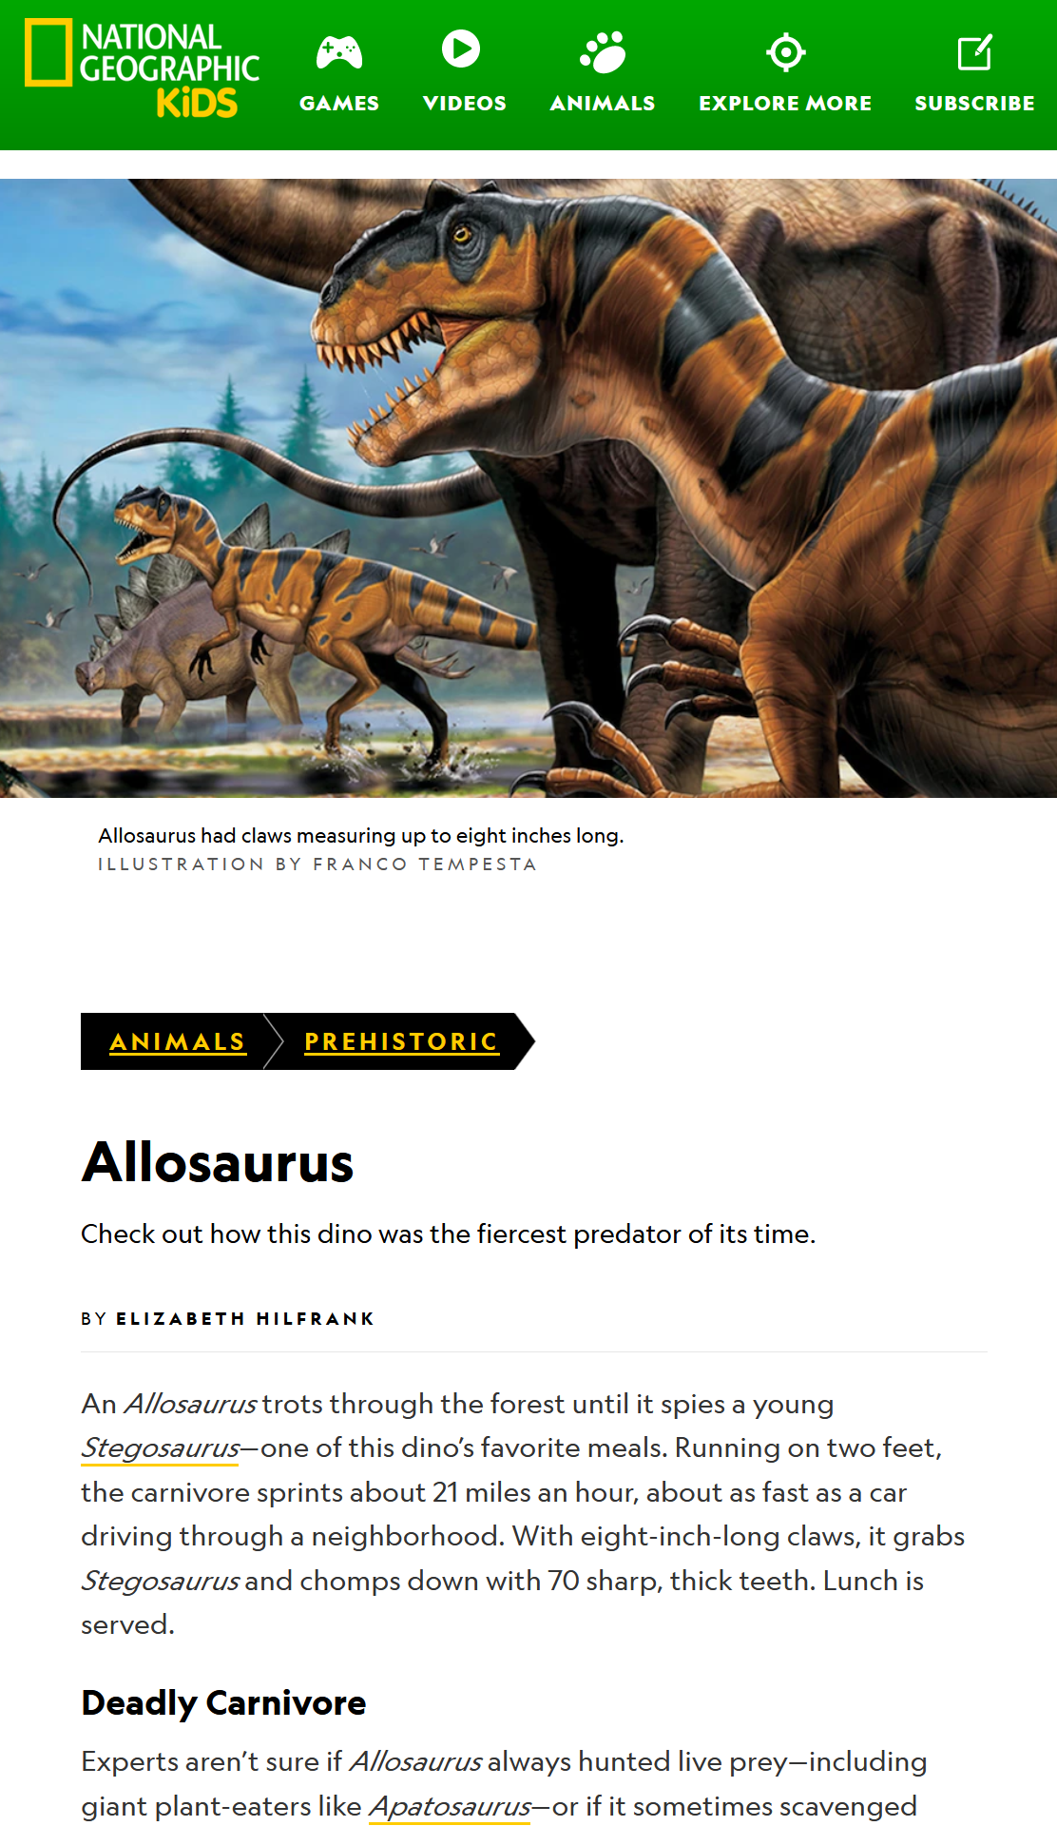
Lee por lo menos 2 libros
Consejos y Trucos
También podrían ver películas, leer un letrero en un museo, o leer sitios web.
Lee, o mira, por lo menos dos fuentes sobre un tema.
Notes:
Explain the third step.
Sources for the images:
From Mild to Wild, Dinosaurs for Kids - Dinosaur Book for 6-Year-Old, Children's Dinosaur Books by Baby Professor
Dinosaurs: The Ultimate Dinosaur Book for Kids: Amazing Dinosaur Facts and Bonus Quiz, Dinosaur Books for Kids 1
https://kids.nationalgeographic.com/animals/prehistoric
Sample script
So we’ve chosen a topic and identified what we are hoping to learn more about. The next step is to read as many books as you can on that topic, but read at least 2! If you don’t have access to that many books on a chosen topic, no worries! Reading facts from a website is fine, too. You can even watch movies! Learning about a new topic can be as fun and creative as you’d like.
Sample script in Spanish
Así que hemos escogido un tema e identificado lo que esperamos aprender sobre ello. El siguiente paso es leer tantos libros como nos sea posible del tema, pero leer por lo menos 2. Si no tiene acceso a tantos libros sobre un tema específico, ¡no se preocupe! El leer datos de un sitio web está bien, también. ¡Incluso puede ver películas! Aprender sobre un tema nuevo puede ser tan divertido y creativo como quiera.

Slide 11
Habla sobre lo que leíste
¿Qué aprendiste sobre (tema)?
¿Aprendiste lo que esperabas aprender? ¿Qué más esperas aprender?
¿El primer texto te ayudó a comprender mejor el segundo? ¿Cómo?
Notes:
Explain how to talk about what you read.
Sample script
So, you’ve read a lot about a topic. What did you learn? Use the questions on this slide to start a discussion about how much your child learned about their topic. This is where we revisit the questions we asked in step 2.
We may not answer all the questions and that’s fine! You can encourage your child to keep reading about this subject. The more you know about a subject the easier it is read and understand texts about that subject. The third question on the slide helps your child reflect on that specifically.
Sample script in Spanish
Ahora, ha leído mucho sobre un tema. ¿Qué aprendió? Utilice las preguntas en esta diapositiva para comenzar una conversación sobre cuánto su hijo aprendió sobre su tema. Este es donde repasamos las preguntas que hicimos en el paso 2.
Posiblemente no contestamos todas las preguntas, y ¡está bien! Puede animarlo a su hijo a seguir leyendo sobre este tema. Cuanto más se sabe de un tema, más fácil es leer y entender textos sobre ello. La tercera pregunta en la diapositiva le ayuda a su hijo a reflexionar específicamente en eso.

Slide 12
Lectura = conversación (K-1)
¿Sobre qué tienes la curiosidad de aprender más?
¿Qué es lo que ya sabes de eso?
¿Qué quieres aprender?
¿Qué aprendiste sobre [the topic]?
Notes:
Remind families that the at-home reading coach always asks questions!
► For multilingual families specifically: Some families may come from a culture where asking questions and “coaching” their child may be an unfamiliar practice. Instead, they may be more used to being directive and having the answers​.
Encourage families to keep trying this coaching technique and assure them that the more they do it, the more comfortable it will become. ​
Although “parent as expert” and “parent as coach” are equally valid positions, asking questions and encouraging children to find the answer out for themselves instead of telling them an answer can help children internalize the learning in a different way.
This is a good time to remind parents that even though asking questions may not at present be a regular practice for them, this is an opportunity for them to acquire and practice new skills that will help their children. Cultural shifts are usually most effective when they're explicit.​
Use this slide to ensure that families have some questions they can ask during practice time.
Ask families to hold up the number of questions they already have written down or are prepared to use. If it looks like the room is prepared, you may skip this slide or ask families to share other questions they have written down throughout the workshop.
Share with families that there are also sample questions on the Reading Tip Sheet.
Sample script
At Springboard, the most important thing we want you to leave with is: to ALWAYS ASK QUESTIONS. You want to ask your child questions to help them figure out words, understand what they’re reading, sound more like a storyteller, and enjoy what they are reading. Today we’ve learned questions to help your child build content knowledge.
Sample script in Spanish
En Springboard, lo más importante con lo que queremos que se vaya es: QUE SIEMPRE HAGA PREGUNTAS. Quiere hacerle preguntas a su hijo para ayudarlo a descifrar palabras, comprender lo que está leyendo, sonar más como un narrador y disfrutar lo que está leyendo. Hoy hemos aprendido preguntas para ayudar a su hijo a construir conocimiento del contenido.

Slide 13
Lectura = conversasión (2-3)
¿Qué esperas aprender sobre este tema?
¿Qué información de fondo piensas necesitar para entender este libro?
¿Cómo está conectado este libro con otros libros que has leído sobre este tema?
Notes:
Remind families that the at-home reading coach always asks questions!
► For multilingual families specifically. Some families may come from a culture where asking questions and “coaching” their child may be an unfamiliar practice. Instead, they may be more used to being directive and having the answers​
Encourage families to keep trying this coaching technique and assure them that the more they do it, the more comfortable it will become. ​
Although “parent as expert” and “parent as coach” are equally valid positions, asking questions and encouraging children to find the answer out for themselves instead of telling them an answer can help children internalize the learning in a different way.
This is a good time to remind parents that even though asking questions may not at present be a regular practice for them, this is an opportunity for them to acquire and practice new skills that will help their children. Cultural shifts are usually most effective when they're explicit.​
Use this slide to ensure that families have some questions they can ask during practice time.
Ask families to hold up the number of questions they already have written down or are prepared to use. If it looks like the room is prepared, you may skip this slide and/or ask families to share other questions they have written down throughout the workshop.
There are also sample questions on the Reading Tip Sheet.
Sample script:
At Springboard, the most important thing we want you to leave with is: to ALWAYS ASK QUESTIONS. You want to ask your child questions to help them figure out words, understand what they’re reading, sound more like a storyteller, and enjoy what they are reading. Today we’ve learned questions to help your child build content knowledge.
Sample script in Spanish
En Springboard, lo más importante con lo que queremos que se vaya es: QUE SIEMPRE HAGA PREGUNTAS. Quiere hacerle preguntas a su hijo para ayudarlo a descifrar palabras, comprender lo que está leyendo, sonar más como un narrador y disfrutar lo que está leyendo. Hoy hemos aprendido preguntas para ayudar a su hijo a construir conocimiento del contenido.

Slide 14
Familias multilingües
Usar esto con libros en cualquier idioma.
¡Hacer preguntas y hablar sobre libros en cualquier idioma! Explicar las palabras del glosario en otra lengua.
Notes:
Use this slide if families’ primary language is not English or they may have specific questions. Alternatively, if you have talked about accommodations throughout the reading tip explanation you may skip this slide or use it to briefly sum up.
Explain the tips on the slide. If you need more detail, see “Ideas to differentiate” in the Workshop Guide.

Slide 15
Tiempo de práctica
1
Escoge un tema.
¡Llámame cuando tengas una pregunta!
2
Apunta algunas preguntas.
3
Lee por lo menos 2 libros.
4
Habla sobre lo que aprendiste.
Notes:
Part 3: Practice time
Note: Practice time should be most of the remaining time. Leave 10 minutes or so at the end for reflection.
Summarize the tip, and remind families to repeat these steps during practice time.
Take a moment to explain that you’ll be circulating around while they practice (to provide 1:1 support and answer any questions).
►Multilingual parents in particular often come with feelings of self-consciousness that can be overcome when they know why they're being observed.
Remind families to ask questions as they use the tip.
There are also sample questions on the Reading Tip Sheet.
To support families, consider underlining two high leverage questions on the Reading Tip Sheet as you circulate.
Remind families they can always work on their action plan or other strategies during practice time, especially if they have questions or want some help with it.
Circulate and work with families. Here are some suggestions:
Walk over to a family. Ask, “Do you have any questions about the reading tip?”
If yes, answer question.
If no, say, “May I listen in for a moment?
Listen for a full minute.
Compliment the family on something they did well and then leave them with one suggestion (if needed)
Walk over to a family and ask, “Can I try this reading tip with your child?”
After you’ve modelled it, ask the adult, “What did you notice me doing?” or say “Did you notice that I…”
Gather “glows”(things that families did that you want to lift up to the group) and “grows” (things families do that you want to stop and correct/clarify for the whole group).
Share the “glows” and “grows” at 10 mins into practice time or wait until the end.
Keeps “grows” anonymous, but congratulate specific families on “glows.”

Slide 16
Reflejar
¿Alguna pregunta sobre el consejo de lectura?
Voltéese y hable con su hijo: ¿Nos sentimos listos para probar este consejo de lectura en casa?
Por favor, comparte cómo podrían usar esto en casa.
¡Su pregunta ayudará a alguien más en este espacio!
Notes:
Part 4: Reflection & updates
Invite participants to ask questions.
Give ample wait time for each question. ​
Remind families that when parents talk they make it safe for more hesitant parents to share. It builds community in the classroom. ​
Encourage other voices to share.
In addition, you could share some “glows” and “grows” you noticed while walking around and supporting families during practice time.
Check in on the goal of Family Workshops.​
Read “Any questions…”? and wait. Let this question hang and give ample wait time.​
Invite families who don’t yet feel equipped to do the reading tip on their own to raise their hand (or indicate in a more private way) so you can check in with them personally before they leave the workshop.
Invite a family volunteer to share how they will use the reading tip at home.
If time permits, you may do a whip-around share.
Invite families to each share one thing (in 30 seconds or less). This could be:
Something they learned
One thing they’re excited to try at home
One thing they found challenging about this tip
One step they will focus on this week.

Slide 17
Comentarios, por favor
¡Su aporte y comentarios mejora nuestro tiempo juntos!
Notes:
Invite families to make a reading plan for the upcoming week.
Remind families that readers need “reading together” time and “reading alone” time.
Remind families that reading in workshops counts as “reading together time” and they should log it (if applicable).
Invite families to give you feedback so that you can facilitate a workshop that works for them!
Families can use the printed feedback form (if available) or a digital feedback form.
Invite families to give you more informal feedback. This could look like a thumbs up if they liked the reading tip or writing one thing they hope for the next workshop.
Use this time to meet individually with families as needed.
Sample script
And finally, I want to make sure I’m hosting a Family Workshop that works for you. Every workshop, you’ll have a chance to give me feedback, and I promise you that I will read it and do my best to incorporate it. Will you fill out the survey before you leave? If you’d rather talk about your suggestions, instead of writing them down, let me know. Thanks and see you at the next workshop!
Sample script in Spanish
Para cerrar, quiero asegurar que estoy dando un taller de familia que les sirve a ustedes. En cada taller, tendrán la oportunidad de proveer comentarios. Yo les prometo que los voy a leer y voy a hacer mi mejor esfuerzo para incorporar los consejos en el próximo taller. ¿Pueden contestar el sondeo antes de irse? Si prefieren platicar sobre sus ideas, en vez de escribirlas, avísenme. ¡Gracias y nos veremos en el próximo taller!

