Slide 1
Introduce the sounds
unable
/ŭ/ /n/ |
/ā/ /b/ /l/
= unable
It’s time to learn new sounds!
We use the sound rule to help us read!
Notes:
See lesson plan for specific instructional guidance.
Introduce the Sound!
Say: Learning new sounds is so cool! Repeat our chant after me!
"It's time to learn new sounds!
We use the sound rule to help us read!"
Do: Say one sentence at a time of the Introduce the Sound chant and ask the students to repeat after you.
Say: Let's learn a super cool new rule today!
Say: In this unit, you learned 9 common prefixes. Remember, a prefix is a group of letters at the beginning of a word that changes the meaning of the word. Today, we'll review decoding, spelling, and determining the meaning of words with the 9 common prefixes you've learned.
Do: Hold up the prefix cards learned in this unit: re, un, dis, non, im, in, mis, pre and post.
Say: When we put a prefix in front of a word, it changes the meaning of the word. For example, when I see unable, I say /u/ /n/ /a/ /b/ /l/ = unable, or not able. Let's review what each of these prefixes mean.
Do: Point or flip through the prefix cards and have students review the meaning of each prefix. (re- again, un -not, dis - not, non - not, im- not, in- not, pre - before, and post - after.)

Slide 2
Introduce the sounds
Notes:
See lesson plan for specific instructional guidance.
Introduce the Sound!
Say: Before we go any further, let's review each of these spellings and all our cards.
Do: Flip through and review all the sound spelling cards students have learned so far. (Sound Letter Cards: a, e, i, o, u, wh, sh, ch, ng, ck, ph, qu, ai, ay, ee, ea, igh, c, g, oa, oe, gu, ar, eigh, ei, ey, er, y, ie, ir, y_e, or, ow, ou, ough, ur, ew, ui, eu, oi, oy, au, wor, ear, gu, gue, kn, gn, wr).
Say: Remember, a prefix is a group of letters that go before a word, that change the meaning of a word.

Slide 3
Blend the sounds
Family Activity
unable
It’s time to blend the sounds!
It’s time to blend the sounds to help us read the words smoothly!
unable
Notes:
See lesson plan for specific instructional guidance.
Blend the Sounds!
Say: Blending sounds helps us read the words smoothly! Repeat our chant after me!
"It's time to blend the sounds!
It's time to blend the sounds to help us read the words smoothly!"
Do: Say one sentence at a time of the Blend the Sounds chant and ask the students to repeat after you.
Say: Let's practice blending the sounds in some words today!
Say: When we blend the sounds in words, it helps us read the words smoothly. Let's try it. Prefixes are letters that come before a word that change the meaning of the word. They are their own syllables. We chop them off to look at the rest of the word when decoding.
Do: Point to the word unable.
Say: I notice that this word has the prefix un in it. We'll underline anything that sticks together and chop off the prefix syllable. I see 3 vowels, so I probably have 3 syllables. I have a prefix, un, a vowel a, and a consonant l-e syllable.
Do: Chop. un | a | ble
Say: I think we're ready to decode the word. Let's try. As you listen to me decode it, you can chop down your arm.
Do: Start at your shoulder, and chop/ tap the sounds out. When it's time to blend, start back at the shoulder and run your hand smoothly down your arm.
Say: u-n says /u/ /n/, a says /a/ because it's an open syllable, b says /b/, l-e says /l/ = /u/ /n/ /a/ /b/ /l/ = "unable". Let's clap out the syllables and blend the word together by syllable using our Double Decker Elkonin Boxes.
Do: Segment and blend the word unable using the Double Decker Elkonin Boxes. un - a -ble
Say: The prefix un means not. This word means not able. Smart blending!
Do: If students need more practice, pick from the word list and follow the steps above.
Word list: replace - to place again, discomfort - not comfortable, inactive - not active, immature - not mature, mistrust - not trust

Slide 4
Read the words
Family Activity
Unlikely Friend
I made an unusual friend today. This friend misbehaves and is undressed! You may think that is unbelievable and impossible. They might be in disbelief. My friend is invisible and nonexistent. I try to make it reappear for others. But, my friend is make believe.
It’s time to read the words!
It’s time to read the words, so we can read smoothly, like we are speaking!
Notes:
See lesson plan for specific instructional guidance.
Read the Words!
Say: When we practice reading the words, it can help us read the words faster and faster. This helps us learn to read smoothly like when we are speaking! Repeat our chant after me!
"It's time to read the words!
It's time to read the words, so we can read smoothly, like we are speaking!"
Do: Say one sentence at a time of the Read the Words chant and ask the students to repeat after you.
Say: Let's practice reading words today!
Say: We are going to read the words. When we practice reading the words, it helps us read faster and faster. This helps us focus on what we can learn from the words. Let's read a short text today. It's a short silly story and has the 8 common prefixes included that we've been working on.
Do: Display the text.
Unlikely friend
I made an unusual friend today.
This friend misbehaves and is undressed!
You may think that is unbelievable and impossible.
They might be in disbelief.
My friend is invisible and nonexistent.
I try to make it reappear for others.
But, my friend is make believe.
Say: When we read these words, we look to see what spelling pattern it uses so we know what vowel sound to make. Let's read this text first to read it and see what's happening in this short story.
Do: Point to the words and read it together. Help students decode as necessary. Pay attention to students who need a little extra support.
Say: Now that we've read it once. You read it again and see how many words with prefixes you can find!
Do: Record students ideas.
re - reappear
un- unlikely, unusual, undressed, unbelievable,
dis - disbelief,
mis - misbehaves,
non - non existent
im - impossible
in - invisible
pre - n/a
post - n/a
Say: So many prefixes! What do these words mean?
Do: Determine the meaning of each word off your lists.
Say: Look at everything you've learned! Those brains are growing!

Slide 5
Decode the words
reshape unlikely
discomfort inactive improbable nonfiction
mistrust preheat
postgraduate
It’s time to decode the sounds in the words!
It’s time to decode the sounds in the words so we can read the words!
Notes:
See lesson plan for specific instructional guidance.
Decode the Words!
Say: Decoding is when you break up the sounds in a word and read each sound one at a time. Then you blend the sounds together to read the word! Repeat our chant after me!
"It's time to decode the sounds in the words!
It's time to decode the sounds in the words so we can read the words!"
Do: Say one sentence at a time of the Decode the Words chant and ask the students to repeat after you.
Say: Let's practice decoding the sounds in words today!
Say: We are going to decode the words. Remember decoding is when you break up the sounds in a word and read each sound one at a time. Then you blend the sounds together to read the word! When we decode the sounds in words, it helps us read the words correctly. Look at our words for today.
Do: Point to the words.
Say: Follow this routine:
Underline any letters that go together. Put dots under your vowels.
Draw in the syllable break.
Look for the spelling patterns.
Name any phonetic rules that help with pronunciation.
Try reading it. Is it right? If not, try another pronunciation.
Do: Partner students.
Say: You and your partner work together to decode these words (reshape, unlikely, discomfort, inactive, improbable, nonfiction, mistrust, preheat, postgraduate). I'll be by to listen. Use your Double Decker Elkonin Boxes.
Do: Listen as students decode the word. Take notes on the students that can accurately articulate the sounds and read the word and students that may need reteaching and/or additional support.
Say: Excellent work applying our new rule to decoding words today!
NOTE: If the "Read the Words" section goes long, you can skip "Decode the Words" for today so that you have enough time to take the Formative Assessment.

Slide 6
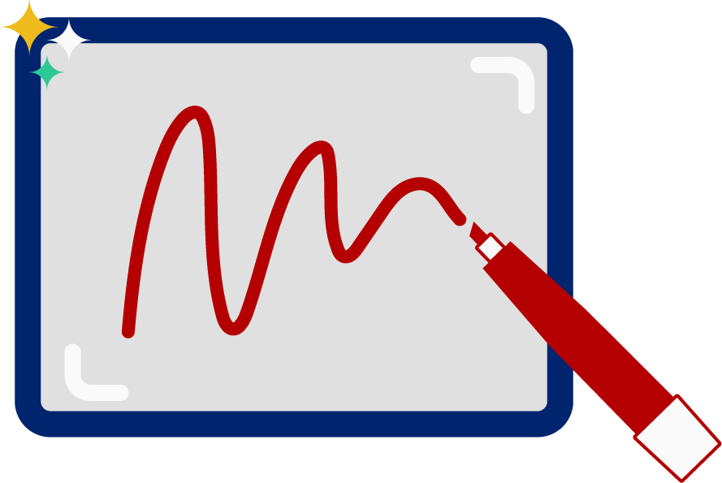
Spell the words
Notes:
See lesson plan for specific instructional guidance.
Follow the directions to administer the Formative Assessment for Level D, Unit 4.

Slide 7
High Frequency Words
Family Activity
Notes:
See lesson plan for specific instructional guidance.
Given that you need to administer Level D, Unit 4 Formative Assessment, there is no new HFW. If you have time, review previously taught words.

