Slide 1
Introduce the sounds
mistrust
/m/ /ĭ/ /s/ |
/t/ /r/ /ŭ/ /s/ /t/
= mistrust
It’s time to learn new sounds!
We use the sound rule to help us read!
Notes:
See lesson plan for specific instructional guidance.
Introduce the Sound!
Say: Learning new sounds is so cool! Repeat our chant after me!
"It's time to learn new sounds!
We use the sound rule to help us read!"
Do: Say one sentence at a time of the Introduce the Sound chant and ask the students to repeat after you.
Say: Let's learn a super cool new rule today!
Say: In this unit, you'll learn 8 common prefixes. A prefix is a group of letters at the beginning of a word that changes the meaning of the word. We'll review decoding, spelling, and determining the meaning of words with the 8 common prefixes.
Do: Hold up the prefix cards to be learned in this unit: re, un, dis, non, im, in, pre and post.
Say: When we put a prefix in front of a word, it changes the meaning of the word. For example, when I see mistrust, I say /m/ /i/ /s/ /t/ /r/ /u/ /s/ /t/ = mistrust.

Slide 2
Introduce the sounds
Notes:
See lesson plan for specific instructional guidance.
Introduce the Sound!
Say: Before we go any further, let's review each of these spellings and all our cards.
Do: Flip through and review all the sound spelling cards students have learned so far. (Sound Letter Cards: a, e, i, o, u, wh, sh, ch, ng, ck, ph, qu, ai, ay, ee, ea, igh, c, g, oa, oe, gu, ar, eigh, ei, ey, er, y, ie, ir, y_e, or, ow, ou, ough, ur, ew, ui, eu, oi, oy, au, wor, ear, gu, gue, kn, gn, wr).
Say: Remember, a prefix is a group of letters that go before a word, that change the meaning of a word.

Slide 3
Blend
the sounds
Family Activity
unafraid
It’s time to blend the sounds!
It’s time to blend the sounds to help us read the words smoothly!
unafraid
Notes:
See lesson plan for specific instructional guidance.
Blend the Sounds!
Say: Blending sounds helps us read the words smoothly! Repeat our chant after me!
"It's time to blend the sounds!
It's time to blend the sounds to help us read the words smoothly!"
Do: Say one sentence at a time of the Blend the Sounds chant and ask the students to repeat after you.
Say: Let's practice blending the sounds in some words today!
Say: When we blend the sounds in words, it helps us read the words smoothly. Let's try it. Prefixes are letters that come before a word that change the meaning of the word. They are their own syllables. We chop them off to look at the rest of the word when decoding.
Do: Point to the word unafraid.
Say: I notice that this word has the prefix un in it. We'll underline anything that sticks together and chop off the prefix syllable. I see 3 vowels, so I probably have 3 syllables. I have a prefix, un, a vowel a and ai. I'll chop before and after the first a.
Do: Chop and underline. un | a | fraid
Say: I think we're ready to decode the word. Let's try. As you listen to me decode it, you can chop down your arm.
Do: Start at your shoulder, and chop/ tap the sounds out. When it's time to blend, start back at the shoulder and run your hand smoothly down your arm.
Say: u-n says /u/ /n/, a says /a/ because it's an open syllable, f says /f/, r says /r/, a-i says /a/, d says /d/ = /u/ /n/ /a/ /f/ /r/ /a/ /d/ = "unafraid". Let's clap out the syllables and blend the word together by syllable using our Double Decker Elkonin Boxes.
Do: Segment and blend the word unafraid using the Double Decker Elkonin Boxes. un - a -fraid
Say: The prefix un means not. This word means not able. Smart blending!
Do: If students need more practice, pick from the word list and follow the steps above.
Word list: replace - to place again, discomfort - not comfortable, inactive - not active, immature - not mature, mistrust - not trust

Slide 4
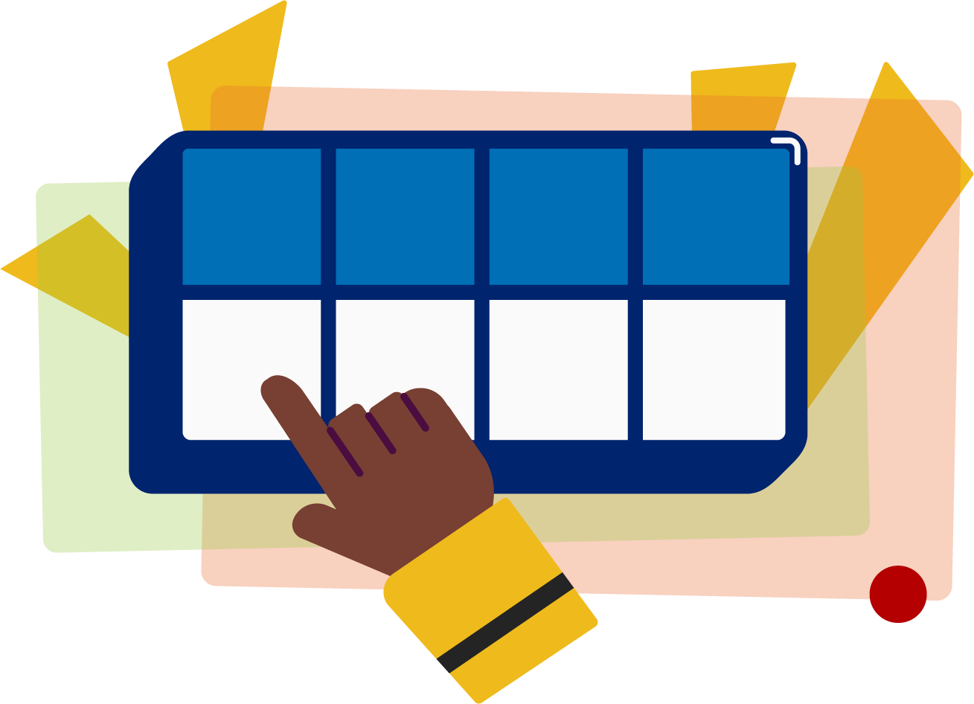
Read the words
Family Activity
Recheck your math problem.
Don’t misuse the couch for a trampoline.
It’s time to read the words!
It’s time to read the words, so we can read smoothly, like we are speaking!
Let’s preread by looking at the table of contents.
Notes:
See lesson plan for specific instructional guidance.
Read the Words!
Say: When we practice reading the words, it can help us read the words faster and faster. This helps us learn to read smoothly like when we are speaking! Repeat our chant after me!
"It's time to read the words!
It's time to read the words, so we can read smoothly, like we are speaking!"
Do: Say one sentence at a time of the Read the Words chant and ask the students to repeat after you.
Say: Let's practice reading words today!
Say: We are going to read the words. When we practice reading the words, it helps us read faster and faster. This helps us focus on what we can learn from the words. Let's look at the first sentence.
Do: Point to the first sentence: Recheck your math problem.
Say: Let's start reading. If we come to a word we don't know, we'll stop and figure it out. Here we go.
Do: Guide the students along in the sentence stopping to decode words when necessary. If students become stuck on a word, use the decoding strategies we've been practicing.
Underline any letters that go together. Put dots under your vowels.
Draw in the syllable break.
Look for the spelling patterns.
Name any phonetic rules that help with pronunciation.
Try reading it. Is it right? If not, try another pronunciation.
When you have it right, start the sentence again to make sure you're reading for meaning.
Say: Excellent work!
Do: Repeat these steps with a couple more sentences.
Sentence 2: Don't misuse the couch for a trampoline.
Sentence 3: Let's pre read by looking at the table of contents.
Say: A prefix is a group of letters before a word that changes the meaning of the word. Those brains are growing!

Slide 5
Decode the words
reshape unlikely
discomfort inactive
improbable nonfiction
mistrust preheat
postgraduate
It’s time to decode the sounds in the word!
It’s time to decode the sounds in the words so we can read the words!
Notes:
See lesson plan for specific instructional guidance.
Decode the Words!
Say: Decoding is when you break up the sounds in a word and read each sound one at a time. Then you blend the sounds together to read the word! Repeat our chant after me!
"It's time to decode the sounds in the words!
It's time to decode the sounds in the words so we can read the words!"
Do: Say one sentence at a time of the Decode the Words chant and ask the students to repeat after you.
Say: Let's practice decoding the sounds in words today!
Say: We are going to decode the words. Remember decoding is when you break up the sounds in a word and read each sound one at a time. Then you blend the sounds together to read the word! When we decode the sounds in words, it helps us read the words correctly. Look at our words for today.
Do: Point to the words.
Say: Follow this routine:
Underline any letters that go together. Put dots under your vowels.
Draw in the syllable break.
Look for the spelling patterns.
Name any phonetic rules that help with pronunciation.
Try reading it. Is it right? If not, try another pronunciation.
Do: Partner students.
Say: You and your partner work together to decode these words (reshape, unlikely, discomfort, inactive, improbable, nonfiction, mistrust, preheat, postgraduate). I'll be by to listen. Use your Double Decker Elkonin Boxes.
Do: Listen as students decode the word. Take notes on the students that can accurately articulate the sounds and read the word and students that may need reteaching and/or additional support.
Say: Excellent work applying our new rule to decoding words today!

Slide 6
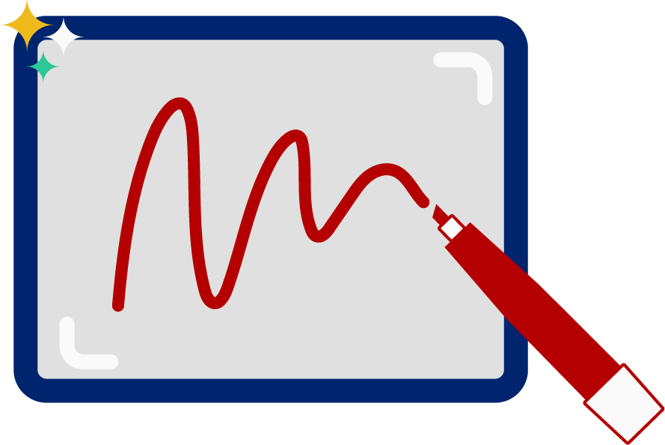
Spell the words
un
e
qual
It’s time to spell the words!
It’s time to spell the words to show we understand the rule!
Notes:
See lesson plan for specific instructional guidance.
Spell the Words!
Say: When we can spell words, it shows that we met the target. When we hear the sounds, we can match the sounds to the correct letters and spell the word! Repeat our chant after me!
"It's time to spell the words!
It's time to spell the words to show we understand the rule!"
Do: Say one sentence at a time of the Spell the Words chant and ask the students to repeat after you.
Say: Let's practice spelling words today!
Say: We are going to spell the words. Remember when we can spell words with the correct rule it shows that we met the target. When we hear the sounds we can match the sounds to the correct letters and spell the word! Listen to our words for today. The word is unequal. How would we spell the word unequal. Let's listen to the sounds and match the sound to the correct letter. Let's start by clapping out the syllables.
Do: Say the word together and clap the syllables.
Say: Unequal. Three syllables. We'll do each syllable. First syllable?
Do: Clap it again and isolate the first syllable. Un | e |qual.
Say: Un. /u/ /n/. Use your whiteboards.
Do: Write u-n.
Say: Clap the syllables again isolate the second syllable. Un | e |qual. Next syllable is e.
Do: Clap and isolate the second syllable.
Say: Write. /e/. If I want the long e sound, I can just do an e because it's an open syllable.
Do: Write e.
Say: Clap the syllables again isolate the third syllable. Un | e |qual. Next syllable is qual.
Do: Clap and isolate the third syllable.
Say: Write. /kw/ /a/ /l/.
Do: Write q - u - a - l.
Say: Let's sound it out to make sure it spells the word we want.
Do: Sound out the word again.
Say: Does this look right?
Do: Allow students to respond.
Say: I think so too! What does this word mean with the prefix?
Do: Allow students to respond.
Say: Yes, un means not. Unequal means not equal. Great work!
Do: Repeat with additional words from list if students need more practice. (replace, disable, informal, nonstop)

Slide 7
High Frequency Words
Family Activity
something
sometimes
We see high frequency words all the time!
Let’s figure out how to read them!
Notes:
See lesson plan for specific instructional guidance.
High Frequency Words!
Say: Some words we can sound out now, some words we'll learn how to sound out later, and some words are rule breakers and we can't sound out. Words that show up a lot in books are called High Frequency Words. Let's learn some! Repeat our chant after me!
"We see high frequency words all the time!
Let's figure out how to read them!"
Do: Say one sentence at a time of the High Frequency Words chant and ask the students to repeat after you.
Say: Let's read our high frequency words!
Say: Today, we're learning 2 new words!
Do: Display the words something and sometimes.
Say: Check out these words. What do you notice?
Do: Give students a few seconds to analyze the words and notice they both begin with some.
Say: Yes. Both of these words are 2 syllables and both of these words begin with the word some. Let's look at the first word and decode it. Underline any letters that stick together.
Do: Point to something.
Say: t-h and n-g stick together.
Do: Put in syllable breaks and underline. some|th i ng.
Say: We're ready to sound it out. "some" /th/ /i/ /ng/ = "something". Something is in my shoe. something. Read it with me.
Do: Listen as students read the word. Display or point out sometimes.
Say: Look at our next word. Any letters that stick together or spelling patterns to point out?
Do: Give students a few minutes to take note.
Say: Yes. There is a final bossy e that makes the i say the long i sound. We're ready to sound it out. "some" /t/ /i/ /m/ /s/ = "sometimes". Sometimes I stay up past bedtime reading books. sometimes. Let's read it together!
Do: Listen as students sound out the word. Offer help as necessary.
Say: Both of these words today are called compound words - they are two words put together that form a new word. sometimes is made up of the word some and times.
Say: Excellent! Let's read our previous high frequency words!
Do: Point to or hold up all the high frequency words to this point as the students read them.
Say: Excellent work learning 2 new high frequency words today.
something, sometimes

