Slide 1


Deletion and Substitution
It’s deletion and substitution time!
We want to change the beginning, middle, and ending sounds!
We want to make a new word!
Notes:
Deletion and Substitution, 5 minutes
See lesson plan for specific instructional guidance.

Slide 2




Introduce the Sounds
  write
  /r/ /ī/ /t/
  = write
It’s time to learn new sounds!
We use the sound rule to help us read!
Notes:
Introduce the Sounds, 5 minutes
See lesson plan for specific instructional guidance.

Slide 3
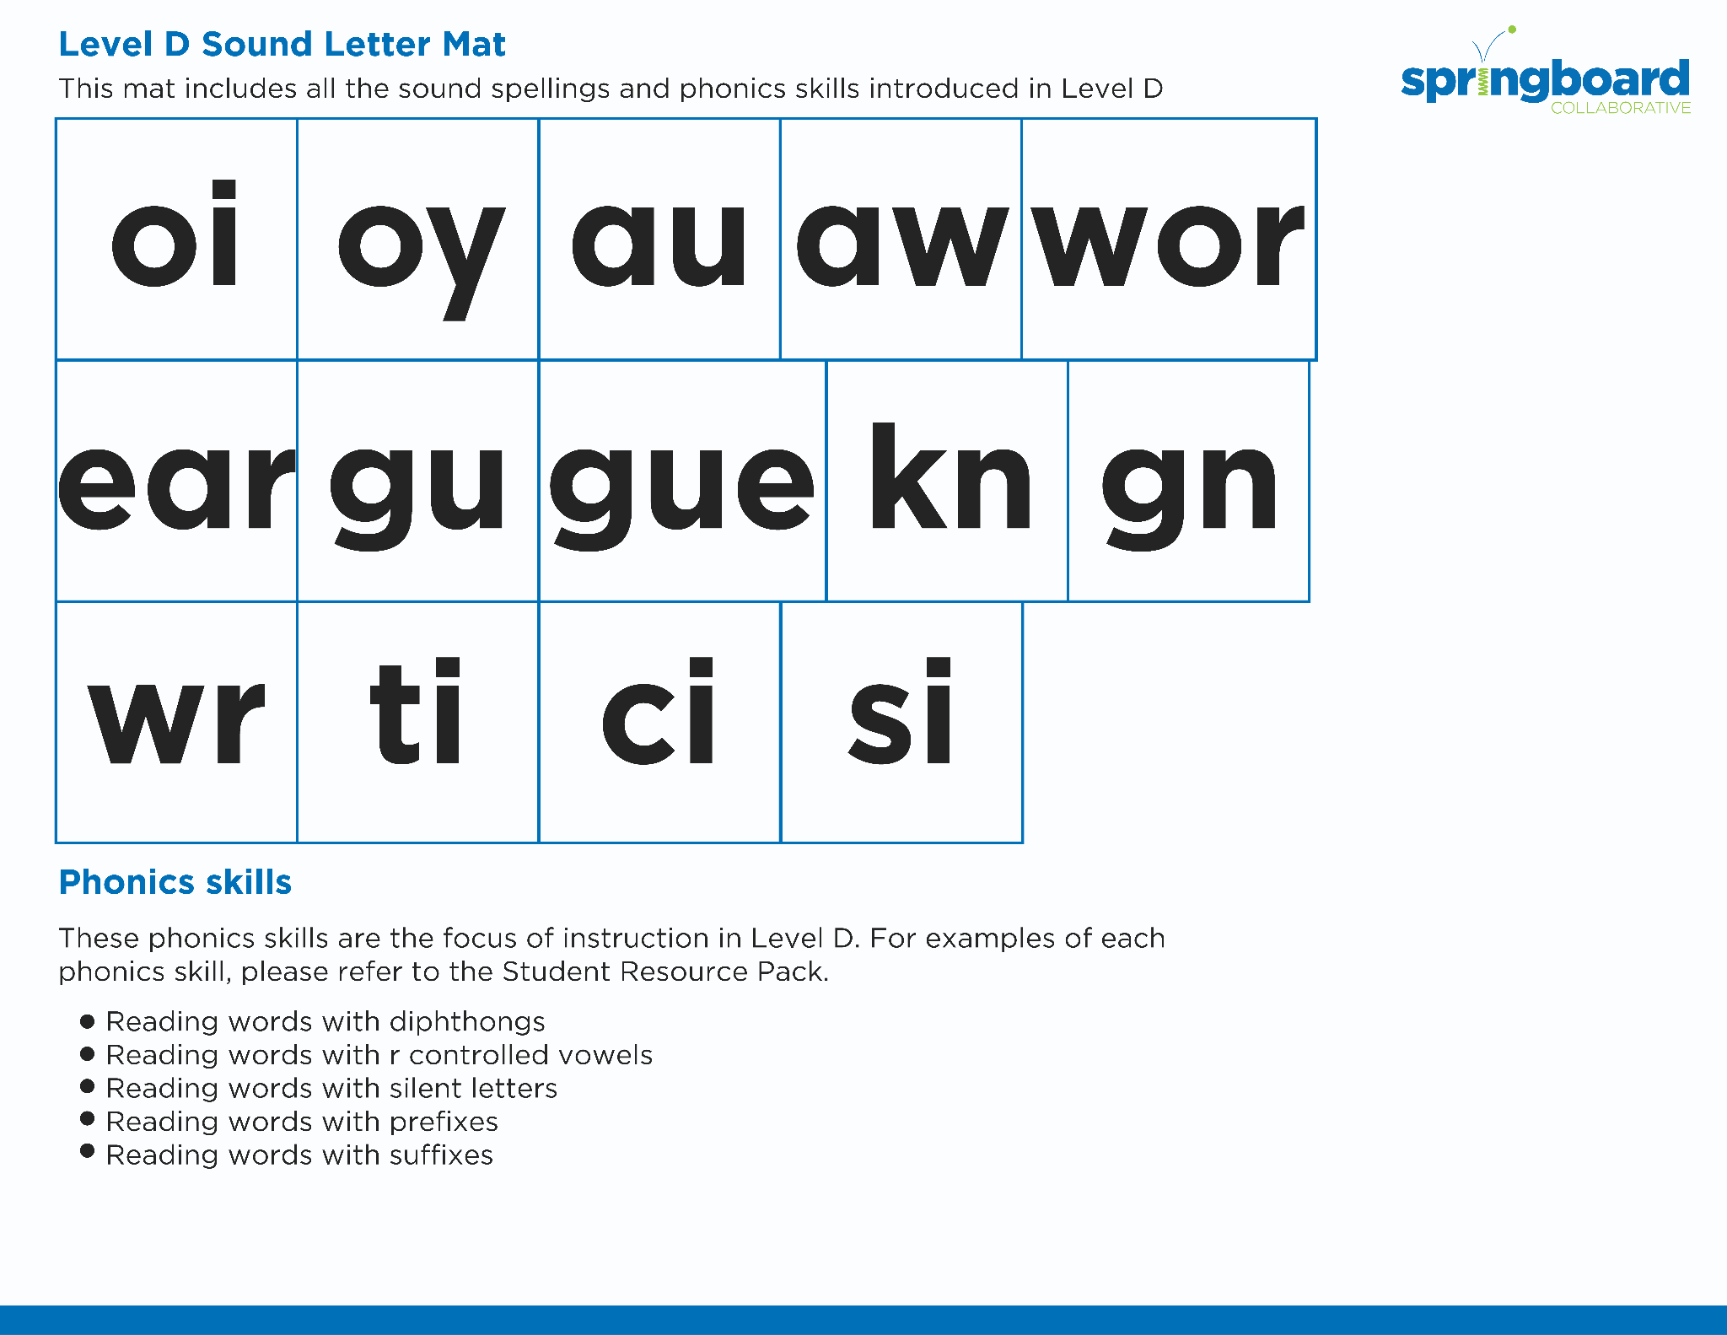
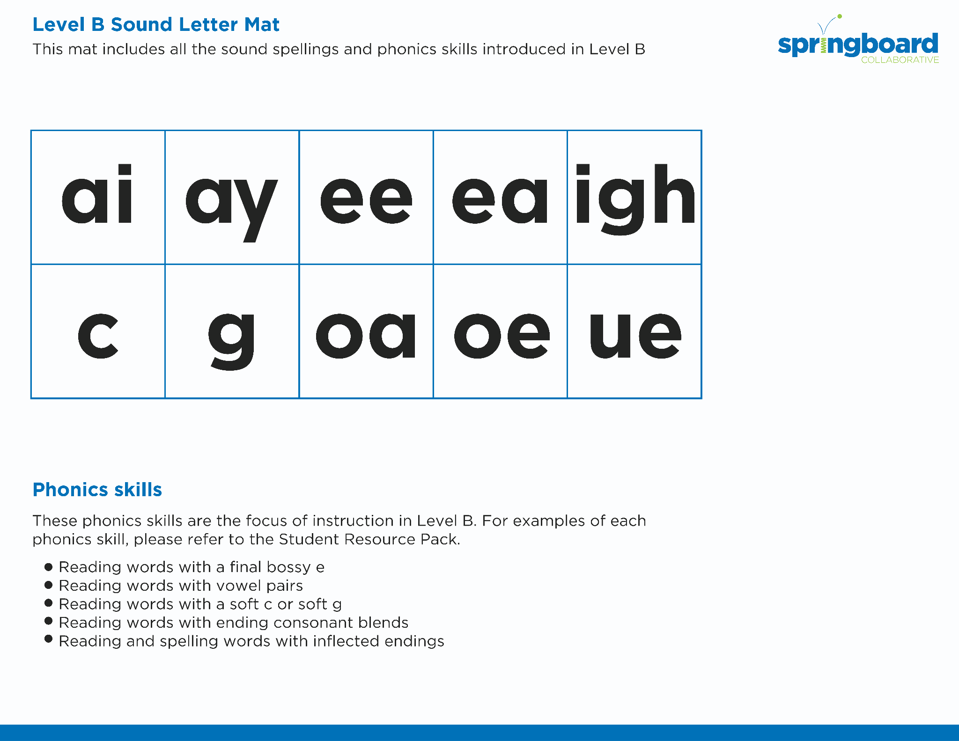
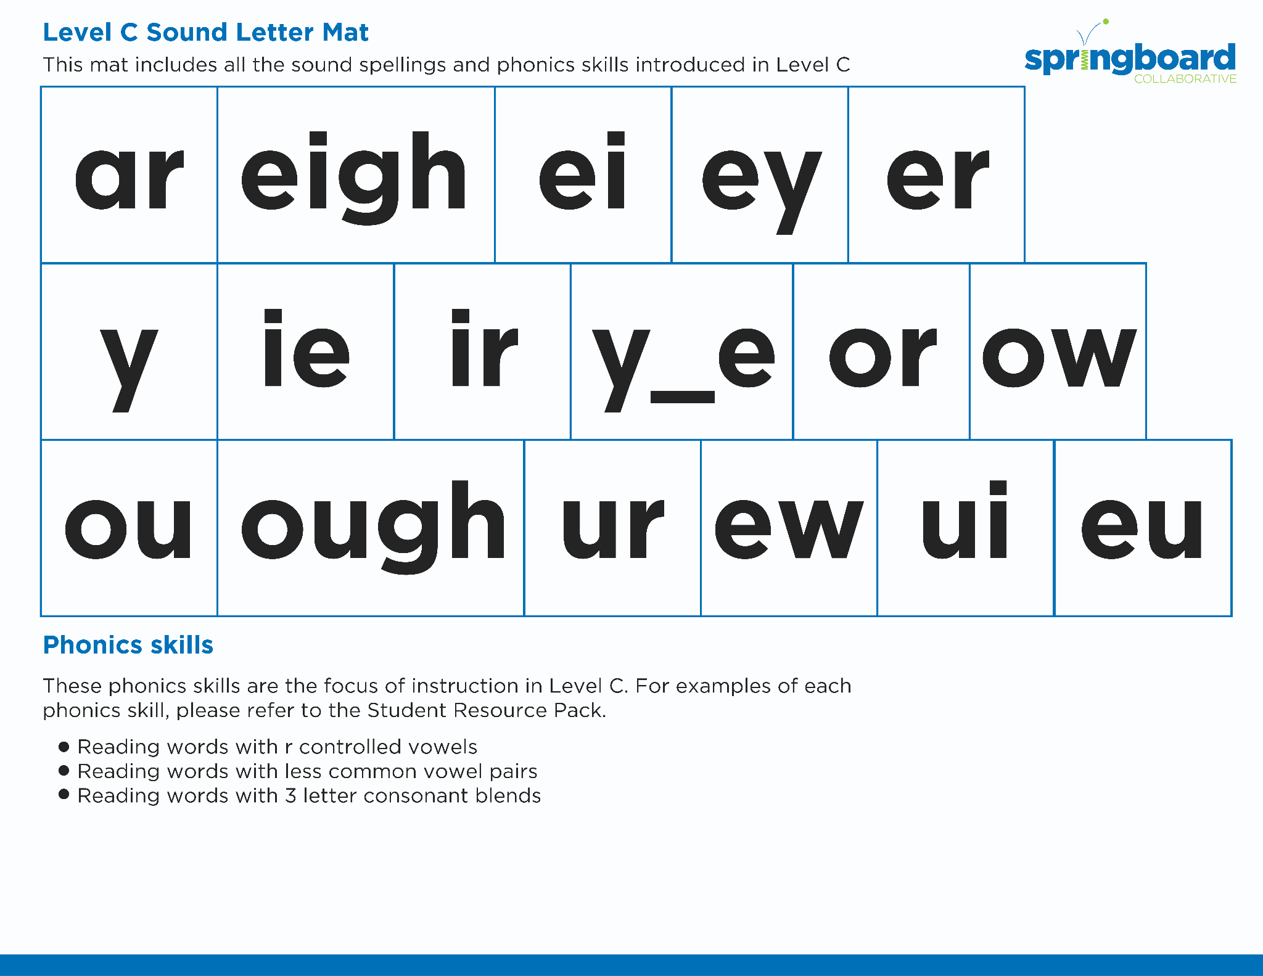
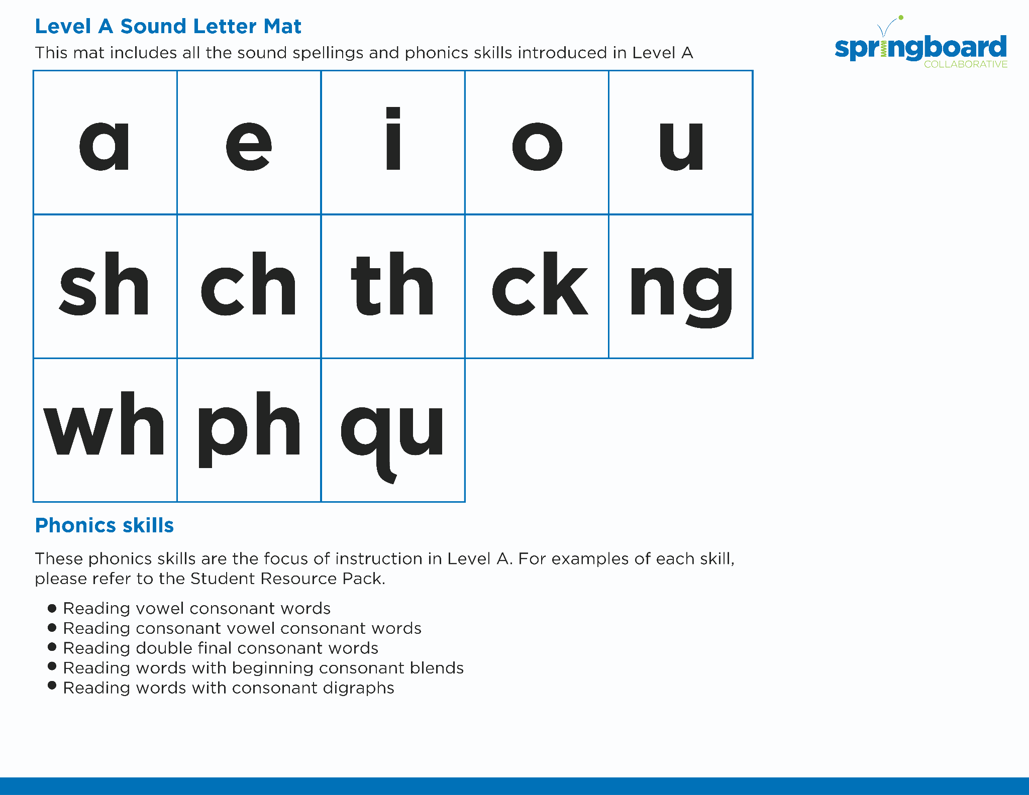
Introduce the Sounds
Notes:
Introduce the Sounds, 5 minutes
See lesson plan for specific instructional guidance.

Slide 4


Blend
the Sounds
wreck
It’s time to blend the sounds!
It’s time to blend the sounds to help us read the words smoothly!
wreck
Notes:
Blend the Sounds, 5 minutes
See lesson plan for specific instructional guidance.

Slide 5


Read
the Words
Write about the wren without using your wrist.
The wreath fell and wrecked the wrap.
It’s time to read the words!
It’s time to read the words, so we can read smoothly, like we are speaking!
The wrench is the wrong tool.
Notes:
Read the Words, 5 minutes
See lesson plan for specific instructional guidance.

Slide 6


  wring
  wreck
  wrath
  write
Decode
the Words
It’s time to decode the sounds in the words!
It’s time to decode the sounds in the words so we can read the words!
Notes:
Decode the Words, 5 minutes
See lesson plan for specific instructional guidance.

Slide 7




Spell
the Words
wr
ea
th
It’s time to spell the words!
It’s time to spell the words to show we understand the rule!
Notes:
Spell the Words, 5 minutes
See lesson plan for specific instructional guidance.

Slide 8

High-
Frequency
Words
write
We see high-frequency words all the time!
Let’s figure out how to read them!
Notes:
High-Frequency Words, 5 minutes
See lesson plan for specific instructional guidance.

Slide 9

Decodable Text
  Time to read.
  Let’s use our new rule!
Notes:
Decodable Text, 15 minutes
See lesson plan for specific instructional guidance.

Slide 10
Response to Text
What does Cassie do when she is birdwatching?
What happened while Cassie was resting?
Why was Cassie so happy on her way home?
How might Cassie feel at the beginning? Middle? End?
Notes:
Response to Text, 10 minutes
See lesson plan for specific instructional guidance.

