Slide 1


Deletion and Substitution
It’s deletion and substitution time!
We want to change the beginning, middle, and ending sounds!
We want to make a new word!
Notes:
Deletion and Substitution, 5 minutes
See lesson plan for specific instructional guidance.

Slide 2



Introduce the Sounds
Consonant L-E
  uncle
  /ŭ/ /n/ | /k/ /l/
  = uncle
It’s time to learn new sounds!
We use the sound rule to help us read!
Notes:
Introduce the Sounds, 5 minutes
See lesson plan for specific instructional guidance.

Slide 3
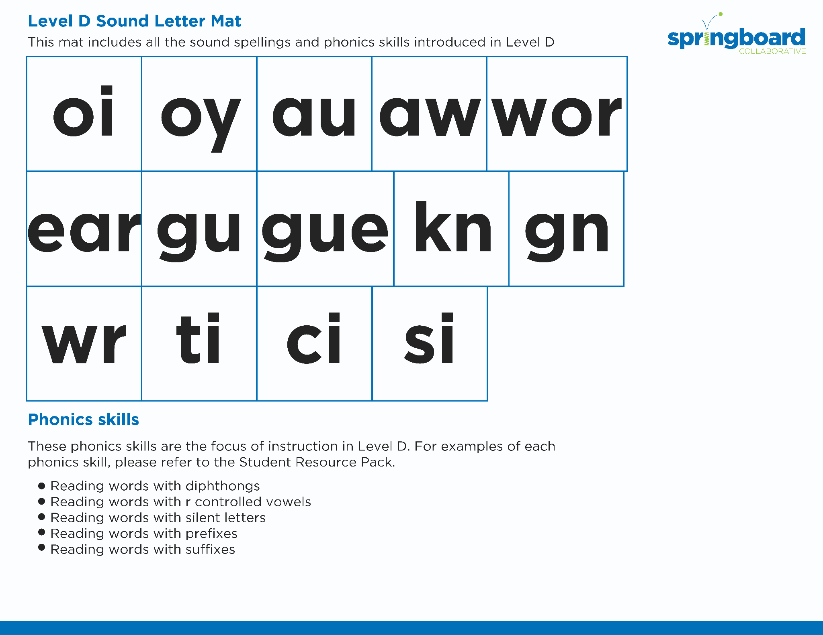
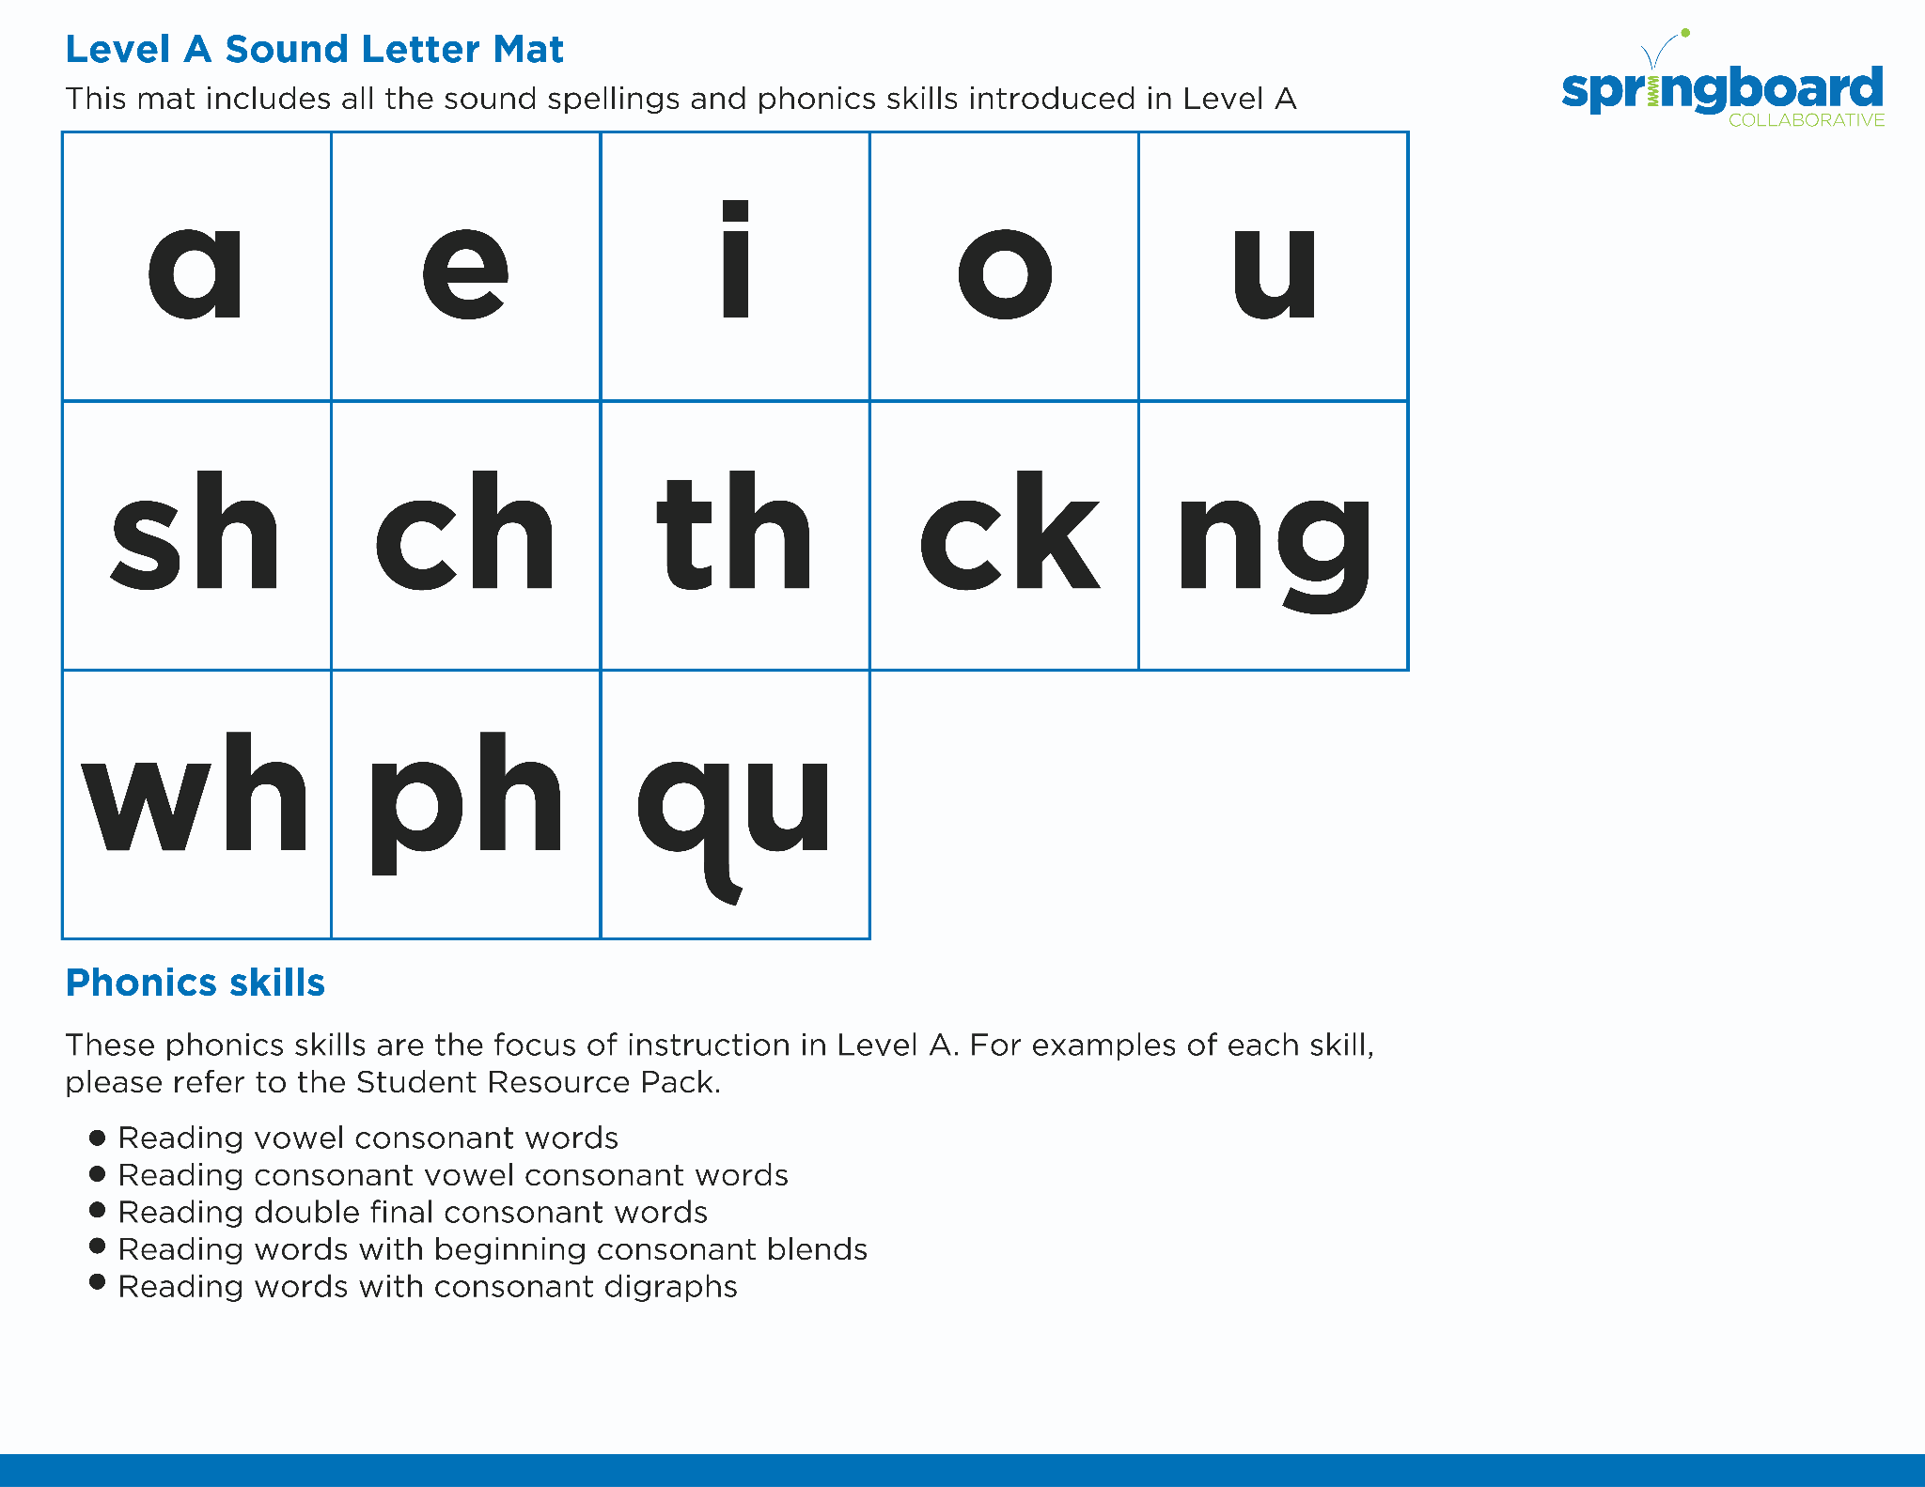
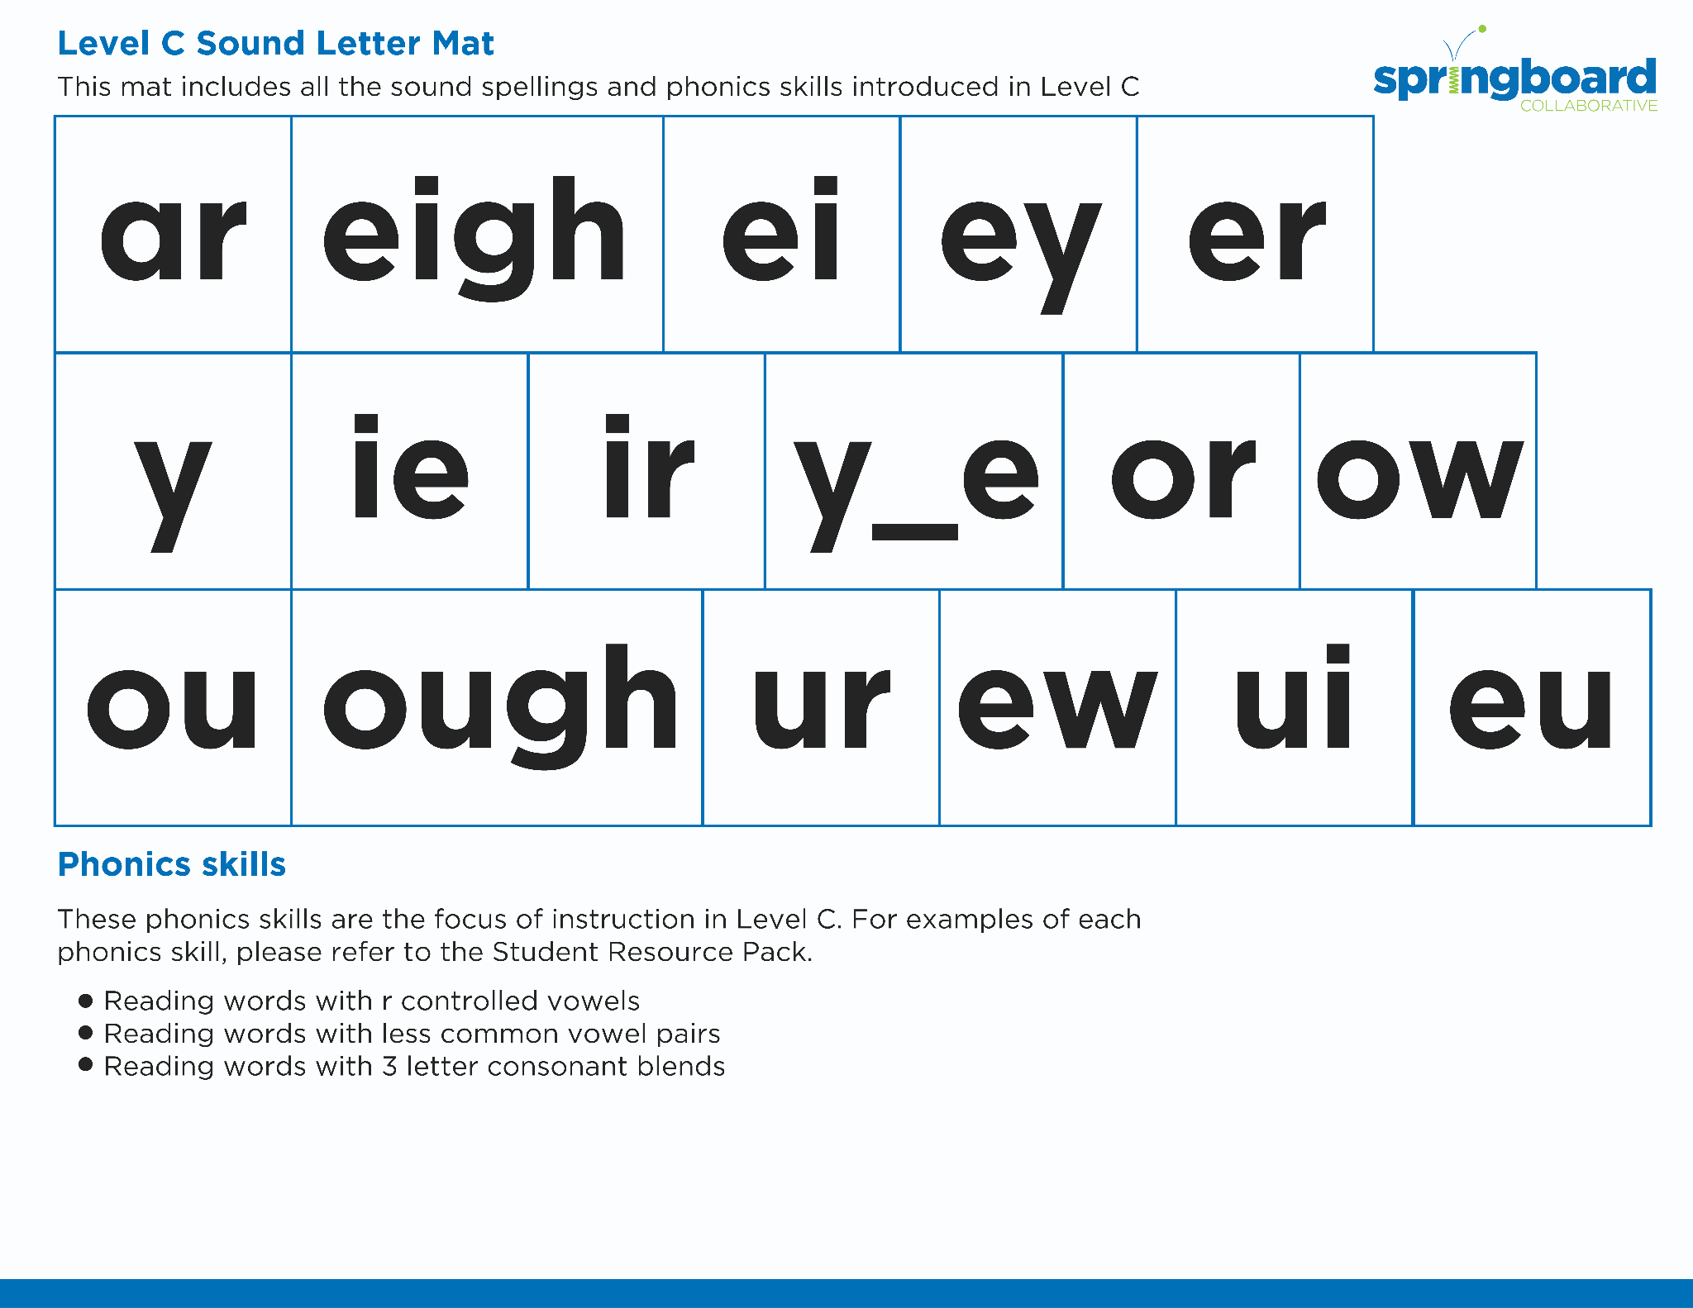
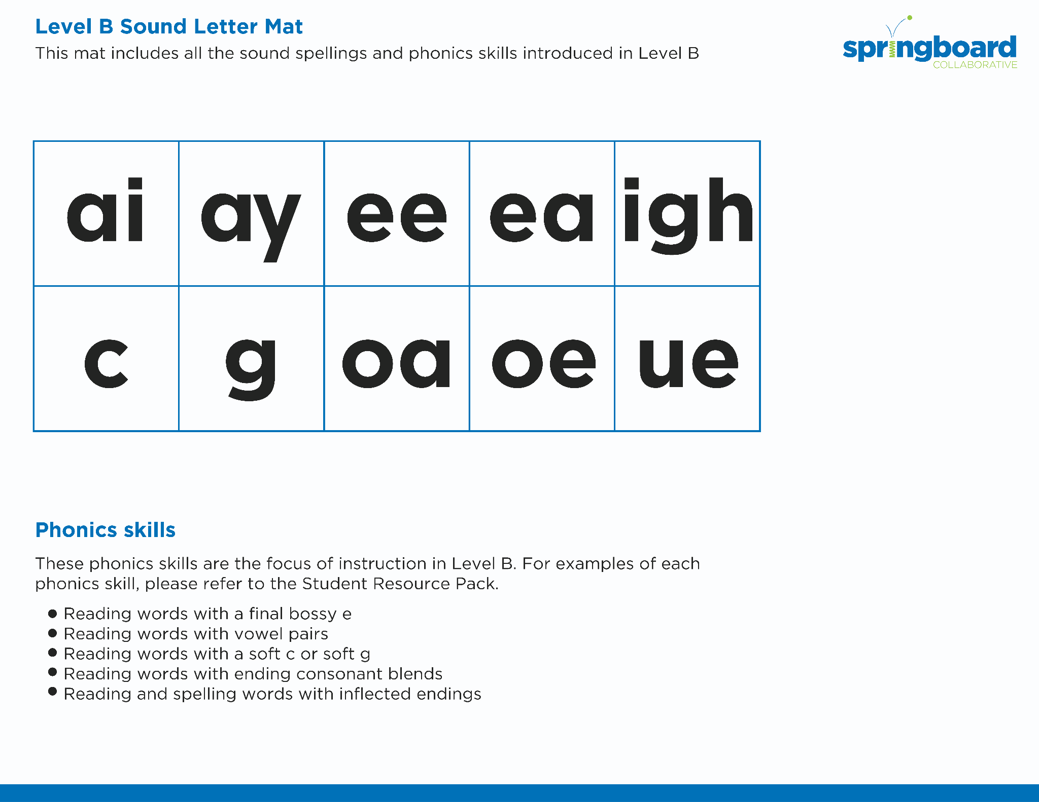
Introduce the Sounds
Notes:
Introduce the Sounds, 5 minutes
See lesson plan for specific instructional guidance.

Slide 4


Blend
the Sounds
uncle
It’s time to blend the sounds!
It’s time to blend the sounds to help us read the words smoothly!
uncle
Notes:
Blend the Sounds, 5 minutes
See lesson plan for specific instructional guidance.

Slide 5


Read
the Words
I had to circle the Skittles with my hand so they didn’t tumble off the table.
Don’t forget to jiggle the handle.
It’s time to read the words!
It’s time to read the words, so we can read smoothly, like we are speaking!
This example is simple.
Notes:
Read the Words, 5 minutes
See lesson plan for specific instructional guidance.

Slide 6


  tumble
  trample
  doodle
  waddle
Decode
the Words
It’s time to decode the sounds in the words!
It’s time to decode the sounds in the words so we can read the words!
Notes:
Decode the Words, 5 minutes
See lesson plan for specific instructional guidance.

Slide 7



Spell
the Words
bun
dle
It’s time to spell the words!
It’s time to spell the words to show we understand the rule!
Notes:
Spell the Words, 5 minutes
See lesson plan for specific instructional guidance.

Slide 8

High-
Frequency
Words
talk
We see high-frequency words all the time!
Let’s figure out how to read them!
Notes:
High-Frequency Words, 5 minutes
See lesson plan for specific instructional guidance.

Slide 9

Decodable Text
  Time to read.
  Let’s use our new rule!
Notes:
Decodable Text, 15 minutes
See lesson plan for specific instructional guidance.

Slide 10
Response to Text
Where did Uncle Billy and Able go?
What senses did they use in the shop?
How might Able have been feeling?
Notes:
Response to Text, 10 minutes
See lesson plan for specific instructional guidance.

