Slide 1
Introduce the sounds
knee
/n/ /ē/
= knee
gnat
/n/ /ă/ /t/
= gnat
It’s time to learn new sounds!
We use the sound rule to help us read!
Notes:
See lesson plan for specific instructional guidance.
Introduce the Sound!
Say: Learning new sounds is so cool! Repeat our chant after me!
"It's time to learn new sounds!
We use the sound rule to help us read!"
Do: Say one sentence at a time of the Introduce the Sound chant and ask the students to repeat after you.
Say: Let's learn a super cool new rule today!
Say: In unit 3, we'll be looking at silent letters and syllabication. Today, we'll look at decoding and spelling words with the spelling pattern k-n and g-n.
Do: Hold up the Sound Letter k-n and g-n cards.
Say: Each of these cards says /n/. The k is silent and the g is silent. K-n says /n/ like knee, /n/ /e/. G-n says /n/ like gnat, /n/ /a/ /t/. Say it with me.
Do: Point to the k-n card and listen for students to say /n/. Repeat with the g-n card and listen for students to say /n/.

Slide 2
Introduce the sounds
Notes:
See lesson plan for specific instructional guidance.
Introduce the Sound!
Say: Before we start practicing decoding, let's review each of these spellings and all our cards.
Do: Flip through and review all the sound spelling cards students have learned so far. (Sound Letter Cards: a, e, i, o, u, wh, sh, ch, ng, ck, ph, qu, ai, ay, ee, ea, igh, c, g, oa, oe, gu, ar, eigh, ei, ey, er, y, ie, ir, y_e, or, ow, ou, ough, ur, ew, ui, eu, oi, oy, au, wor, ear, gu, gue).
Say: Remember, k-n says /n/ and g-n says /n/. Let's practice reading words!

Slide 3
Blend the sounds
knock
Family Activity
It’s time to blend the sounds!
It’s time to blend the sounds to help us read the words smoothly!
knock
Notes:
See lesson plan for specific instructional guidance.
Blend the Sounds!
Say: Blending sounds helps us read the words smoothly! Repeat our chant after me!
"It's time to blend the sounds!
It's time to blend the sounds to help us read the words smoothly!"
Do: Say one sentence at a time of the Blend the Sounds chant and ask the students to repeat after you.
Say: Let's practice blending the sounds in some words today!
Say: When we blend the sounds in words, it helps us read the words smoothly. Let's try it. K-n and g-n say /n/.
Do: Point to the word knock.
Say: I notice that this word has k-n in it. We'll underline anything that sticks together. I need to underline the k-n and the c-k.
Do: Underline the k-n and the c-k. knock.
Say: I think we're ready to decode the word. Let's try. As you listen to me decode it, you can chop down your arm.
Do: Start at your shoulder, and chop/ tap the sounds out. When it's time to blend, start back at the shoulder and run your hand smoothly down your arm.
Say: K-n says /n/, o says /o/, c-k says /k/ = "knock". Let's segment and blend the word together now using our Double Decker Elkonin Boxes.
Do: Segment and blend the word knock using the Double Decker Elkonin Boxes.
Say: Smart blending!
Do: If students need more practice, pick from the word list and follow the steps above.
Word list: knife, sign

Slide 4
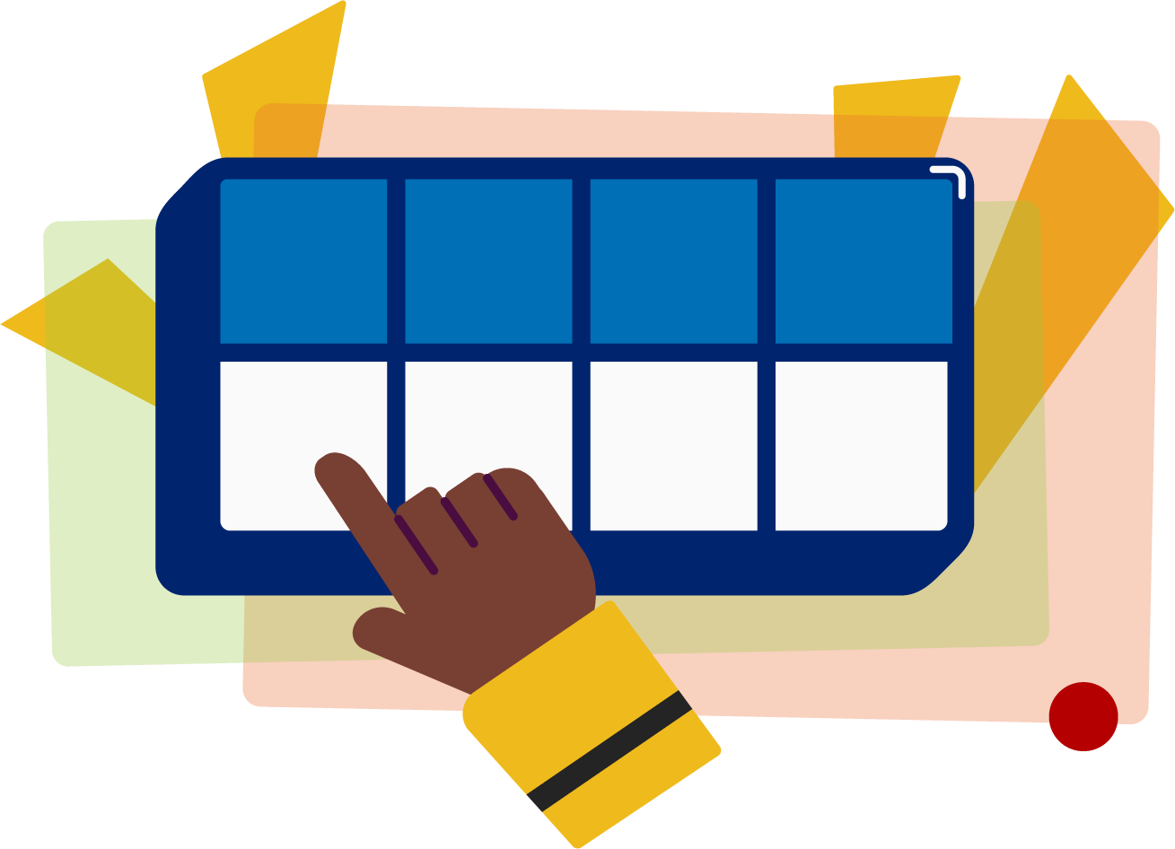
Read the words
Family Activity
I know how to knead dough.
I have knowledge of knights knitting.
It’s time to read the words!
It’s time to read the words, so we can read smoothly, like we are speaking!
The gnome gnashed his teeth.
Notes:
See lesson plan for specific instructional guidance.
Read the Words!
Say: When we practice reading the words, it can help us read the words faster and faster. This helps us learn to read smoothly like when we are speaking! Repeat our chant after me!
"It's time to read the words!
It's time to read the words, so we can read smoothly, like we are speaking!"
Do: Say one sentence at a time of the Read the Words chant and ask the students to repeat after you.
Say: Let's practice reading words today!
Say: We are going to read the words. When we practice reading the words, it helps us read faster and faster. This helps us focus on what we can learn from the words. Let's look at the first sentence.
Do: Point to the first sentence: I know how to knead dough.
Say: Let's start reading. If we come to a word we don't know, we'll stop and figure it out. Here we go.
Do: Guide the students along in the sentence stopping to decode words when necessary. If students become stuck on a word, use the decoding strategies we've been practicing.
Underline any letters that go together. Put dots under your vowels.
Draw in the syllable break.
Look for the spelling patterns.
Name any phonetic rules that help with pronunciation.
Try reading it. Is it right? If not, try another pronunciation.
When you have it right, start the sentence again to make sure you're reading for meaning.
Say: Excellent work!
Do: Repeat these steps with a couple more sentences.
Sentence 2: I have knowledge of knights knitting.
Sentence 3: The gnome gnashed his teeth.
Say: Remember, k-n and g-n say /n/. Those brains are growing!

Slide 5
Decode the words
knack reign
knelt gnarl
It’s time to decode the sounds in the words!
It’s time to decode the sounds in the words so we can read the words!
Notes:
See lesson plan for specific instructional guidance.
Decode the Words!
Say: Decoding is when you break up the sounds in a word and read each sound one at a time. Then you blend the sounds together to read the word! Repeat our chant after me!
"It's time to decode the sounds in the words!
It's time to decode the sounds in the words so we can read the words!"
Do: Say one sentence at a time of the Decode the Words chant and ask the students to repeat after you.
Say: Let's practice decoding the sounds in words today!
Say: We are going to decode the words. Remember decoding is when you break up the sounds in a word and read each sound one at a time. Then you blend the sounds together to read the word! When we decode the sounds in words, it helps us read the words correctly. Look at our words for today.
Do: Point to the words.
Say: Follow this routine:
Underline any letters that go together. Put dots under your vowels.
Draw in the syllable break.
Look for the spelling patterns.
Name any phonetic rules that help with pronunciation.
Try reading it. Is it right? If not, try another pronunciation.
Do: Partner students.
Say: You and your partner work together to decode these words (knack, knelt, gnarl, reign). I'll be by to listen. Use your Double Decker Elkonin Boxes.
Do: Listen as students decode the word. Take notes on the students that can accurately articulate the sounds and read the word and students that may need reteaching and/or additional support.
Say: Excellent work applying our new rule to decoding words today!

Slide 6
Spell the words
knot
ty
It’s time to spell the words!
It’s time to spell the words to show we understand the rule!
Notes:
See lesson plan for specific instructional guidance.
Spell the Words!
Say: When we can spell words, it shows that we met the target. When we hear the sounds, we can match the sounds to the correct letters and spell the word! Repeat our chant after me!
"It's time to spell the words!
It's time to spell the words to show we understand the rule!"
Do: Say one sentence at a time of the Spell the Words chant and ask the students to repeat after you.
Say: Let's practice spelling words today!
Say: We are going to spell the words. Remember when we can spell words with the correct rule it shows that we met the target. When we hear the sounds we can match the sounds to the correct letters and spell the word! Listen to our words for today. The word is knotty. How would we spell the word knotty. Let's listen to the sounds and match the sound to the correct letter. The word is "knotty". Let's start by clapping out the syllables.
Do: Say the word together and clap the syllables.
Say: Knotty. Two syllables. We'll do each syllable. knot|ty. Use your whiteboards.
Do: Draw a line between the syllables. knot|ty
Say: /n/ /o/ /t/. So many choices for spelling of /n/. We'll use k-n.
Do: Write k-n-o-t.
Say: /t/ /e/
Do: Write t-y.
Say: Let's sound it out to make sure it spells the word we want.
Do: Sound out the word again.
Say: Does this look right?
Do: Allow students to respond.
Say: I think so too! Nicely done!
Do: Repeat with additional words from list if students need more practice. (sign, knee)

Slide 7
High
Frequency
Words
Family Activity
know
We see high frequency words all the time!
Let’s figure out how to read them!
Notes:
See lesson plan for specific instructional guidance.
High Frequency Words!
Say: Some words we can sound out now, some words we'll learn how to sound out later, and some words are rule breakers and we can't sound out. Words that show up a lot in books are called High Frequency Words. Let's learn some! Repeat our chant after me!
"We see high frequency words all the time!
Let's figure out how to read them!"
Do: Say one sentence at a time of the High Frequency Words chant and ask the students to repeat after you.
Say: Let's read our high frequency words!
Say: Today, we're learning 1 new word.
Do: Display the word know.
Say: This word has a silent letter. The kn says /n/. We also have two letters that stay together, o-w. In this word, o-w says long o, /o/. Listen to me sound it out. /n/ /o/ = "know". I know silent letter pairs. Let's sound it with our Double Decker Elkonin Boxes.
Do: Listen and support students as they sound out the word.
Say: Excellent! Let's read our previous high frequency words!
Do: Point to or hold up all the high frequency words to this point as the students read them.
Say: Excellent work learning 1 new high frequency word today.
know

