Slide 1


Deletion and Substitution
It’s deletion and substitution time!
We want to change the beginning, middle, and ending sounds!
We want to make a new word!
Notes:
Deletion and Substitution, 5 minutes
See lesson plan for specific instructional guidance.

Slide 2




Introduce the Sounds
  early
  /er/ /l/ | /ē/
  = early
It’s time to learn new sounds!
We use the sound rule to help us read!
Notes:
Introduce the Sounds, 5 minutes
See lesson plan for specific instructional guidance.

Slide 3
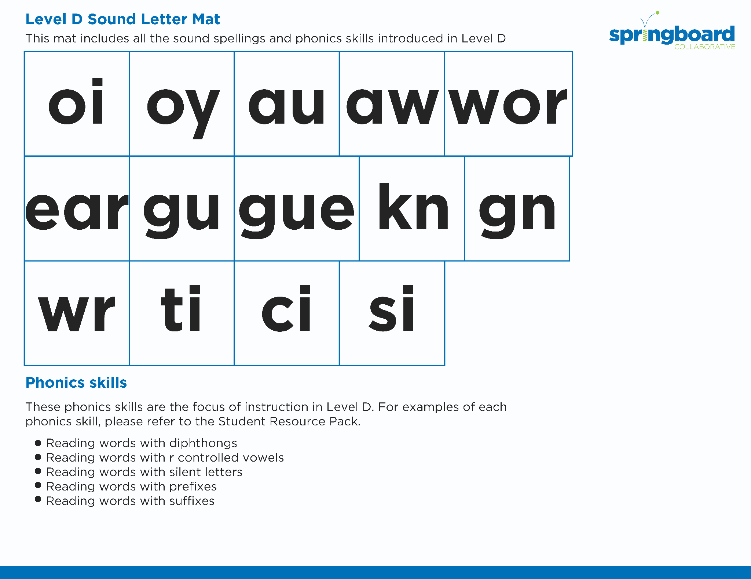
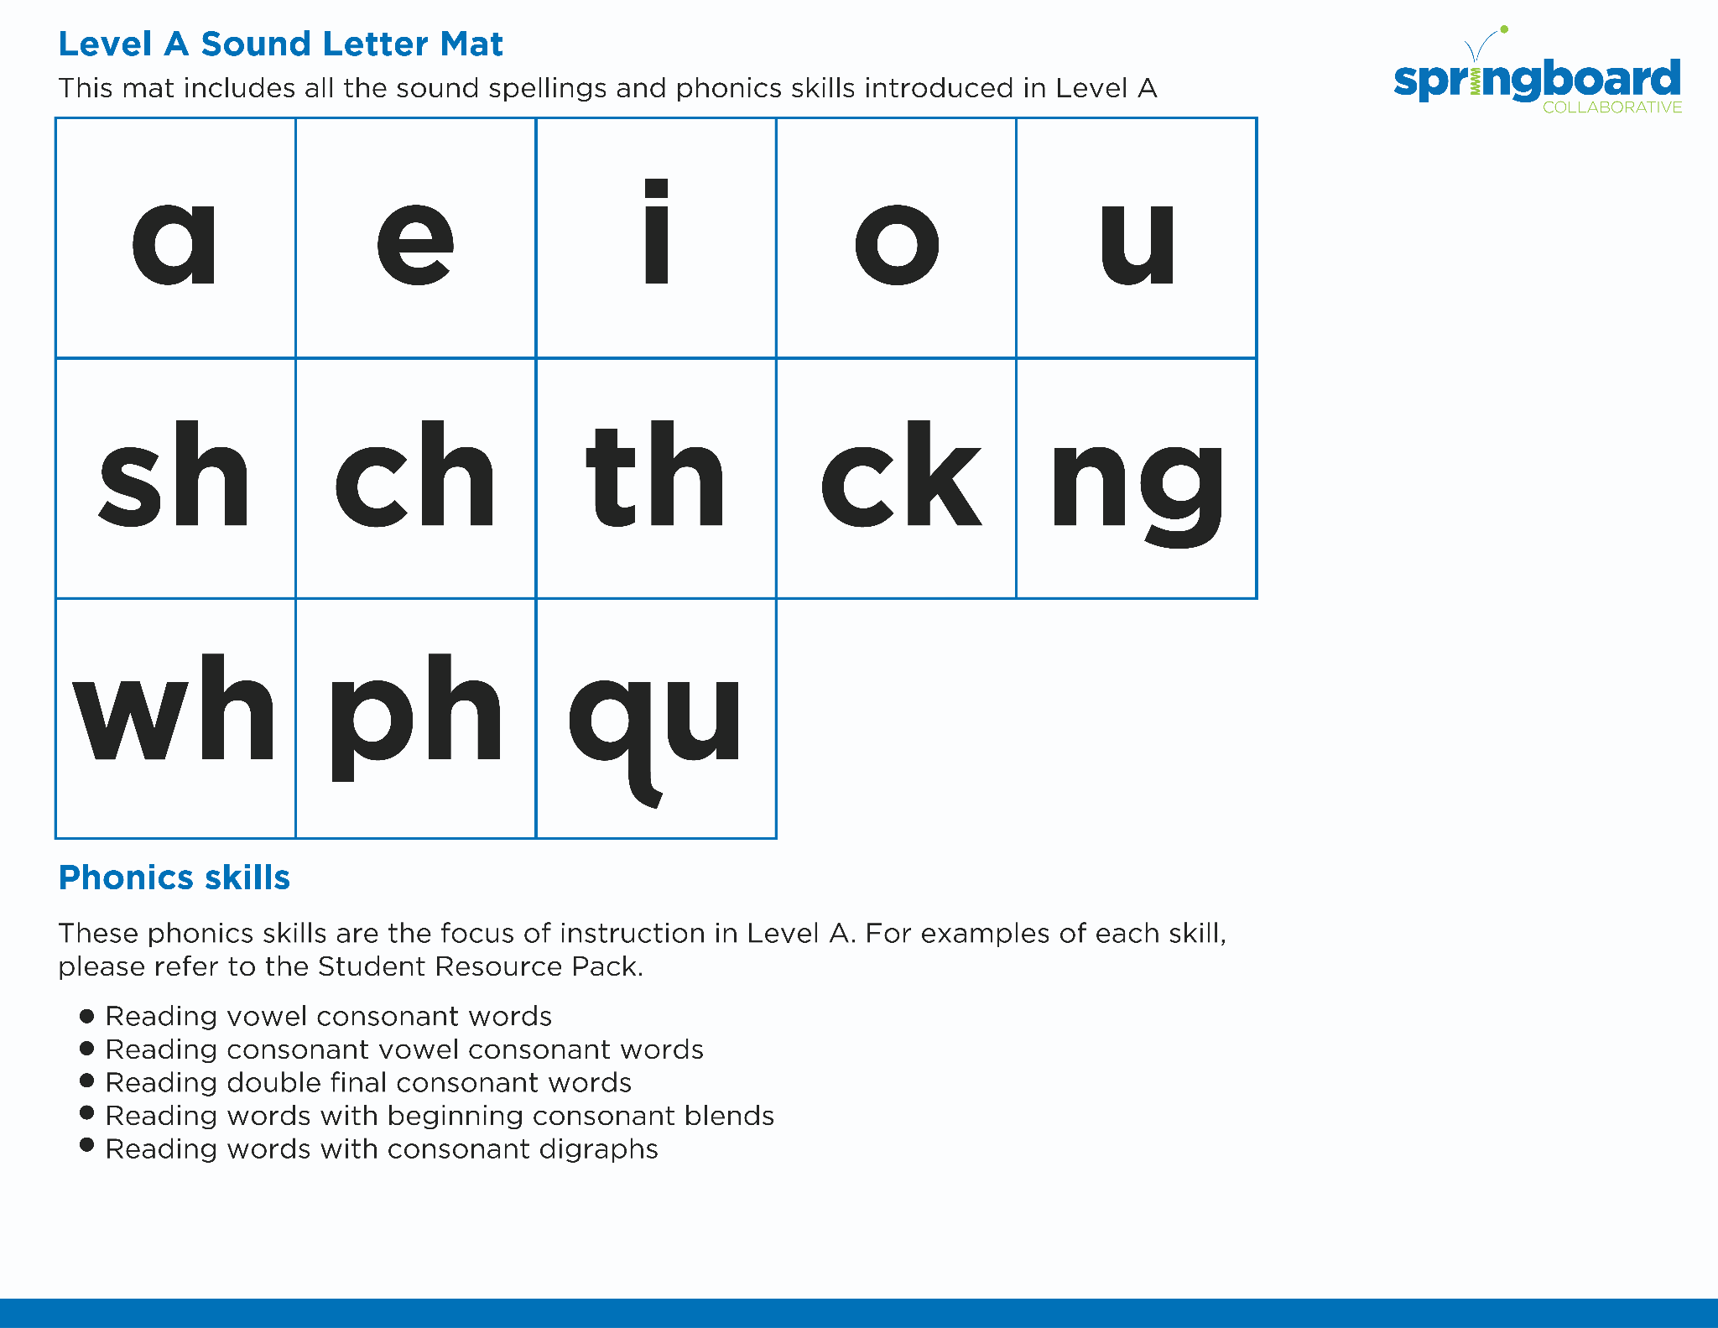
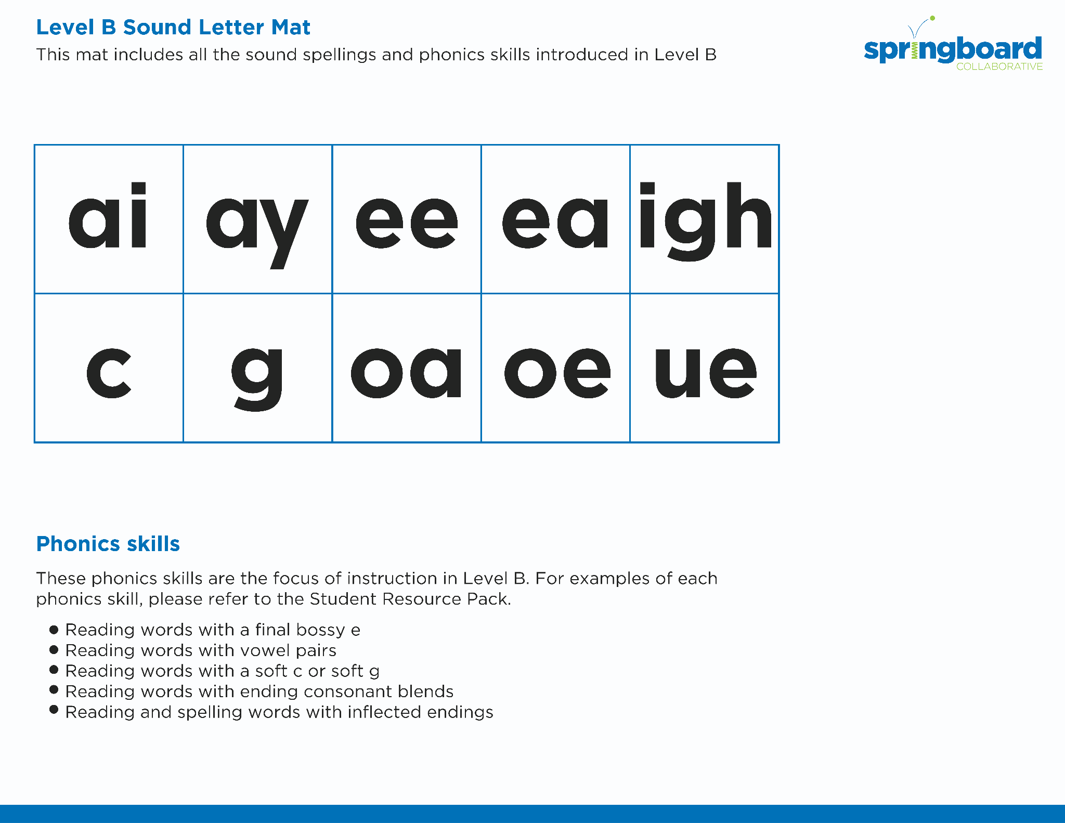
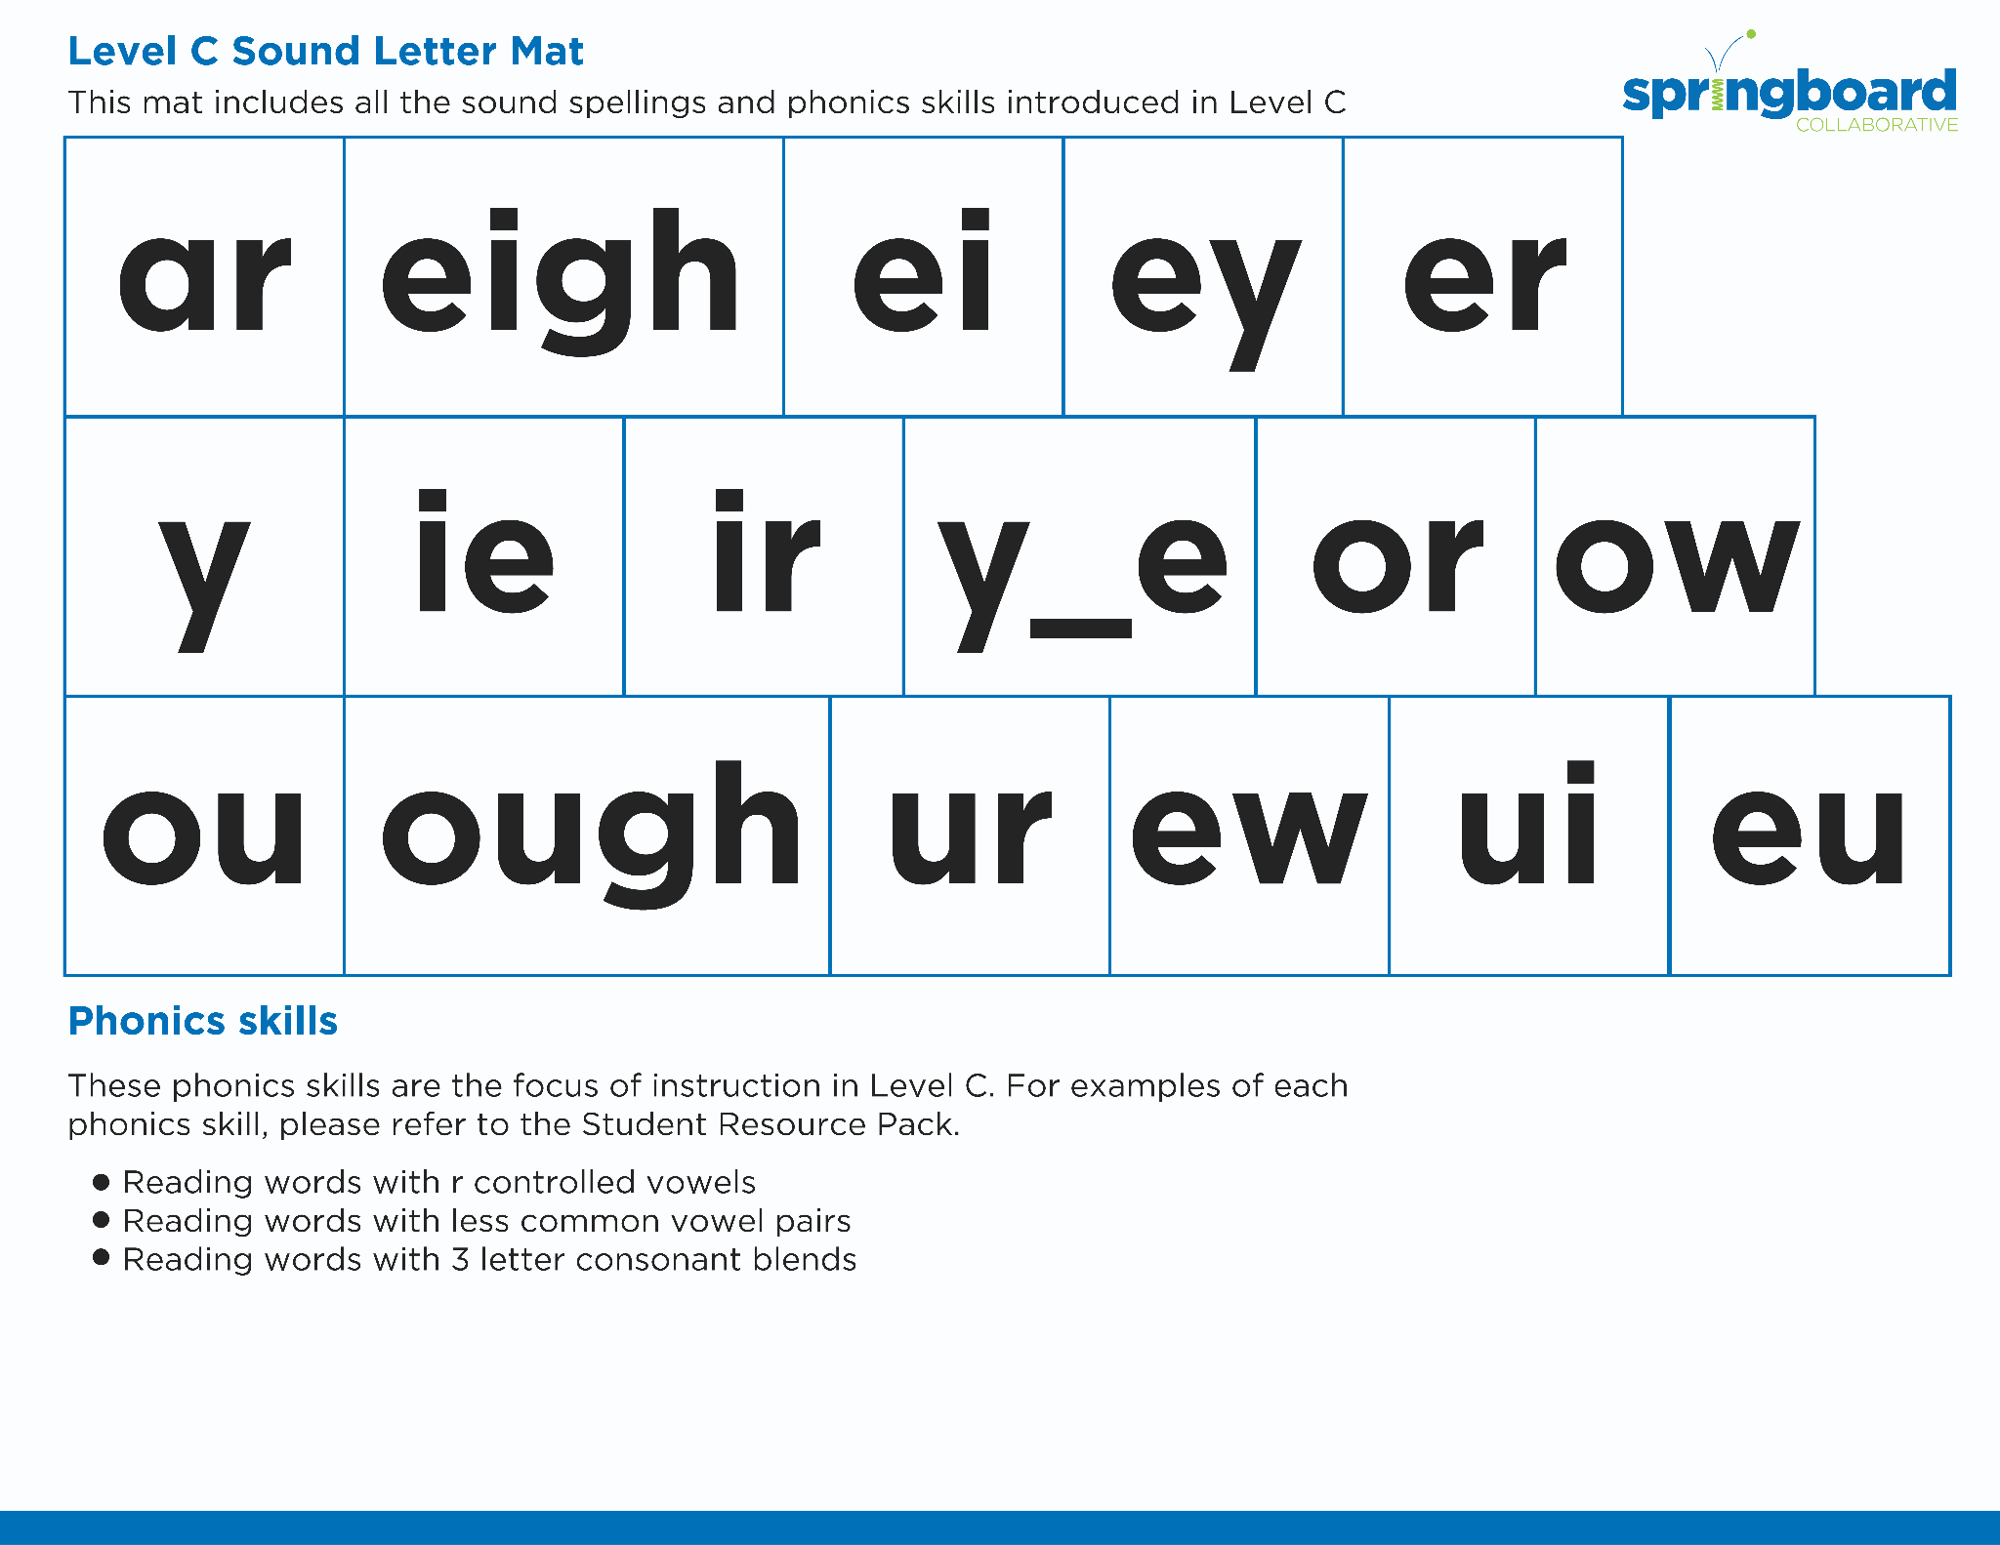
Introduce the Sounds
Notes:
Introduce the Sounds, 5 minutes
See lesson plan for specific instructional guidance.

Slide 4


Blend
the Sounds
search
It’s time to blend the sounds!
It’s time to blend the sounds to help us read the words smoothly!
search
Notes:
Blend the Sounds, 5 minutes
See lesson plan for specific instructional guidance.

Slide 5


Read
the Words
I found a pearl stuck in the earth.
I heard the earl say the search is on!
It’s time to read the words!
It’s time to read the words, so we can read smoothly, like we are speaking!
I want to earn enough money to purchase a pearl.
Notes:
Read the Words, 5 minutes
See lesson plan for specific instructional guidance.

Slide 6


Decode
the Words
  search pearl
  yearn heard
It’s time to decode the sounds in the word!
It’s time to decode the sounds in the words so we can read the words!
Notes:
Decode the Words, 5 minutes
See lesson plan for specific instructional guidance.

Slide 7




Spell
the Words
p
ear
l
It’s time to spell the words!
It’s time to spell the words to show we understand the rule!
Notes:
Spell the Words, 5 minutes
See lesson plan for specific instructional guidance.

Slide 8

High -
Frequency
Words
their
very
We see high-frequency words all the time!
Let’s figure out how to read them!
Notes:
High-Frequency Words, 5 minutes
See lesson plan for specific instructional guidance.

Slide 9

Decodable Text
  Time to read.
  Let’s use our new rule!
Notes:
Decodable Text, 15 minutes
See lesson plan for specific instructional guidance.

Slide 10
What time of year is the strawberry festival?
What happens at the strawberry festival?
What sounds like the best part of the festival to you?
What happens when the weather is bad?
Response to Text
Notes:
Response to Text, 10 minutes
See lesson plan for specific instructional guidance.

