Slide 1


Deletion and Substitution
It’s deletion and substitution time!
We want to change the beginning, middle, and ending sounds!
We want to make a new word!
Notes:
Deletion and Substitution, 5 minutes
See lesson plan for specific instructional guidance.

Slide 2




Introduce the Sounds
  frown
  /f/ /r/ /ow/ /n/
  = frown
It’s time to learn new sounds!
We use the sound rule to help us read!
Notes:
Introduce the Sounds, 5 minutes
See lesson plan for specific instructional guidance.

Slide 3
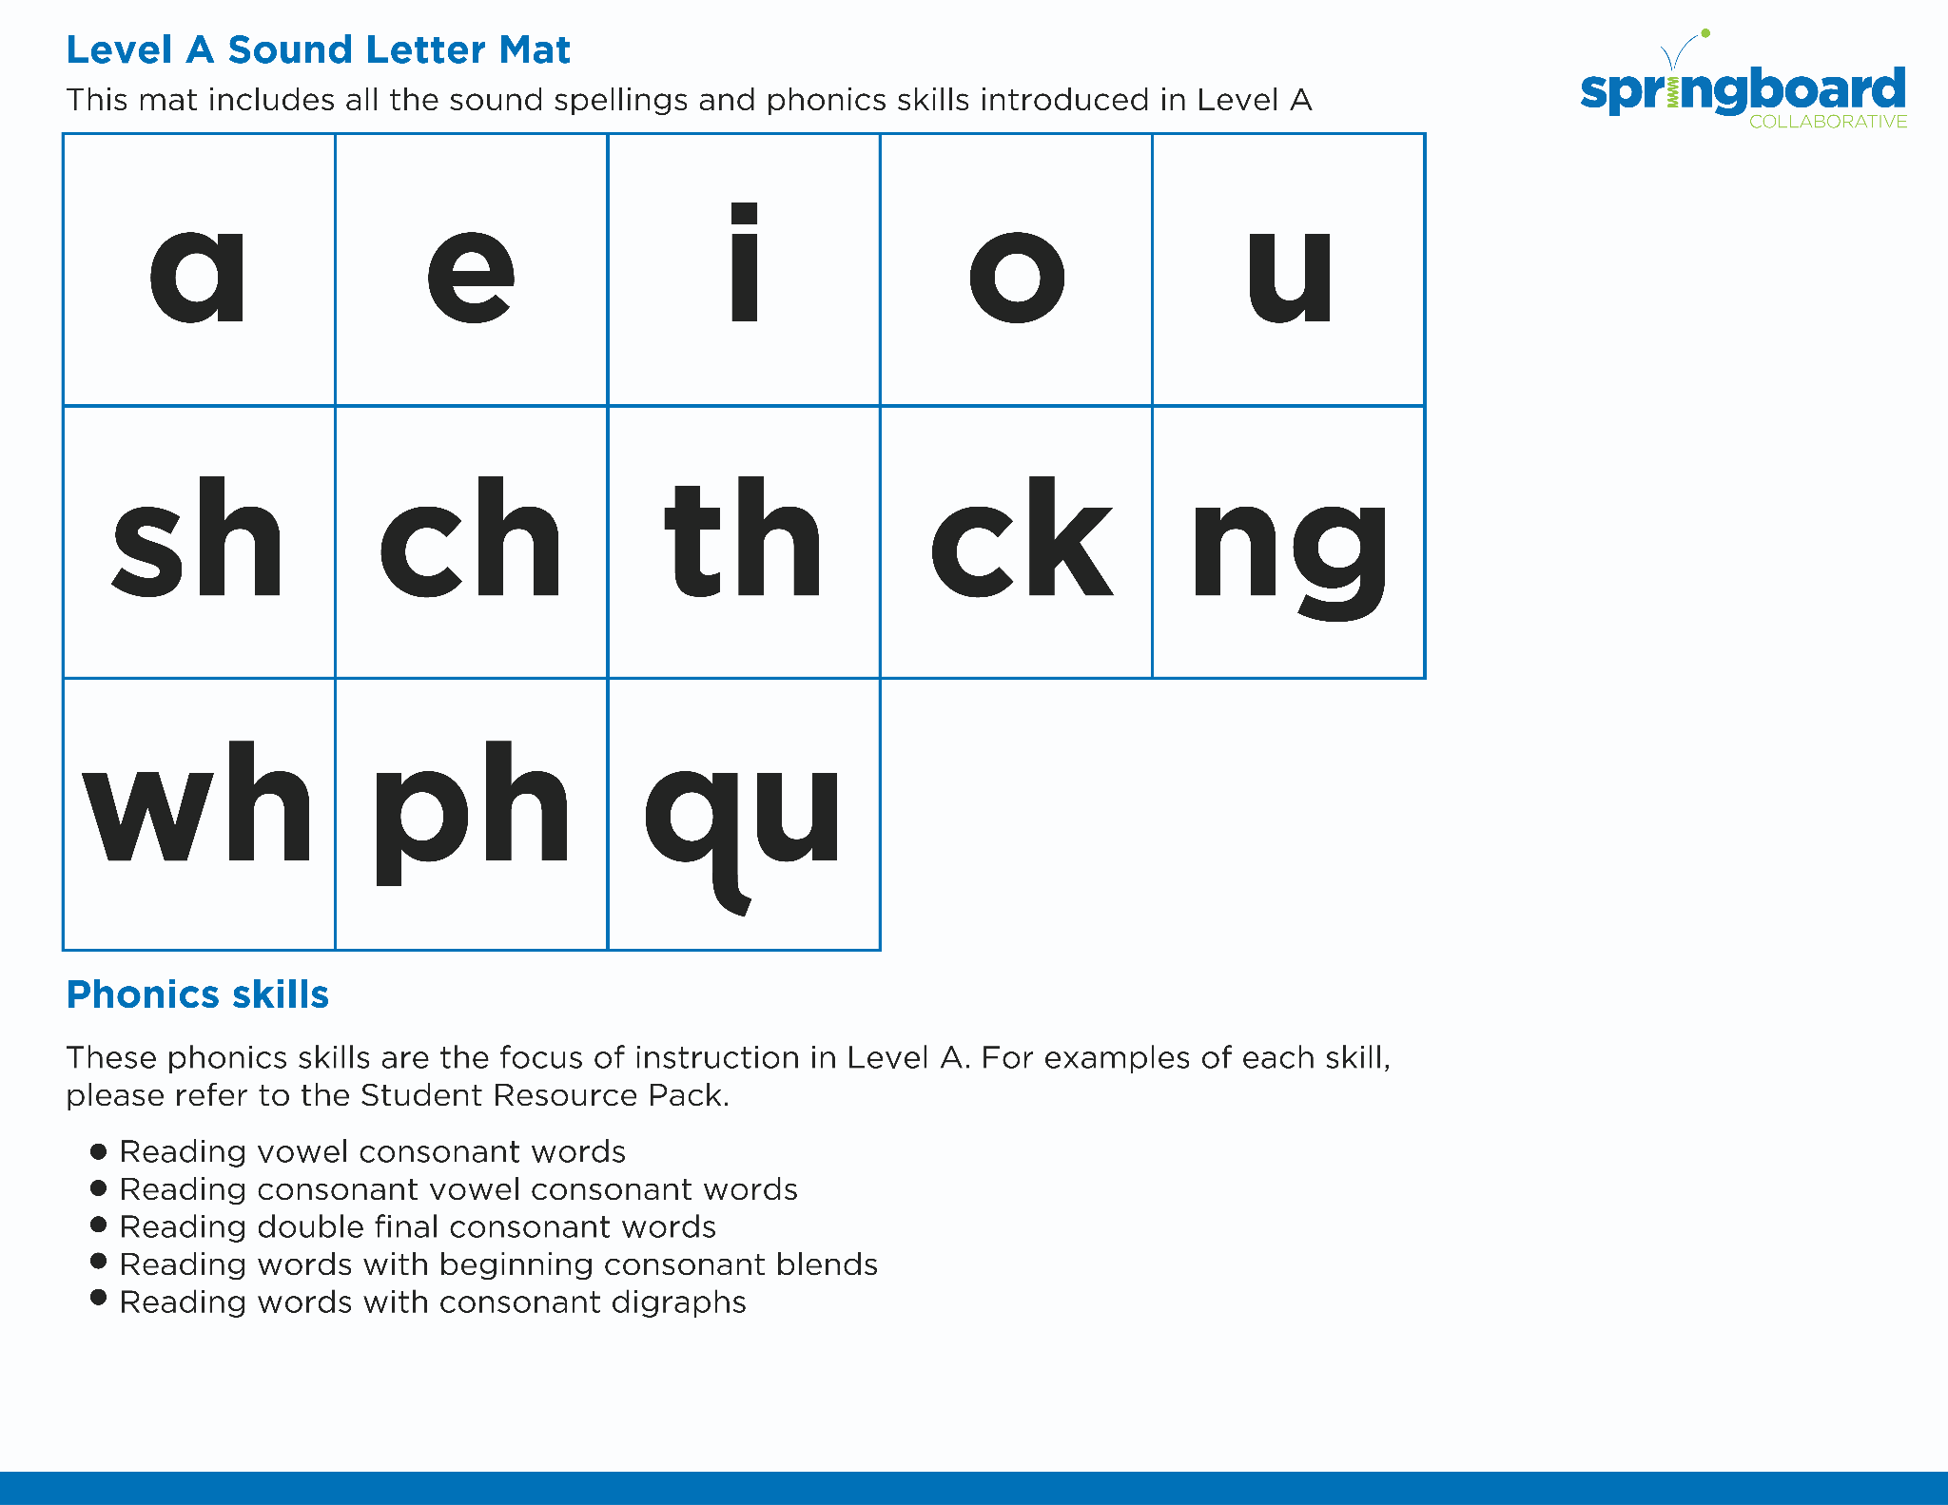
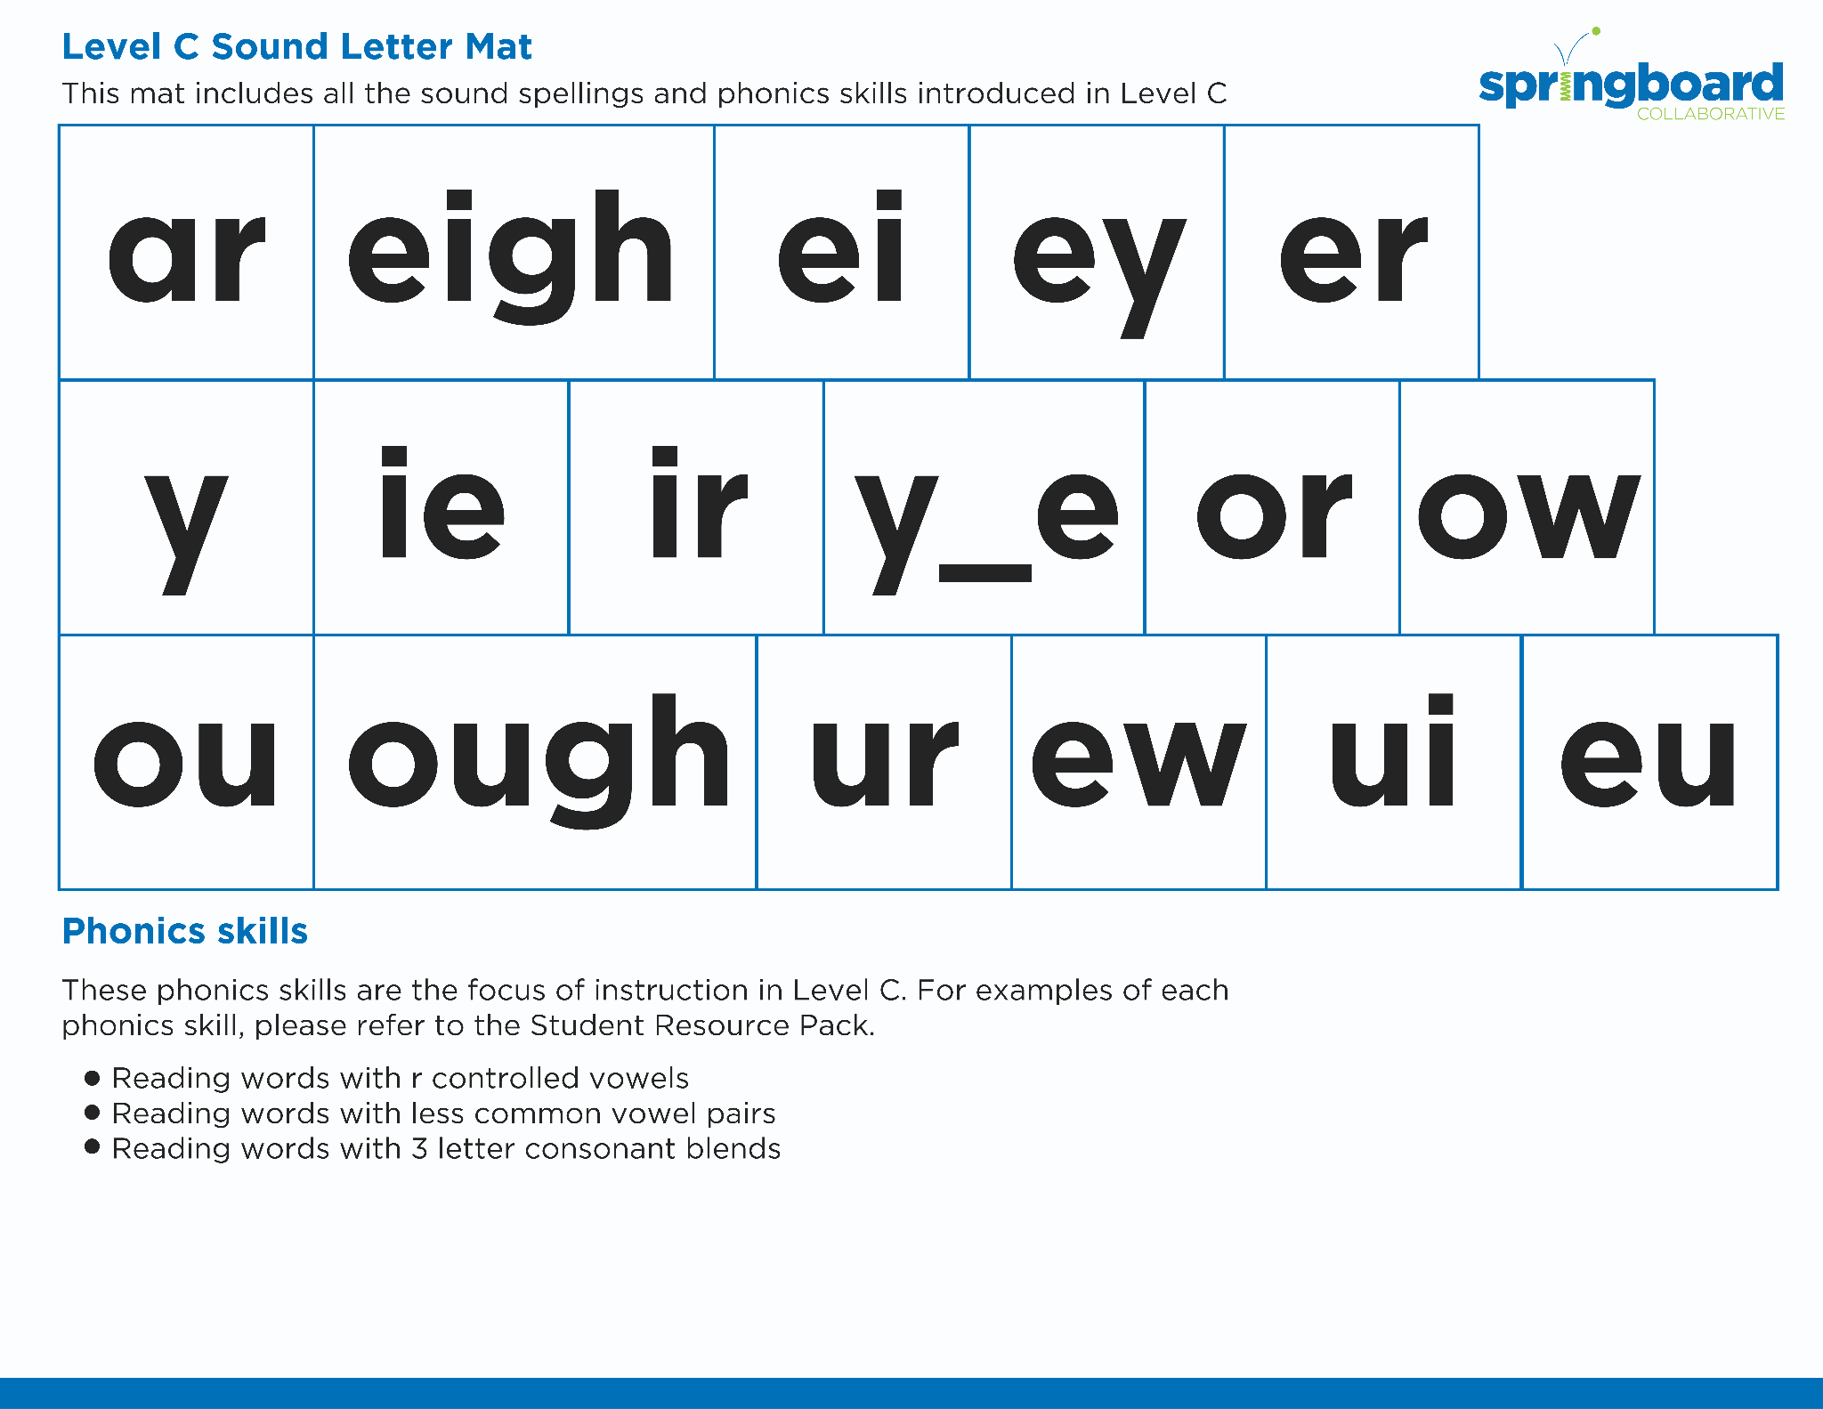
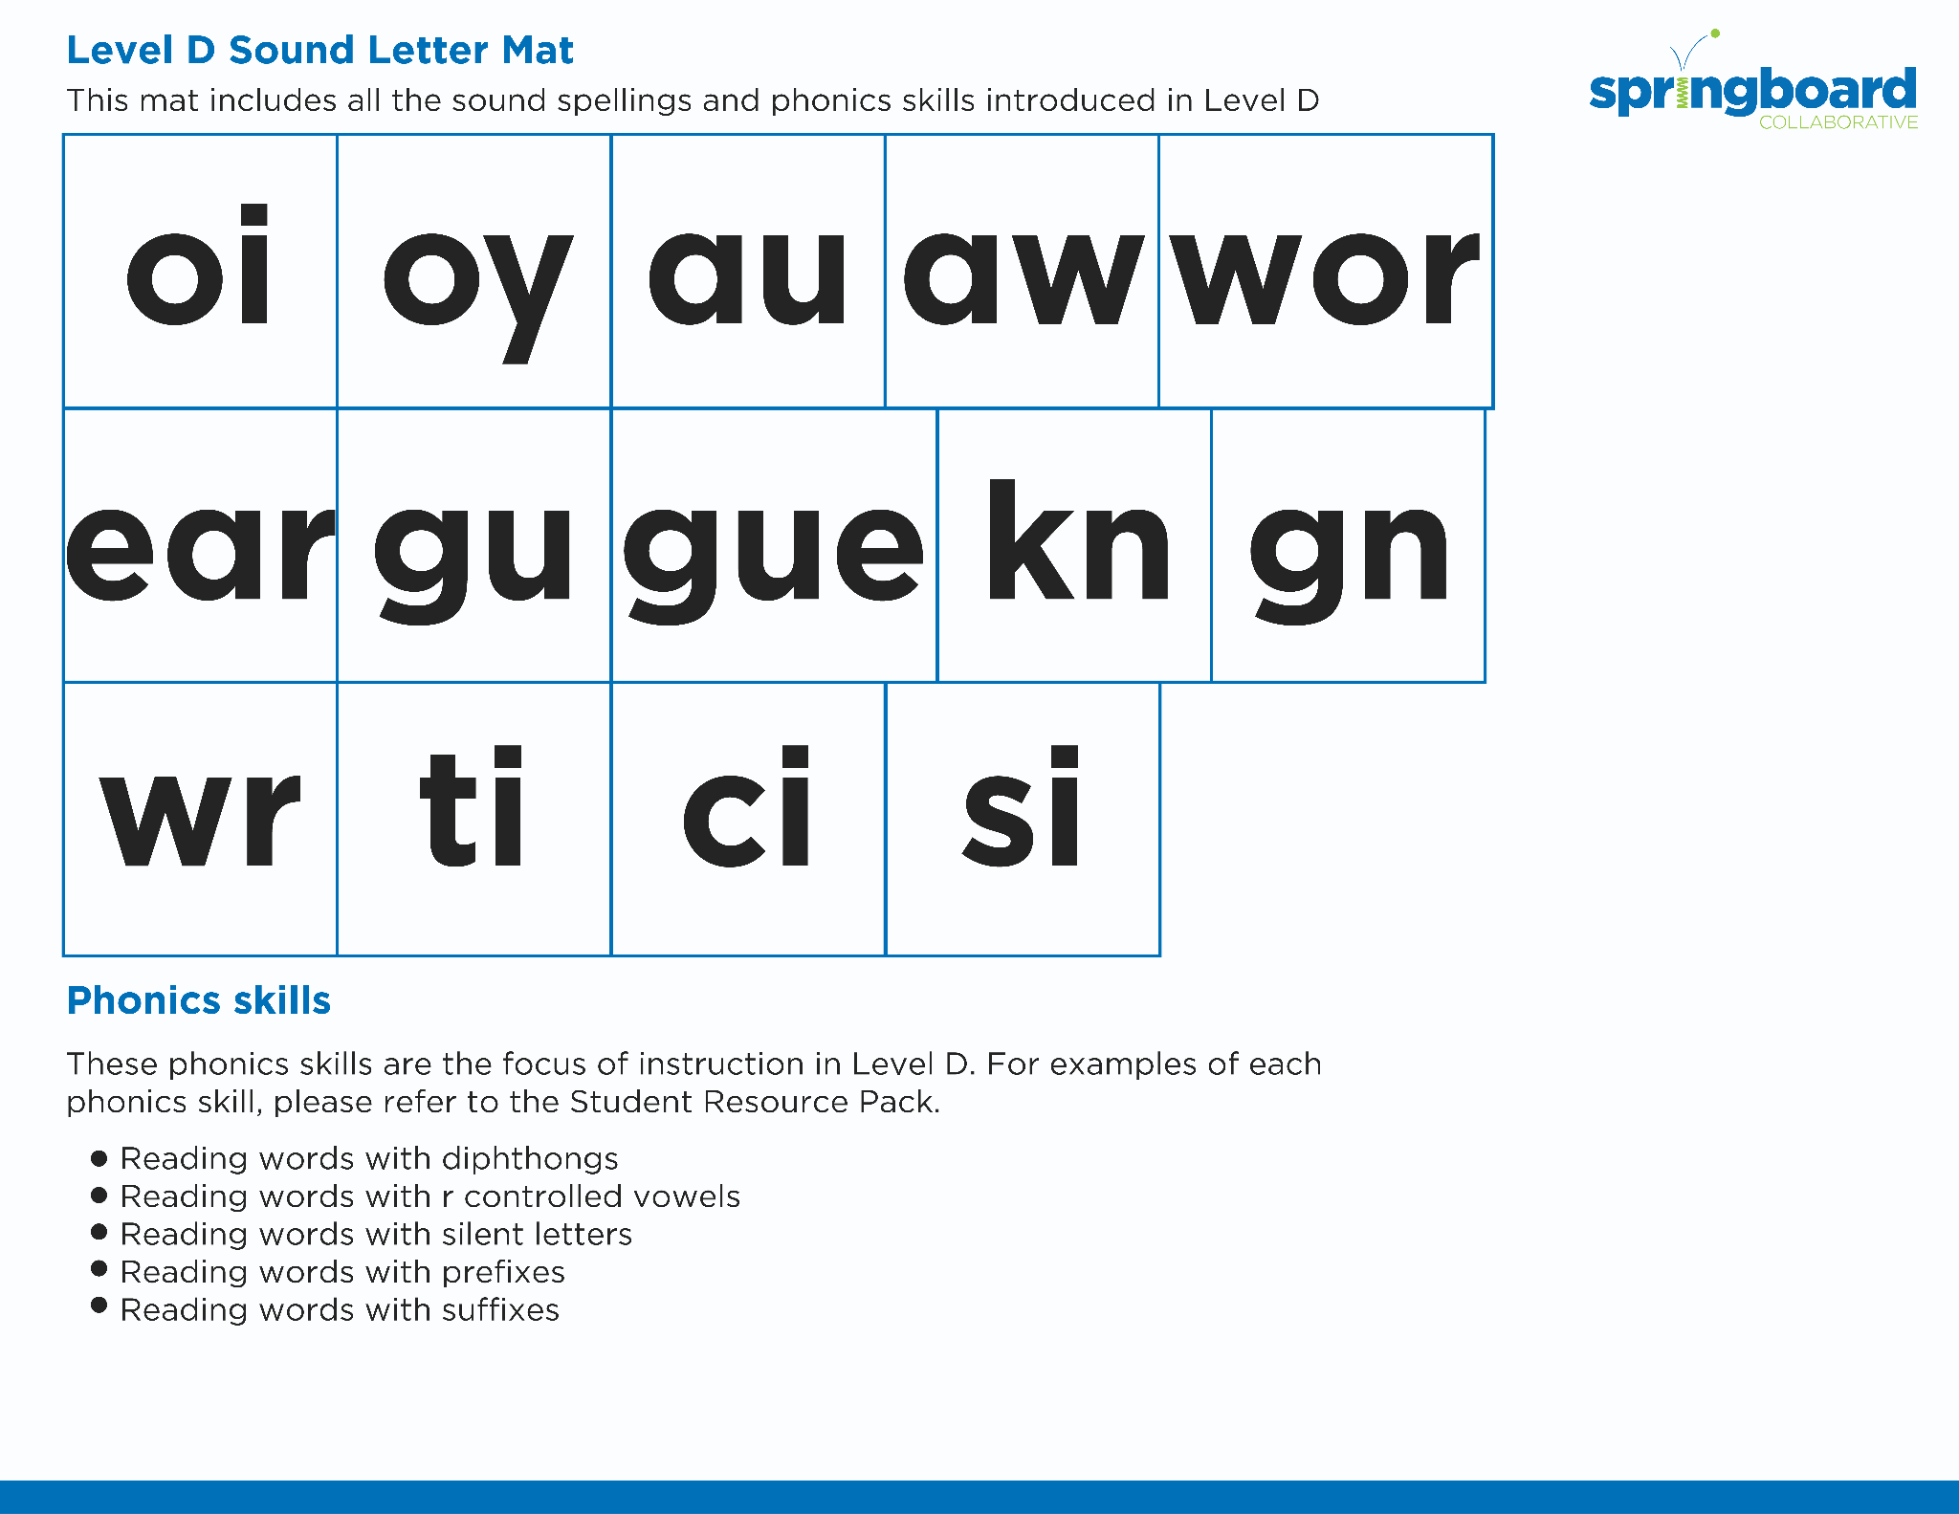
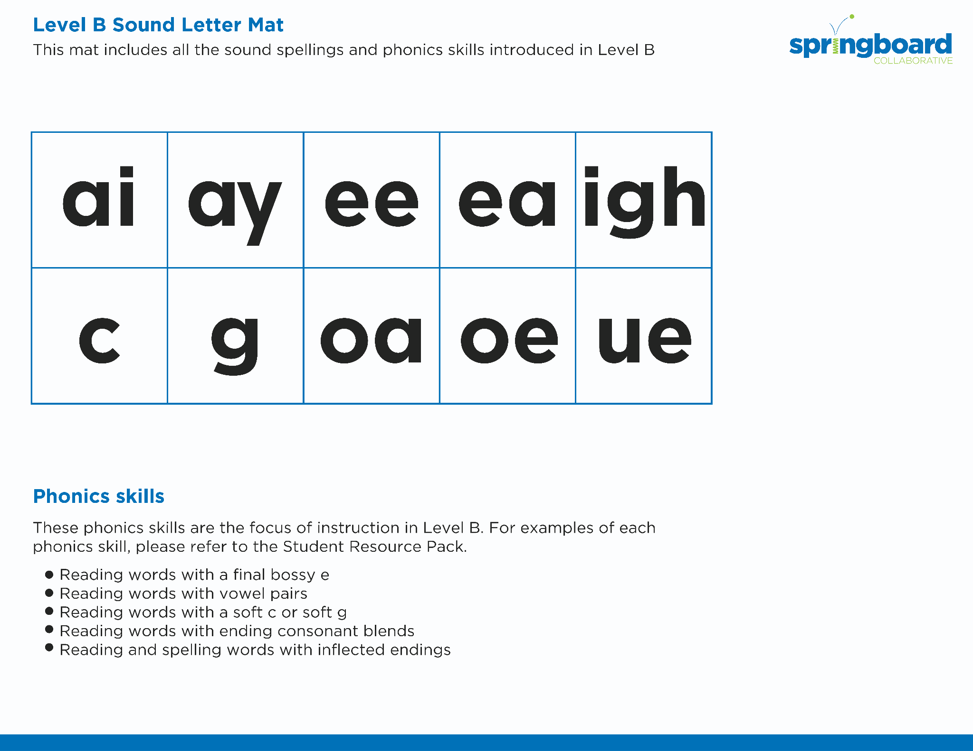
Introduce the Sounds
Notes:
Introduce the Sounds, 5 minutes
See lesson plan for specific instructional guidance.

Slide 4


Blend
the Sounds
frown
It’s time to blend the sounds!
It’s time to blend the sounds to help us read the words smoothly!
frown
Notes:
Blend the Sounds, 5 minutes
See lesson plan for specific instructional guidance.

Slide 5

Blend
the Sounds
crown
crown
Notes:
Blend the Sounds, 5 minutes
See lesson plan for specific instructional guidance.

Slide 6


Read
the Words
Wow! The owl flew downtown.
The clown made the crowd frown.
It’s time to read the words!
It’s time to read the words, so we can read smoothly, like we are speaking!
The cow wore a crown and a gown.
Notes:
Read the Words, 5 minutes
See lesson plan for specific instructional guidance.

Slide 7


Decode
the Words
  drown crowd plow chow vow now how
It’s time to decode the sounds in the words!
It’s time to decode the sounds in the words so we can read the words!
Notes:
Decode the Words, 5 minutes
See lesson plan for specific instructional guidance.

Slide 8





Spell
the Words
c
r
ow
d
It’s time to spell the words!
It’s time to spell the words to show we understand the rule!
Notes:
Spell the Words, 5 minutes
See lesson plan for specific instructional guidance.

Slide 9

High-
Frequency
Words
about
always
We see high-frequency words all the time!
Let’s figure out how to read them!
along
almost
Notes:
High-Frequency Words, 5 minutes
See lesson plan for specific instructional guidance.

Slide 10

Decodable Text
  Time to read.
  Let’s use our new rule!
Notes:
Decodable Text, 15 minutes
See lesson plan for specific instructional guidance.

Slide 11
Response to Text
What does Joey like to do at the farmhouse?
What are some things that Joey did while at his grandmother’s farmhouse?
Notes:
Response to Text, 10 minutes
See lesson plan for specific instructional guidance.

