Slide 1


Deletion and Substitution
It’s deletion and substitution time!
We want to change the beginning, middle, and ending sounds!
We want to make a new word!
Notes:
Deletion and Substitution, 5 minutes
See lesson plan for specific instructional guidance.

Slide 2




Introduce the Sounds
  mount
  /m/ /ow/ /n/ /t/
  = mount
It’s time to learn new sounds!
We use the sound rule to help us read!
Notes:
Introduce the Sounds, 5 minutes
See lesson plan for specific instructional guidance.

Slide 3
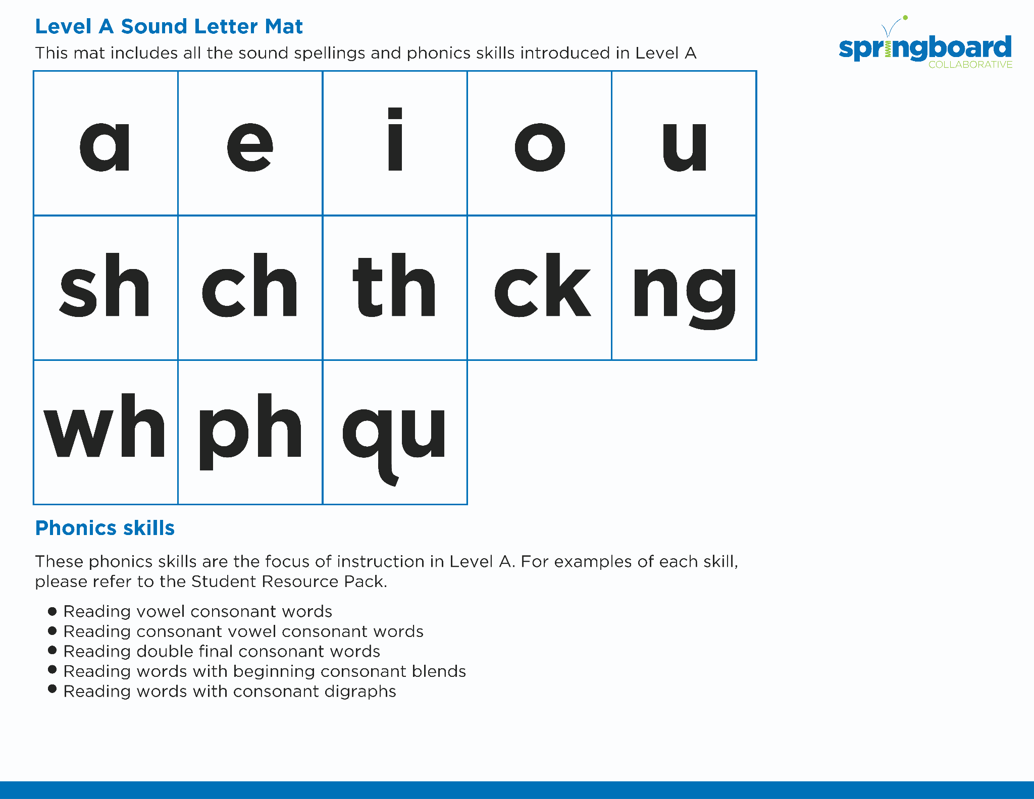
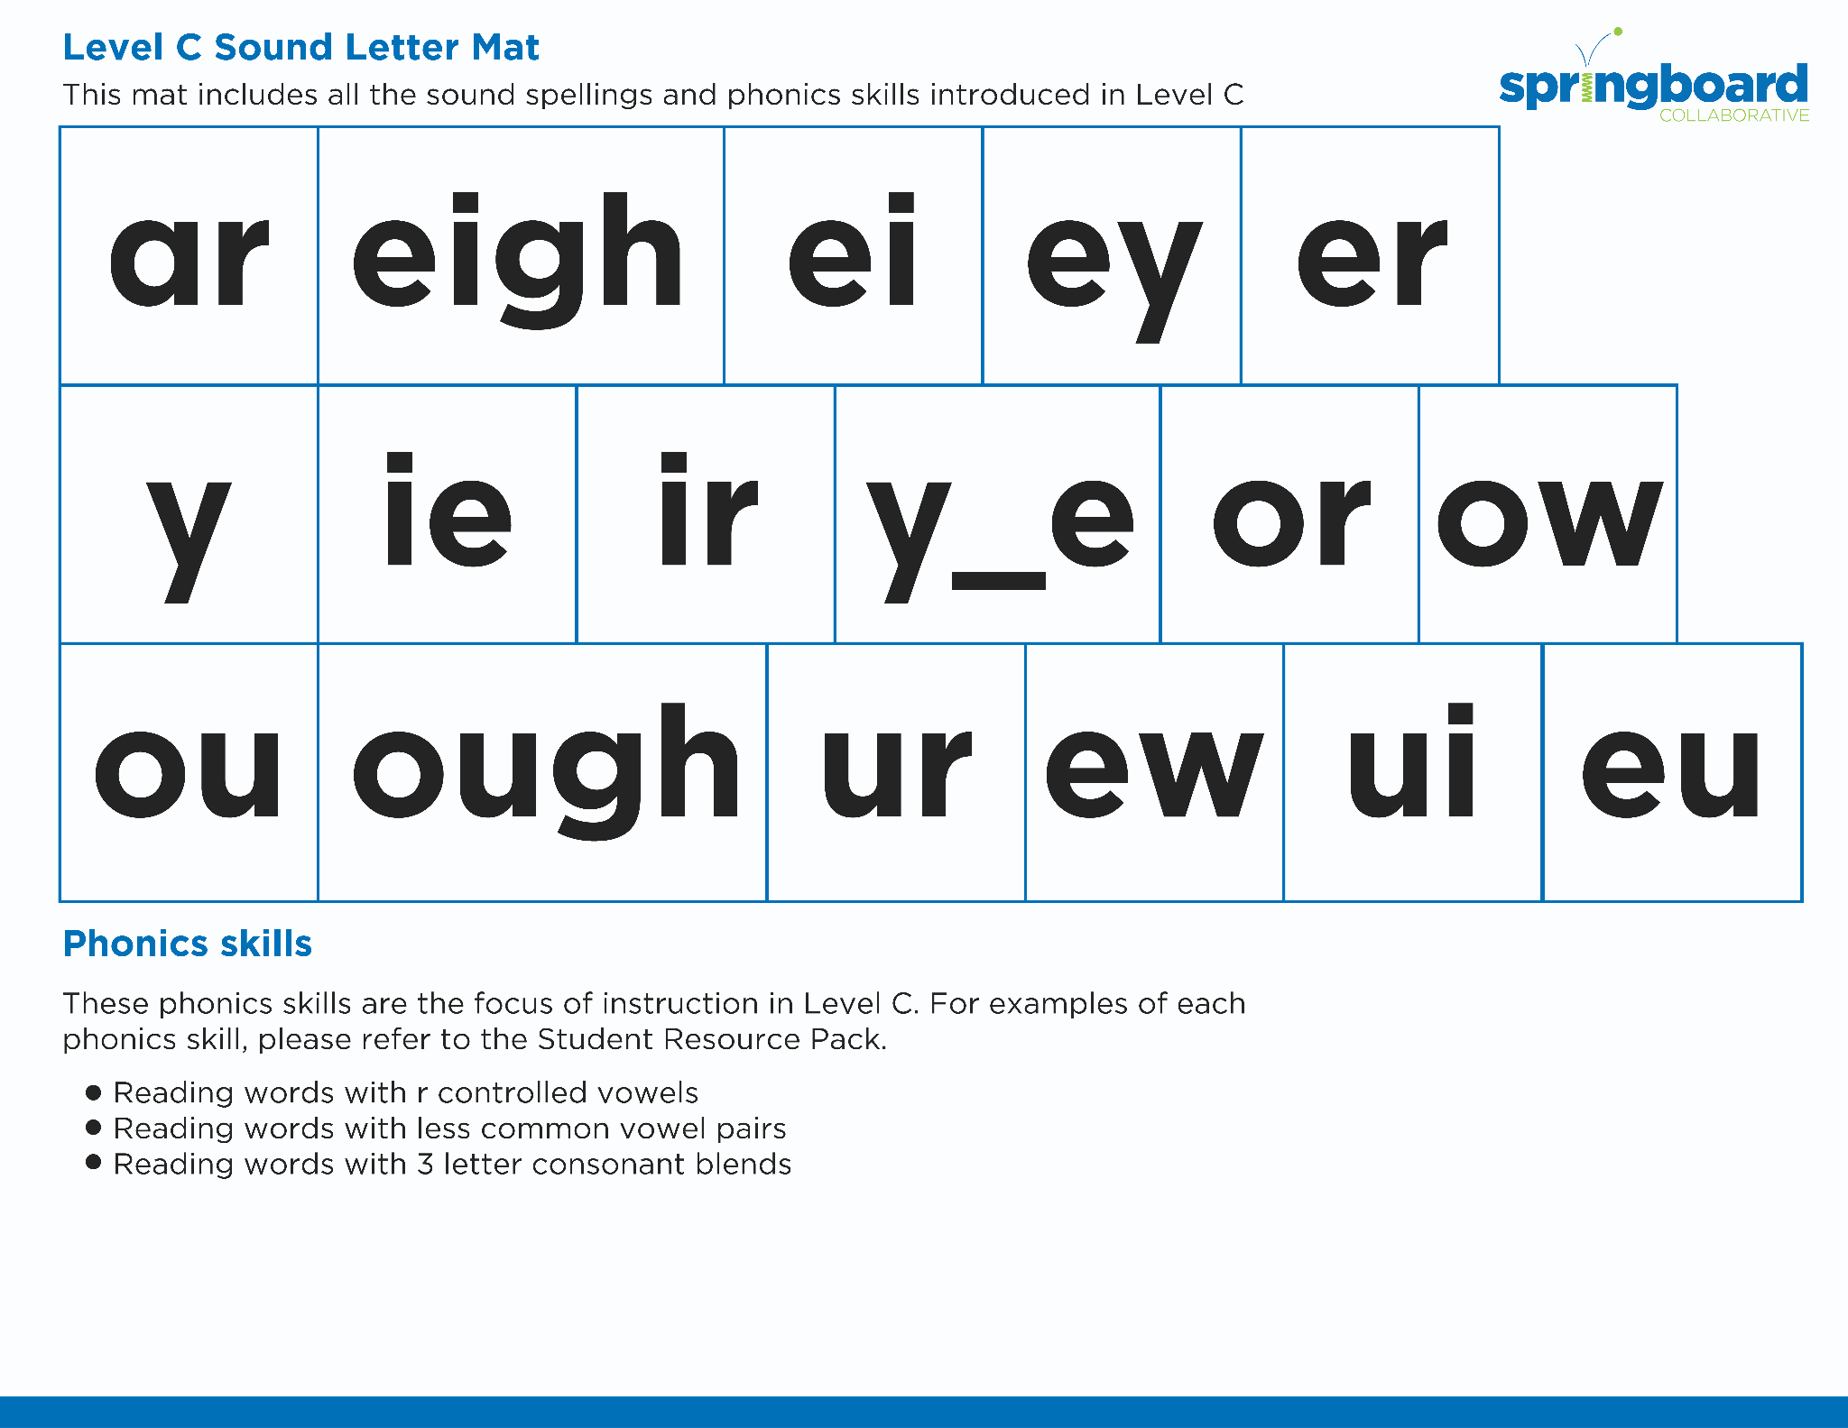
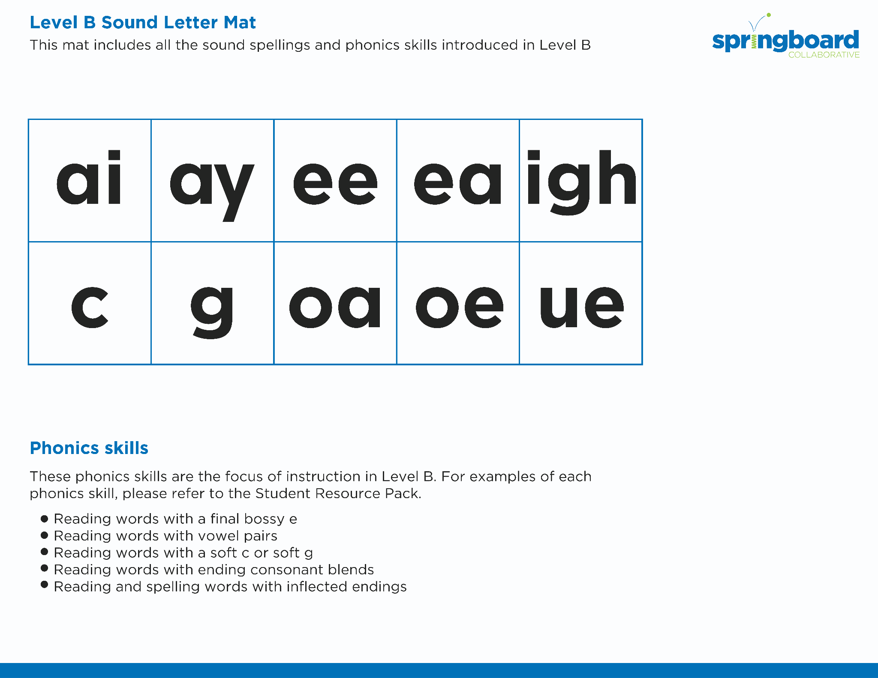

Introduce the Sounds
Notes:
Introduce the Sounds, 5 minutes
See lesson plan for specific instructional guidance.

Slide 4


Blend
the Sounds
mount
It’s time to blend the sounds!
It’s time to blend the sounds to help us read the words smoothly!
mount
Notes:
Blend the Sounds, 5 minutes
See lesson plan for specific instructional guidance.

Slide 5
Blend
the Sounds
proud
proud
Notes:
Blend the Sounds, 5 minutes
See lesson plan for specific instructional guidance.

Slide 6


Read
the Words
The mouse found a treat in our house.
Don’t shout! It is already so loud.
It’s time to read the words!
It’s time to read the words, so we can read smoothly, like we are speaking!
The milk was sour. I spit it out of my mouth.
Notes:
Read the Words, 5 minutes
See lesson plan for specific instructional guidance.

Slide 7


Decode
the Words
  doubt
  ouch cloud
  flour count
  mountain
It’s time to decode the sounds in the words!
It’s time to decode the sounds in the words so we can read the words!
Notes:
Decode the Words, 5 minutes
See lesson plan for specific instructional guidance.

Slide 8





Spell
the Words
b
ou
n
c
e
It’s time to spell the words!
It’s time to spell the words to show we understand the rule!
Notes:
Spell the Words, 5 minutes
See lesson plan for specific instructional guidance.

Slide 9

High-
Frequency
Words
would
We see high-frequency words all the time!
Let’s figure out how to read them!
Notes:
High-Frequency Words, 5 minutes
See lesson plan for specific instructional guidance.

Slide 10

Decodable Text
  Time to read.
  Let’s use our new rule!
Notes:
Decodable Text, 15 minutes
See lesson plan for specific instructional guidance.

Slide 11
Why do you think Joey likes to stay at his grandmother’s farmhouse?
What would you enjoy about staying at the farmhouse?
How do you think Joey feels at the farmhouse and when he is exploring?
Response to Text
Notes:
Response to Text, 10 minutes
See lesson plan for specific instructional guidance.

