Slide 1


Deletion and Substitution
It’s deletion and substitution time!
We want to change the beginning, middle, and ending sounds!
We want to make a new word!
Notes:
Deletion and Substitution, 5 minutes
See lesson plan for specific instructional guidance.

Slide 2




Introduce the Sounds
  choice
  /ch/ /oy/ /s/ = choice
It’s time to learn new sounds!
We use the sound rule to help us read!
Notes:
Introduce the Sounds, 5 minutes
See lesson plan for specific instructional guidance.

Slide 3
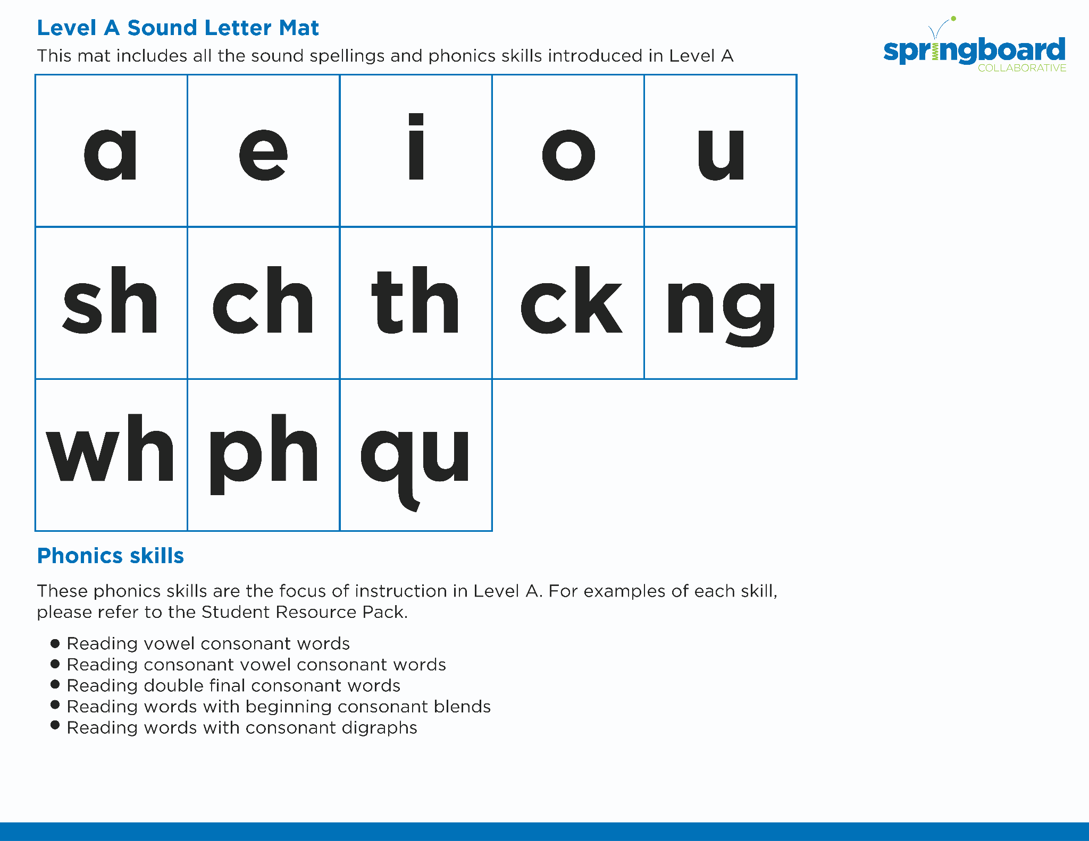

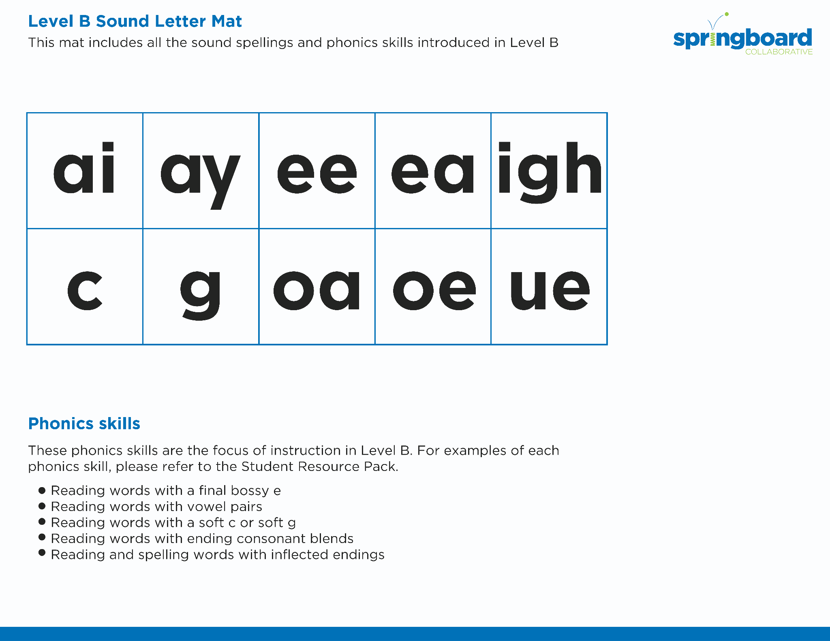
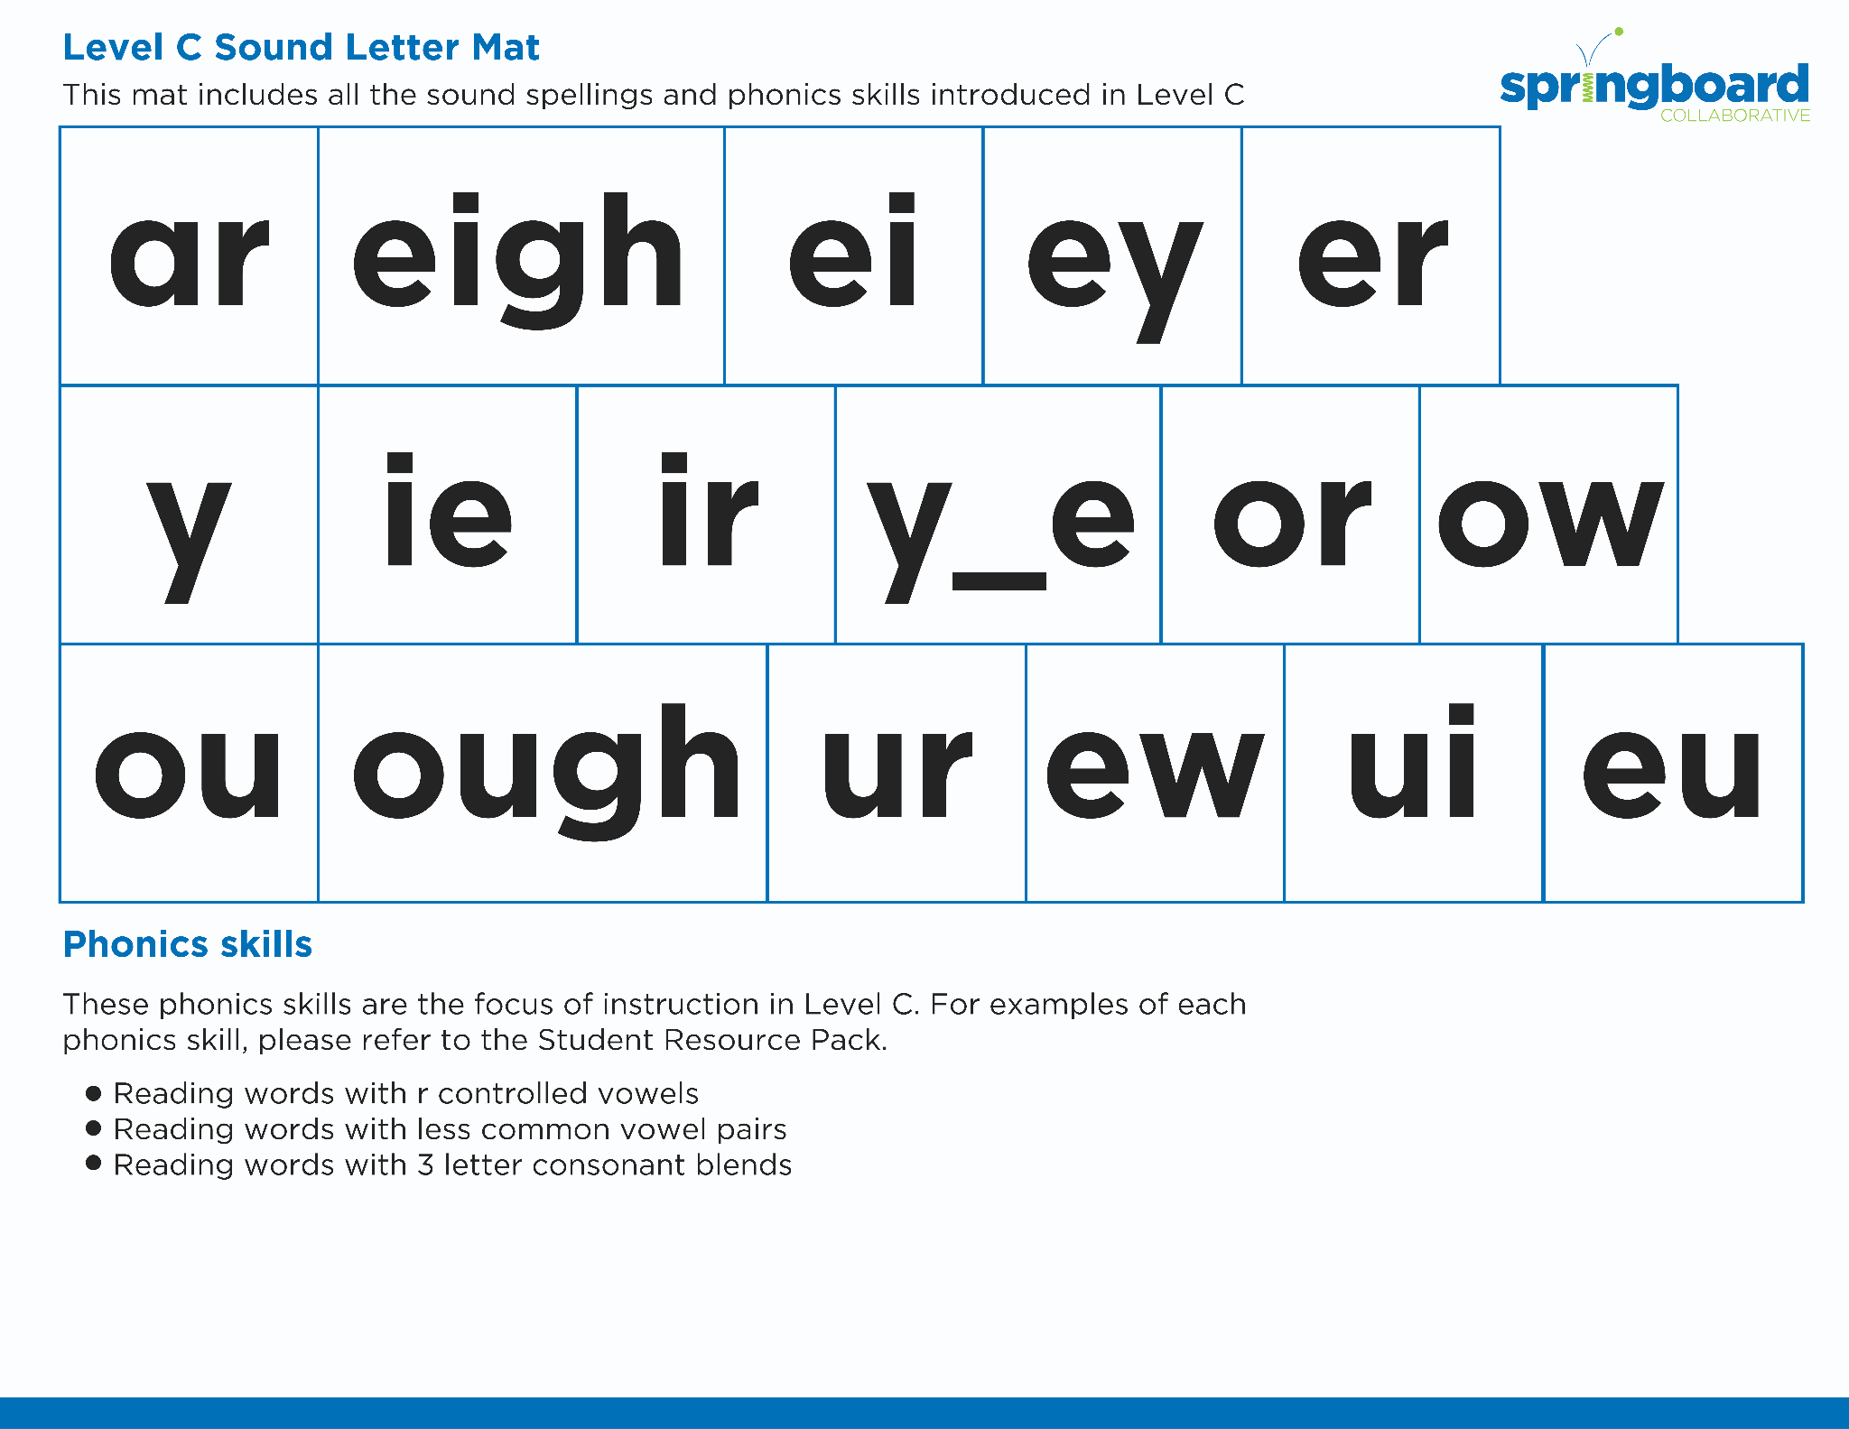
Introduce the Sounds
Notes:
Introduce the Sounds, 5 minutes
See lesson plan for specific instructional guidance.

Slide 4


Blend
the Sounds
choice
turmoil
It’s time to blend the sounds!
It’s time to blend the sounds to help us read the words smoothly!
Notes:
Blend the Sounds, 5 minutes
See lesson plan for specific instructional guidance.

Slide 5


Read
the Words
Please avoid that poor choice.
Hoist the toilet out the door.
It’s time to read the words!
It’s time to read the words, so we can read smoothly, like we are speaking!
Let’s rejoice and join the noisy party.
Notes:
Read the Words, 5 minutes
See lesson plan for specific instructional guidance.

Slide 6


Decode
the Words
  appoint oink
  spoil toilet
  coin avoid
It’s time to decode the sounds in the words!
It’s time to decode the sounds in the words so we can read the words!
Notes:
Decode the Words, 5 minutes
See lesson plan for specific instructional guidance.

Slide 7




Spell
the Words
b
oi
l
It’s time to spell the words!
It’s time to spell the words to show we understand the rule!
Notes:
Spell the Words, 5 minutes
See lesson plan for specific instructional guidance.

Slide 8
Spell
the Words
s
oi
l
Notes:
Spell the Words, 5 minutes
See lesson plan for specific instructional guidance.

Slide 9

Spell
the Words
b
r
oi
l
Notes:
Spell the Words, 5 minutes
See lesson plan for specific instructional guidance.

Slide 10

High-
Frequency
Words
enough
laugh
We see high-frequency words all the time!
Let’s figure out how to read them!
Notes:
High-Frequency Words, 5 minutes
See lesson plan for specific instructional guidance.

Slide 11

Decodable Text
  Time to read.
  Let’s use our new rule!
Notes:
Decodable Text, 15 minutes
See lesson plan for specific instructional guidance.

Slide 12
Response to Text
What choice did Boyd and James have to make?
What caused the crash?
Notes:
Response to Text, 10 minutes
See lesson plan for specific instructional guidance.

