Slide 1


Deletion and Substitution
It’s deletion and substitution time!
We want to change the beginning, middle, and ending sounds!
We want to make a new word!
Notes:
Deletion and Substitution, 5 minutes
See lesson plan for specific instructional guidance.

Slide 2








Introduce the Sounds
It’s time to learn new sounds!
We use the sound rule to help us read!
Notes:
Introduce the Sounds, 5 minutes
See lesson plan for specific instructional guidance.

Slide 3
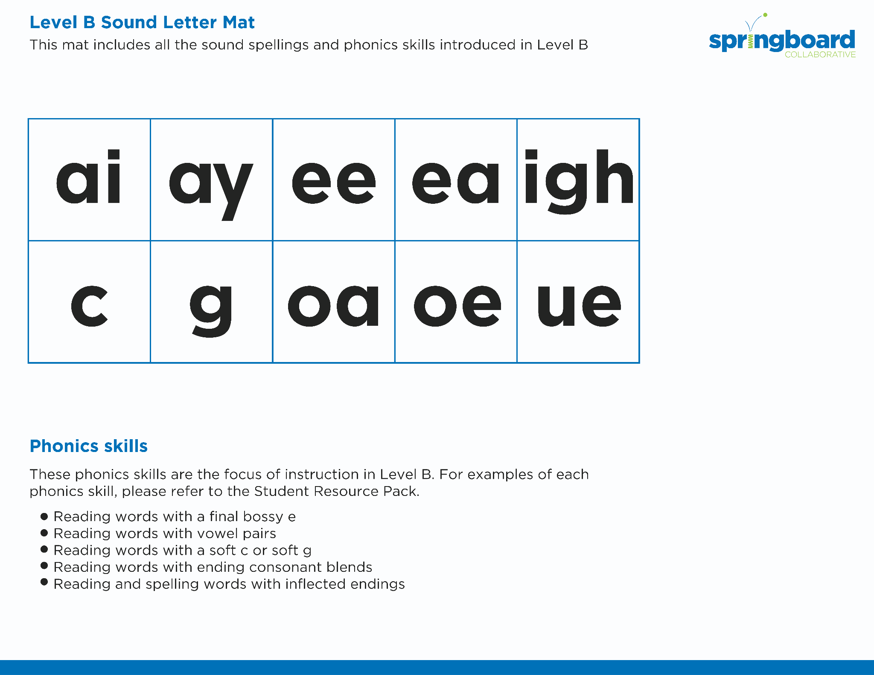
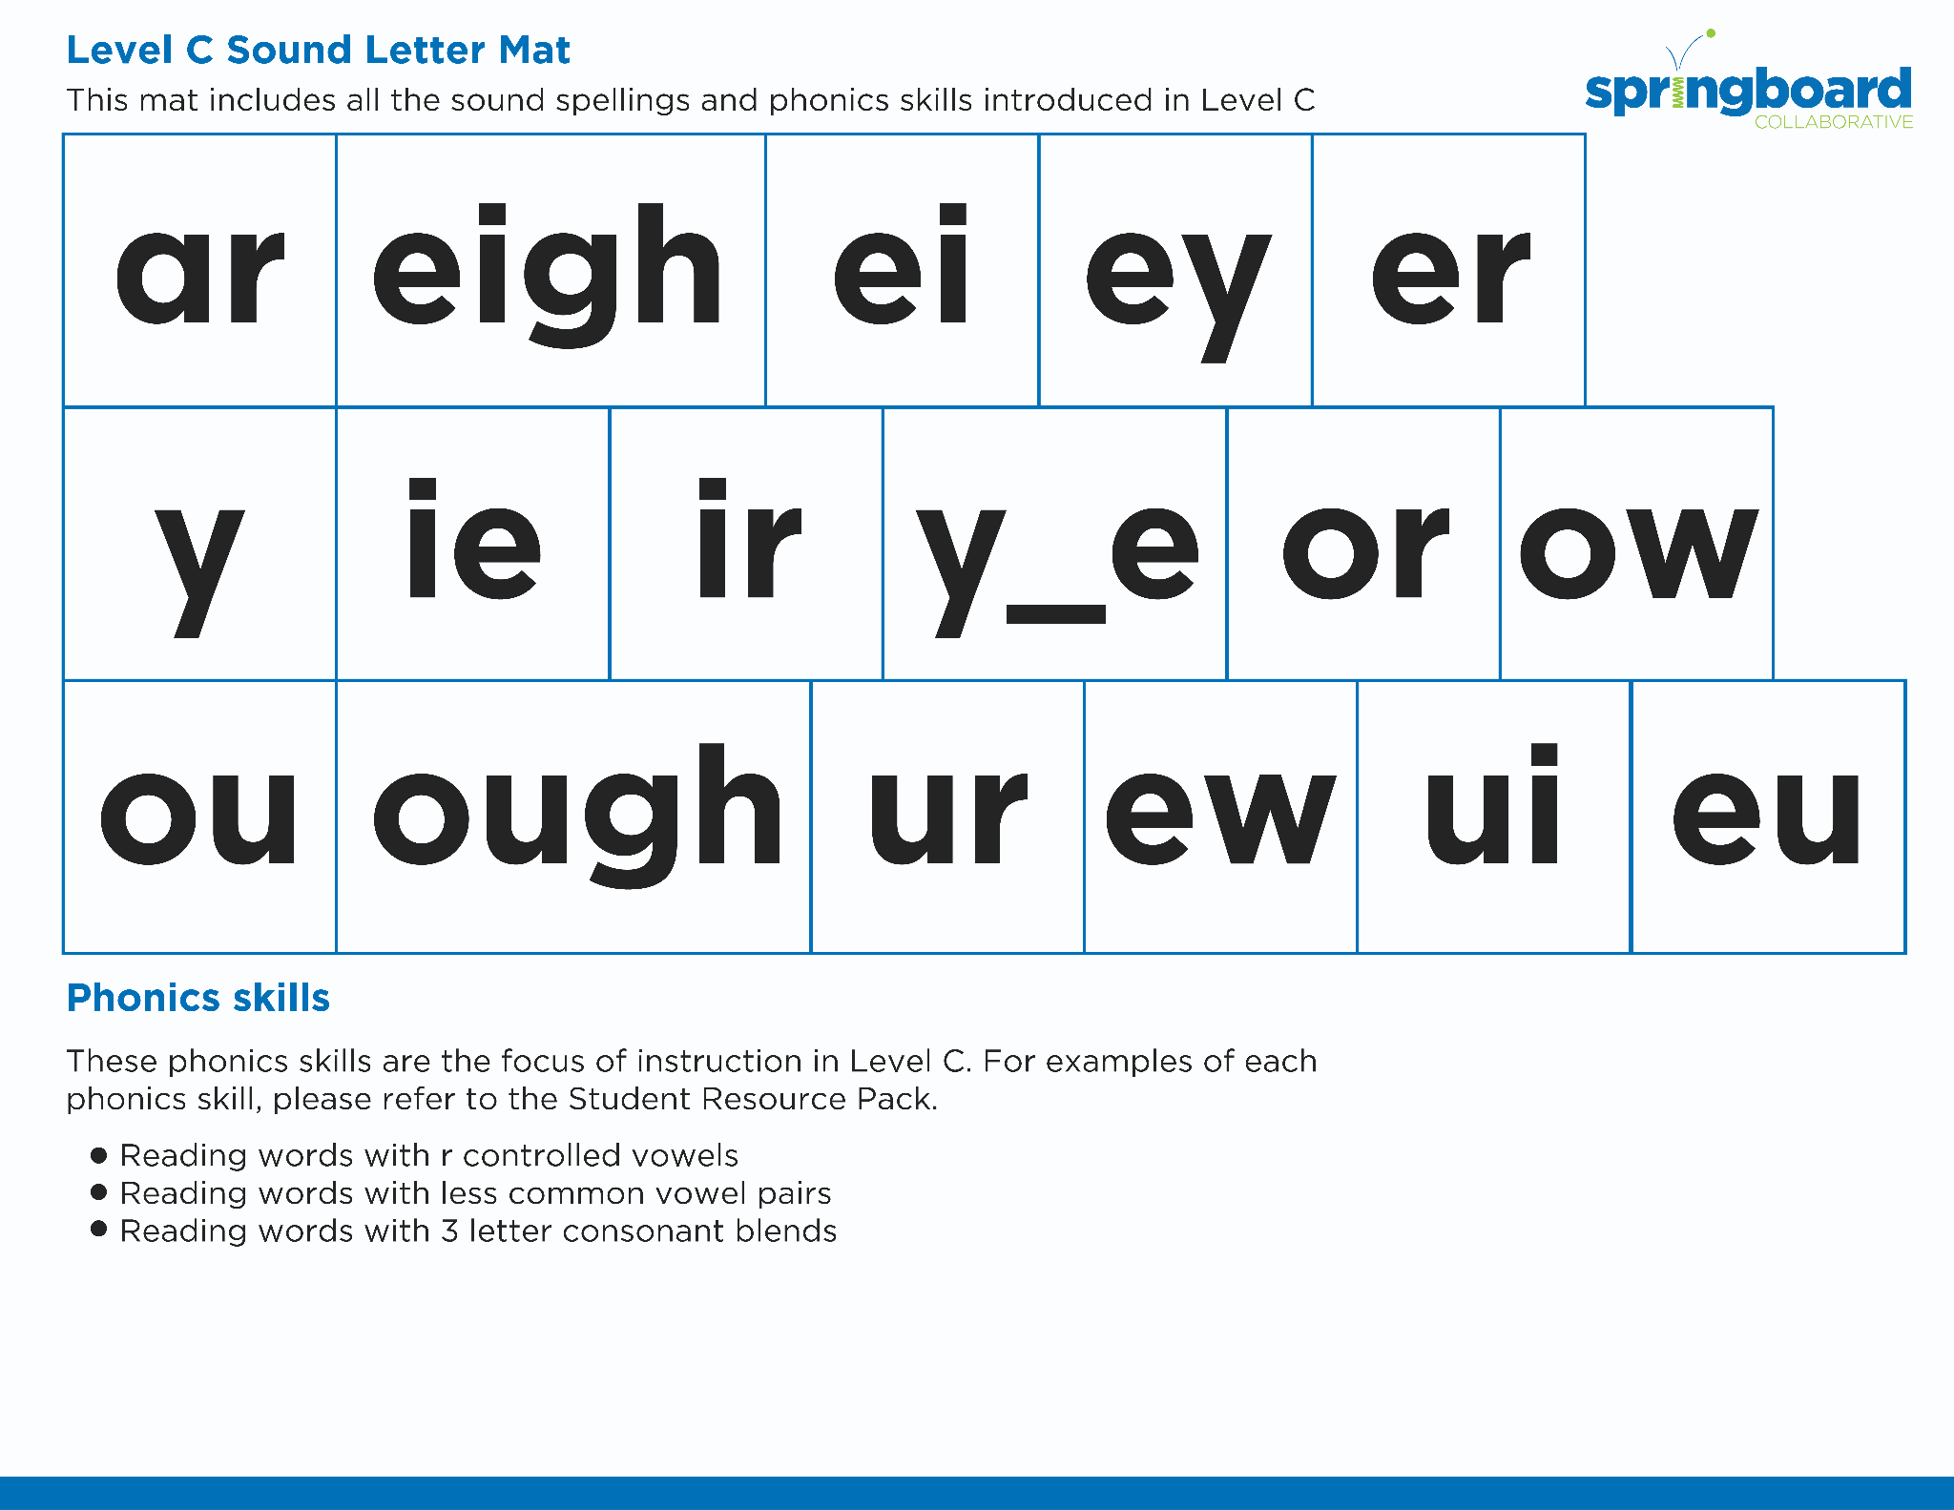
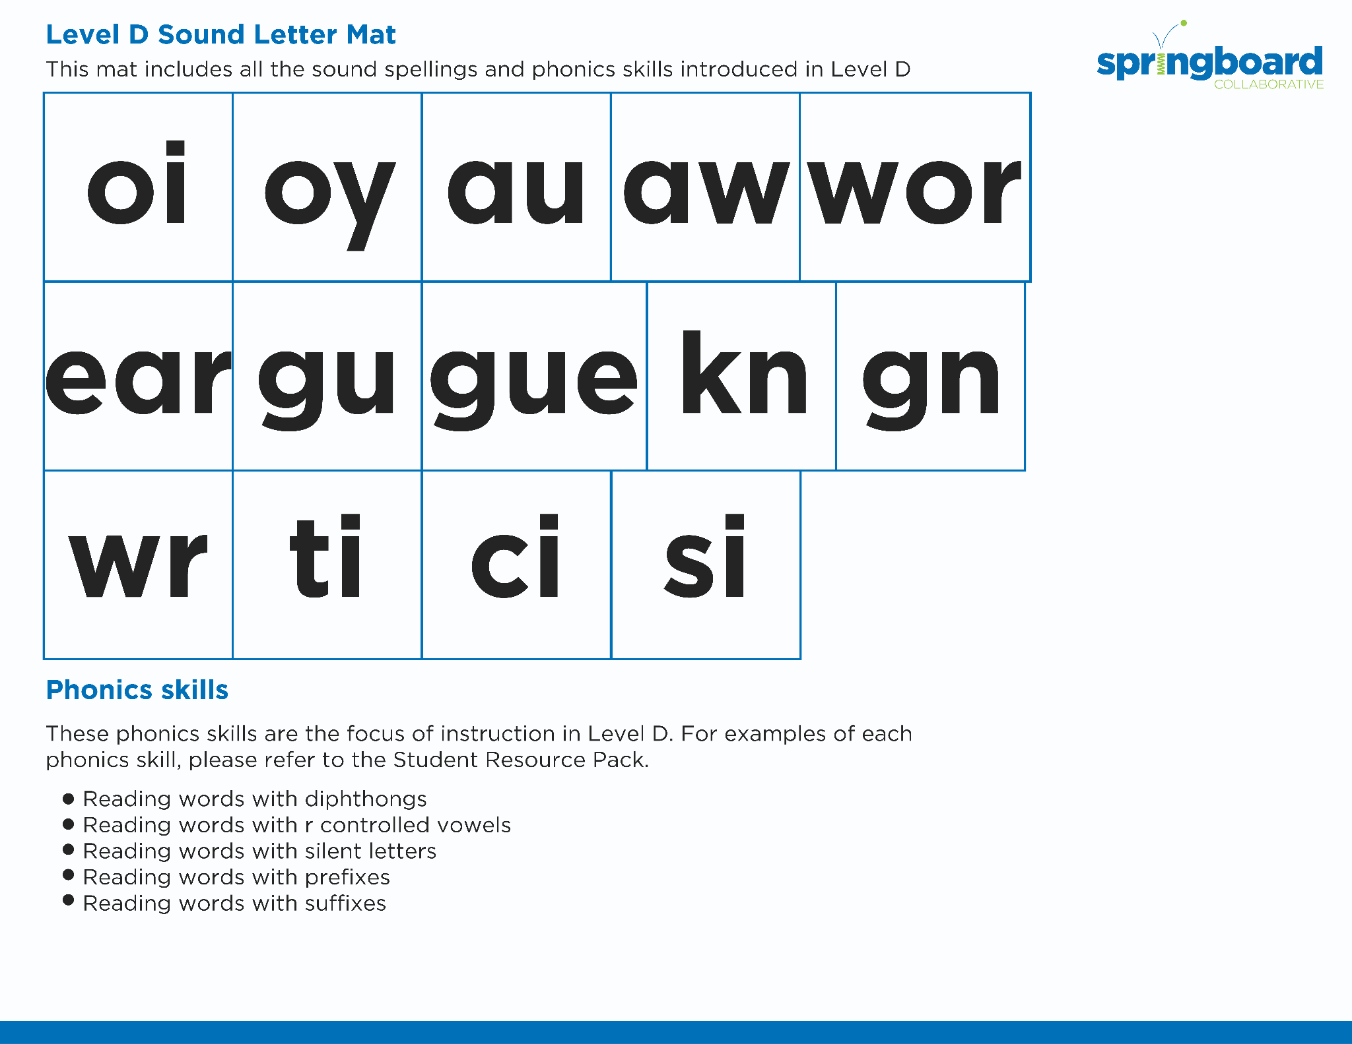
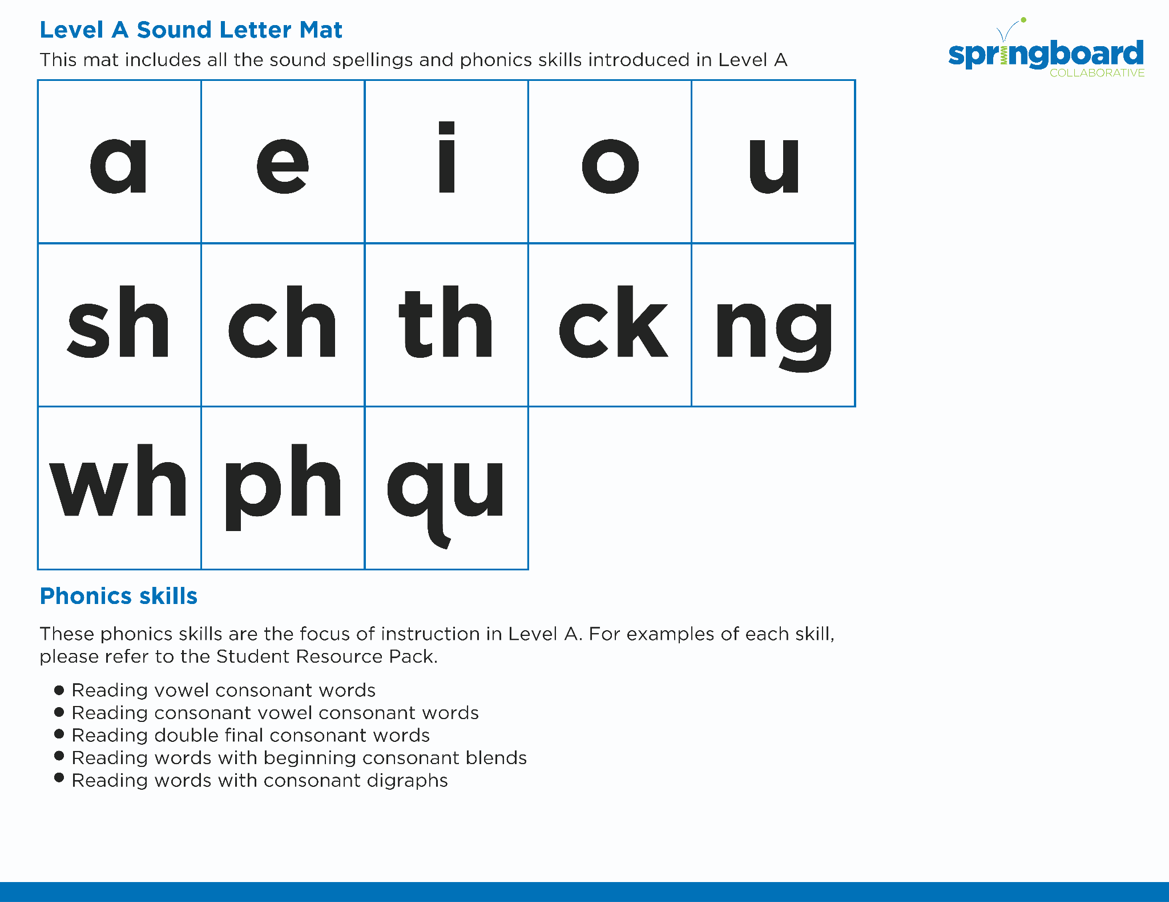
Introduce the Sounds
Notes:
Introduce the Sounds, 5 minutes
See lesson plan for specific instructional guidance.

Slide 4


Blend
the Sounds
avoid
It’s time to blend the sounds!
It’s time to blend the sounds to help us read the words smoothly!
avoid
Notes:
Blend the Sounds, 5 minutes
See lesson plan for specific instructional guidance.

Slide 5
Blend
the Sounds
destroy
destroy
Notes:
Blend the Sounds, 5 minutes
See lesson plan for specific instructional guidance.

Slide 6


Read
the Words
Parade
It’s time to enjoy the noises and sounds of the parade. The acts deploy with applause from the crowd. They rejoice as they move downtown. The floats launch and avoid the owl and hawk. The clowns use caution as they employ loud stunts. Wow! What a show!
It’s time to read the words!
It’s time to read the words, so we can read smoothly, like we are speaking!
Notes:
Read the Words, 5 minutes
See lesson plan for specific instructional guidance.

Slide 7


Decode
the Words
  noise
  annoy audit
  haul brawl clown ouch
It’s time to decode the sounds in the words!
It’s time to decode the sounds in the words so we can read the words!
Notes:
Decode the Words, 5 minutes
See lesson plan for specific instructional guidance.

Slide 8


Formative Assessment
Notes:
Level D Unit 1 Formative Assessment, 15 minutes
See lesson plan for specific instructional guidance. Follow the directions to administer the Formative Assessment for Level D, Unit 1.

