Slide 1


Deletion and Substitution
It’s deletion and substitution time!
We want to change the beginning, middle, and ending sounds!
We want to make a new word!
Notes:
Deletion and Substitution, 5 minutes
See lesson plan for specific instructional guidance.

Slide 2




Introduce the Sounds
  yawn
  /y/ /aw/ /n/
  = yawn
It’s time to learn new sounds!
We use the sound rule to help us read!
Notes:
Introduce the Sounds, 5 minutes
See lesson plan for specific instructional guidance.

Slide 3
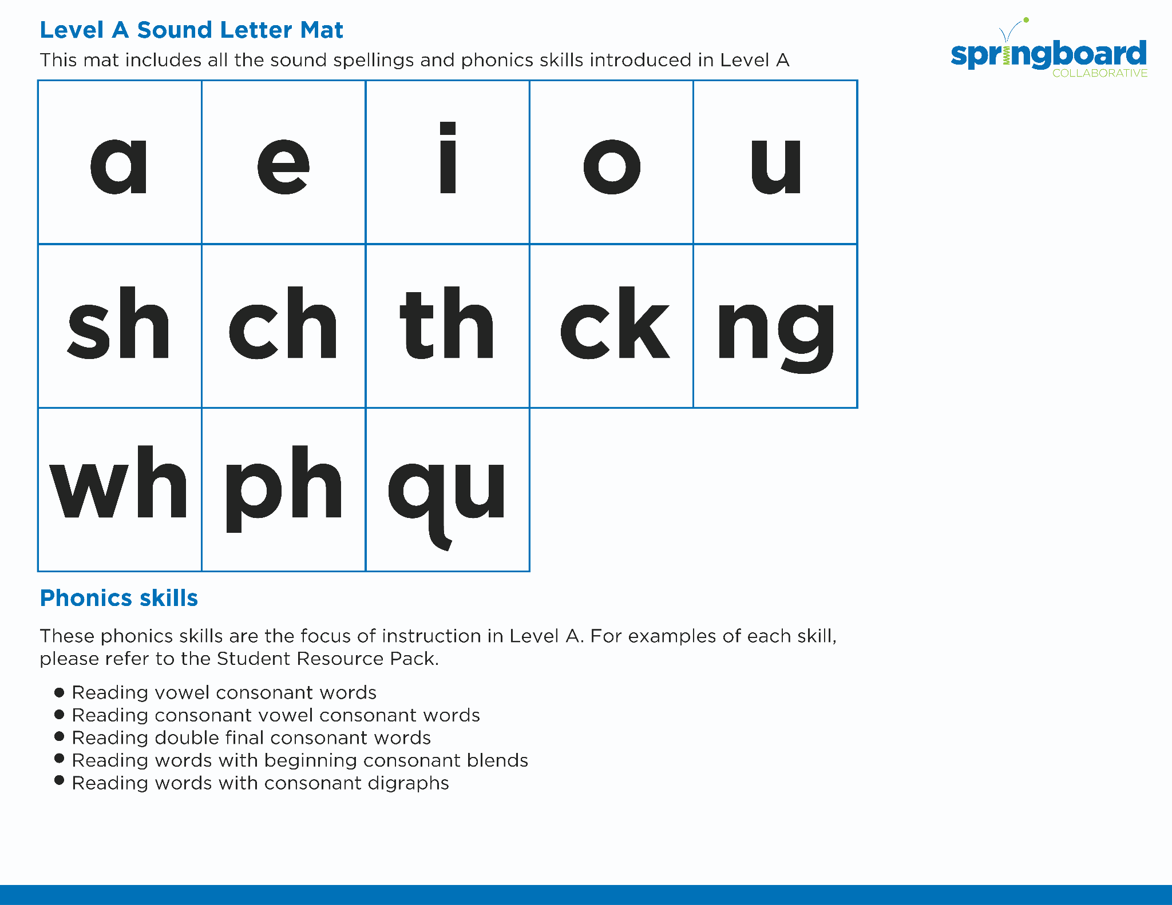

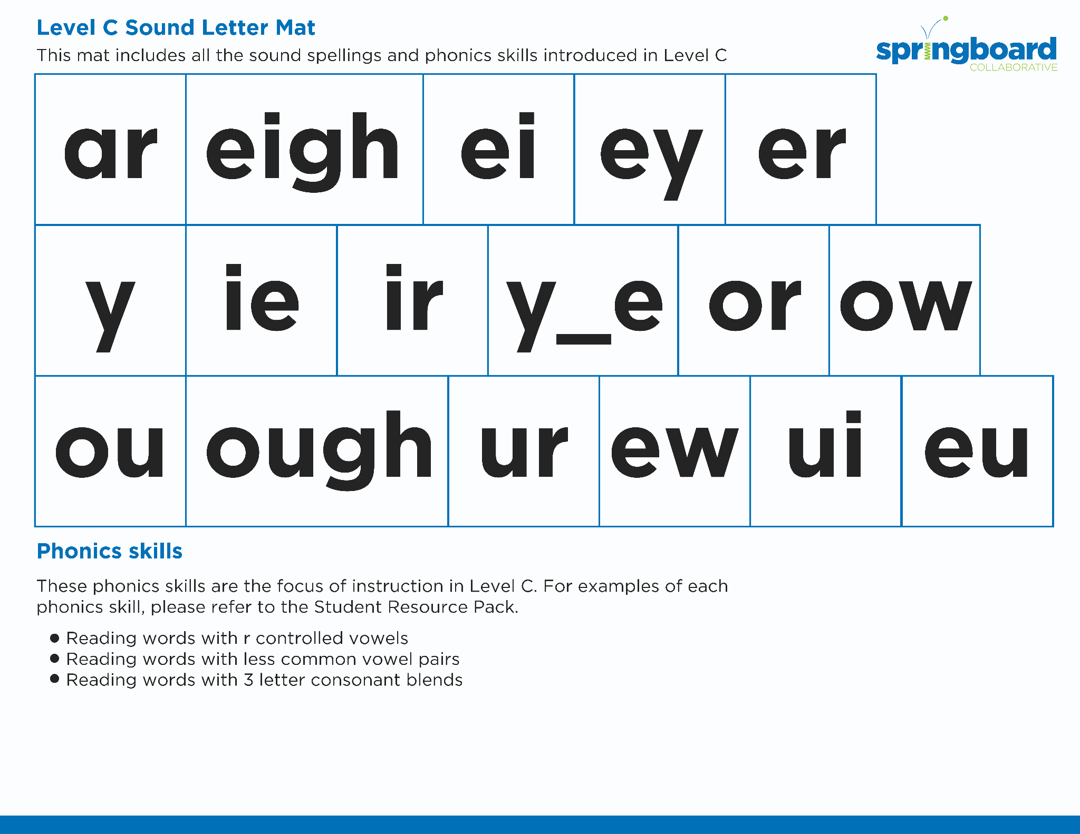

Introduce the Sounds
Notes:
Introduce the Sounds, 5 minutes
See lesson plan for specific instructional guidance.

Slide 4


Blend
the Sounds
sawdust
It’s time to blend the sounds!
It’s time to blend the sounds to help us read the words smoothly!
sawdust
Notes:
Blend the Sounds, 5 minutes
See lesson plan for specific instructional guidance.

Slide 5
Blend
the Sounds
scrawny
scrawny
Notes:
Blend the Sounds, 5 minutes
See lesson plan for specific instructional guidance.

Slide 6


Read
the Words
I can draw an awesome hawk
on a lawn.
I think it’s scrawny and awful.
It’s time to read the words!
It’s time to read the words, so we can read smoothly, like we are speaking!
Don’t make me bawl.
Notes:
Read the Words, 5 minutes
See lesson plan for specific instructional guidance.

Slide 7


Decode
the Words
  shawl yawn
  squawk claw
  crawfish dawn
It’s time to decode the sounds in the words!
It’s time to decode the sounds in the words so we can read the words!
Notes:
Decode the Words, 5 minutes
See lesson plan for specific instructional guidance.

Slide 8



Spell
the Words
scrawn
y
It’s time to spell the words!
It’s time to spell the words to show we understand the rule!
Notes:
Spell the Words, 5 minutes
See lesson plan for specific instructional guidance.

Slide 9

High-
Frequency
Words
people
We see high-frequency words all the time!
Let’s figure out how to read them!
Notes:
High-Frequency Words, 5 minutes
See lesson plan for specific instructional guidance.

Slide 10

Decodable Text
  Time to read.
  Let’s use our new rule!
Notes:
Decodable Text, 15 minutes
See lesson plan for specific instructional guidance.

Slide 11
How have people contributed to pollination over time?
What are some ways that people have used plants over time?
How is our ecosystem affected when there are fewer pollinators?
Response to Text
Notes:
Response to Text, 10 minutes
See lesson plan for specific instructional guidance.

