Slide 1


Deletion and Substitution
It’s deletion and substitution time!
We want to change the beginning, middle, and ending sounds!
We want to make a new word!
Notes:
Deletion and Substitution, 5 minutes
See lesson plan for specific instructional guidance.

Slide 2




Introduce the Sounds
  haunt
  /h/ /aw/ /n/ /t/
  = haunt
It’s time to learn new sounds!
We use the sound rule to help us read!
Notes:
Introduce the Sounds, 5 minutes
See lesson plan for specific instructional guidance.

Slide 3
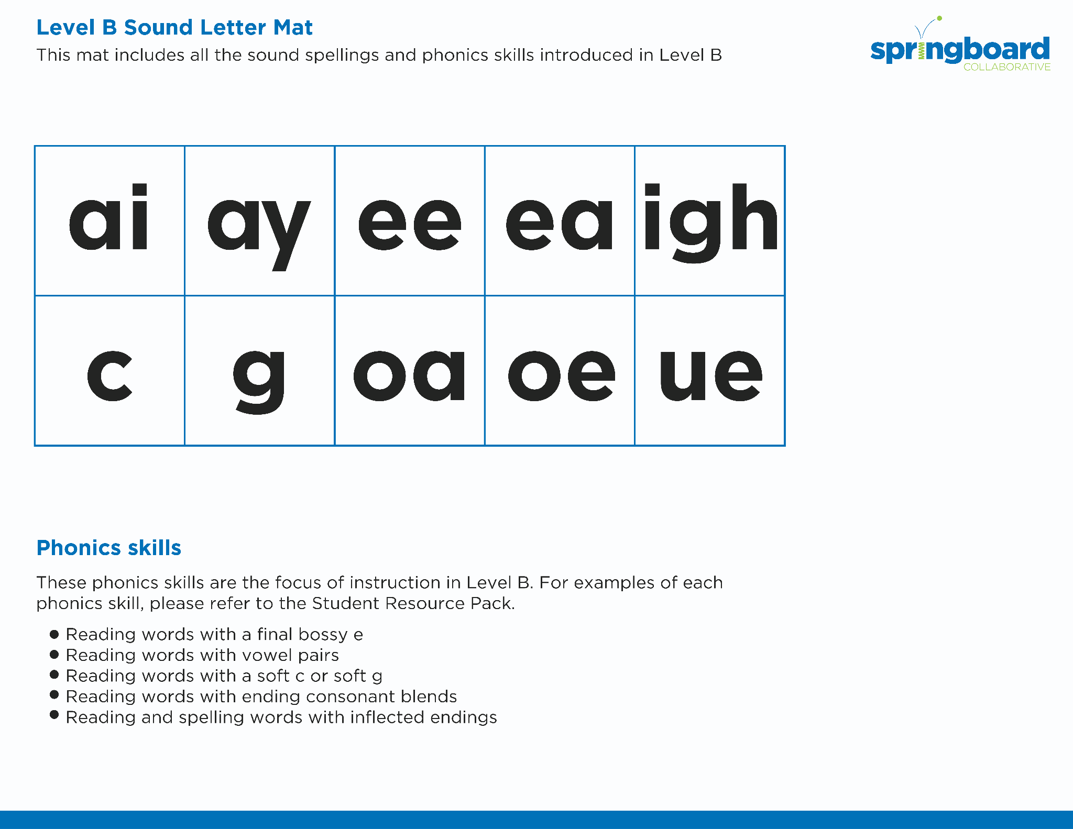
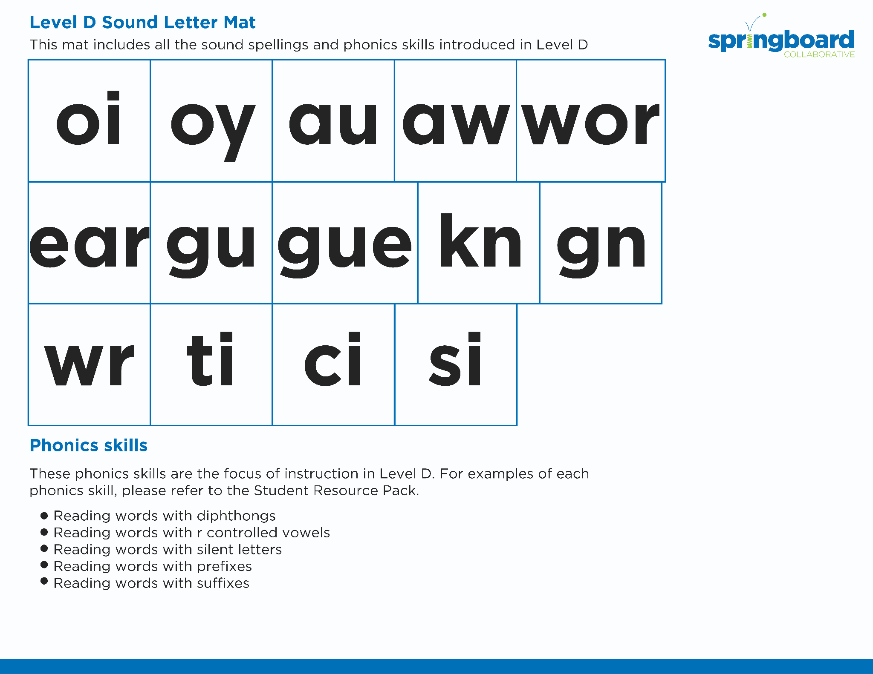
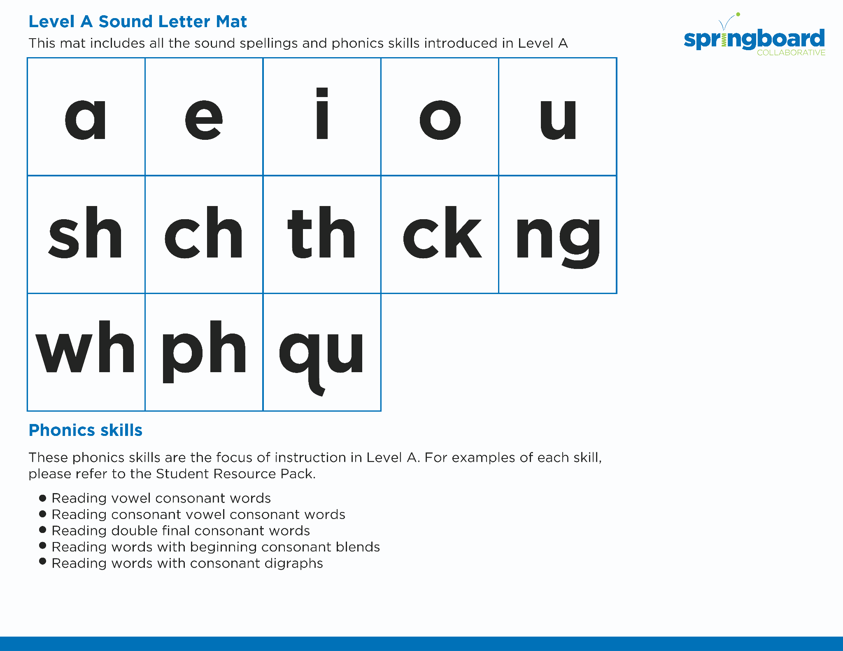
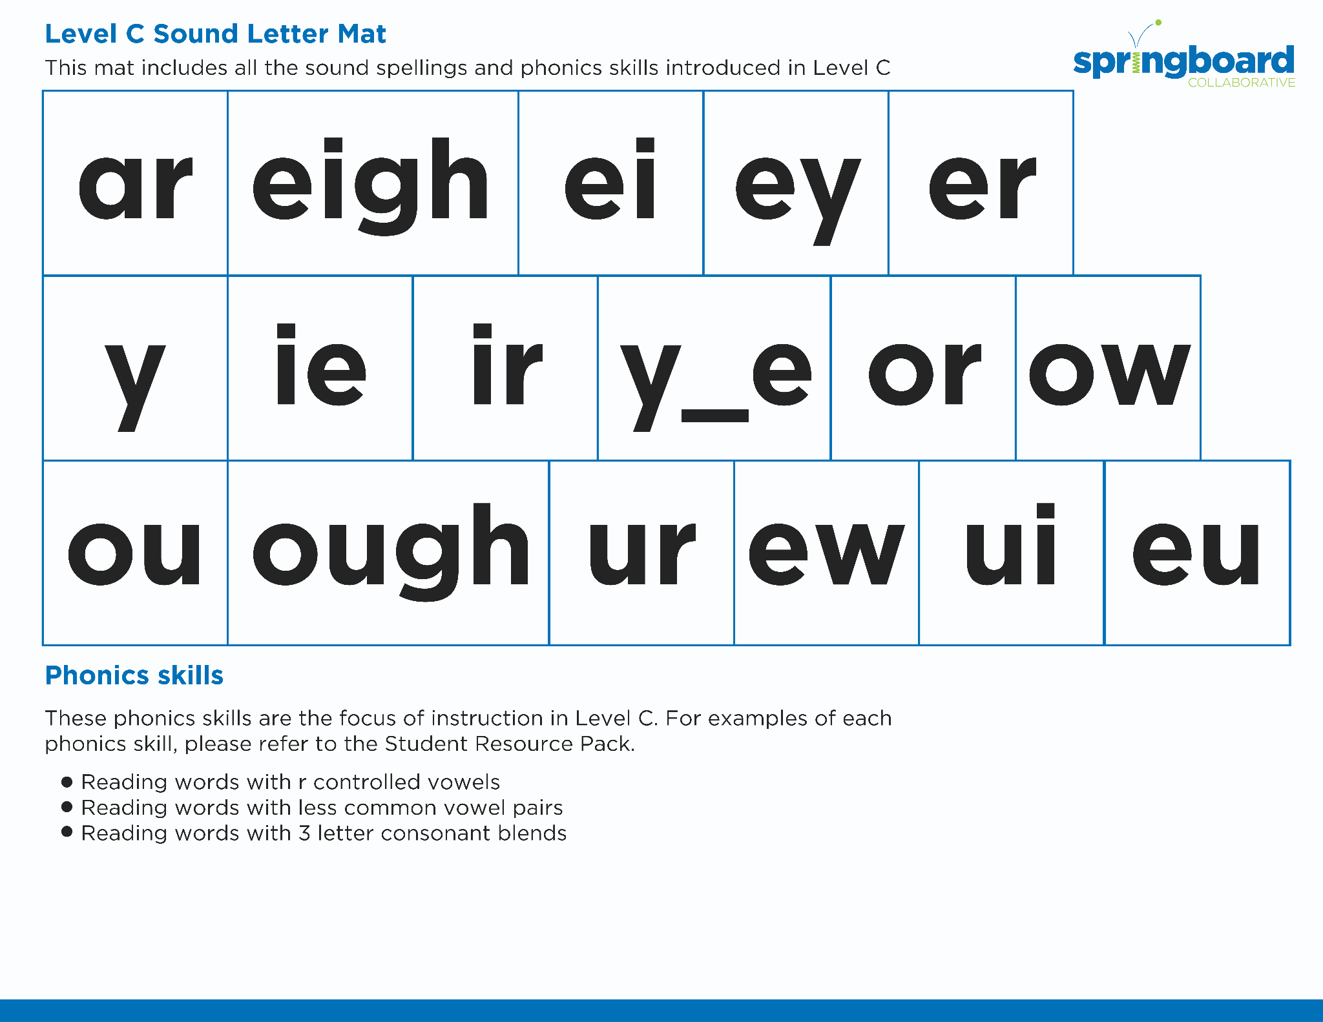
Introduce the Sounds
Notes:
Introduce the Sounds, 5 minutes
See lesson plan for specific instructional guidance.

Slide 4


Blend
the Sounds
applause
It’s time to blend the sounds!
It’s time to blend the sounds to help us read the words smoothly!
applause
Notes:
Blend the Sounds, 5 minutes
See lesson plan for specific instructional guidance.

Slide 5
Blend
the Sounds
exhaust
exhaust
Notes:
Blend the Sounds, 5 minutes
See lesson plan for specific instructional guidance.

Slide 6


Read
the Words
I applaud autumn in August.
Paul will haul the sauce.
It’s time to read the words!
It’s time to read the words, so we can read smoothly, like we are speaking!
Please pause and watch the launch.
Notes:
Read the Words, 5 minutes
See lesson plan for specific instructional guidance.

Slide 7


Decode
the Words
  astronaut clause
  launch haunt
  gauze faucet
  jaunt
It’s time to decode the sounds in the words!
It’s time to decode the sounds in the words so we can read the words!
Notes:
Decode the Words, 5 minutes
See lesson plan for specific instructional guidance.

Slide 8





Spell
the Words
au
to
mat
ic
It’s time to spell the words!
It’s time to spell the words to show we understand the rule!
Notes:
Spell the Words, 5 minutes
See lesson plan for specific instructional guidance.

Slide 9

High-
Frequency
Words
before
because
We see high-frequency words all the time!
Let’s figure out how to read them!
Notes:
High-Frequency Words, 5 minutes
See lesson plan for specific instructional guidance.

Slide 10

Decodable Text
  Time to read.
  Let’s use our new rule!
Notes:
Decodable Text, 15 minutes
See lesson plan for specific instructional guidance.

Slide 11
Where did Audrey and
Willow go?
What did Audrey and Willow see there?
Why did Willow say “It’s not his fault” about the lion?
What do Audrey and Willow decide to hunt for?
Response to Text
Notes:
Response to Text, 10 minutes
See lesson plan for specific instructional guidance.

