Slide 1


Deletion and Substitution
It’s deletion and substitution time!
We want to change the beginning, middle, and ending sounds!
We want to make a new word!
Notes:
Deletion and Substitution, 5 minutes
See lesson plan for specific instructional guidance.

Slide 2




Introduce the Sounds
  purple
  /p/ /er/ /p/ /l/
  = purple
It’s time to learn new sounds!
We use the sound rule to help us read!
Notes:
Introduce the Sounds, 5 minutes
See lesson plan for specific instructional guidance.

Slide 3
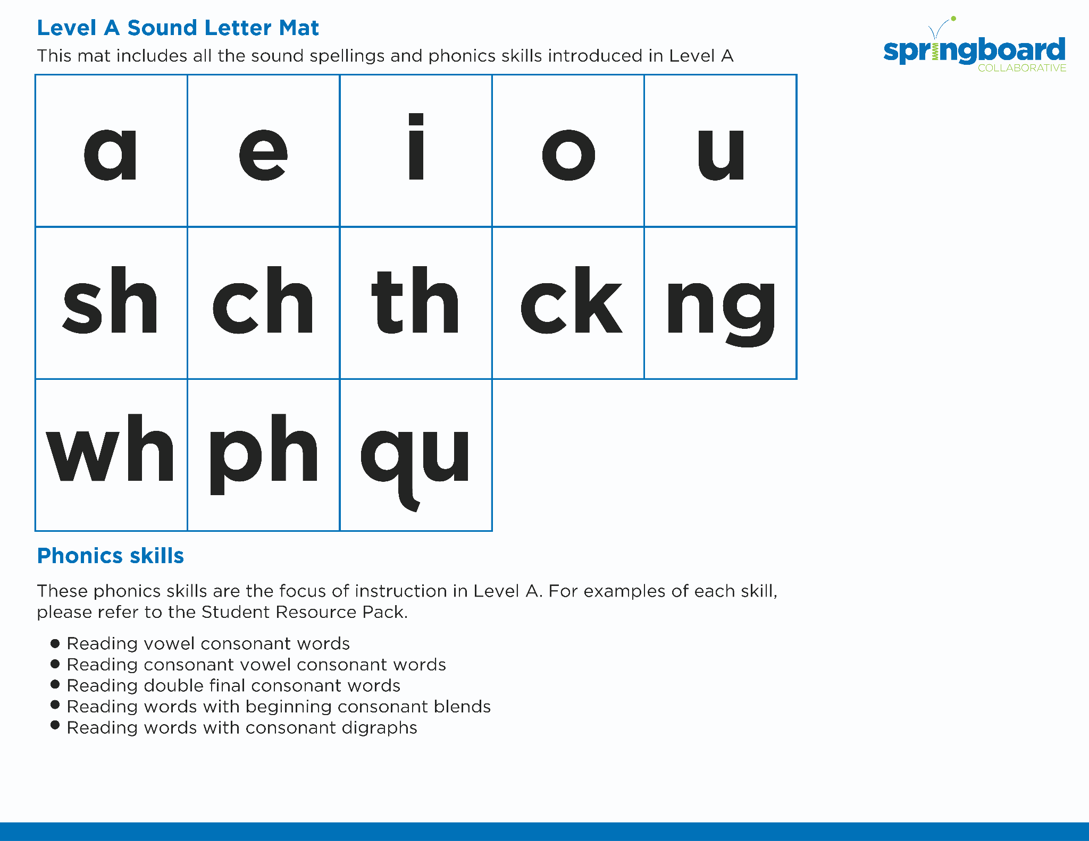
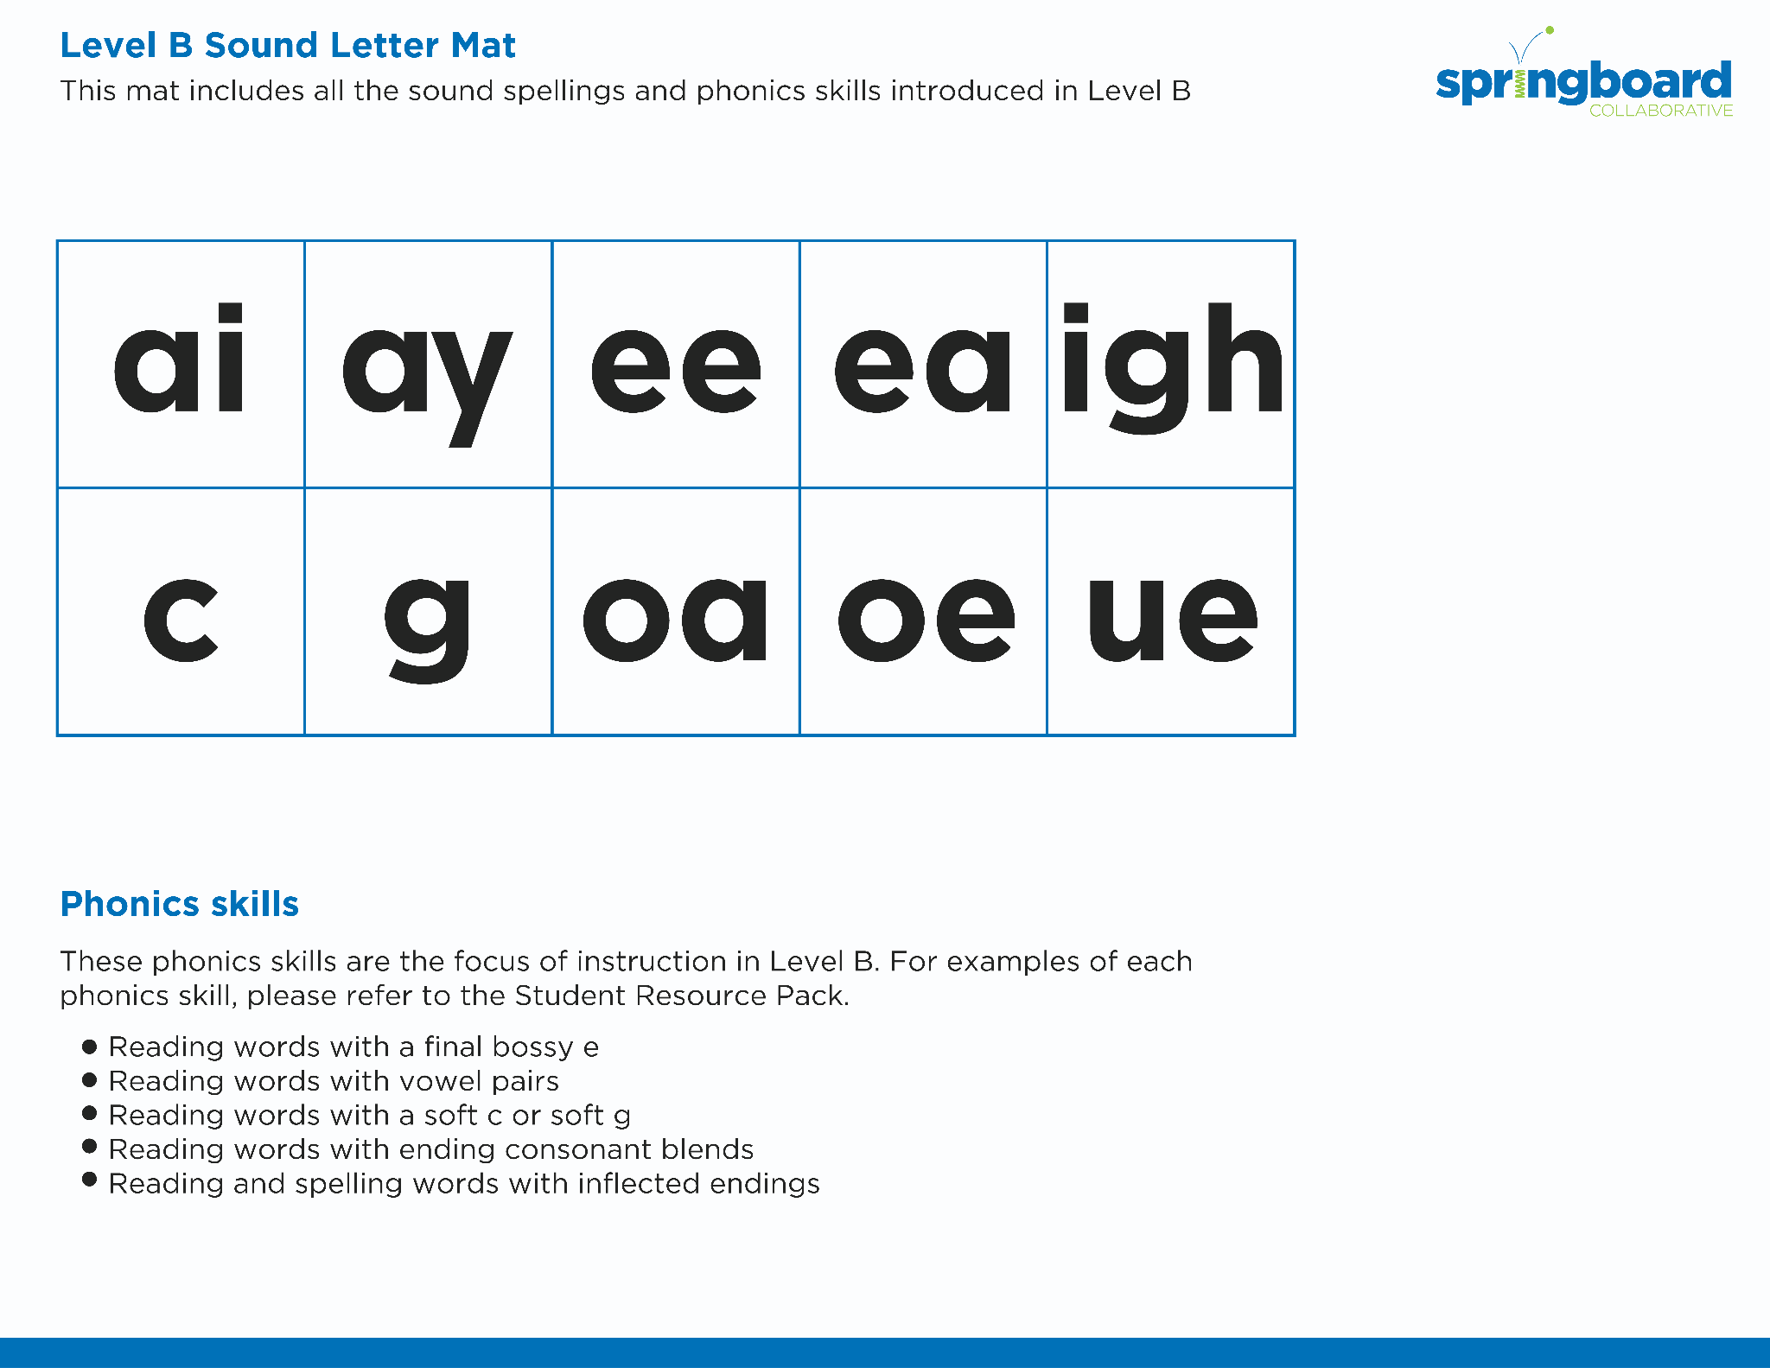

Introduce the Sounds
Notes:
Introduce the Sounds, 5 minutes
See lesson plan for specific instructional guidance.

Slide 4


Blend
the Sounds
burger
It’s time to blend the sounds!
It’s time to blend the sounds to help us read the words smoothly!
burger
Notes:
Blend the Sounds, 5 minutes
See lesson plan for specific instructional guidance.

Slide 5
Blend
the Sounds
sturdy
sturdy
Notes:
Blend the Sounds, 5 minutes
See lesson plan for specific instructional guidance.

Slide 6


Read
the Words
disturb
burlap
The turtle was in a hurry to turn right at the church.
It’s time to read the words!
It’s time to read the words, so we can read smoothly, like we are speaking!
Notes:
Read the Words, 5 minutes
See lesson plan for specific instructional guidance.

Slide 7


Decode
the Words
  urchin spurt
  slurp turnip
  murky
It’s time to decode the sounds in the word!
It’s time to decode the sounds in the words so
we can read the words!
Notes:
Decode the Words, 5 minutes
See lesson plan for specific instructional guidance.

Slide 8




Spell
the Words
b
ur
n
It’s time to spell the words!
It’s time to spell the words to show we understand the rule!
Notes:
Spell the Words, 5 minutes
See lesson plan for specific instructional guidance.

Slide 9
Spell
the Words
t
ur
n
Notes:
Spell the Words, 5 minutes
See lesson plan for specific instructional guidance.

Slide 10

High-
Frequency
Words
there
where
We see high-frequency words all the time!
Let’s figure out how to read them!
Notes:
High-Frequency Words, 5 minutes
See lesson plan for specific instructional guidance.

Slide 11

Decodable Text
  Time to read.
  Let’s use our new rule!
Notes:
Decodable Text, 15 minutes
See lesson plan for specific instructional guidance.

Slide 12
Response to Text
What characteristics do you think Irma has? Why?
What do you do when you want to be really good at something?
Notes:
Response to Text, 10 minutes
See lesson plan for specific instructional guidance.

