Slide 1



Introduce the sounds
Open Syllable
  focus
  /f/ /ō/ /c/ /ŭ/ /s/
  = focus
It’s time to learn new sounds!
We use the sound rule to help us read!
Notes:
See lesson plan for specific instructional guidance.
Introduce the Sound!
Say: Learning new sounds is so cool! Repeat our chant after me!
"It's time to learn new sounds!
We use the sound rule to help us read!"
Do: Say one sentence at a time of the Introduce the Sound chant and ask the students to repeat after you.
Say: Let's learn a super cool new rule today!
Say: Today, we'll look at decoding and spelling words with the long o spelled with an open syllable. For example, when we see focus, we say /f/ /o/ | /c/ /u/ /s/ = focus.
Say: Before we start practicing decoding words with open syllable long o, let's review our sound cards.

Slide 2
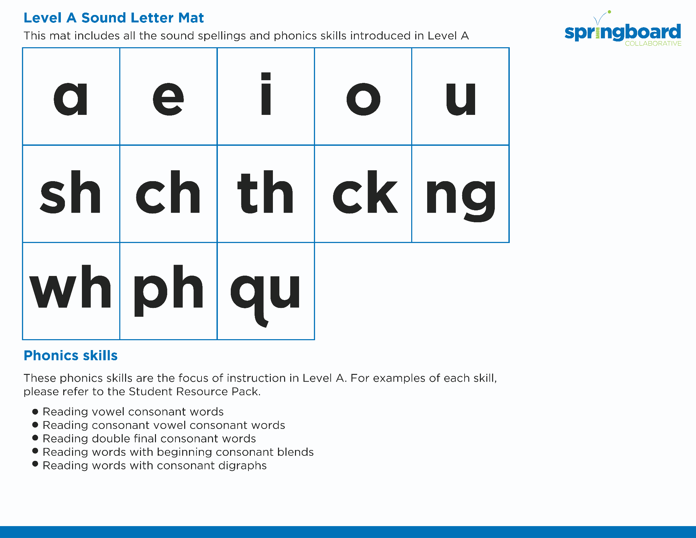
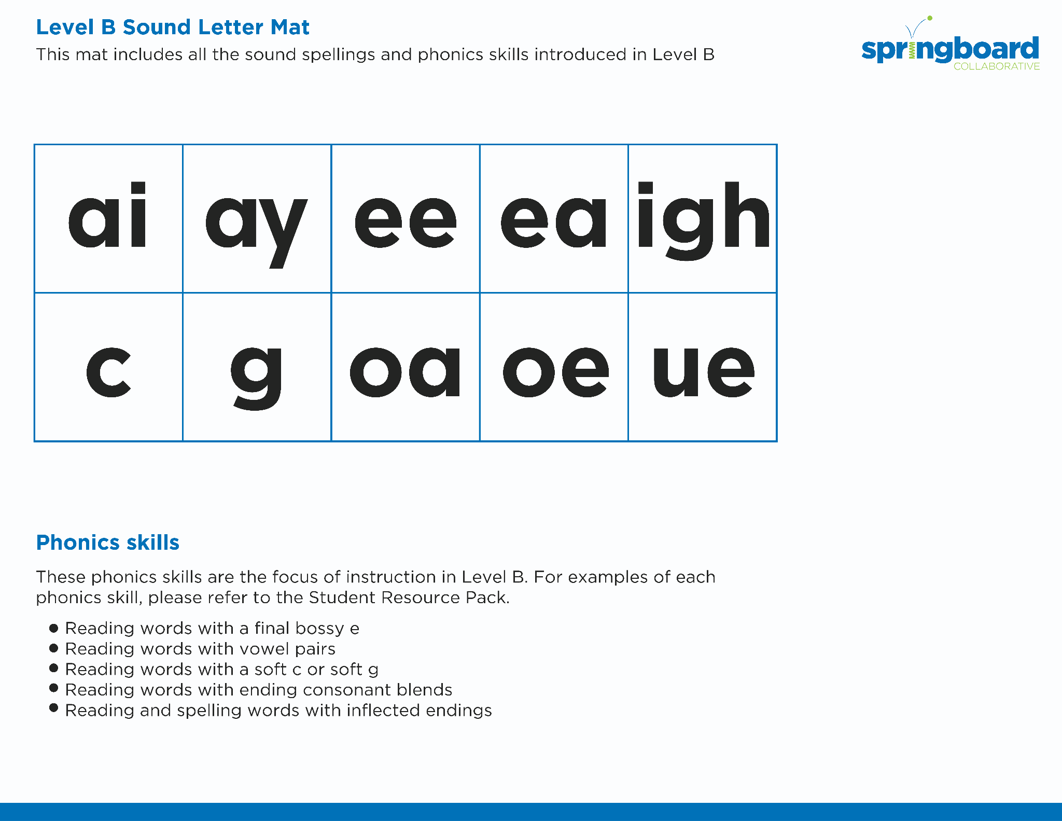
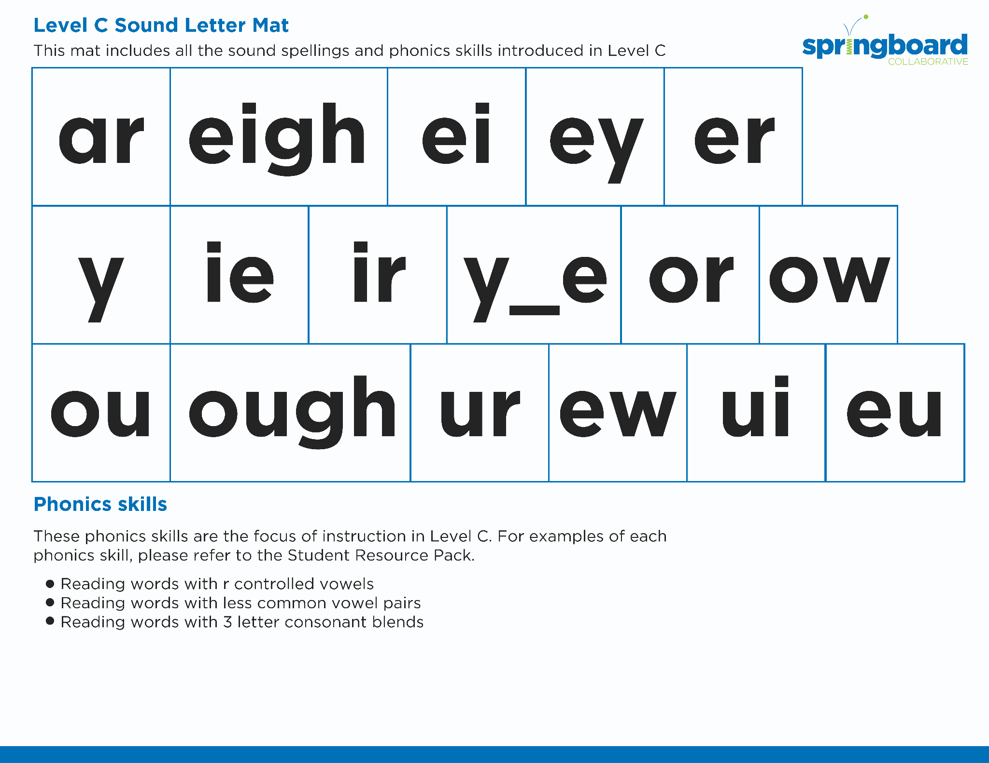
Introduce the sounds
Notes:
See lesson plan for specific instructional guidance.
Introduce the Sound!
Do: Flip through and review all the sound spelling cards students have learned so far. (Sound Letter Cards: a, e, i, o, u, wh, sh, ch, ng, ck, ph, qu, ai, ay, ee, ea, igh, c, g, oa, oe, gu, ar, eigh, ei, ey, er, y, ie, ir, y_e, or, ow, ou, ough)
Say: Remember, an open syllable is a syllable ending with a vowel and it makes the long vowel sound. Let's practice reading our words!

Slide 3



Blend
the sounds
focus
Family Activity
It’s time to blend the sounds!
It’s time to blend the sounds to help us read
the words smoothly!
focus
Notes:
See lesson plan for specific instructional guidance.
Blend the Sounds!
Say: Blending sounds helps us read the words smoothly! Repeat our chant after me!
"It's time to blend the sounds!
It's time to blend the sounds to help us read the words smoothly!"
Do: Say one sentence at a time of the Blend the Sounds chant and ask the students to repeat after you.
Say: Let's practice blending the sounds in some words today!
Say: When we blend the sounds in words, it helps us read the words smoothly. Let's try it. An open syllable is a syllable ending with a vowel and it makes the long vowel sound.
Do: Point to the word focus.
Say: When a word has two vowel and the two vowels are NOT a vowel pair, it probably means the word is 2 syllables. Let's put a dot under our vowels. Let's try dividing the word between the o and c. Now I have two syllables, 1 syllable ending with vowel. /f/ /o/ = "fo". Now, for the second syllable. It looks like it follows the CVC pattern. /k/ /u/ /s/ = "cus" Put it together = "fo" "cus" = "focus".

Slide 4
Blend
the sounds
bonus
Family Activity
bonus
Notes:
See lesson plan for specific instructional guidance.
Blend the Sounds!
Say: Let's do another word, bonus. We'll divide this word after the o. What vowel sounds will we use for the first o and the middle u?
Do: Let the students think about what they know. Remind them of how you spelled focus if necessary.
Say: Yes! The first i will make the long vowel sound because it's an open syllable and the u will make the short sound because it uses the CVC pattern. Do it with me using our Double Decker Elkonin Boxes.
Do: Segment and blend the word bonus using the Double Decker Elkonin Boxes. Take notes on the students that can accurately blend and students that may need reteaching and/or additional support.
Say: Yup! /b/ /o/ /n/ /u/ /s/ = "bonus". Smart blending! Remember, a vowel at the end of a syllable can make the long vowel sound.

Slide 5


Read
the words
Family Activity
locate
yogurt
We will ride the pony to get a donut.
It’s time to read the words!
It’s time to read the words, so we can read smoothly, like we are speaking!
Notes:
See lesson plan for specific instructional guidance.
Read the Words!
Say: When we practice reading the words, it can help us read the words faster and faster. This helps us learn to read smoothly like when we are speaking! Repeat our chant after me!
"It's time to read the words!
It's time to read the words, so we can read smoothly, like we are speaking!"
Do: Say one sentence at a time of the Read the Words chant and ask the students to repeat after you.
Say: Let's practice reading words today!
Say: We are going to read the words. When we practice reading the words, it helps us read faster and faster. This helps us focus on what we can learn from the words. Let's look at the first word.
Do: Point to the word locate.
Say: When we read this word, we look to see what spelling pattern it uses so we know what vowel sound to make. I see that it has three vowels. Put dots under o and a. E does not get a dot because it does not make a sound. It is probably made of 2 syllables because I think one of the vowels is a bossy e. Remember each syllable gets one vowel sound. Let's try dividing the word between the o and the c. Now look at each syllable spelling patterns. What do you see?
Do: Give the students a few seconds to identify that the first syllable is open and will use the long o sound. The second syllable follows the bossy e spelling pattern and will use the long a sound.
Say: I notice that the first syllable is open and will use the long o sound. The second syllable follows the bossy e spelling pattern and will use the long a sound. Let's try. Blend with me.
Do: Listen as students read the word. Take notes on the students that can accurately articulate the sounds and read the word and students that may need reteaching and/or additional support.
Say: Yes, the word is "locate". /l/ /o/ /c/ /a/ /t/ = "locate". Let's look at the next word. How would you read this word?
Do: Point to the word yogurt.
Say: Let's divide this word between the o and g. The first syllable is y-o. The second syllable is g-u-r-t. What spelling patterns do you see?
Do: Listen as students point out that the first syllable is open syllable and should use the long vowel sound. The second syllable has an r controlled vowel and u-r will say /er/. Once you are sure students have identified that, prompt them to blend.
Say: I'm going to show you how I did it. You check to see if you did it the same way. /y/ /o/ /g/ /er/ /t/ = "yogurt". Show me a thumbs up if we matched or a thumb sideways if you were almost there.
Do: Display the sentence: We will ride the pony to get a donut.
Say: Take a couple minutes to read this sentence with your partner. All of the words follow rules you've learned or are High Frequency Words you've learned. Raise your hands when you have the whole sentence read and I'll come listen. You can do it!
Do: Monitor and assist. You may support by asking students to recognize the spelling pattern, prompting students to use the long or short vowel sound, asking students to underline letters that stick together, etc.
Say: I'll read it aloud as you read it with me.
Do: Read sentence.
Say: Remember, a vowel at the end of a syllable makes the long vowel sound. Those brains are growing!

Slide 6


Decode
the words
  donut banjo
  coma moment
It’s time to decode the sounds in the words!
It’s time to decode the sounds in the words so we can read the words!
Notes:
See lesson plan for specific instructional guidance.
Decode the Words!
Say: Decoding is when you break up the sounds in a word and read each sound one at a time. Then you blend the sounds together to read the word! Repeat our chant after me!
"It's time to decode the sounds in the words!
It's time to decode the sounds in the words so we can read the words!"
Do: Say one sentence at a time of the Decode the Words chant and ask the students to repeat after you.
Say: Let's practice decoding the sounds in words today!
Say: We are going to decode the words. Remember decoding is when you break up the sounds in a word and read each sound one at a time. Then you blend the sounds together to read the word! When we decode the sounds in words, it helps us read the words correctly. Look at our words for today.
Do: Point to the words.
Say: Follow this routine:
Underline any letters that go together. Put dots under your vowels.
Draw in the syllable break.
Look for the spelling patterns.
Name any phonetic rules that help with pronunciation.
Try reading it. Is it right? If not, try another pronunciation.
Do: Partner students.
Say: You and your partner work together to decode these words (donut, banjo, coma, moment). I'll be by to listen. Use your Double Decker Elkonin Boxes.
Do: Listen as students decode the word. Take notes on the students that can accurately articulate the sounds and read the word and students that may need reteaching and/or additional support.
Say: Excellent work applying our new rule to decoding words today!

Slide 7



Spell
the words
po
ny
It’s time to spell the words!
It’s time to spell the words to show we understand the rule!
Notes:
See lesson plan for specific instructional guidance.
Spell the Words!
Say: When we can spell words, it shows that we met the target. When we hear the sounds, we can match the sounds to the correct letters and spell the word! Repeat our chant after me!
"It's time to spell the words!
It's time to spell the words to show we understand the rule!"
Do: Say one sentence at a time of the Spell the Words chant and ask the students to repeat after you.
Say: Let's practice spelling words today!
Say: We are going to spell the words. Remember when we can spell words with the correct rule it shows that we met the target. When we hear the sounds we can match the sounds to the correct letters and spell the word! Listen to our words for today. The word is pony. How would we spell the word pony. Let's listen to the sounds and match the sound to the correct letter. The word is "pony". I hear two syllables. Clap them out with me.
Do: Say and clap "po|ny" out as a class.
Say: The first syllable is /p/ /o/. We can spell that with an o because a vowel at the end of a syllable says its name. The second syllable is "ny". /n/ /e/ spelled n and y because a y at the end of a 2 syllable word makes the long e sound. Use your whiteboards.
Do: Watch as students spell the word using the letter and sound connections. Take notes on the students that can accurately articulate the sound and spell the word and students that may need reteaching and/or additional support.
Say: Yes, when we spell the word pony we write the letters p-o-n-y.

Slide 8
Spell
the words
bo
ny
Notes:
See lesson plan for specific instructional guidance.
Spell the Words!
Say: What about if we spell bony. Use your whiteboards.
Do: Encourage students to use what they did for spelling pony and apply it to spelling bony. Circulate and coach students as needed.
Say: Let's check! You check your work as I reveal my work. I spell bony b-o-n-y. How did you do? Great thinking! Awesome job spelling words today!

Slide 9
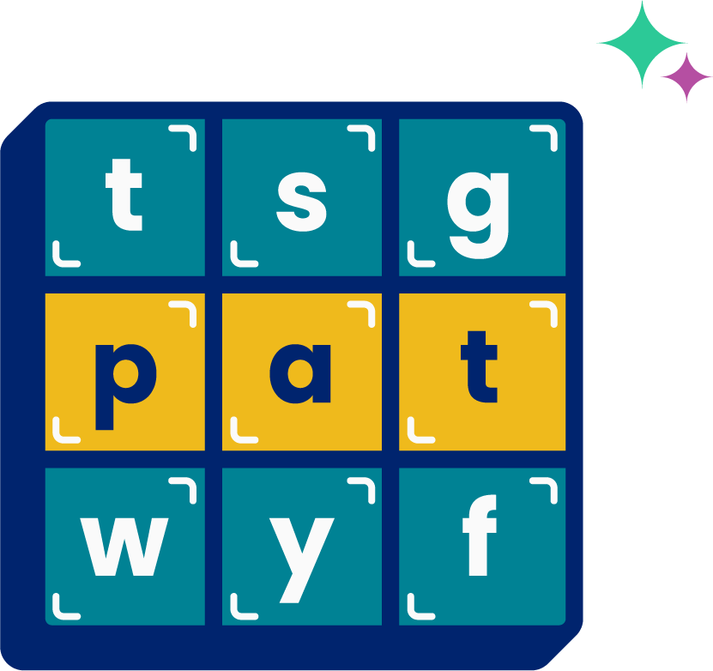
High
Frequency
Words
Family Activity
move
We see high frequency words all the time!
Let’s figure out how to read them!
Notes:
See lesson plan for specific instructional guidance.
High Frequency Words!
Say: Some words we can sound out now, some words we'll learn how to sound out later, and some words are rule breakers and we can't sound out. Words that show up a lot in books are called High Frequency Words. Let's learn some! Repeat our chant after me!
"We see high frequency words all the time!
Let's figure out how to read them!"
Do: Say one sentence at a time of the High Frequency Words chant and ask the students to repeat after you.
Say: Let's read our high frequency words!
Say: Today, we're learning 1 new word that doesn't make the sounds it looks like it should. Some of these high frequency words are tricky, but not too tricky for us!
Do: Display the word move.
Say: This word makes the sounds /m/ /oo/ /v/ = move. We might expect this word to use the long o sound but instead it uses an unusual sound for o. The e is there because... say it with me. English words don't end in v or u. Read this word with me.
Do: Listen to responses.
Say: Yes! m-o-v-e says "move". Read it again.
Do: Point to words and listen to students read.
Say: Excellent! Let's read our previous high frequency words!
Do: Point to or hold up all the high frequency words to this point as the students read them.
Say: Excellent work learning 1 new high frequency word today.
move

