Slide 1




Introduce the sounds
  four
  /f/ /ō/ /r/
  = four
It’s time to learn new sounds!
We use the sound rule to help us read!
Notes:
See lesson plan for specific instructional guidance.
Introduce the Sound!
Say: Learning new sounds is so cool! Repeat our chant after me!
"It's time to learn new sounds!
We use the sound rule to help us read!"
Do: Say one sentence at a time of the Introduce the Sound chant and ask the students to repeat after you.
Say: Let's learn a super cool new rule today!
Say: Today, we'll look at decoding and spelling words with the long o spelled o-u.
Do: Hold up the Sound Letter o-u card.
Say: O-u is one way to make the long o sound. O-u can say long o, /o/ like four gourds. It can also saw ow, /ow/ like mouse and house. It can also say /oo/ and /uh/ like group and trouble. O-u can make four different sounds. Today, we're just focusing on the long o sound. For example, when we see four, we say /f/ /o/ /r/ = four. When I hold up this card we'll say /o/ /ow/ /oo/ /uh/ to help us remember the 4 sounds of o-u. Say it with me.
Do: Listen as all the students say /o/ /ow/ /oo/ /uh/.
Say: When we see this card, we can say /o/ /ow/ /oo/ /uh/ because we know this spelling patterns makes these four sounds.

Slide 2
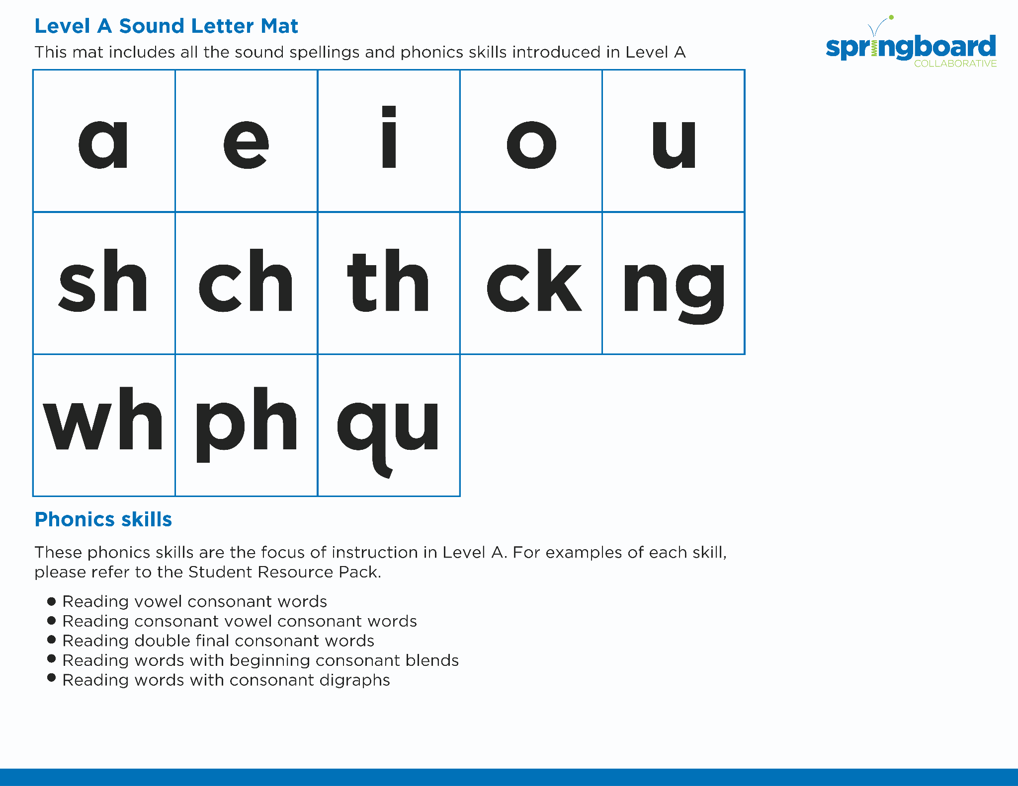
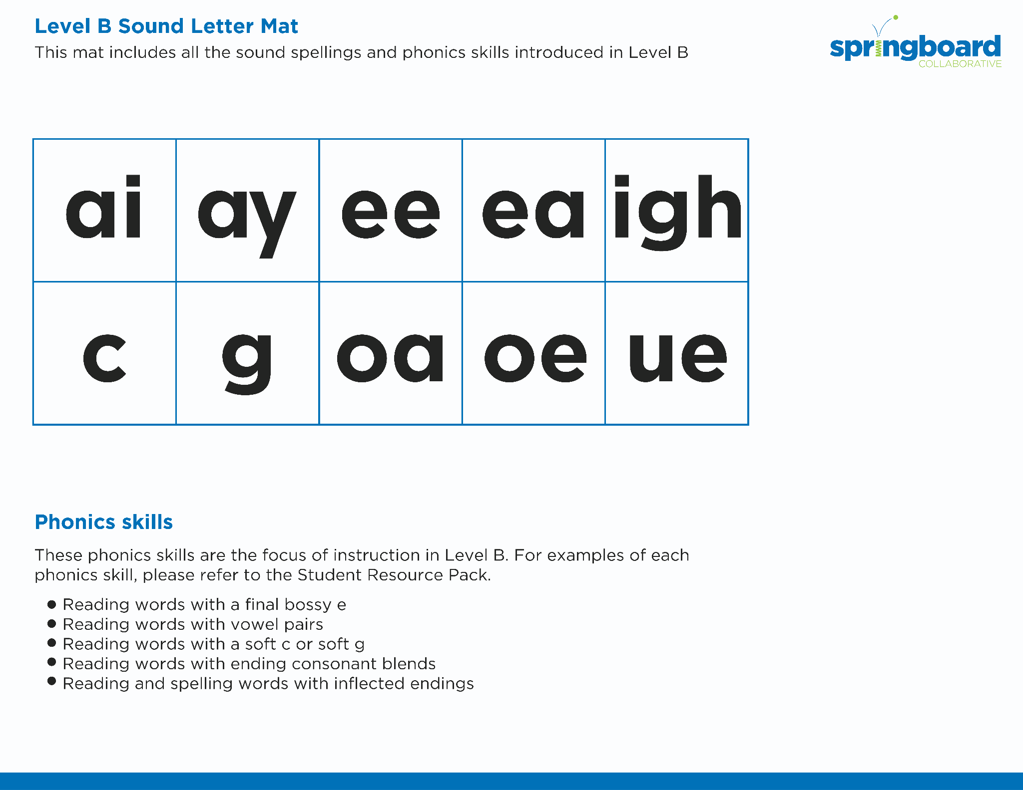
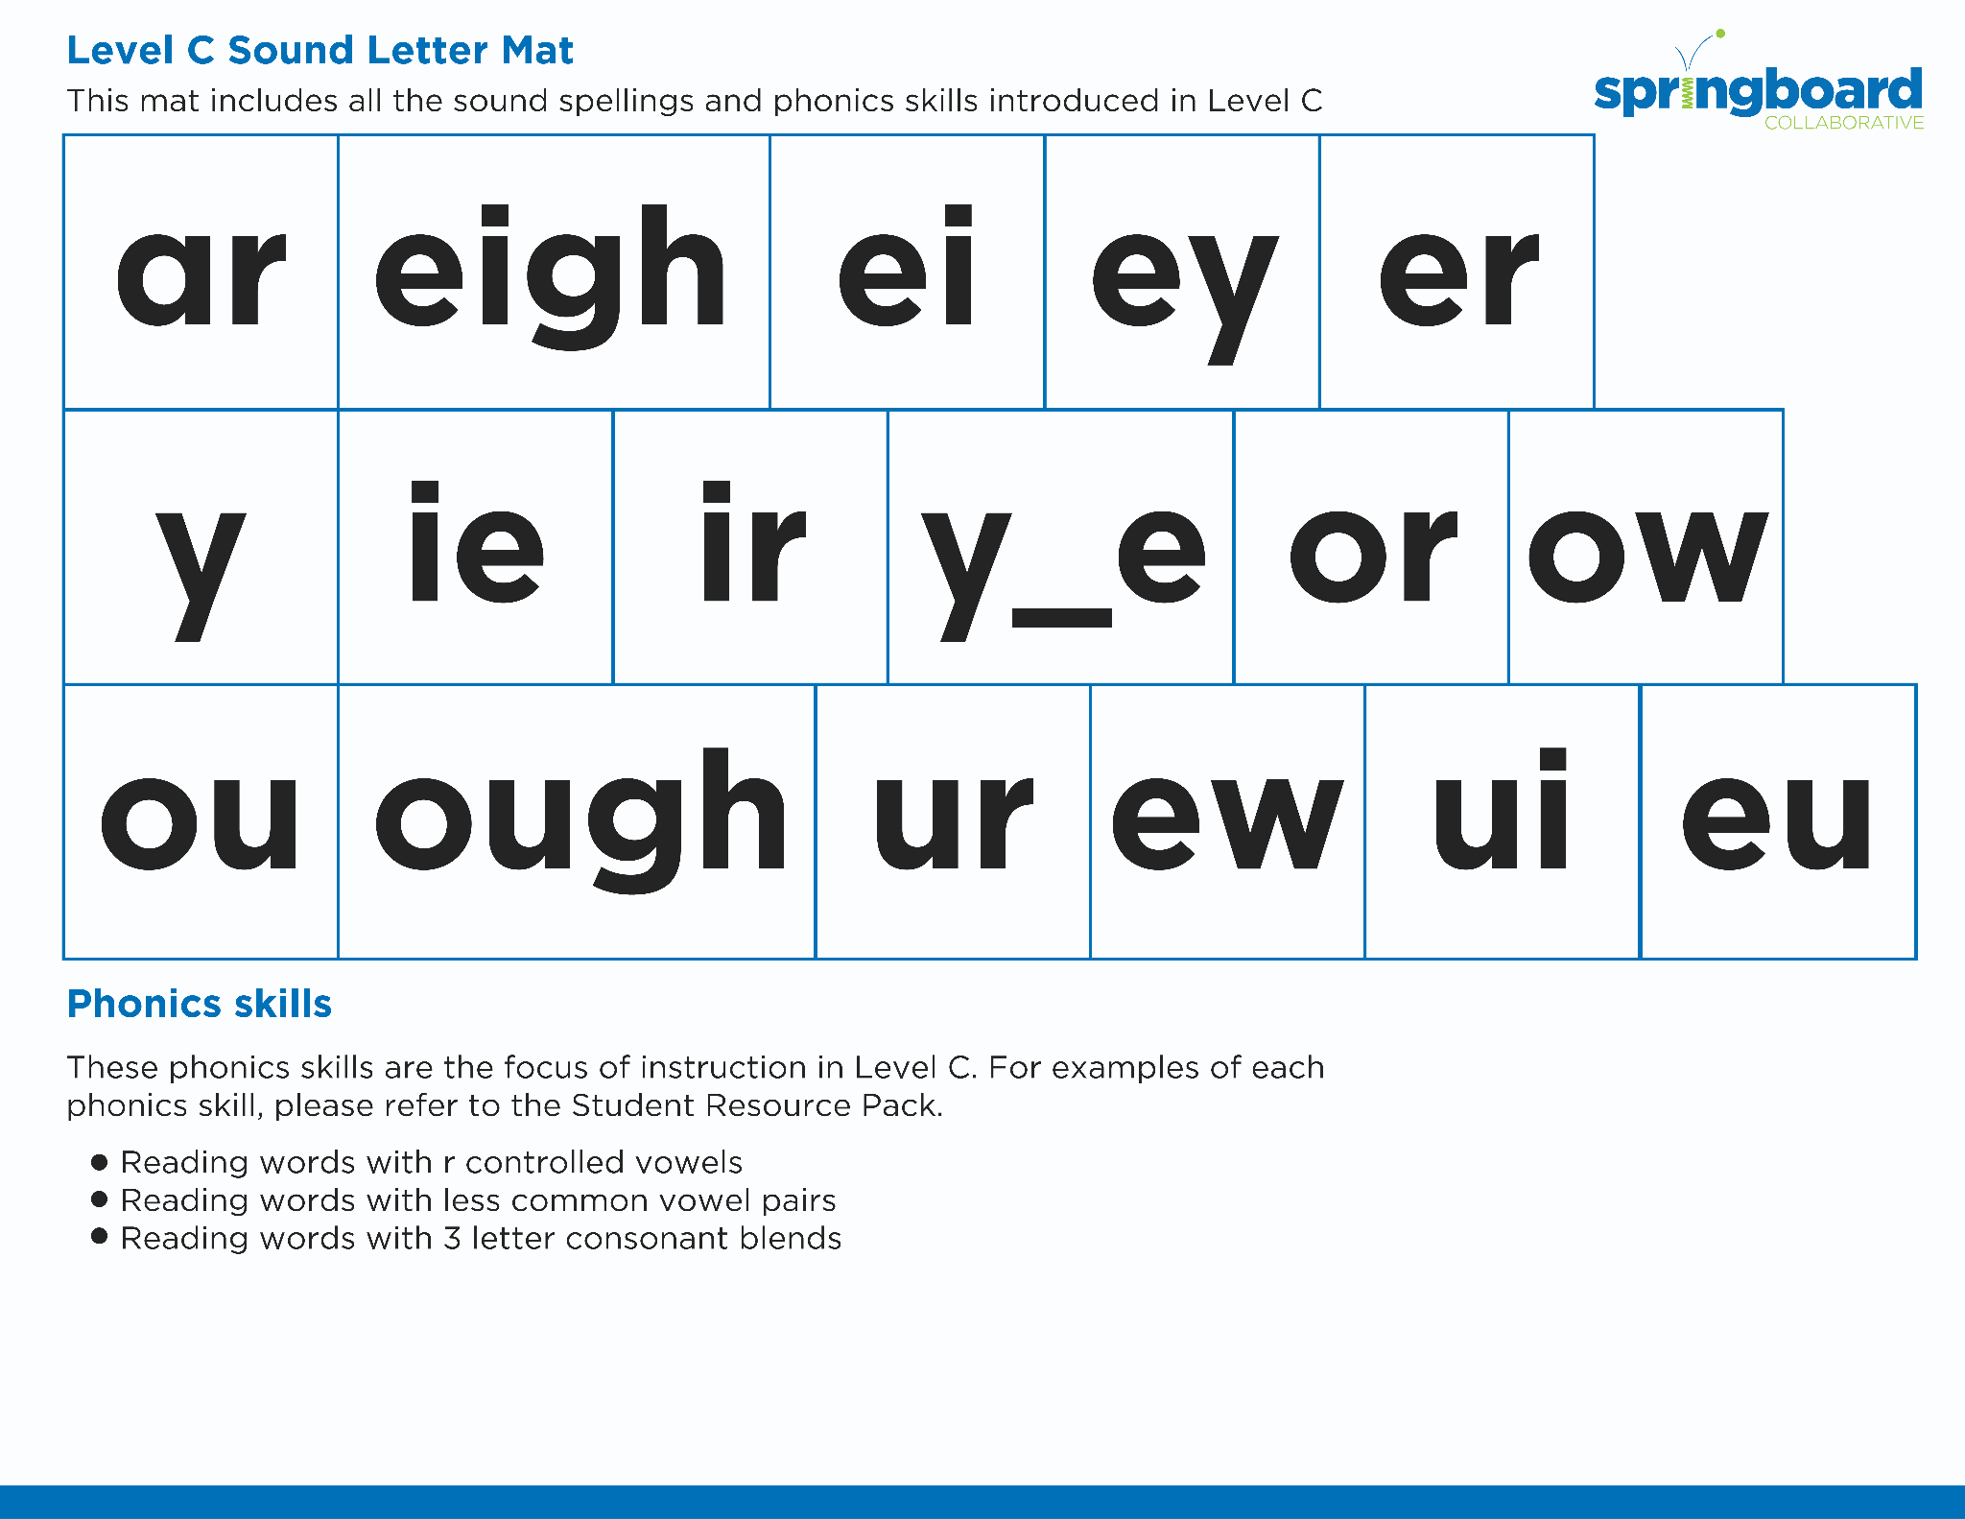
Introduce the sounds
Notes:
See lesson plan for specific instructional guidance.
Introduce the Sound!
Say: Before we start practicing decoding words, let's review our sound cards.
Do: Flip through and review all the sound spelling cards students have learned so far. (Sound Letter Cards: a, e, i, o, u, wh, sh, ch, ng, ck, ph, qu, ai, ay, ee, ea, igh, c, g, oa, oe, gu, ar, eigh, ei, ey, er, y, ie, ir, y_e, or, ow)
Say: Remember, o-u can say /o/ /ow/ /oo/ /uh/. Let's practice reading our new spelling pattern!

Slide 3



Blend
the sounds
four
Family Activity
It’s time to blend the sounds!
It’s time to blend the sounds to help us read
the words smoothly!
cour t
Notes:
See lesson plan for specific instructional guidance.
Blend the Sounds!
Say: Blending sounds helps us read the words smoothly! Repeat our chant after me!
"It's time to blend the sounds!
It's time to blend the sounds to help us read the words smoothly!"
Do: Say one sentence at a time of the Blend the Sounds chant and ask the students to repeat after you.
Say: Let's practice blending the sounds in some words today!
Say: When we blend the sounds in words, it helps us read the words smoothly. Let's try it. Remember, o-u can say /o/ /ow/ /oo/ /uh/.
Do: Point to the word four.
Say: I notice that this word has an o-u.
Do: Underline it to show that it stays together.
Say: Let's sound out the word.
Do: Start at your shoulder, and chop/ tap the sounds out. When it's time to blend, start back at the shoulder and run your hand smoothly down your arm.
Say: /f/ /o/ /r/. Putting it altogether. /f/ /o/ /r/ = "four". Let's segment and blend the word together now using our Double Decker Elkonin Boxes.
Do: Segment and blend the word four using the Double Decker Elkonin Boxes.
Say: Smart blending! Let's look at another word.
Do: Point to the word court.
Say: What do you notice about this word?
Do: Allow students to point our that it has an o-u.
Say: I notice this word uses o-u. Let's try it first with a long o sound. Let's put it together!
Do: Listen as students blend the word. Take notes on the students that can accurately blend and students that may need reteaching and/or additional support.
Say: Yes! /k/ /o/ /r/ /t/ = "court". Remember, o-u can say /o/ /ow/ /oo/ /uh/. Great thinking while blending the sounds today!

Slide 4


Read
the words
Family Activity
soul
course
It’s time to read the words!
It’s time to read the words, so we can read smoothly, like we are speaking!
Please pour four waters.
Notes:
See lesson plan for specific instructional guidance.
Read the Words!
Say: When we practice reading the words, it can help us read the words faster and faster. This helps us learn to read smoothly like when we are speaking! Repeat our chant after me!
"It's time to read the words!
It's time to read the words so we can read smoothly like we are speaking!"
Do: Say one sentence at a time of the Read the Words chant and ask the students to repeat after you.
Say: Let's practice reading words today!
Say: We are going to read the words. When we practice reading the words, it helps us read faster and faster. This helps us focus on what we can learn from the words. Let's look at the first word.
Do: Point to the word soul.
Say: When we read this word, we look to see what spelling pattern it uses so we know what vowel sound to make. I see o-u. Let's underline it to remember it stays together. /s/ /o/ /l/. Put it together /s/ /o/ /l/ = "soul". Your turn using the Double Decker Elkonin Boxes.
Do: Listen as students read the word. Take notes on the students that can accurately articulate the sounds and read the word and students that may need reteaching and/or additional support.
Say: Yes, the word is "soul". Let's look at the next word. How would you read this word?
Do: Point to the word course.
Say: Look at this spelling pattern! I see an o-u. I also see a final e after the s. How will you read this word?
Do: Listen as students read the word. Take notes on the students that can accurately articulate the sound and read the word and students that may need reteaching and/or additional support.
Say: Yes, the word is "course", /k/ /o/ /r/ /s/.
Do: Display the sentence: Please pour four waters.
Say: Take a couple minutes to read this sentence with your partner. All of the words follow rules you've learned or are High Frequency Words you've learned. Raise your hands when you have the whole sentence read and I'll come listen. You can do it!
Do: Monitor and assist. You may support by asking students to recognize the spelling pattern, prompting students to use the long or short vowel sound, asking students to underline letters that stick together, etc.
Say: I'll read it aloud as you read it with me.
Do: Read sentence.
Say: Remember, o-u can say /o/ /ow/ /oo/ /uh/. Those brains are growing!

Slide 5


Decode
the words
  four pour
  court course
  soul
It’s time to decode the sounds in the words!
It’s time to decode the sounds in the words so we can read the words!
Notes:
See lesson plan for specific instructional guidance.
Decode the Words!
Say: Decoding is when you break up the sounds in a word and read each sound one at a time. Then you blend the sounds together to read the word! Repeat our chant after me!
"It's time to decode the sounds in the words!
It's time to decode the sounds in the words so we can read the words!"
Do: Say one sentence at a time of the Decode the Words chant and ask the students to repeat after you.
Say: Let's practice decoding the sounds in words today!
Say: We are going to decode the words. Remember decoding is when you break up the sounds in a word and read each sound one at a time. Then you blend the sounds together to read the word! When we decode the sounds in words, it helps us read the words correctly. Look at our words for today.
Do: Point to the words.
Say: Follow this routine:
Underline any letters that go together. Put dots under your vowels.
Draw in the syllable break.
Look for the spelling patterns.
Name any phonetic rules that help with pronunciation.
Try reading it. Is it right? If not, try another pronunciation.
Do: Partner students.
Say: You and your partner work together to decode these words (four, pour, court, course, soul). I'll be by to listen. Use your Double Decker Elkonin Boxes.
Do: Listen as students decode the word. Take notes on the students that can accurately articulate the sounds and read the word and students that may need reteaching and/or additional support.
Say: Excellent work applying our new rule to decoding words today!

Slide 6




Spell
the words
f
ou
r
It’s time to spell the words!
It’s time to spell the words to show we understand the rule!
Notes:
See lesson plan for specific instructional guidance.
Spell the Words!
Say: When we can spell words, it shows that we met the target. When we hear the sounds, we can match the sounds to the correct letters and spell the word! Repeat our chant after me!
"It's time to spell the words!
It's time to spell the words to show we understand the rule!"
Do: Say one sentence at a time of the Spell the Words chant and ask the students to repeat after you.
Say: Let's practice spelling words today!
Say: We are going to spell the words. Remember when we can spell words with the correct rule it shows that we met the target. When we hear the sounds we can match the sounds to the correct letters and spell the word! Listen to our words for today. The word is four. How would we spell the word four? I have four dogs at home. Let's listen to the sounds and match the sound to the correct letter. The word is "four". I hear /f/ /o/ /r/. We'll use o-u for the long o sound. Use your whiteboards.
Do: Watch as students spell the word using the letter and sound connections. Take notes on the students that can accurately articulate the sound and spell the word and students that may need reteaching and/or additional support.
Say: Yes, when we spell the word four we write the letters f-o-u-r. /f/ /o/ /r/ = f-o-u-r. You spelled it.

Slide 7
Spell
the words
p
ou
r
Notes:
See lesson plan for specific instructional guidance.
Spell the Words!
Say: Let's change four to pour. How do I spell the word pour? Use your whiteboards.
Do: Watch as students spell the word using the letter and sound connections. Take notes on the students that can accurately articulate the sound and spell the word and students that may need reteaching and/or additional support.
Say: Yes, when we write "pour" we write the letters p-o-u-r. Excellent! Remember, o-u can say /o/ /ow/ /oo/ /uh/. Great thinking! Awesome job spelling words today!

Slide 8
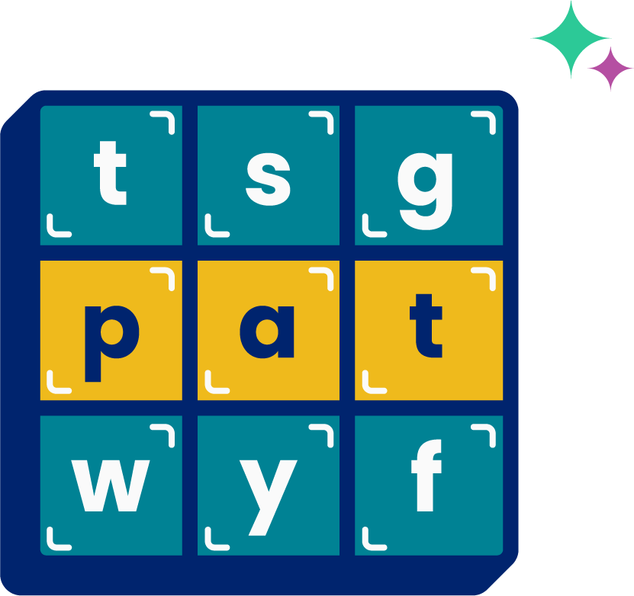
High
Frequency
Words
Family Activity
through
thought
We see high frequency words all the time!
Let’s figure out how to read them!
Notes:
See lesson plan for specific instructional guidance.
High Frequency Words!
Say: Some words we can sound out now, some words we'll learn how to sound out later, and some words are rule breakers and we can't sound out. Words that show up a lot in books are called High Frequency Words. Let's learn some! Repeat our chant after me!
"We see high frequency words all the time!
Let's figure out how to read them!"
Do: Say one sentence at a time of the High Frequency Words chant and ask the students to repeat after you.
Say: Let's read our high frequency words!
Say: Today, we're learning 2 new word! You have to pay attention to the spellings because they can be confusing.
Do: Display the word through.
Say: It begins with a consonant digraph /th/ followed by another consonant /r/. Then, we have a new spelling we haven't learned yet, o-u-g-h pronounced /oo/ in this word. Let's sound out the whole thing. Sound it out with me using your sound mapping boxes.
Do: Sound out /th/ /r/ /oo/ = "through".
Say: All those letters and it's actually only 3 sounds. Excellent!
Do: Display the word thought.
Say: This word begins with t-h saying /th/. This time the o-u-g-h says /aw/. The word ends with a /t/. /th/ /aw/ /t/ = "thought". It can be tricky if you go fast and don't pay attention to the words. Read them one more time with me.
Do: Point or hold up each word, going back and forth between the two.
Say: Let's read our previous high frequency words!
Do: Point to or hold up all the high frequency words to this point as the students read them.
Say: Excellent work learning 2 new high frequency word today.
through, thought

