Slide 1


Deletion and Substitution
It’s deletion and substitution time!
We want to change the beginning, middle, and ending sounds!
We want to make a new word!
Notes:
Deletion and Substitution, 5 minutes
See lesson plan for specific instructional guidance.

Slide 2




Introduce the Sounds
  shir t
  /sh/ /er/ /t/
  = shirt
It’s time to learn new sounds!
We use the sound rule to help us read!
Notes:
Introduce the Sounds, 5 minutes
See lesson plan for specific instructional guidance.

Slide 3
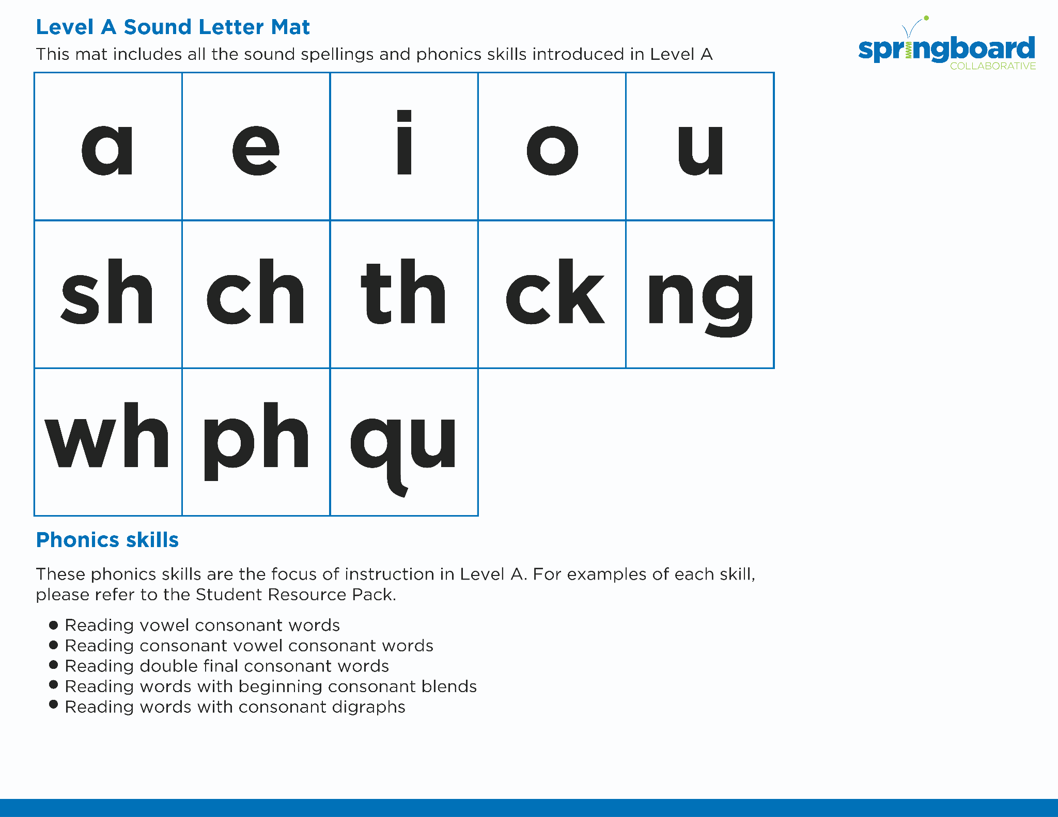
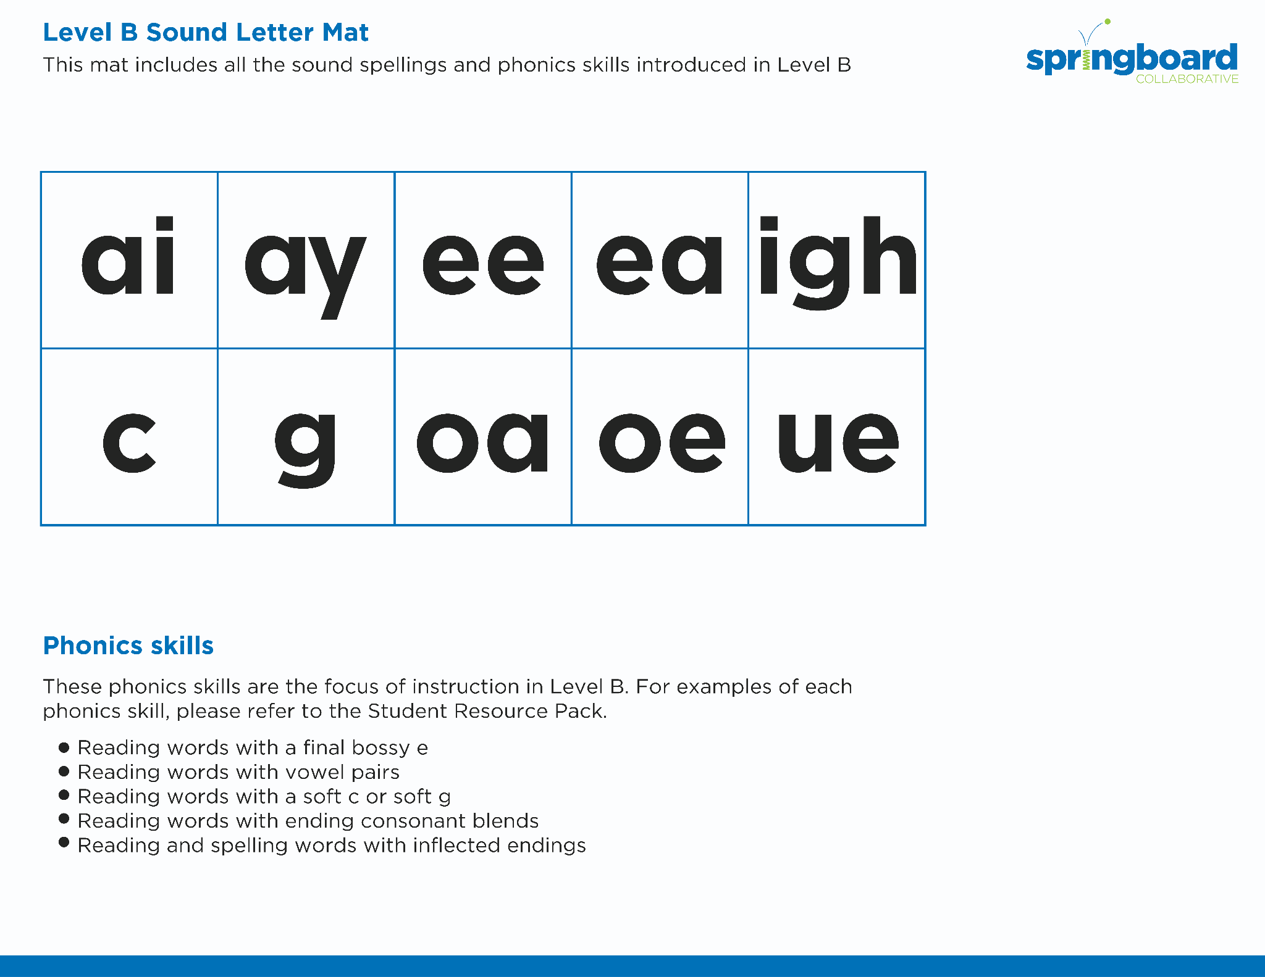
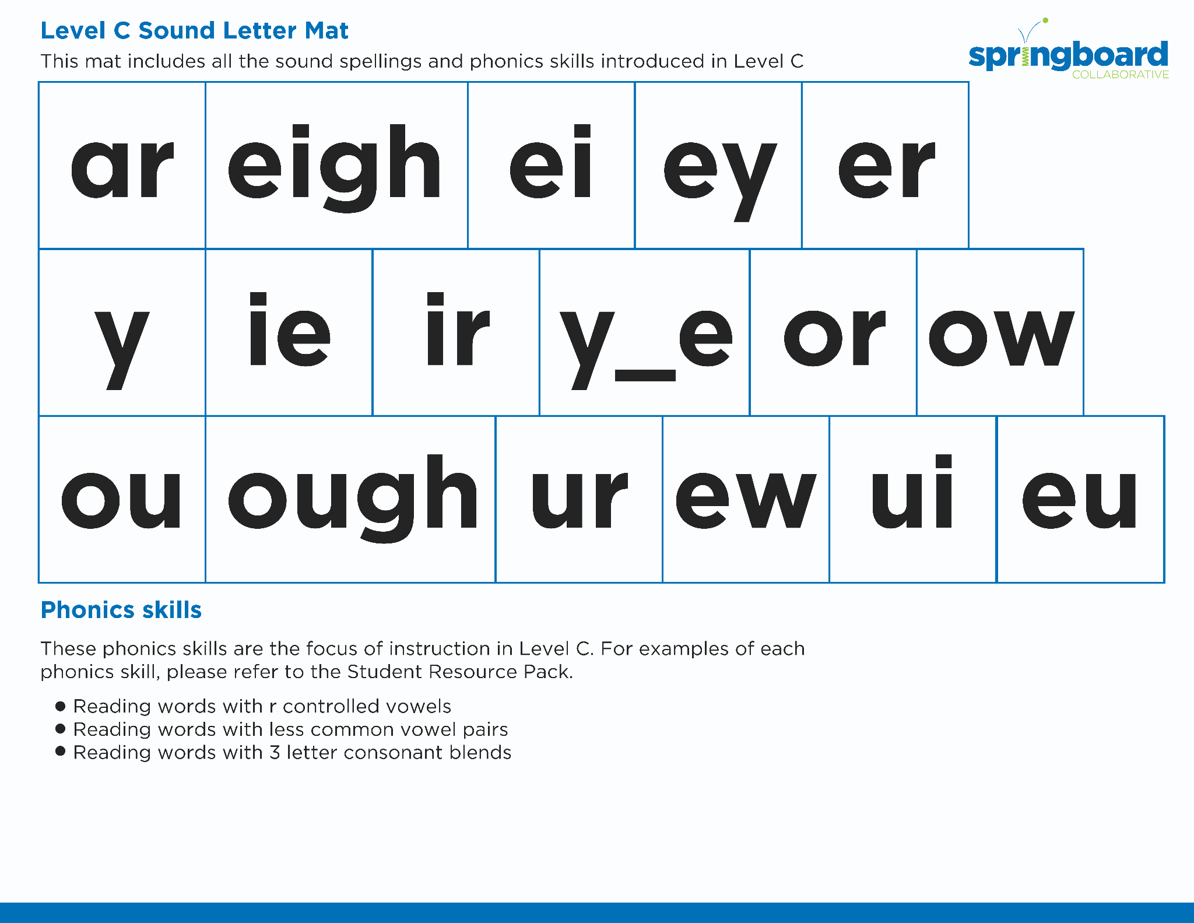
Introduce the Sounds
Notes:
Introduce the Sounds, 5 minutes
See lesson plan for specific instructional guidance.

Slide 4


Blend
the Sounds
bird
shirt
It’s time to blend the sounds!
It’s time to blend the sounds to help us read
the words smoothly!
Notes:
Blend the Sounds, 5 minutes
See lesson plan for specific instructional guidance.

Slide 5


Read
the Words
twirl
thirst
It’s time to read the words!
It’s time to read the words, so we can read smoothly, like we are speaking!
The bird did a whirl and a twirl before landing.
Notes:
Read the Words, 5 minutes
See lesson plan for specific instructional guidance.

Slide 6


Decode
the Words
  quirk squirm
  firm birch
  birth
It’s time to decode the sounds in the word!
It’s time to decode the sounds in the words so we can read the words!
Notes:
Decode the Words, 5 minutes
See lesson plan for specific instructional guidance.

Slide 7





Spell
the Words
s
w
ir
l
It’s time to spell the words!
It’s time to spell the words to show we understand the rule!
Notes:
Spell the Words, 5 minutes
See lesson plan for specific instructional guidance.

Slide 8
Spell
the Words
wh
ir
l
Notes:
Spell the Words, 5 minutes
See lesson plan for specific instructional guidance.

Slide 9

High-
Frequency
Words
earth
learn
We see high-frequency words all the time!
Let’s figure out how to read them!
Notes:
High-Frequency Words, 5 minutes
See lesson plan for specific instructional guidance.

Slide 10

Decodable Text
  Time to read.
  Let’s use our new rule!
Notes:
Decodable Text, 15 minutes
See lesson plan for specific instructional guidance.

Slide 11
Response to Text
Why did Irma love surfing?
What did Irma do to practice surfing?
How do you think Irma felt when the other animals were shocked to see her surfing?
Notes:
Response to Text, 10 minutes
See lesson plan for specific instructional guidance.

