Slide 1


Deletion and Substitution
It’s deletion and substitution time!
We want to change the beginning, middle, and ending sounds!
We want to make a new word!
Notes:
Deletion and Substitution, 5 minutes
See lesson plan for specific instructional guidance.

Slide 2




Introduce the Sounds
  germ
  /j/ /er/ /m/
  = germ
It’s time to learn new sounds!
We use the sound rule to help us read!
Notes:
Introduce the Sounds, 5 minutes
See lesson plan for specific instructional guidance.

Slide 3
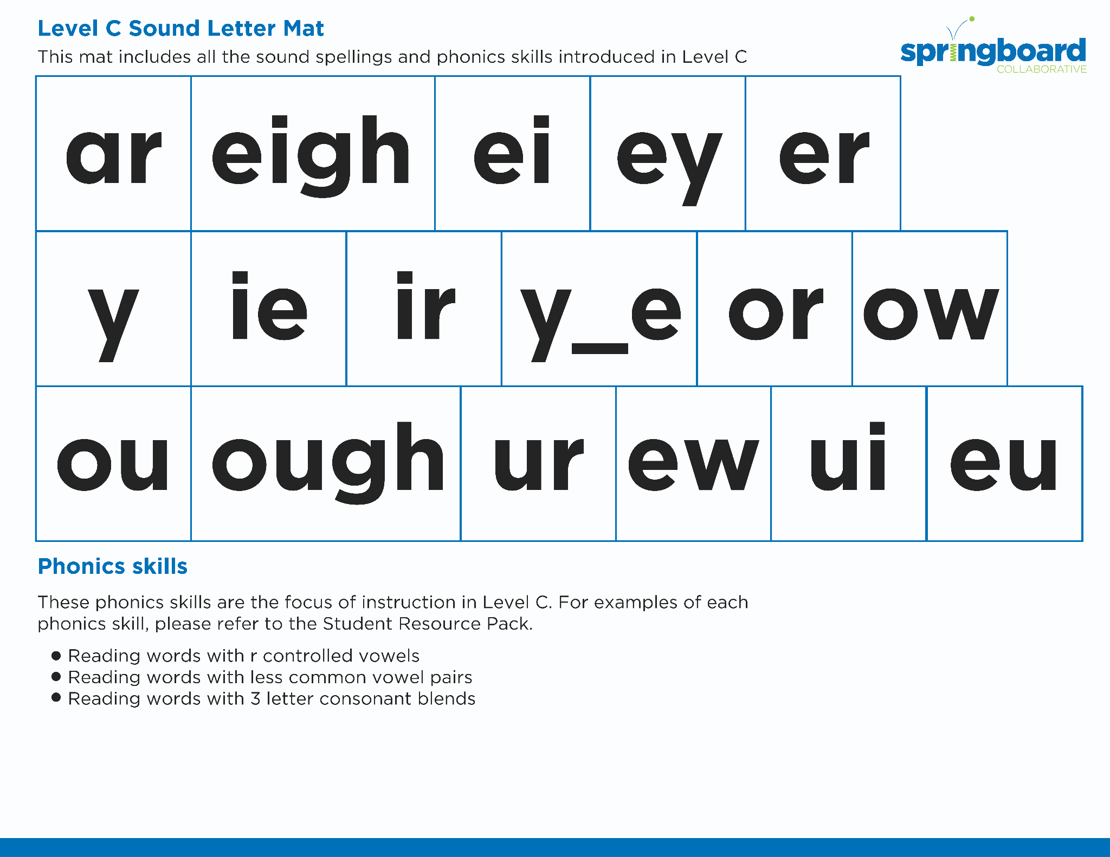
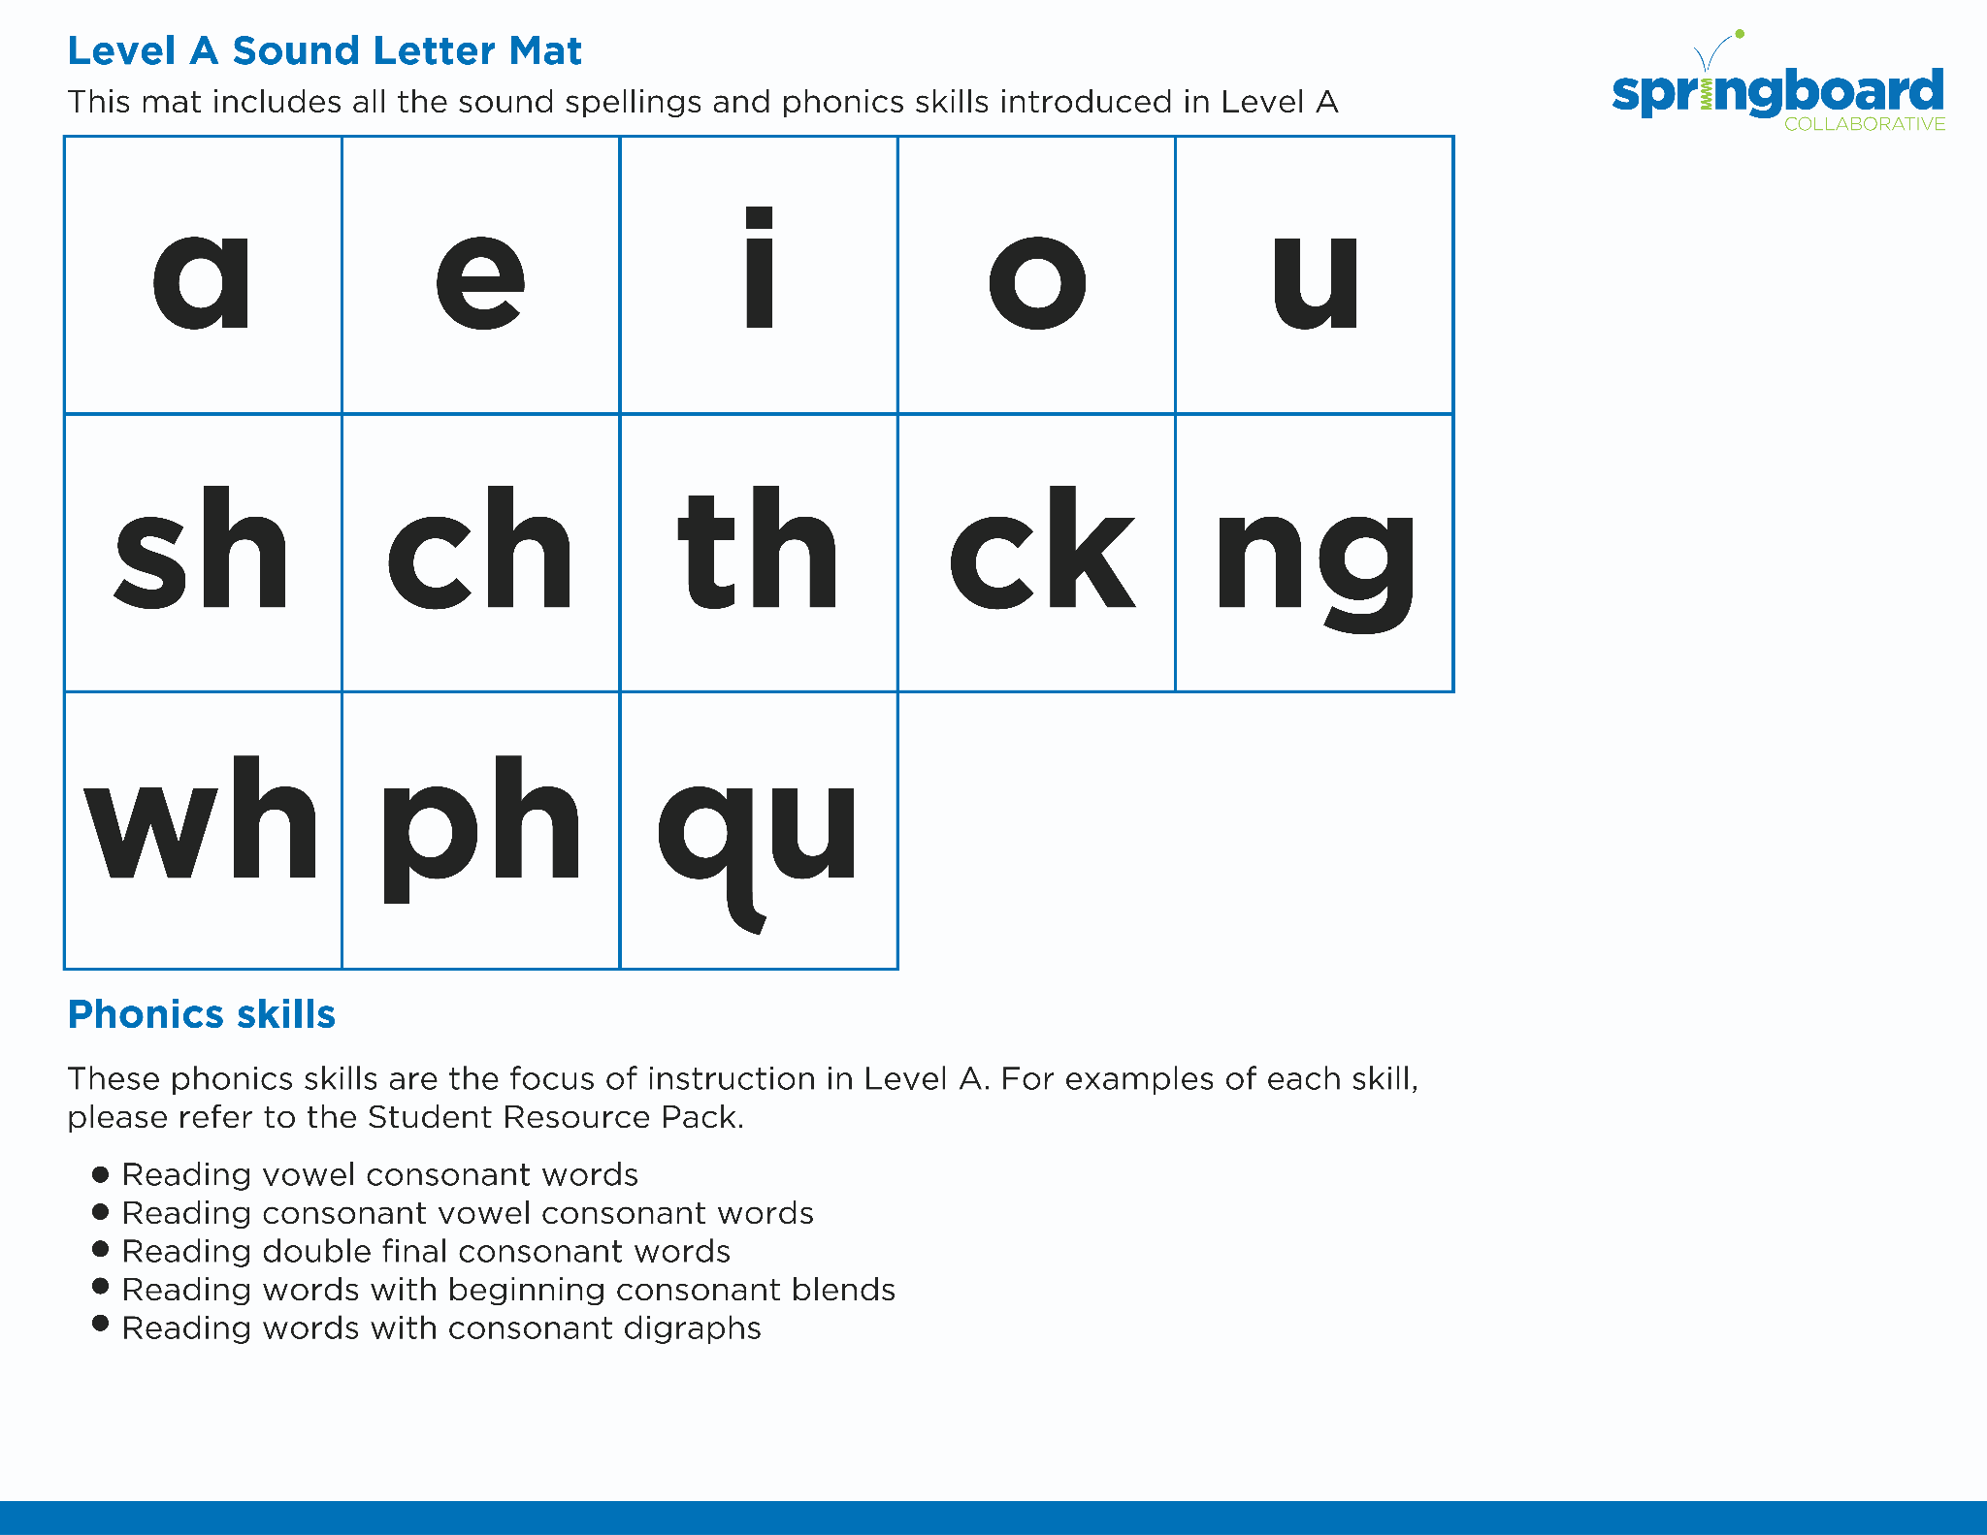

Introduce the Sounds
Notes:
Introduce the Sounds, 5 minutes
See lesson plan for specific instructional guidance.

Slide 4


Blend
the Sounds
her
It’s time to blend the sounds!
It’s time to blend the sounds to help us read the words smoothly!
perch
Notes:
Blend the Sounds, 5 minutes
See lesson plan for specific instructional guidance.

Slide 5


Read
the Words
never
under
The otter went under the river water.
It’s time to read the words!
It’s time to read the words, so we can read smoothly, like we are speaking!
Notes:
Read the Words, 5 minutes
See lesson plan for specific instructional guidance.

Slide 6


Decode
the Words
  perk river
  stern after
  serve
It’s time to decode the sounds in the words!
It’s time to decode the sounds in the words so we can read the words!
Notes:
Decode the Words, 5 minutes
See lesson plan for specific instructional guidance.

Slide 7





Spell
the Words
n
er
v
e
It’s time to spell the words!
It’s time to spell the words to show we understand the rule!
Notes:
Spell the Words, 5 minutes
See lesson plan for specific instructional guidance.

Slide 8
Spell
the Words
s
er
v
e
Notes:
Spell the Words, 5 minutes
See lesson plan for specific instructional guidance.

Slide 9

High-
Frequency
Words
under
father
mother
after
We see high-frequency words all the time!
Let’s figure out how to read them!
letter
answer
Notes:
High-Frequency Words, 5 minutes
See lesson plan for specific instructional guidance.

Slide 10
High-
Frequency
Words
different
another
Notes:
High-Frequency Words, 5 minutes
See lesson plan for specific instructional guidance.

Slide 11

Decodable Text
  Time to read.
  Let’s use our new rule!
Notes:
Decodable Text, 15 minutes
See lesson plan for specific instructional guidance.

Slide 12
Response to Text
What does the sister want to do as a job?
What does the sister do to take care of the ferns?
What is something that you take care of? What do you do?
Notes:
Response to Text, 10 minutes
See lesson plan for specific instructional guidance.

