Slide 1


Deletion and Substitution
It’s deletion and substitution time!
We want to change the beginning, middle, and ending sounds!
We want to make a new word!
Notes:
Deletion and Substitution, 5 minutes
See lesson plan for specific instructional guidance.

Slide 2




Introduce the Sounds
  start
  /s/ /t/ /ar/ /t/ = start
It’s time to learn new sounds!
We use the sound rule to help us read!
Notes:
Introduce the Sounds, 5 minutes
See lesson plan for specific instructional guidance.

Slide 3
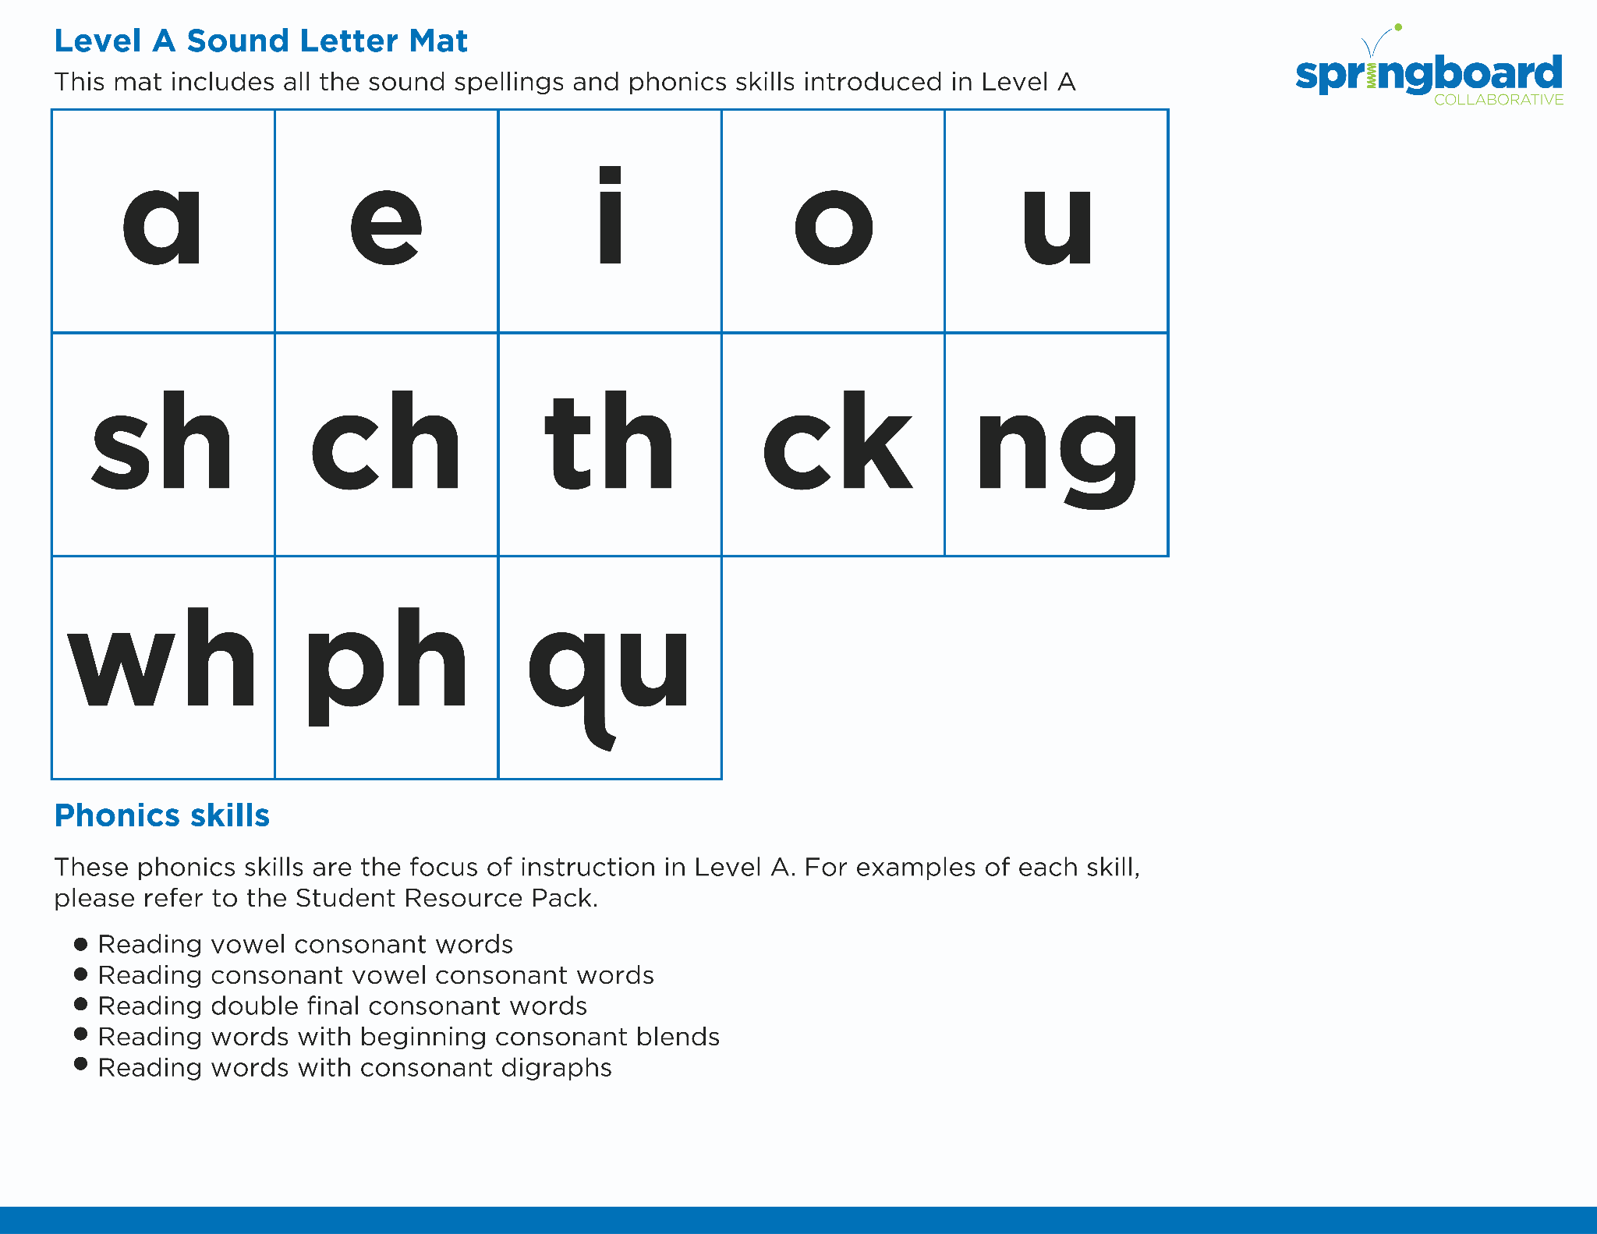
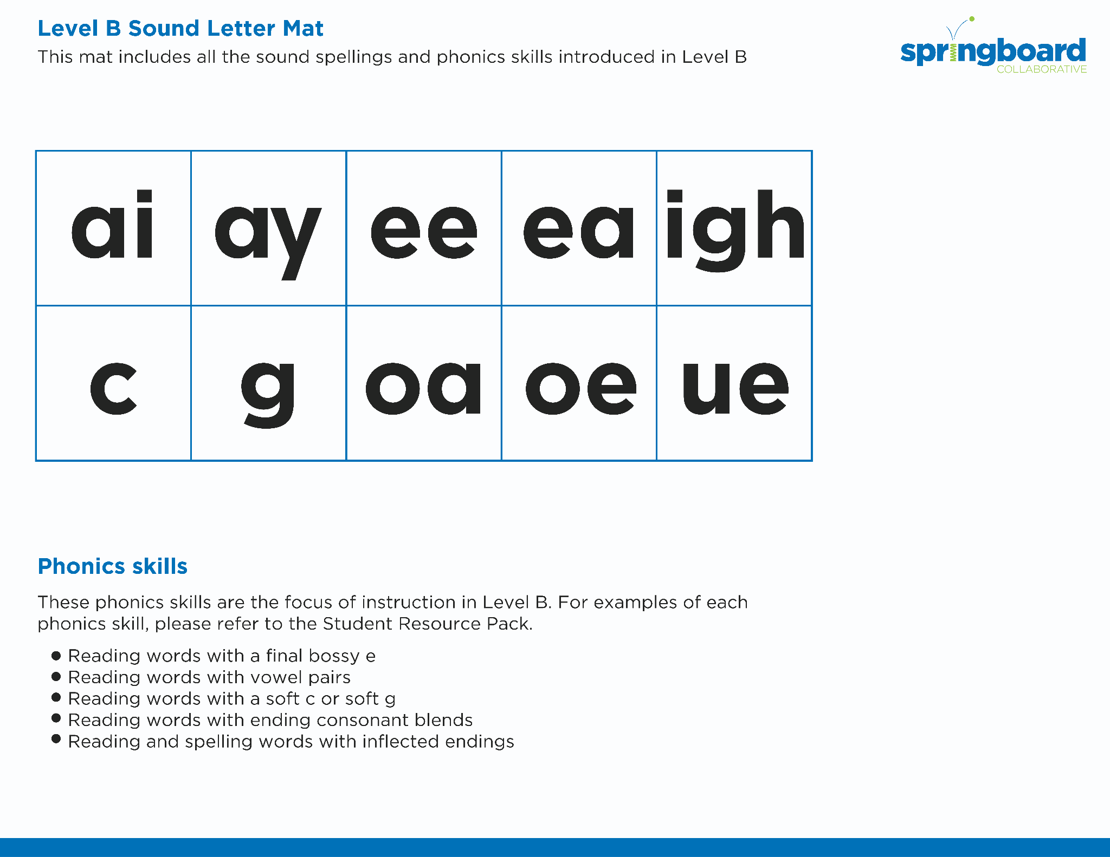
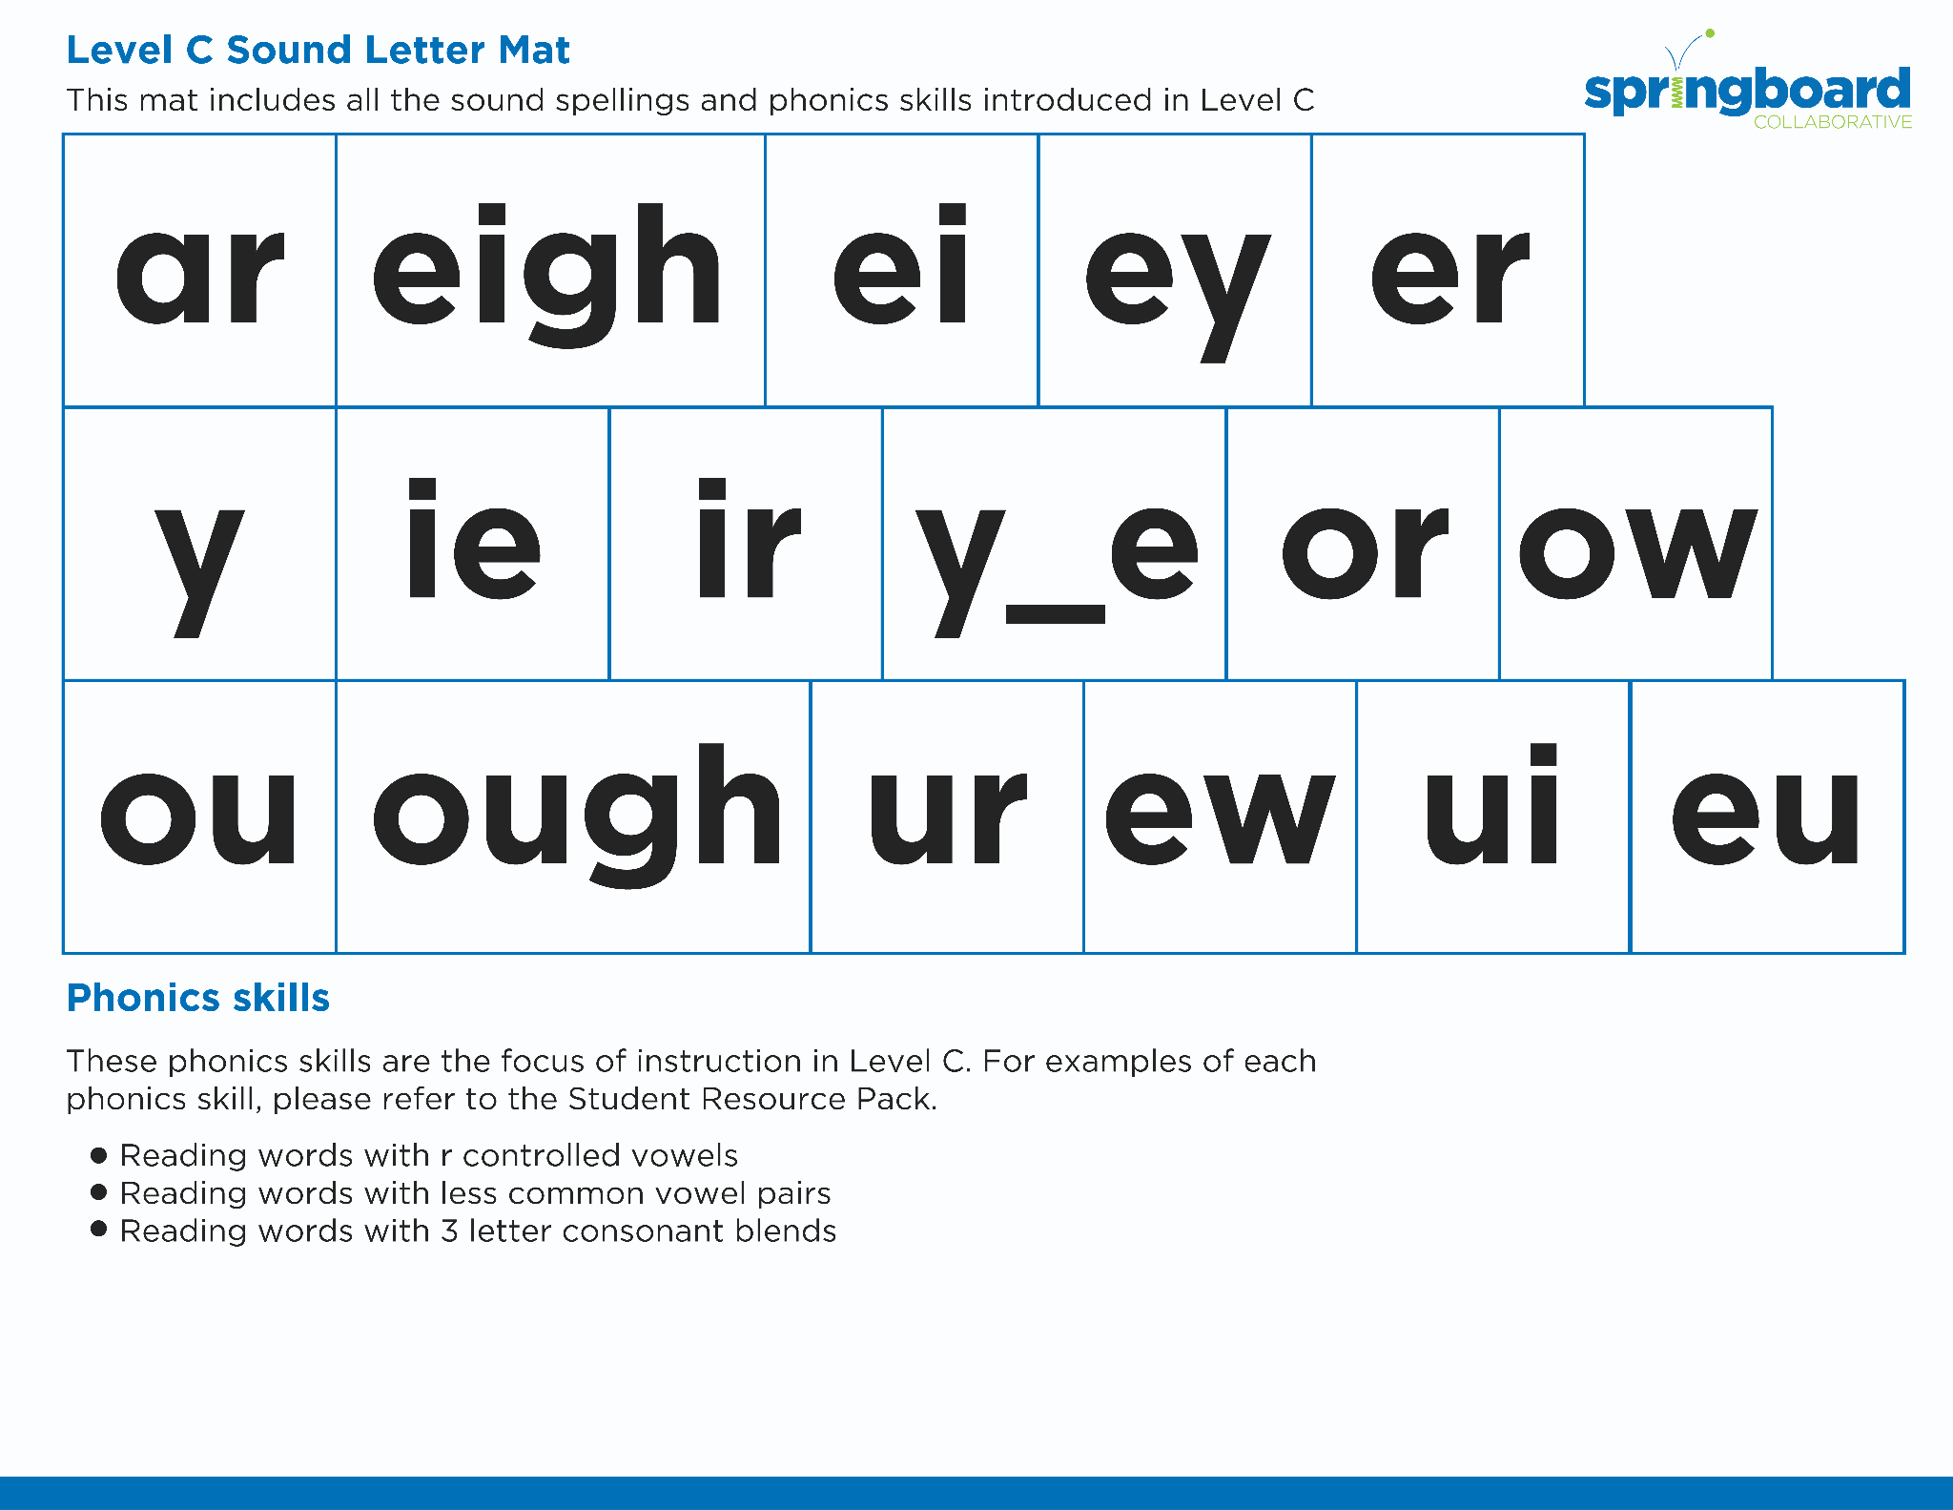
Introduce the Sounds
Notes:
Introduce the Sounds, 5 minutes
See lesson plan for specific instructional guidance.

Slide 4


Blend
the Sounds
farm
It’s time to blend the sounds!
It’s time to blend the sounds to help us read the words smoothly!
target
Notes:
Blend the Sounds, 5 minutes
See lesson plan for specific instructional guidance.

Slide 5


Read
the Words
chart
sharp
It’s time to read the words!
It’s time to read the words, so we can read smoothly, like we are speaking!
I started to open the jar, but it was very hard.
Notes:
Read the Words, 5 minutes
See lesson plan for specific instructional guidance.

Slide 6


Decode
the Words
  park large
  star yard
It’s time to decode the sounds in the words!
It’s time to decode the sounds in the words so we can read the words!
Notes:
Decode the Words, 5 minutes
See lesson plan for specific instructional guidance.

Slide 7





Spell
the Words
c
ar
v
e
It’s time to spell the words!
It’s time to spell the words to show we understand the rule!
Notes:
Spell the Words, 5 minutes
See lesson plan for specific instructional guidance.

Slide 8

Spell
the Words
s
t
ar
v
e
Notes:
Spell the Words, 5 minutes
See lesson plan for specific instructional guidance.

Slide 9

High-
Frequency
Words
large
We see high-frequency words all the time!
Let’s figure out how to read them!
Notes:
High-Frequency Words, 5 minutes
See lesson plan for specific instructional guidance.

Slide 10

Decodable Text
  Time to read.
  Let’s use our new rule!
Notes:
Decodable Text, 15 minutes
See lesson plan for specific instructional guidance.

Slide 11
Response to Text
Why does Omar start while it is still dark?
What does Omar do on his farm?
How do you think Omar feels when he is finished?
Notes:
Response to Text, 10 minutes
See lesson plan for specific instructional guidance.

