Slide 1
Introduce the sounds
they
/th/ /ā/ = they
It’s time to learn new sounds!
We use the sound rule to help us read!
Notes:
See lesson plan for specific instructional guidance.
Introduce the Sound!
Say: Learning new sounds is so cool! Repeat our chant after me!
"It's time to learn new sounds!
We use the sound rule to help us read!"
Do: Say one sentence at a time of the Introduce the Sound chant and ask the students to repeat after you.
Say: Let's learn a super cool new rule today!
Say: Today, we'll look at decoding and spelling words with the long a spelled ey.
Do: Hold up the Sound Letter e-y card.
Say: E-y can make the long a sound. Today, we're focusing on long a. For today, e-y says /a/ like they. we say /th/ /a/ = they. Let's say the new sound together.
Do: Listen as all the students say /a/.

Slide 2
Introduce the sounds
Notes:
See lesson plan for specific instructional guidance.
Introduce the Sound!
Say: Before we start practicing decoding words with e-y, let's review our sound cards.
Do: Flip through and review all the sound spelling cards students have learned so far. (Sound Letter Cards: a, e, i, o, u, wh, sh, ch, ng, ck, ph, qu, ai, ay, ee, ea, igh, c, g, oa, oe, gu, ar, eigh, ei)
Say: Remember, e-y can say /a/ like they. Let's practice reading our words!

Slide 3
Blend the sounds
hey
Family Activity
It’s time to blend the sounds!
It’s time to blend the sounds to help us read the words smoothly!
they
Notes:
See lesson plan for specific instructional guidance.
Blend the Sounds!
Say: Blending sounds helps us read the words smoothly! Repeat our chant after me!
"It's time to blend the sounds!
It's time to blend the sounds to help us read the words smoothly!"
Do: Say one sentence at a time of the Blend the Sounds chant and ask the students to repeat after you.
Say: Let's practice blending the sounds in some words today!
Say: When we blend the sounds in words, it helps us read the words smoothly. Let's try it. E-y can say /a/.
Do: Point to the word hey.
Say: I notice that this word has an e-y. Underline it to help us remember that e-y sticks together. As you listen to me decode it, you can chop down your arm.
Do: Start at your shoulder, and chop/ tap the sounds out. When it's time to blend, start back at the shoulder and run your hand smoothly down your arm.
Say: H says /h/ and E-y says /a/. Let's blend it. /h/ /a/ = "hey". Hey! How are you? Let's segment and blend the word together now using our Double Decker Elkonin Boxes.
Do: Segment and blend the word hey using the Double Decker Elkonin Boxes.
Say: Smart blending! Let's look at another word. Let's substitute the /h/ for /th/.
Do: Point to the word they.
Say: What do you notice about this word?
Do: Allow students to point out that it has "e-y". Prompt students to underline the t-h and the e-y.
Say: We have t-h says /th/, e-y says /a/. /th/ /a/ = "they".
Say: You blend this word one more time.
Do: Listen as students blend the word. Take notes on the students that can accurately blend and students that may need reteaching and/or additional support.
Say: E-y can say /a/. Great thinking while blending the sounds today!

Slide 4
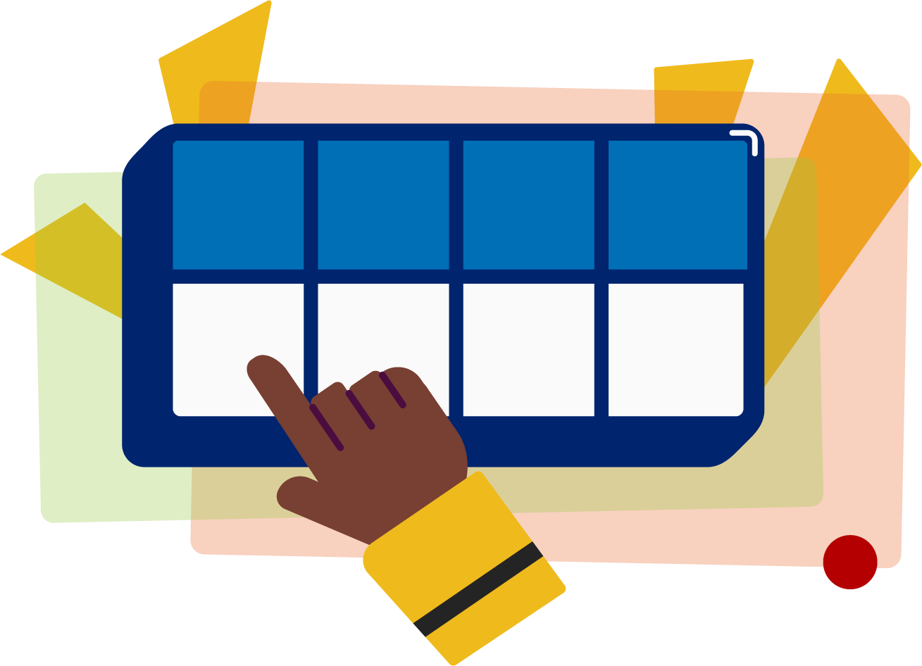
Read the words
Family Activity
prey
grey
Hey! You need to obey the large chart.
It’s time to read the words!
It’s time to read the words, so we can read smoothly, like we are speaking!
Notes:
See lesson plan for specific instructional guidance.
Read the Words!
Say: When we practice reading the words, it can help us read the words faster and faster. This helps us learn to read smoothly like when we are speaking! Repeat our chant after me!
"It's time to read the words!
It's time to read the words, so we can read smoothly, like we are speaking!"
Do: Say one sentence at a time of the Read the Words chant and ask the students to repeat after you.
Say: Let's practice reading words today!
Say: We are going to read the words. When we practice reading the words, it helps us read faster and faster. This helps us focus on what we can learn from the words. Let's look at the first word.
Do: Point to the word prey.
Say: When we read this word, we look to see what spelling pattern it uses so we know what vowel sound to make. I see the spelling pattern e-y. Underline it! Your turn using the Double Decker Elkonin Boxes.
Do: Listen as students read the word. Take notes on the students that can accurately articulate the sounds and read the word and students that may need reteaching and/or additional support.
Say: Yes, the word is "prey". /p/ /r/ /a/ = "prey". Let's look at the next word. How would you read this word?
Do: Point to the word grey.
Say: Look at this spelling pattern! I see a e-y. Underline it! How will you read this word?
Do: Listen as students read the word. Take notes on the students that can accurately articulate the sound and read the word and students that may need reteaching and/or additional support.
Say: Yes, the word is "grey", /g/ /r/ /a/.
Do: Display the sentence: Hey! You need to obey the large chart.
Say: Take a couple minutes to read this sentence with your partner. All of the words follow rules you've learned or are High Frequency Words you've learned. Raise your hands when you have the whole sentence read and I'll come listen. You can do it!
Do: Monitor and assist. You may support by asking students to recognize the spelling pattern, prompting students to use the long or short vowel sound, asking students to underline letters that stick together, etc.
Say: I'll read it aloud as you read it with me.
Do: Read sentence.
Say: Remember, e-y can say /a/. Those brains are growing!

Slide 5
Decode the words
they grey
prey hey
It’s time to decode the sounds in the words!
It’s time to decode the sounds in the words so we can read the words!
Notes:
See lesson plan for specific instructional guidance.
Decode the Words!
Say: Decoding is when you break up the sounds in a word and read each sound one at a time. Then you blend the sounds together to read the word! Repeat our chant after me!
"It's time to decode the sounds in the words!
It's time to decode the sounds in the words so we can read the words!"
Do: Say one sentence at a time of the Decode the Words chant and ask the students to repeat after you.
Say: Let's practice decoding the sounds in words today!
Say: We are going to decode the words. Remember decoding is when you break up the sounds in a word and read each sound one at a time. Then you blend the sounds together to read the word! When we decode the sounds in words, it helps us read the words correctly. Look at our words for today.
Do: Point to the words.
Say: Follow this routine:
Underline any letters that go together. Put dots under your vowels.
Draw in the syllable break.
Look for the spelling patterns.
Name any phonetic rules that help with pronunciation.
Try reading it. Is it right? If not, try another pronunciation.
Do: Partner students.
Say: You and your partner work together to decode these words (they, grey, prey, hey). I'll be by to listen. Use your Double Decker Elkonin Boxes.
Do: Listen as students decode the word. Take notes on the students that can accurately articulate the sounds and read the word and students that may need reteaching and/or additional support.
Say: Excellent work applying our new rule to decoding words today!

Slide 6
Spell the words
o
b
ey
It’s time to spell the words!
It’s time to spell the words to show we understand the rule!
Notes:
See lesson plan for specific instructional guidance.
Spell the Words!
Say: When we can spell words, it shows that we met the target. When we hear the sounds, we can match the sounds to the correct letters and spell the word! Repeat our chant after me!
"It's time to spell the words!
It's time to spell the words to show we understand the rule!"
Do: Say one sentence at a time of the Spell the Words chant and ask the students to repeat after you.
Say: Let's practice spelling words today!
Say: We are going to spell the words. Remember when we can spell words with the correct rule it shows that we met the target. When we hear the sounds we can match the sounds to the correct letters and spell the word! Listen to our words for today. The word is obey. How would we spell the word obey. Let's listen to the sounds and match the sound to the correct letter. The word is "obey". I hear two syllables. Clap them out with me.
Do: Say and clap "o|bey" out as a class.
Say: The first syllable is /o/. We can spell that with an o because a vowel at the end of a syllable says its name. The second syllable is "bey", We'll use e-y to spell long a. /b/ /a/ spelled b-e-y. You spell it. Grab your whiteboards!
Do: Watch as students spell the word using the letter and sound connections. Take notes on the students that can accurately articulate the sound and spell the word and students that may need reteaching and/or additional support.
Say: Yes, when we spell the word obey we write the letters o-b-e-y. Great thinking! Awesome job spelling words today!

Slide 7
High Frequency Words
Family Activity
on
put
was
what
We see high frequency words all the time!
Let’s figure out how to read them!
Notes:
See lesson plan for specific instructional guidance.
High Frequency Words!
Say: Some words we can sound out now, some words we'll learn how to sound out later, and some words are rule breakers and we can't sound out. Words that show up a lot in books are called High Frequency Words. Let's learn some! Repeat our chant after me!
"We see high frequency words all the time!
Let's figure out how to read them!"
Do: Say one sentence at a time of the High Frequency Words chant and ask the students to repeat after you.
Say: Let's read our high frequency words!
Say: Today, we're learning 4 new/ review words! You can decode all of them.
Do: Display the word on.
Say: This is a VC word that follows the rules. /o/ /n/ = "on". Read it with me.
Do: Read the word together. Display the word put.
Say: This is a CVC word that follows the rules. /p/ /u/ /t/ = "put". Read it with me.
Do: Read the word together. Display the word was and what.
Say: The next two words make a little bit of an unusual vowel sound, but mostly follow the rules. /w/ /u/ /s/ = "was" and /wh/ /u/ /t/ = "what". Read them with me.
Do: Make sure students can read the new HFW.
Say: Let's read our previous high frequency words!
Do: Point to or hold up all the high frequency words to this point as the students read them.
Say: Excellent work learning new high frequency words today.
put, was, what, on

