Slide 1


Deletion and Substitution
It’s deletion and substitution time!
We want to change the beginning, middle, and ending sounds!
We want to make a new word!
Notes:
Deletion and Substitution, 5 minutes
See lesson plan for specific instructional guidance.

Slide 2




Introduce the Sounds
  blue
  /b/ /l/ /oo/ = blue
It’s time to learn new sounds!
We use the sound rule to help us read!
Notes:
Introduce the Sounds, 5 minutes
See lesson plan for specific instructional guidance.

Slide 3







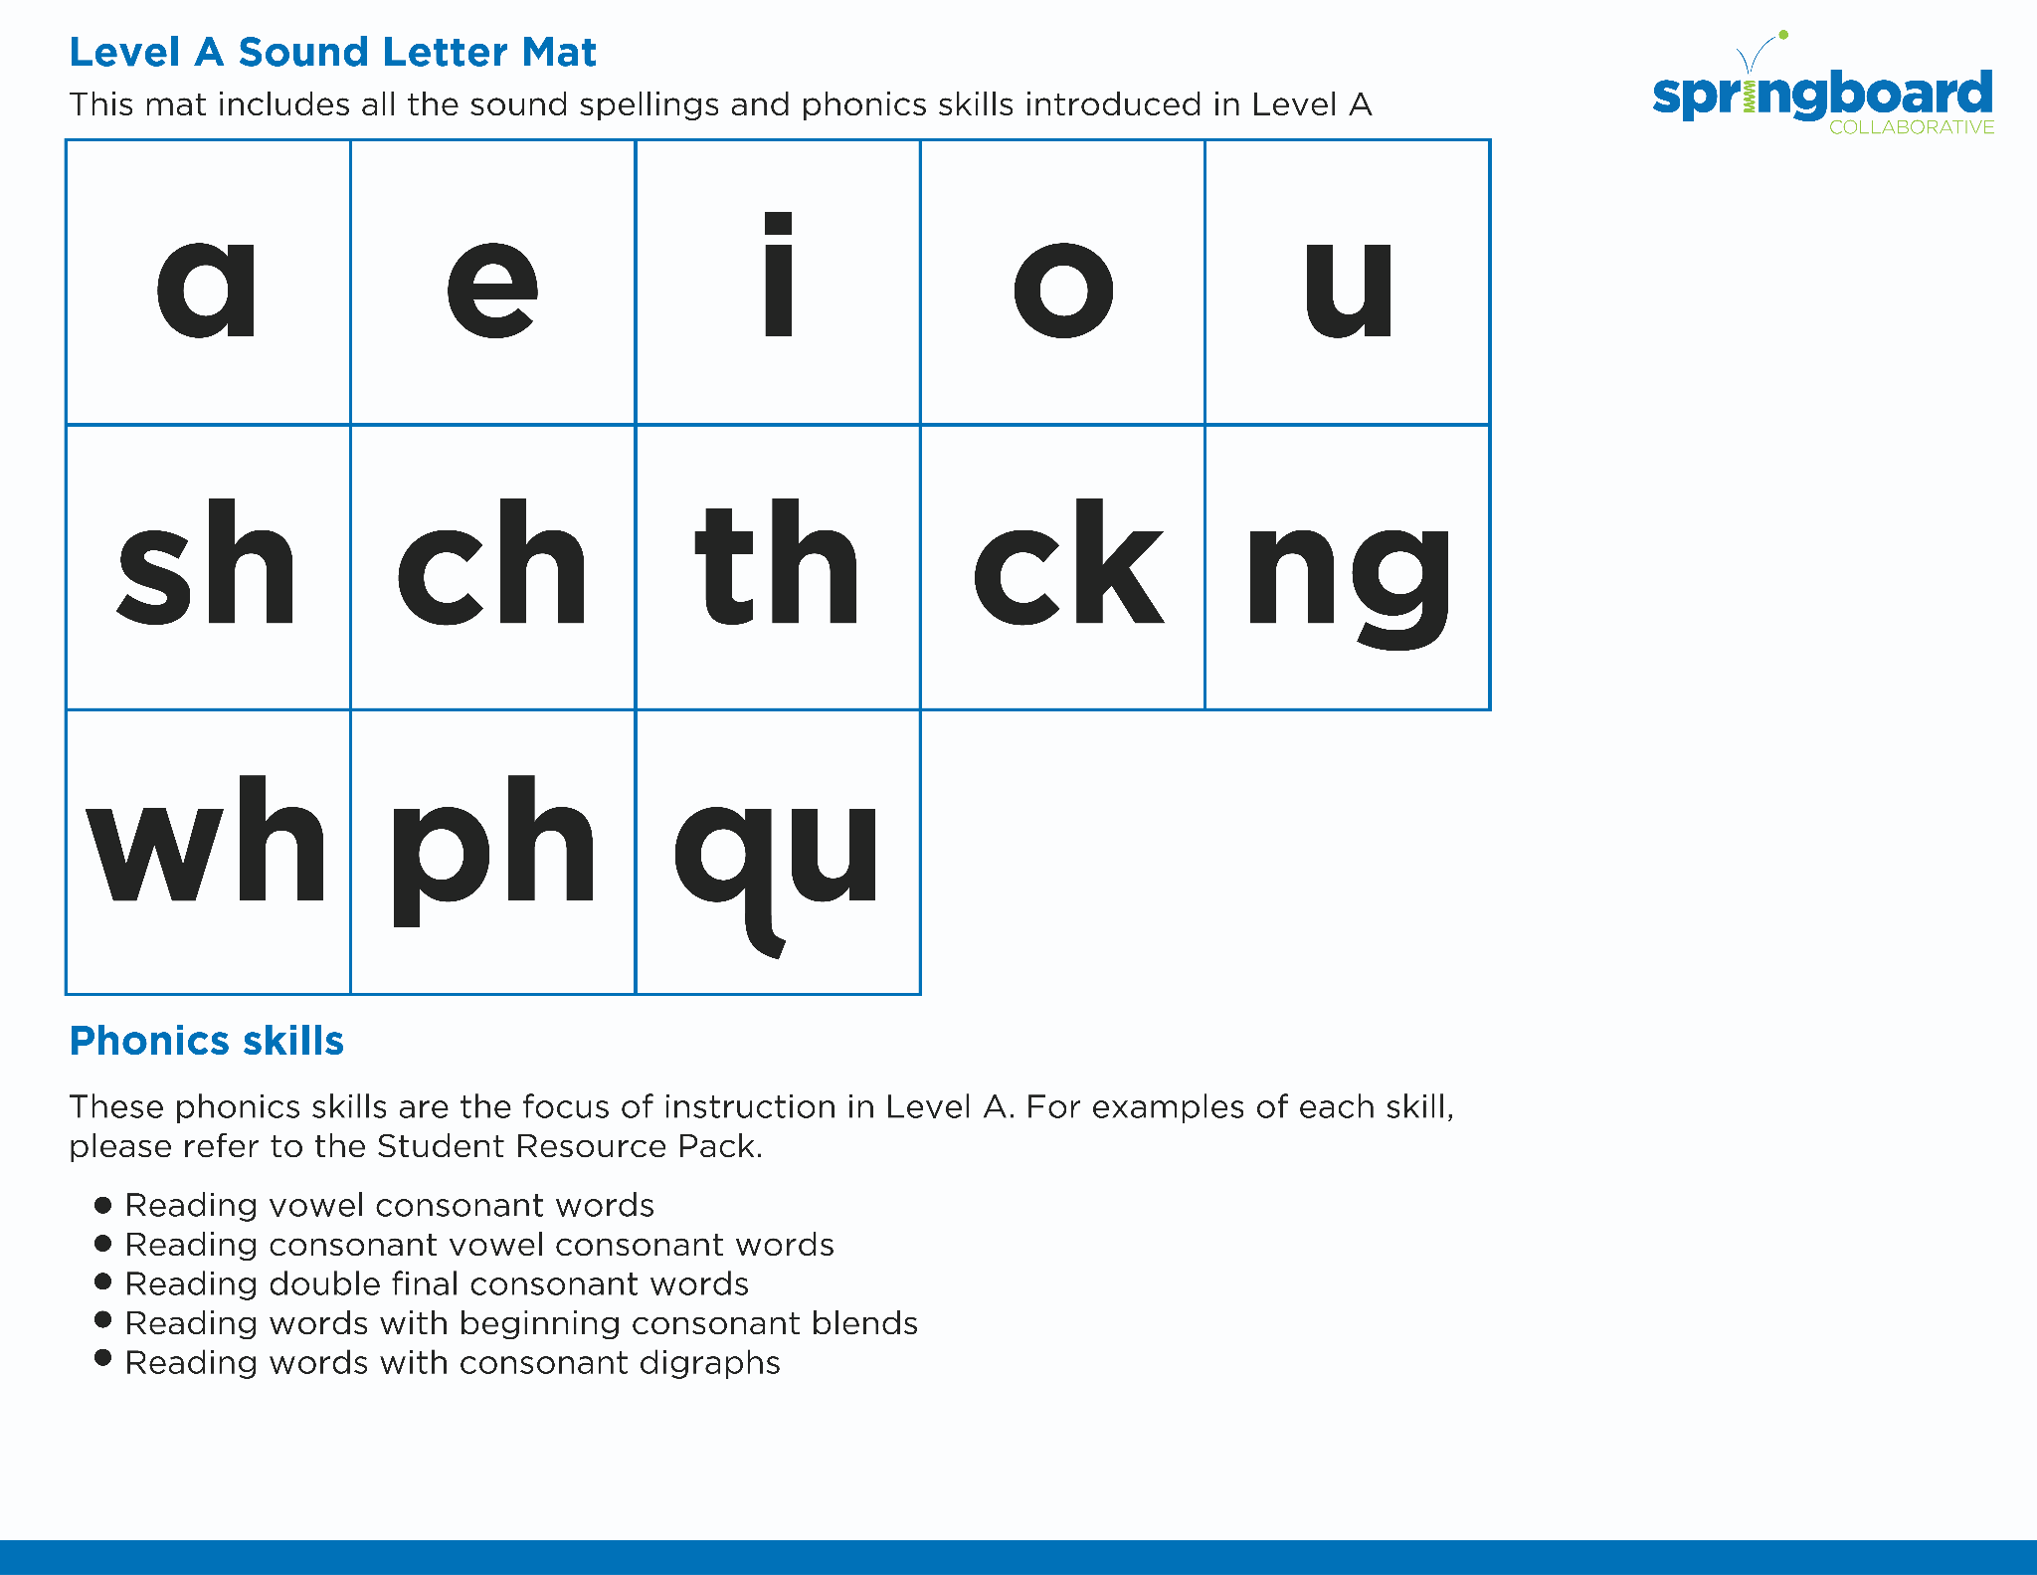
Introduce the Sounds
Notes:
Introduce the Sounds, 5 minutes
See lesson plan for specific instructional guidance.

Slide 4


Blend the Sounds
clue
rescue
It’s time to blend the sounds!
It’s time to blend the sounds to help us read
the words smoothly!
Notes:
Blend the Sounds, 5 minutes
See lesson plan for specific instructional guidance.

Slide 5


Read the Words
due
argue
We used glue and tissue to fix the issue.
It’s time to read the words!
It’s time to read the words, so we can read smoothly, like we are speaking!
Notes:
Read the Words, 5 minutes
See lesson plan for specific instructional guidance.

Slide 6


Decode the Words
  blue true
  glue due
  Sue
It’s time to decode the sounds in the word!
It’s time to decode the sounds in the words so we can read the words!
Notes:
Decode the Words, 5 minutes
See lesson plan for specific instructional guidance.

Slide 7





Spell the Words
a
v
e
n
ue
It’s time to spell the words!
It’s time to spell the words to show we understand the rule!
Notes:
Spell the Words, 5 minutes
See lesson plan for specific instructional guidance.

Slide 8
Spell the Words
ar
g
ue
Notes:
Spell the Words, 5 minutes
See lesson plan for specific instructional guidance.

Slide 9

High-
Frequency
Words
around
We see high-frequency words all the time!
Let’s figure out how to read them!
Notes:
High-Frequency Words, 5 minutes
See lesson plan for specific instructional guidance.

Slide 10

Decodable Text
  Time to read.
  Let’s use our new rule!
Notes:
Decodable Text, 15 minutes
See lesson plan for specific instructional guidance.

Slide 11
Response to Text
Why did Sue and Jude each need glue?
Did the glue work? How do you know?
What could Sue or Jude have done if they did not have any glue?
Notes:
Response to Text, 10 minutes
See lesson plan for specific instructional guidance.

