Slide 1




Introduce the sounds
  blue
  /b/ /l/ /oo/ = blue
It’s time to learn new sounds!
We use the sound rule to help us read!
Notes:
See lesson plan for specific instructional guidance.
Introduce the Sound!
Say: Learning new sounds is so cool! Repeat our chant after me!
"It's time to learn new sounds!
We use the sound rule to help us read!"
Do: Say one sentence at a time of the Introduce the Sound chant and ask the students to repeat after you.
Say: Let's learn a super cool new rule today!
Say: Remember, in this unit, we're learning all about the long vowel sounds and what spelling patterns we use to make the long vowel sound.
Do: Show the Sound Letter ue card.
Say: When a word ends with "ue", it can make two different sounds: long u /u/ or the /oo/ sound. When we see this card, we'll say /u/ /oo/. For example, when we see the word blue we say /b/ /l/ /oo/ = blue. Say it with me.
Do: Listen and respond.

Slide 2







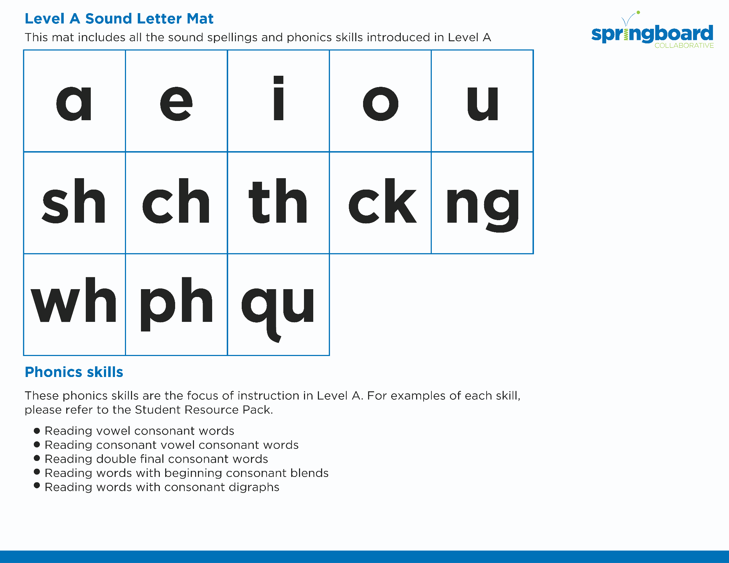
Introduce the sounds
Notes:
See lesson plan for specific instructional guidance.
Introduce the Sound!
Say: Let's practice all our sound letter cards.
Do: Flip through and review all the sound spelling cards students have learned so far including the new card from today, ue. (Sound Letter Cards: a, e, i, o, u, wh, sh, ch, ng, ck, ph, qu, ai, ay, ee, ea, igh, c, g, oa, oe)
Say: Let's practice reading words!

Slide 3



Blend the sounds
clue
Family Activity
rescue
It’s time to blend the sounds!
It’s time to blend the sounds to help us read
the words smoothly!
Notes:
See lesson plan for specific instructional guidance.
Blend the Sounds!
Say: Blending sounds helps us read the words smoothly! Repeat our chant after me!
"It's time to blend the sounds!
It's time to blend the sounds to help us read the words smoothly!"
Do: Say one sentence at a time of the Blend the Sounds chant and ask the students to repeat after you.
Say: Let's practice blending the sounds in some words today!
Say: When we blend the sounds in words, it helps us read the words smoothly. Let's try it. When words end with a bossy e, the e makes the vowel make the long vowel sound, or says its name. The e doesn't make any sound.
Do: Point to the word clue.
Say: I notice that this word has "ue" at the end and I have to decide which sound "ue" makes - long /u/ or /oo/. When we read words that end with "ue", "ue" can make two sounds: long u /u/ like in argue or the /oo/ sound like in blue. So, to decode this word, I'll say /k/ /l/ /oo/. We looked for a clue to help solve the mystery. Let's segment and blend the word together now using our Double Decker Elkonin Boxes.
Do: Segment and blend the word clue using the Double Decker Elkonin Boxes.
Say: Why is this word read as /k/ /l/ /oo/ = "clue"?
Do: Listen as students explain how when we read words that end with "ue", "ue" can make two sounds: long u /u/ like in argue or the /oo/ sound like in blue.
Say: Smart explanations! Let's look at another word.
Do: Point to the word rescue.
Say: This word begins with a consonant, /r/. r says /r/. Next comes a vowel, e. But, I notice the spelling pattern vowel consonant makes the vowel short = /e/. Next is /s/, then /k/, and then I notice that "ue" is a part of this word. In this word "ue" makes the long /u/ sound instead of the /oo/ sound. How would you know which sound "ue" needs to make in this word?
Do: Listen as students explain the rule.
Say: Yes! When we read words that end with "ue", "ue" can make two sounds: long u /u/ like in argue or the /oo/ sound like in blue. So, how do we read this word?
Do: Listen as students blend the word. Take notes on the students that can accurately blend the open syllable using the long vowel sound and students that may need reteaching and/or additional support.
Say: Yes! We have /r/ /e/ /s/ /k/ /u/. The word is /r/ /e/ /s/ /k/ /u/ = "rescue". Remember, when we read words that end with "ue", "ue" can make two sounds; long u /u/ like in argue or the /oo/ sound like in blue. Great thinking while blending the sounds today!

Slide 4


Read the words
Family Activity
due
argue
We used glue and tissue to fix the issue.
It’s time to read the words!
It’s time to read the words, so we can read smoothly, like we are speaking!
Notes:
See lesson plan for specific instructional guidance.
Read the Words!
Say: When we practice reading the words, it can help us read the words faster and faster. This helps us learn to read smoothly like when we are speaking! Repeat our chant after me!
"It's time to read the words!
It's time to read the words, so we can read smoothly, like we are speaking!"
Do: Say one sentence at a time of the Read the Words chant and ask the students to repeat after you.
Say: Let's practice reading words today!
Say: We are going to read the words. When we practice reading the words, it helps us read faster and faster. This helps us focus on what we can learn from the words. Let's look at the first word.
Do: Point to the word due.
Say: When we read words that end with "ue", "ue" can make two sounds: long u /u/ like in argue or the /oo/ sound like in blue. Sound it out using your Double Decker Elkonin Boxes.
Do: Listen as students read the word. Take notes on the students that can accurately articulate the sounds and read the word, and students that may need reteaching and/or additional support.
Say: Yes, the word is "due". /d/ /oo/ = "due". We would not say /d/ /u/, we would say /d/ /oo/ = due. Let's look at the next word. How would you read this word?
Do: Point to the word argue.
Say: Look at this spelling pattern! When we read words that end with "ue", "ue" can make two sounds: long u /u/ like in argue or the /oo/ sound like in blue. How would you read this word?
Do: Listen as students read the word. Take notes on the students that can accurately articulate the sound and read the word, and students that may need reteaching and/or additional support.
Say: Yes, the word is /ar/ /g/ /u/ = "argue".
Do: Display the sentence: We used glue and tissue to fix the issue.
Say: Take a couple minutes to read this sentence with your partner. All of the words follow rules you've learned or are High Frequency Words you've learned. Raise your hands when you have the whole sentence read and I'll come listen. You can do it!
Do: Monitor and assist. You may support by asking students to recognize the spelling pattern, prompting students to use the long or short vowel sound, asking students to underline letters that stick together, etc.
Say: I'll read it aloud as you read it with me.
Do: Read sentence.
Say: Remember, when we read words that end with "ue", "ue" can make two sounds: long u /u/ like in argue or the /oo/ sound like in blue. Those brains are growing!

Slide 5


Decode the words
  blue true
  glue due
  Sue
It’s time to decode the sounds in the word!
It’s time to decode the sounds in the words so we can read the words!
Notes:
See lesson plan for specific instructional guidance.
Decode the Words!
Say: Decoding is when you break up the sounds in a word and read each sound one at a time. Then you blend the sounds together to read the word! Repeat our chant after me!
"It's time to decode the sounds in the words!
It's time to decode the sounds in the words so we can read the words!"
Do: Say one sentence at a time of the Decode the Words chant and ask the students to repeat after you.
Say: Let's practice decoding the sounds in words today!
Say: We are going to decode the words. Remember, decoding is when you break up the sounds in a word and read each sound one at a time. Then you blend the sounds together to read the word! When we decode the sounds in words, it helps us read the words correctly.
Say: Look at our words for today.
Do: Point to the words.
Say: First, look at the spelling pattern to decide what vowel sound to use. Underline anything that sticks together! Next, say each sound. Finally, blend the sounds together to read the words.
Do: Partner students.
Say: You and your partner work together to decode these words (blue, true, glue, due, sue). I'll be by to listen. Use your Double Decker Elkonin Boxes.
Do: Listen as students decode the word. Take notes on the students that can accurately articulate the sounds and read the word, and students that may need reteaching and/or additional support.
Say: Excellent work applying our new rule to decoding words today!

Slide 6





Spell the words
a
v
e
n
ue
It’s time to spell the words!
It’s time to spell the words to show we understand the rule!
Notes:
See lesson plan for specific instructional guidance.
Spell the Words!
Say: When we can spell words, it shows that we met the target. When we hear the sounds, we can match the sounds to the correct letters and spell the word! Repeat our chant after me!
"It's time to spell the words!
It's time to spell the words to show we understand the rule!"
Do: Say one sentence at a time of the Spell the Words chant and ask the students to repeat after you.
Say: Let's practice spelling words today!
Say: We are going to spell the words. Remember, when we can spell words with the correct rule, it shows that we met the target. When we hear the sounds, we can match the sounds to the correct letters and spell the word! Listen to our words for today. The word is avenue. How would we spell the word avenue? Let's listen to the sounds and match the sound to the correct letter. The word is "avenue". I hear /a/ /v/ /e/ /n/ /oo/. I know that sound for /a/ = a and the sound for /v/ = v. I hear a /e/ sound for e, /n/ for n, and /oo/ sound for "ue" at the end. When we read words that end with "ue", "ue" can make two sounds: long u /u/ like in argue or the /oo/ sound like in blue. Grab your whiteboards and write the word.
Do: Watch as students spell the word using the letter and sound connections. Take notes on the students that can accurately articulate the sound and spell the word, and students that may need reteaching and/or additional support.
Say: Yes, when we spell the word avenue we write the letters a-v-e-n-u-e.

Slide 7
Spell the words
ar
g
ue
Notes:
See lesson plan for specific instructional guidance.
Spell the Words!
Say: Now, try spelling argue. How would you spell argue? Grab your whiteboards and write the word.
Do: Watch as students spell the word using the letter and sound connections. Take notes on the students that can accurately articulate the sound and spell the word, and students that may need reteaching and/or additional support.
Say: Yes, when we read words that end with "ue", "ue" can make two sounds: long u /u/ like in argue or the /oo/ sound like in blue. So the word is a-r-g-u-e = argue. Great thinking! Awesome job spelling words today!

Slide 8
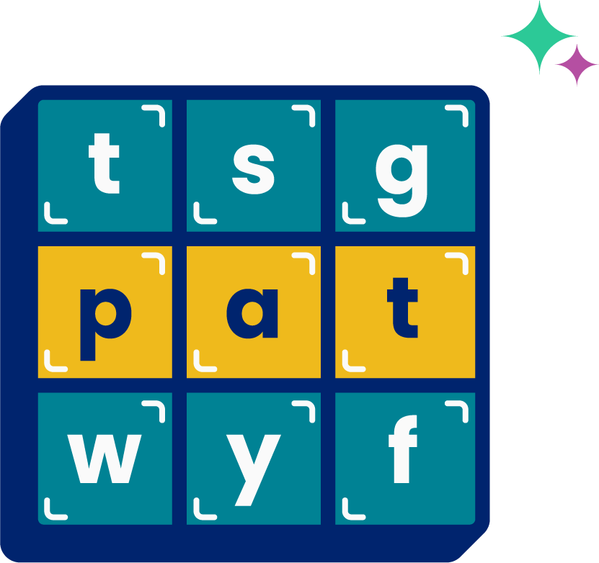
High
Frequency
Words
Family Activity
around
We see high frequency words all the time!
Let’s figure out how to read them!
Notes:
See lesson plan for specific instructional guidance.
High Frequency Words!
Say: Some words we can sound out now, some words we'll learn how to sound out later, and some words are rule breakers and we can't sound out. Words that show up a lot in books are called High Frequency Words. Let's learn some! Repeat our chant after me!
"We see high frequency words all the time!
Let's figure out how to read them!"
Do: Say one sentence at a time of the High Frequency Words chant and ask the students to repeat after you.
Say: Let's read our high frequency words!
Say: Today, we're learning 1 new word!
Do: Display the word around.
Say: We have a 2 syllable word today! The a is by itself. A vowel at the end of a syllable says it's name. /a/. The second syllable is sounded /r/, o-u says /ow/ /n/ /d/ = "round". Let's put the 2 syllables together! /a/ /r/ /ow/ /n/ /d/ = "around". Sometimes when we say this word, the long a sound changes a little. That's ok. Look around for a partner. Around. Sound it out with me using your Double Decker Elkonin Boxes.
Do: Sound out /a/ /r/ /ow/ /n/ /d/ = "around".
Say: Excellent! Let's read our previous high frequency words!
Do: Point to or hold up all the high frequency words to this point as the students read them.
Say: Excellent work learning 1 new high frequency word today.
around

