Slide 1


Blending and Segmenting
It’s blending and segmenting time!
We want to hear all the sounds
in a word.
We want to hear each sound.
You put the sounds together,
when we blend the word.
We take them apart to segment them.
Notes:
Blending and Segmenting, 5 minutes
See lesson plan for specific instructional guidance.

Slide 2






Introduce the Sounds
Open Syllable
  joe
  /j/ /ō/ =
  joe
It’s time to learn new sounds!
We use the sound rule to help us read!
Bossy E
Notes:
Introduce the Sounds, 5 minutes
See lesson plan for specific instructional guidance.

Slide 3





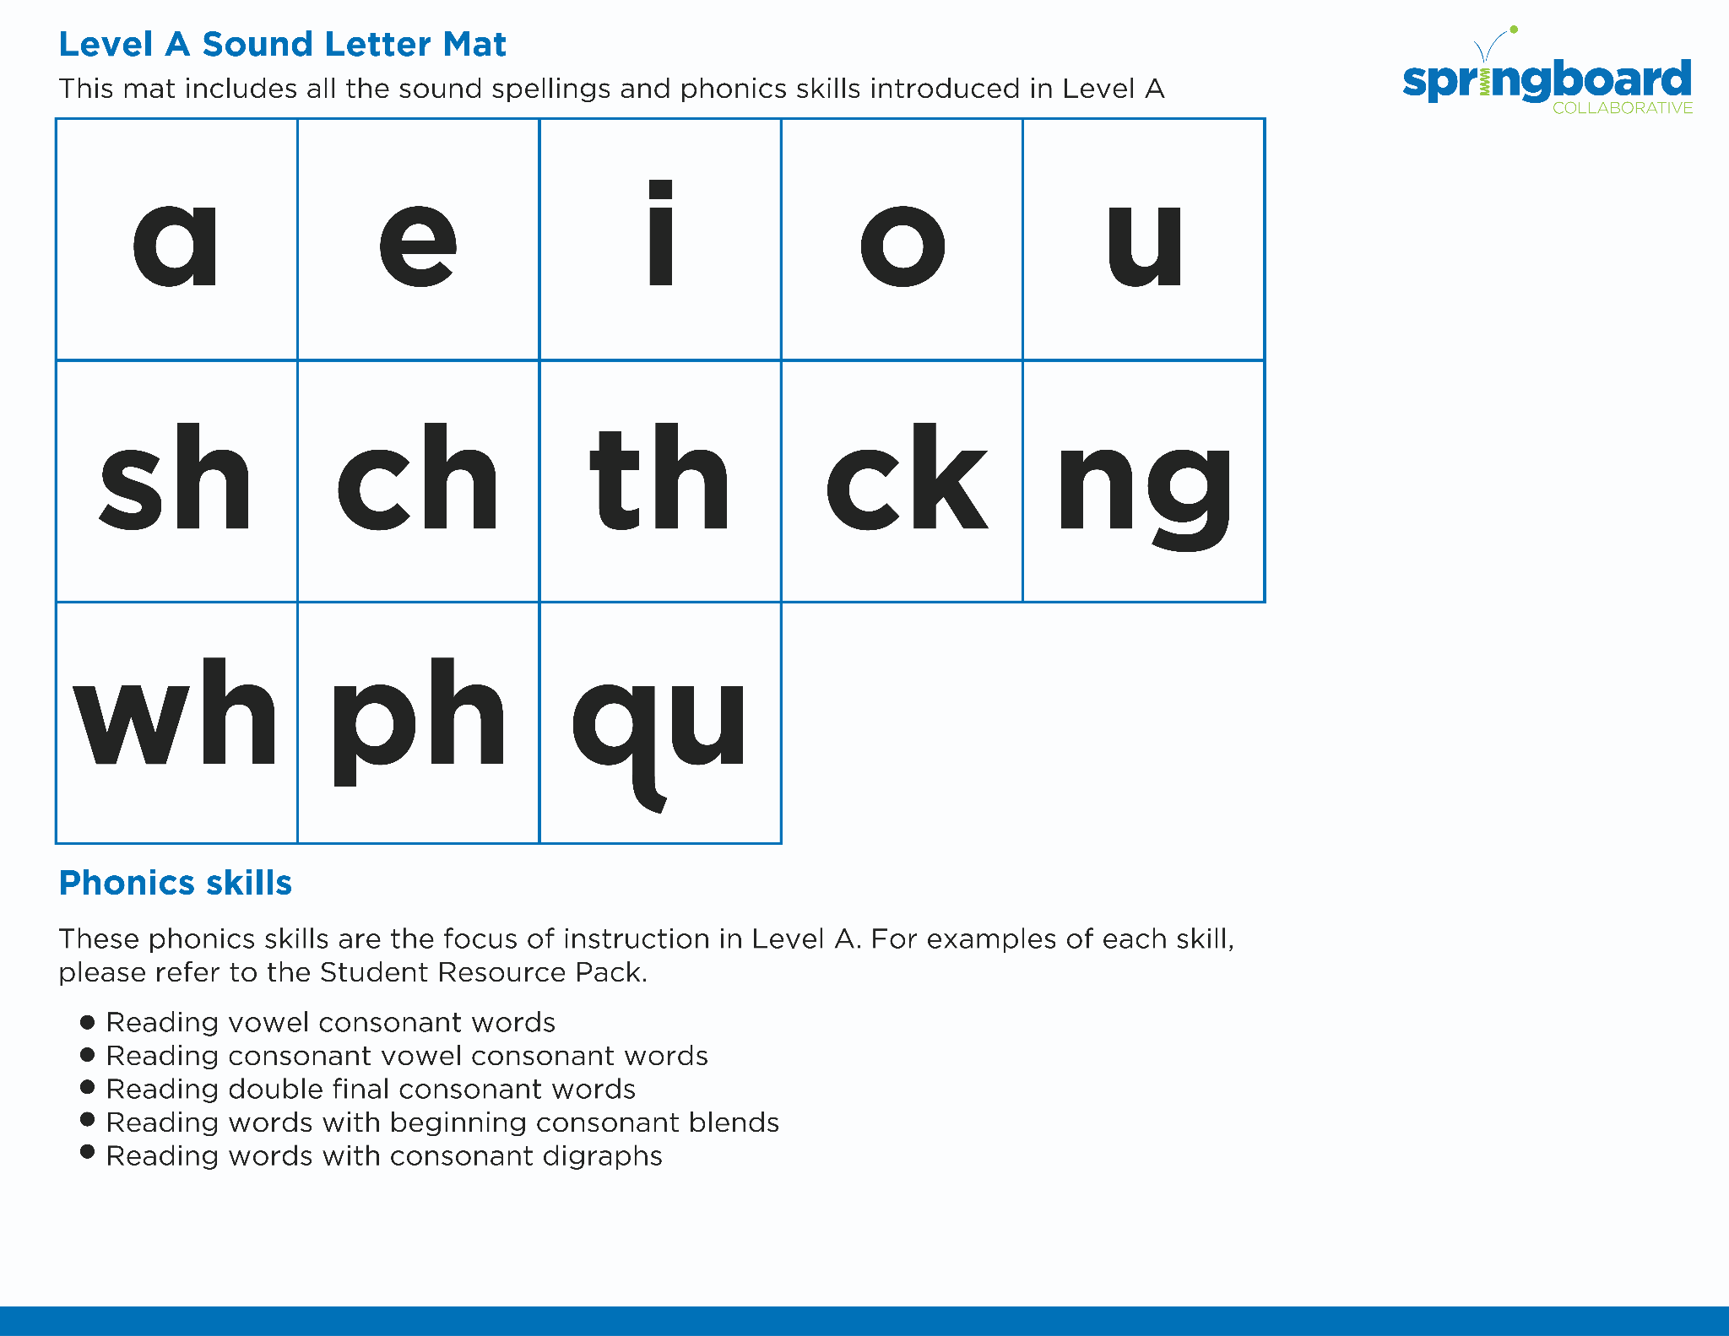
Introduce the Sounds
Notes:
Introduce the Sounds, 5 minutes
See lesson plan for specific instructional guidance.

Slide 4


Blend
the Sounds
go
vote
It’s time to blend the sounds!
It’s time to blend the sounds to help us read the words smoothly!
Notes:
Blend the Sounds, 5 minutes
See lesson plan for specific instructional guidance.

Slide 5


Read
the Words
loaf
aloe
It’s time to read the words!
It’s time to read the words, so we can read smoothly, like we are speaking!
I drove to the coast and put my toes in the cold water.
Notes:
Read the Words, 5 minutes
See lesson plan for specific instructional guidance.

Slide 6


Decode
the Words
  ago also no hose hope
  float loaf
  poem oboe
It’s time to decode the sounds in the words!
It’s time to decode the sounds in the words so
we can read the words!
Notes:
Decode the Words, 5 minutes
See lesson plan for specific instructional guidance.

Slide 7





Spell
the Words
h
o
d
l
It’s time to spell the words!
It’s time to spell the words to show we understand the rule!
Notes:
Spell the Words, 5 minutes
See lesson plan for specific instructional guidance.

Slide 8
Spell
the Words
oa
g
l
Notes:
Spell the Words, 5 minutes
See lesson plan for specific instructional guidance.

Slide 9

High-
Frequency
Words
people
We see high-frequency words all the time!
Let’s figure out how to read them!
Notes:
High-Frequency Words, 5 minutes
See lesson plan for specific instructional guidance.

Slide 10

Decodable Text
  Time to read.
  Let’s use our new rule!
Notes:
Decodable Text, 15 minutes
See lesson plan for specific instructional guidance.

Slide 11
Response to Text
What were people trying to do or get when they went west?
Why did some people have a “tragic time” in the Wild West gold rush?
Notes:
Response to Text, 10 minutes
See lesson plan for specific instructional guidance.

